Slide 1
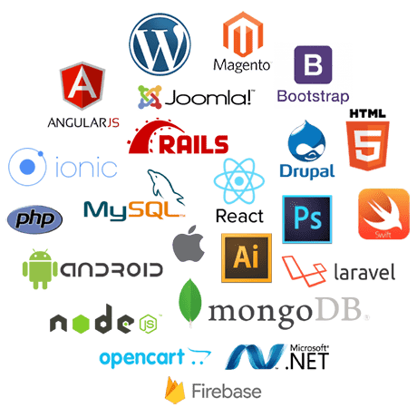

Software Design and Development
Part 2: Development
Dr. Eric HITIMANA

Slide 2
Contents
MVC
Introduction to LARAVEL FRAMEWORK as Case Study
Projects Implementation

Slide 3
1. Model View Controller

Slide 4
MVC – Model View Controller
The classic software design pattern
Used for data-driven user applications
Such apps juggle several tasks:
Loading and storing the data – getting it in/out of storage on request
Constructing the user interface – what the user sees
Interpreting user actions – deciding whether to modify the UI or data
These tasks are largely independent of each other
Model, view, and controller each get one task

Slide 5

A controller can send commands to the model to update the model's state (e.g., editing a document).
It can also send commands to its associated view to change the view's presentation of the model.
A model notifies its associated views and controllers when there has been a change in its state.
This notification allows the views to produce updated output, and the controllers to change the available set of commands.
In some cases, an MVC implementation may instead be 'passive' and other components must poll the model for updates rather than being notified.
A view requests information from the model that it uses to generate an output representation for the user.
[http://en.wikipedia.org/wiki/Model%E2%80%93view%E2%80%93controller]

Slide 6
Illustration of MVC
Client
Controller
Model
View
HTTP Request
Request Data
Return Data
Send Data retrieved from the Model
HTTP Response
Formatted output

Slide 7
Model
Which database table is the requested data stored in?
Talks to data source to retrieve and store data
What SQL query will get me the data
I need?

Slide 8
View
Asks the model for data and presents it in a user-friendly format
Would this text look better in blue or red? In the bottom corner
or front and center?
Should these items go in a dropdown list or radio buttons?

Slide 9
Controller
The user just clicked the “hide details” button. I better tell the view.
Listens for the user to change data or state in the UI, notifying the model or view accordingly
The user just changed the event details. I better let the model know to update the data.

Slide 10
Benefits of MVC
Organization of code
Maintainable, easy to find what you need
Ease of development
Build and test components independently
Flexibility
Swap out views for different presentations of the same data (ex: calendar daily, weekly, or monthly view)
Swap out models to change data storage without affecting user

Slide 11
MVC Flow in Theory
In theory…
Patterns of behavior in response to inputs (controller) are independent of visual geometry (view).
Controller contacts view to interpret what input events should mean in the context of the view.
In practice…
View and controller are so intertwined that they almost always occur in matched pairs (ex: command line interface).
Many architectures combine the two.
View
Model
Controller

Slide 12
MVC Flow in Practice
View
Model
Controller

Slide 13
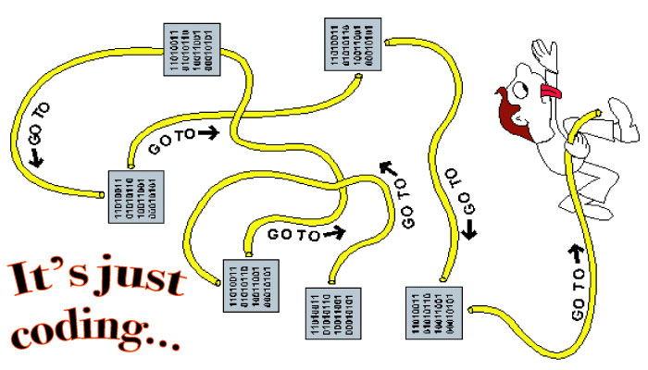
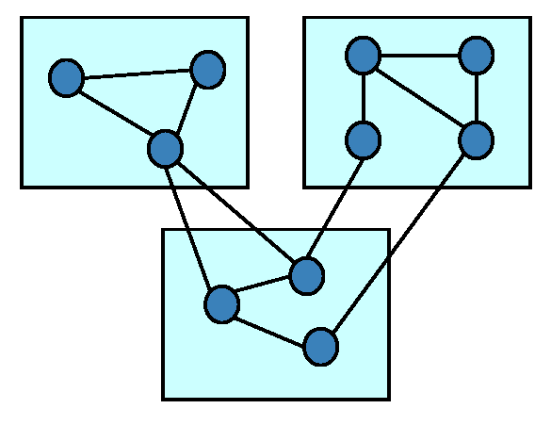
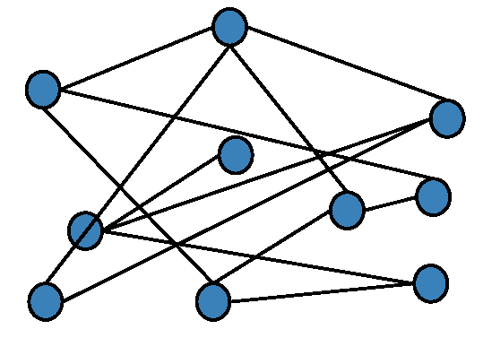
Coding structures
Spaghetti Code
Haphazard connections, probably grown over time
No visible cohesive groups
High coupling: high interaction between random parts
Understand it: all or nothing
Modular Coding
High cohesion within modules
Low coupling between modules
Modules can be understood separately
Interaction between modules is easily understood and thoroughly specified
Micro-services Coding
Both examples have 10 modules and 13 connections!

Slide 14
2. Development with Laravel Framework as Case Study

Slide 15
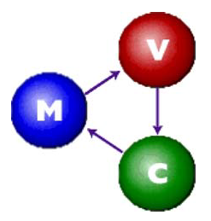
Laravel’s Model-based Architecture
“Laravel architecture is rooted in the model-view-controller (MVC) design that dates to Smalltalk.
“MVC architecture calls for a visual application to be broken up into three separate parts:
A model that represents the data for the application
The view that is the visual representation of that data
A controller that takes user input on the view and translates that and changes in the model.”

Slide 16

Content
Unit 1: Laravel - Overview
Install Laravel with Composer
File's structure
Unit 2: Laravel – Routing, and Middleware
Unit 3: Laravel – Controller – Request – Cookies and Response
Unit 4: Laravel – Model – Eloquent – Relationships
Unit 5: Laravel – Views – Blades – Redirections
Unit 6: Laravel – Authentication – Authorization
Unit 7: Combining all together

Slide 17
Unit 1: Laravel Overview
Unit 1: Laravel – Overview

Slide 18
…
What is Laravel ?
Install Laravel with Composer
Files structure
What is artisan and how does it save us time?
Routing and route types
What is Middleware and how to use it?
What is Blade ?
Database and Eloquent ORM
CRUD with validation and database connection (practical task)
Best practices when coding in Laravel

Slide 19
Installation
Install PHP (XAMPP)
Install Composer
Install Code Editor (Vs Code)
Run the following command:
composer create-project Laravel/Laravel --prefer-dist ZYZ_project
5. Start the server
php artisan serve
6. Visit the address shown

Slide 20

What is?
Laravel is an MVC PHP framework created by Taylor Otwell in 2011
Free open-source license with many contributors worldwide
One of the best frameworks together with Symfony, CodeIgniter, Yii
Has powerful features, saving us time
Uses Symfony packages

Slide 21
Main components
Composer:
It is a tool that includes all the dependencies and libraries.
It allows a user to create a project with respect to the mentioned framework.
It can allow third-party libraries to be installed easily.
2. Artisan
A command line interface
It includes a set of commands which assists in building a web application.
These commands are incorporated from the Symphony framework as add-on features in Laravel.

Slide 22

Let’s install Laravel
Laravel uses Composer to manage its dependencies
Composer is dependency management tool for PHP, like a library full of books
NOT like Yum or apt
Per project tool (vendor folder), not per system
Install by using the command:
composer create-project --prefer-dist laravel/laravel laravel-softuni

Slide 23
Unit 1: Laravel Overview
Laravel is an open-source PHP framework, which is robust and easy to understand.
It follows a model-view-controller design pattern.
Laravel reuses the existing components of different frameworks which helps in creating a web application.
The web application thus designed is more structured and pragmatic.
Laravel offers a rich set of functionalities that incorporates the basic features of PHP frameworks like CodeIgniter, and other programming languages like Ruby on Rails.
Laravel has a very rich set of features that will boost the speed of web development.
If you are familiar with Core PHP and Advanced PHP, Laravel will make your task easier.
It saves a lot of time if you are planning to develop a website/ web application from scratch.
Moreover, a website built in Laravel is secured and prevents several web attacks.

Slide 24
Advantages
The web application becomes more scalable, owing to the Laravel framework.
Considerable time is saved in designing the web application since Laravel reuses the components from another framework in developing the web application.
It includes namespaces and interfaces, thus helping to organize and manage resources.

Slide 25
Features of Laravel
Modularity
Testability
Routing
Configuration management
Query Builder and ORM
Schema Builder
Template Engine
E-mail
Authentication
Radis
Queues
Event and command bus

Slide 26
Features
Blade template engine – combines templates with a data model to produce views
Migrations – version control system for database, update your database easier
Database seeding – provides a way to populate database tables with test data used for testing
Pagination – easy-to-use advanced pagination functionalities
Forms security – provides CSRF (Cross-site Request Forgery) token middleware, protecting all the forms

Slide 27
Features
Eloquent ORM (object-relational mapping) – implements ActiveRecord
Query builder – helps you to build secured SQL queries
Restful controllers – provides a way for separating the different HTTP requests (GET, POST, DELETE, etc.)
Blade template engine – combines templates with a data model to produce views

Slide 28
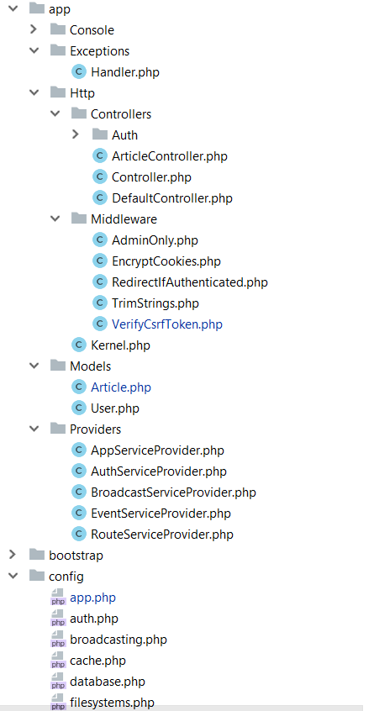
The structure
app/Http folder contains the Controllers, Middlewares and Kernel file
All the models should be located in app/Models folder
The service providers that are bootstrapping functions in our app are located in app/Providers folder
All the config files are located in app/config folder

Slide 29
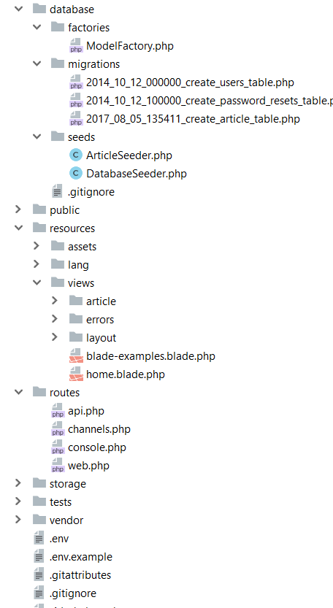
Database folder contains the migrations and seeds
The public folder is the actual folder you are opening on the web server.
All JS / CSS / Images / Uploads are located there.
The resources folder contains all the translations, views and assets (SASS, LESS, JS)
that are compiled into public folder
The routes folder contains all the routes for the project
All the logs / cache files are located in storage folder
The vendor folder contains all the composer packages (dependencies)

Slide 30
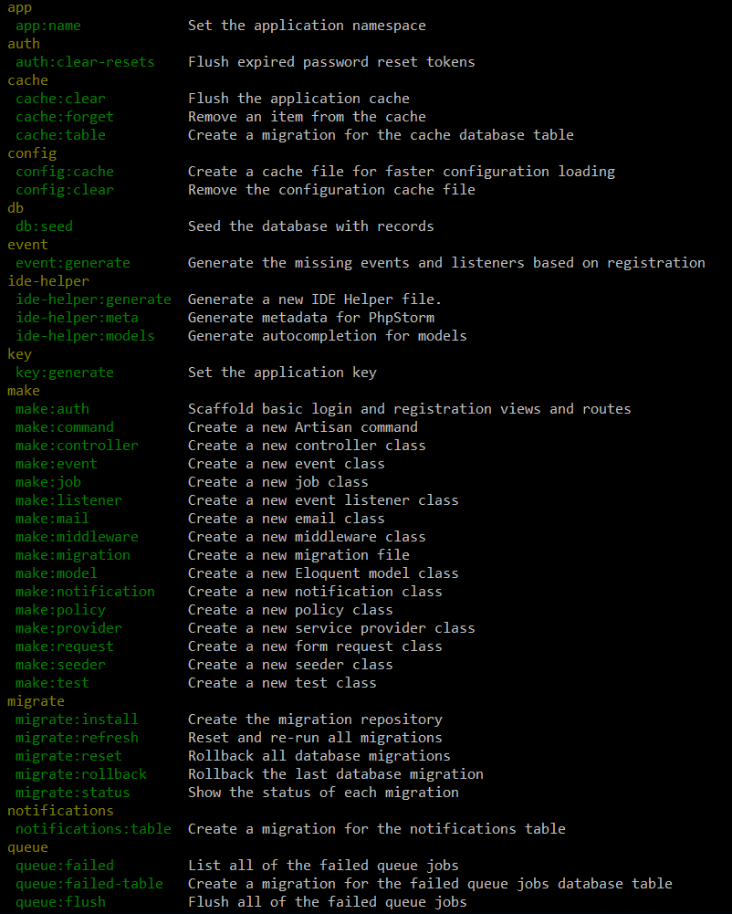
Artisan !
Artisan is command-line interface for Laravel
Commands that are saving time
Generating files with artisan is recommended
Run php artisan list in the console

Slide 31
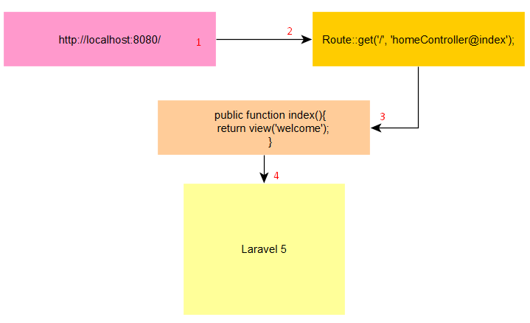
Routing
The best and easy routing system I’ve seen
Routing per middleware / prefix or namespace
Routing per request method (GET, POST, DELETE, etc.)
ALWAYS name your route !
Be careful with the routing order !
Let’s see routing examples

Slide 32
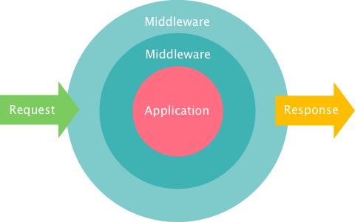
Middleware
The middleware is the mechanism for filtering the HTTP requests
Laravel includes several middlewares – Authentication, CSRF Protection
The auth middleware checks if the user visiting the page is authenticated through a session cookie
The CSRF token protection middleware protects your application from cross-site request forgery attacks by adding a token key for each generated form

Slide 33
Blade
Blade is the powerful template engine provided by Laravel
All the code inside the blade file is compiled to static html file
Supports plain PHP
Saves time
Better components mobility, extend and include partials

Slide 34
Eloquent & Database
The Eloquent ORM (Object-relational mapping) provides simple ActiveRecord implementation for working with the database
$article = new Article();
$article->title = ‘Article title’;
$article->description = ‘Description’;
$article->save();
INSERT INTO `article` (`title`, `description`) VALUES (‘Article title’, ‘Description’);

Slide 35
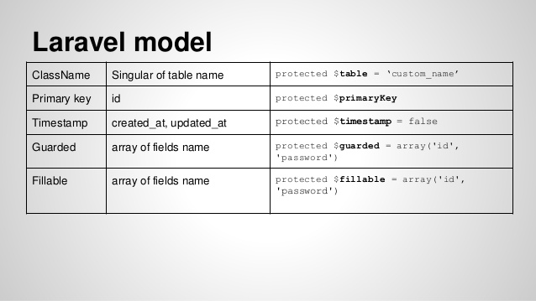
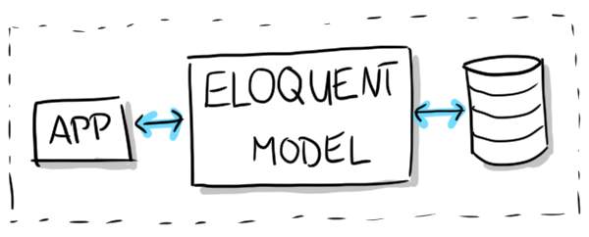
Each table has its own “Model”. You can use the model to read, insert, update or delete row from the specific table
Let’s check one model

Slide 36
Practical task
We will play with Laravel and create a CRUD for recipes (Create, Read, Update, Delete).
The recipe will have the following columns/fields:
Id – primary key – not null
Title – varchar – 255 length – not null
Description – text – nullable
Status – enum [ active / inactive ] – not null – defaults to active
Created At – datetime – not null
Updated At – datetime – not null

Slide 37

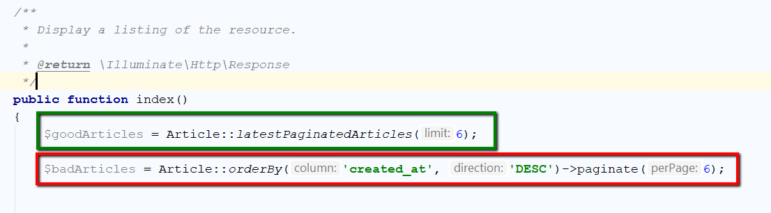
Best practices in Laravel
Just in case, NEVER write queries or model logic inside the controller! The controller’s job is to communicate with the model and pass data to the view.

Slide 38
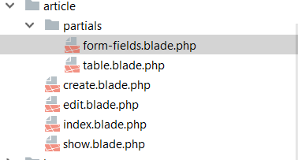
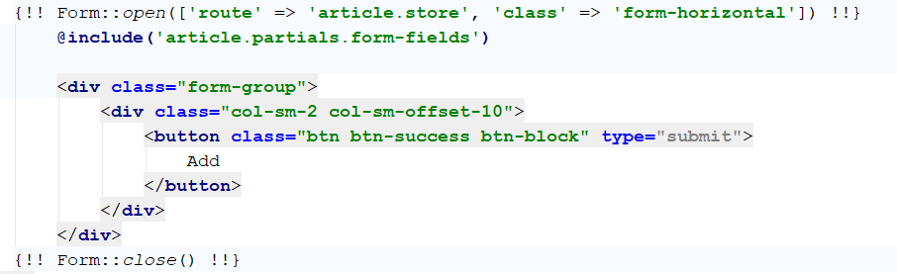
Views mobility
Extend and include partials. For example, share the same form fields on 2 pages – add and edit

Slide 39
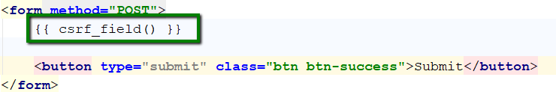
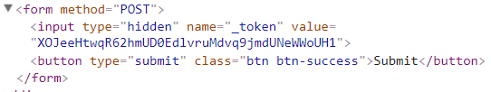
Forms security
Always use the CSRF token protection that Laravel provides in forms you create, the hackers will not be able to spam your forms and database

Slide 40
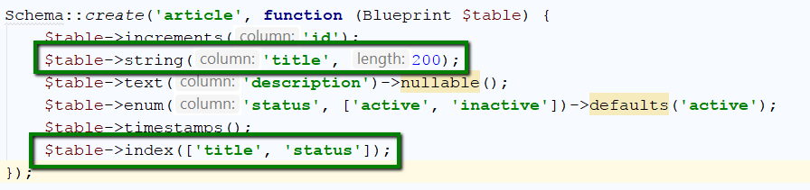
Database architecture
Be careful with the database architecture, always use the proper length for specific column and never forget the indexes for searchable columns

Slide 41
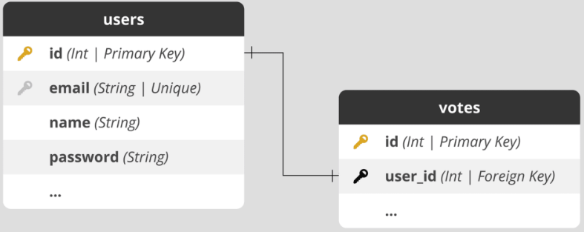
Table Cardinalities
1. ONE – TO - ONE
Laravel 9 One to One Relationship Example
https://www.itsolutionstuff.com/post/laravel-9-one-to-one-relationship-exampleexample.html

Slide 42
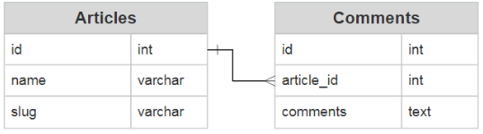
Table Cardinalities
2. ONE – TO - MANY
Laravel 9 One to Many Relationship Example
https://www.itsolutionstuff.com/post/laravel-9-one-to-many-eloquent-relationship-tutorialexample.html

Slide 43
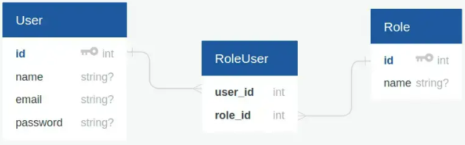
Table Cardinalities
3. MANY – TO - MANY
Laravel 9 Many-to-Many Relationship Example
https://www.itsolutionstuff.com/post/laravel-9-many-to-many-eloquent-relationship-tutorialexample.html

Slide 44
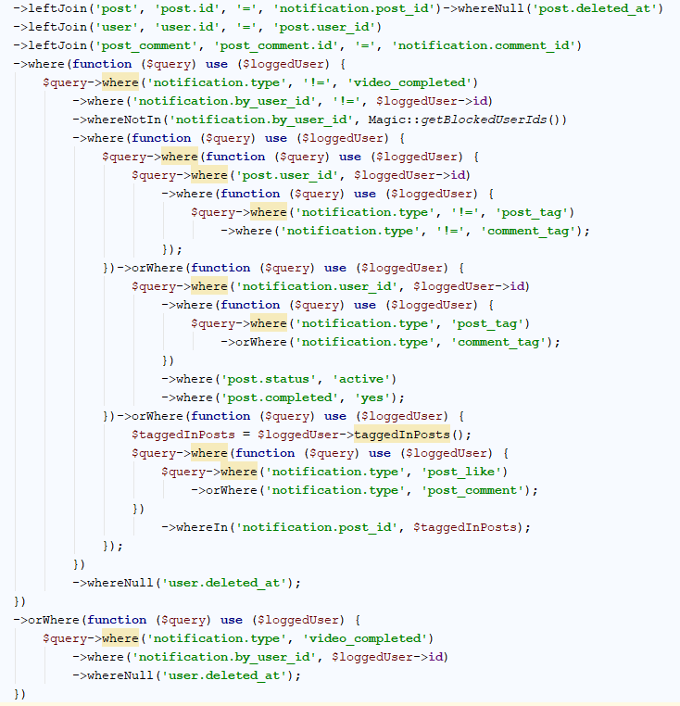
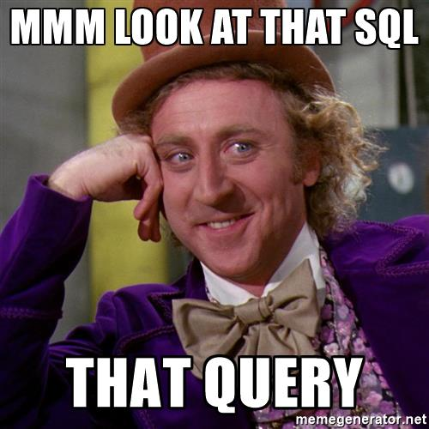
Big Query
Avoid the big query unless you really have to do it. The big query is hard to debug and understand.
You can merge the small queries into one to save the CPU time on the server, but sometimes the query becomes way too big.

Slide 45
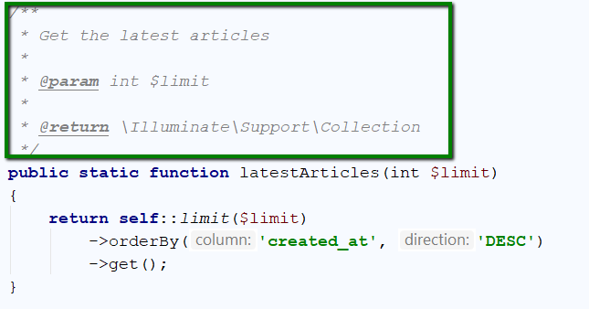
Don’t forget the PHPDoc
Don’t forget to write comments for each method or complicated logic. The PHPDoc comments are helping the IDE to autosuggest easier and the developers to understand the piece of code

Slide 46
3. Team-wise Implementation of the Projects

Slide 47
Thank you! Questions?

