Slide 1
Como escrever uma tese?
Curso Metodologia da Pesquisa

Slide 2
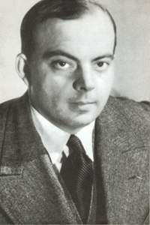
O que você deve buscar?
"Em tudo na vida a perfeição é finalmente atingida, não quando nada mais existe para acrescentar, mas quando não há mais nada para retirar." (Antoine de Saint-Exupéry)

Slide 3
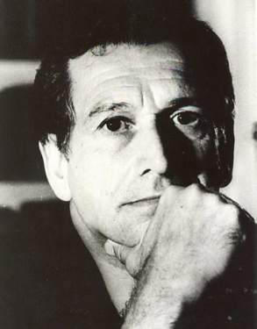
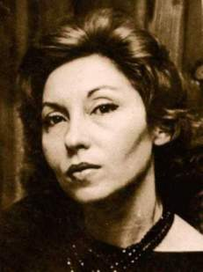
Escrever tem de ser difícil?
“Para mim, o ato de escrever é muito difícil e penoso, tenho sempre de corrigir e reescrever várias vezes. Basta dizer, como exemplo, que escrevi 1100 páginas datilografadas para fazer um romance no qual aproveitei pouco mais de 300”. (Fernando Sabino)
"Que ninguém se engane, só consigo a simplicidade através de muito trabalho”. (Clarisse Lispector)

Slide 4
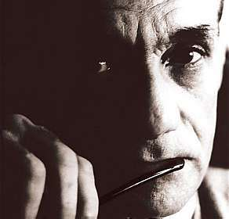
Lições de João Cabral de Melo Neto
"Minha luta é tentar botar coisas complexas numa linguagem simples. Geralmente, fracasso"
“As palavras pedra ou faca ou maçã, palavras concretas, são bem mais fortes, poeticamente, do que tristeza, melancolia ou saudade.”

Slide 5
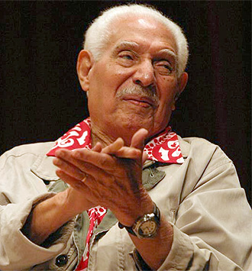
Lições de Dorival Caymmi
Só louco
Amou como eu amei.
Só louco
Quis o bem que eu quis.
Ah, insensato coração
Porque me fizeste sofrer?
Porque de amor p'ra entender
É preciso amar?
Por que?
Só louco.

Slide 6
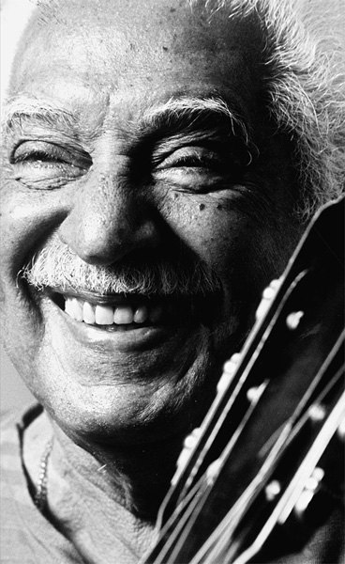
Lições de Dorival Caymmi
Maurino, Dadá e Zeca, ô, Embarcaram de manhã.
Era quarta-feira santa, dia de pescar e de pescador.
Quarta-feira santa, dia de pesca-dor.
Se sabe que muda o tempo,
Sabe que o tempo vira,
Aí o tempo virou.
Maurino que é de guentar, guentou.
Dadá que é labutar, labutou.
Zeca, esse, nem falou.
Era só jogar a rede e puxar a rede...

Slide 7
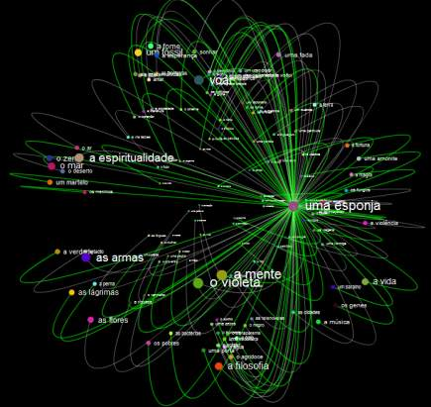

Escrever é cortar palavras: microcontos
“A mulher que amei, se transforma em fantasma. Eu sou o lugar das aparições” (José Arreola)
“Vende-se: sapatos de bebê, sem uso” (Ernst Hemingway).

Slide 8
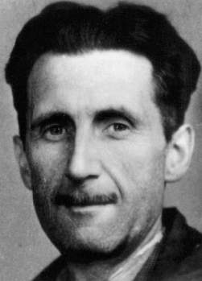
As dicas de George Orwell
Never use a metaphor, simile, or other figure of speech which you are used to seeing in print.
Never use a long word where a short one will do.
If it is possible to cut a word out, always cut it out.
Never use the passive where you can use the active.
Never use a foreign phrase, a scientific word, or a jargon word if you can think of an everyday English equivalent.
Break any of these rules sooner than say anything outright barbarous.

Slide 9
Why is one sentence better than another?
Because we knew nothing about local conditions, we could not determine how effectively the committee had allocated funds to areas that most needed assistance.
Our lack of knowledge about local conditions precluded determination of committee action effectiveness in fund allocation to those areas in greatest need of assistance.
SUBJECT | VERB | COMPLEMENT
character | action

Slide 10
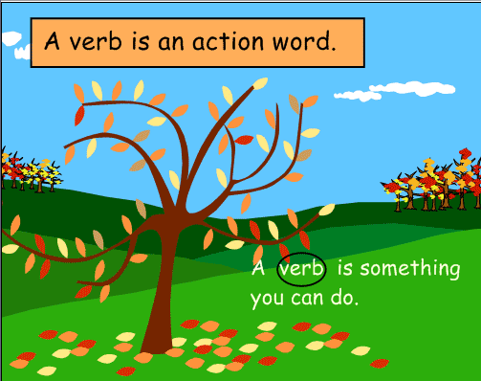
Verbos x substantivos
Nominalizações: substantivos derivados de verbos
discover discovery
move movement
resist resistance
react reaction
fail failure
refuse refusal
think thought
Evite as nominalizações. Use sempre os verbos originais.

Slide 11
Verbos e palavras simples onde couber
This demonstrates an understanding of the history, diversity and commonality of the peoples of the nation, the reality of human interdependence, the need for global cooperation, and a multicultural perspective.

Slide 12
Verbos e palavras simples onde couber
This demonstrates an understanding of the history, diversity and commonality of the peoples of the nation, the reality of human interdependence, the need for global cooperation, and a multicultural perspective.
This shows we understand why history and common beliefs in each nation matter. Across the world, people need to work together and respect their different cultural backgrounds.

Slide 13
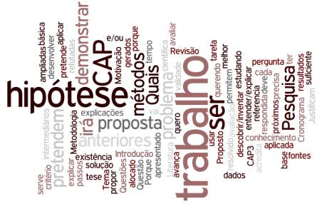
O começo deve ter impacto no leitor
Tudo começa com sua proposição central: ela deve estar bem escrita e bem destacada na introdução
“This paper develops a spatial statistical analysis of the determinants associated to land-use change in Amazonia. We use a spatially explicit database with 25km×25km regular cells covering the forest area, including 50 environmental and socio-economic variables to support a
spatially explicit statistical analysis”.

Slide 14
O começo deve ter impacto no leitor
Tudo começa com sua proposição central: ela deve estar bem escrita e bem destacada na introdução
“Deforestation in the Brazilian Amazonia has a significant impact on biodiversity loss and carbon emission. This paper examines the driving forces behind land change in Amazonia. We performed a spatial statistical analysis, using 50 environmental and socio-economic variables in a database of 25km×25km cells covering the forest area”.

Slide 15
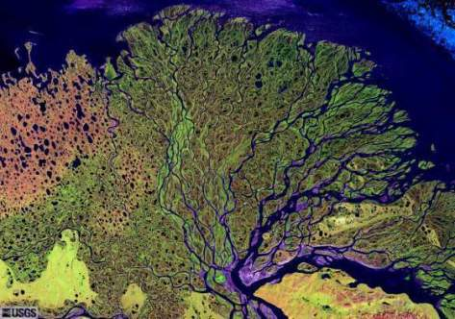
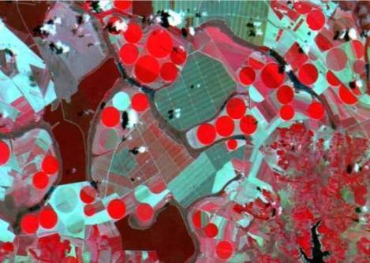
Exemplo de proposição central
Despite over 30 years of experience in data gathering, processing and analysis and the widespread nature of remote sensing imagery, the ontological status of images remains an open issue. It is surprisingly difficult to provide a straightforward answer to a basic question, “What’s in an image?”

Slide 16

Escrever por parágrafos
O parágrafo é a unidade básica do texto científico. Cada parágrafo deve conter uma única idéia.
Parágrafo
tópico
apresenta o assunto
material de suporte
desenvolve as idéias
conclusão
completa o argumento.

Slide 17


Parágrafo: o antigo antes do novo...
Parágrafo
Tópico (antigo)
liga com parágrafos anteriores
material de suporte
(faz sequência lógica)
conclusão (novo)
contém frase mais importante
liga com próximo parágrafo

Slide 18


Parágrafo: o antigo antes do novo...
Nos estudos anteriores, Fulano et al (1999) abordaram o problema de exclusão social sob o ponto de vista de ....Seus resultados não incluem tal visão.... Em nosso trabalho, a abordagem adotada permite....
Como vimos anteriormente, a caracterização da ocupação da Amazônia é feita considerando....No entanto, é possível incluir com os dados de sensoriamento remoto uma nova perspectiva...

Slide 19
Parágrafos consistentes fazem a diferença
“This paper proposes a methodology for mining patterns of change that supports the extraction of spatial configurations from remote sensing image databases. This methodology addresses the problem of describing land use change based on remote sensing image classification. The results show that pattern classification techniques associated to remote sensing image interpretation are a step forwards in the understanding and modeling of land use change. It also helps a more effective use of the large remote sensing image databases available in agencies such as USGS, ESA and INPE. Using satellite images and concepts of landscape ecology, the methodology provides a way to identify deforestation patterns in a complex domain such as Amazon tropical forest.”

Slide 20
Parágrafos consistentes fazem a diferença
“This paper proposes a methodology for mining patterns of change that supports the extraction of spatial configurations from remote sensing image databases. This methodology addresses the problem of describing land use change based on remote sensing image classification. The results show that pattern classification techniques associated to remote sensing image interpretation are a step forwards in the understanding and modeling of land use change. It also helps a more effective use of the large remote sensing image databases available in agencies such as USGS, ESA and INPE. Using satellite images and concepts of landscape ecology, the methodology provides a way to identify deforestation patterns in a complex domain such as Amazon tropical forest.”
“This paper proposes a method for discriminating land change patches extracted from remote sensing image databases and hence describing agents of land use change. The method combines techniques from digital image processing, landscape ecology and data mining. After each image is classified, we measure land change patches using landscape ecology metrics, and then use data mining to label them. We successfully applied the technique for identifying patterns of change in the Amazon tropical forest. The results show that the proposed method is useful for extracting information from large land remote sensing image databases.”

Slide 21
Parágrafos consistentes fazem a diferença
“This paper proposes a method for discriminating land change patches extracted from remote sensing image databases and hence describing agents of land use change. The method combines techniques from digital image processing, landscape ecology and data mining. After each image is classified, we measure land change patches using landscape ecology metrics, and then use data mining to label them. We successfully applied the technique for identifying patterns of change in the Amazon tropical forest. The results show that the proposed method is useful for extracting information from large land remote sensing image databases.”

Slide 22
Parágrafos consistentes fazem a diferença
“This paper proposes a method for discriminating land change patches extracted from remote sensing image databases and hence describing agents of land use change. The method combines techniques from digital image processing, landscape ecology and data mining. After each image is classified, we measure land change patches using landscape ecology metrics, and then use data mining to label them. We successfully applied the technique for identifying patterns of change in the Amazon tropical forest. The results show that the proposed method is useful for extracting information from large land remote sensing image databases.”
“Deforestation in Amazonia is brought about by different agents, including large crop producers, timber extractors, cattle ranchers and settlers. It is important to identify the different types of agents of change. In this paper, we propose a method for describing agents of land use change, using land change patches extracted from remote sensing images. The method combines techniques from digital image processing, landscape ecology and data mining. We successfully applied the technique for identifying agents of change in the Amazon tropical forest.

Slide 23
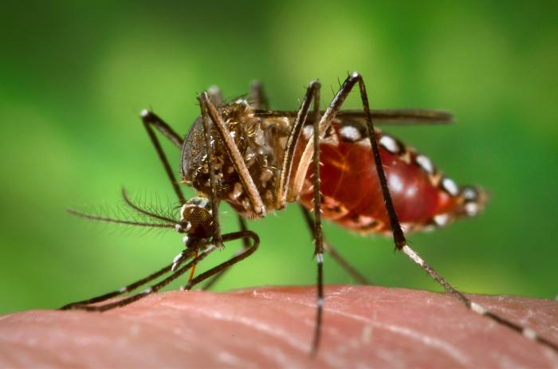

Não seja um mosquito: não pique o leitor!
Models of Aedes aegypti population dynamics can be classified as deterministic [Ferreira and Yang 2003] or stochastic [Otero et al. 2006; Focks et al. 1993a]. To understand the spatial-temporal dynamics of these populations, this work proposes a new approach to couple Aedes aegypti population dynamic models with local scale spatially-explicit models, which are integrated with geographical databases. This way, at each simulation time step, the variation in population size calculated by the dynamic models are allocated in a grid of rectangular and regular cells used to represent the Geographical Space. (Style Writer = Dreadful)

Slide 24


Não seja um mosquito: não pique o leitor!
Models of Aedes aegypti population dynamics can be classified as deterministic [Ferreira and Yang 2003] or stochastic [Otero et al. 2006; Focks et al. 1993a]. To understand the spatial-temporal dynamics of these populations, this work proposes a new approach to couple Aedes aegypti population dynamic models with local scale spatially-explicit models, which are integrated with geographical databases. This way, at each simulation time step, the variation in population size calculated by the dynamic models are allocated in a grid of rectangular and regular cells used to represent the Geographical Space. (Style Writer = Dreadful)
Studying Aedes aegypti mosquitos is important for public health, as they transmit dengue fever. To understand how Aedes aegypti spread dengue, we propose a model that simulates how mosquitos grow and move in space and time. We calculate the number of mosquitos using a population model and we move the mosquitos in a cell space using a spatial diffusion model. In this way, the model captures how the mosquito spreads dengue.
(Style Writer = Good)

Slide 25
O que há de errado com este parágrafo?
Land use changes are the result of the complex interaction between human and biophysical driving forces, which act over a wide range of temporal and spatial scales. The scale on which the process is studied affects the explanation of the phenomenon. Relationships between the land use and the forces driven in local studies cannot be inferred directly for regional scales, due to properties as non linearity, emergence and collective behavior. In different scales, different processes can have dominant influence on the land use system. Regional dynamics impact and are impacted by local conditions in interactions top-down and bottom-up. According to Becker (2005): “it is impossible today, more than ever, to understand what happens in one place, and consequently, to conceive and implement adequate public policies, without considering the interests and conflicting actions at different geographical scales”.
Uso da voz passiva
Falta de sequência lógica dos argumentos
Conclusão não conclui
Parágrafo não respira!

Slide 26
Melhorou?
Land change models are useful to foresee trajectories of land use that might result from alternative decisions and policies. When building land use models, we need to capture how humans interact with nature. We can look at the problem at different temporal and spatial scales. Whether we consider society as households, communities, nations, or global companies makes a difference on what we model. To build land change scenarios and support proper public policies, we need to consider driving forces and conflicts at different geographic scales (Becker 2005).
Primeira frase contém o tópico
Argumentos seguem lógica
Conclusão contém a msg principal

Slide 27

A questão do plágio
In the scientific community, the idea that landscape and urban models must be spatially explicit is common sense, so that they can reproduce and analyze spatial patterns found in geographical reality. Any spatial process has an inherent scale, and attempts to model that process at levels of resolution coarser than the inherent scale will inevitably fail (Parker, 2002).
Este texto está ótimo, mas foi feito com “cut-and-paste”.

Slide 28
Reescreva, não faça plágio
In the scientific community, the idea that landscape and urban models must be spatially explicit is common sense, so that they can reproduce and analyze spatial patterns found in geographical reality. Any spatial process has an inherent scale, and attempts to model that process at levels of resolution coarser than the inherent scale will inevitably fail (Parker, 2002).
Spatially-explicit modeling has great benefits for understanding geographical reality. The location of each change allows a better analysis of the underlying forces that cause change. However, all spatially-explicit models require an adequate choice of the spatial resolution. This resolution depends on the inherent scale of the spatial process being modeled. If we model the process at an inappropriate scale, the model will not be realistic (Parker, 2002)

Slide 29
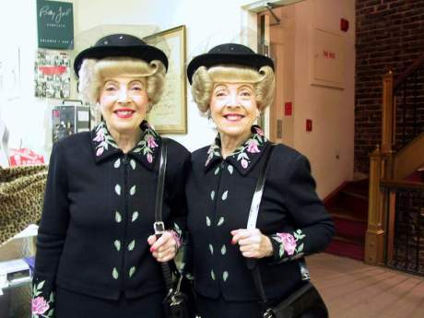
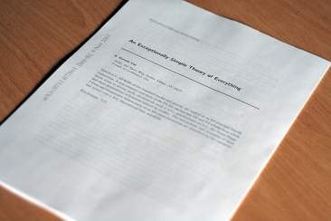
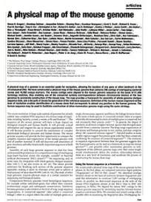
Você pode se plagiar?
Reuso de até 30% de um artigo científico anterior é o limite máximo aceitável para um novo artigo
Artigo em conferência pode ser aproveitado para revista
Partes de um artigo científico podem também ser reusadas para um artigo de divulgação
(Pamela Samuelson, Self-Plagiarism or Fair Use, Communications of the ACM, August 1994)

