Slide 1
IBM Applied Data Science Capstone
Finding the most suitable area in London for a new residential building
Gilberto Agostinho
May 2020

Slide 2
Introduction
Business problem:
housing development company
best area in London to construct a new building
3-bedroom apartments targeted to middle-class families
ample amenities such as supermarkets, parks, restaurants, cafes, etc.
they also prefer a more central area

Slide 3
Data
The data used in this project comes from several sources:
The list of London areas and their boroughs is obtained from a table from Wikipedia
The latitude and longitude of these boroughs is obtained using the geocoder package. This information will be used to search for venues within those boroughs
Venue data is obtained using the FourSquare API

Slide 4
Methodology
scrapping Wikipedia using BeautifulSoup
cleaning the data using regex
obtaining location for each area using geocoder
acquiring a list of venues using FourSquare
groupping the data by area and filtering out the ones that do not conform to the required venue categories
look for the closest ones to the centre of London

Slide 5
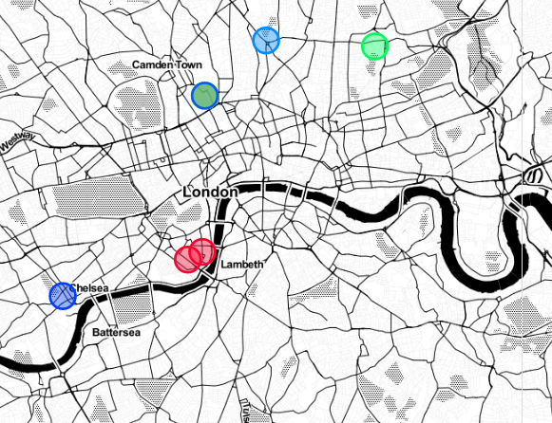
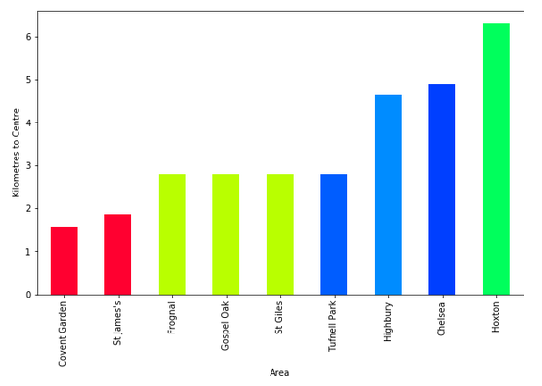
Results and Discussion
there are 9 areas in London which conform to our client’s needs: Bethnal Green, Holborn, St James’s, and Wapping.
Convent Garden and St James’s are the closest ones to the centre of the city.

Slide 6
Conclusion
Given our findings above, we can strongly recommend our client to consider the areas of Convent Garden or St James’s. Both are very central and have all basic amenities required within a radius of 500m.
Three areas in the borough of Camden could also constitute good choices but are further away from the centre of the city.

