Slide 1

Consumer Driven Contract Test
Spring Cloud Contract: Sprintboot users with Java and Kotlin
Pact: Golang, REACT, etc.

Slide 2
What it is
Testing http and message integrations using contracts between a producer and consumer(s).
An Alternative to the brittle integration tests
Consumers upload contracts to the pact broker after tests have passed
Producer tests involve getting fetching all uploaded consumer contracts and verifying them against producer events. If not matched, producer tests fail. Producer team must reach out to consumers who contract verification is failing so they can update their responses and a new contract uploaded. Then the producer verification will succeed.
Actors: consumer, producer, interactions, pact broker
Notes:
Interactions: mock a response given a request (also called STUBS)

Slide 3

Issues with Integration tests
Tests the entire system (why not just integration points?). E.g. testing a call to singlesend api calls segments, contact, snowflake etc. which incurs more costs and increases latency
Integration tests are usually flaky due to things like network, external API latency, etc. leads to long deployments
As producer, its hard to tell all dependent consumers. How we communicate changes to consumers? With pact, we get a nice graph showing consumer-producer relationship
Creates dependencies between live APIs
Slow running builds ($Latency,A=sum of dependency tree)$

Slide 4
Benefits of contract tests
Simpler, with testing a single integration point at a time without deploy
No dedicated test environments. Run on local machine or docker
Fast and reliable feedback
Tests scale linearly. No dependency tree in calls like for integration tests
Deploy services independently. Removes need for complicated release coordination since we have static knowledge about system compatibility with contracts

Slide 5
Use cases of contract tests
Restful microservices
Asynchronous messaging with queues
Etc
Goals:
* reduce reliance on complex test environments with integration tests
* removing end-to-end integration tests

Slide 6
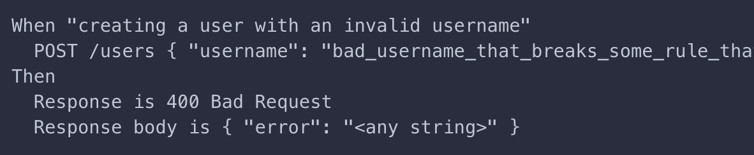
How PACT works
HTTP
Spin up mock provider that pact broker provides
create tests for the consumer and generate contracts (GET, POST, etc.). Response generated by pact interaction logic.
Pack mock checks: consumer makes correct calls and can handle the response
Notes:
Integration tests require live consumer and producer apps talking to each other. If provider has its own provider which also has another provider down the tree. We end up testing the entire cascading chain of systems.
With pack, only tests the immediate provider service

Slide 7
How PACT works
HTTP
Contracts uploaded to pack broker (packflow is the commercial version)
Provider verification:
pull down consumer contracts
Replay requests against the provider,
Verify provider can respond to each consumer’s request
For each request, the response (headers, body, code, etc.) match the rules specified in the consumer contracts
Notes:
Integration tests require live consumer and producer apps talking to each other. If provider has its own provider which also has another provider down the tree. We end up testing the entire cascading chain of systems.
With pack, only tests the immediate provider service

Slide 8
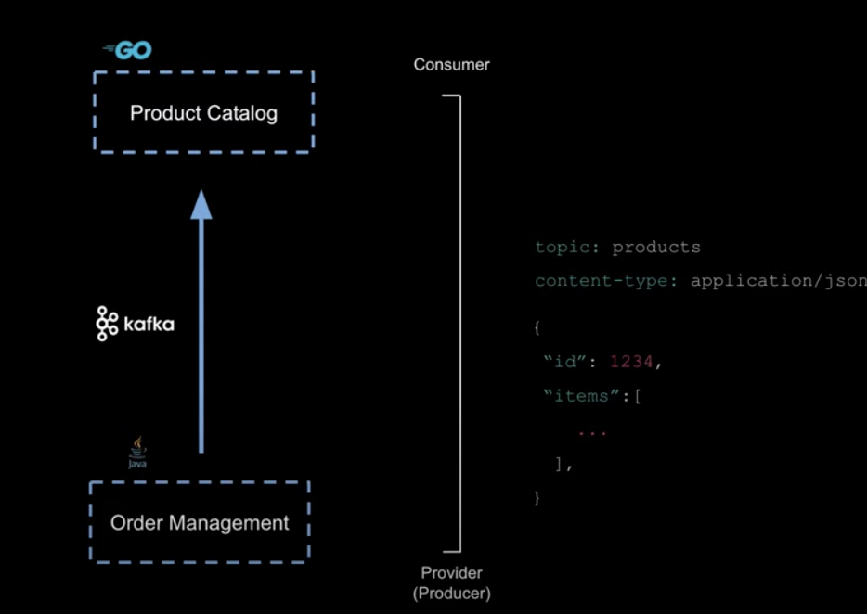
How PACT works
Asynchronous integration (SQS, MQ, Kafka, etc.)
Ex:
Pack mocks the kafta with a
Contract, metadata and data. (Won’t
care about the order mgt system here)
- Pack pushes a message to the
Consumer and invokes message handler
which processes the message
Notes:
Integration tests require live consumer and producer apps talking to each other. If provider has its own provider which also has another provider down the tree. We end up testing the entire cascading chain of systems.
With pack, only tests the immediate provider service

Slide 9
How PACT works
Asynchronous integration (SQS, MQ, Kafka, etc.)
Consumer serializes the contract and uploads to broker
Pact replays the request and invokes the provider’s function that produced the message
Verify the produced event above against the message details in the contract.
REFERENCES: https://docs.pact.io/, https://spring.io/guides/gs/contract-rest/
Notes:
Integration tests require live consumer and producer apps talking to each other. If provider has its own provider which also has another provider down the tree. We end up testing the entire cascading chain of systems.
With pack, only tests the immediate provider service

