Slide 1
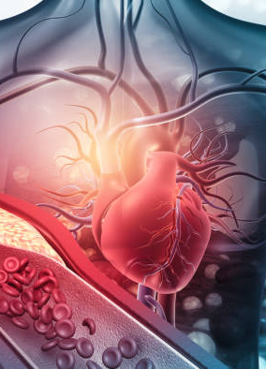
Automated Cardiovascular Disease Diagnosis Using Honey Badger Optimization With Modified Deep Learning Model
UNDER THE GUIDANCE OF
Department of Mathematics,
VIT Vellore.
PRESENTED BY
GILBERT RAJ V

Slide 2
abstract
Addressing the global health challenge of cardiovascular disease (CVD) through the development of the ACVD-HBOMDL Model.
Integrating min-max scaling, Honey Badger Optimization for feature selection, and a modified deep learning neural network for CVD classification, enhanced by Bayesian hyperparameter tuning.
Targeting crucial aspects - feature selection and hyperparameter tuning, addressing challenges in handling large healthcare datasets. HBO and DLMNN together offer a novel approach for accurate and rapid CVD diagnosis.

Slide 3
introduction
Cardiovascular disease (CVD) is a major cause of mortality, necessitating preemptive measures for early detection and risk prediction.
The project leverages electronic health records to create a decision support system, combining patient data, artificial intelligence, and domain knowledge for efficient CVD diagnosis.
Conventional manual analysis of heart disease information is time-consuming and prone to misdiagnosis, highlighting the need for more effective approaches.
Emphasizing the role of artificial intelligence, particularly deep learning and machine learning, the project aims to build a predictive model for CVD detection, surpassing the limitations of manual methods.
The project introduces the Automated Cardiovascular Disease Diagnosis using Honey Badger Optimization with Modified Deep Learning (ACVD-HBOMDL) Model, integrating standard scaling, Honey Badger Optimization, Deep Learning Modified Neural Network, and Bayesian optimization for enhanced accuracy and performance in CVD detection.

Slide 4
Problem statement
Despite medical technology advancements, accurate and timely CVD diagnosis remains challenging. Expanding healthcare datasets complicate disease prediction, hindering practitioners in understanding intricate feature relationships.
Individuals, especially those with risk factors like hypertension, diabetes, and obesity, face increased susceptibility to CVD. Healthcare providers struggle to deliver preventive measures and early interventions.
Introducing the ACVD-HBOMDL Model to tackle complex CVD prediction challenges. Utilizing advanced machine learning techniques for feature selection and hyperparameter tuning aims to enhance diagnostic accuracy, speed, and ultimately improve patient outcomes while easing healthcare system burdens.

Slide 5
objective
The goal is to develop the ACVD-HBOMDL model, aiming to precisely classify cardiovascular diseases through advanced machine learning techniques.
The objective is to employ the Honey Badger Optimization for feature selection, with the goal of enhancing model efficiency by identifying crucial features in medical datasets.
The goal is to apply Standard scaling for preprocessing medical data, with the objective of ensuring standardized inputs to achieve robust model performance.
The objective is to optimize the hyperparameters of the DLMNN classifier using Bayesian optimization, aiming to achieve improved model precision and generalization.
The goal is to evaluate the ACVD-HBOMDL on benchmark medical datasets, with the objective of validating its practical effectiveness in real-world scenarios.

Slide 6
Literature survey
TITLE - An Ensemble Feature Selection Methodology That Incorporates Domain Knowledge for Cardiovascular Disease Diagnosis
AUTHOR - Burak Kolukisa, V. C. Gungor, Burau Bakir-Gungor
YEAR – 2020
METHODOLOGY - The envisioned system leverages machine learning for cost-effective CAD diagnosis through the analysis of specific physical and biochemical values. Results show promise, with the Multilayer Perceptron achieving 85.47% accuracy using nine selected features, indicating potential for an accurate and efficient CAD classification system.

Slide 7
Literature survey
TITLE - An optimal artificial neural network based big data application for heart disease diagnosis and classification model
AUTHOR - R. T. Selvi and I.Muthulakshmi
YEAR – 2020
METHODOLOGY - The Big Health application utilizes OANN for heart disease diagnosis, addressing resource distribution and cost challenges. Effective in both offline and online predictions, it proves valuable in real-time analysis.

Slide 8
Literature survey
TITLE - Machine learning and IoT applied to cardiovascular diseases identification through heart sounds: A literature review
AUTHOR - S. Brites, L. M. Silva, J. L. Barbosa, S. J. Rigo, S. D. Correia, and V. R. Leithardt
YEAR – 2021
METHODOLOGY - Integrating machine learning and IoT, the system aims to identify diseases through heart sounds, emphasizing the prevalence of wearable sensors, digital stethoscopes (79.31%), and machine learning algorithms (58.62%) based on the literature review.

Slide 9
Literature survey
TITLE - Conceptual design of a machine learning-based wearable soft sensor for non-invasive cardiovascular risk assessment
AUTHOR - P. Arpaia, R. Cuocolo, F. Donnarumma, A. Esposito, N. Moccaldi, A. Natalizio, and R. Prevete
YEAR – 2021
METHODOLOGY - The envisioned system focuses on home care for the elderly, utilizing the soft sensor for real-time cardiovascular risk assessment with an 80% accuracy, even with limited training data.

Slide 10
Literature survey
TITLE – Heart disease prediction using supervised machine learning algorithms: Performance analysis and comparison
AUTHOR - M. M. Ali, B. K. Paul, K. Ahmed, F. M. Bui, J. M. W. Quinn, and M. A.Moni
YEAR – 2021
METHODOLOGY - The system employs the RF algorithm, achieving 100% accuracy on a Kaggle dataset. The simplicity of this approach underscores its potential utility in early-stage heart disease prediction.

Slide 11
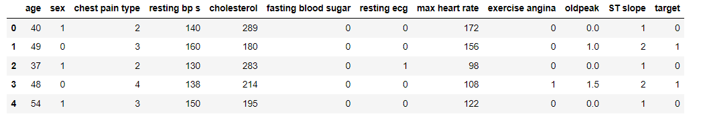
Heart disease dataset

Slide 12
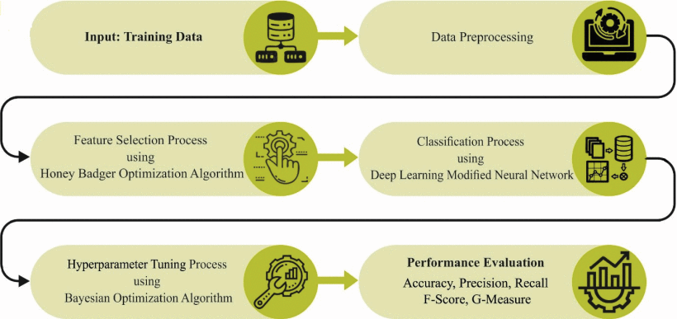
Methodology
Importing the packages.
Exploring the dataset.
Data Preprocessing
Visualization using seaborn and matplotlib
Feature Selection – Honey Badger Optimization
Splitting the data for training and testing
Building the model
Evaluating the model

Slide 13
methodology
This project addresses limitations by introducing a Stacking Classifier for improved accuracy, utilizing Honey Badger Optimization for feature selection, and optimizing model performance with deep learning and Bayesian optimization. The user-friendly Flask front end with authentication enhances the overall system's practicality and usability.

Slide 14
ALgorithms
Rep Tree Algorithm
Support Vector Machine
Bagging Algorithm
Artificial Neural Network
J48
Spectral Clustering Algorithm
Stacking Classifier(RF+ET with LightGBM)

Slide 15
stacking classifier
The stacking classifier integrates multiple base models, such as RF, ET, and LightGBM, into a single "super model." Each base model contributes its own unique approach to the classification task.
Each individual base model, such as RF and ET, has its own strengths and weaknesses. RF is known for its robustness to outliers and noisy data, while ET excels in capturing complex patterns in the data. LightGBM, on the other hand, is known for its efficiency and speed in handling large datasets.
The stacking classifier aggregates the predictions from each base model, combining them into a final prediction.
The stacking classifier has the potential to outperform any single model.

Slide 16
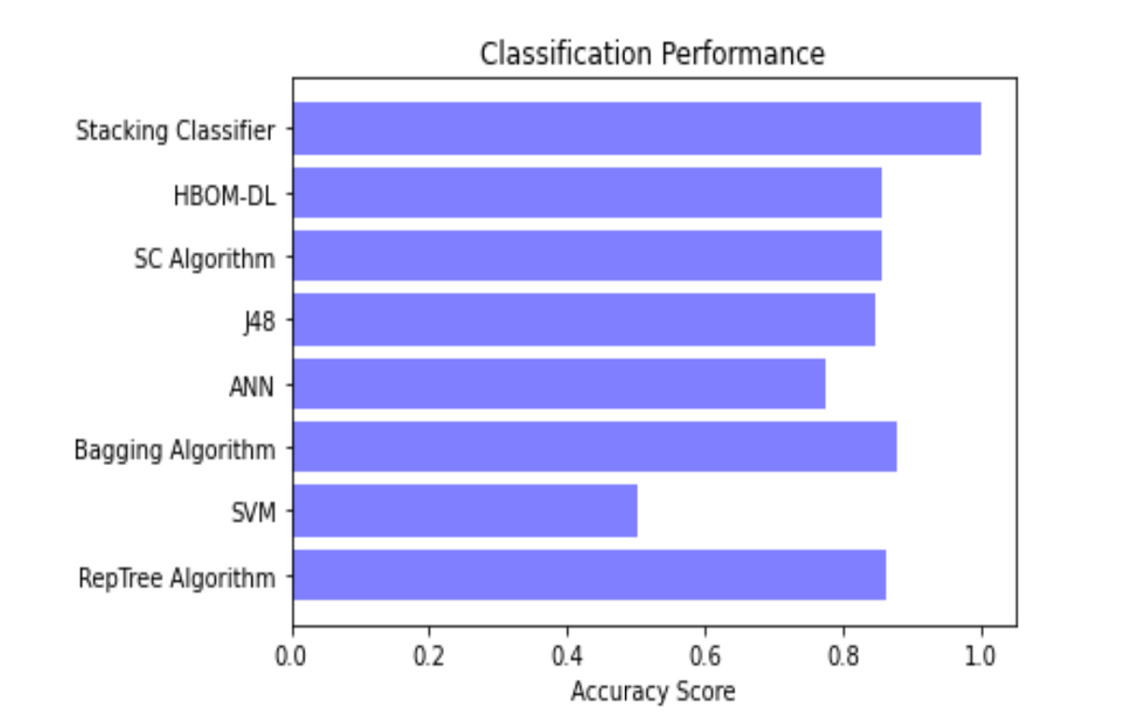
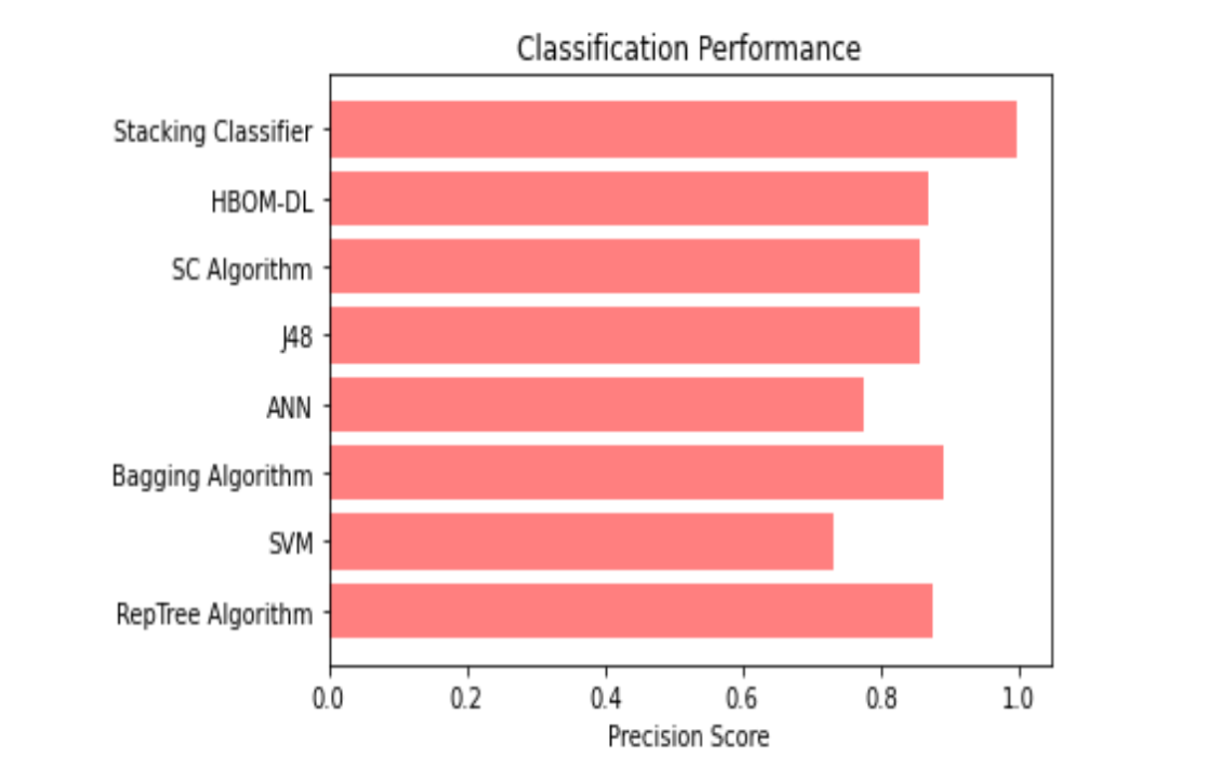
Performance evaluation

Slide 17
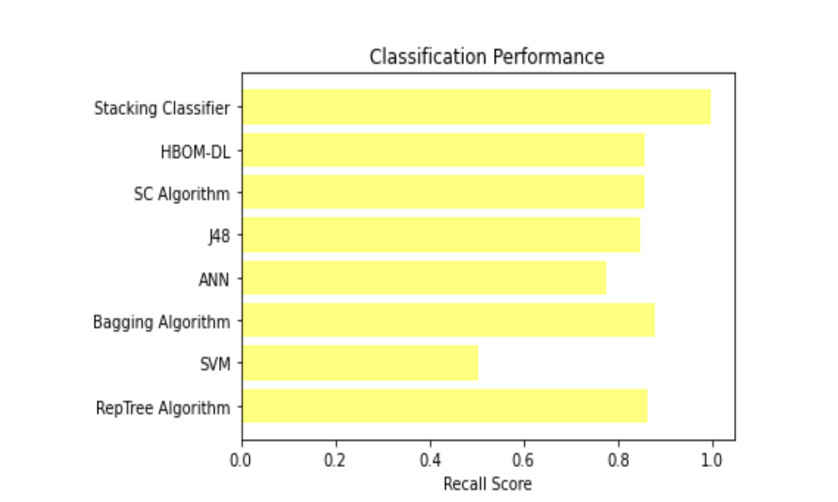
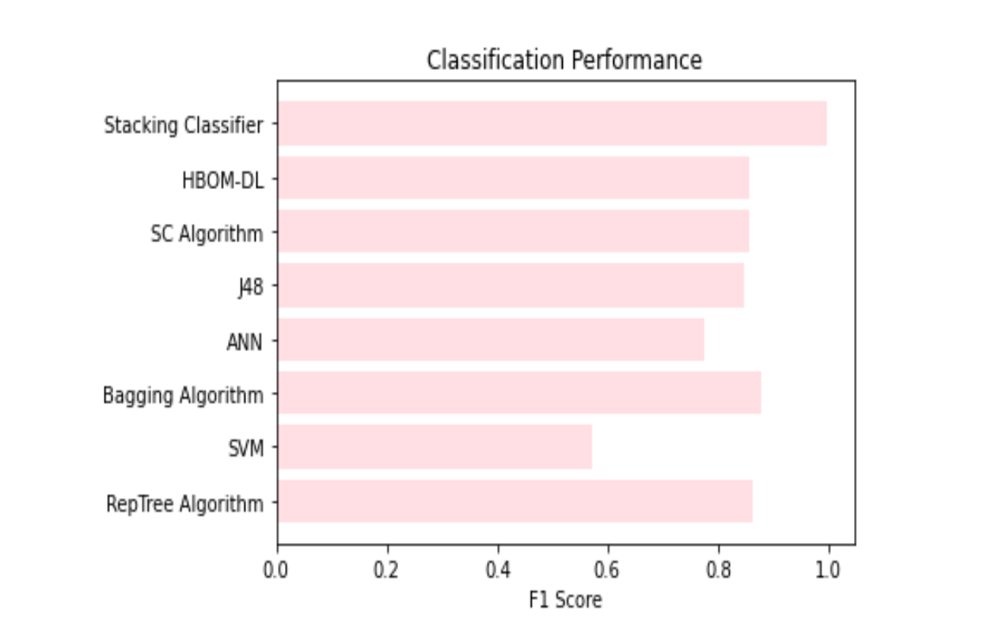
Performance evaluation

Slide 18
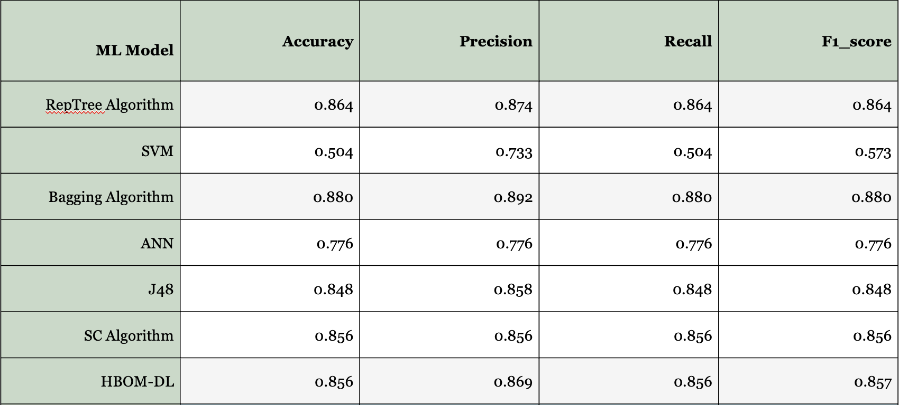
Performance evaluation

Slide 19
Web interface using flask
1. Microframework : It focuses on simplicity and extensibility. Flask does not come with built-in features for database management, authentication, or form validation.
2. Pythonic : Flask is written in Python and follows the principles of the Python programming language, such as readability and simplicity.
3. Extensibility: Flask provides a simple yet powerful extension mechanism that allows developers to add additional functionality to their applications from database integration to authentication and authorization.

Slide 20
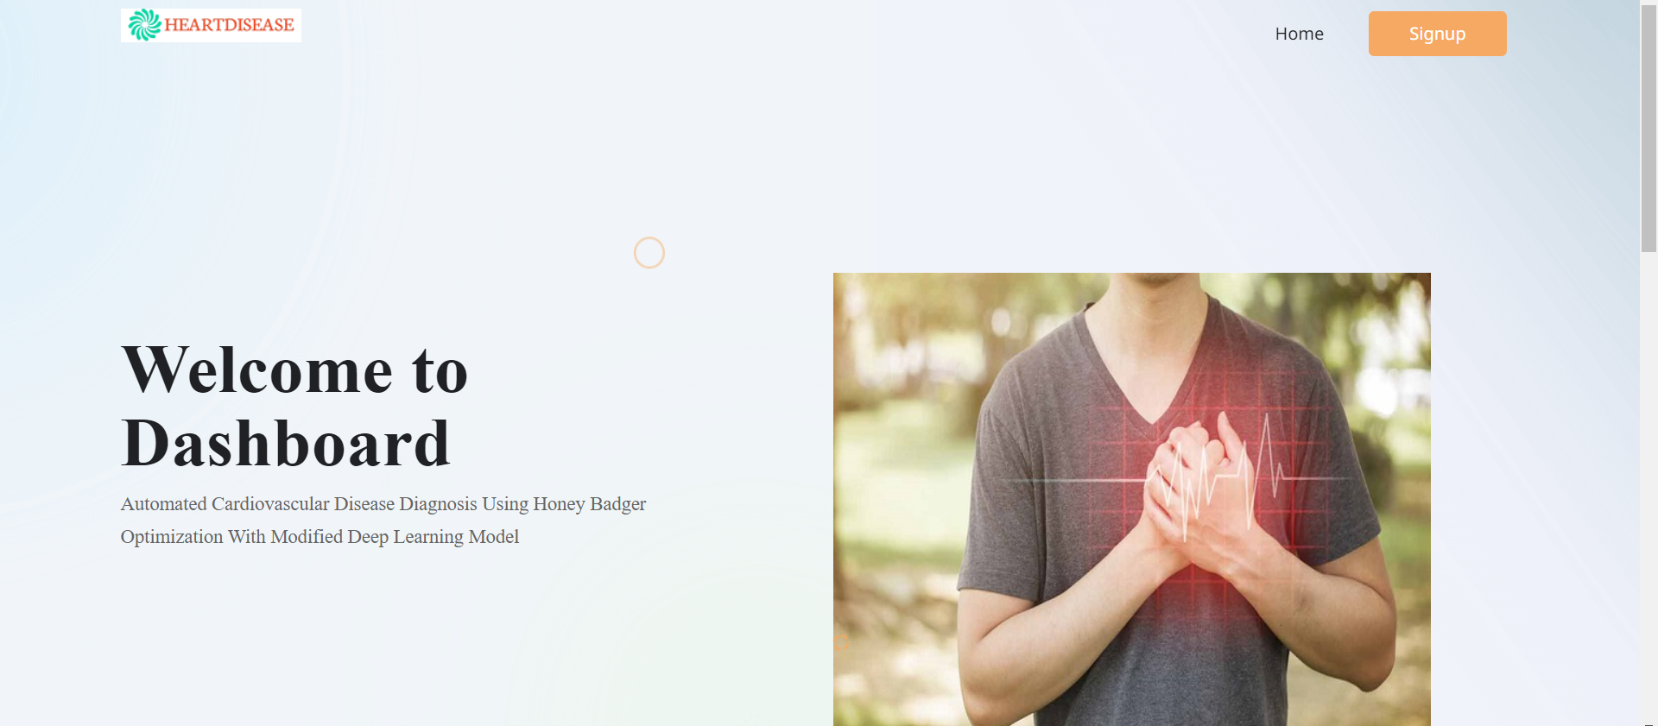
Dashboard

Slide 21
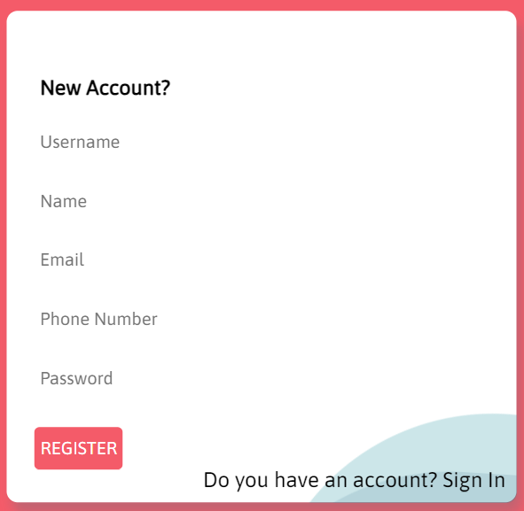
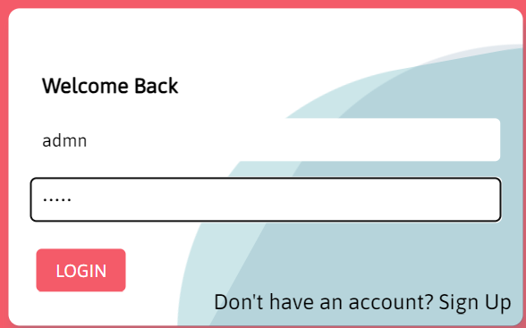
Signup and login page

Slide 22
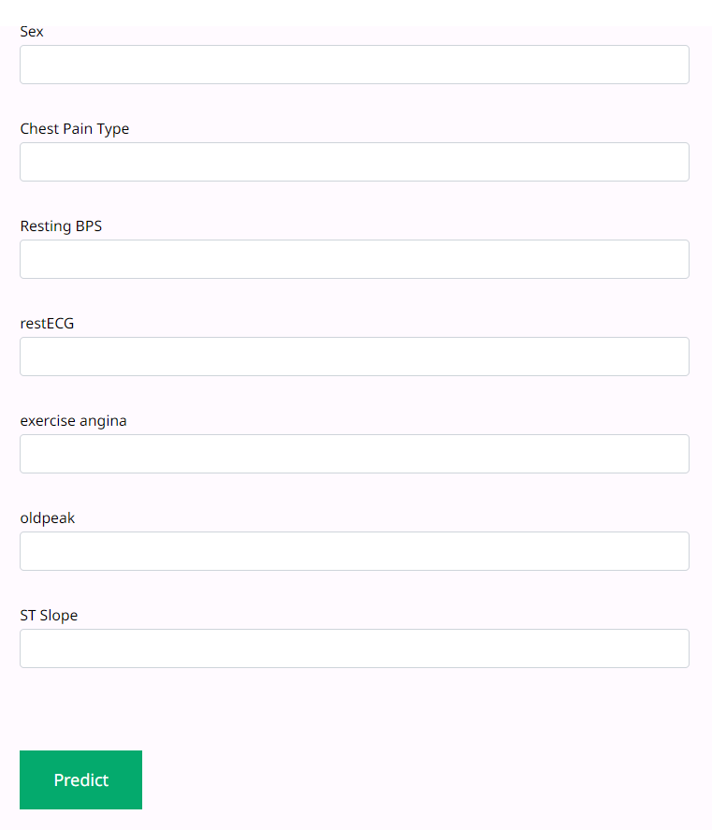
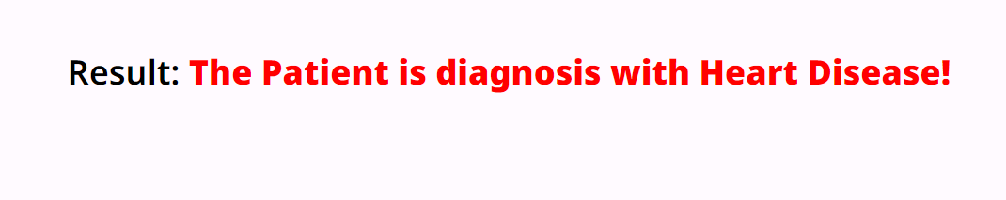
Input from the user and prediction

Slide 23
limitations
1. Data Quality
Biases
Missing Values
Inconsistencies
2. Model Interpretability
Feature Importance
3. Security and Regulatory Considerations
Secure Data Storage
User Authentication

Slide 24
conclusion
Innovative Model Design: The ACVD-HBOMDL model combines Honey Badger Optimization with modified deep learning, showcasing a novel approach for superior cardiovascular disease prediction.
Efficient Feature Selection: Leveraging Honey Badger Optimization ensures efficient feature selection, allowing the model to focus on relevant data and potentially enhance accuracy and efficiency in CVD prediction.
Diverse Algorithmic Strategy: By integrating various algorithms like RepTree, SVM, Bagging, ANN, J48, SC, and HBOM-DL, ACVD-HBOMDL enriches its predictive capabilities, creating a robust and reliable system.
User-Centric Interface: With a user-friendly web interface built with Flask and SQLite, ACVD-HBOMDL prioritizes user experience, facilitating seamless interaction for clinicians and bridging the gap between advanced prediction models and practical application in real-world healthcare settings.

Slide 25
future work
Incorporate Additional Sources
Explore Additional Datasets
Clinical Trial Validation

Slide 26
Work plan
TASK | DESCRIPTION OF WORK | STARTING BY | FINISHING BY
Task 1 | Project Planning | Jan 05, 2024 | Jan 20, 2024
Task 2 | Abstract Writing | Jan 21, 2024 | Jan 25, 2024
Task 3 | Abstract Review 1 | Feb 07, 2024 | Feb 07, 2024
Task 4 | Data Preprocessing | Feb 08, 2024 | Feb 15, 2024
Task 5 | Visualization | Feb 15, 2024 | Feb 29, 2024
Task 6 | Building the model | Mar 01, 2024 | Mar 10, 2024
Task 7 | Review II ( Midterm Review) | Mar 11, 2024 | Mar 15, 2024
Task 8 | Creating a web interface | Mar 16, 2024 | Mar 25, 2024
Task 9 | Result and Conclusion | Mar 26, 2024 | Mar 31, 2024
Task 10 | Final Review (Guide) | April 01, 2024 | April 06, 2024
Task 11 | Structuring the Final thesis and Formatting it | April 07, 2024 | April 30, 2024
Task 12 | Final Review (HoD) | May 08, 2024 | May 08, 2024
Task 13 | Final Project Report Submission | May 08, 2024 | May 08, 2024

Slide 27
Thank you

