Slide 1
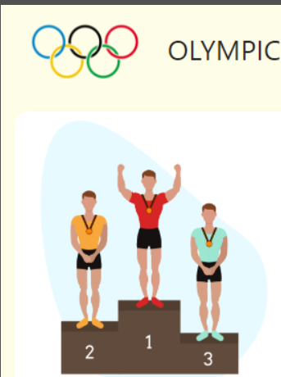
A Comprehensive Analysis of Olympic Trends and Medal Success

Slide 2
Introduction
Motivation:
Analyzing Olympic data gives the chance to discover trends, further optimize training strategies, and underpin evidence-based decisions in view of enhancing athletic performance and competitiveness at a national level.
Goals/Objectives:
Analyze trends in Olympic performance and participation.
Identify medal distribution patterns by nationality, age, and gender.
Analyze demographic factors influencing medal success.

Slide 3
Dataset Overview
Data Source- The dataset is sourced from Olympic dataset which is available on Kaggle.
The data has been gathered through Kaggle Dataset: "120 years of Olympic history: Athletes and results". Complementary sources: Wikipedia, International Olympic Committee (IOC), SportsDataIO API, Django Mustang GitHub repository.
Authors - Kaggle contributors and community for validation and Complementary data verified by the IOC and Wikipedia
Dataset Overview-
Geographic Scope: Global: Covers athletes and events from 200+ countries participating in the Olympic Games during the years 2000–2016.
Temporal Scope: Focuses on the years 2000-2016 (Summer and Winter games)
Utility: Analyze trends in medal distribution by gender, nationality, and age. nobles talent scouting based on athlete demographics.

Slide 4
Exploring Data and Crafting the Story
Time Spent: Considerable time was spent understanding the dataset, cleaning, and pre-processing to ensure accuracy and consistency.
Data Preprocessing: Imputed missing values in columns such as Age, Height and weight for completeness and normalized categorical columns like NOC to ensure uniformity
Filtering: Dropped columns with minimal variance or redundant information(columns with a single value), removed rows with significant data discrepancies, ensuring realistic timelines and consistent event data
Outliners & Categorization: Identified and addressed outliners in physical metrics(e.g. athletes with improbable height/weight values), categorized medal achievements and participation trends for better story telling
Visual displays & story crafting: Developed visualizations highlighting athlete demographics, participation trends and medal distribution.

Slide 5
Key Variable Definition
Participation Count: The total number of events an athlete participated in during a specific Olympic year.
Performance Rank: Relative ranking of athletes based on medal achievements and event performance.
Games: The specific Olympic event, including the year and season
NOC: The National Olympic Committee code, that represents the country or region.
Season: Specifies whether the Olympic Games were held in Summer or Winter.
Sport: The broader category of competition (e.g., Swimming, Athletics).

Slide 6
Limitations of Data
Missing Data: Some fields, such as medals and physical attributes (age, height, weight), have missing values
Aggregated Information: The dataset focuses on athletes but lacks contextual details such as training history or socio-economic factors.
Historical Context: Notes in the country data suggest political or historical changes might not be reflected accurately across all events.
Representation: Smaller nations or underrepresented sports may lack comprehensive data.

Slide 7
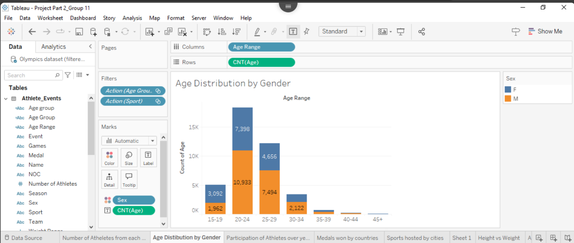
Question: "How does the age distribution of athletes differ by gender across various age groups?"

Slide 8
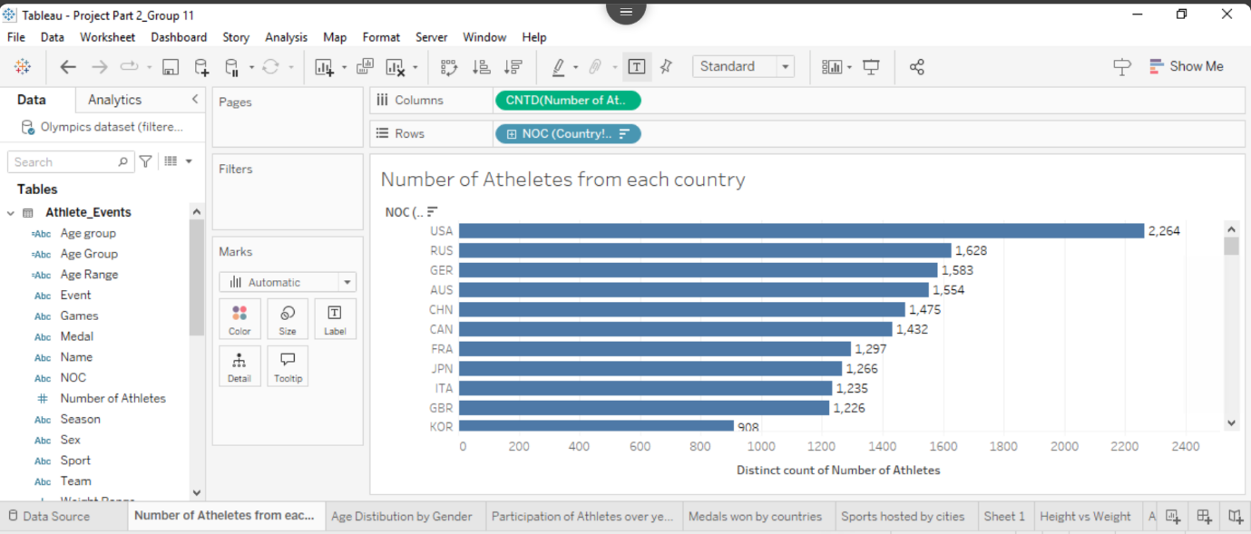
Question: "Which countries have the highest representation of athletes in the Olympics?"

Slide 9
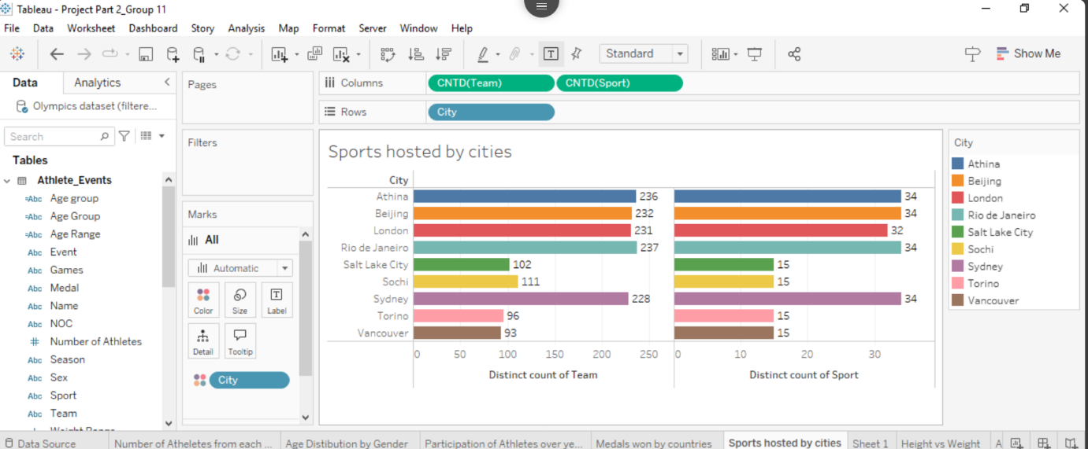
Question: "Which cities have hosted the most sports and teams in the Olympics?"

Slide 10
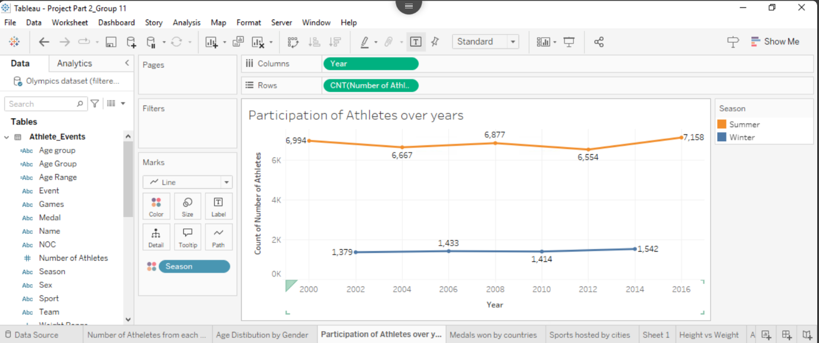
Question: "How has athlete participation in the Summer and Winter Olympics changed over time?"

Slide 11
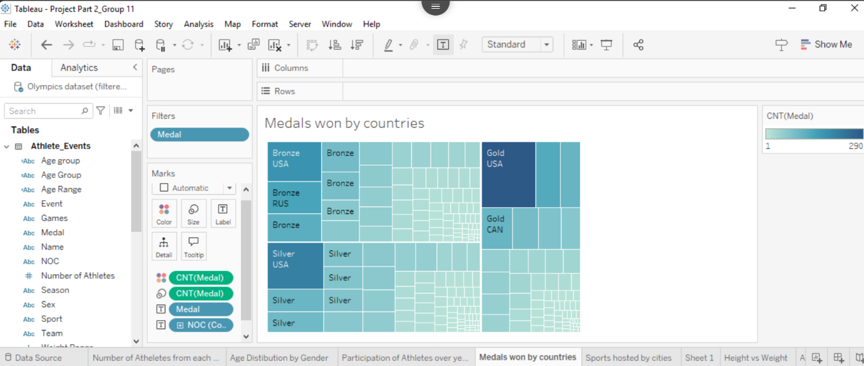
Question: "Which countries have won the most medals, and what types of medals (gold, silver, bronze) do they predominantly win?"

Slide 12
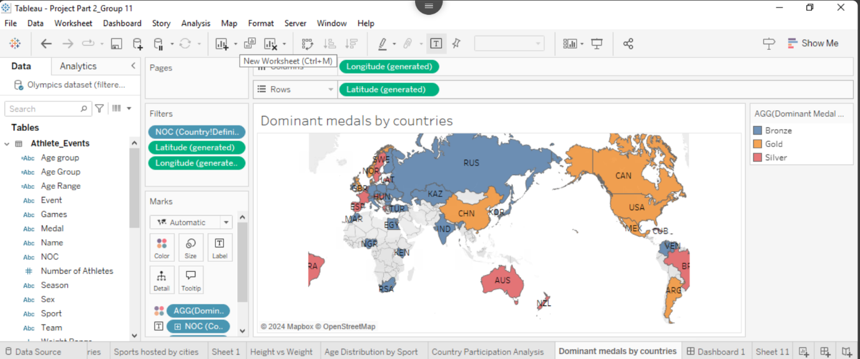
Question: "Which type of medal (gold, silver, or bronze) is most dominant for each country participating in the Olympics?"

Slide 13
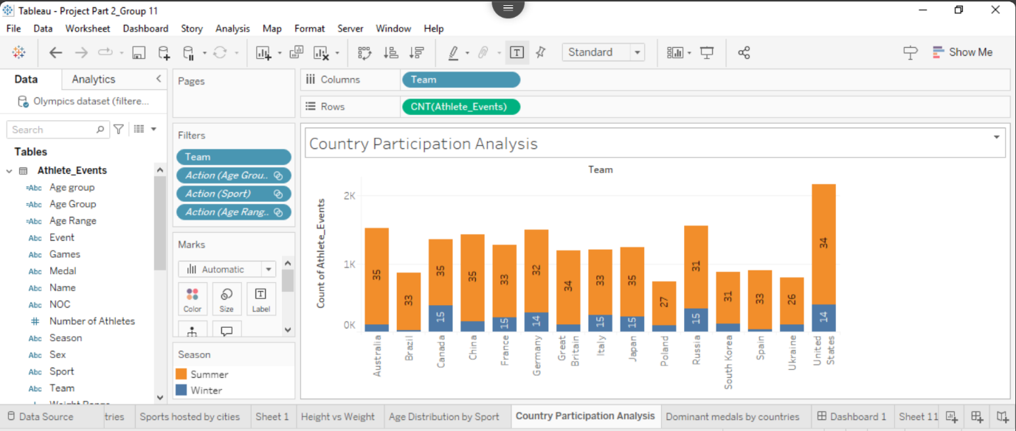
Question: "How does participation in the Olympics vary between countries, and how is it divided between Summer and Winter Games?"

Slide 14
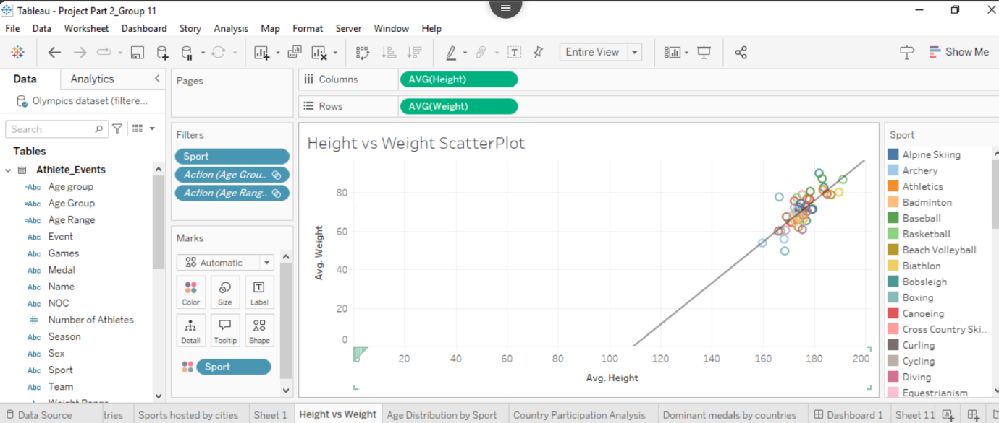
Question: "What is the relationship between height and weight across different sports, and do specific sports show distinct patterns in this relationship?"

Slide 15
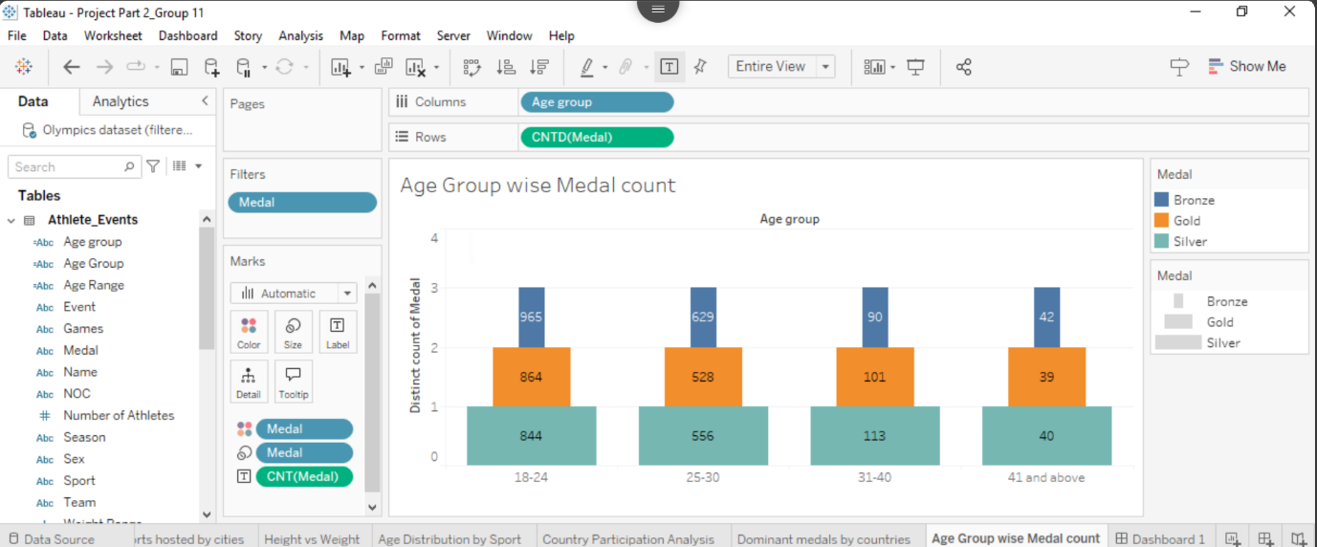
Question: "How is the distribution of medals (gold, silver, bronze) across different age groups of athletes in the Olympics?"

Slide 16
Conclusion
Participation Trend: Countries such as the USA, China top the list in sending athletes to the Olympics. The Summer Olympics have always drawn in more participants compared to the Winter Games.
Distribution of Medal Patterns: The general medal success is monopolized by a limited set of nations; there is a considerable contribution of younger athletes from the 20-25 age bracket, mainly for physically demanding sports.
Demographic insights: It can be noticed that there is relationship of gender and other physical characteristics, height, and weight with medal success in certain sports that will aid in talent identification and optimization of training.
Strategic Implications: Medal and demographic analyses provides an indication to national committees regarding resource allocation, focusing on sports and demographics that can give the highest medal potential.
Future Scope: The findings make a case for data-driven approaches in sports management, as this would further help in the refinement of training programs and strategizing in context for future Olympic events.

