Slide 1
SepsisDx
ML-Powered Sepsis Classification from Urine Biomarkers
Web Application Overview
Digital Biosciences | An MDC Studio Portfolio Company
sepsis-dx.com

Slide 2
Executive Summary
SepsisDx
What is SepsisDx?
by Digital Biosciences
SepsisDx is a web-based clinical decision support tool for early sepsis detection
Uses machine learning to classify sepsis from urine ELISA biomarker measurements
Two key biomarkers: CRP/Creatinine ratio and IP-10/Creatinine ratio (pg/mg)
Validated against gold standard: Blood culture + Sepsis-3 criteria (SOFA ≥ 2)
Compares ML predictions with traditional SepsisDx rule-based thresholds
Five classifier options: Baseline, Logistic Regression, Random Forest, XGBoost, Neural Network
Full SHAP explainability for transparent, interpretable predictions
5
Classifiers
2
Biomarkers
SHAP
Explainability
REST
API

Slide 3
Application Architecture
SepsisDx
Technology stack and deployment
by Digital Biosciences
Frontend
Deployment Stack
Tailwind CSS, Chart.js, Bootstrap Icons Responsive design, dark navy theme
NVIDIA Jetson AGX Thor (aarch64)
Gunicorn on port 8082
Nginx reverse proxy on port 8443
Cloudflare Tunnel → sepsis-dx.com
Systemd service management
Session auth (werkzeug hashing)
Log rotation with logrotate
Backend
Flask + Blueprints, Gunicorn (gthread) Session-based auth, CORS enabled
ML Engine
scikit-learn, SHAP, XGBoost Background training with threading

Slide 4
Application Pages
SepsisDx
8 main sections accessible from the navigation bar
by Digital Biosciences
Dashboard
Predict
Batch
Train
/
/predict/
/batch/
/train/
System overview, quick predict, model stats, reference samples
Single patient classification with SHAP explanations
CSV upload for bulk classification & download
Configure & run model training with CV metrics
Models
Explain
Datasets
Help
/models/
/explain/
/datasets/
/help/
View, activate, delete exported ML models
SHAP plots, ROC curves, decision boundaries
Browse data, generate synthetic datasets
User manual, API docs, clinical glossary

Slide 5
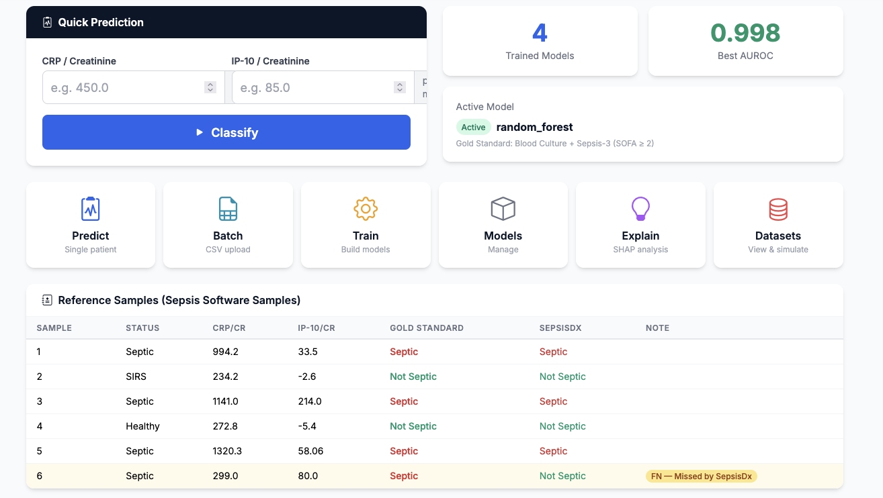
Dashboard
SepsisDx
/ — System overview and quick access to all features
by Digital Biosciences
Functions
Quick Predict form — enter CRP/Cr and IP-10/Cr for instant classification
System statistics cards: total models, best AUROC, active model
6-card navigation grid linking to all major features
Reference samples table with 6 pre-configured test cases
Highlights false negative cases (Sample 6) for awareness
Shows both ML prediction and SepsisDx rule-based comparison
Active model badge in navbar with real-time indicator

Slide 6
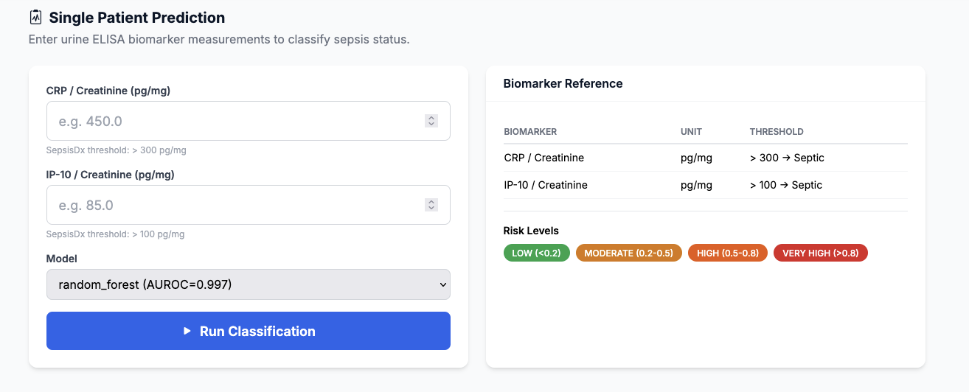
Prediction — Input Form
SepsisDx
/predict/ — Enter biomarker values for classification
by Digital Biosciences
Input Form Features
CRP/Creatinine ratio input (pg/mg) — threshold hint: >300 = Septic
IP-10/Creatinine ratio input (pg/mg) — threshold hint: >100 = Septic
Model selection dropdown showing all models with AUROC scores
Biomarker reference table with clinical thresholds
Risk level color legend: LOW, MODERATE, HIGH, VERY HIGH
Validates inputs before submission

Slide 7
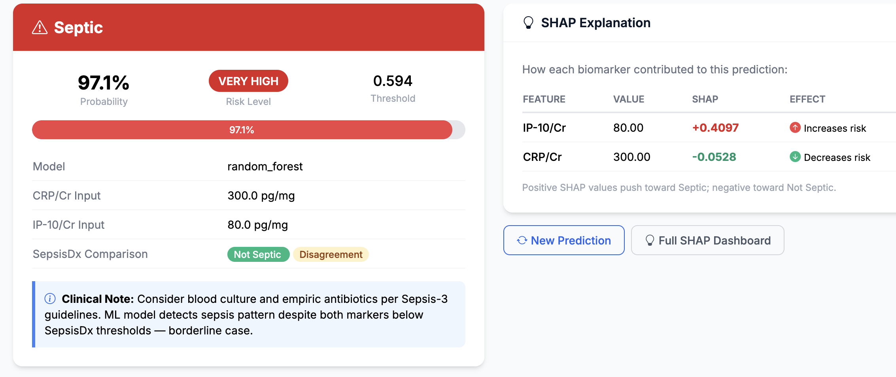
Prediction — Results
SepsisDx
/predict/run — Classification result with SHAP explanation
by Digital Biosciences
Result Features
Large color-coded result: Red (Septic) or Green (Not Septic)
Probability percentage with visual progress bar
Risk level badge: LOW / MODERATE / HIGH / VERY HIGH
Optimal threshold indicator used for classification
SepsisDx rule-based comparison (agreement check)
SHAP contribution table per feature with direction arrows
Clinical context note with actionable guidance
Links to new prediction and full SHAP dashboard

Slide 8
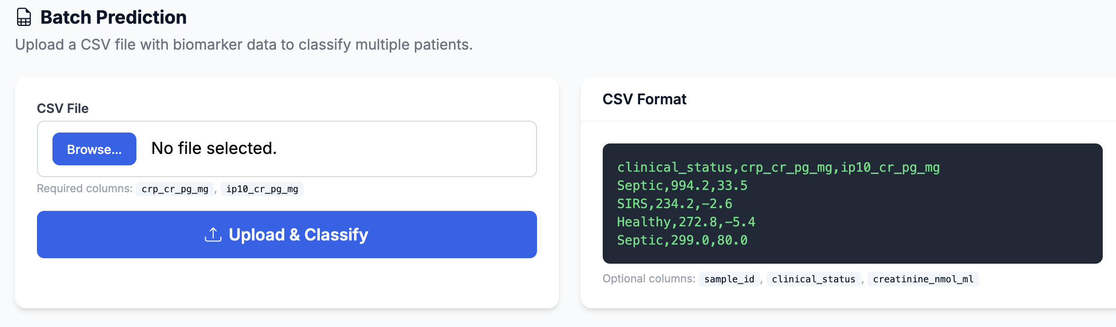
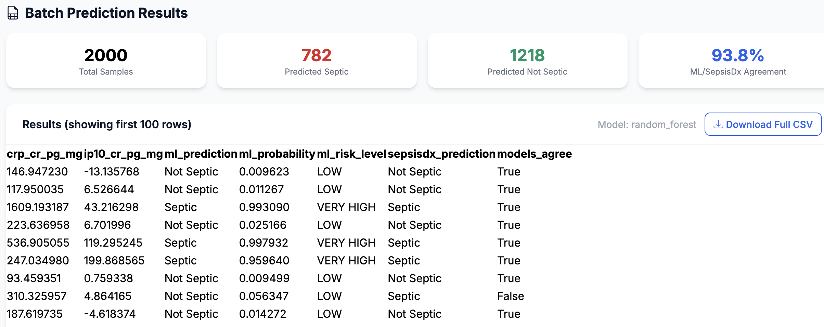
Batch Classification
SepsisDx
/batch/ — Upload CSV for bulk predictions
by Digital Biosciences
Upload
CSV file upload with format specification
Required columns: crp_cr_pg_mg, ip10_cr_pg_mg
Optional: sample_id, clinical_status, creatinine
Example CSV format displayed for reference
Results
Summary cards: total, septic, not septic, agreement %
Results table showing first 100 rows
Full CSV download with all predictions
Columns: probability, risk level, SepsisDx comparison

Slide 9
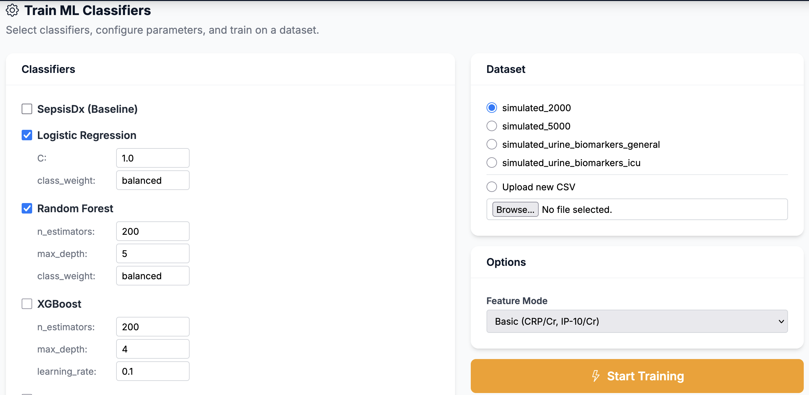
Training — Configuration
SepsisDx
/train/ — Select classifiers, dataset, and parameters
by Digital Biosciences
Configuration Options
5 classifiers available:
• SepsisDx Baseline (rule-based threshold)
• Logistic Regression (C, class_weight)
• Random Forest (n_estimators, max_depth)
• XGBoost (learning_rate, max_depth)
• Neural Network (hidden layers, max_iter)
Per-classifier parameter customization
Dataset selection: existing CSVs or file upload
Feature mode: Basic (2 features) or Extended (7)
Background training with real-time progress

Slide 10
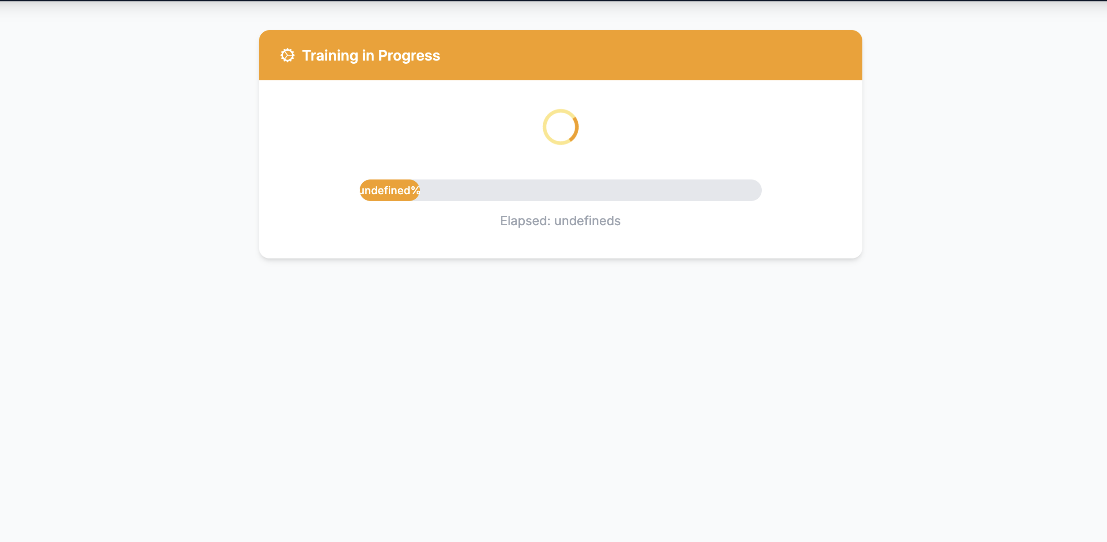
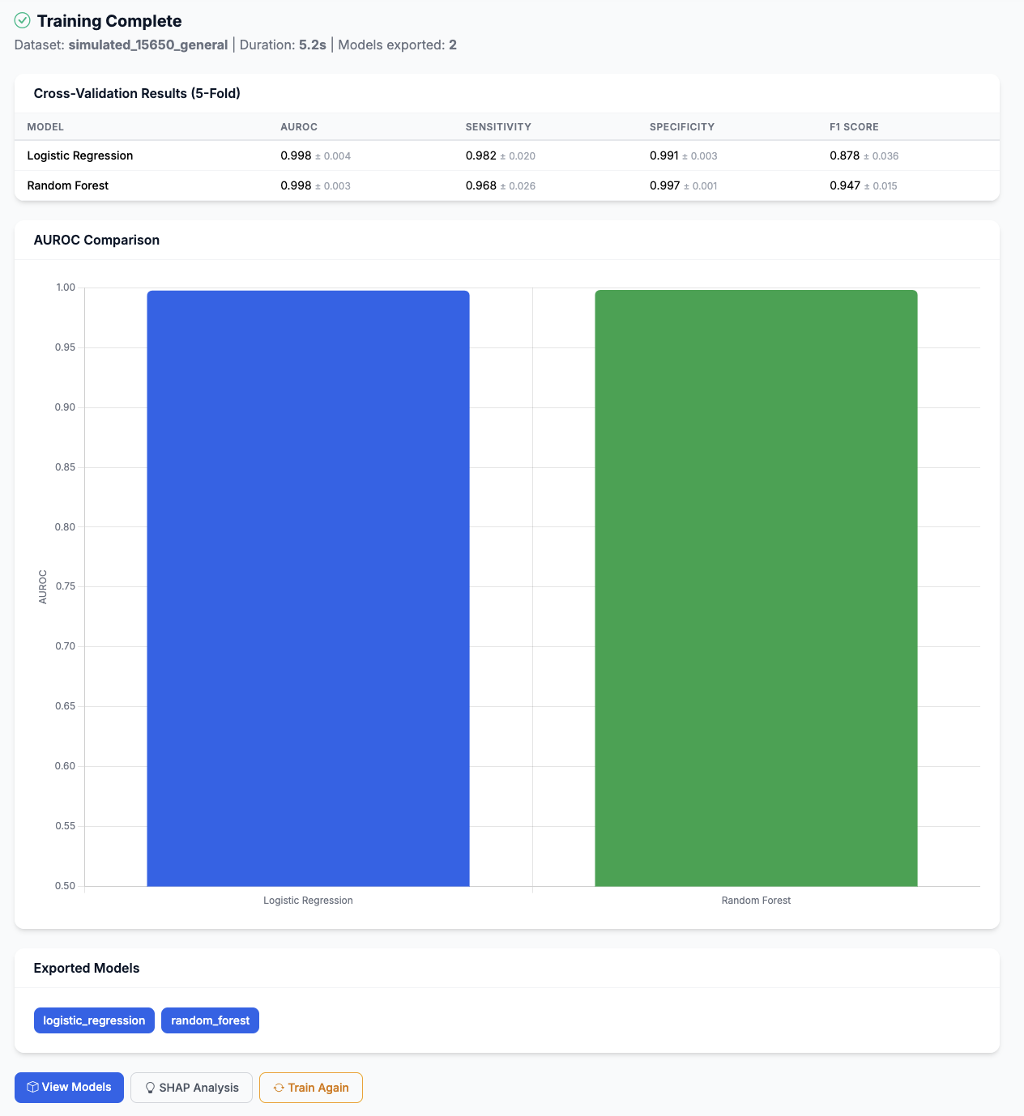
Training — Progress & Results
SepsisDx
Real-time progress tracking and cross-validation metrics
by Digital Biosciences
Progress Tracking
Animated spinner with status messages
Progress bar updates every 2-3 seconds
Elapsed time counter
Auto-redirects to results on completion
Results Display
5-fold cross-validation metrics table
AUROC, Sensitivity, Specificity, F1 (mean ± std)
AUROC comparison bar chart
List of exported model files
Links to Models page and SHAP analysis

Slide 11
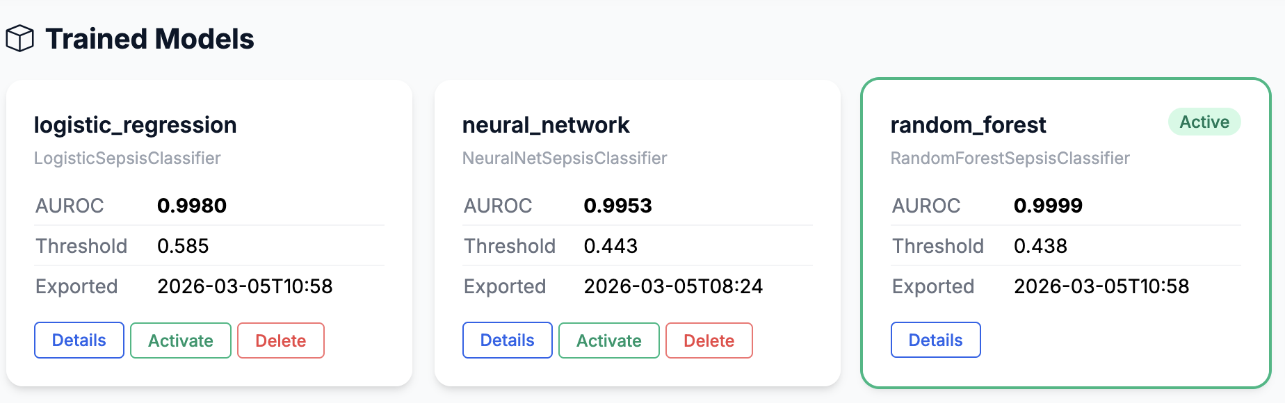
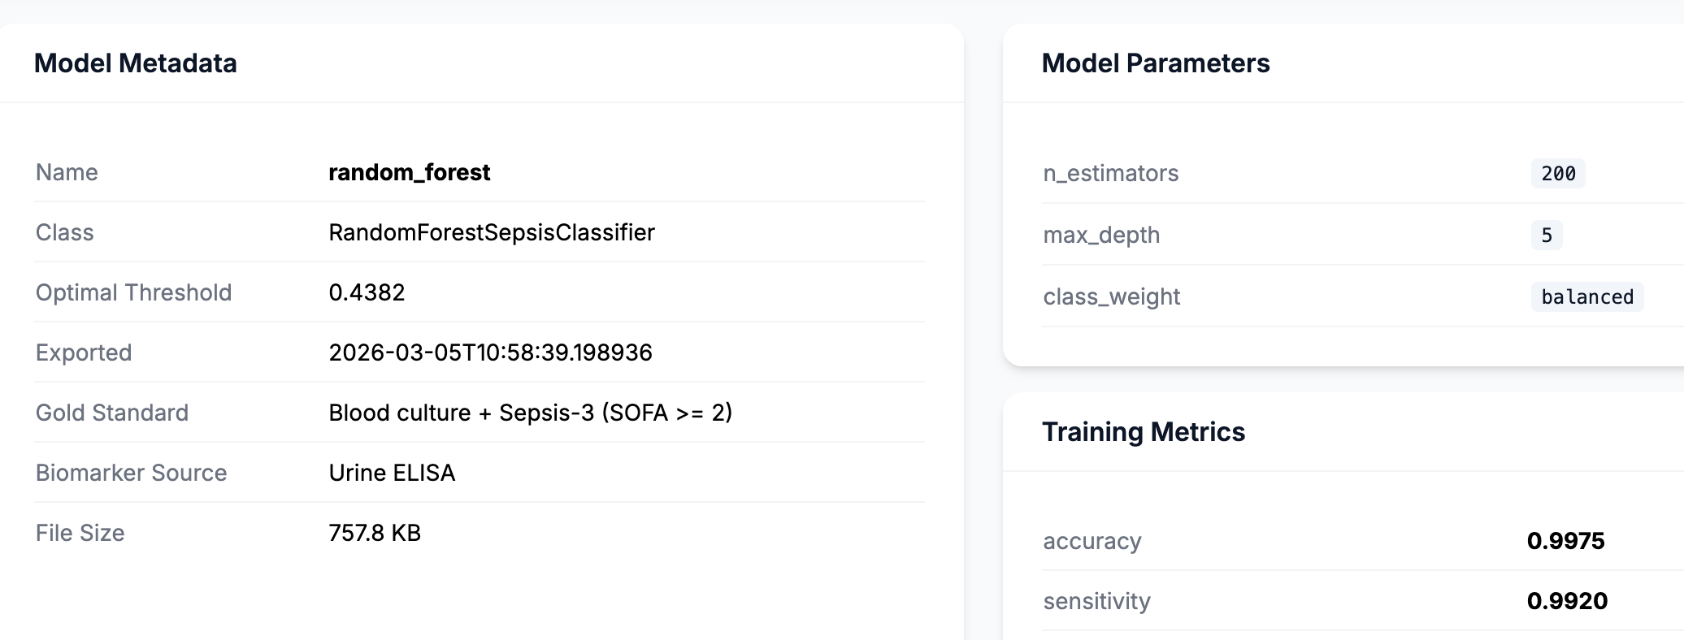
Model Management
SepsisDx
/models/ — View, activate, and manage trained models
by Digital Biosciences
Models List
Responsive card grid (1-4 columns)
Active model highlighted with colored ring
Shows: name, classifier type, AUROC, threshold, export date
Actions: View Details, Activate, Delete (with confirmation)
Model Detail
Full metadata: name, class, threshold, export time
Gold standard and biomarker source info
Model hyperparameters table
Training metrics (AUROC, sensitivity, specificity, etc.)
File size information

Slide 12
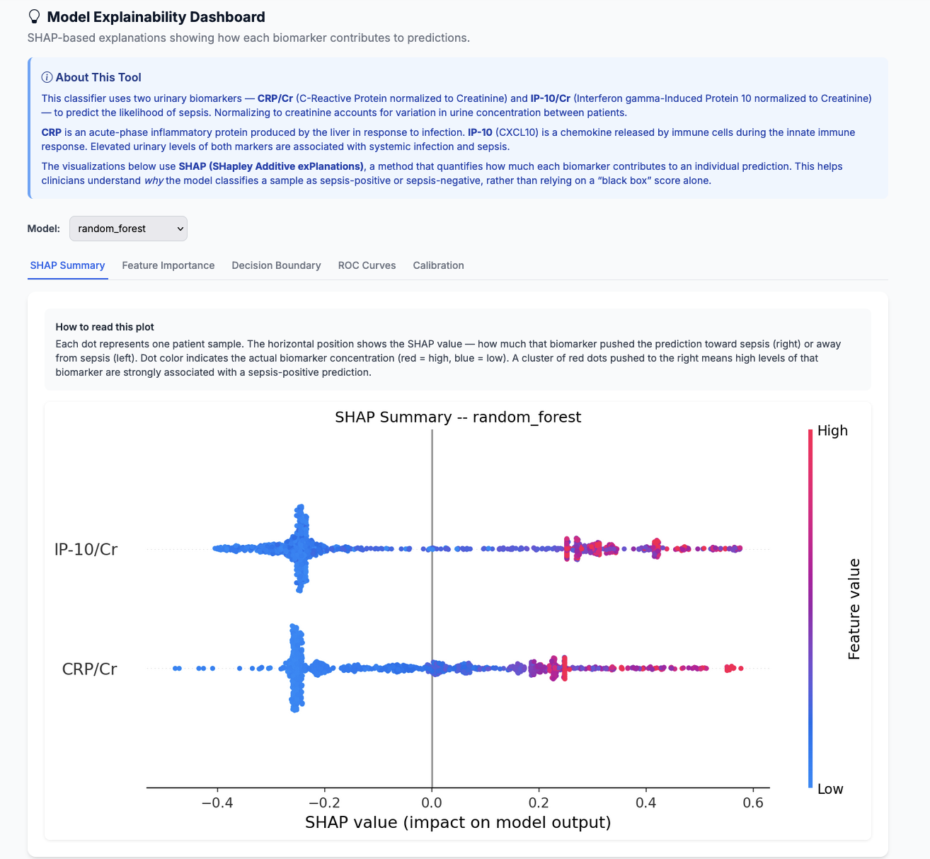
SHAP Explainability Dashboard
SepsisDx
/explain/ — Model interpretation and visualization
by Digital Biosciences
Visualization Tabs
SHAP Summary Plot — Feature impact distribution across all samples
Feature Importance — Mean |SHAP| values ranked by contribution
Decision Boundary — 2D visualization of classification regions
ROC Curves — Model performance comparison with literature benchmarks
Calibration Curves — Predicted vs. actual probability reliability
Key Features
Model selector dropdown for comparison
Plots generated on-demand (server-side)
Lazy-loaded images for performance
Dynamic updates when switching models

Slide 13
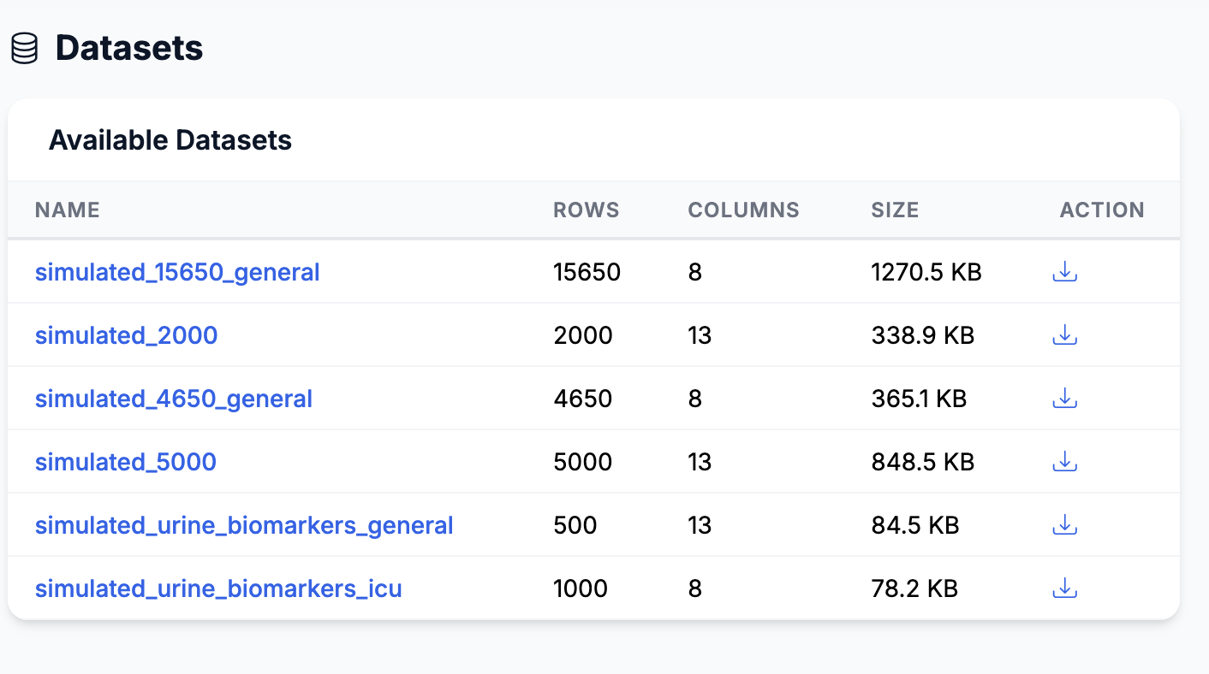
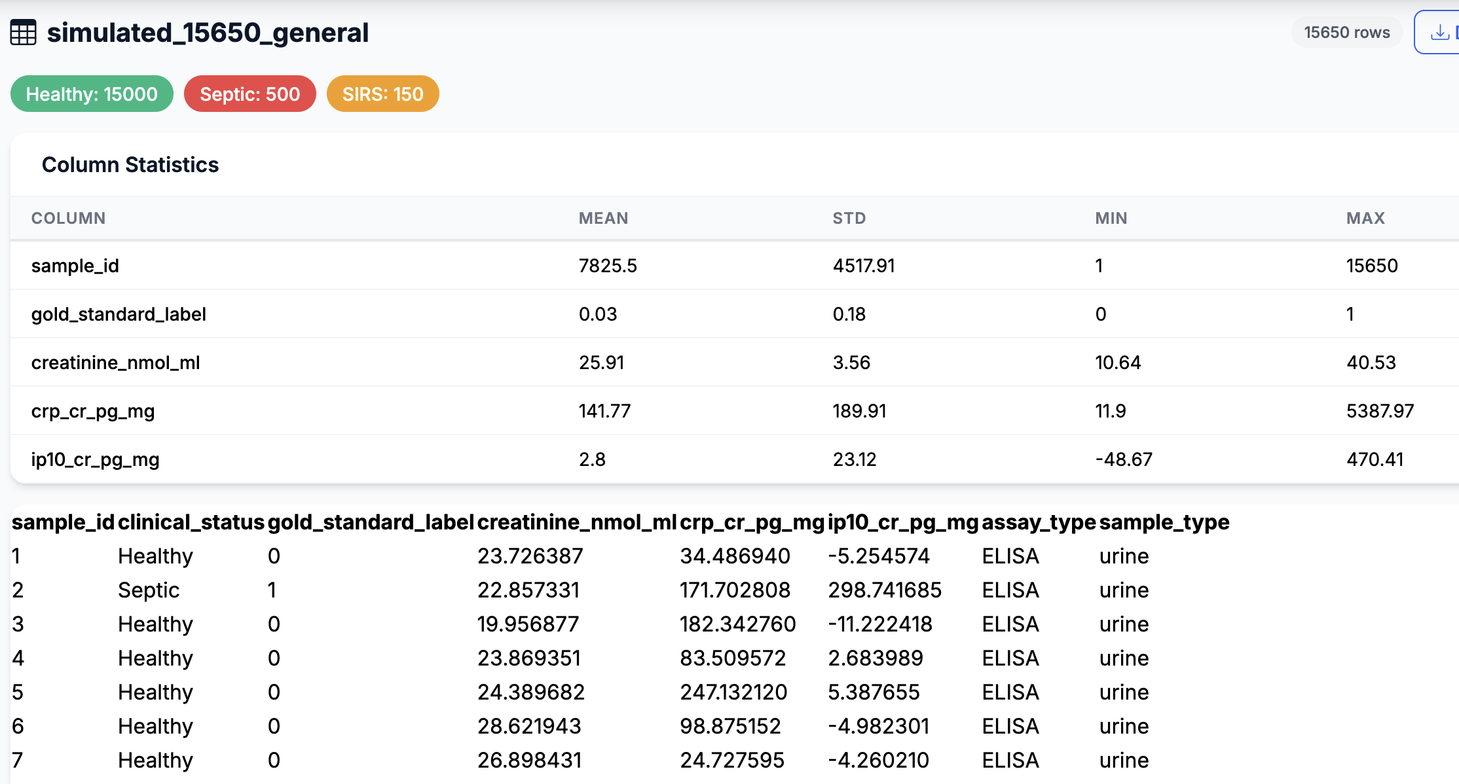
Dataset Management
SepsisDx
/datasets/ — Browse data and generate synthetic datasets
by Digital Biosciences
Configure: septic, SIRS, healthy sample counts
Population profiles: General, ICU, Pediatric
Noise levels: Low, Medium, High
Optional extended biomarkers (7 features)
Dataset Viewer
Column statistics (mean, std, min, max)
Class distribution badges (color-coded)
Paginated data table (50 rows/page)
CSV download for any dataset

Slide 14
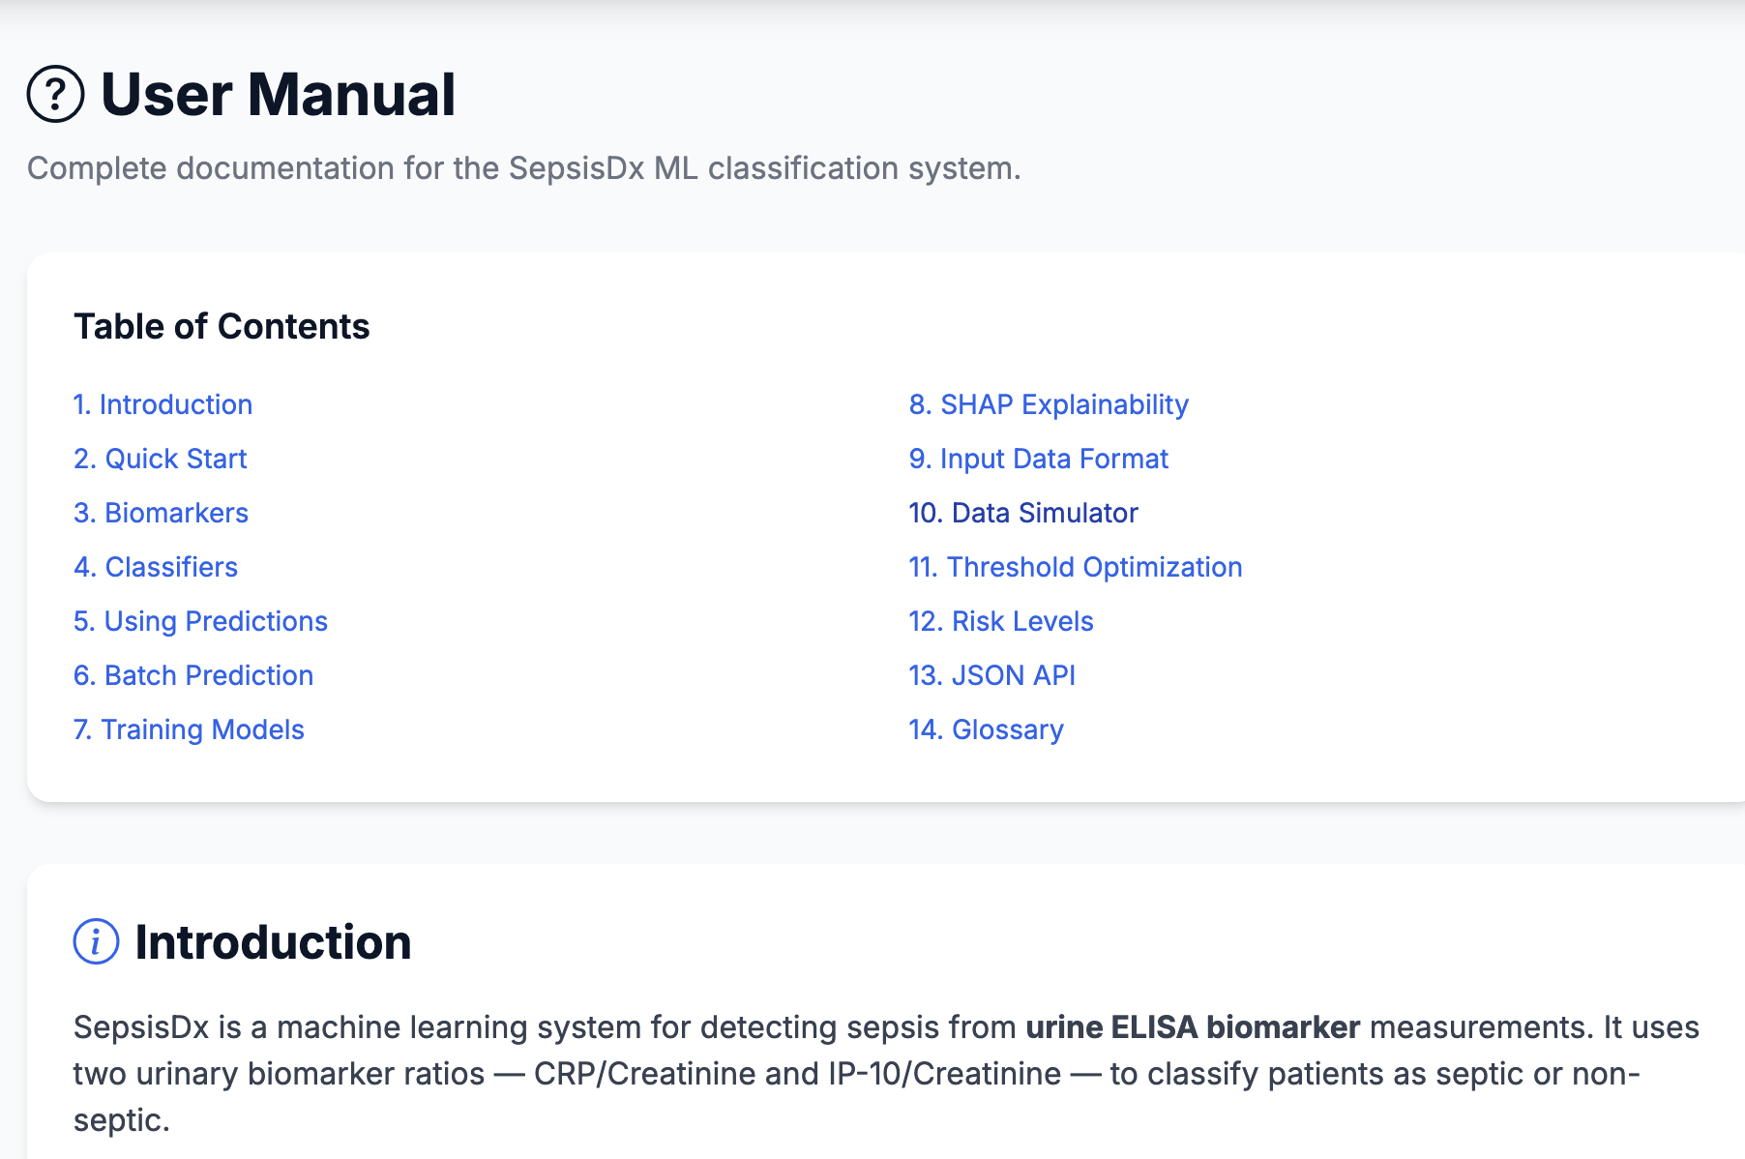
Help Page & REST API
SepsisDx
/help/ and /api/ — Documentation and programmatic access
by Digital Biosciences
Help Page (14 Sections)
Introduction & Quick Start guide
Biomarker reference (CRP/Cr, IP-10/Cr thresholds)
Classifier descriptions and use cases
Using predictions, risk levels, clinical notes
Training pipeline and SHAP interpretation
Input data format with example CSV
Threshold optimization strategies
Clinical & ML glossary (15 terms)
REST API Endpoints
GET /api/health — Service health check (no auth)
POST /api/predict — JSON prediction (crp_cr, ip10_cr)
GET /api/models — List all exported models

Slide 15
SepsisDx — Complete ML Pipeline for Sepsis Detection
Predict
Train
Explain
Manage
Single & batch patient classification with probability scoring
5 classifiers with cross-validation and threshold optimization
SHAP plots, ROC curves, decision boundaries for transparency
Model versioning, activation, dataset browsing & generation
Digital Biosciences • An MDC Studio Portfolio Company
sepsis-dx.com | dbmsciences.com | mdcstudio.com

