Slide 1
Meter³ Thermocouple Swap Test
Nestor Garcia
Dec 4th, 2024

Slide 2
Description
Purpose: To assess offsets stemming from the Thermal Instrumentation Cards (TICs) by eliminating potential contributions from thermocouples or the Isothermal Junction Box (IJB). Differences between Part 1 and Part 2 readings should reveal TIC-specific performance
Test Procedure:
  Part 1: IJB thermocouple Set A connected to TIC 0 and Set B connected to TIC 1. Data collected at room temperature alongside legacy thermocouples.
  Part 2: Swapped inputs — Set A now connects to TIC 1 and Set B to TIC 0. Data collection continued.
  Part 3: Swap back — Set A now connects back to TIC 0 and Set B back to TIC 1. Data collection continued.
Additional Details:
  The test was conducted twice, approximately 24 hours apart, to assess repeatability and stability of the data and TIC performance.
  The procedure will also be repeated at high temperatures in the upcoming weeks.
  Diagram and results are presented in the following slides.

Slide 3
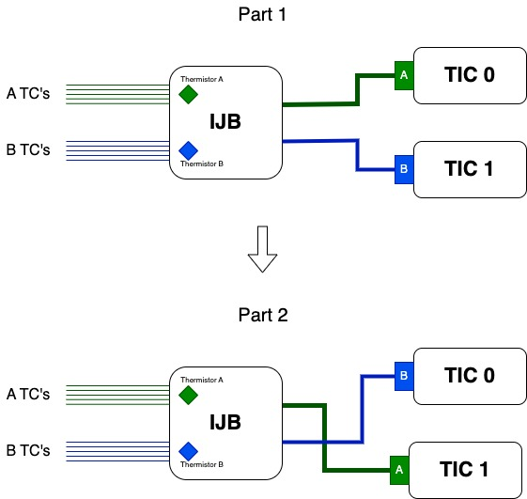
Figure depicting the configuration changes.

Slide 4
Room Temperature Data Details (~20°C)
New System is sampled at ~ 1- second intervals; Legacy System is sampled every 60 seconds.
Applied a moving mean filter to New System data (average of 60 data points = 1 minute).
Thermocouple reference format: TC[A][B], where A is the TIC number and B is the TIC TC channel.
  Ex. TC01 is a thermocouple connected to TIC 0, channel 1.

Slide 5
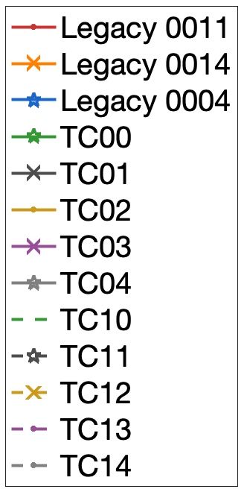
Plot Details
Distinguishing between TICs
  TIC 0 lines are solid
  TIC 1 lines are dashed
Distinguishing between TIC channels
  Channels are assigned a specific color
    Ex. TC00 and TC10 are both green.
Distinguishing between Bundles
  Bundles are identified by markers and noted explicitly on the slide.
    Bundle 1 = ‘ . ’
    Bundle 2 = ‘ x ‘
    Bundle 3 = ‘star’
Refer to plot legend for additional details.
Legend

Slide 6
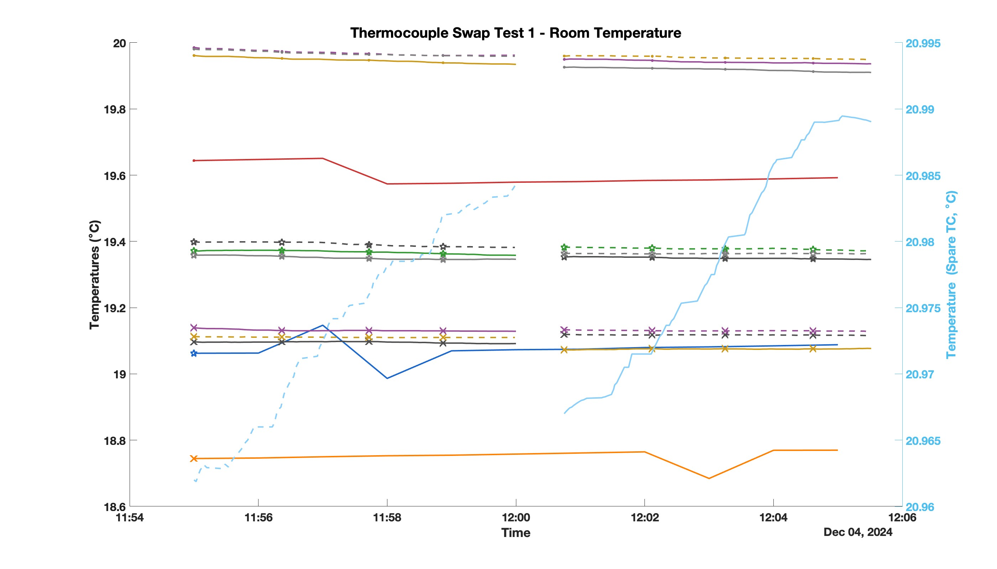
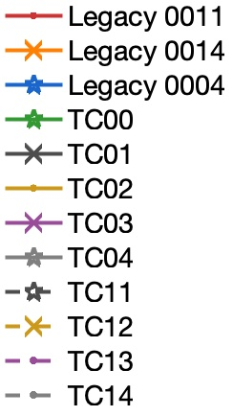
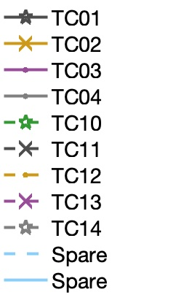
~ 19.95 °C
Bundle 1
ΔT_{New – Legacy} ~ 0.37 °C
~ 19.58 °C
20.9841°C
~ 19.36 °C
Bundle 2
ΔT_{New – Legacy} ~ 0.25 °C
~ 19.07 °C
~ 19.11 °C
Bundle 3
ΔT_{New – Legacy} ~ 0.31 °C
20.9671°C
~ 18.76 °C
Part 1
Part 2

Slide 7
Table 1: Room Temperature Test 1 Results
IJB TC | TIC TC Channel (Part 1) | Temperature (Part 1, °C) | Corresponding TIC TC Channel (Part 2) | Temperature (Part 2, °C) | Temperature Delta (Part 2 – Part 1, °C) | Notes
A0 | TC00 | 19.358 | TC10 | 19.383 | 0.025 | Legacy TC0014
A1 | TC01 | 19.092 | TC11 | 19.119 | 0.027 | Legacy TC0004
A2 | TC02 | 19.935 | TC12 | 19.96 | 0.025 | Legacy T0011
A3 | TC03 | 19.129 | TC13 | 19.133 | 0.004 | Legacy TC0004
A4 | TC04 | 19.346 | TC14 | 19.364 | 0.018 | Legacy TC0014
B0 | TC10 | 20.984 | TC00 | 20.967 | -0.017 | Spare – Recording ambient temperature.
B1 | TC11 | 19.382 | TC01 | 19.353 | -0.029 | Legacy TC0014
B2 | TC12 | 19.11 | TC02 | 19.073 | -0.037 | Legacy TC0004
B3 | TC13 | 19.962 | TC03 | 19.95 | -0.012 | Legacy T0011
B4 | TC14 | 19.959 | TC04 | 19.926 | -0.033 | Legacy T0011
Deltas range from -0.037°C to +0.027°C, revealing consistent performance across TICs at room temperature.

Slide 8
Table 2: Room Temperature Test 1 Results (Swapped back)
IJB TC | TIC TC Channel (Part 2) | Temperature (Part 2, °C) | Corresponding TIC TC Channel (Part 3) | Temperature (Part 3, °C) | Temperature Delta (Part 3 – Part 2, °C) | Notes
A0 | TC10 | 19.349 | TC00 | 19.332 | -0.027 | Legacy TC0014
A1 | TC11 | 19.299 | TC01 | 19.293 | -0.006 | Legacy TC0004
A2 | TC12 | 19.658 | TC02 | 19.640 | -0.018 | Legacy T0011
A3 | TC13 | 19.303 | TC03 | 19.329 | 0.026 | Legacy TC0004
A4 | TC14 | 19.341 | TC04 | 19.332 | -0.009 | Legacy TC0014
B0 | TC00 | 21.481 | TC10 | 21.482 | 0.001 | Spare – Recording ambient temperature.
B1 | TC01 | 19.321 | TC11 | 19.353 | -0.032 | Legacy TC0014
B2 | TC02 | 19.253 | TC12 | 19.311 | 0.058 | Legacy TC0004
B3 | TC03 | 19.649 | TC13 | 19.670 | 0.021 | Legacy T0011
B4 | TC04 | 19.624 | TC14 | 19.666 | 0.042 | Legacy T0011
Deltas range from -0.027°C to +0.058°C, larger magnitude deltas but still negligible.

Slide 9
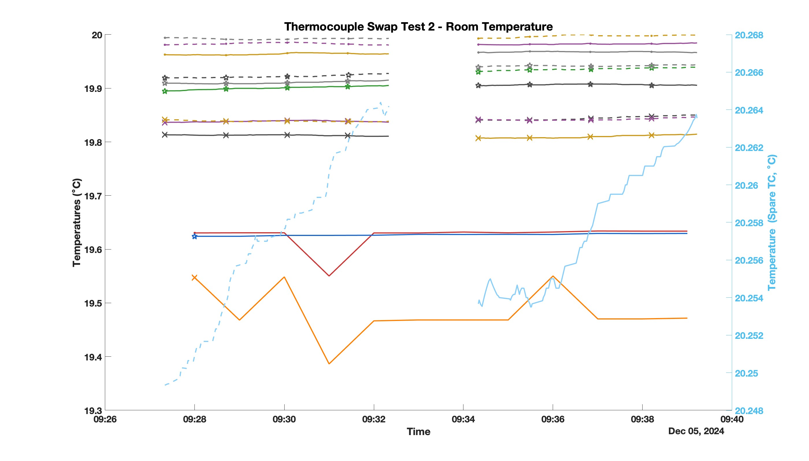
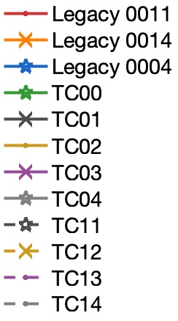
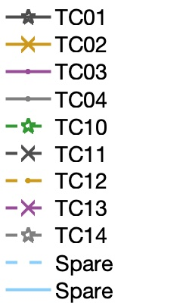
~ 19.98 °C
Bundle 1
ΔT_{New – Legacy} ~ 0.35 °C
~ 19.92 °C
20.2641 °C
~ 19.83 °C
Bundle 2
ΔT_{New – Legacy} ~ 0.29 °C
Bundle 3
ΔT_{New – Legacy} ~ 0.36 °C
~ 19.63 °C
~ 19.63 °C
20.2537 °C
~ 19.47 °C
Part 1
Part 2

Slide 10
Table 3: Room Temperature Results 2
IJB TC | TIC TC Channel (Part 1) | Temperature (Part 1, °C) | Corresponding TIC TC Channel (Part 2) | Temperature (Part 2, °C) | Temperature Delta (Part 2 – Part 1, °C) | Notes
A0 | TC00 | 19.905 | TC10 | 19.931 | 0.026 | Legacy TC0014
A1 | TC01 | 19.812 | TC11 | 19.841 | 0.029 | Legacy TC0004
A2 | TC02 | 19.964 | TC12 | 19.993 | 0.029 | Legacy T0011
A3 | TC03 | 19.837 | TC13 | 19.842 | 0.005 | Legacy TC0004
A4 | TC04 | 19.915 | TC14 | 19.939 | 0.024 | Legacy TC0014
B0 | TC10 | 20.264 | TC00 | 20.254 | -0.010 | Spare – Recording ambient temperature.
B1 | TC11 | 19.928 | TC01 | 19.905 | -0.023 | Legacy TC0014
B2 | TC12 | 19.839 | TC02 | 19.807 | -0.032 | Legacy TC0004
B3 | TC13 | 19.980 | TC03 | 19.982 | 0.002 | Legacy T0011
B4 | TC14 | 19.993 | TC04 | 19.967 | -0.026 | Legacy T0011
Deltas range from -0.032°C to +0.029°C, revealing consistent performance across TICs at room temperature.

Slide 11
Table 4: Room Temperature Test 2 Results (Swapped back)
IJB TC | TIC TC Channel (Part 2) | Temperature (Part 2, °C) | Corresponding TIC TC Channel (Part 3) | Temperature (Part 3, °C) | Temperature Delta (Part 3 – Part 2, °C) | Notes
A0 | TC10 | 19.912 | TC00 | 19.891 | -0.021 | Legacy TC0014
A1 | TC11 | 19.838 | TC01 | 19.809 | -0.029 | Legacy TC0004
A2 | TC12 | 20.024 | TC02 | 19.992 | -0.032 | Legacy T0011
A3 | TC13 | 19.842 | TC03 | 19.835 | -0.007 | Legacy TC0004
A4 | TC14 | 19.927 | TC04 | 19.896 | -0.031 | Legacy TC0014
B0 | TC00 | 20.447 | TC10 | 20.489 | 0.042 | Spare – Recording ambient temperature.
B1 | TC01 | 19.881 | TC11 | 19.910 | 0.031 | Legacy TC0014
B2 | TC02 | 19.804 | TC12 | 19.836 | 0.032 | Legacy TC0004
B3 | TC03 | 20.001 | TC13 | 20.011 | 0.010 | Legacy T0011
B4 | TC04 | 19.990 | TC14 | 20.026 | 0.036 | Legacy T0011
Deltas range from -0.032°C to +0.042°C, larger magnitude deltas but still negligible.

Slide 12
Analysis of Temperature Deltas
Delta Observations:
  Deltas range from -0.037 °C to +0.058 °C.
  Positive vs. Negative Deltas: Magnitude of positive and negative deltas should ideally be similar if no systematic offset exists.
    Example:
      A0 (TC00 to TC10): +0.025°C
      B0 (TC10 to TC00): -0.017°C
    Differences in magnitude indicate possible TIC-specific variations.
Potential Causes:
  Reference Voltage Differences: Variations in TIC reference voltages likely contribute to the observed differences.
  Environmental Factors: Minor environmental noise or connection variability might also impact deltas.

Slide 13
Results at Room Temperature
Differences between positive and negative deltas suggest very slight offsets between TICs (in the range of hundredths of °C).
  Variability across TICs is likely due to reference voltage discrepancies.
Repeatability testing after 24 hours showed similar delta ranges, indicating good stability over time.
High accuracy with minimal drift was observed, although slight adjustments in reference voltage could improve consistency further.
Swapping thermocouples back (comparing Tables 1 and 2, as well as Tables 3 and 4) resulted in consistent temperature deltas, indicating no significant drift in TIC performance.
  Repeatability across swaps suggests stable TIC operation.
  Calibration focused on reducing minor reference voltage discrepancies will be implemented and is likely to improve overall consistency.

Slide 14
Results at Room Temperature cont.
Comparison with Legacy Thermocouples: The average delta temperatures between the new TCs and the legacy TCs in each bundle showed slight differences, suggesting good agreement overall.
  **Test 1 ΔT _{New – Legacy} **: Bundle 1: 0.37°C, Bundle 2: 0.25°C, Bundle 3: 0.31°C.
  **Test 2 ΔT _{New – Legacy} **: Bundle 1: 0.35°C, Bundle 2: 0.29°C, Bundle 3: 0.36°C.
The consistency between Test 1 and Test 2 deltas indicates stable performance of the new TCs relative to the legacy TCs, with minimal drift over time. This further supports the reliability of the new TCs, although the slight differences suggest that minor calibration may still be beneficial to bring all readings into closer alignment.

Slide 15
Next Steps
Repeat test at high temp (around 1000 °C, TBD)
  Scheduled for 11 Dec 24
Repeat test with TIP chassis in environmental chamber to assess TIC performance in varying ambient temperatures (20 – 40 °C).
  Date TBD.
Determine ‘absolute’ accuracy of both systems against a calibrated reference. Which is closer to true temp?
  Date and Method TBD.
    Sand bath? Environmental chamber?
Calibrate TIC reference voltages and repeat tests.
  Calibration routine not yet developed.
  Could hard-code TIC specific reference voltage values into CCHM.
    This would require careful tracking of system configuration during tests.
  Date TBD.

Slide 16
Table 5: Goal Temp = 1180 C Results
IJB TC | TIC TC Channel (Part 1) | Temperature (Part 1, °C) | Corresponding TIC TC Channel (Part 2) | Temperature (Part 2, °C) | Temperature Delta (Part 2 – Part 1, °C) | Notes
A0 | TC00 | 1155.22 | TC10 | 1155.36 | 0.14 | Legacy TC0014
A1 | TC01 | 1171.59 | TC11 | 1171.64 | 0.05 | Legacy TC0004
A2 | TC02 | 1167.89 | TC12 | 1167.76 | -0.13 | Legacy T0011
A3 | TC03 | 1170.15 | TC13 | 1170.11 | -0.04 | Legacy TC0004
A4 | TC04 | 1151.52 | TC14 | 1151.52 | 0.00 | Legacy TC0014
B0 | TC10 | 21.47 | TC00 | 21.51 | 0.04 | Spare – Recording ambient temperature.
B1 | TC11 | 1152.23 | TC01 | 1152.17 | -0.06 | Legacy TC0014
B2 | TC12 | 1173.45 | TC02 | 1173.38 | -0.07 | Legacy TC0004
B3 | TC13 | 1167.63 | TC03 | 1167.56 | -0.07 | Legacy T0011
B4 | TC14 | 1169.45 | TC04 | 1169.33 | -0.16 | Legacy T0011
Deltas range from -0.16°C to +0.14°C, revealing consistent performance across TICs at room temperature.

Slide 17
Table 6: Goal Temp = 1180 C Results (Swapped back)
IJB TC | TIC TC Channel (Part 2) | Temperature (Part 2, °C) | Corresponding TIC TC Channel (Part 3) | Temperature (Part 3, °C) | Temperature Delta (Part 3 – Part 2, °C) | Notes
A0 | TC10 | 1155.37 | TC00 | 1155.19 | -0.18 | Legacy TC0014
A1 | TC11 | 1171.54 | TC01 | 1171.53 | -0.01 | Legacy TC0004
A2 | TC12 | 1167.95 | TC02 | 1167.78 | -0.17 | Legacy T0011
A3 | TC13 | 1170.25 | TC03 | 1169.98 | -0.27 | Legacy TC0004
A4 | TC14 | 1151.60 | TC04 | 1151.49 | -0.11 | Legacy TC0014
B0 | TC00 | 21.48 | TC10 | 21.5 | -0.02 | Spare – Recording ambient temperature.
B1 | TC01 | 1152.19 | TC11 | 1152.20 | 0.01 | Legacy TC0014
B2 | TC02 | 1173.34 | TC12 | 1173.36 | 0.02 | Legacy TC0004
B3 | TC03 | 1167.56 | TC13 | 1167.53 | -0.03 | Legacy T0011
B4 | TC04 | 1169.32 | TC14 | 1169.37 | 0.05 | Legacy T0011
Deltas range from -0.27°C to +0.05°C, larger magnitude deltas but still negligible.

Slide 18
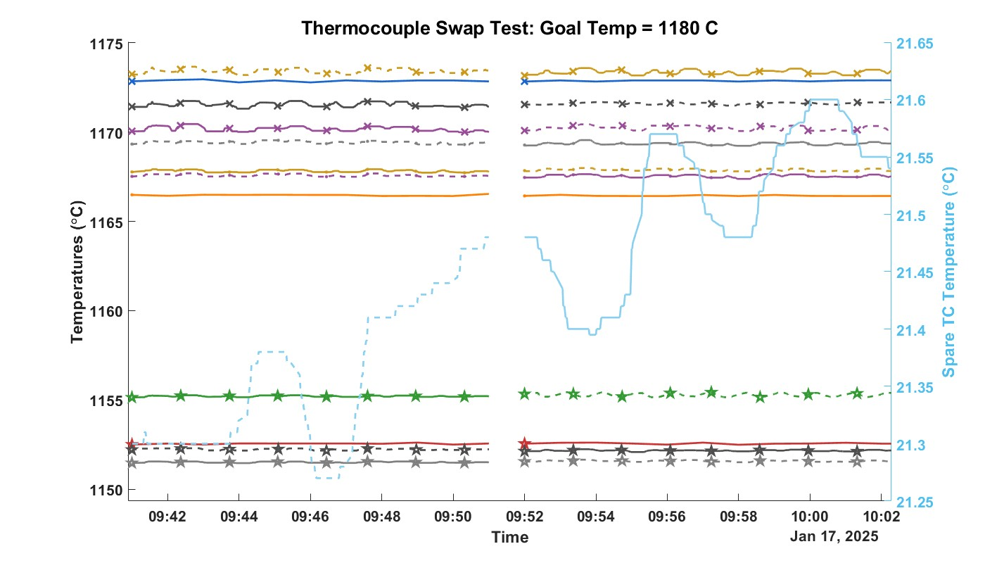
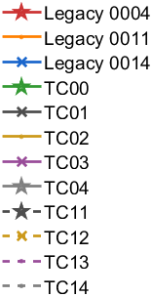
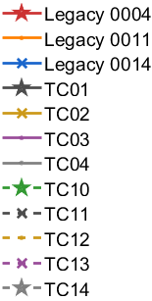

Bundle 2
ΔT_{New – Legacy} ~ -1.22 °C
Bundle 3
ΔT_{New – Legacy} ~ 2.44 °C
Bundle 1
ΔT_{New – Legacy} ~ 0.41 °C

Slide 19
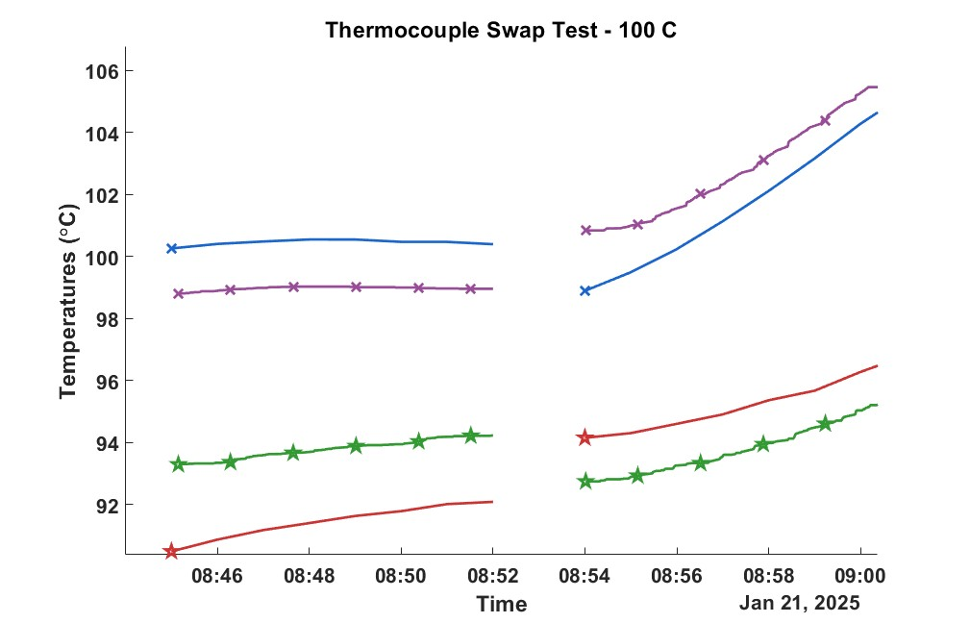
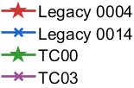
TIC Channel
L1
A3
A0
L2

