Slide 1
CS410 Course project: Review-sentiment model using Fasttext
with Yelp open data
Please refer to Github README for more detail instructions on how to run the code.

Slide 2
Objective of this project
The objective is to generate a machine learning model that can determine the sentiment of given text.
Gitlab - Python codes that are used to pre-process the data, train model, and re-rank the reviews are all in Here.
Data source - Yelp open data that has been used for this project can be downloaded Here.
Visualization – The analysis are elaborated in an interactive visualization page Here.

Slide 3
Steps to run the codes
1. Download Yelp open data set - Download it from here.
All we need is two files: yelp_academic_dataset_business.json, yelp_academic_dataset_review.json
2. Pre-process the text data
Transform JSON format data into rows and columns and remove stop keywords and special characters. Label 'BAD' for reviews that has 1,2 stars 'GOOD' for 4, 5 stars. Randomly split 80% of the rows into train set and the rest of 20% for validation set.
3. Train the model using Fasttext (word2vec)
Fasttext is a library for efficient text classification and representation learning. It is similar to word2vec which embeds words into vectors using word co occurrence within certain window.
4. Assign the sentiment score to all reviews
With the average sentiment model, assigned every reviews with the sentiment probability between 0~1 (0: BAD, 1: GOOD) using predict_proba function provided in Fasttext.

Slide 4
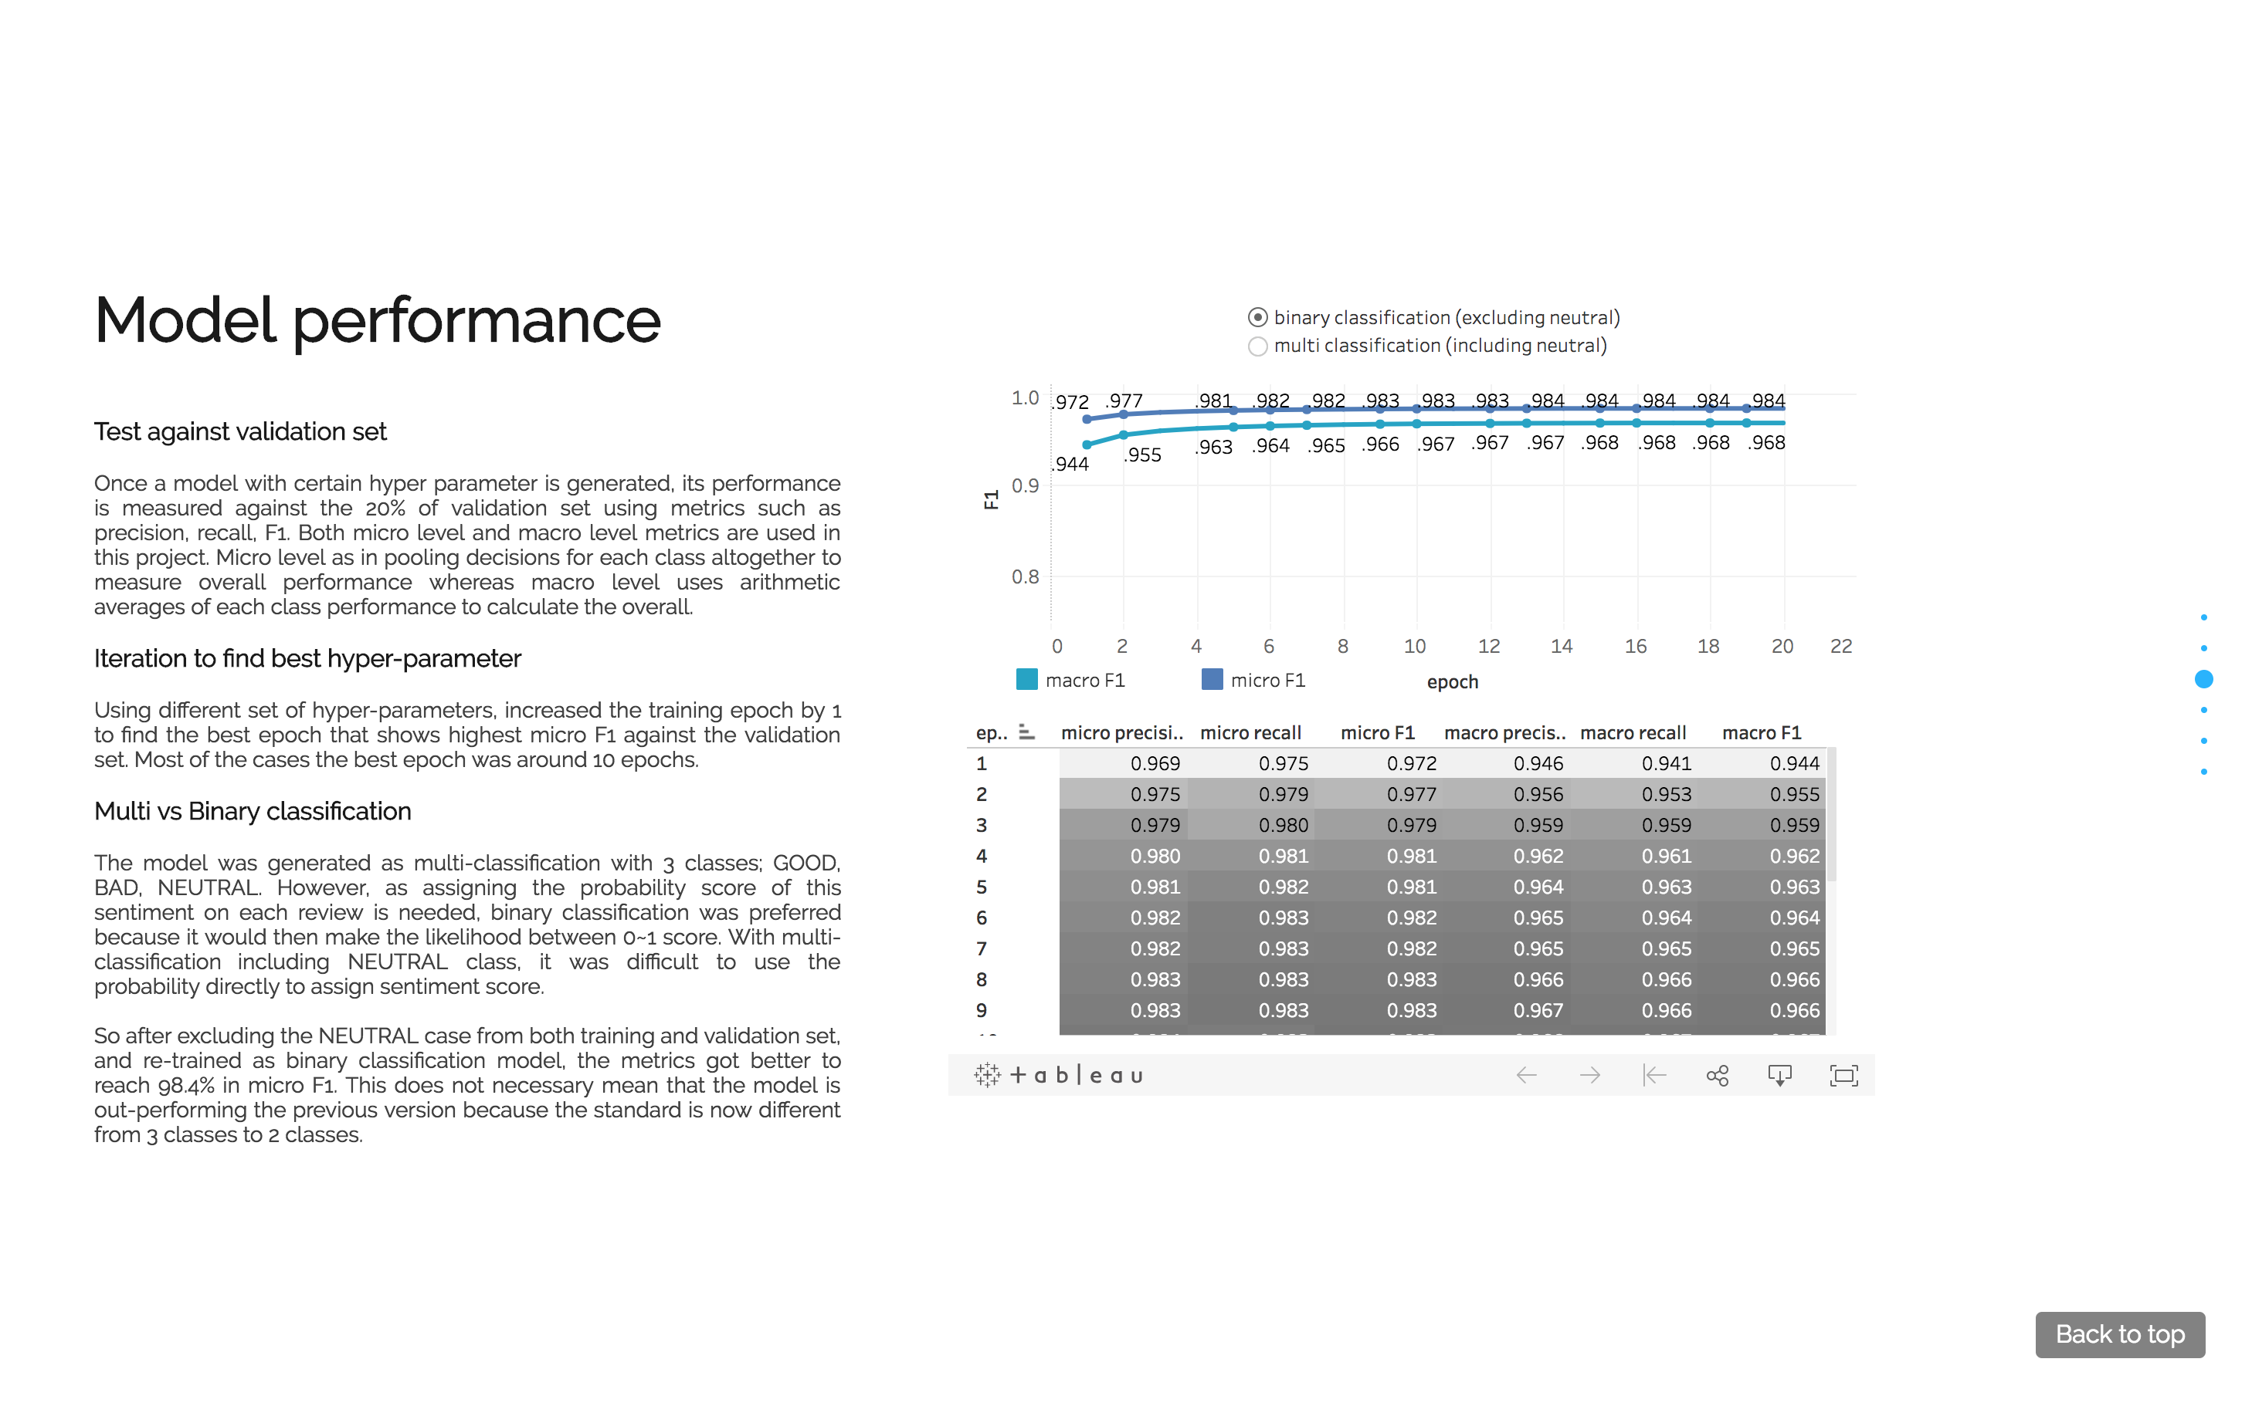
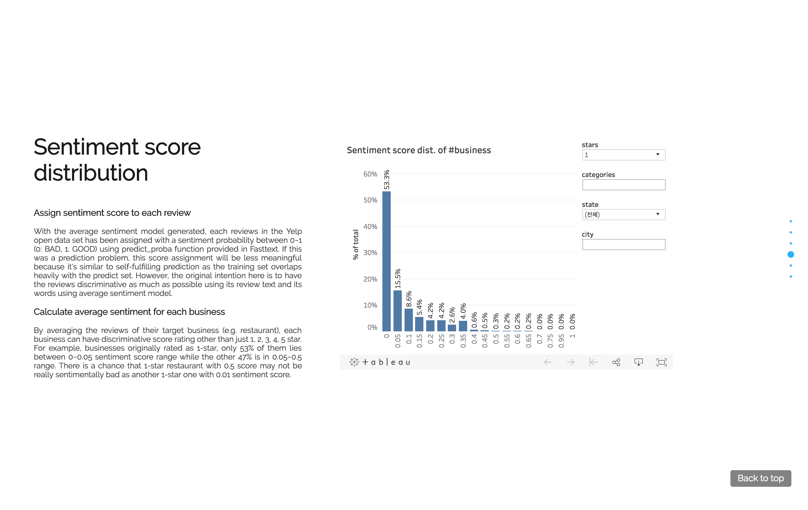
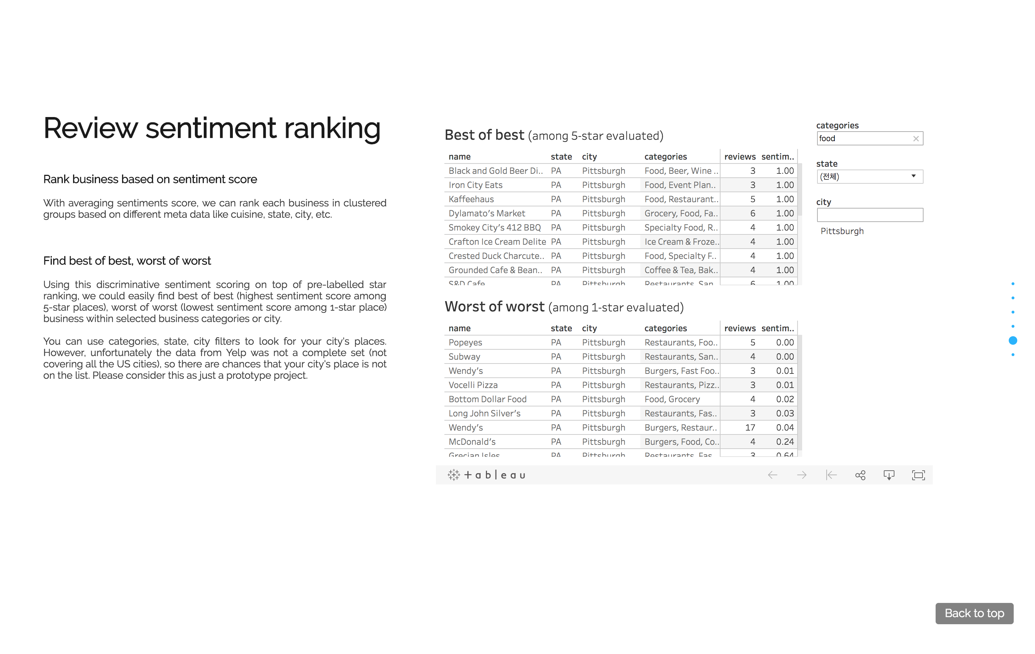
Analysis and use of the output
Please look at the interactive visualization page for details

Slide 5
What is the function of your system?
The original idea was to build a ‘general’ review-score-model which can be used across different review sites (e.g. Trip advisor, Yelp, etc.).
However, due to lack of data, and lack of time to build web crawlers to fetch data source from multiple sites, this prototype version is only implemented using Yelp open data to generate a model with assigning the sentiment score back to the original source reviews.

Slide 6
Why is this function useful?
If the original plan could have been carried out(review data collected from multiple source with assigning each business with the general score model), there are 2 main aspects that this function can be useful.
Business review ratings can be more relievable since each business will likely have much more rating data points from various sources.
Even if different sites have different rating scale or each individual having different standard in rating (some generous, others stricter), using general scoring model and parsing the review text, it will produce the same scale reflecting the actual degree of the service level of given business (e.g. restaurants, etc.).

Slide 7
Is this function already supported in any way by the current systems/tools?
Possibly exists already, but not that I know of.
How did you implement this function?
Using Fasttext. Fasttext is a library for efficient text classification and representation learning. It is similar to word2vec which embeds words into vectors using word co occurrence within certain window. The main difference between word2vec and Fasttext is that Fasttext can use sub-word ngram when embedding the words (e.g. Apple -> 'ap', 'app', 'appl', 'apple', 'ppl', 'pple', 'pple', 'ple', 'le'). For more information, please visit Here.

Slide 8
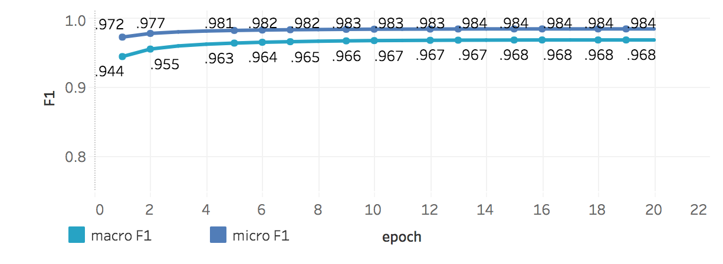
How well does your system work?
From randomly splitting the original review data 80% as training set vs 20% as validation set, the micro F1 rate reaches to 98.4% against the validation set in binary classification setting (with bad vs good labels).

Slide 9
Any ideas for further improvement?
As mentioned earlier, this data is not a full Yelp review nor it contains sources from different sites. So in order to make this system useful, a web crawler would be in needed to fetch reviews from various sources.
Also, if the sentiment model can get more sophisticated along with word2vec representation, different dimensions of sentiment could also be calculated in the future rather than just having plain BAD vs GOOD. (e.g. Service: BAD, Food: GOOD, Location: BAD, etc.)

