Slide 1
Michael Trittin's
Race for the Cure
CSSE 372: SPMP Presentation
Team D(wight)
Michael Trittin
RJ DeCramer
Jim Gildersleeve

Slide 2
Agenda
project management approach
estimates
risks
schedule of deliverables
current status

Slide 3

Software Project Management Approach
agile model
build client confidence
clear up miscommunication
5 iterations
basic tracking
viewing results
workflow management
edit old information and reports
faxing and data export

Slide 4

Software Project Estimates
process-based/delphi estimation & COCOMO-II
planning poker to generate estimates for features
process-based: 50 months, $459,635, 4 developers
cocomo: 80 months, $500,000, 6 developers
Triangulation
cost: $479,818 (average)
effort: 60 months (average)
schedule: closer to 14 month cocomo estimation
process based does not account for scheduling conflicts

Slide 5
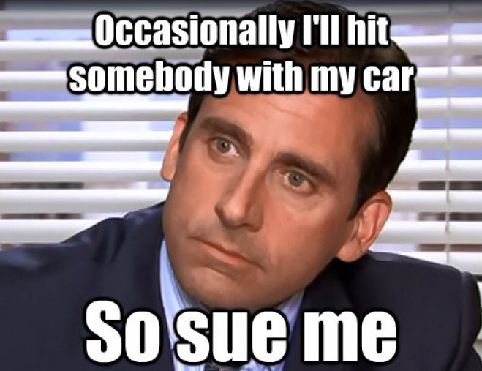
Software Project Risks
risk will be evaluated at beginning and end of each feature
risk categories
performance
cost
support
schedule
privacy
risks like this can be avoided and contained with proper risk management

Slide 6
Software Project Risks (cont.)
below are the top five risks identified in the project
developer gets sick or takes leave of absence
front-end/gold plating worried about more than back-end development
system not compliant with HIPAA standards
developers are inexperienced, or not enough developers to finish project on time

Slide 7
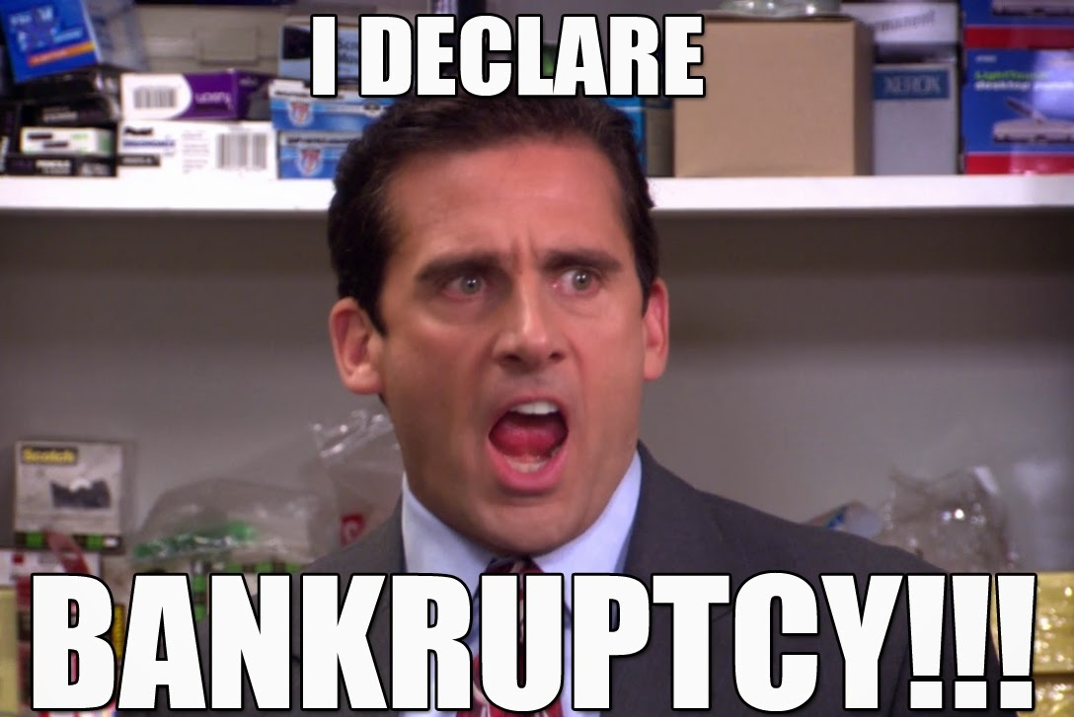
Software Project Risks (cont.)
highest risk: developer absence
probability - 80% risk value: 1.6
mitigation plan: avoid overworking employees, create an enforced schedule, incorporate "absent day bank" into the schedule
contingency plan: hire outside employment, or schedule current employees for overtime
mitigate so this doesn't happen

Slide 8
Project Schedule of Deliverables
iteration | feature
1 | track data for a specific sample, doctors order tests from the labs, track multiple samples, run multiple assays on a single sample
2 | results via web portal, filter and sort samples, log variations in tests, phd techs update protocols
3 | assign work, track workflow, display schedule for a lab tech, support protocol training
4 | edit previous sample data, generate historical reports, access control, schedule late/sick days
5 | confirmation of variables outside of reasonable range, faxing, export data for audit

Slide 9
Software Project Status
project has currently spent $310,000 out of a $479,818 budget
33% of project was scheduled to be completed to date, but 50% of project is actually completed
cpi of 0.77 indicates project is over-budget, but spi of 1.52 indicates project is well ahead of schedule
team will have to cut back on spending to stay under budget, but can afford to lose time and stay on schedule

Slide 10
Sources
http://differencebarristersolicitor.com/wp-content/uploads/2015/08/bankruptcy.jpg
https://images-na.ssl-images-amazon.com/images/M/MV5BMjI4NjkwODkwNF5BMl5BanBnXkFtZTgwMjg5OTU1MjE@._V1_UY1200_CR485,0,630,1200_AL_.jpg
https://lh3.googleusercontent.com/wdZT2WTdxE1EjDwXZKPhN1HPFu_PJy_gF-omaLWbby-G2dj_A1Tx6YVYgRXmcRAlDGRk2-M=s111
https://dontgiveupworld.com/wp-content/uploads/2015/04/Good-Managers-Quote-on-Fire-Hire-and-Inspire-by-Michael-Scott-from-The-Office.jpeg

