Slide 1
UNIVERSAL PERK
Nutrition & Lifestyle Platform
Web
Android
Web • iOS • Android
iOS
One shared product across three channels
Developer Kickoff & Delivery Brief
Prepared for Sosina Yitay

Slide 2
01 / SHARED UNDERSTANDING
Project at a glance
Simple explanation
Client
Cyster, LLC
Dr. Joseph Michaels + Samantha Milton
Platforms
Responsive web
iOS + Android
Deadline
Launch before US Thanksgiving
A digital platform that helps users discover nutrition content, make better eating choices, track nutrition, and save progress across web and mobile.
Scope model
Fixed fee + fixed scope
Delivery
1-week sprint cadence
Monetization
No paywall in this phase
PM goal: make delivery visible
Dev goal: build in testable slices
Client goal: polished, reliable product

Slide 3
02 / USERS
Who are we building for?
The product targets people at a turning point with their body, health, or lifestyle.
Surgery preparation
Needs structured nutrition before a procedure
Recovery
Needs safer, clearer daily food choices
Weight loss
Needs goal-aware, lower-calorie guidance
Muscle gain
Needs nutrition choices aligned with strength goals
Maintenance
Needs consistent habits after progress
Lifestyle change
Needs simple starting point and encouragement
Important boundary: this is not a medical advice product.
The AI assistant must answer from approved client content and avoid medical advice.

Slide 4
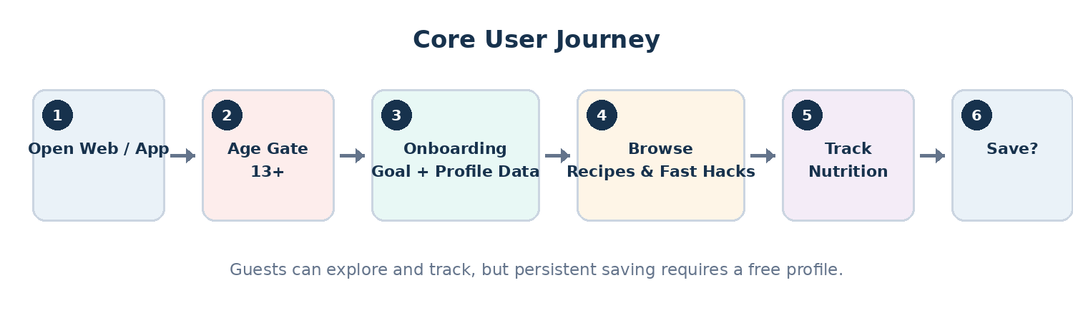
03 / USER FLOW
Main user journey
Business rule
Guests can browse and track, but saving requires a free profile.

Slide 5
04 / PRODUCT MODULES
Main feature areas
Onboarding
Age gate, goal, profile data, resumable progress
Content
Recipes and restaurant “fast hacks” from client PDFs
Tracking
Guest nutrition logging with save prompt
Profile
Saved items, goals, preferences and progress
Admin
Upload, review, approve and publish content
AI
Semantic search, assistant, imagery and personalization
Everything connects through shared content, profile data, APIs, and analytics.

Slide 6
05 / MOSCOW FRAMEWORK
Scope priorities
MUST HAVE
Age gate, auth, onboarding, guest tracking, profile storage, clean content UI, guided tour, legal pages, web/iOS/Android
SHOULD HAVE
Search, admin upload and review, favourites, push notifications, dashboard, web-to-app prompt
COULD HAVE
Community reporting, partnership framework, ordering links, educational tools, advanced UX, acquisition analytics
WON’T THIS PHASE
Subscriptions, medical advice, restaurant negotiations, legal copy drafting, brand naming
When schedule tightens, we cut from the bottom — not from core user value.

Slide 7
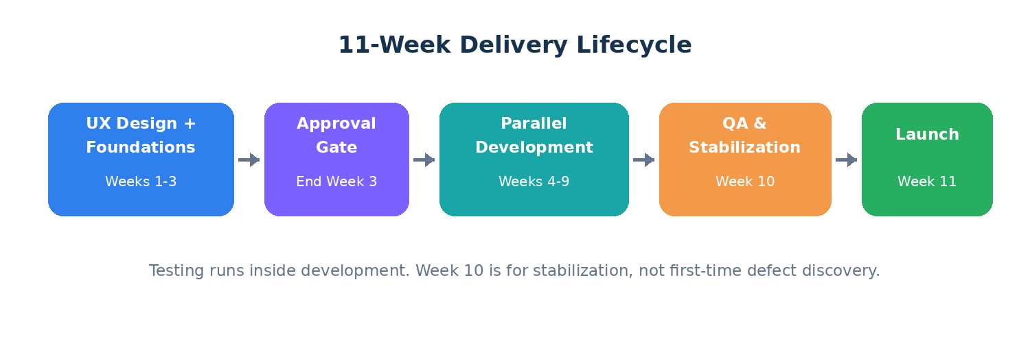
06 / ROADMAP
Delivery lifecycle
Key message
QA is not a final week activity. Every story must be tested inside the sprint where it is built.

Slide 8
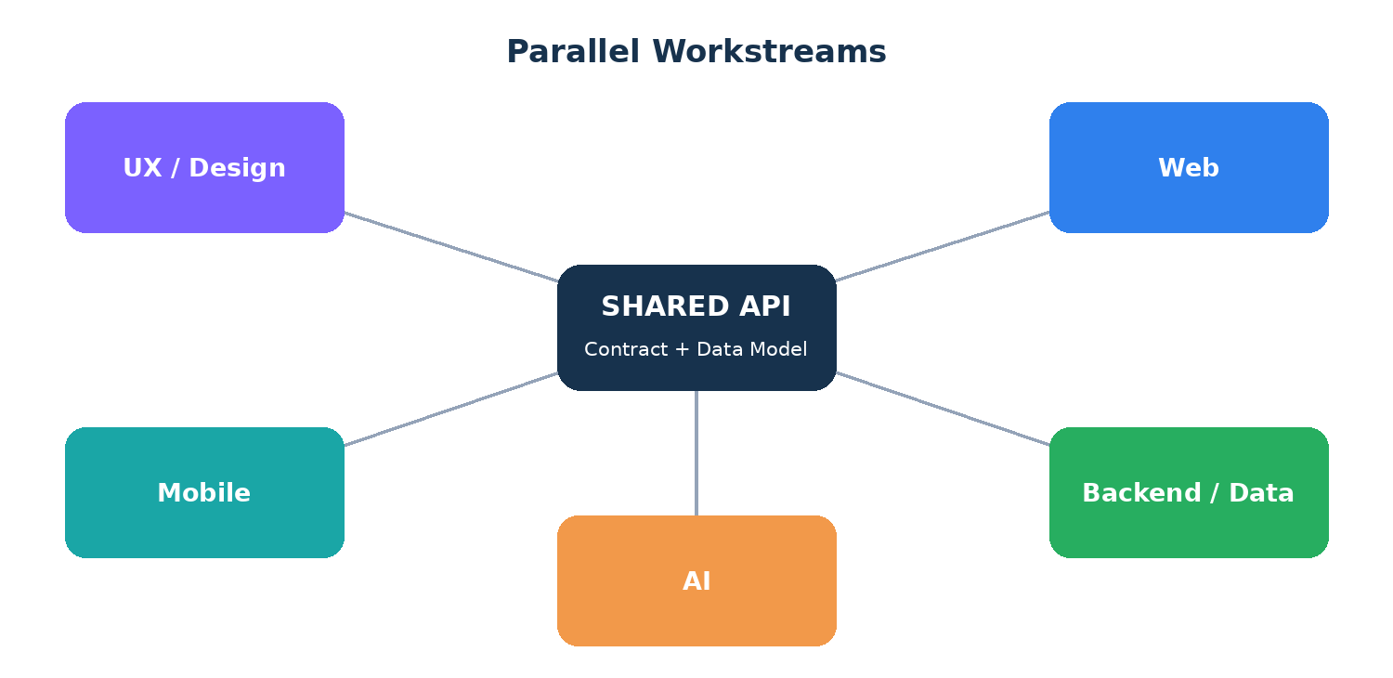
07 / DELIVERY MODEL
Parallel workstreams
The API contract is the coordination point. Web and mobile should build against mocked responses while real backend endpoints are completed.

Slide 9
08 / OWNERSHIP
Team responsibilities
PM / Scrum Master
Sosina
Backlog, ceremonies, QA, risks, reporting
Technical Lead
Samuel
Architecture, DevOps, API, escalation
UX Designer
UX
Flows, designs, prototype, design system
Backend Dev
Backend
API, database, content pipeline
Web Dev
Frontend
Responsive web app
Mobile Dev
Mobile
iOS and Android apps
AI Owner
Open
Search, assistant, imagery, personalization

Slide 10
09 / DELIVERY CONTROL
Jira and story quality
Backlog
Ready
In Progress
Code Review
Ready for QA
QA
Ready for Demo
Done
Definition of Ready
A story has clear requirements, acceptance criteria, design/assets if needed, known dependencies, estimate, and a testable outcome.
Definition of Done
Code complete, reviewed, tested, 80% coverage maintained, merged, deployed to staging, verified, and ready to demo.
Rule to remember: code complete ≠ Done.

Slide 11
10 / QUALITY STRATEGY
QA starts from week one
Functional
Feature does what was requested
Positive
Normal user path works
Negative
Invalid inputs handled
Edge cases
Limits and unusual sequences
Integration
API + frontend/mobile work
Cross-platform
Web, iOS, Android consistency
Regression
Existing features still work
AI safety
Grounded, safe, no medical advice
S1 Critical
Blocks launch, security, data loss
S2 High
Major feature broken
S3 Medium
Partial failure; workaround
S4 Low
Minor or cosmetic

Slide 12
11 / RISK FOCUS
Risks to manage early
Client PDFs late
Blocks content pipeline
Hard PDF parsing
Creates hidden backend effort
UX approval delay
Blocks feature development
API delay
Web/mobile wait on backend
AI owner open
Capacity unclear
Testing postponed
Week 10 becomes discovery
Legal/store accounts late
Launch blocked
Store review issues
External dependency
Risk habit: every blocker needs an owner, early warning signal, and mitigation.

Slide 13
12 / MOBILIZATION
First week action plan
PM / Scrum Master
Confirm dates and open items, set up Jira, create risk/dependency trackers, prepare QA strategy, define DoR/DoD.
Technical Lead
Confirm architecture, repos, environments, CI/CD, security posture, API ownership and due date.
Developers
Start boilerplate, test harnesses, data model, API draft, component foundations, and technical risk review.
Whole Team
Join story writing, estimate work, agree delivery rules, run pre-mortem, surface risks early.
Week 1 is not a waiting week. It is alignment + foundations + risk removal.

Slide 14
13 / MEETING STRUCTURE
Developer kickoff agenda
• Why the project exists and who the client is
• Who the product is for and what problem it solves
• Core user journey and main feature areas
• 11-week lifecycle and parallel workstreams
• Team roles, scope priorities, and API dependency
• Jira workflow, Definition of Ready, Definition of Done
• QA responsibility, defect severity, and testing expectations
• Pre-mortem: imagine we failed to launch — what caused it?
• Capture open questions, risks, owners, and next actions
Expected outcome
Everyone understands the product, the schedule, the risks and the first sprint responsibilities.
Meeting rule
Do not leave with hidden uncertainty. Questions become decisions, risks or action items.

Slide 15
Shared understanding first.
Small testable stories second.
Visible delivery every week.
Universal Perk — Nutrition & Lifestyle Platform
Developer Kickoff & Delivery Brief

