Slide 1
OpenId Connect
OIDC and OAuth2 in Action
Ralf Roßmüller

Slide 2
OpenID Connect - Agenda
Introduction
Endpoints
Authorization Flows
JSON Web Tokens
ID Token
References
OpenID Connect - OIDC and OAuth2 in Action
© 2020 AUSY Technologies Germany AG I Ort, München. Monat 05/2022 I Autor: Ralf Roßmüller

Slide 3
Introduction

Slide 4




OpenID Connect - Introduction
How can a third party application access
our data without our credentials?
Authorization
Server
authorize
Resource
Owner
Client
(App)
uses
access
Resource
Server
OpenID Connect – OIDC and OAuth2 in Action
© 2020 AUSY Technologies Germany AG I Ort, München. Monat 05/2022 I Autor: Ralf Roßmüller

Slide 5
OpenID Connect - Introduction
Access Delegation with OAuth2
Authorization
Server
3. Authentication and Consent
2. Request
Authorization
4. Access Token
Resource
Owner
Client
(App)
6. Introspect
Access Token
1. Request
service
5. Access Resources
with Access Token
Resource
Server
OpenID Connect – OIDC and OAuth2 in Action
© 2020 AUSY Technologies Germany AG I Ort, München. Monat 05/2022 I Autor: Ralf Roßmüller

Slide 6
OpenID Connect - Introduction
Authentication with OIDC and OAuth2
Authorization
Server
3. Authentication and Consent
2. Request
Authorization
4. Access Token
and ID Token
Resource
Owner
Client
(App)
6. Introspect
Access Token
1. Request
service
5. Access Userinfo
with Access Token
Resource
Server
OpenID Connect – OIDC and OAuth2 in Action
© 2020 AUSY Technologies Germany AG I Ort, München. Monat 05/2022 I Autor: Ralf Roßmüller

Slide 7
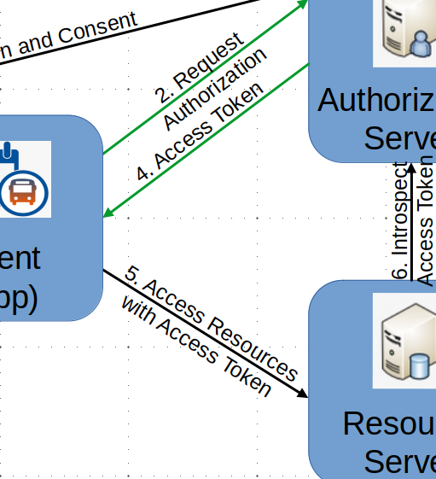
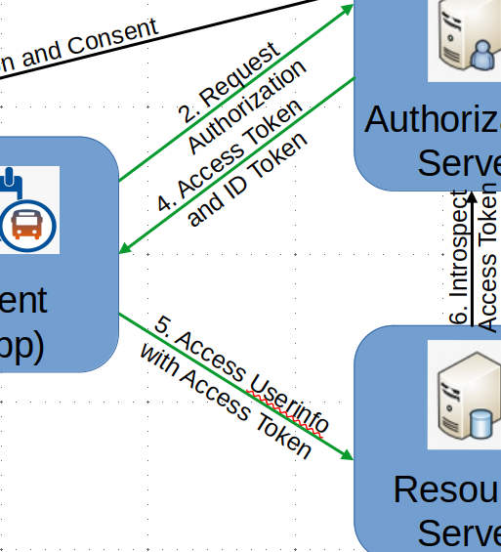
OpenID Connect - Introduction
OAuth2 vs OIDC
OAuth2 (Open Authorization)
Is a protocol for authorization
Allows clients to access resources on behalf of a user
Provides Access Tokens and Refresh Tokens
OIDC (OpenID Connect)
Is a protocol for authentication
Adds an identity layer on top of the OAuth2 protocol
Allows clients to verify the identity of the user
Provides ID Tokens
OpenID Connect – OIDC and OAuth2 in Action
© 2020 AUSY Technologies Germany AG I Ort, München. Monat 05/2022 I Autor: Ralf Roßmüller

Slide 8
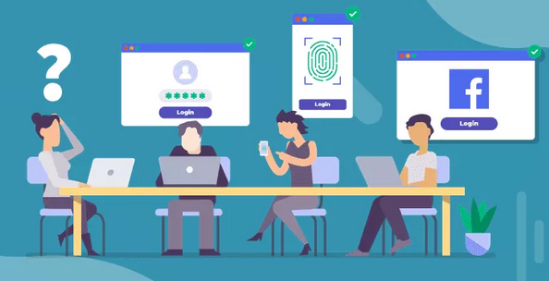
OpenID Connect - Introduction
Common abbreviations & definitions
Authentication
The process of verifying a user identity
Password
Multi-factor
Biometric
Authorization
The process of granting access to specific resources
OpenID Connect – OIDC and OAuth2 in Action
© 2020 AUSY Technologies Germany AG I Ort, München. Monat 05/2022 I Autor: Ralf Roßmüller

Slide 9
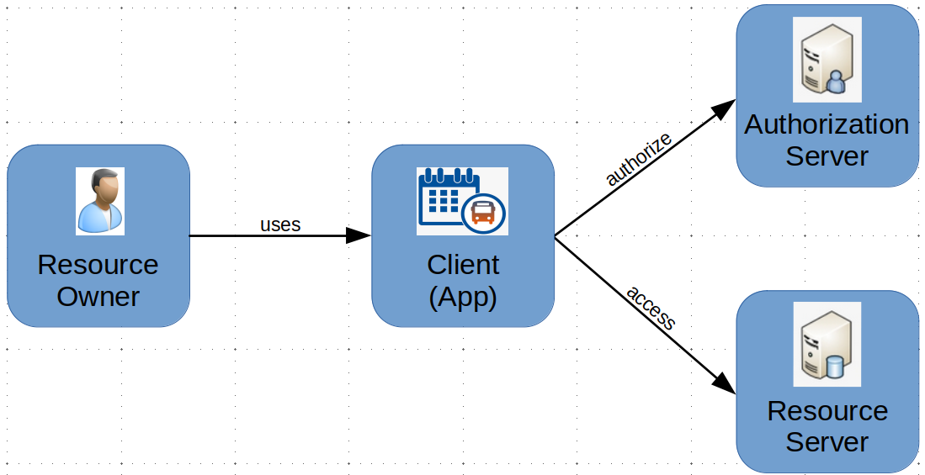
OpenID Connect - Introduction
Common abbreviations & definitions
RO – Resource Owner, User, Subject (sub)
The owner of resources who delegates access to relying parties
RP – Relying Party, Client, Application, Audience (aud)
Generally a application that wants to authenticate a user and to access resources
OP – OIDC Provider, Identity Provider (IdP), Authorization Server (AS), Issuing Authority (iss)
Provides authentication and authorization for relying parties
Resource Server – API
Holds resources that belongs to the resource owner
OpenID Connect – OIDC and OAuth2 in Action
© 2020 AUSY Technologies Germany AG I Ort, München. Monat 05/2022 I Autor: Ralf Roßmüller

Slide 10
OpenID Connect - Introduction
Common abbreviations & definitions
Scopes
Access control information that are used by the relying party to request specific permissions from a user
Claims
Key/value pairs that contain information about a user
JWT – JSON Web Tokens
Base64 encoded, self-contained JSON object
Tokens – API keys, Access Token, Refresh Token
An opaque, unique secret string that is used to access protected resources
OpenID Connect – OIDC and OAuth2 in Action
© 2020 AUSY Technologies Germany AG I Ort, München. Monat 05/2022 I Autor: Ralf Roßmüller

Slide 11
Endpoints

Slide 12
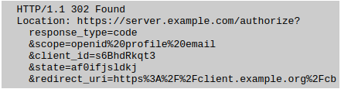
OpenID Connect – Endpoints
Authorization Endpoint (OAuth2)
Request the user‘s authentication and consent
Request
response_type (required)
Determines the authorization flow to be used
Valid values are “code”, “token” and “id_token”
client_id (required)
The identifier of the client valid at the Authorization Server
scope (required)
OpenID Connect requests must contain the scope “openid”
OpenID Connect – OIDC and OAuth2 in Action
© 2020 AUSY Technologies Germany AG I Ort, München. Monat 05/2022 I Autor: Ralf Roßmüller

Slide 13
OpenID Connect – Endpoints
Authorization Endpoint (OAuth2)
Request continued
redirect_uri (required)
Redirection URI to which the response will be sent
state (optional)
Opaque value used to maintain state between the request and the callback
Mitigate Cross-Site Request Forgery (CSRF)
acr_values (OIDC, optional)
Requested Authentication Context Class Reference values
nonce (OIDC, depends on response_type)
String value used to associate a Client session with an ID Token, and to mitigate replay attacks
OpenID Connect – OIDC and OAuth2 in Action
© 2020 AUSY Technologies Germany AG I Ort, München. Monat 05/2022 I Autor: Ralf Roßmüller

Slide 14

OpenID Connect – Endpoints
Authorization Endpoint (OAuth2)
Response
HTTP 302 redirect response to the given redirect URI
Authorization Code (code) for Authorization Code Flow
Access Token (token) and/or ID Token (id_token) for Implicit Flow
The given State (state) from the request
OpenID Connect – OIDC and OAuth2 in Action
© 2020 AUSY Technologies Germany AG I Ort, München. Monat 05/2022 I Autor: Ralf Roßmüller

Slide 15
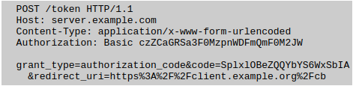
OpenID Connect – Endpoints
Token Endpoint (OAuth2)
Clients obtain access token, ID token and optionally a refresh token in exchange for an authorization code
Request
Client Credentials (client_id and client_secret) for authentication
Grant Type (grant_type) with the value „authorization_code“
The Code (code) from the Authorize Request
The Redirect URI (redirect_uri) used in the Authorize Request
OpenID Connect – OIDC and OAuth2 in Action
© 2020 AUSY Technologies Germany AG I Ort, München. Monat 05/2022 I Autor: Ralf Roßmüller

Slide 16
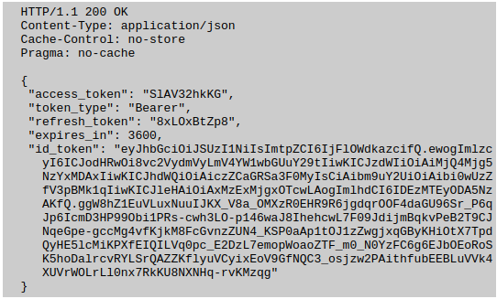
OpenID Connect – Endpoints
Token Endpoint (OAuth2)
Response
Bearer Token that contains
Access Token (access_token)
ID Token (id_token)
Refresh Token (refresh_token)
OpenID Connect – OIDC and OAuth2 in Action
© 2020 AUSY Technologies Germany AG I Ort, München. Monat 05/2022 I Autor: Ralf Roßmüller

Slide 17

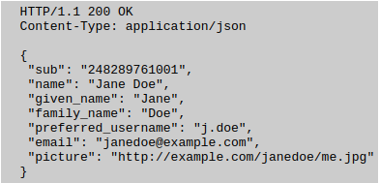
OpenID Connect – Endpoints
Userinfo Endpoint (OIDC)
Standardized resource endpoint to obtain user information
Request
Valid Access Token
Response
Subject Identifier (sub) is always returned
Additional claims that depends on the request
OpenID Connect – OIDC and OAuth2 in Action
© 2020 AUSY Technologies Germany AG I Ort, München. Monat 05/2022 I Autor: Ralf Roßmüller

Slide 18
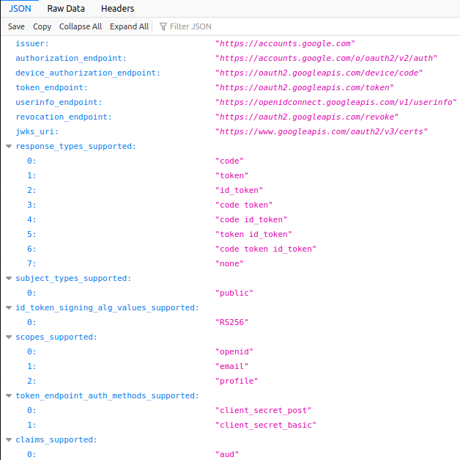
OpenID Connect – Endpoints
Well-Known Configuration Endpoint (OIDC)
Returns the OpenID configuration values
Endpoints
Supported response types
Supported scopes
Supported claims
JWKS URI
Google Accounts
https://accounts.google.com/.well-known/openid-configuration
OpenID Connect – OIDC and OAuth2 in Action
© 2020 AUSY Technologies Germany AG I Ort, München. Monat 05/2022 I Autor: Ralf Roßmüller

Slide 19
Authorization Flows

Slide 20
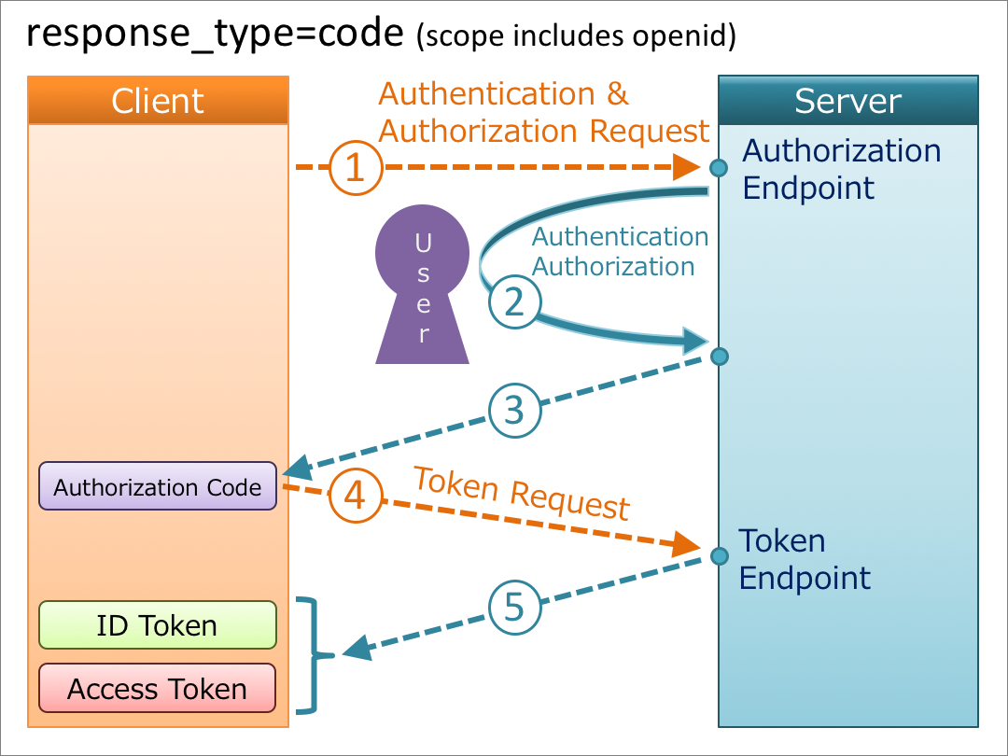
OpenID Connect – Authorization Flows
Authorization Code Flow
Returns onetime authorization code
Does not expose tokens to the front channel
Authorized clients obtain tokens
Intended for server-side applications
OpenID Connect – OIDC and OAuth2 in Action
© 2020 AUSY Technologies Germany AG I Ort, München. Monat 05/2022 I Autor: Ralf Roßmüller

Slide 21
Hands On
Authorization Code Flow
https://www.oauth.com/playground/index.html

Slide 22
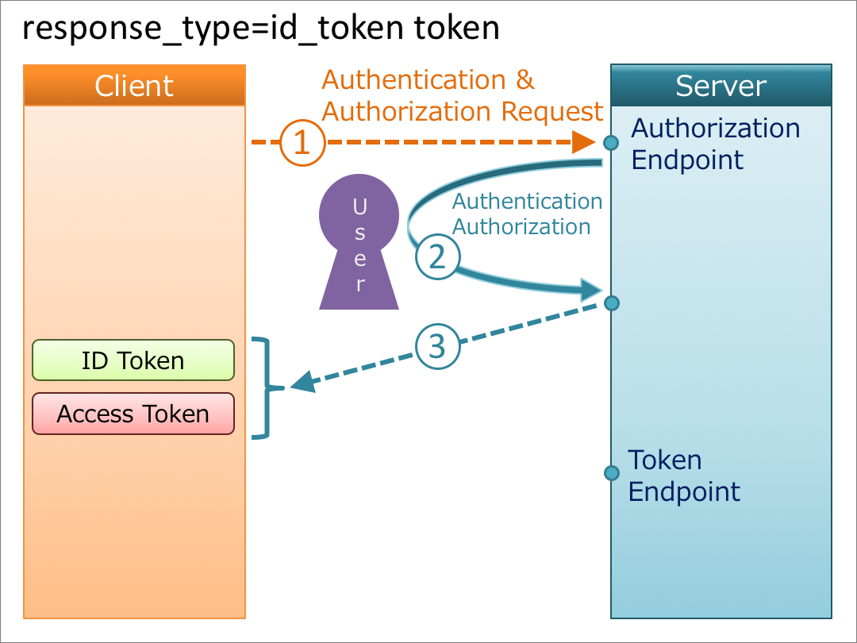
OpenID Connect – Authorization Flows
Implicit Flow
Returns id token and/or access token
Expose tokens to the front channel
Intended for browser-based applications
OpenID Connect – OIDC and OAuth2 in Action
© 2020 AUSY Technologies Germany AG I Ort, München. Monat 05/2022 I Autor: Ralf Roßmüller

Slide 23
Hands On
Implicit Flow
https://www.oauth.com/playground/index.html

Slide 24
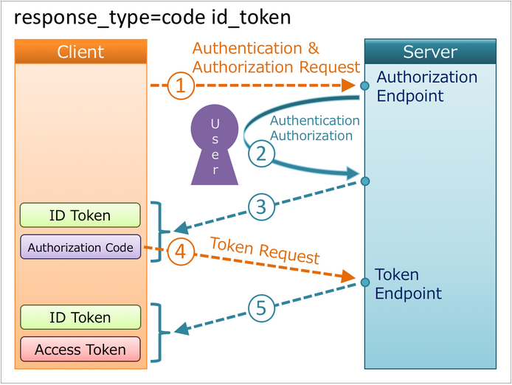
OpenID Connect – Authorization Flows
Hybrid Flow
Returns authorization code and tokens
Expose tokens to the front channel
Intended for clients that need processing before requesting the Access Token
OpenID Connect – OIDC and OAuth2 in Action
© 2020 AUSY Technologies Germany AG I Ort, München. Monat 05/2022 I Autor: Ralf Roßmüller

Slide 25
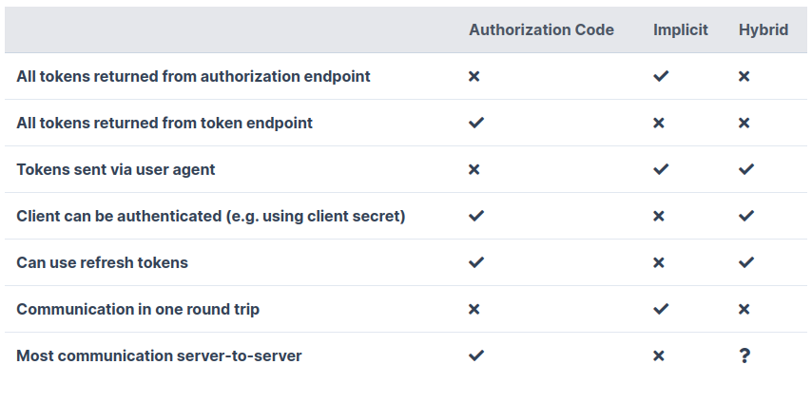
OpenID Connect – Authorization Flows
Flow Features
OpenID Connect – OIDC and OAuth2 in Action
© 2020 AUSY Technologies Germany AG I Ort, München. Monat 05/2022 I Autor: Ralf Roßmüller

Slide 26
JSON Web Tokens

Slide 27
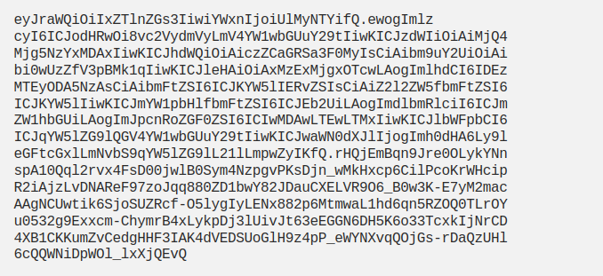
OpenID Connect – JSON Web Tokens
What is JSON Web Token
Is an open standard (RFC 7519)
Defines compact and self-contained JSON objects
Are base64 encoded
Can securely transmitting data between parties
Are digitally signed and/or encrypted using HMAC, RSA or ECDSA
OpenID Connect – OIDC and OAuth2 in Action
© 2020 AUSY Technologies Germany AG I Ort, München. Monat 05/2022 I Autor: Ralf Roßmüller

Slide 28
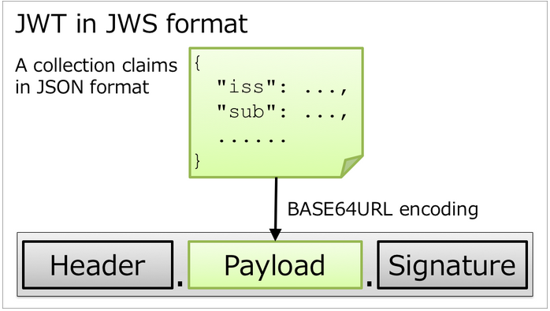
OpenID Connect – JSON Web Tokens
JSON Web Signature (JWS)
Consists of three parts seperated by dots
Header
Type of the token (typ)
Signing algorithm (alg)
Key ID (kid)
Payload
Contains the data (claims)
Signature
Created from header and payload
Used to verify that the data was not changed
OpenID Connect – OIDC and OAuth2 in Action
© 2020 AUSY Technologies Germany AG I Ort, München. Monat 05/2022 I Autor: Ralf Roßmüller

Slide 29
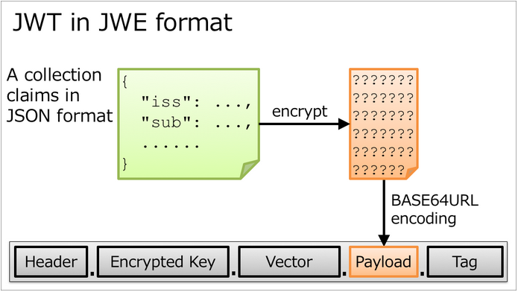
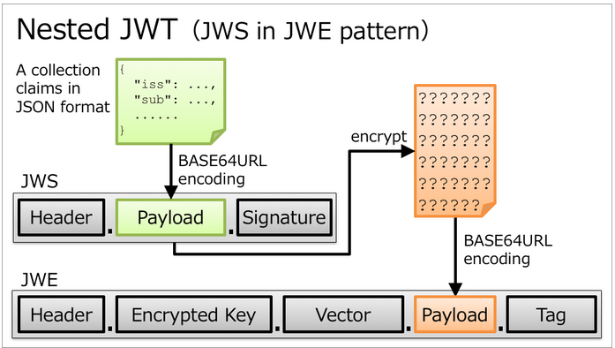
OpenID Connect – JSON Web Tokens
JSON Web Encryption (JWE)
Consists of five parts seperated by dots
Header
Encrypted Key
Initialization Vector
Ciphertext
AuthenticationTag
OpenID Connect – OIDC and OAuth2 in Action
© 2020 AUSY Technologies Germany AG I Ort, München. Monat 05/2022 I Autor: Ralf Roßmüller

Slide 30
ID Token

Slide 31
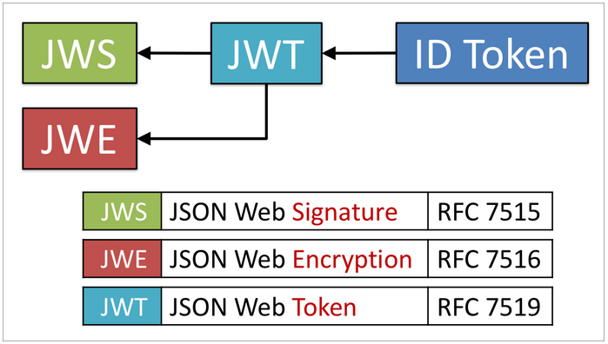
OpenID Connect – ID Token
ID Token (OIDC)
Must be signed using JWS
Optionally both signed and then encrypted using JWS and JWE
May contain custom claims
Required claims defined by OIDC
Issuer identifier (iss)
The case sensitive URL of the issuer of the id token
Subject identifier (sub)
Locally unique and never reassigned identifier within the issuer for the user
Audience(s) (aud)
List of audiences that id token is intended for
OpenID Connect – OIDC and OAuth2 in Action
© 2020 AUSY Technologies Germany AG I Ort, München. Monat 05/2022 I Autor: Ralf Roßmüller

Slide 32

OpenID Connect – ID Token
ID Token (OIDC)
Required claims defined by OIDC continued
Expiration time (exp)
The expiration time of the id token
Issued time (iat)
The time which the id token was issued
Optional claims defined by OIDC
Authentication Context Class Reference (acr)
The Authentication Context Class that the authentication performed should satisfy
Authentication Methods References (amr)
List of authentication methods used in the authentication
OpenID Connect – OIDC and OAuth2 in Action
© 2020 AUSY Technologies Germany AG I Ort, München. Monat 05/2022 I Autor: Ralf Roßmüller

Slide 33
OpenID Connect – ID Token
ID Token (OIDC)
Optional claims defined by OIDC continued
Authorized Party (azp)
The party to which the id token was issued
Nonce (nonce)
String value used to associate a client session with the ID Token, and to mitigate replay attacks
Optional claims defined by the Authorization Server
OpenID Connect – OIDC and OAuth2 in Action
© 2020 AUSY Technologies Germany AG I Ort, München. Monat 05/2022 I Autor: Ralf Roßmüller

Slide 34
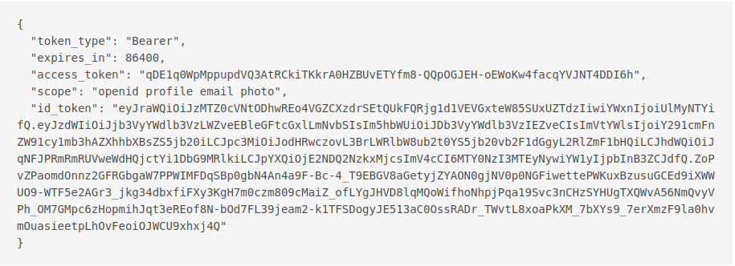
OpenID Connect – ID Token
ID Token (OIDC)
OpenID Connect – OIDC and OAuth2 in Action
© 2020 AUSY Technologies Germany AG I Ort, München. Monat 05/2022 I Autor: Ralf Roßmüller

Slide 35
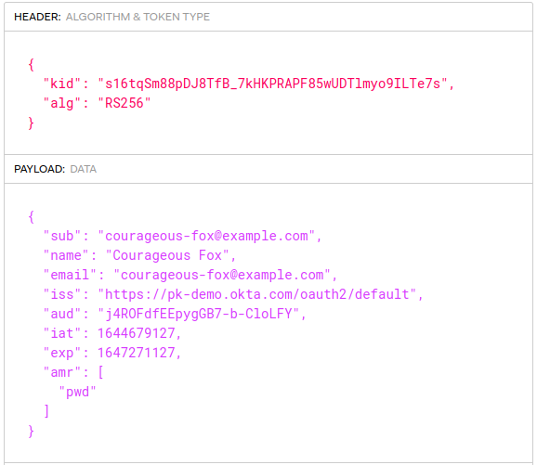
OpenID Connect – ID Token
ID Token (OIDC)
OpenID Connect – OIDC and OAuth2 in Action
© 2020 AUSY Technologies Germany AG I Ort, München. Monat 05/2022 I Autor: Ralf Roßmüller

Slide 36
Hands On
OpenID Connect
https://www.oauth.com/playground/index.html

Slide 37
OpenID Connect – ID Token
ID Token (OIDC)
Verifying ID Tokens
Validation is defined in the OpenID Connect Specifications
Validate the signature using the algorithm specified in the header
Validate the Issuer Identifier (iss), the Audience (aud) and the Authorized Party (azp)
Validate the Expiration Time (exp)
Validate the Nonce if it was sent in the Authorization Request
OpenID Connect – OIDC and OAuth2 in Action
© 2020 AUSY Technologies Germany AG I Ort, München. Monat 05/2022 I Autor: Ralf Roßmüller

Slide 38
References

Slide 39
OpenID Connect – References
Specification and Tutorials
OAuth 2 Authorization Framework
https://datatracker.ietf.org/doc/html/rfc6749
OpenID Connect Specifications
https://openid.net/developers/specs/
Diagrams of All OpenID Connect Flows
https://darutk.medium.com/diagrams-of-all-the-openid-connect-flows-6968e3990660
Understanding ID Token
https://darutk.medium.com/understanding-id-token-5f83f50fa02e
OpenID Connect – OIDC and OAuth2 in Action
© 2020 AUSY Technologies Germany AG I Ort, München. Monat 05/2022 I Autor: Ralf Roßmüller

Slide 40
OpenID Connect – References
Tools
Oauth 2.0 Playground
https://www.oauth.com/playground/index.html
JWT IO
https://jwt.io
OpenID Connect – OIDC and OAuth2 in Action
© 2020 AUSY Technologies Germany AG I Ort, München. Monat 05/2022 I Autor: Ralf Roßmüller

