Slide 1
Unit testing with Qt
Versión 0.9

Slide 2
Objetives
Basic concepts of unit testing
Unit testing strategy
How to structure Unit testing with Qt
Unit testing using data set
Continuous Delivery and Continuous Deployment

Slide 3
Basic concepts

Slide 4
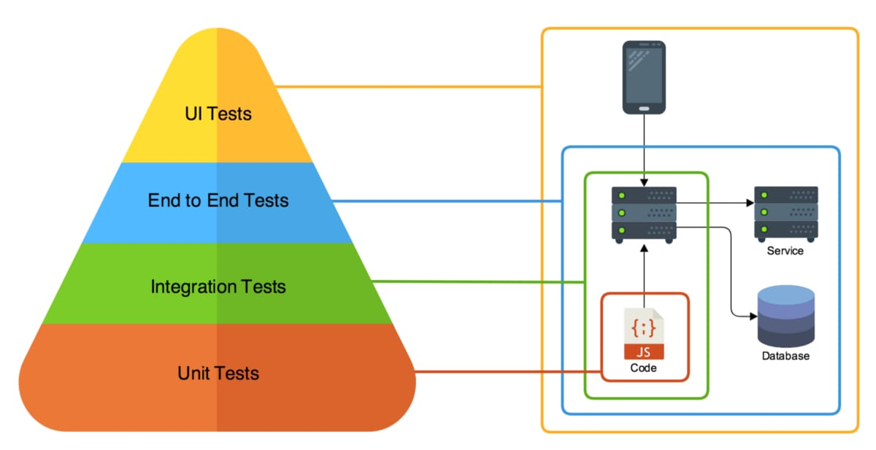
Environment for testing

Slide 5


Acceptance testing
Business
Use Cases
Unit testing in development
If a bug was found in production
A Unit testing should be created.
“If we continue finding bugs in production or acceptance test,
May be the unit testing need to increase the coverage.

Slide 6
Finding the green
Writing a good unit testing isn’t easy.
Good Unit Test: When the test is in Green, we should trust in the code, if it is not possible, we need to improve the Unit test.
The idea is when we see the red color in a Unit test we must check the code and try to find a solution.
If several test are in red, and the team thinks that might be a problem on the environment or a database, we will have an adverse effect.
The test must be treated as production code. We must design and maintain it

Slide 7
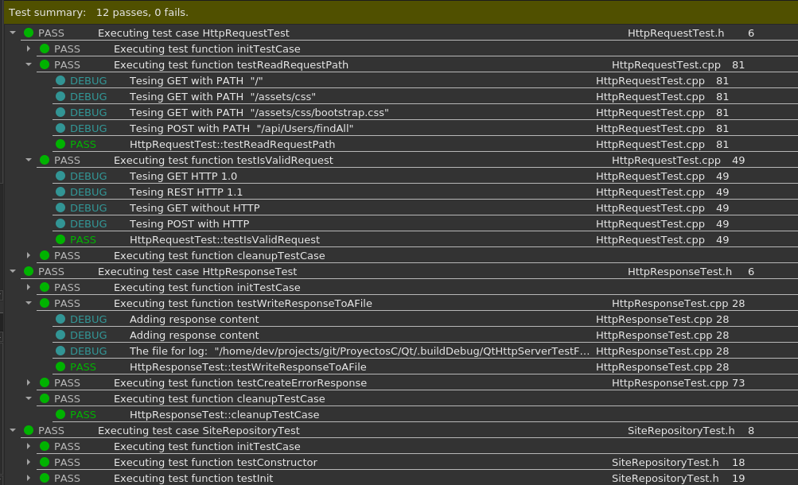
Test Runner on QtCreator

Slide 8
Why our test suite stops being reliable?
For the same reasons that the code does.
It doesn’t have a good design, architecture and well structured test cases.
Insufficient experience in the business to create good test cases.
Only the test take care of the integrity of the test.
The unit test requires continuous refactorings as the code.
Don’t repeat your self.
Don’t repeat your self.

Slide 9
Considerations
Is better to have repeteable unit tests, even when they are few
Use natural language to write the intentions or asserts
The X method must return a list with 3 elements
The method must sign in with the user “admin”
The taxes parameters must exists in the configuration
The xml file for an invoice must exists
The acceptance criteria must be defined
It will be great that developers and tester work together in Unit testing
The Unit tests must be maintained as source code.

Slide 10
Why Unit Tests are helpful
Unit testing must be executed faster in developer machine, to always run them.
The test must have all needed resources in the developer machine
The Unit test should not require special configurations or environment to run.
Unit test can be used as regression test in some case
When doing code refactoring
We could run in a build server or with test runner to have reports.
They can be run in a Nightly Build and before a release.

Slide 11
Unit testing with Qt

Slide 12
Writing Unit testing with Qt
The Unit Tests must run independently
They must prepare the data and configuration for execution.
Is better to prepare the data for Unit test over dumps of production environment (Except for performance testing or Staging)
Prepare the configuration files and data files in the Unit Test base folder
DO NOT use the same path as production.
For SMS, create ETROOT path and modify your programs to use an Environment Variable
DO NOT use hard coded paths.
The programs must be capable to use the default file name or a different file for Unit Testing
It is better to have small number of test, but they must be reliable
“Never configure the same way as production”

Slide 13
Good Unit Tests
Write reliable test
Validate when the test must be deleted
Test only one scenario
Avoid logic in unit testing
Separate the Unit Tests from Integration test
Make code reviews in tests
Maintainable
Test only public methods
Remove de duplicate code
Write the [SetUp] method correctly
Write isolated Unit tests
avoid calls between Unit tests
Try to avoid multiple Asserts for different cases or scenarios.

Slide 14
Writing reliable Unit Tests
Name the Unit Test, including the scenario to test.
Describe the intentions in the comments of Unit tests
Define the expected result for unit test (run, fail, and what returns).
Name correctly the variables of the unit test
Write readable asserts, with understandable meaning.
If we can´t find a good way to write, is better than write nothing.
Write what should have happened.
“The result was {0} and {1} was expected” VS “The process try to read a on existent file and the code {0} was returned, when the program expects {1} ”
Separate the assert from calculations
Don’t use: QCOMPARE(“2019-09-09”, dateTimeFormater.format(2019-09-09))

Slide 15
Unit test cicle
First the initTestCase() was invoked before all the methods
For each method:
The init() was invoked before the test method
The unit test method was invoked
All the assert are executed, as long as QFAIL is not executed.
After the unit test method finished, the cleanup() was called
Finally the cleanUpTestCase() was executed.

Slide 16
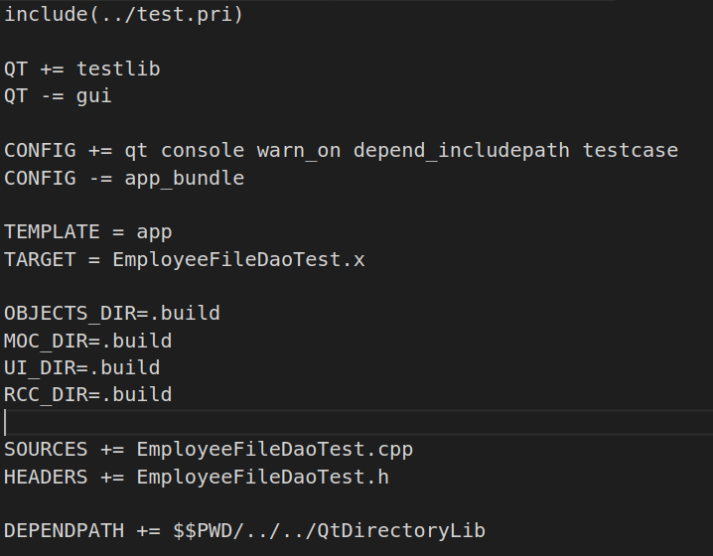
Prepare the test project –.pro file
Include the test.pri inside .pro file.
Add the Qt Unit Test library:
QT += testlib
If you don’t use UI components remove gui.
QT -= gui
In CONFIG variable include:
CONFIG += qt console testcase
Create a TARGET for the Project, for example:
TARGET = EmployeeFileDaoTest.test
Separate the code of generated files in a different folder( mocs, objects, etc.)
OBJECTS_DIR=.build
MOC_DIR=.build
UI_DIR=.build
RCC_DIR=.build

Slide 17
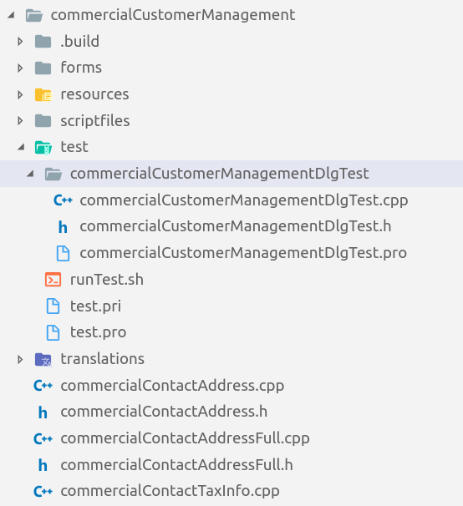
Folder structure with Qt Test for existing projects
The test Project will have a Project of subdir type (For example: test)
It’s strongly recommended to have a test.pri for test Project and its subfolders.
Use a bash file to run all the test of the folder (run-test.sh) or use make check inside test folder
To create a friendly report you could use xunit-viewer.
A Project should be created for each class to be tested, for example (commercialCustomerManagementDlgTest)
The Unit test should have .h and .cpp for each testing class:
commercialCustomerManagementDlgTest.cpp
commercialCustomerManagementDlgTest.h
At the end of the .cpp file a macro should be added
QTEST_MAIN(commercialCustomerManagementDlgTest)

Slide 18
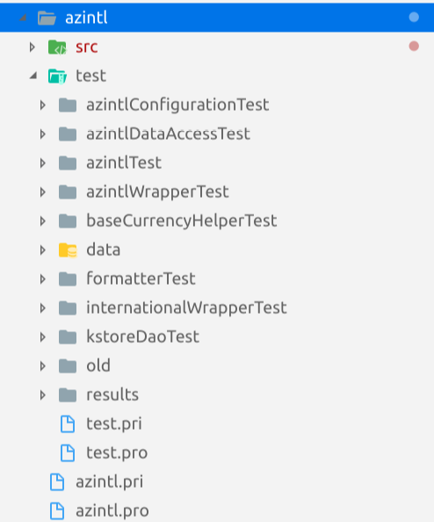
Folder structure with Qt Test for new projects
The main project will be a subdir Project
The Project will have two folders:
One for src that will be of type library or application.
The src folder will have all the classes or code of the library or application
A test folder that will be a subdir Project
One folder for each class to test
A file test.pri for common configuration for testing
Add data folder to include all the files required for the test (configuration, datafiles, sqlite databases, etc).
A result folder for unit test html report using xunit-viewer or to integrate with Jenkins in a future
Create a library.pri that have al the common configuration used for the Project. In the example azintl.pri
If it’s possible use relative paths between the test and src trying to avoid the to run make install, before execute make in test folder.
Create a run-test.sh that run all the repeatable test and include in it parameters to generate reports in html.

Slide 19
Considerations
Always take care the .pri files and be secure that the Project compiles in terminal.
Use relative paths or environment variables like ETROOT, GEMINI_ROOT, etc.
Include in .pro and .pri files the DEPENDPATH, INCLUDEPATH, QMAKE_LIBDIR, LIBS as needed.
Make compilation test on main folder, in src folder, in test folder and some of the projects inside the test folders.
Add the extension .test in the .pro file TARGET for Unit tests
Always verify the LD_LIBRARY_PATH and ldconfig for compilation process.
It’s recommended to use the INSTALL_ROOT variable for compilation.

Slide 20
QT Macros for Unit testing
QVERIFY: This macro test a boolean condition, if the condition is true the test pass, otherwise a Fail will be returned.
QVERIFY(c2.getA() == "A");
QVERITY2: It shows a better message writted for the developer if the boolean condition is false.
QVERIFY2(c2.getA() == "A", "first operand doesn't match");
QCOMPARE: This macro shows more information when you compare two elements, if the expression fail shows the difference between the elements.
QCOMPARE(mCalc.Sum(), A0 + B0);
FAIL! : TestCalculator::testSum() Compared values are not the same
Actual (mCalc.Sum()): 10
Expected (A0 + B0) : 12

Slide 21
Macros used on QT
QFAIL: It marks test with a failure. It is commonly used when a condition occurs and we need to finish the test process. For example if one condition in initTestCase() fail, is better to finish the Test.
f(!fileNotLoaded)
QFAIL("Int size is not 4 on this platform.");
QSKIP: If this macro is in the code the following code after it will not be executed.
void TestClass::testSum()
{
QSKIP("Sum have not been implemented yet...");
}
QWARN: This macro prints an alert message if the test find an unexpected condition.
QWARN("trying to verify the file");

Slide 22
Main method macros
QTEST_MAIN(TestName): Used to test full QT Application
QTEST_GUILESS_MAIN(TestName): Test an application with core Qt libraries: No GUI, but the event loop is available
QTEST_APPLES_MAIN(TestName): Test an application without GUI and without events

Slide 23
Unit test example
/*!
* \brief Test the find all employees using the DAO, The intentions are:
* - The file must contains three elements in the file
*/
void EmployeeFileDaoTest::testFindAll() {
// Prepare the file for the unit test
std::string str = "./employee.data";
const char *fileName = str.c_str();
bool isFileRemoved = FileUtil::deleteFileIfExists(fileName);
if(!isFileRemoved) {
QFAIL("The file must be removed before the ");
}
// Create DAO
EmployeeFileDao *dao = new EmployeeFileDao(fileName);
// Create some registers
Employee e;
e = createEmployee("Alejandro Andrés","Almanza Robledo", "Juan Altamirano #4998",
"alejandro.robledo@gmail.com", 6149883982, 8990);
dao->addEmployee(&e);
// Create two more registers
// Find all the employees
EmployeeResult result = dao->findAll();
qDebug() << "The number of employees in file " << result.numberOrRecors;
// Printing the list (If we wish to validate visually)
dao->printList(result);
QVERIFY2(result.numberOrRecors == 3, "The file must contains three elements in the file");
// What else we can test and how?
}
Scenario and intentions
Prepare the resources for the test or use init() method
Create data for the unit test
Invoke the process
Show some information for visual validation
Test the ASSERTS used in the test

Slide 24
Unit test with Datasets ⁽¹⁾
A new method that ends with “_data” should be added. For example:
testBusinessNameRegExpInvalid()
testBusinessNameRegExpInvalid_data()
Write a test case matrix with: QTest::addColumn<Type>("name of column")
Add test cases using the defined columns:
Unit test case name << First column << Second column ;
QTest::newRow("name of the case") << <Object for column name> << <Object for column result>;
Example:
QTest::newRow("Name with *") << QString::fromUtf8("*A KEN I OZAWA ME*") << false;
QTest::newRow("Name with {}") << QString::fromUtf8("A {I OZAWA M}E.") << false;
QTest::newRow("Name with :") << QString::fromUtf8("A {I OZAWA :M}E.") << false;
QTest::addColumn<QString>("name");
QTest::addColumn<bool>("result");

Slide 25
Unit test with Datasets ⁽²⁾
Add the QFETCH in the test methods to read the Test case matrix.
The unit test method will be executed for each case registered in the _data method.
The _data methods will be helpful when we need to evaluate many cases for example with regexp validators, formatters, etc.
void commercialCustomerManagementDlgTest::testBusinessNameRegExpInvalid()
{
// Fetching the data
QFETCH(QString, name);
QFETCH(bool, result);
QRegExp rx(businesNameRegex);
QCOMPARE(rx.exactMatch(name), result);
}

Slide 26
When some test fail, what should I do?
What that it means?
A problem with the environment could exists
A bug in the unit test could exists
The unit test intentions or assumptions of the unit test have changed
The unit test catch a bug
The next step is to fix the problem with the test or code.
Modify the code to avoid the error doesn’t occur again.
In the plan consider the time to fix and run Unit tests.
If the Unit test generates intermittent failures, they must be assed to Quarantine or a repair category.

Slide 27
Some things to consider
Find a way to categorize the test, for example:
Validation: Those tests should be repeatable and must be executed by developers to validate the system.
Fix: Those test depends of an environment configuration o specific case in a flow and they couldn’t be executed in a continues approach.
Integration: Those test executes a complex business process and it requires services like databases, application servers, etc. For example: Make and order, invoicing, etc.
The Unit test should be executed with a tool or automatically.
Add the Unit test as part of the build process.

Slide 28
Tips
The Unit test must include Asserts (QVERIFY, QCOMPARE, QFAIL, etc.)
The intentions must be readable
The intentions are affirmations that are verified with the asserts.
Try to have a success scenario and one scenario that catch a failure
If one method requires a null validation, verify the conditions in an scenario.
If you read data validate the information, for example:
If you read a sales list, verify that each sale has the most important date, data, transaction, etc.
Many problems in the application are data problems.

Slide 29
Tips (2)
Refactor the unit test when needed
If our Unit test has many scenarios, divide it.
If the method to test is very complex, divide it.
If use files in our Unit test create constants or methods to access them.
If more tan one Unit test uses the same file, you could create a method or utility class to access it.
Divide the test in categories, production, fix, quarantine.
Remember the Unit tests are code, we need to take care of it and redesign it.

Slide 30
Lab scenario

Slide 31
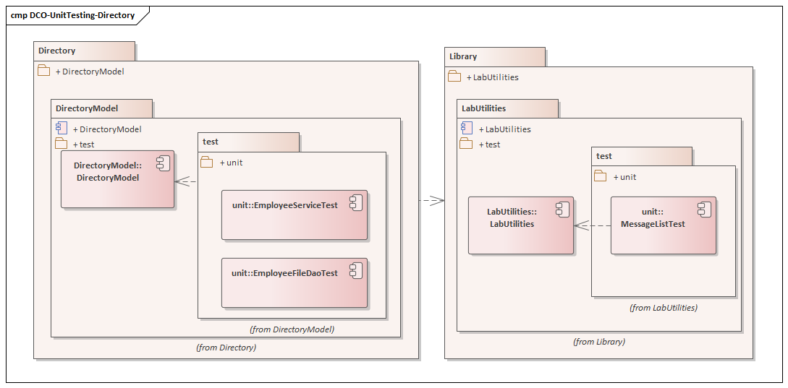
Lab’s components (UML)

Slide 32
Scenario 1
Implement the Unit tests methods with the intentions defined in EmployeeFileDaoTest
findAll()
findEmployeeById()
addMultiple()
Fix the code failures

Slide 33
Scenario 2
Create the Project “EmployeeServiceTest”
Include .pri in the project
Create the class “EmployeeServiceTest” for unit testing (Code .cpp and .h)
Add the class to the Project file EmployeeServiceTest.pro.
Create data oriented unit test for the method:
testIsValidWithValidEmployee()
Create a valid employee and verify the result
Create unit test for the method:
testSaveValidEmployeeCaseSaveAndUpdate:
Save a new Employee, validate the result
Update the employee and validate the result
Read the saved empleoyee using the EmployeeFileDao to validated the saved employee
Run the unit test with console or Qt Creator

Slide 34
Improve my code for Unit Testing
Should I divide my method?

Slide 35
Improve our code for Unit testing (1)
Try to create repeatable methods
Before creating a method, think well the return type.
Divide the methods in small methods with only one function
Divide the process in data extraction, process, store, transformation, etc.
Think in isolated functions, for example functions that receive parameters, process and return the result.
Reduce the use of instance variables in methods.
Create invalid data or scenarios for our test.
If our method takes many arguments evaluate to create a parameter object.

Slide 36
Improve our code for Unit testing (2)
Store data in text files, or use data oriented test.
If our test insert information in a database or file remove the information before finish the test method
If the test requires information in database or files, insert, read, validate and delete cycle the information
To store information in databases or files create objects on the test with different scenarios to validate the save or update process.

Slide 37
Data preparation for testing
When we create a method think, how do I get the data for my test?
Save the test data in file inside the unit testing Project
Create a folder with name data inside the unit test Project.
If we couldn’t get real information for testing, use the application logs to store information that helps in unit testing.
If the Unit test is very complex, modify your code to save the data structure in a file and create a process to read in the unit test.
Prepare your Unit test to receive the data objects o read files to execute scenarios.
Create process that takes data snapshots and save them in files as Unit test scenarios.
Write the code that read the data in an independent method, and create another that process the read data.

