Slide 1


















Cloud Architecture
Service Endpoint
Peering
App Gateway
Azure AD
Authentication
App Insights
Monitoring
Event Grid Topic
Monitor
Monitors VM
NSG
NSG
Function App
Order Processing
Storage Account
AKS
Cart App
App Service
Inventory App
VM
Weather API
VM
Catalog App
Key Vault
Stores Secrets
Peering
NSG
Cosmos DB
ACR
Cart Docker
Redis
Azure SQL

Slide 2


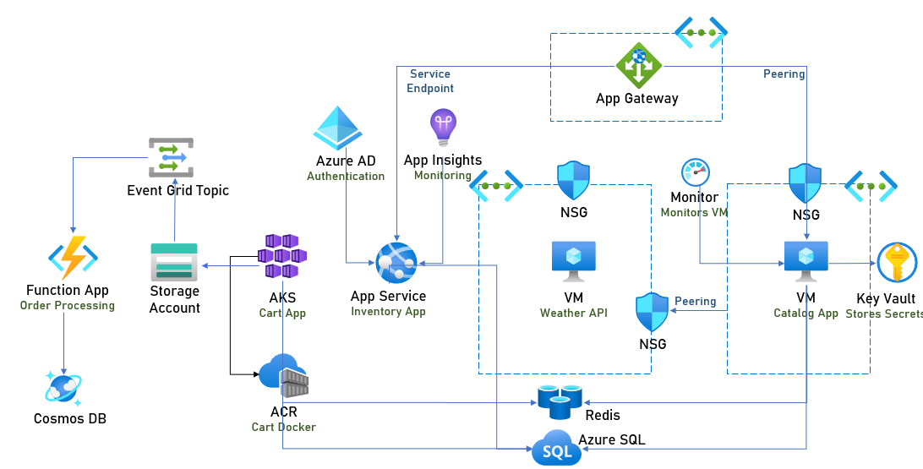
Cloud Architecture with DR
Traffic Manager
Front Door
Primary
Secondary
App Service
Inventory DR App

