Slide 1
Cellular Automata --A journey of rebirth and annihilation

Slide 2
Define a world

Slide 3
Status: Life, or Death?
0 | 0 | 0 | 0 | 0 | 1 | 0 | 0 | 0 | 0

Slide 4
Given a world
Cells = 10
Initialize n cells = 1, others null(0)
Scan consequent cells by each 3
Update for next generation
1st gen
0 | 0 | 0 | 0 | 0 | 1 | 0 | 0 | 0 | 1
 | 111 | 110 | 101 | 100 | 011 | 010 | 001 | 000
Rule90 | 0 | 1 | 0 | 1 | 1 | 0 | 1 | 0
Determine via looking up rule30
Continuous border:
1, 0, 0, 0, 1, 0, 1, 0, 1, 0
1st gen
0 | 0 | 0 | 0 | 0 | 1 | 0 | 0 | 0 | 1
1 | 0 | 0 | 0 | 1 | 0 | 1 | 0 | 1 | 0
2nd gen

Slide 5
Rule the iteration
Think about neighbors: 000, 000, 000, 001, 010, 100, 000, 000
-- if ??? or ???:
to survive
--else:
to die
0 | 0 | 0 | 0 | 0 | 1 | 0 | 0 | 0 | 0
Current status:
? | ? | ? | ? | ? | ? | ? | ? | ? | ?
Iterate next generation:

Slide 6
Logical Determination by combinations of Left, Mid, Right
1
0
1
0
1
0
1
0
1
0
1
0
1
0
Dec | 2⁷=128 | 2⁶=64 | 2⁵=32 | 2⁴=16 | 2³=8 | 2²=4 | 2¹=2 | 2⁰=1
Bin | 111 | 110 | 101 | 100 | 011 | 010 | 001 | 000
Rule90 | 0 | 1 | 0 | 1 | 1 | 0 | 1 | 0
Rule30 | 0 | 0 | 0 | 1 | 1 | 1 | 1 | 0

Slide 7
Initialize n cells
Count live neighbors
Update for next generation
Iteration 2~3
*Finish in advance if the maximum number of live neighbors of all cells is less than 2

Slide 8
Grid: 8*8
Logical Determination
Survive: Live Neighbors = 2
Survive or Birth: Live Neighbors = 3
Die: Live Neighbor < 2 or >3

Slide 9
--Start:
Initialize 4 cells

Slide 10
 |  | 1 | 1 | 1
 |  | 2 | 2 | 3 | 1
 |  | 3 | 3 | 3 | 1
 |  | 2 | 2 | 3 | 1
 |  | 1 | 1 | 1
2. Count live neighbors

Slide 11
3. Update for next generation

Slide 12
 |  | 1 | 2 | 2 | 1
 | 1 | 3 | 4 | 3 | 2
 | 1 | 3 | 6 | 5 | 3
 | 1 | 3 | 4 | 3 | 2
 |  | 1 | 2 | 2 | 1
2. Count live neighbors

Slide 13
3. Update for next generation

Slide 14
 | 1 | 1 | 2 | 1 | 1
 | 2 | 1 | 3 | 1 | 2 | 1
 | 3 | 2 | 5 | 3 | 2 | 1
 | 2 | 1 | 3 | 1 | 2 | 1
 | 1 | 1 | 2 | 1 | 1
2. Count live neighbors

Slide 15
3. Update for next generation

Slide 16
 |  | 1 | 1 | 1
1 | 2 | 3 | 2 | 3 | 2 | 1
1 | 1 | 3 | 4 | 3 | 1 | 1
1 | 2 | 3 | 2 | 3 | 2 | 1
 |  | 1 | 1 | 1
2. Count live neighbors

Slide 17
3. Update for next generation

Slide 18
 | 1 | 2 | 3 | 2 | 1
 | 2 | 2 | 4 | 2 | 2
 | 3 | 4 | 8 | 4 | 3
 | 2 | 2 | 4 | 2 | 2
 | 1 | 2 | 3 | 2 | 1
2. Count live neighbors

Slide 19
3. Update for next generation

Slide 20
 |  | 1 | 1 | 1
 | 1 | 2 | 2 | 2 | 1
1 | 2 | 2 | 3 | 2 | 2 | 1
1 | 2 | 3 | 4 | 3 | 2 | 1
1 | 2 | 2 | 3 | 2 | 2 | 1
 | 1 | 2 | 2 | 2 | 1
 |  | 1 | 1 | 1
2. Count live neighbors

Slide 21
3. Update for next generation

Slide 22
 |  | 1 | 1 | 1
 | 1 | 3 | 3 | 3 | 1
1 | 3 | 4 | 5 | 4 | 3 | 1
1 | 3 | 5 | 8 | 5 | 3 | 1
1 | 3 | 4 | 5 | 4 | 3 | 1
 | 1 | 3 | 3 | 3 | 1
 |  | 1 | 1 | 1
2. Count live neighbors

Slide 23
3. Update for next generation

Slide 24
 | 1 | 2 | 3 | 2 | 1
1 | 2 | 2 | 2 | 2 | 2 | 1
2 | 2 | 4 | 3 | 4 | 2 | 2
3 | 2 | 3 |  | 3 | 2 | 3
2 | 2 | 4 | 3 | 4 | 2 | 2
1 | 2 | 2 | 2 | 2 | 2 | 1
 | 1 | 2 | 3 | 2 | 1
2. Count live neighbors

Slide 25
3. Update for next generation

Slide 26
 | 1 | 3 | 3 | 3 | 1
1 | 2 | 4 | 4 | 4 | 2 | 1
3 | 4 | 4 | 5 | 4 | 4 | 3 | 1
3 | 4 | 5 | 4 | 5 | 4 | 3 | 1
3 | 4 | 4 | 5 | 4 | 4 | 3 | 1
1 | 2 | 4 | 4 | 4 | 2
 | 1 | 3 | 3 | 3 | 1
 |  | 1 | 1 | 1
2. Count live neighbors

Slide 27
3. Update for next generation

Slide 28
 | 1 | 1 | 2 | 1 | 1
1 | 2 | 2 | 3 | 2 | 2 | 1 | 1
1 | 2 |  |  |  | 2 | 1 | 2
2 | 3 |  |  |  | 3 | 2 | 3
1 | 2 |  |  |  | 2 | 1 | 2
1 | 2 | 2 | 3 | 2 | 2 | 1 | 1
 | 1 | 1 | 2 | 1 | 1
 | 1 | 2 | 3 | 2 | 1
2. Count live neighbors

Slide 29
 | 1 | 1 | 2 | 1 | 1
1 | 2 | 2 | 3 | 2 | 2 | 1 | 1
1 | 2 |  |  |  | 2 | 1 | 2
2 | 3 |  |  |  | 3 | 2 | 3
1 | 2 |  |  |  | 2 | 1 | 2
1 | 2 | 2 | 3 | 2 | 2 | 1 | 1
 | 1 | 1 | 2 | 1 | 1
 | 1 | 2 | 3 | 2 | 1
3. Update for next generation

Slide 30
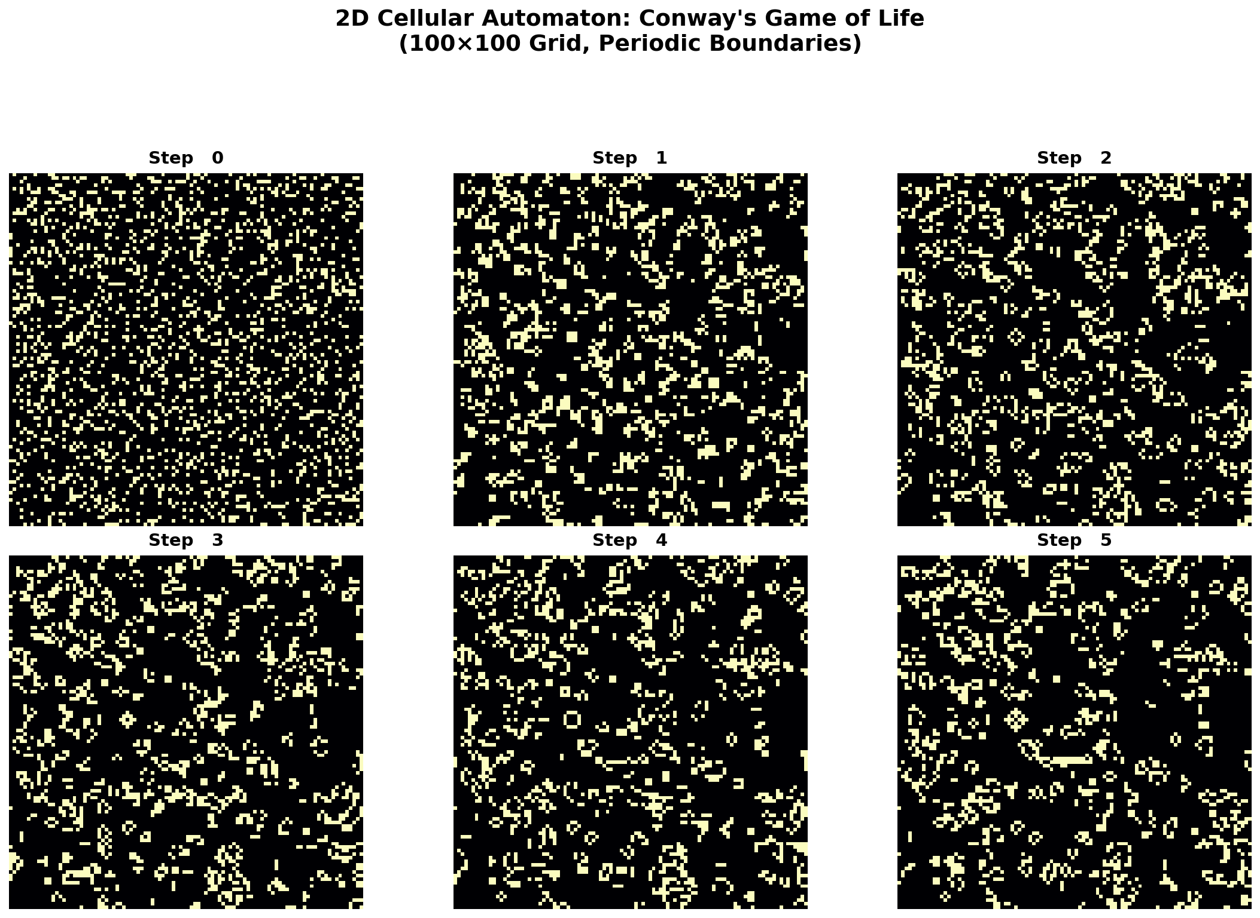

Slide 31
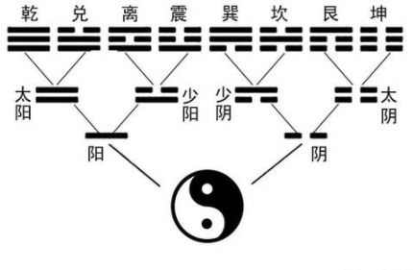
“道生一，一生二，二生三，三生万物” “The Tao produced One; One produced Two; Two produced Three; Three produced all things.”

Slide 32
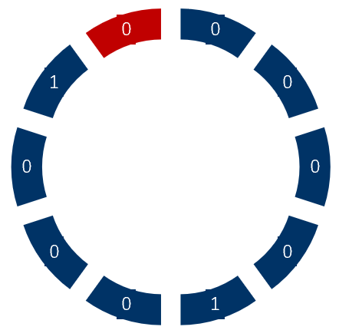
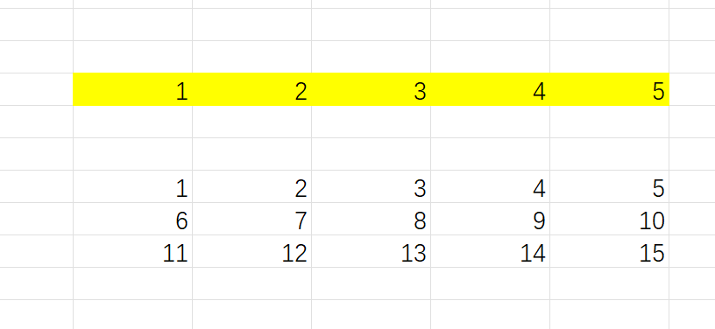
Given world
“无为而治” “Governing by non-action.”
0 | 0 | 0 | 0 | 0 | 1 | 0 | 0 | 0 | 1
How about borders:
1. Continuous border:
Obtain neighbors
100, 000, 000, 000, 001, 010, 100, 000, 001, 010

Slide 33
More neighbors
1
0
1
0
1
0
“大音希声，大象无形” “The greatest music has the faintest notes; the greatest icon is without form.
1
0
1
0
1
0
1
0
1
0
1
0
1
0
1
0
1
0
1
0
1
0
1
0
Dec | 2¹⁵ | 2¹⁴ | 2¹³ | 2¹² | 2¹¹ | 2¹⁰ | 2⁹ | 2⁸ | 2⁷=128 | 2⁶=64 | 2⁵=32 | 2⁴=16 | 2³=8 | 2²=4 | 2¹=2 | 2⁰=1
Bin | 1111 | 1110 | 1101 | 1100 | 1011 | 1010 | 1001 | 1000 | 0111 | 0110 | 0101 | 0100 | 0011 | 0010 | 0001 | 0000

Slide 34
