Slide 1
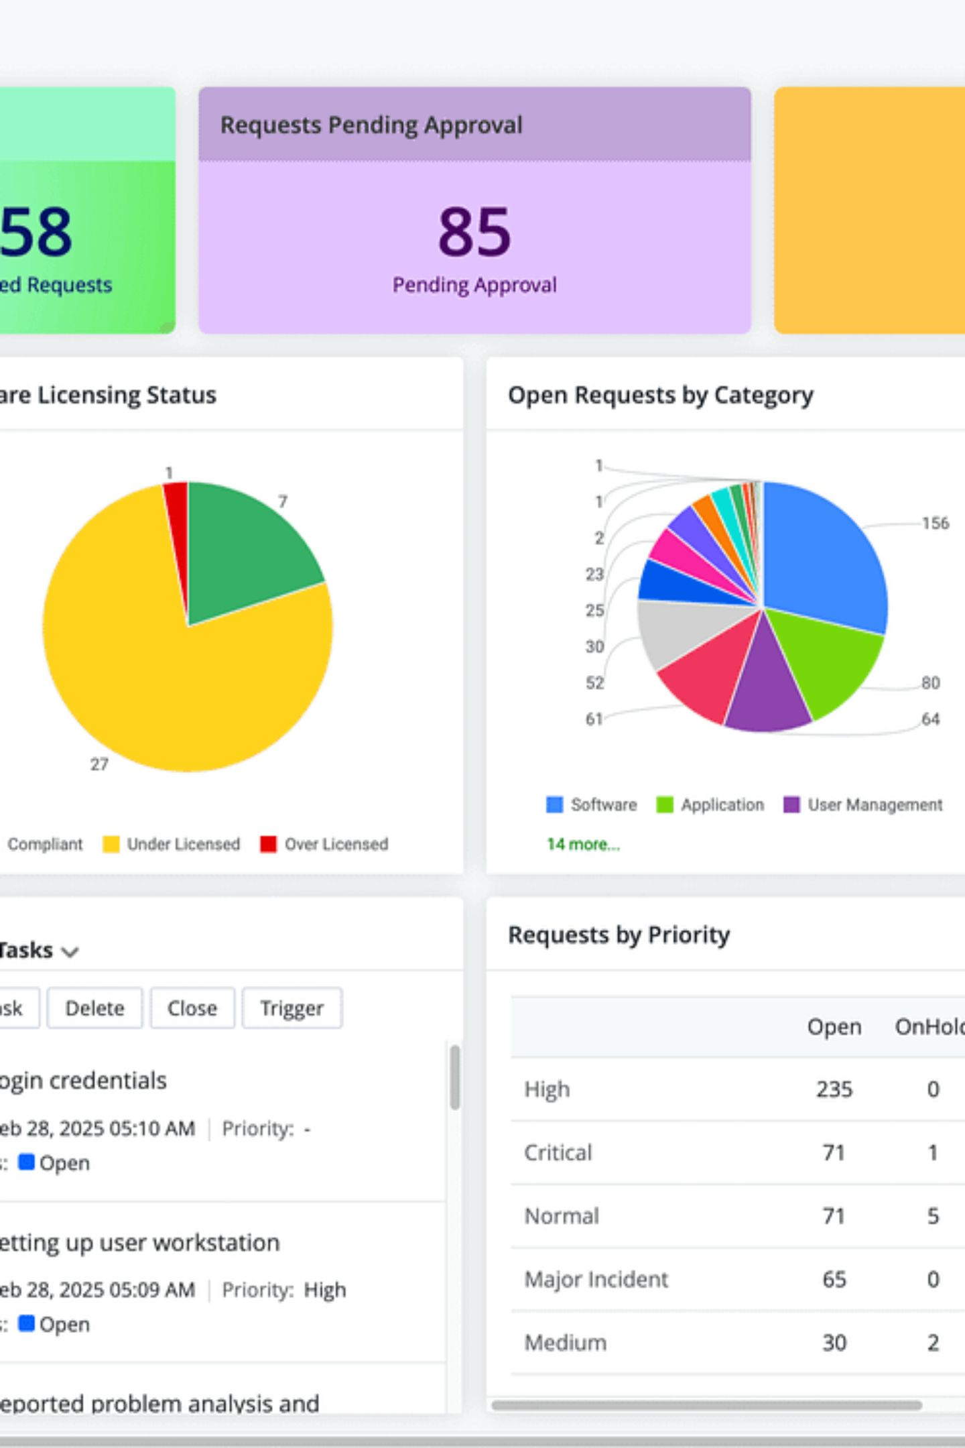

Veridian Corp — Internal IT Support Agent
Grounded Deterministic‑First Agentic Control Pipeline · Student: Jatin Pal · Target: Antigravity Agent Framework
Executive technical brief for internal IT architects and engineering stakeholders at Veridian Corp. Theme accents: #3E2513, #F3E3D8.

Slide 2
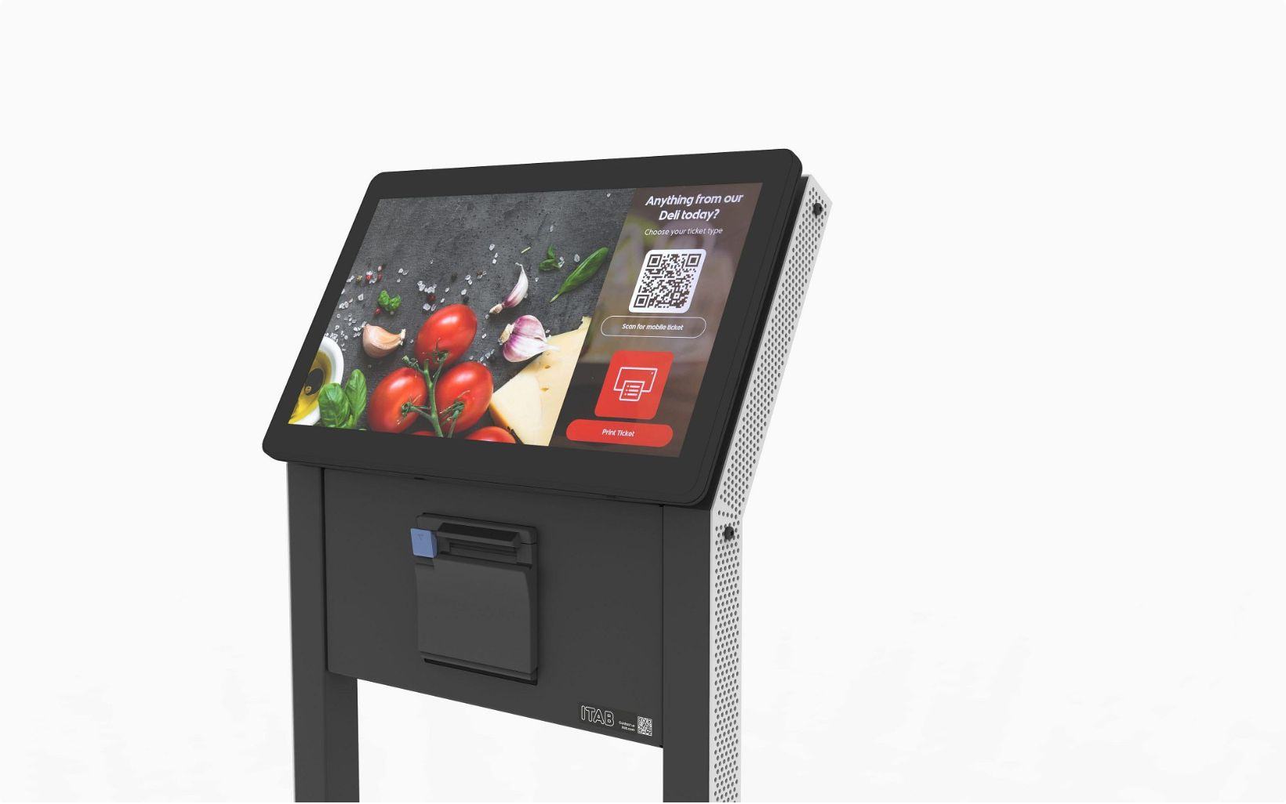
Problem Statement & Operational Scope
Context (21–25 Sep 2026)
High volume employee requests: password resets, VPN issues, software approvals, hardware replacements and finance access. Windowed operational evaluation with 15 representative requests (REQ‑01 → REQ‑15).
Primary Risk
Ungrounded LLM outputs: hallucinations, unauthorized approvals, or silent policy violations. System must prevent autonomous decisions outside KB‑01…KB‑10 and formal policies.

Slide 3
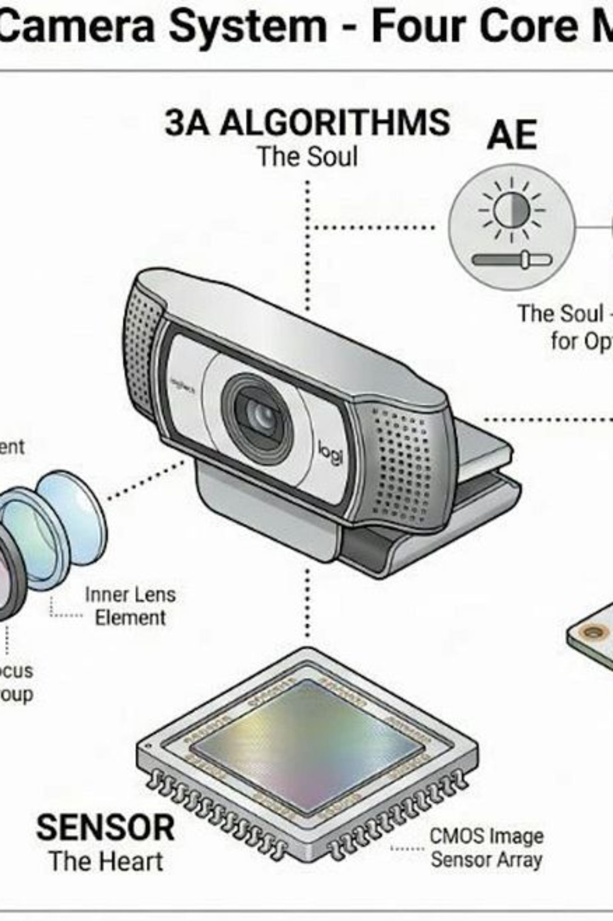
Architecture Overview — Hybrid Control Pipeline
Deterministic control layered with LLM intent parsing. Pipeline nodes: Intent Parsing → Context Grounding → Policy Decision → Action Hooks → Response Generation. Deterministic rules gate every state transition; LLM provides intent labels and human‑readable explanations only where allowed.

Slide 4

5‑Node Flow (Diagram)
Intent Parsing
Context Grounding
Policy Decision
Action Hooks
Diagram emphasises gating: every proposed action must pass Policy Decision with a KB match or explicit APPROVE by a human reviewer.

Slide 5
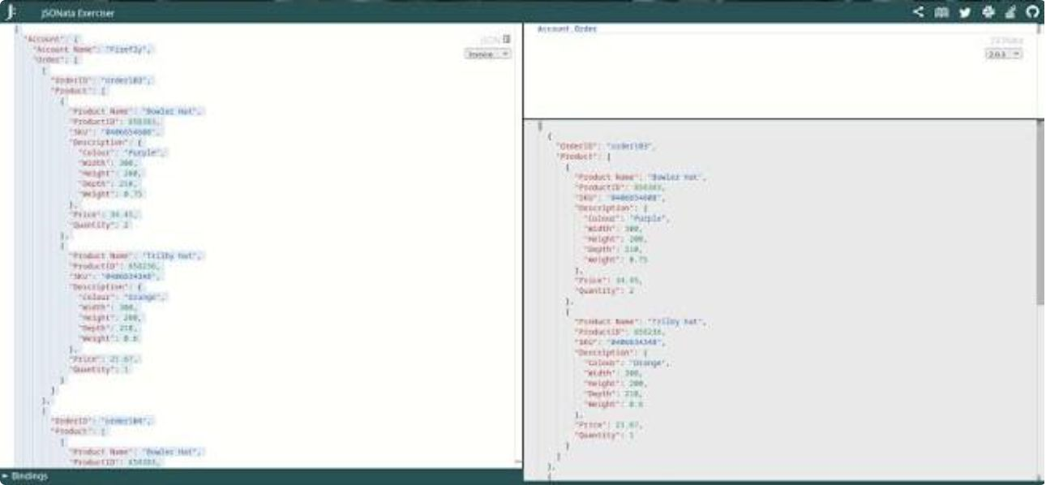
Core State Machine & Action Taxonomy
Execution uses a unified JSON state object passed between nodes. The object contains: request metadata, intent label, KB matches, policy flags, decision token, audit hash.
1
2
3
4
RESOLVE
APPROVE
ROUTE
CLARIFY
Deterministic automation for safe tasks (e.g., password unlock per KB‑01, VPN certificate renewal KB‑02).
Requires qualified approver when criteria met (e.g., asset order if age > 3 years — KB‑03).
Escalate multi‑domain cases (Security: KB‑04/KB‑09; Finance: KB‑08/KB‑10) for cross‑functional review.
Trigger structured clarification protocol when essential context is missing (manager, justification, timestamps).

Slide 6
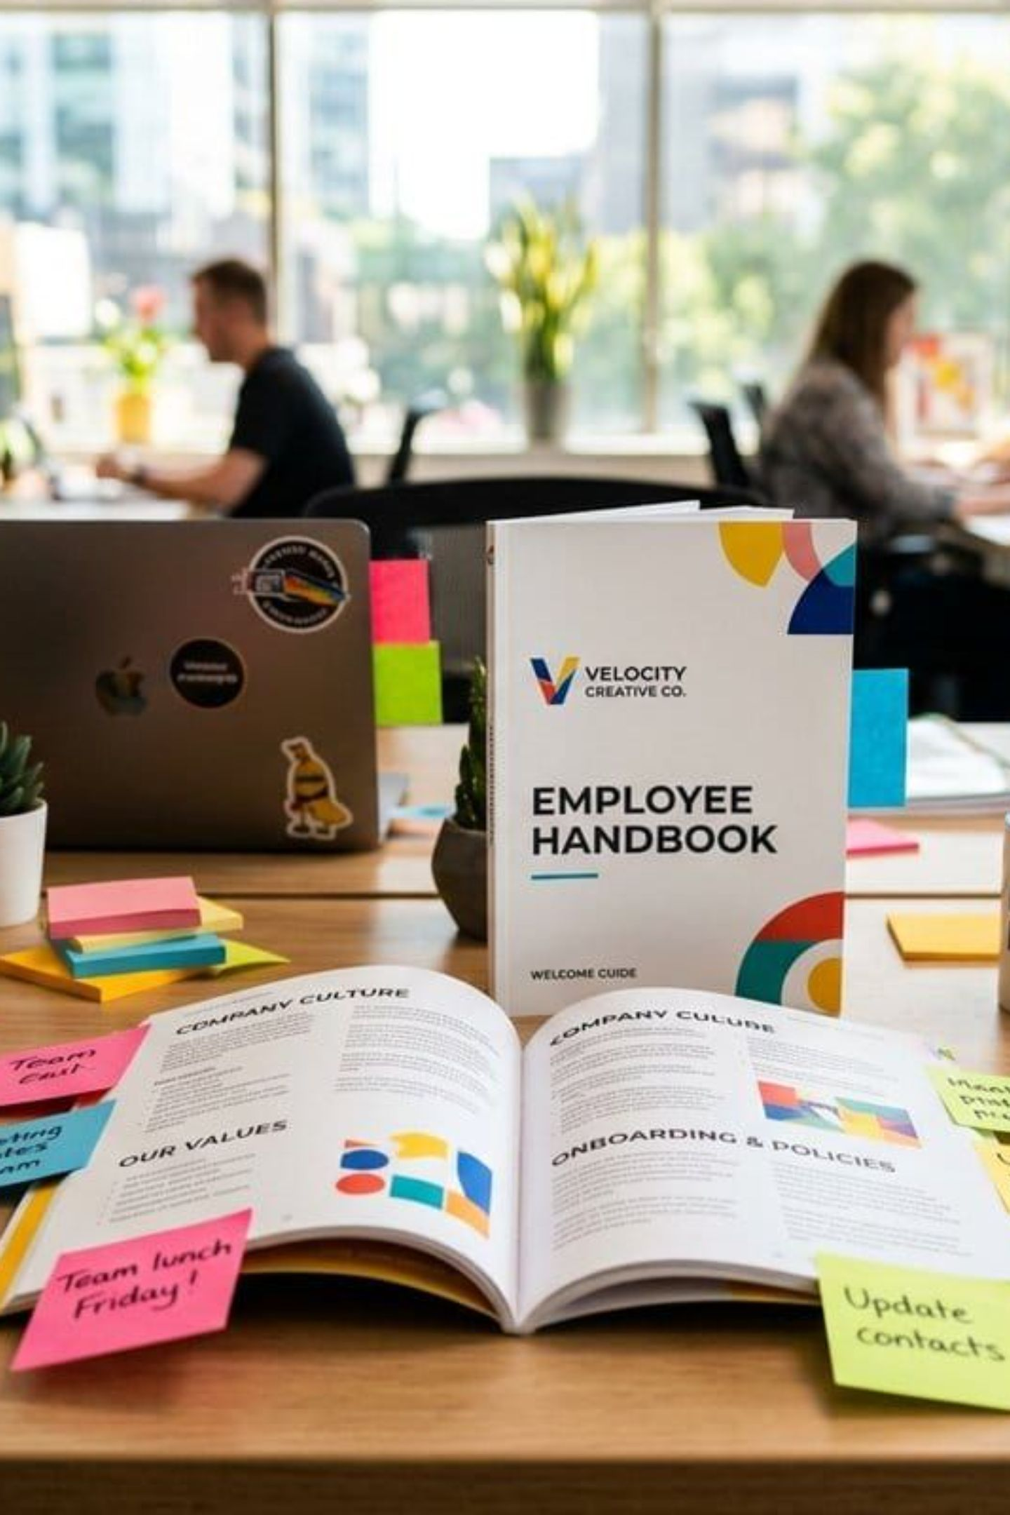
Policy Mapping & Business Logic Rules
Decisions reference canonical knowledge bases KB‑01…KB‑10 plus Asset Management Policy and ticket history. Policy mappings implemented as deterministic rule table: condition → KB reference → permitted outcome → required evidence.
Hardware (KB‑03)
3‑year lifecycle threshold → ORDER when failure persists after 2 repair attempts; else REPAIR.
Security (KB‑04, KB‑09)
Non‑catalog software requires security review; suspected phishing triggers quarantine and NO‑FORWARD guardrail.
Access & Governance (KB‑01, KB‑02, KB‑07, KB‑08)
Grant workflows enforce manager sign‑off and finance bounds; contractors use limited ephemeral tokens.

Slide 7

Historical Precedent Engine & Context Retrieval
Ticket dataset (Active & Closed): TK‑1042 → TK‑1051 used for precedent matching. Retrieval returns top‑k precedents with similarity score, matched KB citations, and required artifacts (manager approval docs, asset tags).
Case Study — REQ‑10 (Kavya Pillai)
Matched precedent TK‑1050 (J. Fernandes): identical role, access level, and business justification. Enforced manager sign‑off and Finance justification before APPROVE path.

Slide 8
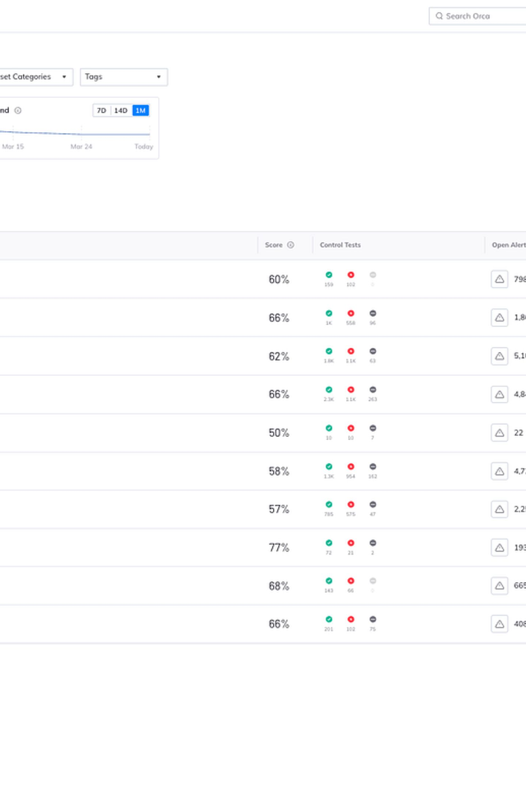
Batch Evaluation & Compliance Metrics
Test suite executed across REQ‑01 → REQ‑15. Results captured in batch_benchmark_compliance_report.csv and per‑request JSON execution traces for audit. Key metrics tracked:
Policy Compliance Rate
All evaluated requests produced deterministic decisions with KB citations and zero ungrounded actions.
Traceability
Every action includes an audit hash, KB references, timestamp and reviewer token if APPROVE or ROUTE was selected.
Artifacts
Automated artifacts: CSV summary, JSON traces, and an attachable evidence bundle per ticket for compliance review.

Slide 9
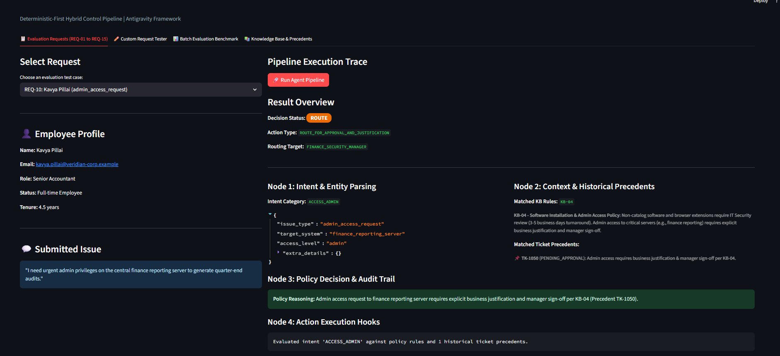
User Interface & Demonstration Walkthrough
Streamlit dashboard implements operational controls and observability:
Request Selector: choose REQ‑01 → REQ‑15 and replay traces
5‑Node Execution Trace Inspector: view state object and policy gating at each node
Custom Prompt Sandbox: safe LLM prompts with limited tokenization and no direct action hooks
One‑Click Batch Benchmark: run compliance suite and generate CSV + JSON artifacts

Slide 10

Edge Cases, Safeguards & Interview Defense
Built‑in safeguards and predefined handling of edge cases:
Phishing (REQ‑08)
Finance Boundary (REQ‑12)
Ambiguity (REQ‑15)
Immediate quarantine; NO‑FORWARD enforced; email artefacts stored; route to Security (KB‑04) for analysis.
Structured clarify protocol issues minimal, scoped questions (who, when, justification) and pauses execution until required fields are populated.
Requests triggering Finance DB lookups that return null are routed to Finance with a suggested query and evidence requirements; no direct DB writes are allowed.
Conclusion: production‑ready agent combining speed, deterministic safety, and full auditability. Live walkthrough materials — architecture, code structure, audit traces, state graph — are prepared for technical defence.

