Slide 1
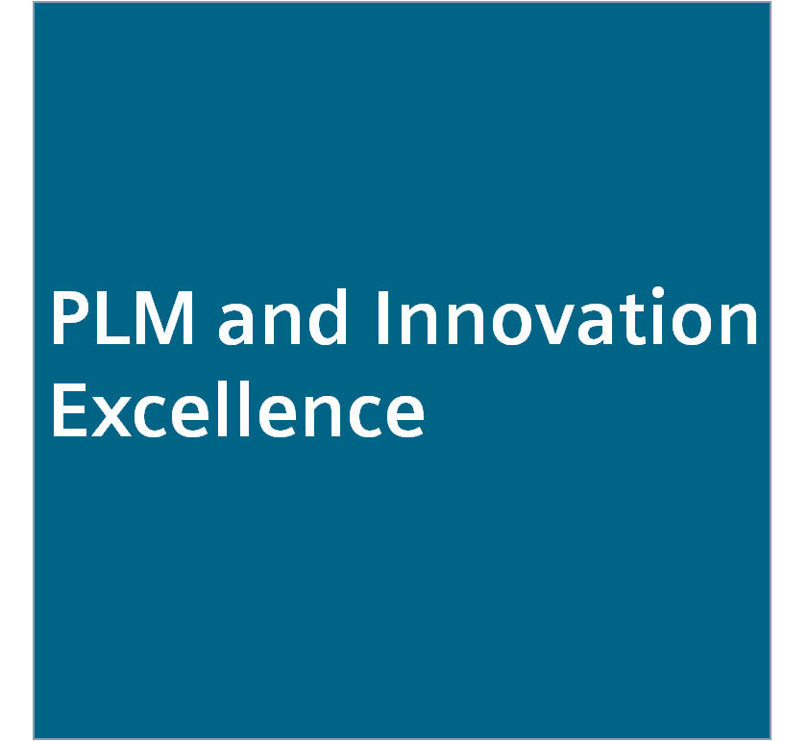
The Siemens Development System Introduction January 2017
PLM and Innovation Excellence - Siemens Operating Model
Restricted © Siemens AG 2017

Slide 2
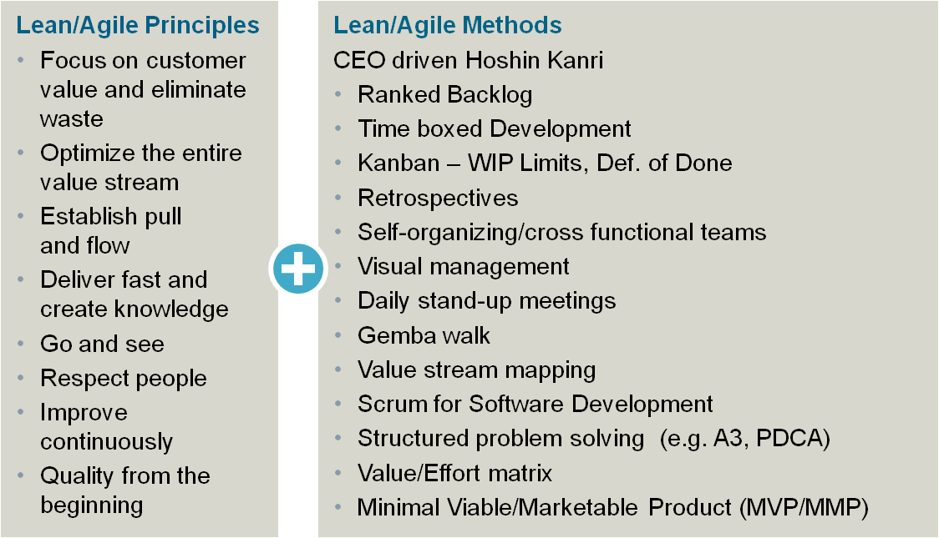
Siemens establishes a Siemens Development System in PLM to become much faster and flexible
Executive Summary – Siemens Development System
8 + 14
~ 40 till FY17
~ 300 till FY19
~ 1000 till FY21
Set of common, business-proven principles and methodologies
One SDS manager per BU
Clear mandate based on full management commitment
Dedicated time and budget for continuous improvement activities and knowledge exchange
Act on behalf of BU in lean communities and networks
Lean leadership
PLM heads: CTOs, R&D, ENG and PPM
PLM and Innovation Excellence Board as role model
Culture Lab - 1 day
Go and see with 1-2 visits p.a. to best-in class BUs
Lean for Leaders: 2+2 day coaching & training
Functional experts
Strengthen expert programs based on BU needs
Continue with lean experts
Adapt R&D project manager development to SDS
Integrate SDS in system / SW architects programs
1
2
3
4
The PLM and Innovation Board, representing all Divisions of Siemens decided on September 9, 2016 to implement the Siemens Development System (SDS)
SDS = Siemens Development System, p.a. = per annum, SPS = Siemens Production System
Source: Decision of PLM and Innovation Baord on Sep. 9, 2016

Slide 3
Having the right mindset in place, the SDS method framework is the “operating toolkit” to become much faster and more flexible across PLM
1
Value
stream mapping
Structured problem solving
(e.g. A3)
CEO driven Hoshin Kanri
Retro- spectives
Time Boxed Development
Visual Management
Scrum
Self-organizing / cross functional teams
Ranked Backlog
Gemba walk
Value effort matrix
Minimal viable / marketable product
MVP/ MMP
Kanban – WIP limits, definition of done
Daily stand-up meetings
The SDS methods are tools to implement modern development approaches
For more details and up-to-date information please click here

Slide 4
The eight principles of the Siemens Development System
Focus on customer value and eliminate waste | We know our customers and strongly focus on their benefit. We eliminate all types of non-value adding activities.
Establish pull and flow | We organize work and empower people to create fast, flexible and continuous flow – we limit work demand to capacity and maximize throughput.
Go and see | We go to the place of action and see what really happens in order to accelerate communication and decision making. We ask for impediments and offer support.
Improve continuously | We keep on improving. Lean is a journey, not a final state.
Optimize the entire value stream | We foster effective, trustful and networked collaboration between all involved global and local functions along the entire value stream.
Deliver fast and create knowledge | We actively request customer feedback in fast iterations. We encourage systematic learning and continuous knowledge exchange.
Respect people | Our teams thrive on pride, commitment, trust and applause. We value colleagues from other functions and their competence and contributions. Our managers respect their employees and provide support.
Build quality in from the beginning | We build in quality from the start. We regard problems as treasures. We detect them immediately at the point of origin and sustainably solve the root cause.

Slide 5
The methods of the Siemens Development System (1/2)
CEO-driven Hoshin Kanri | A strategic planning methodology, applied on BU / Segment level and used to align goals between all functions.
Time-boxed development | Strive for iterative, incremental interdisciplinary development or commissioning to gain early feedback, ideally in fixed time frames.
Retrospectives | Systematic approach to regularly reflect collaboration and team work in short cycles by identifying good practices and possible improvements.
Visual management | Key information for daily work is visualized to get transparency as basis for open and trustful communication across all hierarchical levels in order to improve efficiency and overall performance.
Ranked backlog | Ordering the work packages as guidance for daily work – what needs to be done before the next step – as early alignment and commitment of all functions involved.
Kanban – WIP limits, definition of done | Balancing of work in progress (WIP) with the available capacity, transparent communication of status and clear definition of completion criteria to improve lead time and efficiency.
Self-organizing / cross-functional teams | The team includes all functions necessary to get the work done and decides HOW it’s going to do its work within the given business constraints and without departmental thinking (silos), but rather focused on product, solution, etc.

Slide 6
The methods of the Siemens Development System (2/2)
Daily stand-up meetings | Daily / regular meetings on all hierarchical levels to communicate: • What did I accomplish? • What do I plan to achieve until the next stand-up? • What obstacles are impeding my progress?
Gemba walk | Go and See by management replacing reports and indirect information capturing.
Scrum for software development | A time-boxed iterative and incremental approach using ranked backlogs and visual management.
Value / Effort matrix | Evaluation and prioritization of work packages based on their value and implementation effort, e.g. to create a ranked backlog.
Value stream mapping | Method to analyze and optimize the process based on the value stream.
Structured problem solving (e.g. A3, PDCA) | Structured approaches to guide collaborative in-depth problem solving by identifying root causes, and to continuously improve on all levels.
Minimal viable / marketable product (MVP / MMP) | Develop a system in smallest usable chunks to gain fast (customer) feedback.

Slide 7
Our ambition level for PLM and Innovation Excellence
Siemens acts and is perceived as an
Entrepreneurial
Innovation leader and
Digital champion
North Star statements
We…
… understand customer desires and meet them precisely in an end-to-end relationship
… innovate faster and more agile than current and tomorrow’s competitors
… combine internal know-how with competencies outside of Siemens
… invest courageously in next generation growth opportunities
… link the physical and digital world

Slide 8
Guiding principles to strengthen innovation power in rapidly changing markets with faster acting competitors
Innovation
From …
To …
Create an environment and culture where new growth opportunities are systematically identified and developed, leveraging open innovation tools, methods and programs
Incremental portfolio maintenance and development
Courageous invest in next generation growth opportunities
Fragmented and small-scale collaborations with mostly German R&D partners
A global open innovation strategy (e.g. universities, start-ups, crowd, …)
Independent innovation and IP process
Integrated innovation and IP process allowing an early harvesting and protection of ideas

Slide 9
In a digital world, structured experiments and continuous customer validation are keys to successful innovation
Modern Product and Portfolio Management
From …
To …
Develop and implement methods and role models which enable much stronger focus on customer value and fast iteration
Internal striving for compliance with portfolio strategy
Continuous calibration against clearly proven customer value
Focus on product maintenance and developing of less demanded variants
Balancing budgets between courageous phase out and pioneering innovations
Perceived silo and process dominated thinking
Entrepreneurial cross functional teams with early and fast proof of concepts in an open failure culture
Speed of phase out and simplification of existing portfolio is a prerequisite for innovation speed in a constraint system. Have the courage to invest in game-changing innovations!

Slide 10
Innovation speed and fast learning cycles will be a key competitive advantage
Modern R&D and Engineering
From …
To …
Create a living lean culture on all hierarchy levels in a digitalized PLM that massively increases speed and agility along complete PLM
Focus on resource utilization and perfect planning
Focus on ability to produce results in fast iterations
Fragmented tool landscape and poor exploitation of digital opportunities
Full leverage of a seamless digital tool chain
Knowledge islands and silo thinking in hierarchical structures
Trustful collaboration and continuous benefits across functions
Let’s implement lean and agile methodologies throughout PLM! They are proven!

