Slide 1
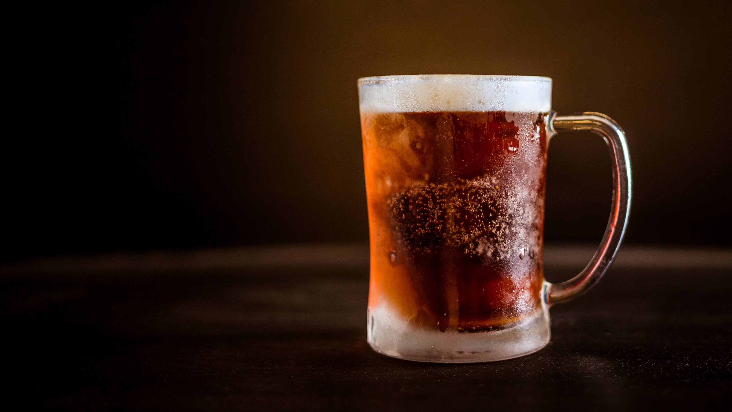
Ethanol Content Measurement in Micro-brewed beer
Bsc. Gil Goldman
Unrestricted

Slide 2
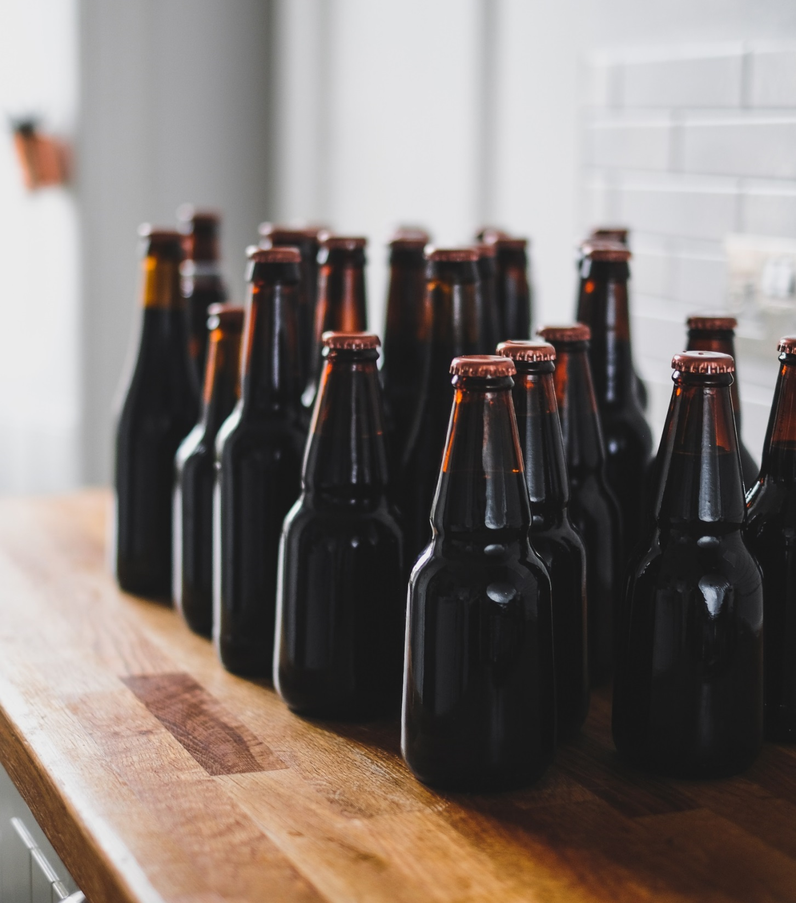
Thousands of liters of beer go wasted every day

Slide 3
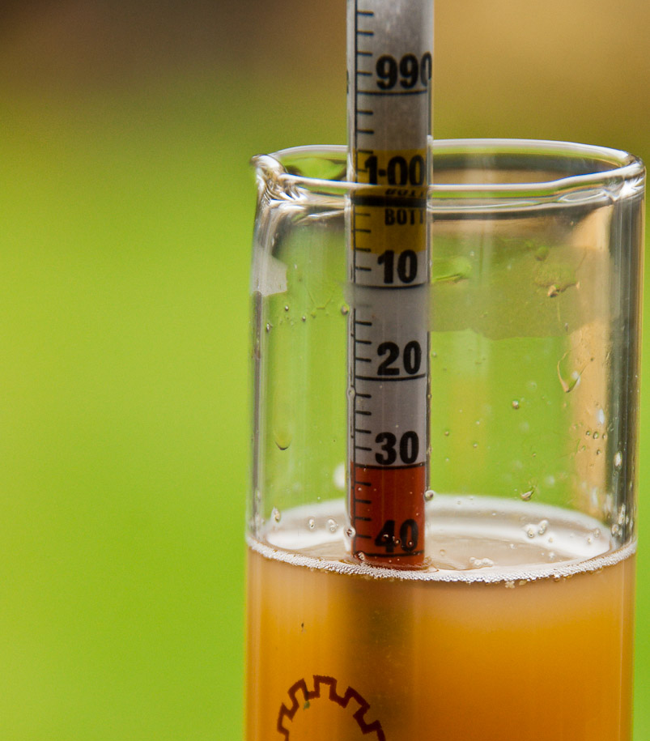
How it works
Retrieve a sample
Drop hydrometer
Compare result to tables and formulas
Throw away beer sample (!)

Slide 5
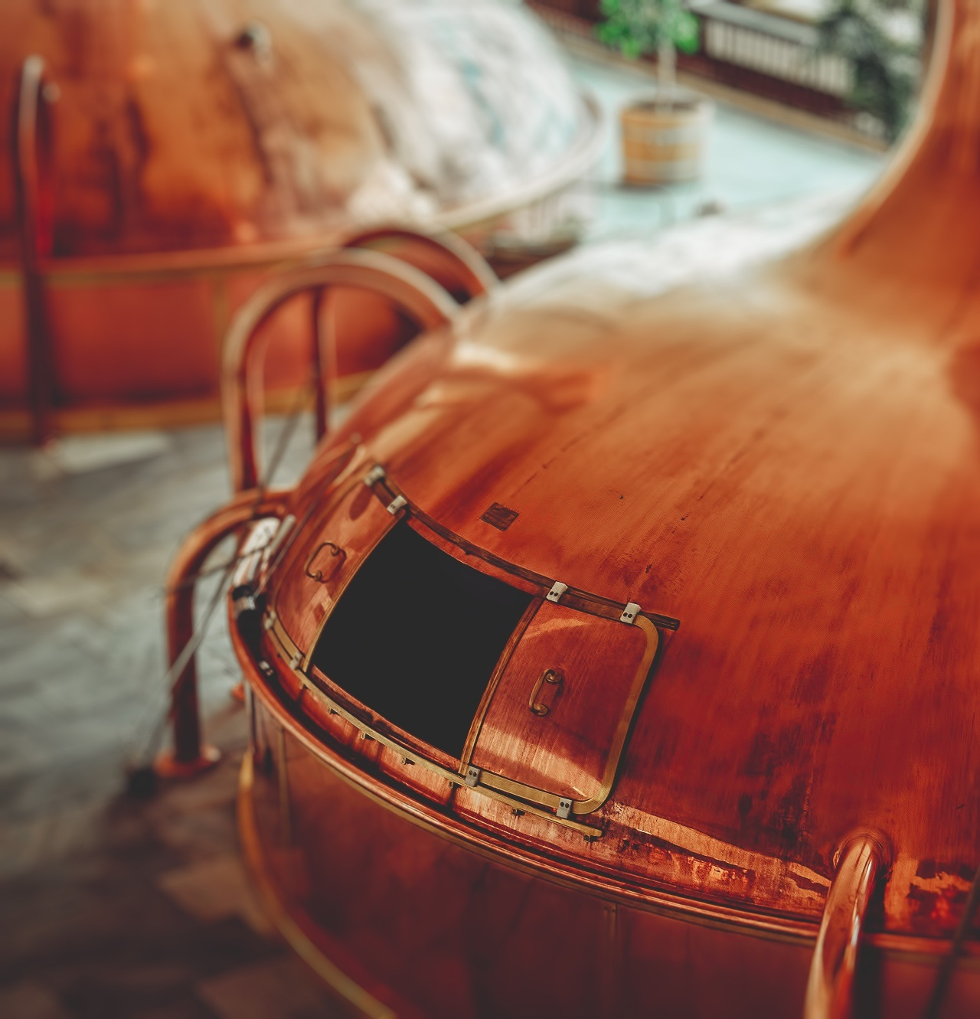
Parameters
Accurate
±2 mm
±0.002 SG
±0.26 ABV
Low Cost
Priority
Less than 15 $US

Slide 6
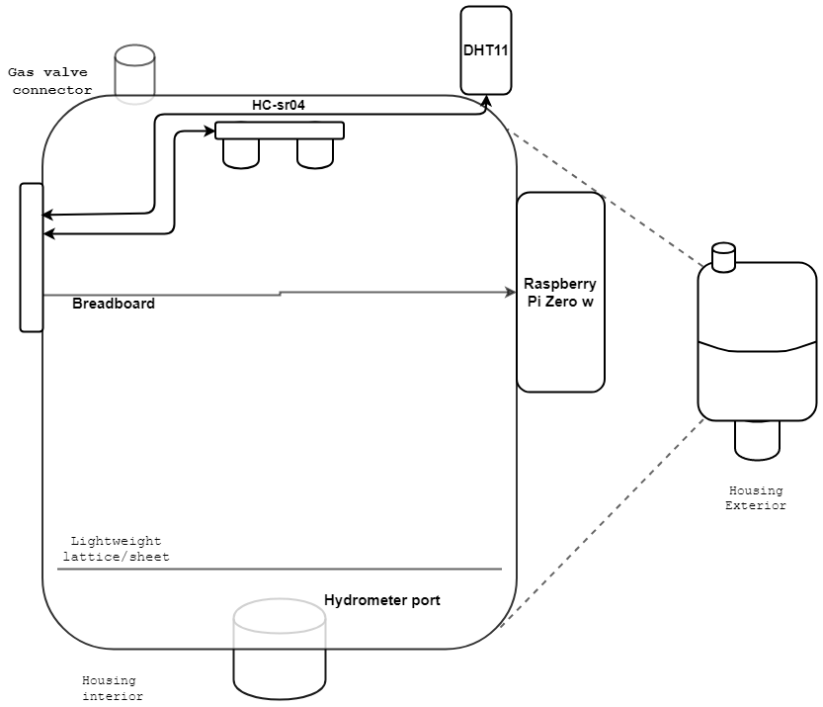
Physical Architecture
Raspberry Pi Zero W
HC-SR04
DHT11

Slide 7
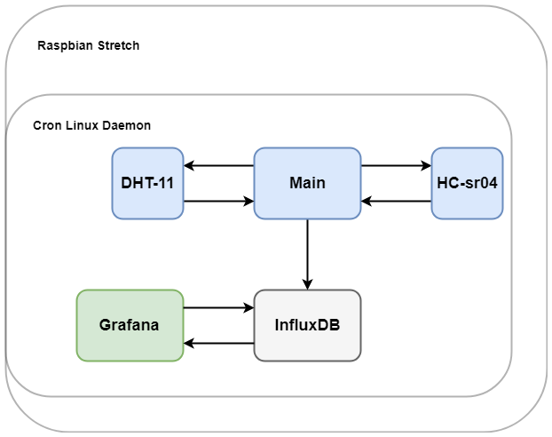
Software Architecture
Python, C
Over 1000 lines of code
Modular
Maintainable, usable, extendable

Slide 8
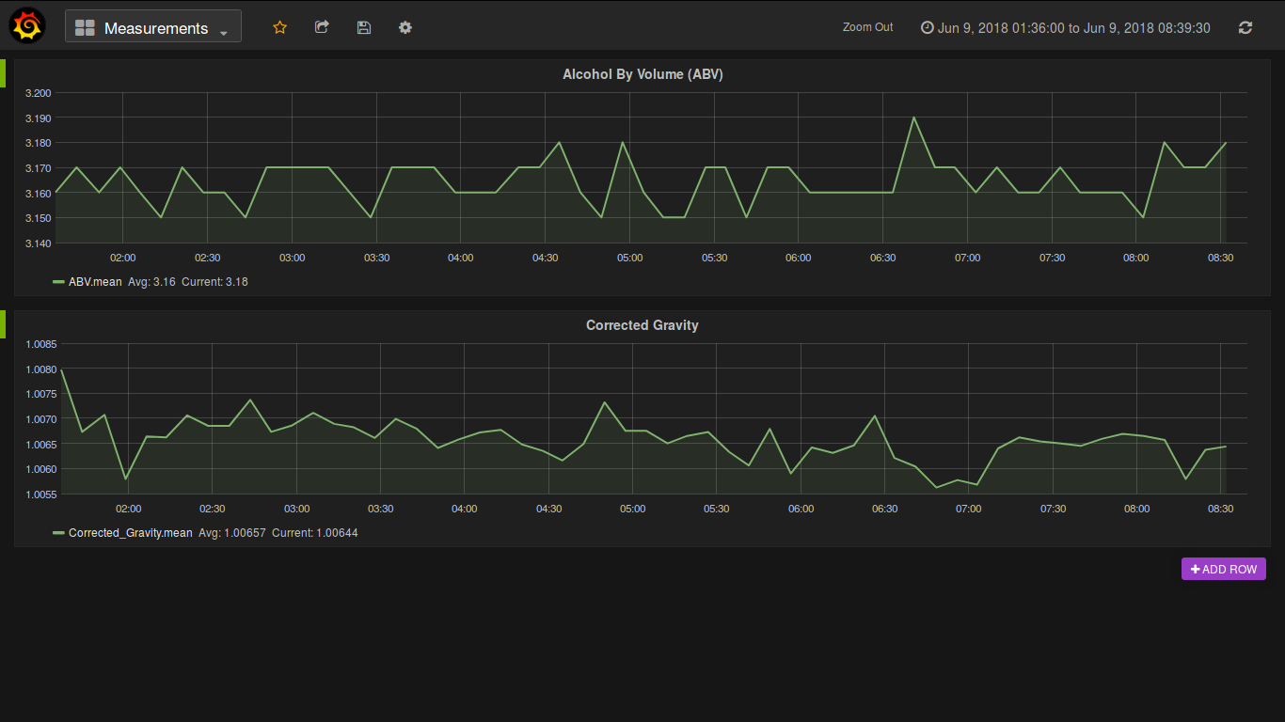

Slide 9
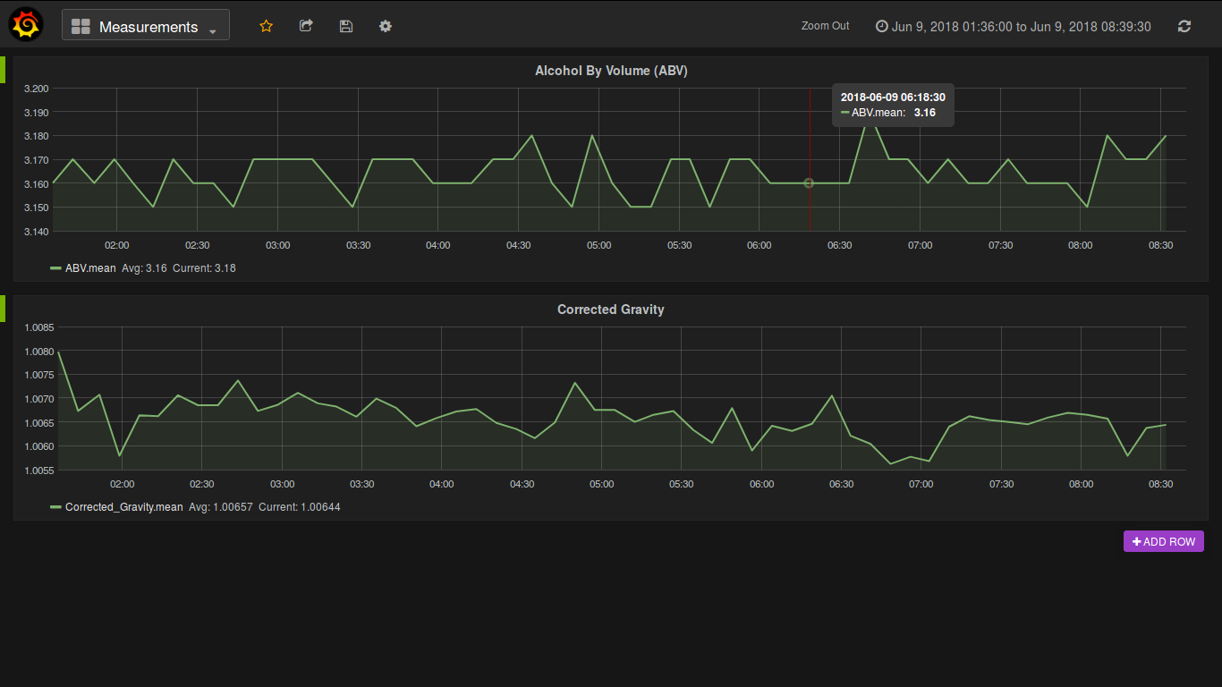

Slide 10
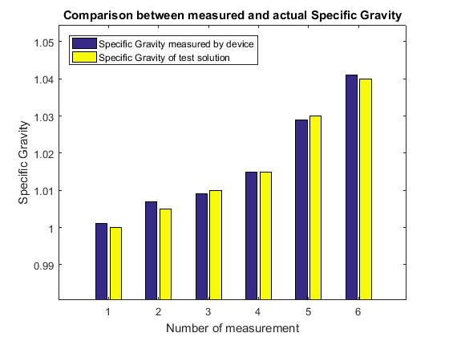
Conclusion
Final cost < 15$ USD
Distance accuracy < 1 mm
Corrected gravity accuracy < 0.002

Slide 11
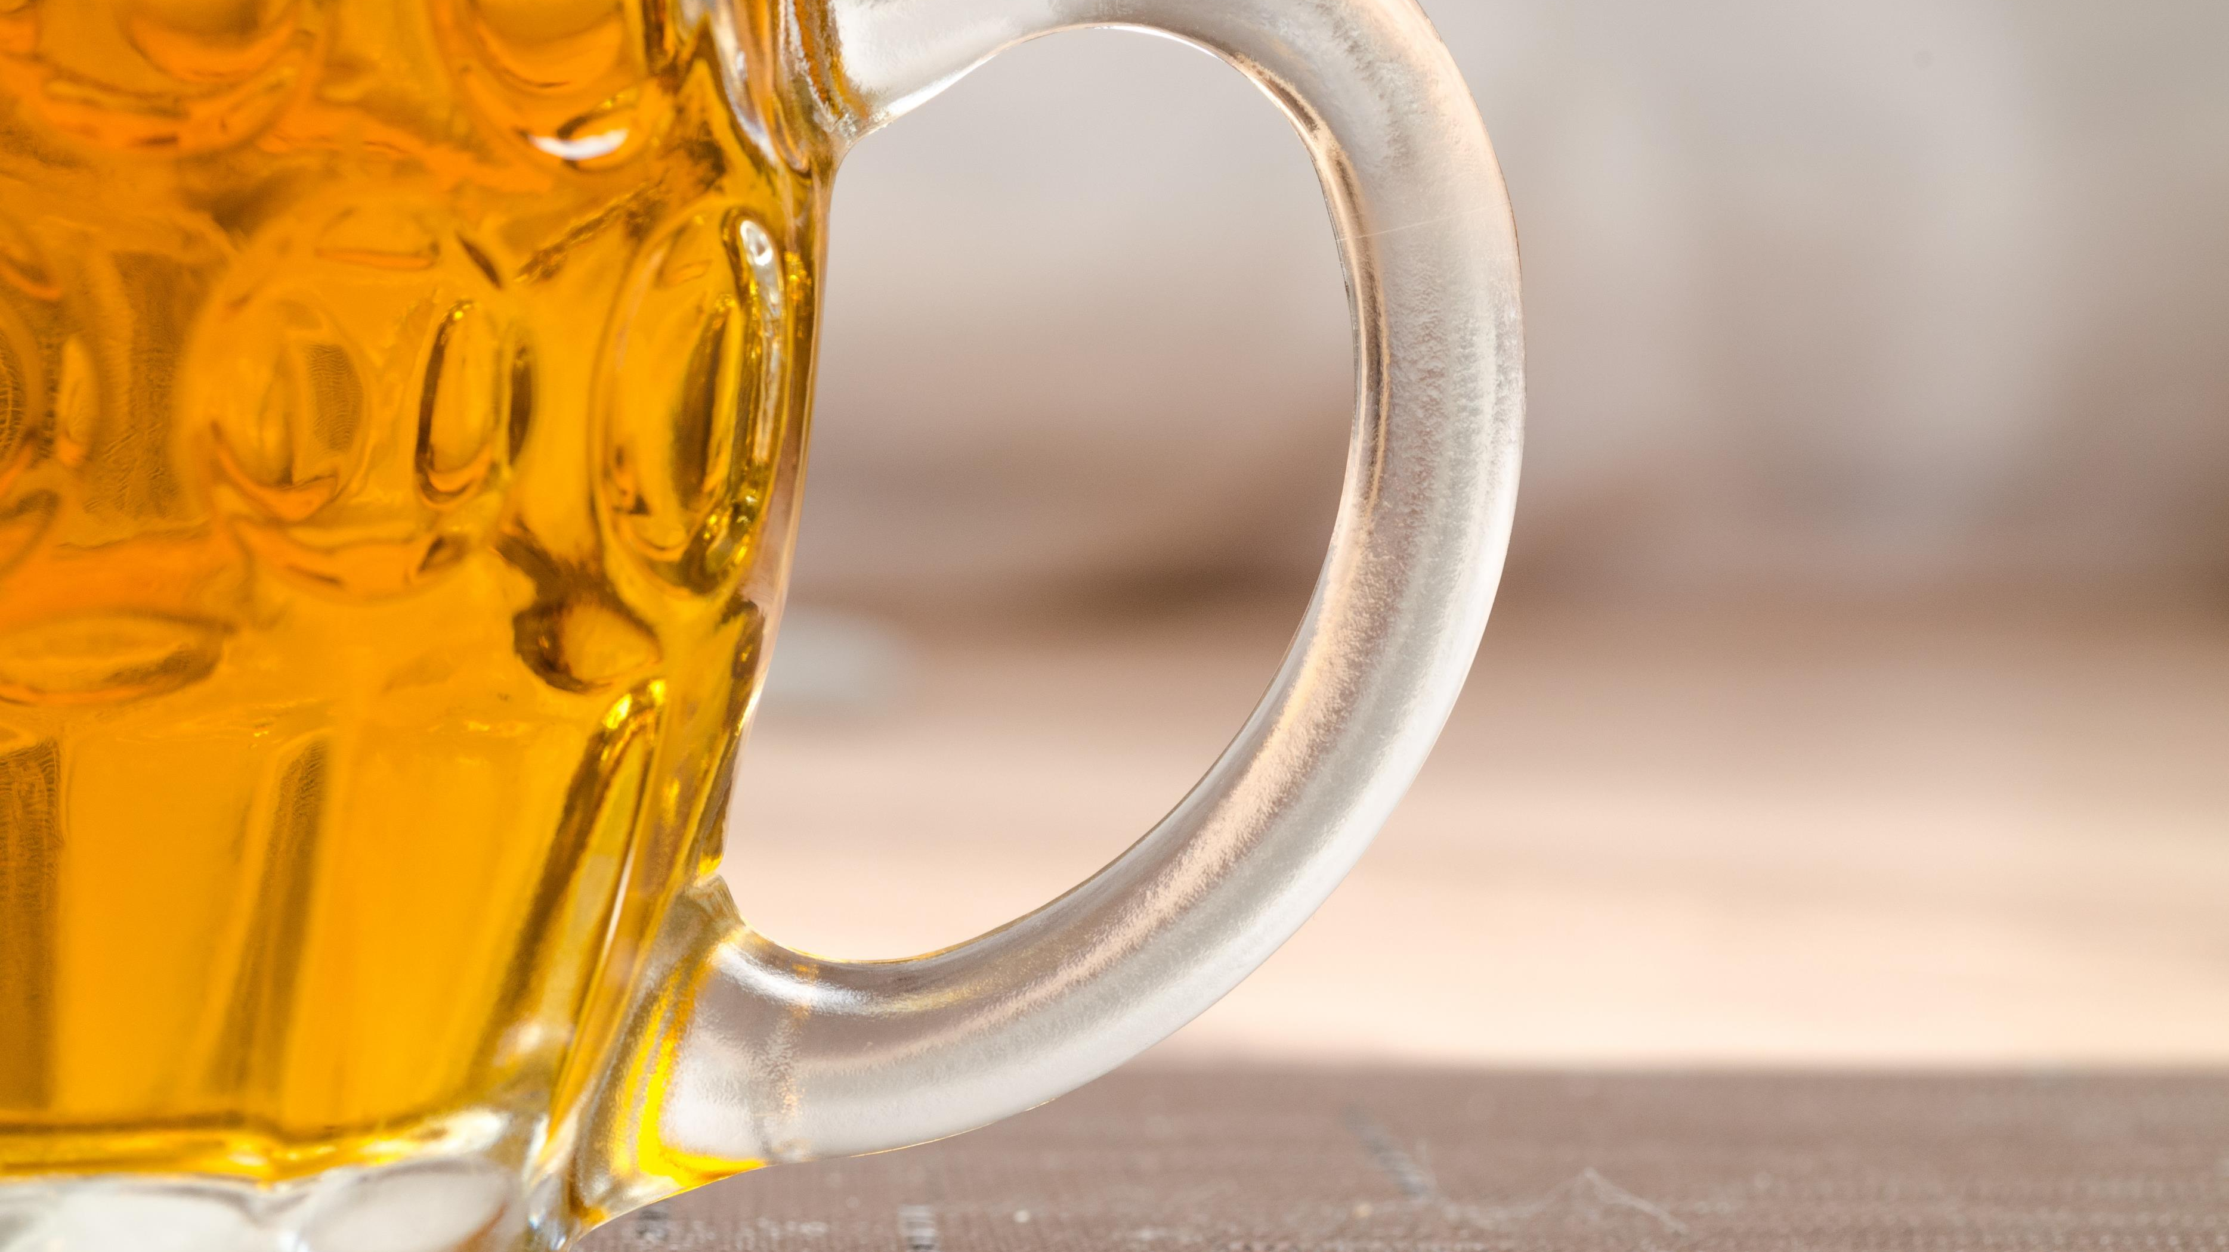
Happy to answer any questions
Title by Patrick Fore on Unsplash
Bottles by Adam Wilson on Unsplash
Brewery by Jeff Frank on Unsplash
Hydrometer by David Blaikie
Closing Beer by Lukas from Pexels

