Slide 1
Three Days of the Good Parts
Douglas Crockford

Slide 2
The First Day
Programming Style and Your Brain
And Then There Was JavaScript
Function the Ultimate
The Metamorphosis of Ajax
ES5: The New Parts
The Second Day
Fun with Functions
The Third Day
Fun with Functions
Principles of Security
Managing Asynchronicity
The Better Parts

Slide 3
Programming Style & Your Brain
Douglas Crockford

Slide 4
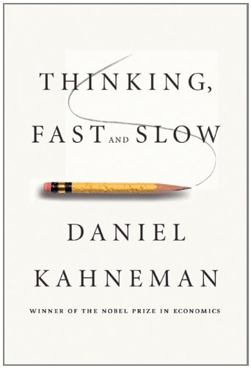

Slide 5
Head. Gut.
Two Systems.

Slide 6
Visual Processing.
An analogy.

Slide 7
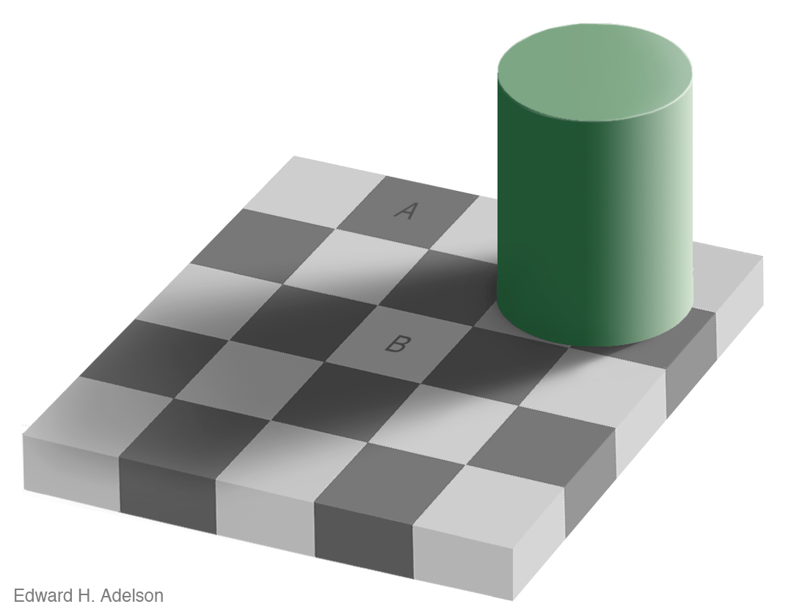

Slide 10
Advertising.

Slide 11
Tobacco.

Slide 12
Computer Programs.
The most complicated things people make.

Slide 13
Artificial Intelligence.

Slide 14
Programming Language.

Slide 15
Perfection.

Slide 16
Hunters and Gatherers.

Slide 17
Programming uses Head and Gut.
Tradeoffs.

Slide 18
JavaScript.
Good Parts.
Bad Parts.

Slide 19
JSLint.
JSLint defines a professional subset of JavaScript.
http://www.JSLint.com/

Slide 20
WARNING!
JSLint will hurt your feelings.

Slide 21
Left or Right?
block
{
....
}
block {
....
}

Slide 22
Left or Right?
block
{
....
}
Be consistent.
block {
....
}
Everyone should do it like I do.

Slide 23
Left or Right?
return
{
ok: false
};
SILENT ERROR!
return {
ok: true
};
Works well in JavaScript.

Slide 24
return
{
ok: false
};

Slide 25
return; // semicolon insertion
{
ok: false
};

Slide 26
return;
{ // block
ok: false
};

Slide 27
return;
{
ok: false // label
};

Slide 28
return;
{ // useless
ok: false // expression
}; // statement

Slide 29
return;
{
ok: false; // semicolon
}; // insertion

Slide 30
return;
{
ok: false;
}; // empty statement

Slide 31
return;
{ // unreachable statement
ok: false;
}

Slide 32
return
{
ok: false
};
return;
{
ok: false;
}

Slide 33
Prefer forms that are error resistant.

Slide 34
switch statement.
The fallthrough hazard.

Slide 35
“That hardly ever happens”
is another way of saying “It happens”.

Slide 36
A good style can help produce better programs.
Style should not be about personal preference and self-expression.

Slide 37
THEROMANSWROTELATIN ALLINUPPERCASEWITH NOWORDBREAKS ORPUNCTUATION

Slide 38
Medieval copyists introduced lowercase, word breaks, and punctuation.
These innovations helped reduce the error rate.

Slide 39
Good use of style can help reduce the occurrence of errors.

Slide 40
The Elements of Style William Strunk
http://www.crockford.com/wrrrld/style.html

Slide 41
Programs must communicate clearly to people.

Slide 42
Use elements of good composition where applicable.
For example, use a space after a comma, not before.

Slide 43
Use spaces to disambiguate parens.
No space between a function name and (.
One space between all other names and (.
Wrong:
foo (bar);
return(a+b);
if(a=== 0) {…}
function foo (b) {…}
function(x) {…}

Slide 44
Immediately Invocable Function Expressions
function () {
...
}(); // Syntax error!

Slide 45
Immediately Invocable Function Expressions
(function () {
...
})();

Slide 46
Immediately Invocable Function Expressions
(function () {
...
})()
Dog balls

Slide 47
Immediately Invocable Function Expressions
(function () {
...
}()); // Neatness counts.

Slide 48
The Heartbreak of Automatic Semicolon Insertion
x = y // <-- Missing semicolon
(function () {
...
}());
Never rely on automatic semicolon insertion!

Slide 49
with statement.
with (o) {
foo = koda;
}
o.foo = koda;
o.foo = o.koda;
foo = koda;
foo = o.koda;

Slide 50
with statement.
with (o) {
foo = koda;
}
o.foo = koda;
o.foo = o.koda;
foo = koda;
foo = o.koda;
I am not saying that it isn’t useful.
I am saying that there is never a case where it isn’t confusing.

Slide 51
Confusion must be avoided.

Slide 52
Transitivity? What's That?
0 == '' // true
0 == '0' // true
'' == '0' // false
false == 'false' // false
false == '0' // true
" \t\r\n " == 0 // true
Always use ===, never ==.

Slide 53
If there is a feature of a language that is sometimes problematic, and if it can be replaced with another feature that is more reliable, then always use the more reliable feature.

Slide 54
Multiline string literals
var long_line_1 = "This is a \
long line"; // ok
var long_line_2 = "This is a \
long line"; // syntax error

Slide 55
Avoid forms that are difficult to distinguish from common errors.

Slide 56
if (a = b) {…}
a = b; if (a) {…}
if (a === b) {…}

Slide 57
Make your programs look like what they do.

Slide 58
Scope.
Block scope v function scope.

Slide 59
var statement.
It gets split into two parts:
The declaration part gets hoisted to the top of the function, initializing with undefined.
The initialization part turns into an ordinary assignment. So
function foo() {
...
var myVar = 0, myOtherVar;
Expands into
function foo() {
var myVar = undefined,
myOtherVar = undefined;
...
myVar = 0;

Slide 60
Declare all variables at the top of the function. Declare all functions before you call them.

Slide 61
for (var i …) {…}
Variable i is not scoped to the loop.

Slide 62
Write in the language you are writing in.

Slide 63
Let there be let.

Slide 64
Global variables.
Global variables are evil.
Avoid global variables.
When using global variables, be explicit.
UPPER_CASE
Global variables should be as rare as hens teeth and stick out like a sore thumb.

Slide 65
new prefix
Forgetting new causes a constructor to clobber global variables without warning.
Fixed in ES5/strict.

Slide 66
Constructor functions should be named with InitialCaps.
Nothing else should be named with InitialCaps.

Slide 67
var a = b = 0;
var a = 0, b = 0;
b = 0;
var a = b;

Slide 68
Write in a way that clearly communicates your intent.

Slide 69
if (a) b(); c();

Slide 70
if (a) b(); c();
if (a) {b(); c();}
if (a) {b();} c();

Slide 71
As our processes become more agile, our coding must be more resilient.

Slide 72
++

Slide 73
++
x += 1

Slide 74
++
x += 1
x++

Slide 75
++
x += 1
x++
++x

Slide 76
++x; ++x;
x += 2;

Slide 77
For no cost, by adopting a more rigorous style, many classes of errors can be automatically avoided.

Slide 78
Bad stylists
Under educated.
Old school.
Thrill seeker.
Exhibitionist.

Slide 79
“That was intentional.”
“I know what I’m doing.”

Slide 80
Performance.
Performance specific code is usually crufty.
Clean code is easier to reason about.
Premature optimization is the root of all evil. Donald Knuth
Most of the code has a negligible impact on performance. Only optimize the code that is taking the time.
Algorithm replacement is vastly more effective than code fiddling.

Slide 81
Programming is the most complicated thing that humans do.
Computer programs must be perfect.
Humans are not good at perfect.

Slide 82
Designing a programming style demands discipline.
It is not selecting features because they are liked, or pretty, or familiar.

Slide 83
The Abyss

Slide 84
The JSLint style was driven by the need to automatically detect defects.
Forms that can hide defects are considered defective.

Slide 85
Language Subsetting.
Only a madman would use all of C++.

Slide 86
There will be bugs.
Do what you can to move the odds to your favor.

Slide 87
Next Chapter 2: Then There Was JavaScript

