Slide 1
Chapter 2
And Then There Was JavaScript

Slide 2
The Big Bang
The Dawn of Man
JavaScript

Slide 3
The First Important Discovery of the 21st Century
JavaScript has good parts.

Slide 4
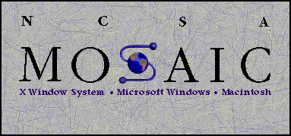

Slide 5


Slide 6
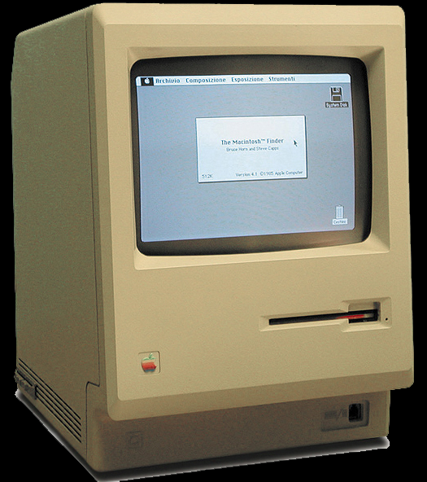

Slide 7
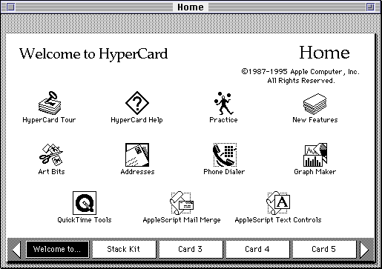

Slide 8
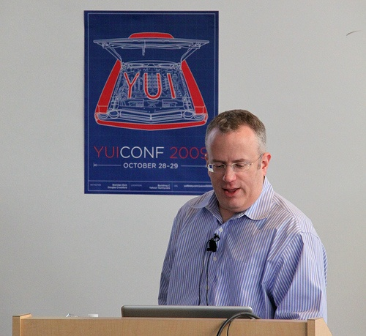

Slide 9
Java
Scheme
Self
LiveScript
JavaScript
JScript
ECMAScript

Slide 10
Java
Scheme
Self
LiveScript
JavaScript
JScript
ECMAScript

Slide 11
Java
Scheme
Self
LiveScript
JavaScript
JScript
ECMAScript

Slide 12
Java
Scheme
Self
LiveScript
JavaScript
JScript
ECMAScript

Slide 13
ECMAScript
1999 Third Edition ES3
2009 Fifth Edition ES5
Default
Strict
2015 Sixth Edition ES6

Slide 14
Where do Bad Parts come from?
Legacy
Good Intentions
Haste
For the most part, the bad parts can be avoided.
The problem with the bad parts isn’t that they are useless.

Slide 15
Objects

Slide 16
An object is a dynamic collection of properties.
Every property has a key string that is unique within that object.

Slide 17
Get, set, and delete
get
object.name
object[expression]
set
object.name = value;
object[expression] = value;
delete
delete object.name
delete object[expression]

Slide 18
[keys] must be strings
Automatic type coercion.

Slide 19
Object literals
An expressive notation for creating objects.
var my_object = {
foo: bar,
name: "value",
"@#$%*": "grawlix"
};

Slide 20
Classes v Prototypes

Slide 21
Working with prototypes
Make an object that you like.
Create new instances that inherit from that object.
Customize the new objects.
Classification and taxonomy are not necessary.

Slide 22
Delegation
Differential Inheritance

Slide 23
Object.create(prototype)
Prototypal Inheritance

Slide 24
var mother = {
a: 1,
b: 2
};
mother
Object.prototype
a | 1
b | 2

Slide 25
var mother = {
a: 1,
b: 2
};
var daughter = Object.create(mother);
daughter
mother
Object.prototype
a | 1
b | 2

Slide 26
var mother = {
a: 1,
b: 2
};
var daughter = Object.create(mother);
daughter.b += 2;
daughter
mother
Object.prototype
b | 4
a | 1
b | 2

Slide 27
var mother = {
a: 1,
b: 2
};
var daughter = Object.create(mother);
daughter.b += 2;
daughter.c = 9;
daughter
mother
Object.prototype
b | 4
c | 9
a | 1
b | 2

Slide 28
Object.create(null)

Slide 29
Object and …
Number
Boolean
String
Array
Date
RegExp
Function

Slide 30
Number

Slide 31
Number literals
.01024e4
1.024e+3
10.24E2
102.4E+1
1024.e0
1024.00
1024
10240e-1

Slide 32
Numbers
Only one number type
No integer types
64-bit binary floating point
IEEE-754 (aka Double)

Slide 33
Good that we don’t have int
a > 0
b > 0
c = a + b;
Possible results:
c < a
c < b

Slide 34
Associative Law does not hold
(a + b) + c === a + (b + c)
Produces false for some values of a, b, c.
Integers under 9007199254740992 (9 quadrillion) are ok.
9007199254740992 === 9007199254740992 + 1

Slide 35
(a + 1) – 1 === a
Can be false.

Slide 36
Decimal fractions are approximate
a = 0.10;
b = 0.20;
c = 0.30;
a + b === c
false
(a + b) + c === a + (b + c)
false

Slide 37
Number methods
toExponential
toFixed
toLocaleString
toPrecision
toString
valueOf

Slide 38
Number methods
if (!Number.prototype.trunc) {
Number.prototype.trunc =
function trunc(number) {
return (number >= 0)
? Math.floor(number)
: Math.ceil(number);
};
}

Slide 39
Numbers are first class objects
A number can be stored in a variable.
A number can be passed as a parameter.
A number can be returned from a function.
A number can be stored in an object.
A number can have methods.

Slide 40
Math object
abs
acos
asin
atan
atan2
ceil
cos
exp
floor
log
max
min
pow
random
round
sin
sqrt
tan

Slide 41
Math object
E
LN10
LN2
LOG10E
LOG2E
PI
SQRT1_2
SQRT2
function log2(x) {
return Math.LOG2E *
Math.log(x);
}

Slide 42
NaN
Special number: Not a Number
Result of undefined or erroneous operations
Toxic: any arithmetic operation with NaN as an input will have NaN as a result
NaN is not equal to anything, including NaN
NaN === NaN is false
NaN !== NaN is true
isNaN(NaN) is true

Slide 43
x = x + 1
Mathematical nonsense.

Slide 44
x = x + 1
Infinity

Slide 45
x = x + 1
Infinity
Number.MAX_VALUE
1.7976931348623157e+308

Slide 46
x = x + 1
Infinity
Number.MAX_VALUE
9007199254740992

Slide 47
x = x + 1
But not NaN
because NaN === NaN is false

Slide 48
x = x + 1
But not NaN
because NaN === NaN is false
NaN !== NaN is true!

Slide 49
Boolean
true
false

Slide 50
String

Slide 51
Strings
A sequence of 0 or more 16-bit Unicode characters
UCS-2, not quite UTF-16
No awareness of surrogate pairs
No separate character type
Characters are represented as strings with length of 1
Strings are immutable
Similar strings are equal ( === )
String literals can use single or double quotes with \ escapement.
Use " for external strings.
Use ' for internal strings and characters.

Slide 52
Convert a number to a string
Use number’s method (toString)
Use String function
str = num.toString();
str = String(num);

Slide 53
Convert a string to a number
Use the Number function.
Use the + prefix operator.
Use the parseInt function.
num = Number(str);
num = +str;

Slide 54
parseInt function
parseInt(str, 10)
Converts the value into a number.
It stops at the first non-digit character.
parseInt("12em") === 12
The radix (10) should always be used.
parseInt("08") === 0
parseInt("08", 10) === 8

Slide 55
String length
string.length
The length property determines the number of 16-bit characters in a string.
Extended characters are counted as 2.

Slide 56
String methods
charAt
charCodeAt
compareLocale
concat
indexOf
lastIndexOf
localeCompare
match
replace
search
slice
split
substring
toLocaleLowerCase
toLocaleUpperCase
toLowerCase
toString
toUpperCase
trim
valueOf

Slide 57
trim
if (typeof String.prototype.trim !== 'function') {
String.prototype.trim = function () {
return this.replace(
/^\s*(\S*(\s+\S+)*)\s*$/, "$1");
};
}

Slide 58
Array

Slide 59
Arrays
Array inherits from Object.
Indexes are converted to strings and used as names for retrieving values.
Very efficient for sparse arrays.
Not very efficient in most other cases.
One advantage: No need to provide a length or type when creating an array.

Slide 60
length
Arrays, unlike objects, have a special length property.
It is always 1 larger than the highest integer subscript.

Slide 61
Array Literals
An array literal uses []
It can contain any number of expressions, separated by commas
myList = ['oats', 'peas', 'beans'];
New items can be appended
myList[myList.length] = 'barley';
The dot notation should not be used with arrays.

Slide 62
Array methods
concat
every
filter
forEach
indexOf
join
lastIndexOf
map
pop
push
reduce
reduceRight
reverse
shift
slice
some
splice
toLocaleString
toString
unshift

Slide 63
sort
var n = [4, 8, 15, 16, 23, 42];
n.sort();
// n is [15, 16, 23, 4, 42, 8]

Slide 64
Deleting Elements
delete array[number]
Removes the element, but leaves a hole in the numbering.
array.splice(number, 1)
Removes the element and renumbers all the following elements.

Slide 65
Deleting Elements
myArray = ['a', 'b', 'c', 'd'];
delete myArray[1];
// ['a', undefined, 'c', 'd']
myArray.splice(1, 1);
// ['a', 'c', 'd']

Slide 66
Arrays v Objects
Use objects when the names are arbitrary strings.
Use arrays when the names are sequential integers.
Don't get confused by the term Associative Array.

Slide 67
Date
The Date function is based on Java's Date class.
It was not Y2K ready.

Slide 68
RegExp
/\/(\\[^\x00-\x1f]|\[(\\[^\x00-\x1f]|[^\x00-\x1f\\\/])*\]|[^\x00-\x1f\\\/\[])+\/[gim]*/
http://jex.im/regulex/

Slide 69
Function

Slide 70
All values are objects
Except null and undefined.

Slide 71
null undefined
A values that are not objects.

Slide 72
undefined
The default value for variables and parameters.
The value of missing members in objects and arrays.

Slide 73
typeof
The typeof prefix operator returns a string identifying the type of a value.
type | typeof
object | 'object'
function | 'function'
array | 'object'
number | 'number'
string | 'string'
boolean | 'boolean'
null | 'object'
undefined | 'undefined'

Slide 74
Array.isArray
alert(Array.isArray([])); // true
if (typeof Array.isArray !== 'function') {
Array.isArray = function (value) {
return Object.prototype
.toString.apply(value) ===
'[object Array]';
};
}

Slide 75
Falsy values
false
null
undefined
"" (empty string)
0
NaN
All other values (including all objects) are truthy.
"0" "false"
All values can be said to be boolish.

Slide 76
Loosely Typed
Any of these types can be stored in an variable, or passed as a parameter to any function.
The language is not untyped.
This is a good part.

Slide 77
Reference
Objects can be passed as arguments to functions, and can be returned by functions
Objects are passed by reference.
Objects are not passed by value.
The === operator compares object references, not values
true only if both operands are the same object

Slide 78
C
JavaScript is syntactically a C family language
It differs from C mainly in its type system, which allows functions to be values

Slide 79
Identifiers
Starts with a letter or _ or $
Followed by zero or more letters, digits, _ or $
By convention, all variables, parameters, members, and function names start with lower case
Except for constructor functions which start with upper case
Initial _ should be reserved for implementations
$ should be reserved for machines.

Slide 80
Comments
// slashslash line comment
/*
slashstar
block
comment
*/

Slide 81
Operators
Arithmetic
+ - * / %
Comparison
== != < > <= >=
Logical
&& || !
Bitwise
& | ^ >> >>> <<
Ternary
?:

Slide 82
+
Addition and concatenation
If both operands are numbers,
then
add them
else
convert them both to strings concatenate them
'$' + 3 + 4 = '$34'

Slide 83
+
Unary operator can convert strings to numbers
+"42" = 42
Also
Number("42") = 42
Also
parseInt("42", 10) = 42
+"3" + (+"4") = 7

Slide 84
/
Division of two integers can produce a non-integer result
10 / 3 3.3333333333333335

Slide 85
%
The remainder operator, not the modulo operator.
-1 % 8 // -1, not 7

Slide 86
== !=
Equal and not equal
These operators can do type coercion
It is always better to use === and !==, which do not do type coercion.

Slide 87
Evils of type coercion
'' == '0' // false
0 == '' // true
0 == '0' // true
false == 'false' // false
false == '0' // true
false == undefined // false
false == null // false
null == undefined // true
' \t\r\n ' == 0 // true
1 == [1] // true
true == [1] // true
true == [true] // false

Slide 88
&&
logical and
If first operand is truthy
then result is second operand
else result is first operand

Slide 89
||
logical or
If first operand is truthy
then result is first operand
else result is second operand

Slide 90
!
Prefix logical not operator.
If the operand is truthy, the result is false. Otherwise, the result is true.
!! produces booleans.

Slide 91
Bitwise
& | ^ >> >>> <<
The bitwise operators convert the operand to a 32-bit signed integer, and turn the result back into 64-bit floating point.

Slide 92
Statements
expression
if
switch
while
do
for
break
continue
return
try/throw

Slide 93
Break statement
Statements can have labels.
Break statements can refer to those labels.
loop: for (;;) {
...
if (…) {
break loop;
}
...
}

Slide 94
For statement
Iterate through all of the elements of an array:
for (i = 0; i < array.length; i += 1) {
// within the loop,
// i is the index of the current member
// array[i] is the current element
}
Use the forEach or map method instead.

Slide 95
For in statement
Iterate through all of the members of an object:
for (name in object) {
if (object.hasOwnProperty(name)) {
// within the loop,
// name is the key of current member
// object[name] is the current value
}
}
Use Object.keys instead.

Slide 96
Switch statement
Multiway branch.
The switch value does not need to a number. It can be a string.
The case values can be expressions.
Danger: Cases fall through to the next case unless a disruptive statement like break ends the case.

Slide 97
Throw statement
throw new Error(reason);
throw {
name: exceptionName,
message: reason
};

Slide 98
Try statement
try {
plan_a();
} catch (ignore) {
plan_b();
}

Slide 99
Next:
Act III
Function the Ultimate

