Slide 1
Episode IV
The Metamorphosis of Ajax

Slide 2
“all the world’s a page and all the men and women merely pointers and clickers.”

Slide 3
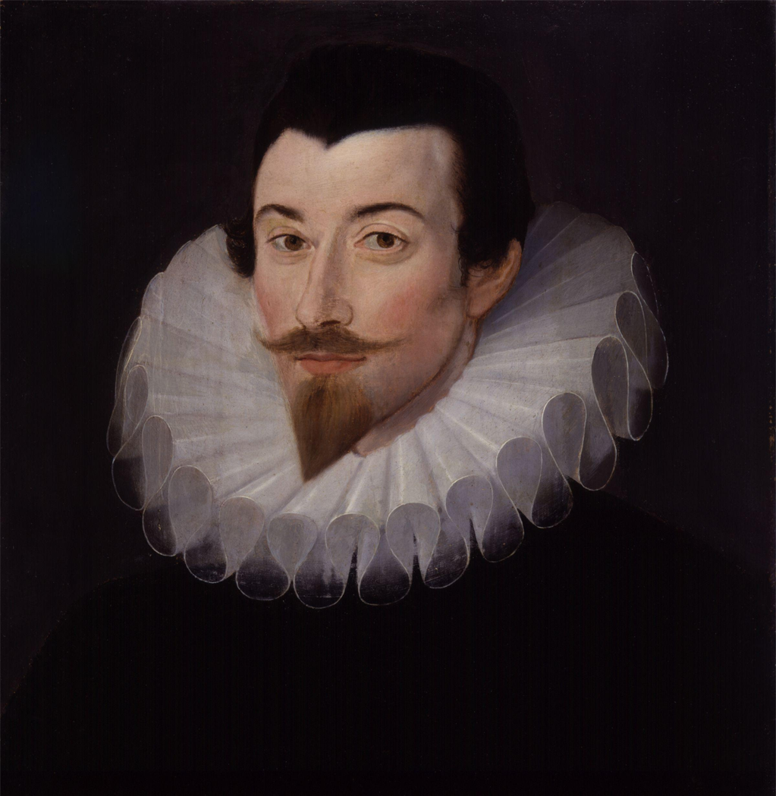
Sir John Harrington

Slide 4
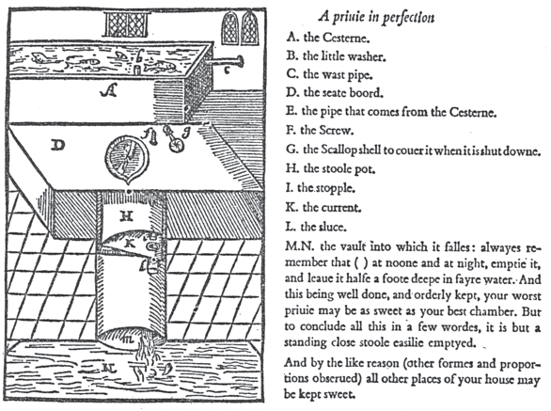

Slide 5
Ajax
1596

Slide 6
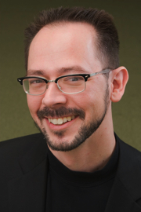
Jesse James Garrett

Slide 7
Ajax
2005

Slide 8
Word Processing
Binary
Proprietary
Textual
Open
Standalone
Shared Logic
Personal Computer

Slide 9
RUNOFF
.SK 1
Text processing and word processing systems
typically require additional information to
be interspersed among the natural text of
the document being processed. This added
information, called "markup", serves two
purposes:
.TB 4
.OF 4
.SK 1
1.#Separating the logical elements of the
document; and
.OF 4
.SK 1
2.#Specifying the processing functions to be
performed on those elements.
.OF 0
.SK 1

Slide 10
GML
:h1.Chapter 1: Introduction
:p.GML supported hierarchical containers, such as
:ol
:li.Ordered lists (like this one),
:li.Unordered lists, and
:li.Definition lists
:eol.
as well as simple structures.
:p.Markup minimization (later generalized and
formalized in SGML),
allowed the end-tags to be omitted for the "h1"
and "p" elements.

Slide 11
:eol.
::ol.
</ol>

Slide 12
Brian Reid’s Scribe
@Quote(Any damn fool)
( ) [ ] { }
< > " " ' '
@Begin(Quote)
Any damn fool
@End(Quote)
1980

Slide 13
Scribe
@techreport(PUB, key="Tesler", author="Tesler, Larry", title="PUB: The Document Compiler", year=1972, number="ON-72", month="Sep", institution="Stanford University Artificial Intelligence Project") @book(Volume3, key="Knuth",
author="Knuth, Donald E.", title="Sorting and Searching", publisher="Addison-Wesley", year=1973, volume=3,
series="The Art of Computer Programming", address="Reading, Mass.")

Slide 14
Runoff
Scribe
T_{E}X
GML
SGML
L^{A}T_{E}X
HTML

Slide 15
HTML was not state-of-the-art when it was introduced in the late 20th century.
It was intended for simple document viewers.
It was not intended to be an application platform.

Slide 16
A lot of people looked at the WWW and thought it didn’t have what it takes.

Slide 17
The web standards were grown from a naïve hypertext system under intense, highly unstable competitive pressure.

Slide 18
It wasn’t designed to do all of this Ajax stuff.
Its success is due to a lot of clever people who found ways to make it work.

Slide 19
HTML
A huge improvement over SGML.
Much simpler.
More resilient. The Dark Side.
Authors have virtually no control over presentation.
Too limited: Classitis and iditis.
It did not anticipate applications beyond simple document retrieval.

Slide 20
Two forms for writing outlines
ol, li nesting
h1, h2… not nesting

Slide 21
Web page is not a page
The thing that the WWW calls a page isn’t really a page at all. It is a scroll.
The scroll is an ancient technology.

Slide 22
SGML Strikes Back
<p> changed from a separator to a container.
Mythical Semantic Markup.
The XML Fiasco.

Slide 23
CSS
Cascading Style Sheets.
Unhealthy separation of structure and presentation.
Long, fragile lists of self-contradictory rules.
Each rule has two parts: Selector and declaration.
Difficult to understand. Difficult to use.

Slide 24
CSS’s Five Big Problems
Lack of modularity.
Selector management is complicated.
Declarations are too weak for modern web applications.
Not intended for dynamic content.
It is unimplementable. It’s all about the quirks.

Slide 25
CODEpendence
“CSS isn’t bad. You just don’t understand it like I do.”

Slide 26
If that was all there was, the web would have been replaced by now.

Slide 27
“Another software technology will come along and kill off the Web, just as it killed News, Gopher, et al. And that judgment day will arrive very soon -- in the next two to three years”
George F. Colony
Chairman of the Board and CEO
Forrester Research, Inc. [2000]

Slide 28
JavaScript

Slide 29
The Document Object Model
The DOM.
It is what most people hate when they say they hate JavaScript.
The browser’s API.
Brendan Eich, Netscape.
Influenced by a book on HyperCard
Scott Isaacs, Microsoft.

Slide 30
In the original Netscape model, not all elements were scriptable.
In the Microsoft model, all elements are completely scriptable.
But it wasn’t finished.

Slide 31
Browser

Slide 32
Scripted Browser

Slide 33
<script></script>
<!-- // -->
Hack for Mosaic and Navigator 1.0.
language=javascript
Deprecated.
src=URL
Highly recommended.
Don’t put code on pages.
type=application/ecmascript
Ignored.

Slide 34
document.write
Allows JavaScript to produce HTML text.
Before onload: Inserts HTML text into the document.
After onload: Uses HTML text to replace the current document.
Not recommended.

Slide 35
<script></script>
Script files can have a big impact on page loading time.
Place <script src> tags as close to the bottom of the body as possible. (Also, place CSS <link> as high in the head as possible.)
Minify and gzip script files.
Reduce the number of script files as much as possible.

Slide 36
Document Tree Structure
document
document.
documentElement
document.body

Slide 37
child, sibling, parent

Slide 38
child, sibling, parent

Slide 39
child, sibling, parent

Slide 40
child, sibling, parent

Slide 41
Walk the DOM
Using recursion, follow the firstChild node, and then the nextSibling nodes.
function walkTheDOM(node, func) {
func(node);
node = node.firstChild;
while (node) {
walkTheDOM(node, func);
node = node.nextSibling;
}
}

Slide 42
getElementsByClassName
function getElementsByClassName(className) {
var results = [];
walkTheDOM(document.body, function (node) {
var a, c = node.className, i;
if (c) {
a = c.split(' ');
for (i = 0; i < a.length; i += 1) {
if (a[i] === className) {
results.push(node);
break;
}
}
}
});
return results;
}

Slide 43
childNodes

Slide 44
Retrieving Nodes
document.getElementById(id)
document.getElementsByName(name)
node.getElementsByTagName(tagName)

Slide 45
Manipulating Elements
<IMG> has these properties:
align 'none', 'top', 'left', ...
alt string
border integer (pixels)
height integer (pixels)
hspace integer (pixels)
id string
isMap boolean
src url
useMap url
vspace integer (pixels)
width integer (pixels)
node.property = expression;

Slide 46
Manipulating Elements
Old School
if (my_image.complete) {
my_image.src = superurl;
}
New School
if (my_image.getAttribute('complete')) {
my_image.setAttribute('src', superurl);
}

Slide 47
Style
node.className
node.style.stylename
node.currentStyle.stylename Only IE
document.defaultView().
getComputedStyle(node, "").
getPropertyValue(stylename);

Slide 48
Style Names
CSS
background-color
border-radius
font-size
list-style-type
word-spacing
z-index
float
DOM
backgroundColor
borderRadius
fontSize
listStyleType
wordSpacing
zIndex
cssFloat

Slide 49
Making Elements
document.createElement(tagName)
document.createTextNode(text)
node.cloneNode()
Clone an individual element.
node.cloneNode(true)
Clone an element and all of its descendents.
The new nodes are not connected to the document.

Slide 50
Linking Elements
node.appendChild(new)
node.insertBefore(new, sibling)
node.replaceChild(new, old)
old.parentNode.replaceChild(new, old)

Slide 51
Removing Elements
node.removeChild(old)
It returns the node.
Be sure to remove any event handlers.
old.parentNode.removeChild(old)

Slide 52
innerHTML
The W3C standard does not provide access to the HTML parser.
All A browsers implement Microsoft's innerHTML property.
Security hazard.

Slide 53
Which Way Is Better?
It is better to build or clone elements and append them to the document?
Or is it better to compile an HTML text and use innerHTML to realize it?
Favor clean code and easy maintenance.
Favor performance only in extreme cases.
The DOM is massively inefficient.

Slide 54
Events
The browser has an event-driven, single-threaded programming model.
Events are targeted to particular nodes.
Events cause the invocation of event handler functions.

Slide 55
Mouse Events
The target is the topmost (z-index) node containing the cursor.
click
dblclick
mousedown
mousemove
mouseout
mouseover
mouseup

Slide 56
Input Events
The target is the node having focus.
blur
change
focus
keydown
keypress
keyup
reset
submit

Slide 57
Event Handlers
Netscape
node["on" + type] = f;
Microsoft
node.attachEvent("on" + type, f);
W3C
node.addEventListener(type, f, false);

Slide 58
Event Handlers
The handler takes an optional event parameter.
Microsoft did not send an event parameter, using the global event object instead.

Slide 59
Event Handlers
function (e) {
e = e || event;
var target =
e.target || e.srcElement;
...
}

Slide 60
Trickling and Bubbling
Trickling is an event capturing pattern which provides compatibility with the Netscape 4 model. Avoid it.
Bubbling means that the event is given to the target, and then its parent, and then its parent, and so on until the event is canceled.

Slide 61
Why Bubble?
Suppose you have 100 draggable objects.
You could attach 100 sets of event handlers to those objects.
Or you could attach one set of event handlers to the container of the 100 objects.

Slide 62
Cancel Bubbling
Cancel bubbling to keep the parent nodes from seeing the event.
e.cancelBubble = true;
if (e.stopPropagation) {
e.stopPropagation();
}

Slide 63
Prevent Default Action
An event handler can prevent a browser action associated with the event (such as submitting a form).
e.returnValue = false;
if (e.preventDefault) {
e.preventDefault();
}
return false;

Slide 64
Performance
Touching a node has a cost.
Styling can have a big cost.
Reflow can have a big cost.
Repaint can have a big cost.
Random things like nodelist can have a big cost.
In most applications, JavaScript has a small cost.

Slide 65
Performance
Speed Tracer [Chrome]
Performance Dashboard [IE]
Optimization without good performance data is a waste of time.

Slide 66
A small amount of JavaScript can transform the DOM (one of the world’s awfullest APIs) into something pleasant and productive.
Ajax libraries are fun and easy to make.

Slide 67
JavaScript Libraries
Portability
Correction
Model
Widgets

Slide 68
How to choose?
It would take longer to do a complete evaluation of all of the existing libraries than to build a new one from scratch.

Slide 69
Subject all of the candidates to JSLint.

Slide 70
Division of Labor
How is the application divided between the browser and the server?

Slide 71
Pendulum of Despair
Server
The browser
is a terminal.

Slide 72
Pendulum of Despair
Server
The browser
is a terminal.
Browser
The server is
a file system.

Slide 73
Seek the Middle Way.
A pleasant dialogue between specialized peers.
Minimize the volume of traffic.

