Slide 1

Contents:
Introduction to IAM
IAM Users
IAM Groups
IAM Policies
IAM Role

Slide 2



Chancellor
Mechanical
college
ACCOUNTS AND FINANCE
Unrestricted access
Owner
CIVIL
ECE
Admin office
R&D
IT
Restricted access
Student
Department(group)

Slide 3
AWS CLOUD
Unrestricted access
Root User
IAM
Restricted access
IAM User
IAM Group

Slide 4
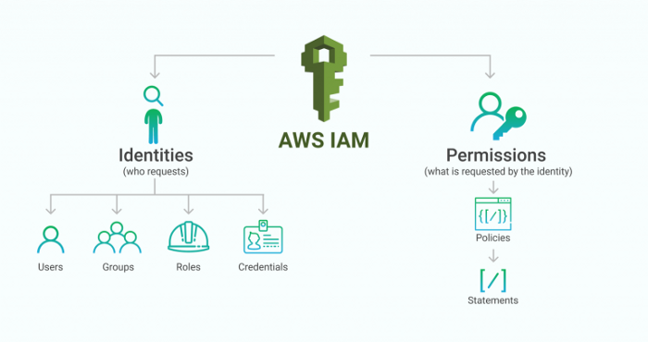

Slide 5
Introduction to IAM
AWS Identity and Access Management (IAM) is a web service that helps you securely control access to AWS resources.
Allows to create and manage AWS users and groups, and use permissions to allow and deny their access to AWS resources.
Control who is authenticated (signed in) and authorized (has permissions) to use resources
IAM is offered at no additional charge.

Slide 6
IAM features
Shared access to your AWS account : Give permission to administrator without sharing password and access key.
Granular permissions : Access to different resources.
Multi-factor authentication (MFA) : extra security. Duo, Microsoft authenticator
Identity information for assurance : who logged in and logged out.
Free to use
Integrated with many AWS services
Identity federation : Temporary access to AWS account.
Accessing IAM : through management console, SDKs, CLI, IAM HTTPS API.

Slide 7
User
An entity that we create in AWS to represent the person or application that uses it to interact with AWS.
Users can access AWS in different ways depending on credentials.
1. Console Password
2. Access Keys
3. SSH keys for use with Code Commit.
Types of Users
1. Root User: Email we use when creating an AWS account.
2. IAM User: Instead of sharing root credentials, we create individual IAM users.
Each user has their own password.
Users can have access keys for programmatic access.
3. Federated User: Identities from Corporate Directory or OpenID providers. (Trust between two parties)
Federated user
Active directory federated services
STS Security token services……….access to AWS services

Slide 8
Groups
Collection of IAM users.
Groups let us specify permissions for multiple users.
We attach permission policies to the group
Any user in a group automatically has the permissions that are assigned to the group
A group can contain many users, and a user can belong to multiple groups.
Groups cannot be nested

Slide 9
Policies
An entity that, when attached to an identity or resource, defines their permissions.
Policies are stored in AWS as JSON documents that defines the permissions for specific identity (users) or resource (S3 Bucket).
We can attach policies in users, groups or roles.
AWS evaluates these policies when a principal entity (user or role)makes a request.
IAM's Policy Evaluation Logic denies all requests by default, so successful actions/operations have to be explicitly allowed by the admin within the user and resource policies.

Slide 10
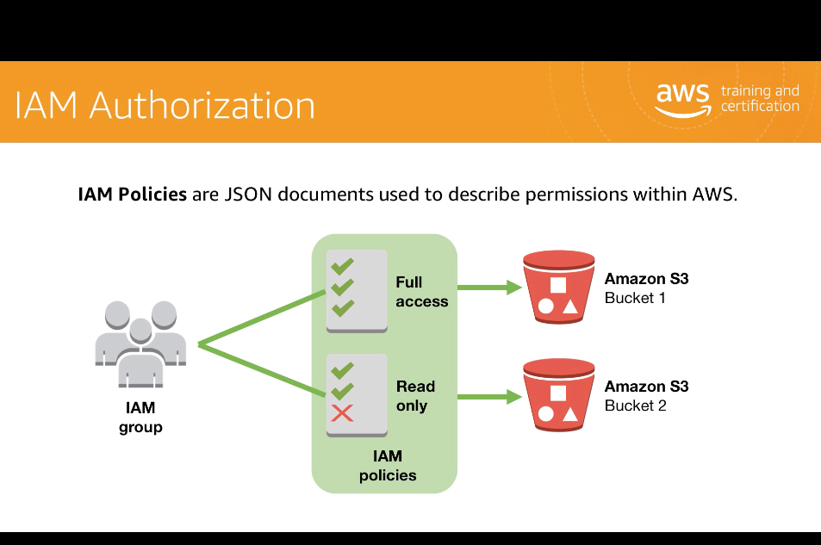

Slide 11
Role
IAM identity that has specific set of permissions.
Similar to users
Intended to be assumable by anyone who needs it.
When you assume a role, it provides you with temporary security credentials for your role session.
Two ways to use a role: Interactively in the IAM console and Programmatically with the AWS CLI or AWS API.
Common scenarios for which we will use IAM Role
Providing Access to an AWS Service
Providing Access Across AWS Accounts
Providing Access to Third-Party AWS Accounts
Providing Access Through Identity Federation

Slide 12
IAM Best Practices
Create Individual Users, avoid using root credentials
Grant Minimum Privileges
Manage Permissions with Groups Restrict Privileged access further with conditions
Configure a strong password policy
Rotate Security Credentials Regularly Enable MFA for privileged users
Use IAM roles to share access

