Slide 1
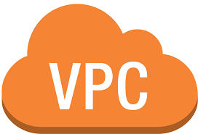

Slide 2
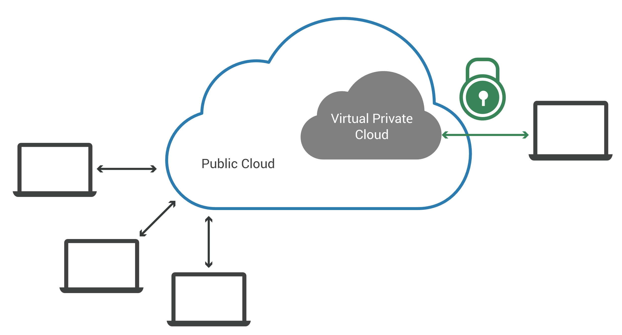
VPC
A virtual private cloud (VPC) is a secure, isolated private cloud hosted within a public cloud.
IP address
An IP address is a unique address that identifies a device on the internet or a local network.

Slide 3
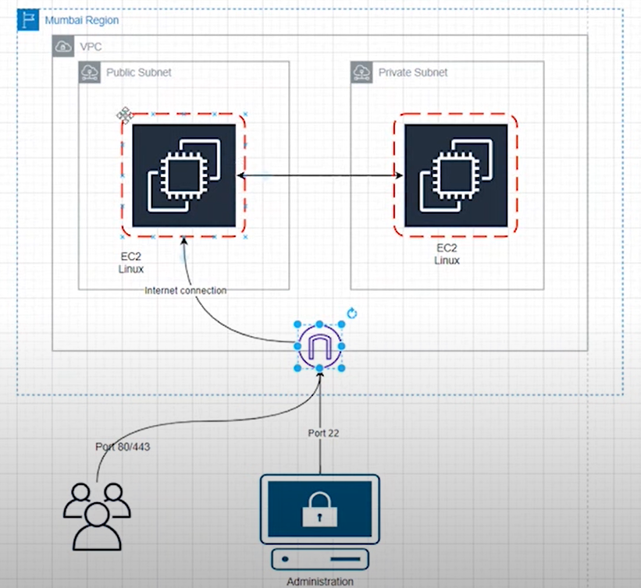
Subnet: A subnet is a range of IP addresses in your VPC.
Route tables: to determine where network traffic from your subnet or gateway is directed.

Slide 4
Class A : IP addresses are used for huge networks, like those deployed by Internet Service Providers (ISPs). Class A IP addresses support up to 16 million hosts range: 0-127
Class B : used for medium and large-sized networks in enterprises and organizations. They support up to 65,000 hosts on 16,000 individual networks. range: 128-191
Class C : used in small business and home networks. These support up to 256 hosts on each of 2 million networks. range: 192-223
Class D : is reserved for a not widely used, and reserved for special cases largely for services and applications to stream audio and video to many subscribers at once. range: 224- 255
Class E : addresses are reserved for research purposes by those responsible for Internet networking and IP address research, management, and development.

Slide 5
CIDR Block (Classless inter-domain routing)
CIDR is a set of Internet protocol (IP) standards that is used to create unique identifiers for networks and individual devices.
In VPC to create subnets
For example: 10.0.0.0/16 ----2^(32-16)=65536 hosts available
10.0.0.0/24 -----2^(32-24)=256 hosts
10.0.1.0/24
10.0.256.0/24
But in VPC there are 5 reserved Subnets. So if 10.0.0.0/24 ------ 256-5=251 hosts
Where 10.0.0.0 is for VPC routing, 10.0.0.255 is for broadcasting &
(10.0.0.1),(10.0.0.2),(10.0.0.3) for future use.
So subnetting only starts from 28 lowest sizing i.e. 10.0.0.0/28 -----16 hosts
(10.0.0.0/32-----1), (10.0.0.0/31-----2), & (10.0.0.0/29----8 host, again NA coz in that 5 are reserved only 3 are useable. Low Ip sizing

Slide 6
Gateway
A gateway connects your VPC to another network.
Internet gateway : connect your VPC to the internet.
Nat gateway : instances in a private subnet can connect to services outside your VPC but external services cannot initiate a connection with those instances. (One way)
Transit Gateway : which acts as a central hub, to route traffic between your VPCs, VPN connections, and AWS Direct Connect connections.
Security Group
A security group controls the traffic that is allowed to reach and leave the resources that it is associated with.
NACL : Network Access control List, at subnet level.

Slide 7
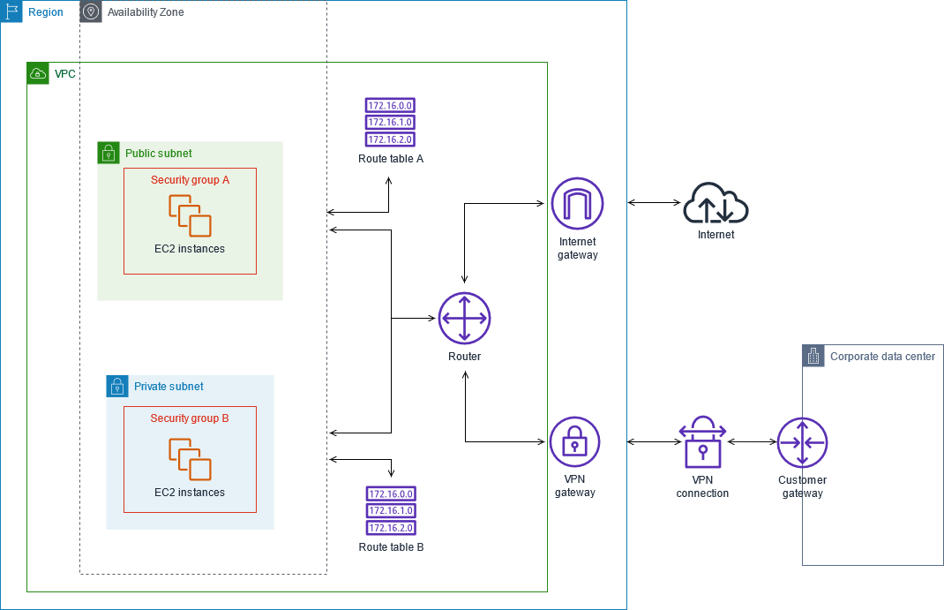

Slide 8
AWS Global Infrastructure
Regions :Physical locations spread across the globe to host your data.
Currently there are 27 launched regions.
Availability Zones: AZ is combination of one or more datacenters in a region. Min 2 AZ needed to achieve high availability.
Edge Locations: where end user access services.

Slide 9
Basic Networking Concepts
Protocols
Protocol Layers
Network Interconnection/Internet
A network can be defined as a group of computers and other devices connected in some ways so as to be able to exchange data.
Each of the devices on the network can be thought of as a node; each node has a unique address.
Addresses are numeric quantities that are easy for computers to work with, but not for humans to remember.
Example: 204.160.241.98 -Some networks also provide names that humans can more easily remember than numbers.
Example: www.javasoft.com, corresponding to the above numeric address.
Internet address Consists of 4 bytes separated by periods Example: 136.102.233.49
Ports An IP address identifies a host machine on the Internet.
An IP port will identify a specific application running on an Internet host machine.
A port is identified by a number, the port number.

Slide 10
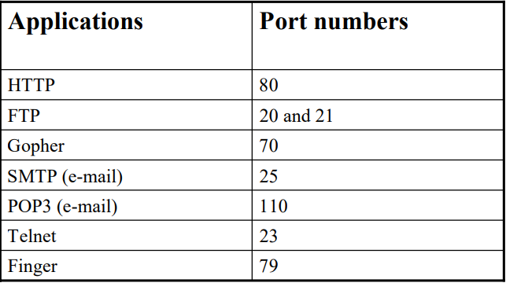
There are some port numbers which are dedicated for specific applications.

Slide 11
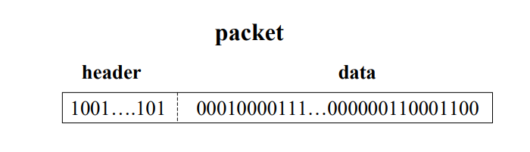
Data Transmission
In modern networks, data are transferred using packet switching.
Messages are broken into units called packets, and sent from one computer to the other.
At the destination, data are extracted from one or more packets and used to reconstruct the original message.
Each packet has a maximum size, and consists of a header and a data area.
The header contains the addresses of the source and destination computers and sequencing information necessary to reassemble the message at the destination.

Slide 12
Types of Networks
Wide Area Networks (WANs) & Local Area Networks (LANs).
WANs -Cover cities, countries, and continents. Based on packet switching technology –Ex: Asynchronous Transfer Mode (ATM), Integrated Services Digital Network (ISDN)
LANs -Cover buildings or a set of closely related buildings. -Ex: Ethernet, Token Ring, and Fibber Distributed Data Interconnect (FDDI).

