Slide 1
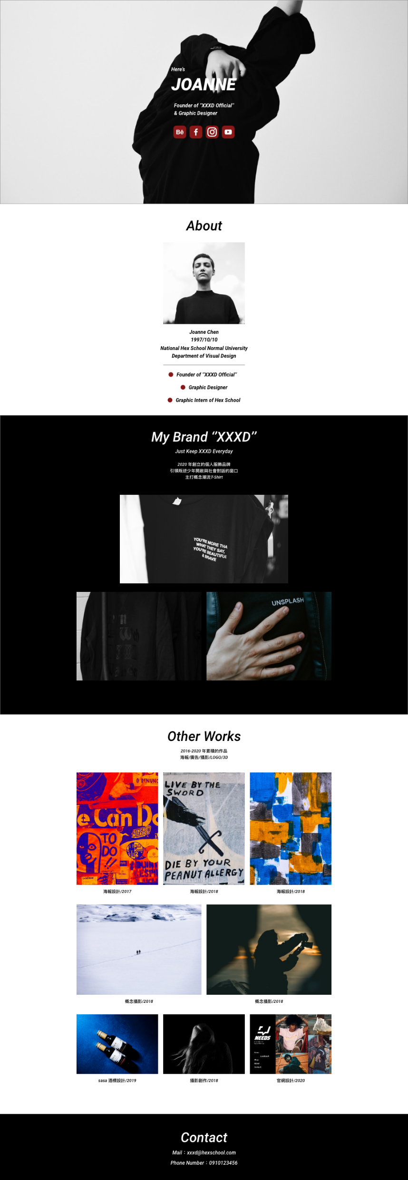
.wrap>
.container{w1200 m0-auto}
.header>.container>(ul>(li>p)+(li>h1)+(li>p)+(li>ul.media>li*4>img))
.header{bgi df}
.media{df}
.about>.container>(h2+img+(ul>li*4)+ul>li*3>(div+p))
Div{br50%}
.brand>.container>(h2>span)+p+(ul.brand-photo>li*3)
.brand-photo{df fwwr}
.works>.container>h2+p+ul.works-photo>li*8>(a>img)+p
.works-photo{df fww}
.footer>.container>h2+ul>li*2>a

