Slide 1
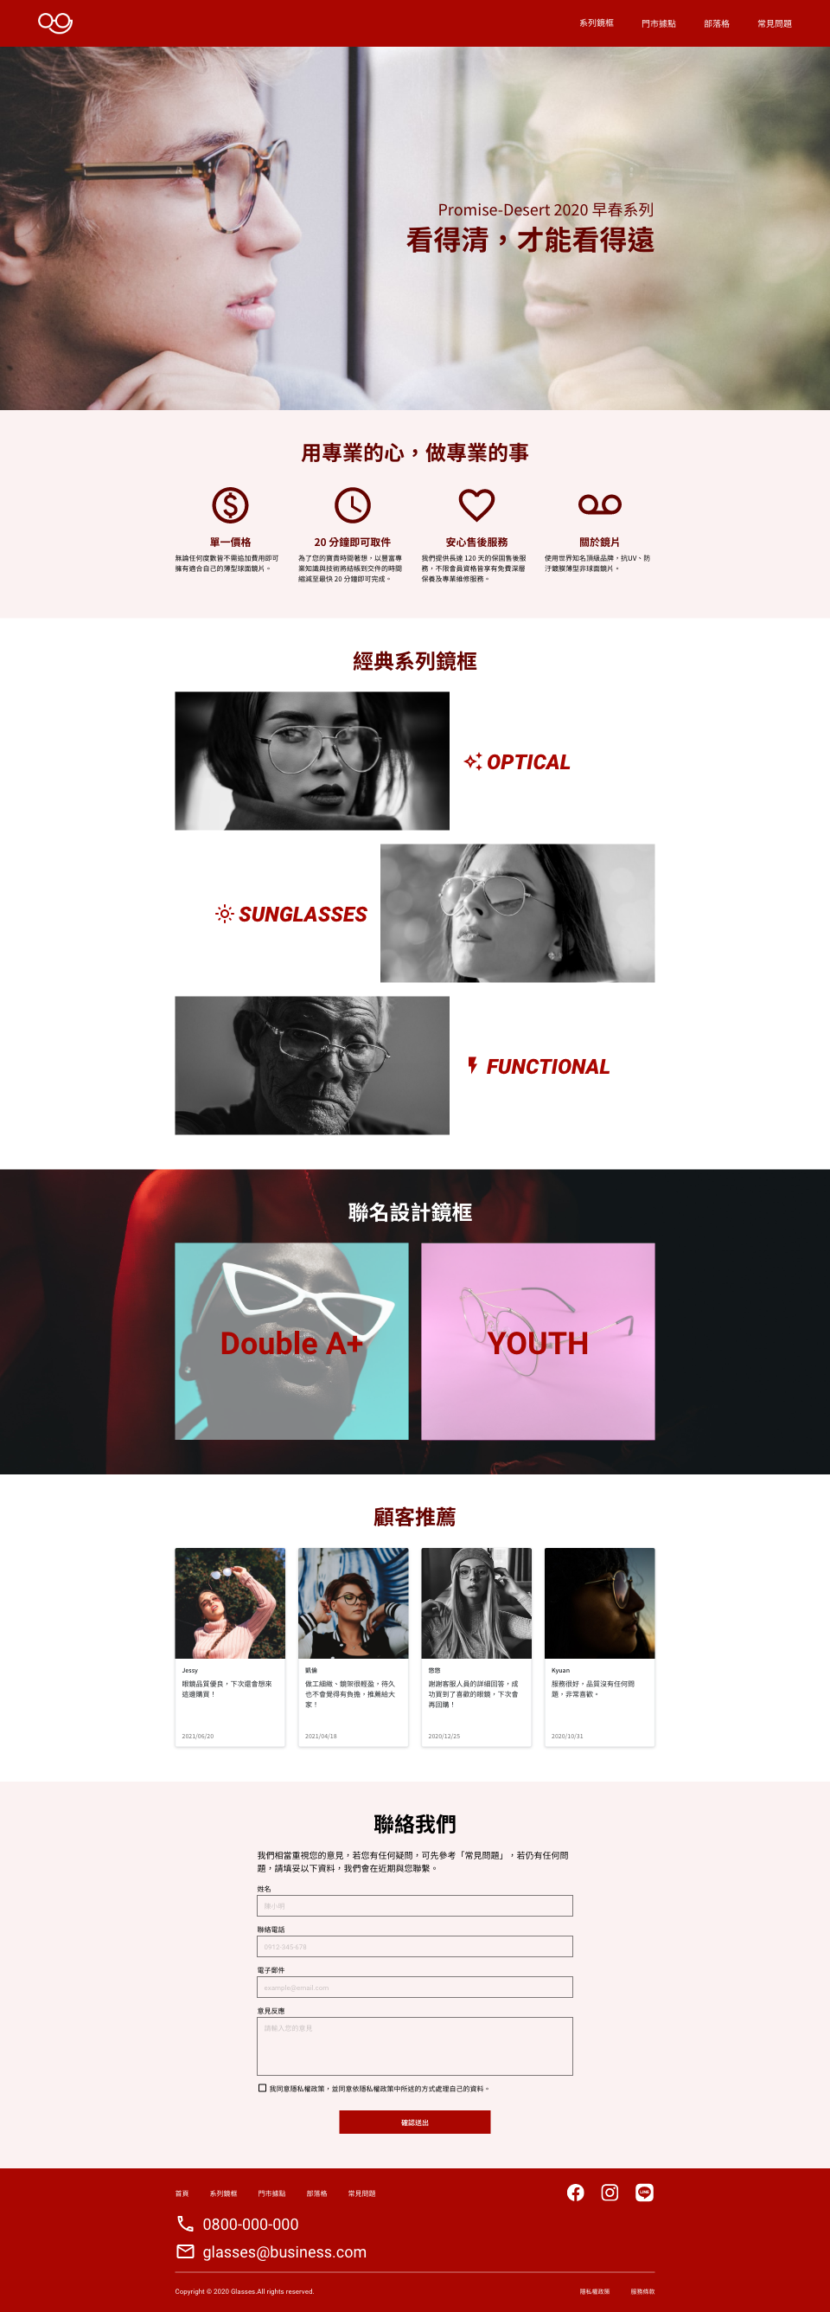
Layout
logo.png
以圖片代替文字
.header.d-flex>(h1+(ul.navbar.d-flex>li*4.nav-item>a[href=“#”]))
icon-mail.svg
icon-phone.svg
icon-fb.svg
icon-ig.svg
icon-line.svg
.footer>(.bottommenu.d-flex>(ul.navbar.d-flex>li*5>a[href=“#”])+(ul.social.d-flex>li*3>a[href=“#”]>img))
+(ul.contactinfo>li*2>(img+a))+.copyright.d-flex>p+(ul.d-flex>li*2)

Slide 2
.container max-width:1110px
M0-auto
.banner>.slogan>span
Bg-image
position
banner.png
icon-dollar.svg
icon-clock.svg
icon-heart.svg
.feature>.container>h2.title> ul.d-flex>li*4>img+h4+p
.prod1>h2.title> ul.d-flex>li.d-flex*3>img+h3 fxw:wrap-reverse
product-1.png
product-2.png
product-3.png
icon-thunder.svg
icon-sun.svg
.prod2>.container>h2.title> ul.d-flex>li*2>img+p.coption jcsb
bg.png
product-8.png
product-9.png
rec-1.png
rec-2.png
Rec-3.png
rec-4.png
.cs>h2.title> ul.d-flex>li*4>img+(ul>li*3> p.name+p.recommend+p.date)
.suggest>.container>h2.title> p>form.d-flex> (label+input)*4>input(checkbox>button
(input type:email number text) textarea fd:colum

Slide 3
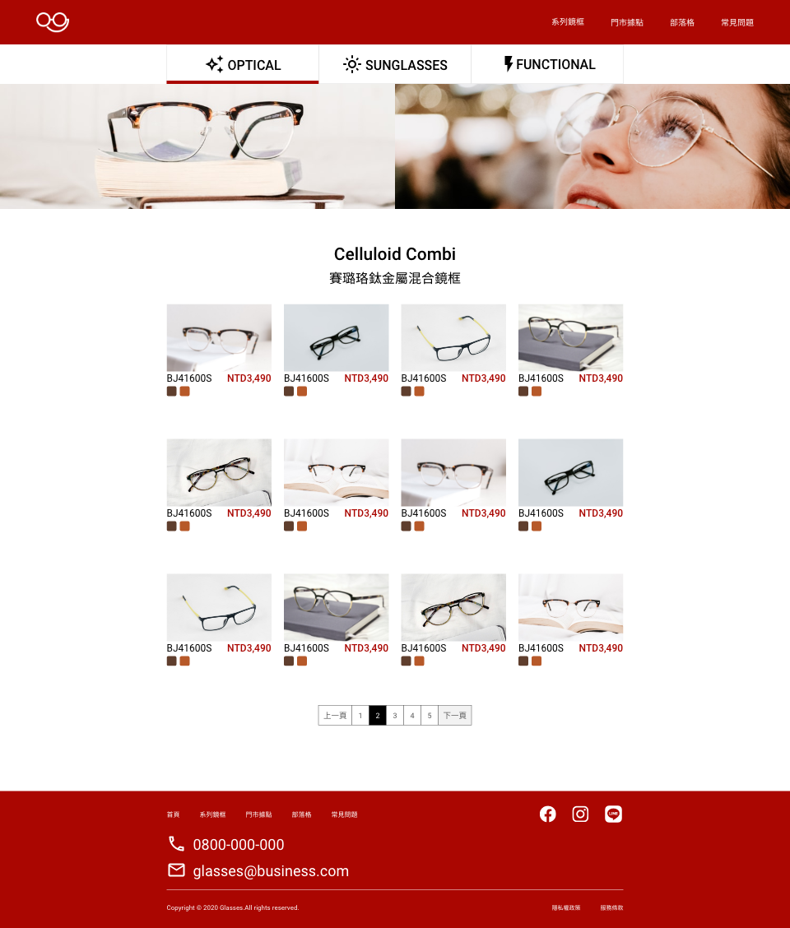
.container>ul.topnav>li*3>img+p
.banner>div.banner-photo*2
.prod-celluloid>.container>h2>span>ul.prod-info>li*12>a>img+div>p*2.prod-number.price+div*2.color
Ul.navbuttons>li*7>a

