Slide 1
JAVA vs KOTLIN

Slide 2
Java – overview
Popular
Created in 1995
Owned by oracel

Slide 3
Java uses
Mobile applications
Desktop applications
Web applications
Web servers and application servers
Games
Database connection

Slide 4
Java – applications
Twitter
Signal
Cash app
Spotify

Slide 5
Kotlin - overview
Based on JVM
Developed by JetBrains
Released in 2016

Slide 6
Kotlin uses
Mobile and server-side applications
Client-side with JavaScript of JavaFX

Slide 7
Kotlin – applications
Pinterest
Trello
Evernote

Slide 8
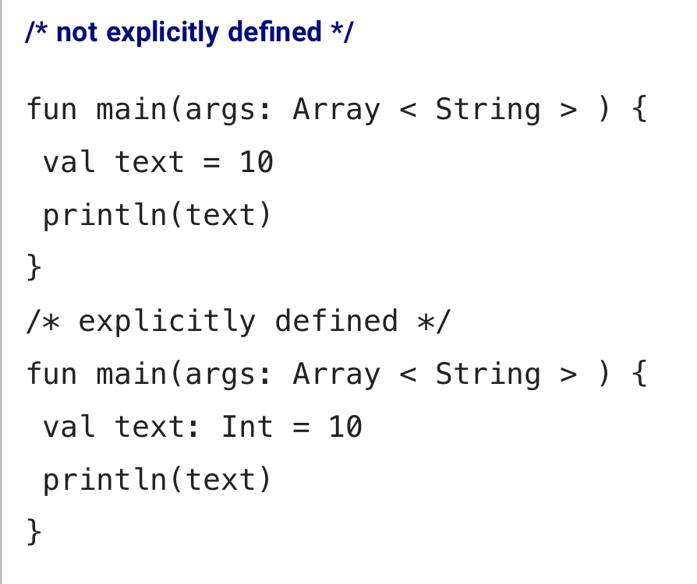
Features of Java and Kotlin - Type inference
https://www.xenonstack.com/blog/kotlin-andriod/

Slide 9
Features of Java and Kotlin - Null safety
 | Java | Kotlin
Null references (NullPointerException ) | Does not eliminate | Eliminate

Slide 10
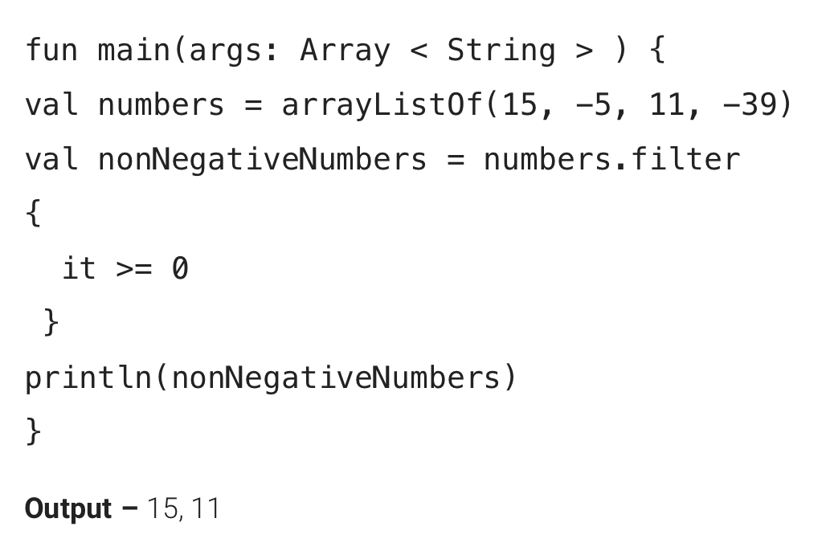
Features of Java and Kotlin - Functional programming
Kotlin is a functional programming language.
Kotlin consists of many useful methods
Kotlin much handier when it comes to collections
Another example:
fun alphaNum (func: () -> Unit) {}

Slide 11
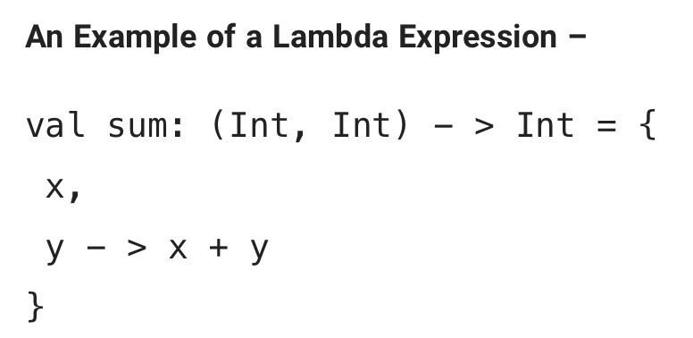
Then use “sum(2,2)’ in order to call it
https://www.xenonstack.com/blog/kotlin-andriod/

Slide 12
Features of Java and Kotlin - Data classes
Data classes lead to Auto-generation of boilerplate
Equals
hashCode
toString
getters/setters

Slide 13
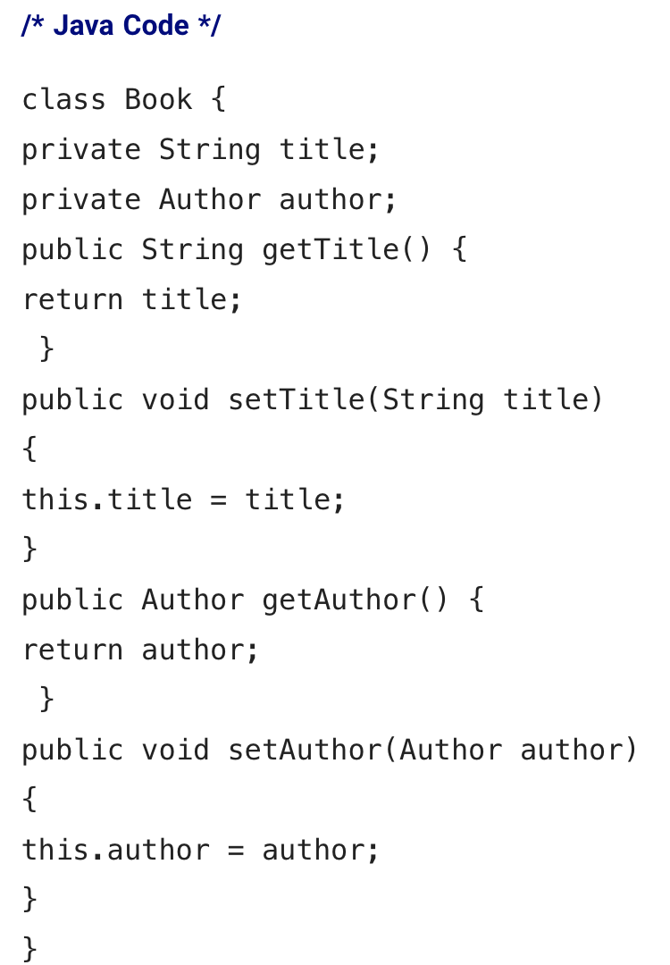
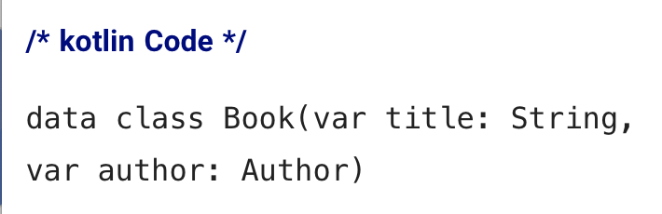
https://www.xenonstack.com/blog/kotlin-andriod/

Slide 14
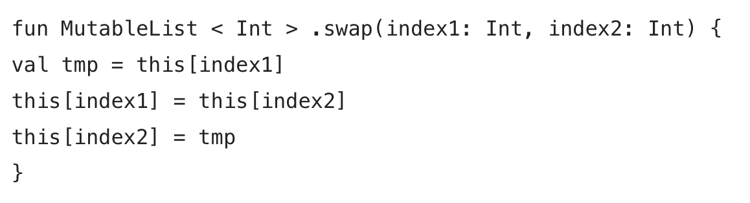
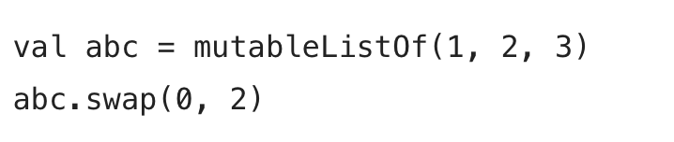
Features of Java and Kotlin - Extension functions
Kotlin allows to extend the existing classes functionality’s without inheriting from them.
The following function adds a swap function to MutableList:
https://www.xenonstack.com/blog/kotlin-andriod/

Slide 15
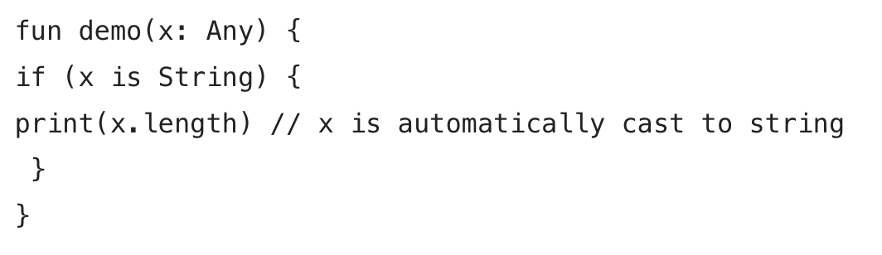
Features of Java and Kotlin - Smart Cast
No need to use explicit cast operation in Kotlin
https://www.xenonstack.com/blog/kotlin-andriod/

Slide 16
Features of Java and Kotlin - Coroutines and Threads
Threads
Operate more efficiently
Used to perform complicated tasks in the background
Coroutines
Simplify code that executes asynchronously
Helps to manage long-running tasks
Threads vs Coroutines
Coroutines similar to threads
Coroutines are multitasked
Threads preemptively multitasked
https://developer.android.com/kotlin/coroutines
https://en.wikipedia.org/wiki/Coroutine

Slide 17
Features of Java and Kotlin - Coroutines and Threads
Kotlin coroutines are presented as a lightweight alternative to Java Threads.
Coroutines uses thread pools in background
Coroutines are bound to any particular thread
Coroutines can start executing in one thread, suspend execution, and resume on a different thread.
Coroutines managed by the Kotlin runtime
When sleeping a thread, it is blocked for a particular period of time
In coroutines, developer may suspend execution.
https://piotrminkowski.com/2020/06/23/kotlin-coroutines-vs-java-threads/

Slide 18
Pros of Java
Works in different platforms (Windows, Mac, Linux, etc.)
Write once, run anywhere
It is an object-oriented language.
Prevents errors
Organized program
Simple maintenanace
Easy to learn and simple to use
Free, powerful and secure
Huge community support
Two kinds of exceptions
Checked exceptions
Unchecked exceptions
https://www.w3schools.com/java/java_intro.asp
https://www.altexsoft.com/blog/engineering/pros-and-cons-of-java-programming/

Slide 19
Cons of Java
Syntax a little complicated
Poor performance
Android API design problems

Slide 20
Pros of Kotlin
Works in different platforms (Mac, embedded systems)
Code is smaller that Java
All libraries and frameworks made in Java can run in Kotlin
Safe against NullPointerException
https://www.altexsoft.com/blog/engineering/pros-and-cons-of-java-programming/

Slide 21
Cons of Kotlin
Limited resources
Fewer libraries
Fewer developers
Does not have checked exceptions

Slide 22
Converting Java to Kotlin
Use Android Studio
Handle nullability-compilation errors
Android annotations
Build script
Apply lateinit on @ViewById
Convert data-object into small classes

Slide 23
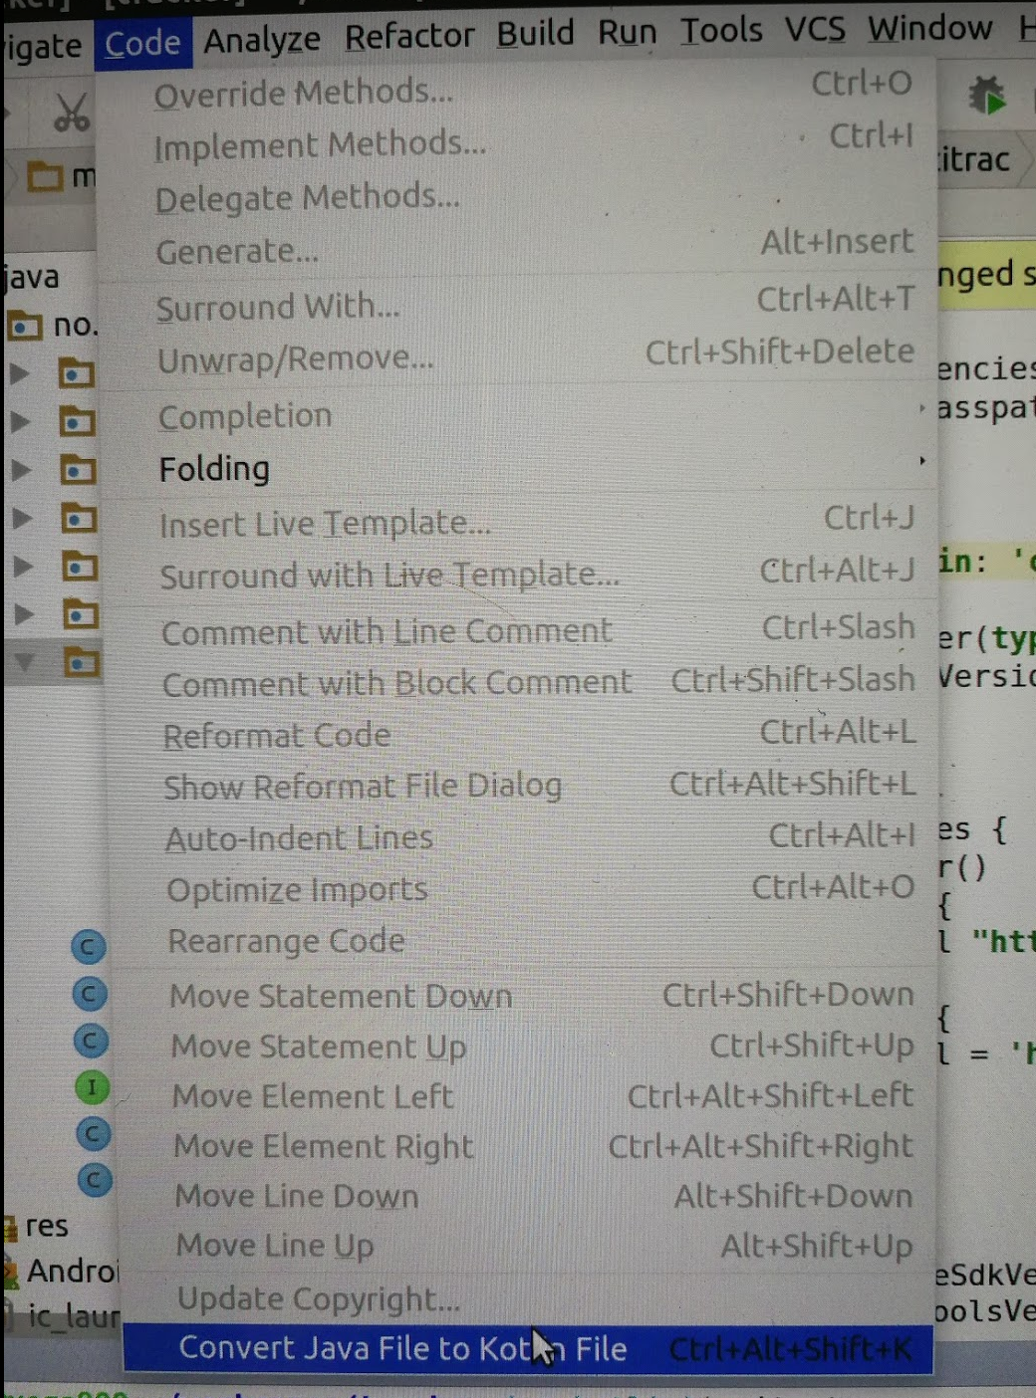
Convert your project
Select src/main/java folder
Code -> convert Java File to Kotlin File.
.java -> .kt

Slide 24
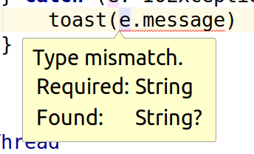
Nullability issues

Slide 25
Android-annotation
Add kotlin-kapt plugin to your build-script and add android-annotation-dependency to the kapt-configuration
Notes:
https://nilsmagnus.github.io/post/android-annotations-kotlin/

Slide 26
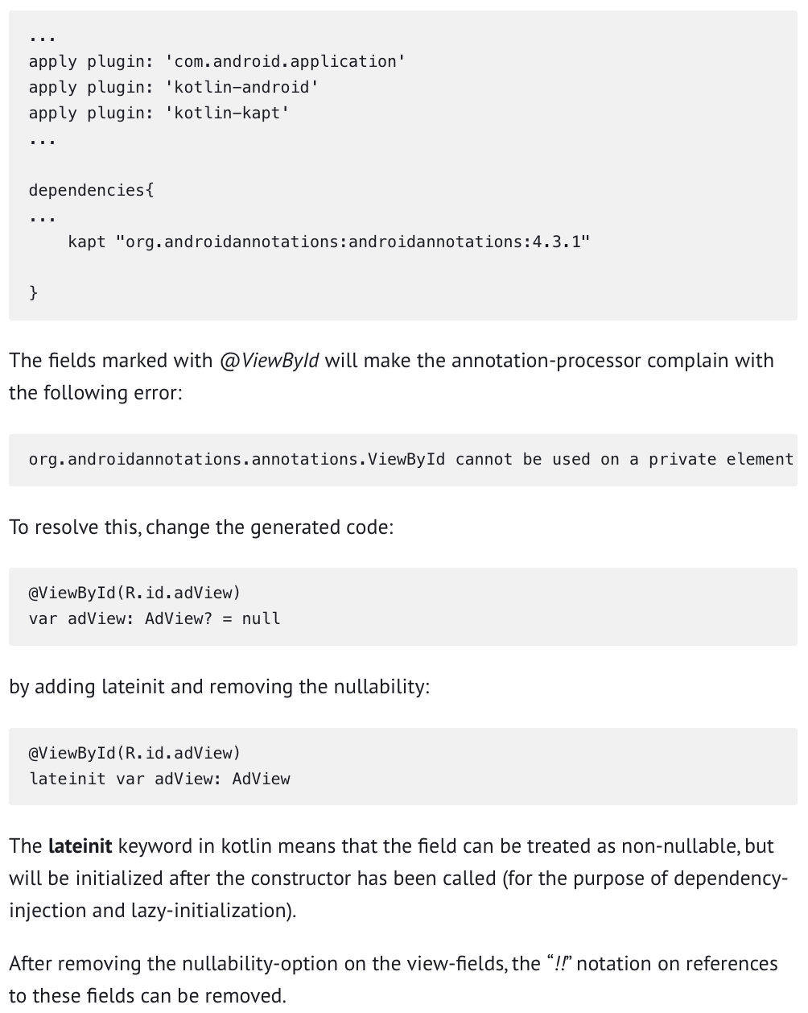

Slide 27
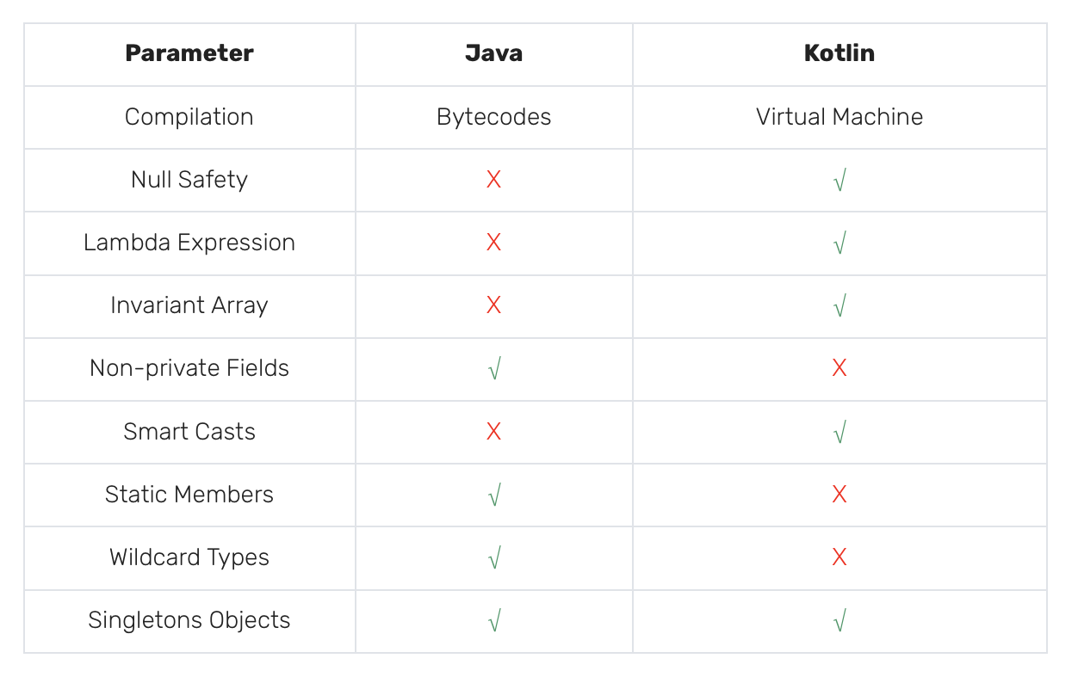
Java or Kotlin?
According to Xenonstack comparison

Slide 28
Resources
https://www.xenonstack.com/blog/kotlin-andriod/
https://developer.android.com/kotlin/coroutines
https://en.wikipedia.org/wiki/Coroutine
https://piotrminkowski.com/2020/06/23/kotlin-coroutines-vs-java-threads/
https://www.w3schools.com/java/java_intro.asp
https://www.altexsoft.com/blog/engineering/pros-and-cons-of-java-programming/
https://nilsmagnus.github.io/post/android-annotations-kotlin/

