Slide 1



Frédéric Gillardo
LAPP/IN2P3/CNRS
gillardo@lapp.in2p3.fr
Data Science
Notes:
Présentation : LAPP que savent-ils sur le lapp ?
Stage big data architect
Mon parcours professionnel
Un point sur eux
Python?
Anacoda?
Git?

Slide 2
Data locality Paradigm
Playing card example
HDFS
Map / Reduce
Spark
Notes:
Supervision dans CTA
Présentation projet CTA
Protocole de supervision existant de HESS : OPC
Protocole de supervision dans CTA : OPCUA
Autres protocoles : Mqtt / RestAPi
Maintenance prédictive
industrie 4.0 exemple : EPCIS
Exemple de supervision informatique : Nagios

Slide 3
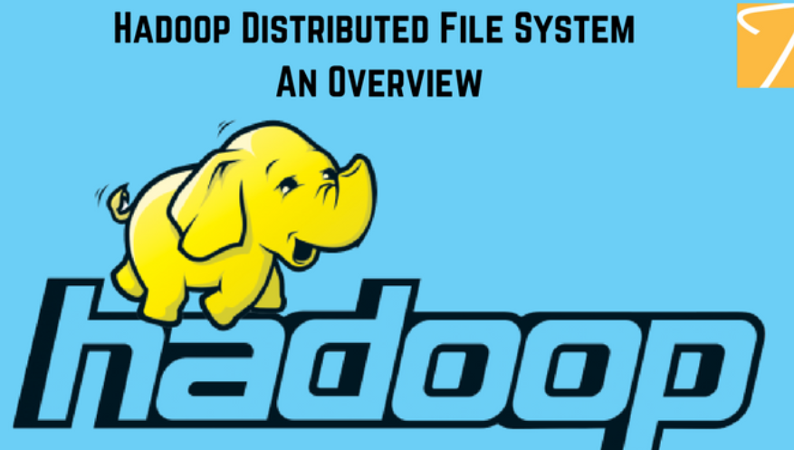
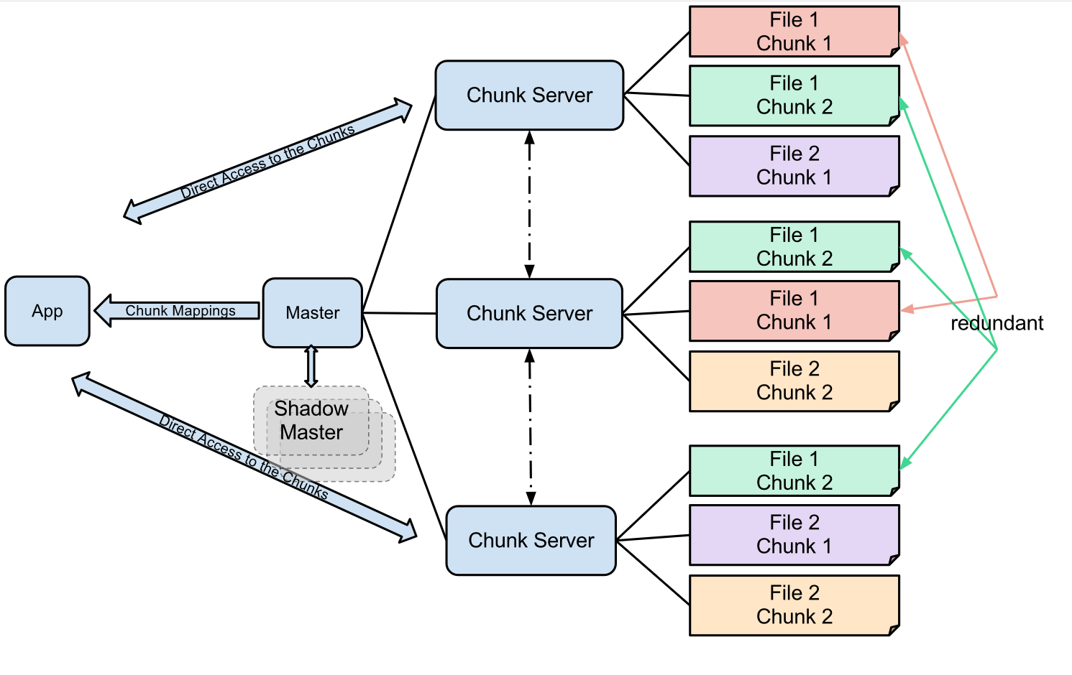
HDFS
Hadoop provides a software framework for distributed storage and processing of big data using the MapReduce programming model. Originally designed for computer clusters built from commodity hardware

Slide 4
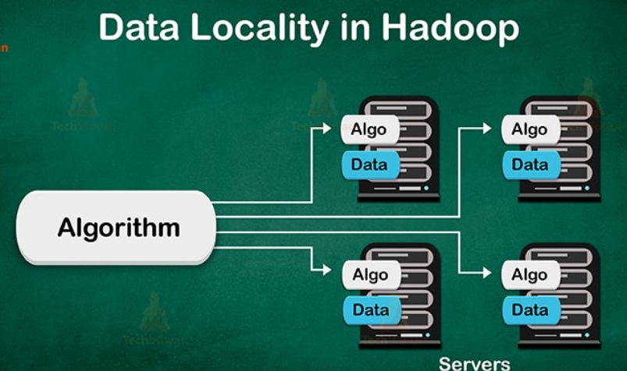
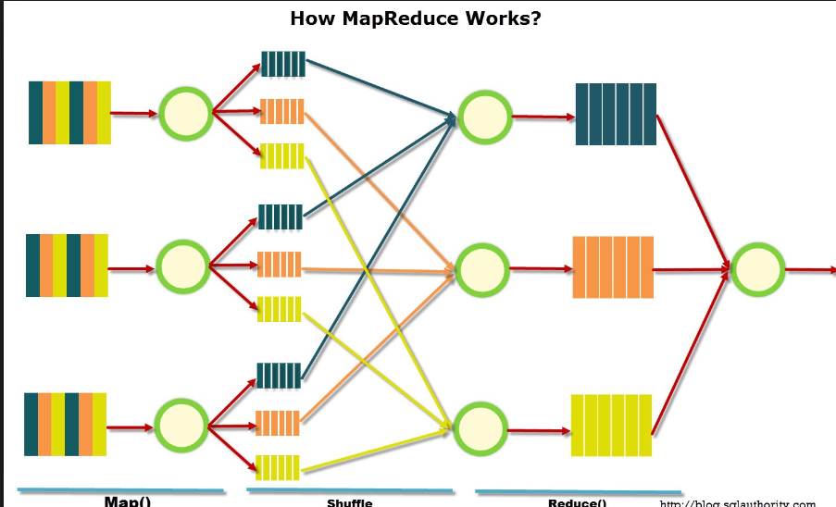
Map / Reduce
Data locality refers to the ability to move the computation close to where the actual data resides on the node, instead of moving large data to computation.

Slide 5
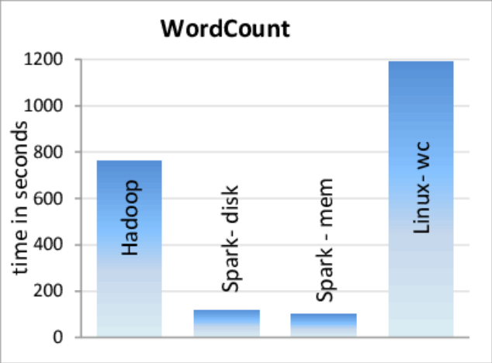

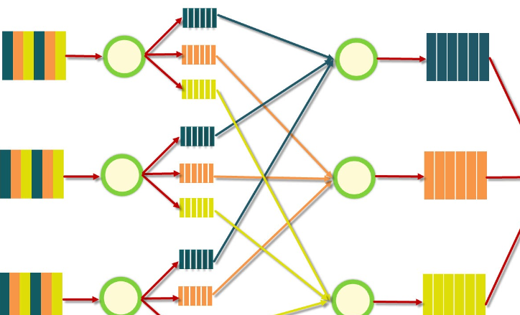
Spark
Rdd Dataframe
Lazy evaluation

Slide 6
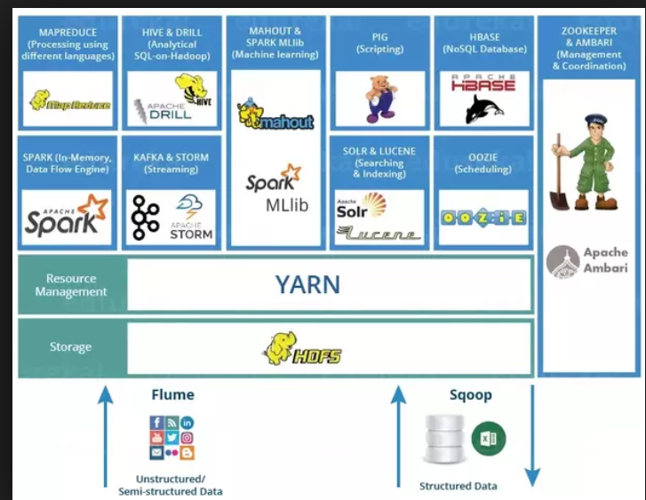
Hadoop ecosystem

Slide 7
Notebook
Open account on https://community.cloud.databricks.com
Run the Quick start notebook
Follow instruction from https://github.com/gillardoLapp/data-science_student/MapReduce/Readme.txt

