Slide 1
Making an Impact in our Communities: PA
DSCI – 511

Slide 2
Our Team
Justin, Rachel, Grace and RJ

Slide 3
Who did what?
RJ and Grace worked on created the code that grabs the data from the Census and Wikipedia.
Justin and Rachel created our interface for our database which stores our data.

Slide 4
Agenda
Backstory of our Project
What was our process like?
Outcome
What we would do differently

Slide 5

Backstory
When we started to plan our project, we wanted to create a dataset that would help make a positive impact on our communities.
We concluded that the best way to make this happen is to learn about our community resources in PA.

Slide 6
Backstory Part 2
In most cases, the best way to look up information is to google and use several sources to create an background of the community you work with.
We decided to ask, "What if we create a tool that allows us to gather crucial information about a county in one accessble space?"

Slide 7
Our Plan
The first Question we asked is "What information do we want to grab?
The Census Bureau conducts surveys on behalf of various federal government and local government agencies on topics such as employment, crime, health, consumer expenditures, and housing.

Slide 8
Who can use this information?
We want to use the data to create a tool for
non-profit organizations
government agencies
communities to understand their communities better.

Slide 9
How can we reach this goal?
Using SQL, We created a database containing important census data and important Wikipedia.
The database allows the interested parties to look up counties in Pennsylvania and find information about:
A General description about the county from Wikipedia
Census Data including income, Healthcare Coverage , employment and poverty level

Slide 10
Our Process
First, we had to collect the data from the Census.
Currently, the Census Bureau offers the public wider access to key U.S. statistics through the Census application programming interface (API)
We can access the API by signining up for a Key through their website.
They offer several different surveys to access data.

Slide 11
API
We chose The American Community Survey (ACS) from 2019 to pull data.
The American Community Survey (ACS) is an ongoing survey that provides data every year -- giving communities the current information they need to plan investments and services.
2020’s data is unavailable, but will be released soon.

Slide 12
How do we get information from the API?
First we get our key from the website:
Each survey provides a code that represents a question from the Census.
You then need to chose if you want to look at a state, county, or townships
We then use the get command to receive the data as a JSON.

Slide 13
Example
requests.get("https://api.census.gov/data/2019/acs/acs1/profile?get=NAME," + Code from Census + "&for=county:*&in=state:42" + Key)

Slide 14
We then Parsed through the JSON file and created lists to hold our data.
Using tools like BeautifulSoup, we used the parsed data from the JSON file to webscrape Wikipedia.

Slide 15
Our Data
Following this, We then exchanged the question code to find the data we want and we parse and add the data to our list.
The data looks something like this before we add it to our database:
[County, Wikipedia Summary, Income Data, Health Care, Employment in the county, and poverty level]

Slide 16

What were some challenges that we faced?
The Census data is released yearly, so we can only grab data from the surveys that the Census API allows us.
Not everyone fills out the Census, so These results are always estimates
Navigating through the Census API can be difficult, since there is so much questions to go through.

Slide 17
Now that we have the data, Where is it stored?
Platform
MySQL
Hosting
MySQL Workbrench
Why SQL?
Open source
Manipulation
Easy to understand and learn

Slide 18
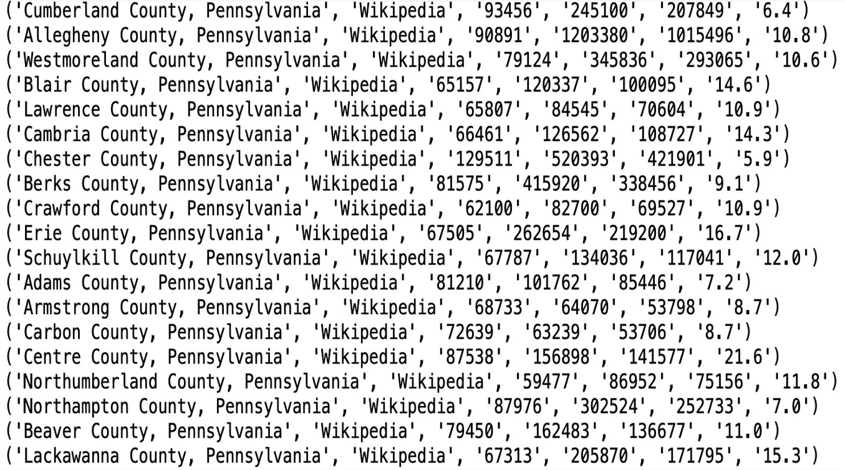
Output
Data | Format
Name of County | str
Wikipedia Summary | str
Income Data | str
How many people are currently have Healthcare coverage? | str
How many people are employed? | str
Percent of Individuals who are under the poverty line | str

Slide 19
Is this project scalable?
All we need is to change the state code to get data from other states.
We can also add more questions by changing the Question code.
We can access older Census data for further data analysis.

Slide 20
What's Next?
We will format the data we receive from the Census in a more user friendly way.
We will try to split the name into county and state.

Slide 21
Questions?

