Slide 1
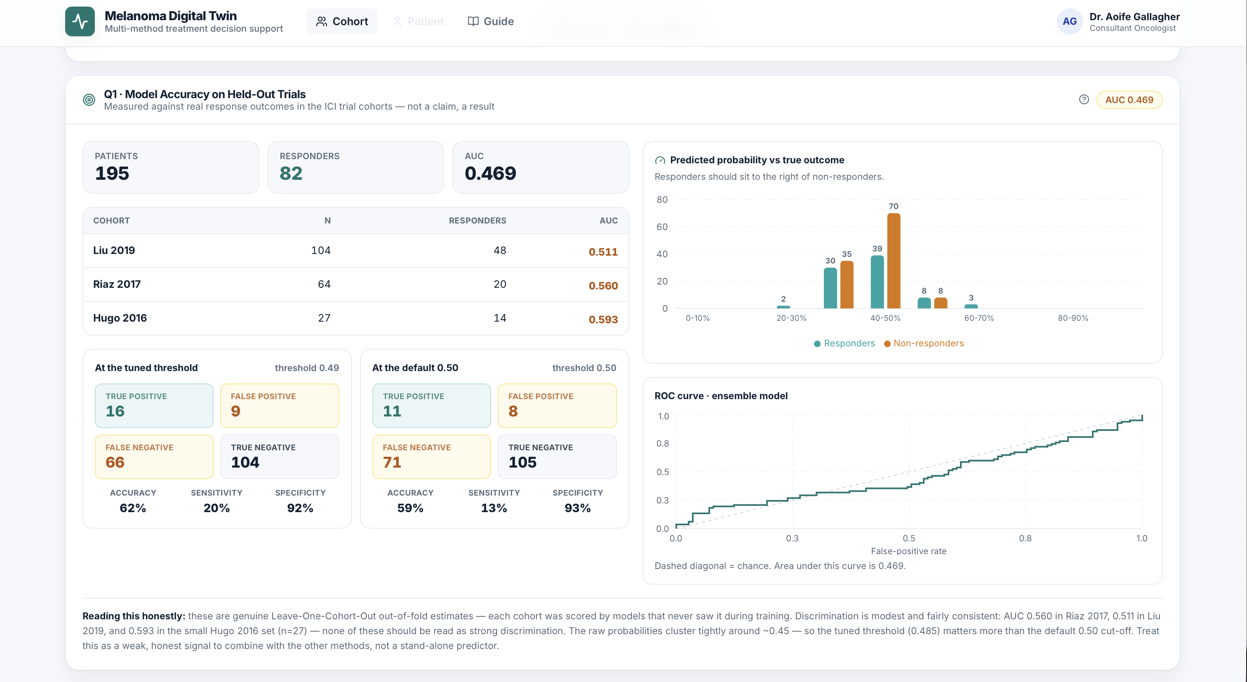
MEIN40330 Final Project
Melanoma Treatment Decision Support:​
Where Every Method Converges​
Presented by:​​
Amanda Dominy | Anthony Smaldore | Gift Ndukwu​ | Hena Adlakha | Jinish Rajan | Meave Graham​​
  4th August 2026
Notes:
We are group 2.
My name is Meave.
The title of our work is Melanoma Treatment Decision Support: Where Every Method Converges

Slide 2
Our Story
Speaker | Content / Research Question | Source
Meave | Why Melanoma? | Literature Overview
Anthony & Jinish | Can a mechanistic ODE model predict how melanoma patients respond to targeted therapy and immunotherapy? | TCGA-SKCM (PanCancer Atlas 2018): RNA-seq expression, mutation, clinical/survival, and proteomics data.
Amanda | Can a biologically grounded machine learning framework accurately predict immunotherapy response and generalise across clinical trial cohorts? | 3 iAtlas cohorts
Gift | Can we predict melanoma cell viability under standard-of-care drug treatment from gene expression, and does it align with predicted immunotherapy response? | GDSC2 drug response (AUC), DepMap RNA expression, TCGA-SKCM (cBioPortal) patient expression
Hena | Can DepMap dependency and expression data identify melanoma-selective vulnerabilities and nominate potential new drug targets? | DepMap 24Q2: CRISPR dependency, RNA expression and cell-line metadata. CRISPR Chronos gene-effect data Dependency probability data CCLE expression data
Intro
Chapter 1
Chapter 2
Chapter 3
🎯 Goal: to move from understanding melanoma biology to supporting personalised treatment decisions
Notes:
I am going to introduce our story and why we chose melanoma.
Next, over 3 chapters, my colleagues will present how they addressed our research questions using ODEs, ML models and target discovery.
We will then conclude with how we have brought these methods together to support clinicians in making treatment decisions.

Slide 3
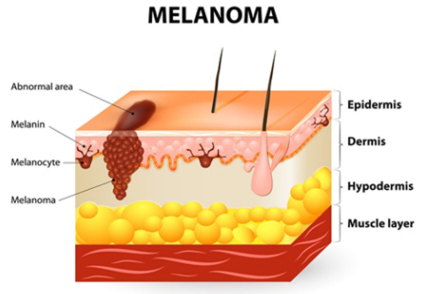
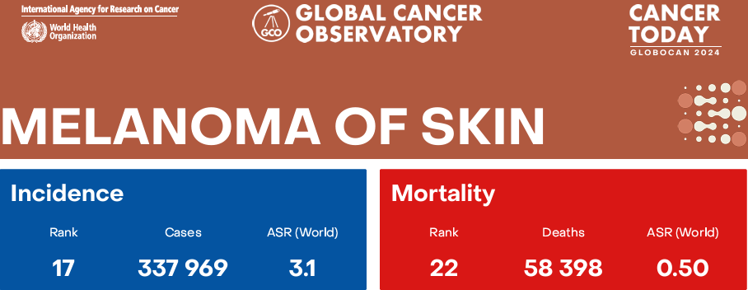
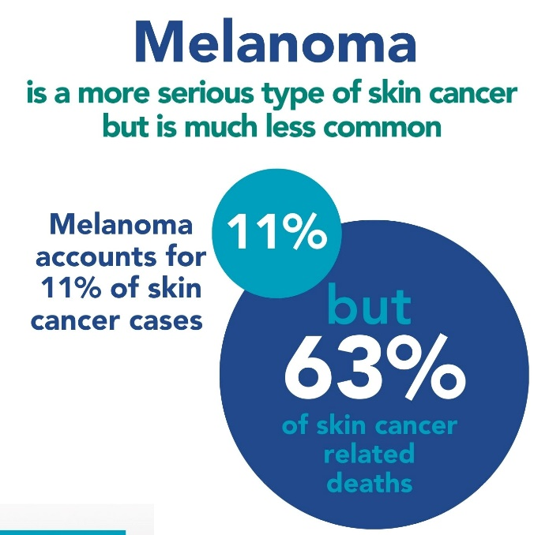
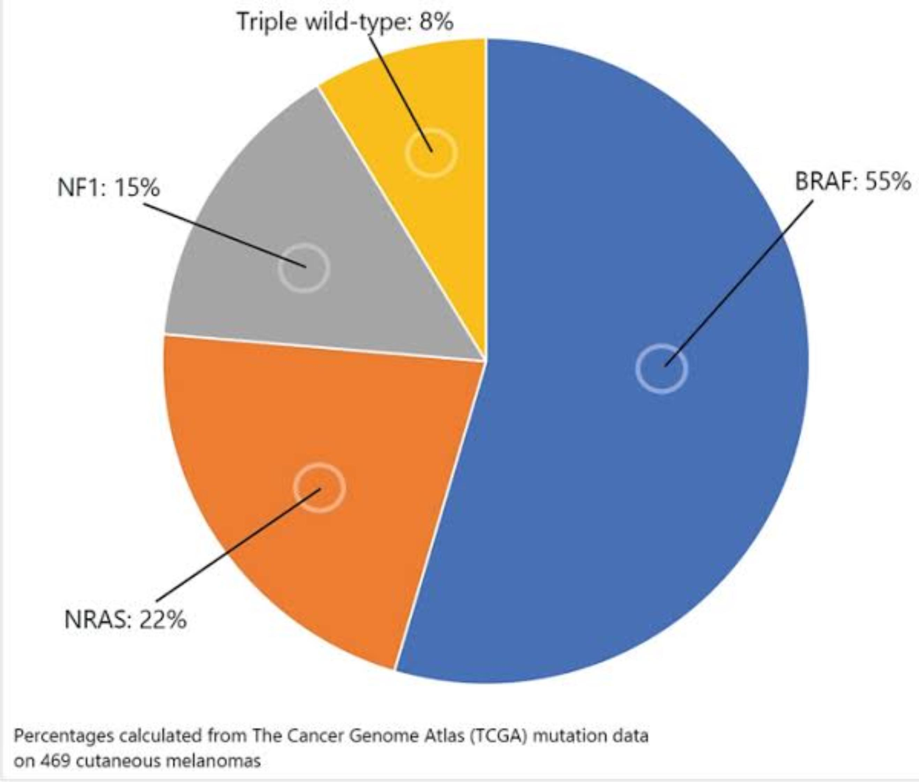

Melanoma: Current Treatment Landscape
Most aggressive skin cancer
Major molecular drivers
Stage-dependent treatment
Advanced
Immunotherapy
(ICIs)
Targeted therapy
(BRAF/MEK inhibitors)
Localised
Surgery
Lazic & Medeiros 2024
🎯
Takeaway: Multiple treatment options are available for advanced melanoma.
Notes:
Melanoma is a malignancy arising from abnormal proliferation of melanocytes, the pigment-producing cells of the skin.
Globally, there are 338k new cases annually and over 58k deaths.
It is the least common but most aggressive form of skin cancer....for example in Ireland, it accounts for only around 11 percent of skin cancer cases but is responsible for approximately 63 percent of skin cancer-related deaths.
At the molecular level, melanoma is driven by several key genomic alterations, most notably B-RAF, NRAS and NF1, which contribute to dysregulation of the MAPK signalling pathway and promote tumour growth.
Treatment depends on disease stage. Localised melanoma is typically managed surgically and can often be cured when detected early.
For advanced disease, there are 2 approaches.
The first is immunotherapy, particularly immune checkpoint inhibitors which stimulate anti-tumour immune responses and can produce durable long-term benefit.
The second is targeted therapy for patients with B-RAF mutations. Anthony is going to provide an overview of these pathways.
While these therapies have transformed patient outcomes, responses remain highly variable between individuals.

Slide 4
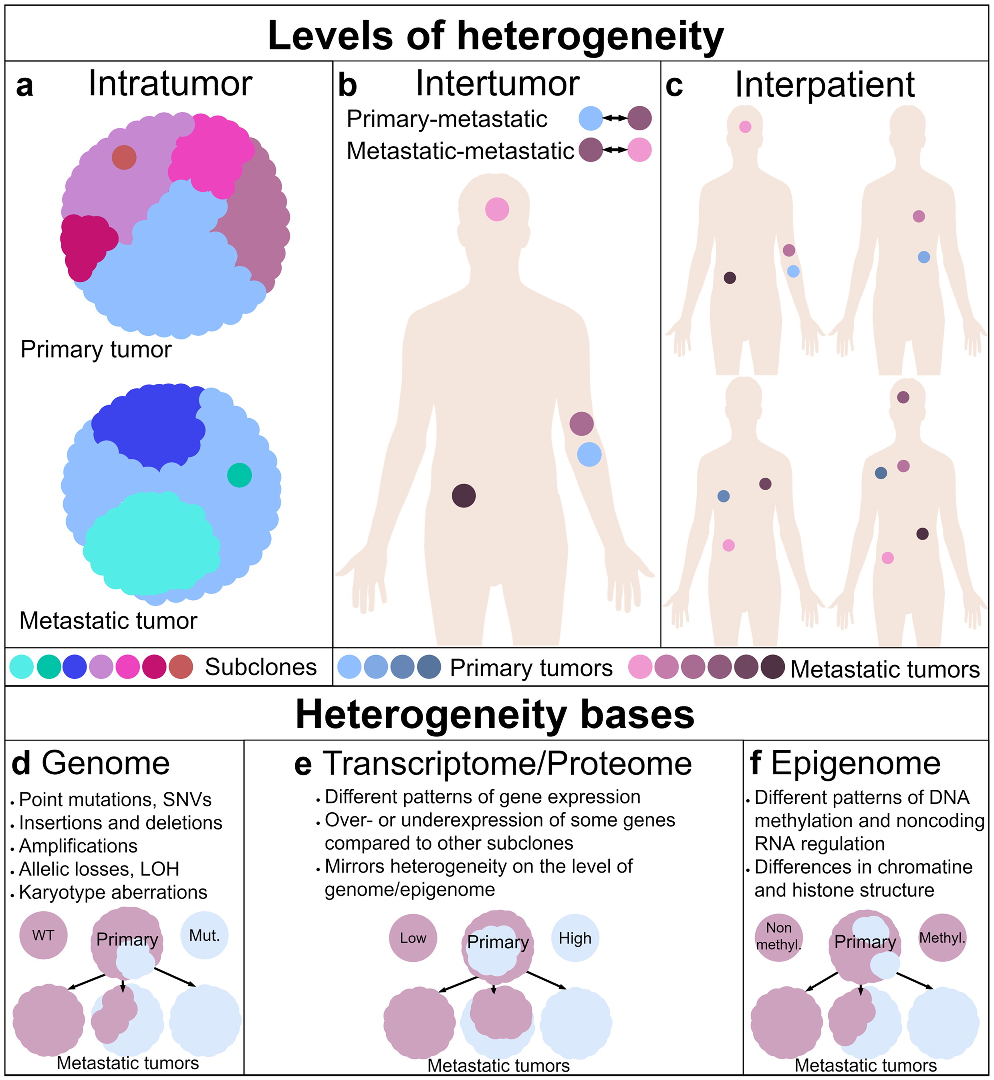
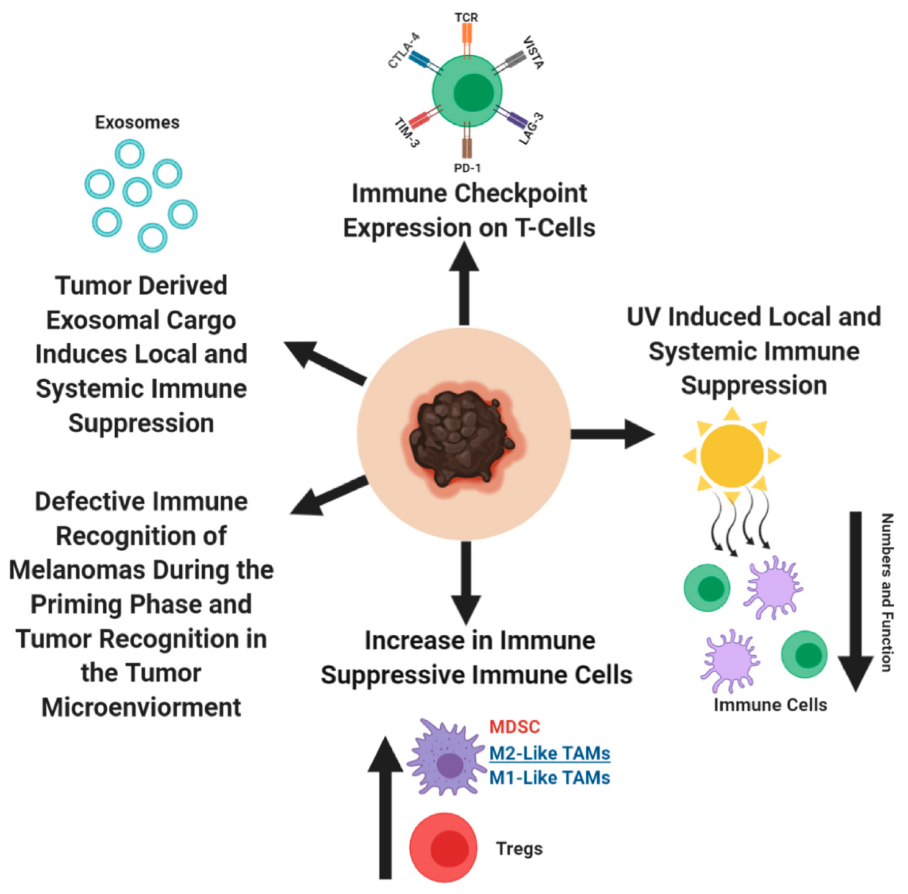
Same Diagnosis. Different Outcomes.
<50% durable response to anti-PD-1 immunotherapy
BRAF/MEK-targeted therapy response up to ~70%, but resistance can develop
Boutros et at, 2024; Sade-Feldman et al, 2018
Tumour heterogeneity
Complex immune reactions
Pasquali et al 2020
Mroz & Rocco 2017
🎯
Takeaway: Different tumour characteristics lead to different tumour responses.
Notes:
Immunotherapy doesn't work for everyone, and targeted therapy doesn't last forever.
With anti-PD-1 immunotherapy fewer than 50% of patients experience durable response.
Targeted therapies can produce rapid tumour shrinkage in up to 70% patients with BRAF-mutant disease, but resistance frequently develops over time.
Why does this happen?
The answer lies in the biological complexity of melanoma, specifically tumour differences and immune response.
Tumour heterogeneity refers to genetic, molecular and cellular differences within tumours. These differences influence response to treatment and disease progression.
Differences in the tumour immune microenvironment strongly influence whether the immune system successfully eliminates tumour cells.
As a result, patients with apparently similar disease can experience very different outcomes.
This raises a key question: can we predict how an individual patient's tumour will respond before treatment begins?
I will now hand over to Anthony for chapter 1 of our story.

Slide 5
Chapter 1
Can a mechanistic ODE model predict how melanoma patients respond to targeted therapy and immunotherapy?

Slide 6
Melanoma Signalling Pathways
MAPK growth signalling (top) and the PD-1/PD-L1 immune checkpoint (bottom)
Growth
receptor
Cell membrane
RAS
NRAS mut. ~18%
RAF
BRAF V600E ~45%
Vemurafenib
Encorafenib
MEK
MAPK/ERK Kinase
Trametinib
Binimetinib
ERK
active = "pERK"
Proliferation
& survival
Tumour cell
T-cell
activates
blocked by drug
mutated / overactive in melanoma
PD-L1
PD-1
anti-PD-1 /
anti-CTLA-4
T-cell "brake" released
by checkpoint blockade
Cytotoxic attack
on tumour
Notes:
Before I get into the model, this is the biology it's built on. Top row is the MAPK growth pathway — a receptor signal runs through RAS, RAF, MEK, ERK to drive proliferation. In about 45% of melanomas, BRAF is mutated and stuck 'on' — that's the RAF node highlighted here. Vemurafenib and trametinib-class drugs block this cascade at those two points. Bottom row is the separate immune checkpoint, Anthony will talk more about it where PD-L1 on the tumour talks to PD-1 on the T-cell to keep it switched off, and checkpoint drugs block that handshake instead. My model simulates the top pathway mechanistically, as a system of equations, rather than treating it as a black box

Slide 7
The four ODE modules
Four ODE models built utilizing patient inputs for all 421 TCGA-SKCM patients and adapted from published literature and their models.
MODULES
PUBLISHED SOURCES
PATIENTS MODELED
4
6
421
ODE Model Overview
Module A computes effective RAF drive from drug dose → sets Module B’s V1
Module B integrates the MAPK cascade to steady state → pERK
Module D computes the checkpoint suppression (f_kill) independently, from PD-1/PD-L1 expression + anti-PD-1 dose
Module C uses pERK (proliferation) and f_kill (killing) as fixed inputs, integrated over days
Modules A and D are solved instantly as algebra; B and C are the modules integrated over time
Takeaway: An integrated ODE model with 4 sub-modules that integrates per patient inputs from the 421 TCGA-SKCM dataset.
Takeaway:

Slide 8
The Signalling – Part 1: Module A
The RAF-inhibitor paradox emerges from binding and will be passed as input to Module B.
Module A: RAF dimer + drug
Symbol | Meaning
drug | Vemurafenib concentration (nM) — the dose being swept
Kd | Vemurafenib's binding affinity for a RAF protomer (universal)
Coop | Negative-cooperativity factor for the 2nd binding site (=20; 2nd-site Kd = Coop·Kd)
Γ | Drug-induced dimerisation strength (universal)
Kdim | Dimer abundance scaling per unit RAS-GTP (universal)
RASGTP | RAS-GTP level — set by genotype (V600E: low, NRAS: high, WT: basal)
RAF_tot | Total RAF pool — scaled per patient by BRAF expression
V600Efrac | 1 if patient has BRAF-V600E, else 0
V1 | Kholodenko's published baseline Raf-activation Vmax (=2.5), carried over from Module B
A_ref | Reference RAF signal at zero drug/basal RAS-GTP/mean expression — normalises V1_eff only
a = drug / Kd
b = drug / (Coop · Kd)
p = drug / (Kd + drug)
Z = 1 + 2a + a·b
active_per_dimer = (2 + 2a) / Z
A_dimer = Kdim · RASGTP · RAF_tot · (1 + Γ·p) · active_per_dimer
A_mono = V600Efrac · RAF_tot · Kd / (Kd + drug)
A_total = A_mono + A_dimer
V1_eff = V1 · A_total / A_ref
Poulikakos et al. (2010)
Rukhlenko et al. (2018)
Takeaway: The RAF paradox emerges from Module A’s binding equilibrium, then propagates through Module B’s Cascade through the V1_eff term.

Slide 9
The Signalling – Part 2: Module B
Propagation of RAF-inhibitor paradox through the MAPK Cascade in Module B.
Module B: MAPK Cascade
Symbol | Meaning
Raf, RafP | Un-/phosphorylated Raf (states)
MEK, MEKp, MEKpp | Un-/mono-/di-phosphorylated MEK (states)
ERK, ERKp, ERKpp | Un-/mono-/di-phosphorylated ERK (states; ERKpp = pERK readout)
Ki, n1 | Feedback-inhibition constant & Hill coefficient (universal)
K1–K10 | Michaelis constants (universal, Kholodenko Table 2)
V2, V5, V6, V9, V10 | Dephosphorylation Vmax constants (universal)
k3, k4, k7, k8 | Phosphorylation rate constants (universal)
V1_eff | Input from Module A (replaces Kholodenko's fixed V1)
Raf, RafP | Un-/phosphorylated Raf (states)
MEK, MEKp, MEKpp | Un-/mono-/di-phosphorylated MEK (states)
v1 = V1_eff·Raf / [(1+(ERKpp/Ki)^n1)·(K1+Raf)]
v2 = V2·RafP / (K2+RafP)
v3 = k3·RafP·MEK / (K3+MEK)
v4 = k4·RafP·MEKp / (K4+MEKp)
v5 = V5·MEKpp / (K5+MEKpp)
v6 = V6·MEKp / (K6+MEKp)
v7 = k7·MEKpp·ERK / (K7+ERK)
v8 = k8·MEKpp·ERKp / (K8+ERKp)
v9 = V9·ERKpp / (K9+ERKpp)
v10 = V10·ERKp / (K10+ERKp)
dRaf/dt = v2-v1 dRafP/dt = v1-v2
dMEK/dt = v6-v3 dMEKp/dt = v3+v5-v4-v6
dMEKpp/dt = v4-v5 dERK/dt = v10-v7
dERKp/dt = v7+v9-v8-v10 dERKpp/dt = v8-v9 (pERK)
Kholodenko (2001)
Takeaway: The RAF paradox emerges from Module A’s binding equilibrium, then propagates through Module B’s Cascade through the V1_eff term.

Slide 10
The Tumour-Immune Half – Part 1: Module C
Tumour growth is driven mechanistically by Module B’s pERK, while checkpoint blockade (Module D) gates how much of the patient’s own immune killing capacity is released.
Module C: Melanoma tumor-imune dynamics
Symbol | Meaning
pERK | Module B's steady-state output for this dose/patient
pERK_ref | Cohort-reference pERK (WT, mean expression, zero drug)
PROLIF_MIN, PROLIF_CAP | Clipping bounds on the proliferation ratio (universal)
T8_SCALE | Calibration constant mapping infiltration score onto effector density (universal)
infiltration | Patient's mean(CD8A, PRF1, GZMA) expression
λC, CM, dC | Growth rate, carrying capacity, death rate — universal (Lai et al. Table 2)
eta8 | Base CD8 killing rate — universal (Lai et al. Table 2)
CYT_patient, CYT_mean | Patient's cytolytic score vs. cohort mean
f_kill | Module D's output (fraction of killing not checkpoint-blocked)
C | Tumour burden — the state being integrated (the readout)
prolif = clip(pERK / pERK_ref, PROLIF_MIN, PROLIF_CAP)
T8 = T8_SCALE · infiltration
eta8_i = eta8 · CYT_patient / CYT_mean
dC/dt = λC · prolif · C · (1 - C/CM) - eta8_i · f_kill · T8 · C - dC · C
Lai & Friedman (2017),
Nave & Sigron (2022)
Takeaway: Growth and killing are mechanistically driven by pERK from Module B, and by the checkpoint state (f_kill, Module D). The tumour-burden output carries the RAF paradox and each patient’s own immune biology.

Slide 11
The Tumour-Immune Half – Part 2: Module D
Tumour growth is driven mechanistically by Module B’s pERK, while checkpoint blockade (Module D) gates how much of the patient’s own immune killing capacity is released.
Module D: Checkpoint axis (anti-PD-1)
Symbol | Meaning
PDCD1_TOTAL_0, PDL1_TOTAL_0 | Baseline PD-1 / PD-L1 pool sizes at mean expression (universal)
PDCD1_expr, CD274_expr | Patient's PDCD1 / CD274 expression (normalised)
antiPD1 | Anti-PD-1 concentration (nM) — the dose being swept
Kd_PA | Anti-PD-1's binding affinity for PD-1 (universal)
Kd_PL | PD-1·PD-L1 complex binding affinity (universal)
PD1_tot = PDCD1_TOTAL_0 · PDCD1_expr
PDL1_tot = PDL1_TOTAL_0 · CD274_expr
P_free = PD1_tot / (1 + antiPD1/Kd_PA)
Q = min(PDL1_tot · P_free / (Kd_PL + P_free), PD1_tot)
f_kill = 1 - Q/PD1_tot
Lai & Friedman (2017), Rooney et al. (2015)
Takeaway: Growth and killing are mechanistically driven by pERK from Module B, and by the checkpoint state (f_kill, Module D). The tumour-burden output carries the RAF paradox and each patient’s own immune biology.

Slide 12
The ODE digital twin simulates immunotherapy response
One shared tumour-immune equation – driven by a simulated anti-PD-1 checkpoint axis instead of BRAFi – solved per-patient for the 421 TCGA-SKCM cohort.
PATIENTS SIMULATED
ANTI-PD-1 DOSE RANGE
CHECKPOINT INPUTS
421
0-500 nM
PD-1, PD-L1, CYT
How the Targeted arm & Immunotherapy arm are different
Shared Mechanism – both arms use the same tumour-immune equation: growth → CD8killing → death
Targeted arm (BRAFi) – dials proliferation via pERK; checkpoint held at baseline
Immunotherapy arm (anti-PD-1) – dials CD8 killing via the checkpoint gate; pERK held at baseline
Takeaway: Same digital Twin with a new immunotherapy arm which substitutes a checkpoint-gated killing term for the BRAFi-driven proliferation term.
Notes:
Both the targeted & immunotherapy arms use the same tumor-immune equation with the phases: tumor growth, offset by CD8 T-cell killing and a rate of cell death
The targeted arms reduces proliferation with the BRAF inhibitor while the immunotherapy arm dials killing
The checkpoint modeling adds a PD-1 & PD-L1 checkpoint gate where anti-PD-1 depletes PD-1 and unlocks the CD8 killing effect - and this effect is capped by each patient's own cytolytic score
The immunotherapy arm is based on the same 421 TCGA-SKCM patients with the addition of their PD-1, PD-L1, and CYT expression.

Slide 13
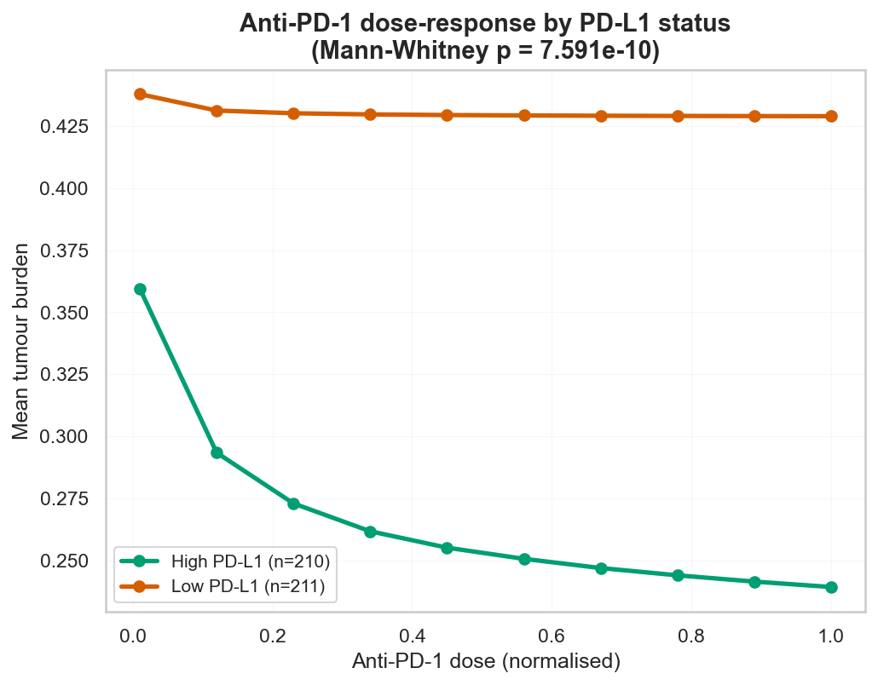
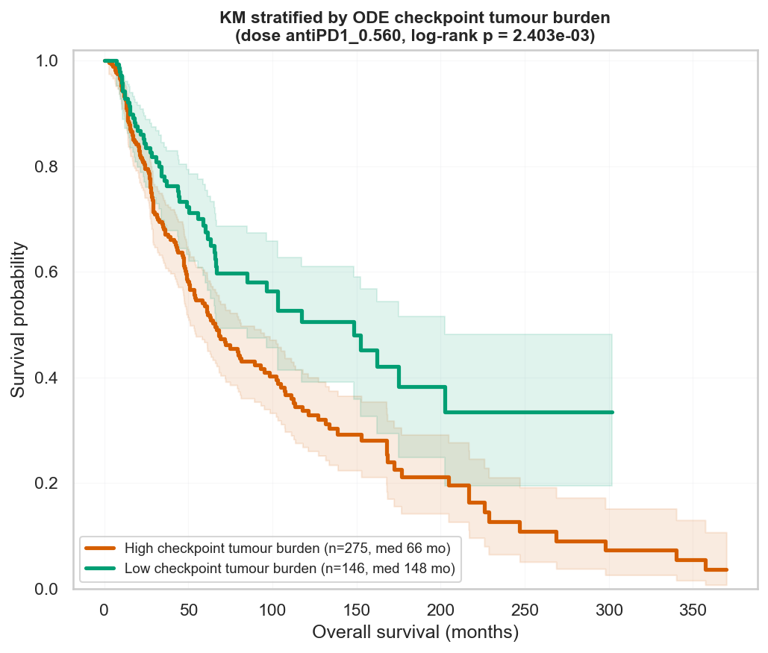
ODE checkpoint burden stratifies real survival
Anti-PD-1 dose-response behaves correctly by PD-L1 status, and the resulting modelled checkpoint burden significantly separates patients by TCGA-SKCM overall survival.
PATIENTS (ANTI-PD-1 ARM)
HIGH-PD-L1 BURDEN DROP
LOW-PD-L1 BURDEN DROP
CHECKPOINT BURDEN SURVIVAL
421
33.4%
2.0%
p = 0.0024 (66 vs 148 mo)
Anti-PD-1 dose-response by PD-L1 status
KM stratified by ODE checkpoint tumour burden
Takeaway: Correct dose-response and a significant survival split (p=0.0024) validate the checkpoint arm indirectly and produce the strongest prognostic signal for the ODE model.
Notes:
Stratification by PD-L1 status shows this in action
Where in high-PD-L1 tumors, anti-PD-1 depletes PD-1 and releases CD8 killing resulting in modelled tumor burden dropping around 33 percent
While in low-PD-L1 tumors, there's little checkpoint to block in the first place, so tumor burden barely moves and the model behaves as expected for poor-checkpoint tumor which is likely non-responsive
This modeled checkpoint of tumor burden separates real survival where patients with low burden live a median 148 months versus 66 months for high burden and is statistically significant
These dose-response and this survival split are how we indirectly validate the immunotherapy arm since RPPA cannot be used

Slide 14
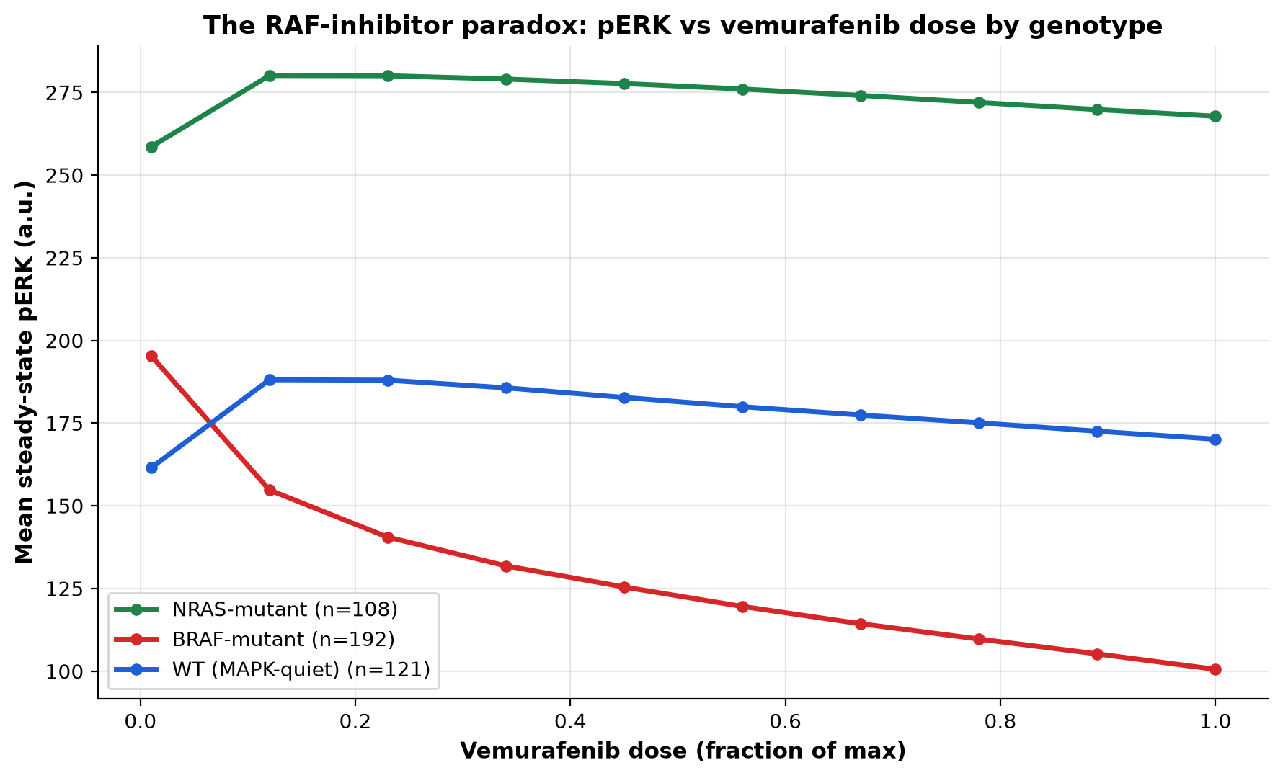
The ODE digital twin reproduces real BRAF-inhibitor pharmacology
A mechanistic digital twin — RAF-dimer drug binding → MAPK cascade → tumour-immune dynamics — solved per-patient from real TCGA-SKCM molecular data, for all 421 patients.
PATIENTS SIMULATED
BRAF-MUTANT
NRAS-MUTANT
MAPK-QUIET WT
BRAF-MUT pERK SUPPRESSION
WT / NRAS pERK CHANGE
421
192 (45.6%)
108
121
-48.5%
+3 to +5%
pERK vs vemurafenib dose, by genotype
Why this happens
BRAF-mutant: Vemurafenib blocks the constitutively active BRAF→MEK→ERK signal — pERK falls with dose.
BRAF-WT / NRAS-mutant: the same drug paradoxically activates MAPK signalling via RAF dimers — a real, published effect, reproduced here directly from the mechanism, not fit to it.
Baseline hierarchy: NRAS (259) > BRAF-mutant (195) > WT (162) — matches known MAPK-pathway activity across melanoma subtypes.
Takeaway: BRAF-mutant tumours respond to vemurafenib; BRAF-WT and NRAS-mutant tumours show the real RAF-inhibitor paradox — reproduced from the mechanism, matching published pharmacology.
Notes:
So that's the immunotherapy arm. Now the other half of the same twin — targeted therapy. Same 421 patients, same equation, but here the drug acts on proliferation instead of checkpoint killing: vemurafenib binding RAF and cascading through MAPK signalling.
Start with what we'd expect: in BRAF-mutant tumours — the red line — vemurafenib blocks the constitutively active signal, and pERK drops by about 49% as dose increases. The drug does what it's supposed to do.
But watch BRAF-wild-type and NRAS-mutant tumours — blue and green. Same drug, opposite direction — pERK actually rises at low-to-moderate dose before flattening. That's the real, published RAF-inhibitor paradox: without the V600E mutation, vemurafenib binds one half of a RAF dimer and drives the other half to transactivate. Our mechanism reproduces this without ever being told to

Slide 15
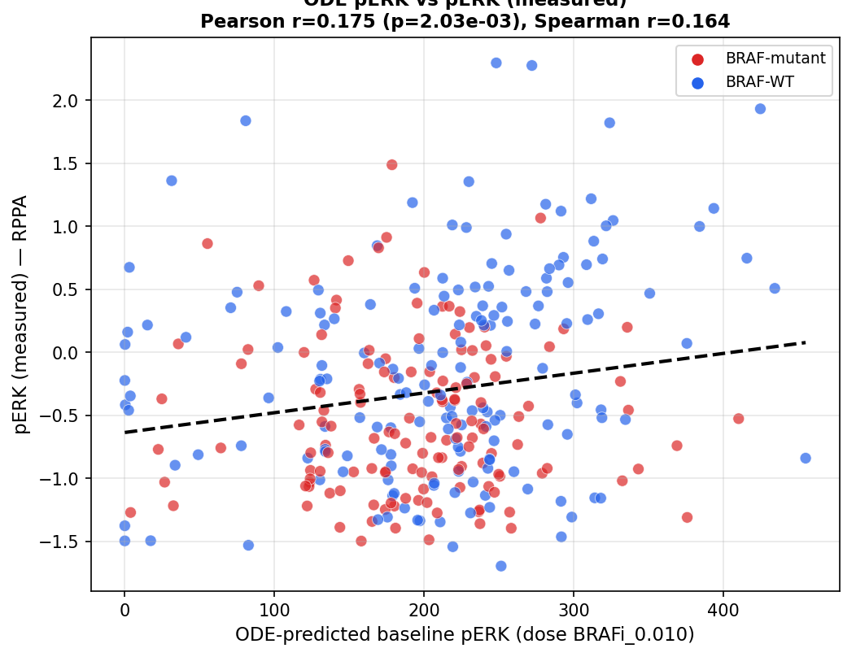
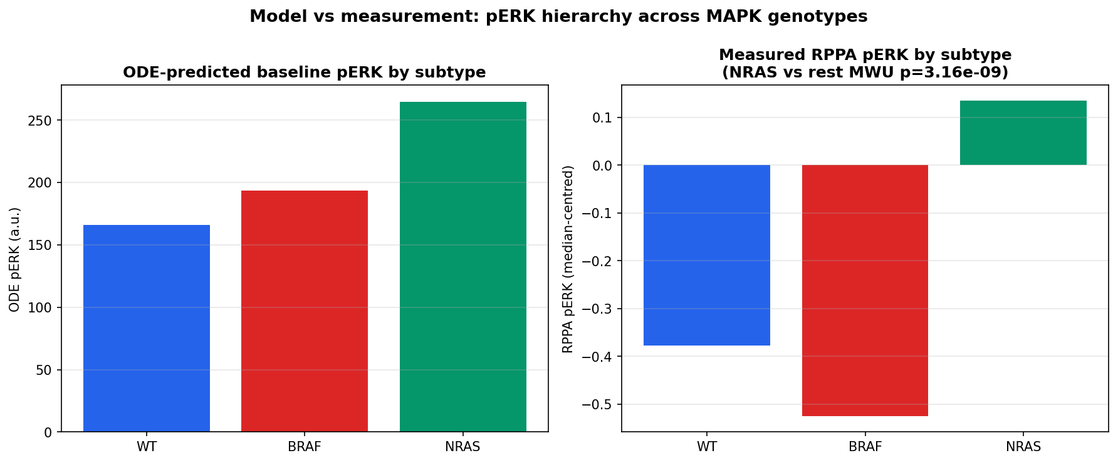
Validation: ODE pERK matches real biology
Baseline pERK, predicted purely from the BRAFi/MAPK mechanism, independently correlates with orthogonal RPPA protein measurements and correctly ranks genotype activity.
RPPA CORRELATION (n=310)
SPEARMAN
GENOTYPE RANK AGREEMENT
BASELINE pERK HIERARCHY
r=0.175, p=0.002
r=0.164, p=0.004
p=3.2×10⁻⁹
NRAS>BRAF-mut>WT
ODE pERK vs measured RPPA protein (n=310)
Genotype hierarchy: model vs measurement
Takeaway: Baseline pERK, derived purely from the mechanism, independently correlates with measured RPPA protein and reproduces the known MAPK-activity hierarchy across melanoma subtypes.
Notes:
A model that just fits its own training data isn't worth much, so we validated baseline pERK against something the model never saw: TCGA's RPPA data — direct, independent protein measurements, from a completely different assay.
Predicted pERK correlates with measured pERK — Pearson r=0.175, p=0.002, across 310 patients. Not huge, but real, and in the right direction.
More convincing: the genotype ranking. Both the model and the actual measured protein agree that NRAS-mutant tumours have the highest pERK, then BRAF-mutant, then wild-type — p=3.2×10⁻⁹. The mechanism doesn't just correlate, it gets the biology's ordering right, independently confirmed."

Slide 16
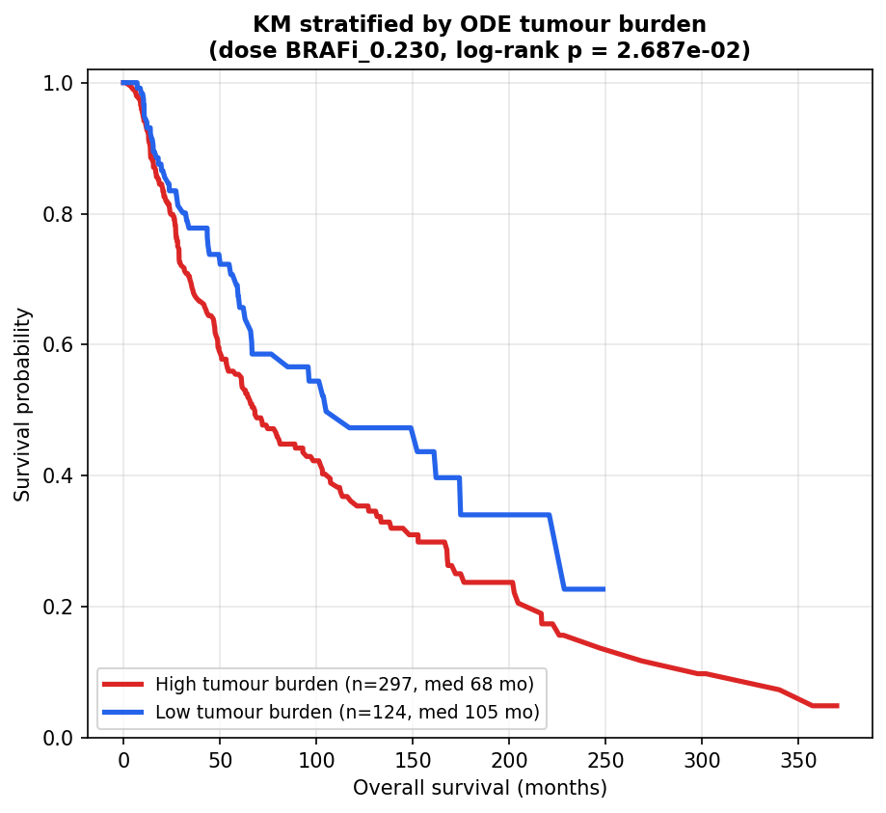
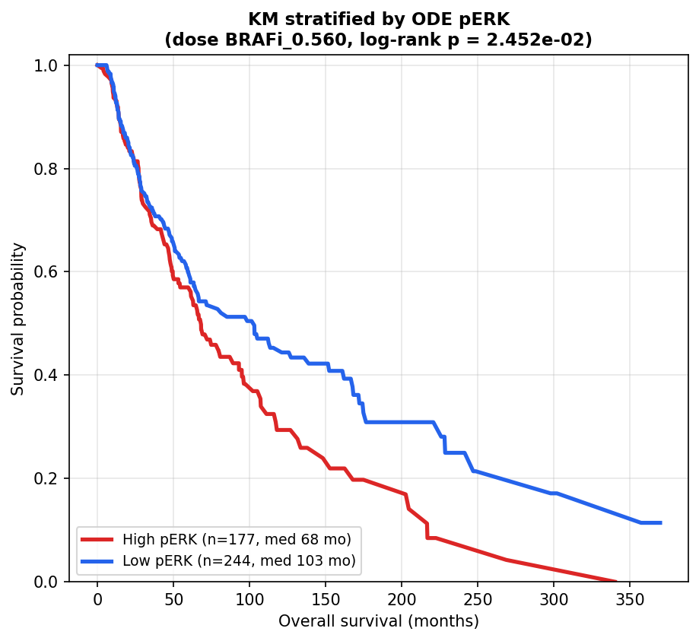
ODE Tumour burden and pERK stratify real survival
Both ODE readouts for the targeted-therapy arm — simulated tumour burden and baseline pERK — significantly separate patients by real TCGA-SKCM overall survival.
PATIENTS (BRAFi ARM)
BRAFi TUMOUR BURDEN
BRAFi pERK
OPTIMAL BRAFi DOSE
421
p=0.027 (68 vs 105 mo)
p=0.025 (68 vs 103 mo)
0.23–0.56
KM stratified by ODE tumour burden
KM stratified by ODE baseline pERK
Takeaway: Both ODE-derived readouts for the targeted-therapy arm significantly separate patients by real overall survival
Notes:
Same test we just saw for the immunotherapy arm — does any of this matter clinically? We stratified real TCGA overall survival by two ODE readouts for the targeted-therapy arm.
Simulated tumour burden: high vs low burden splits patients into 68 versus 105 months median survival, log-rank p=0.027. Baseline pERK does the same — 68 versus 103 months, p=0.025.
Two independent mechanistic readouts, from the same underlying model, both significantly separating real patient outcomes. That's genuine prognostic signal and we can actually explain why a given patient is high-risk, not just flag that they are.

Slide 17
Chapter 2
Can a machine-learning framework predict both clinical immunotherapy response across melanoma trial cohorts and cell viability under standard-of-care treatments, and are these predictions biologically aligned?
Notes:
This chapter asks a simple but important question: can we use machine learning to predict which melanoma patients benefit from which treatment, and do those predictions reflect the underlying biology of treatment response?

Slide 18
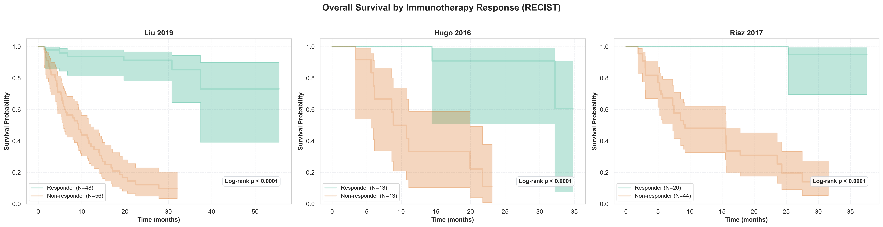
iAtlas datasets
The clinical problem with immunotherapy
Liu et al. 2019 (N = 122)
Hugo et al. 2016 (N = 27)
Riaz et al. 2017 (N = 107)
Anti-PD-1 therapy yields transformative survival for a minority, but leaves nearly 60% of patients non-responsive
NON-RESPONSE RATE
SURVIVAL PENALTY
SURVIVAL BENEFIT
2Y SURVIVAL GAP
TRIAL VALIDATION
CLINICAL TRIALS
~60%
9.2 mos
95%
93.6%
N = 194
3
113/194 → PD
NR median OS
HR 0.05 (95% CI: 0.02-0.10)
vs 16.8% for NR
Pooled clinical cohorts
cBioPortal
Responders survive 4x longer (log rank p < 0.0001 across all 3 trials)
Takeaway: Accurate pre-treatment prediction is critical to bridge the 77% 2-year survival gap between responders and non-responders
Notes:
The reason this matters becomes clear in the clinic. Anti-PD-1 checkpoint inhibitors can be life-changing for some patients, but nearly 60% of metastatic melanoma patients don't respond.
Non-responders have a median overall survival of just 9.2 months. Meanwhile, responders have dramatically improved survival, with a 95% reduction in mortality risk and a 77% gap in 2-year survival compared with non-responders.
Predicting response before treatment could help patients avoid ineffective therapies and ensure they receive the most appropriate treatment earlier.

Slide 19
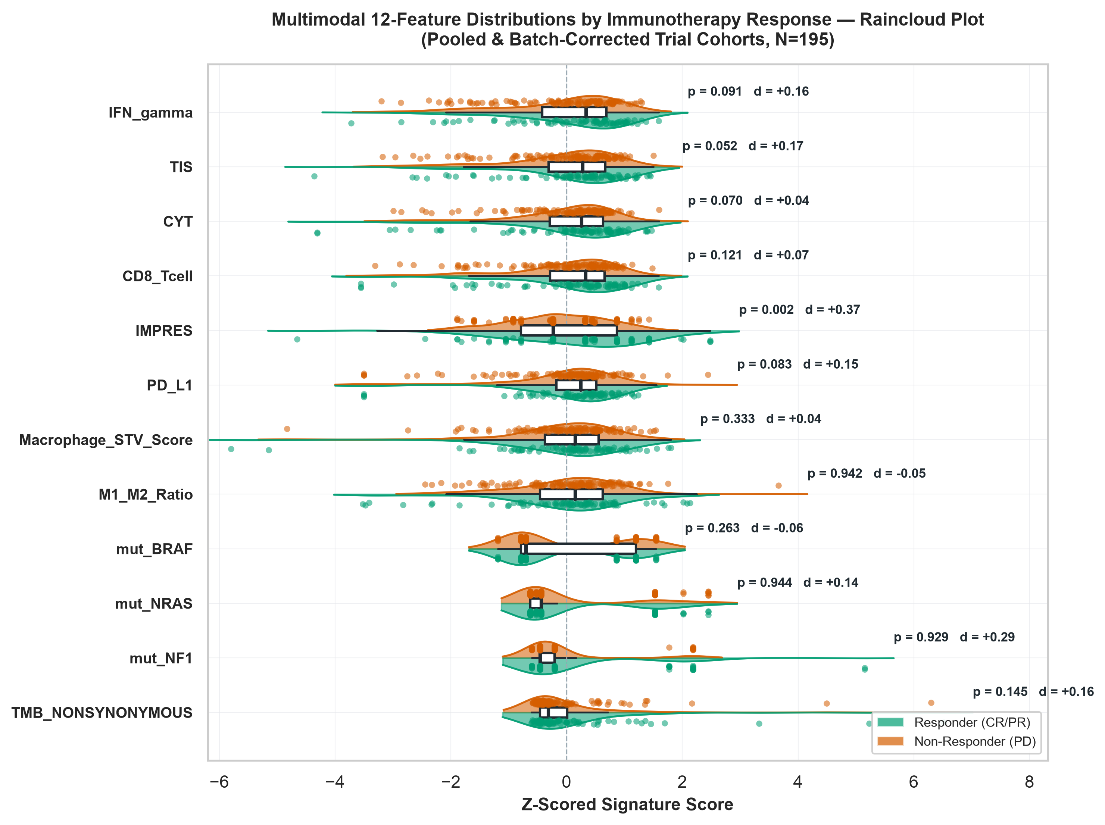
Feature engineering: curated signatures vs raw high-dimensional data
Compressing ~20,000 raw genes into a lower dimensional space eliminates D ≫ N overfitting and preserves cross-cohort generalisation
LIU 2019 (iAtlas)
RIAZ 2017 (iAtlas)
HUGO 2016 (iAtlas)
TOTAL ICI COHORT
COMMON GENES
N = 122
N = 107
N = 27
N = 256
19,757
Primary trial cohort
Validation trial cohort
Validation trial cohort
N = 195 after cleaning
Harmonised transcripts
Curated Signatures vs Uncurated Data-driven Feature Selection (SelectKBest)
IMMUNE SIGATURES
M1/M2 RATIO
IFN-γ, TIS, CYT, CD8, IMPRES,
PD-L1
6
1
Pro-inflammatory M1
Anti-inflammatory M2
MUTATIONAL BURDEN
MACROPHAGE STV
1
1
Nonsynonymous
TMB
M2 density and
stromal barrier
DRIVER MUTATIONS
COMBINED MATRIX
BRAF
NRAS
NF1
Feature
Multimodal
integration
3
12
Ayers et al. 2017, Auslander et al. 2018, Rooney et al. 2015, Liu et al. 2019, Charoentong et al. 2017, Rukhlenko 2026 (private communication, M1/M2 STV, by email)
Takeaway: Multimodal features outperform raw transcriptomics across cohorts without overfitting
Notes:
Rather than feeding 20,000 noisy, raw genes directly into models, we engineered a compact 12-feature biological profile. This combined six immune-related transcriptomic signatures with tumour mutational burden, macrophage activity, and key melanoma driver mutations.
Curated features improved performance for SVM, Random Forest, and XGBoost, with SVM achieving the best CV AUC (0.684). Regularised linear models (Elastic Net, L1 Lasso) performed similarly with either feature strategy, suggesting that biological knowledge provides the greatest benefit for capturing complex non-linear patterns

Slide 20
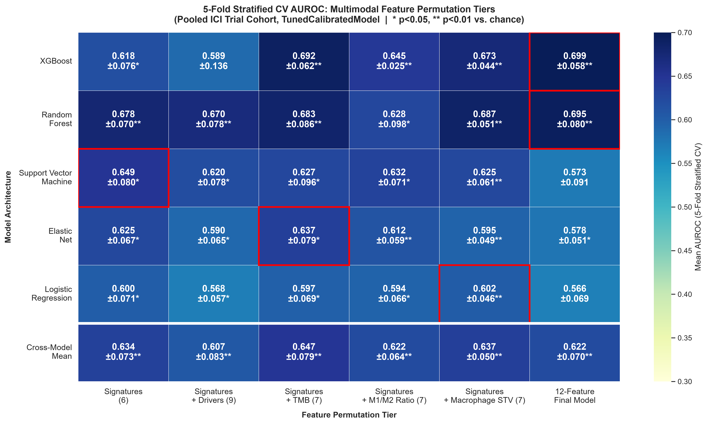
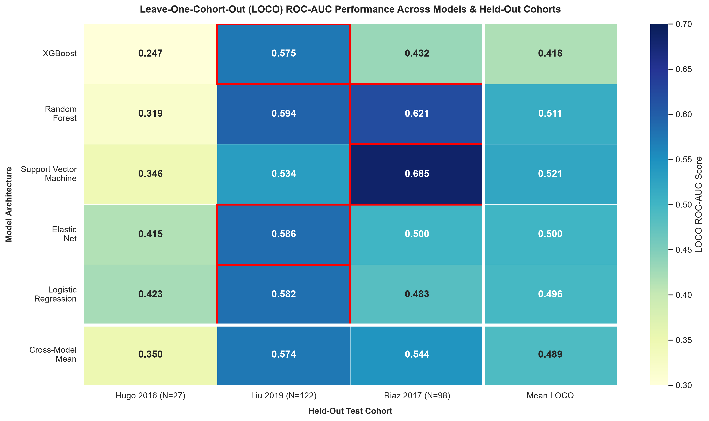
Model performance: LOCO validation with curated feature set
Leave-One-Cohort-Out (LOCO) evaluation simulates deployment to unseen clinical sites, assessing true model generalisability under real-world platform shifts
5-fold validation vs Leave-One-Cohort-Out
Takeaway: LOCO evaluation reveals real-world performance limits, showing that SVM and ElasticNet are the most resilient models across unseen datasets.
Notes:
To assess real-world deployment, we tested our 5 models using Leave-One-Cohort-Out (LOCO) validation, where an entire clinical trial cohort is held out during training. Unlike standard 5-fold cross-validation, LOCO tests how well a model transfers to a completely new clinical setting.
As expected, performance decreased, reflecting differences between clinical centres and patient populations.
SVM achieved the strongest out-of-cohort result on the Riaz data while ElasticNet showed the most consistent performance across unseen cohorts
Small cohorts such as Hugo introduced a lot of variability

Slide 21
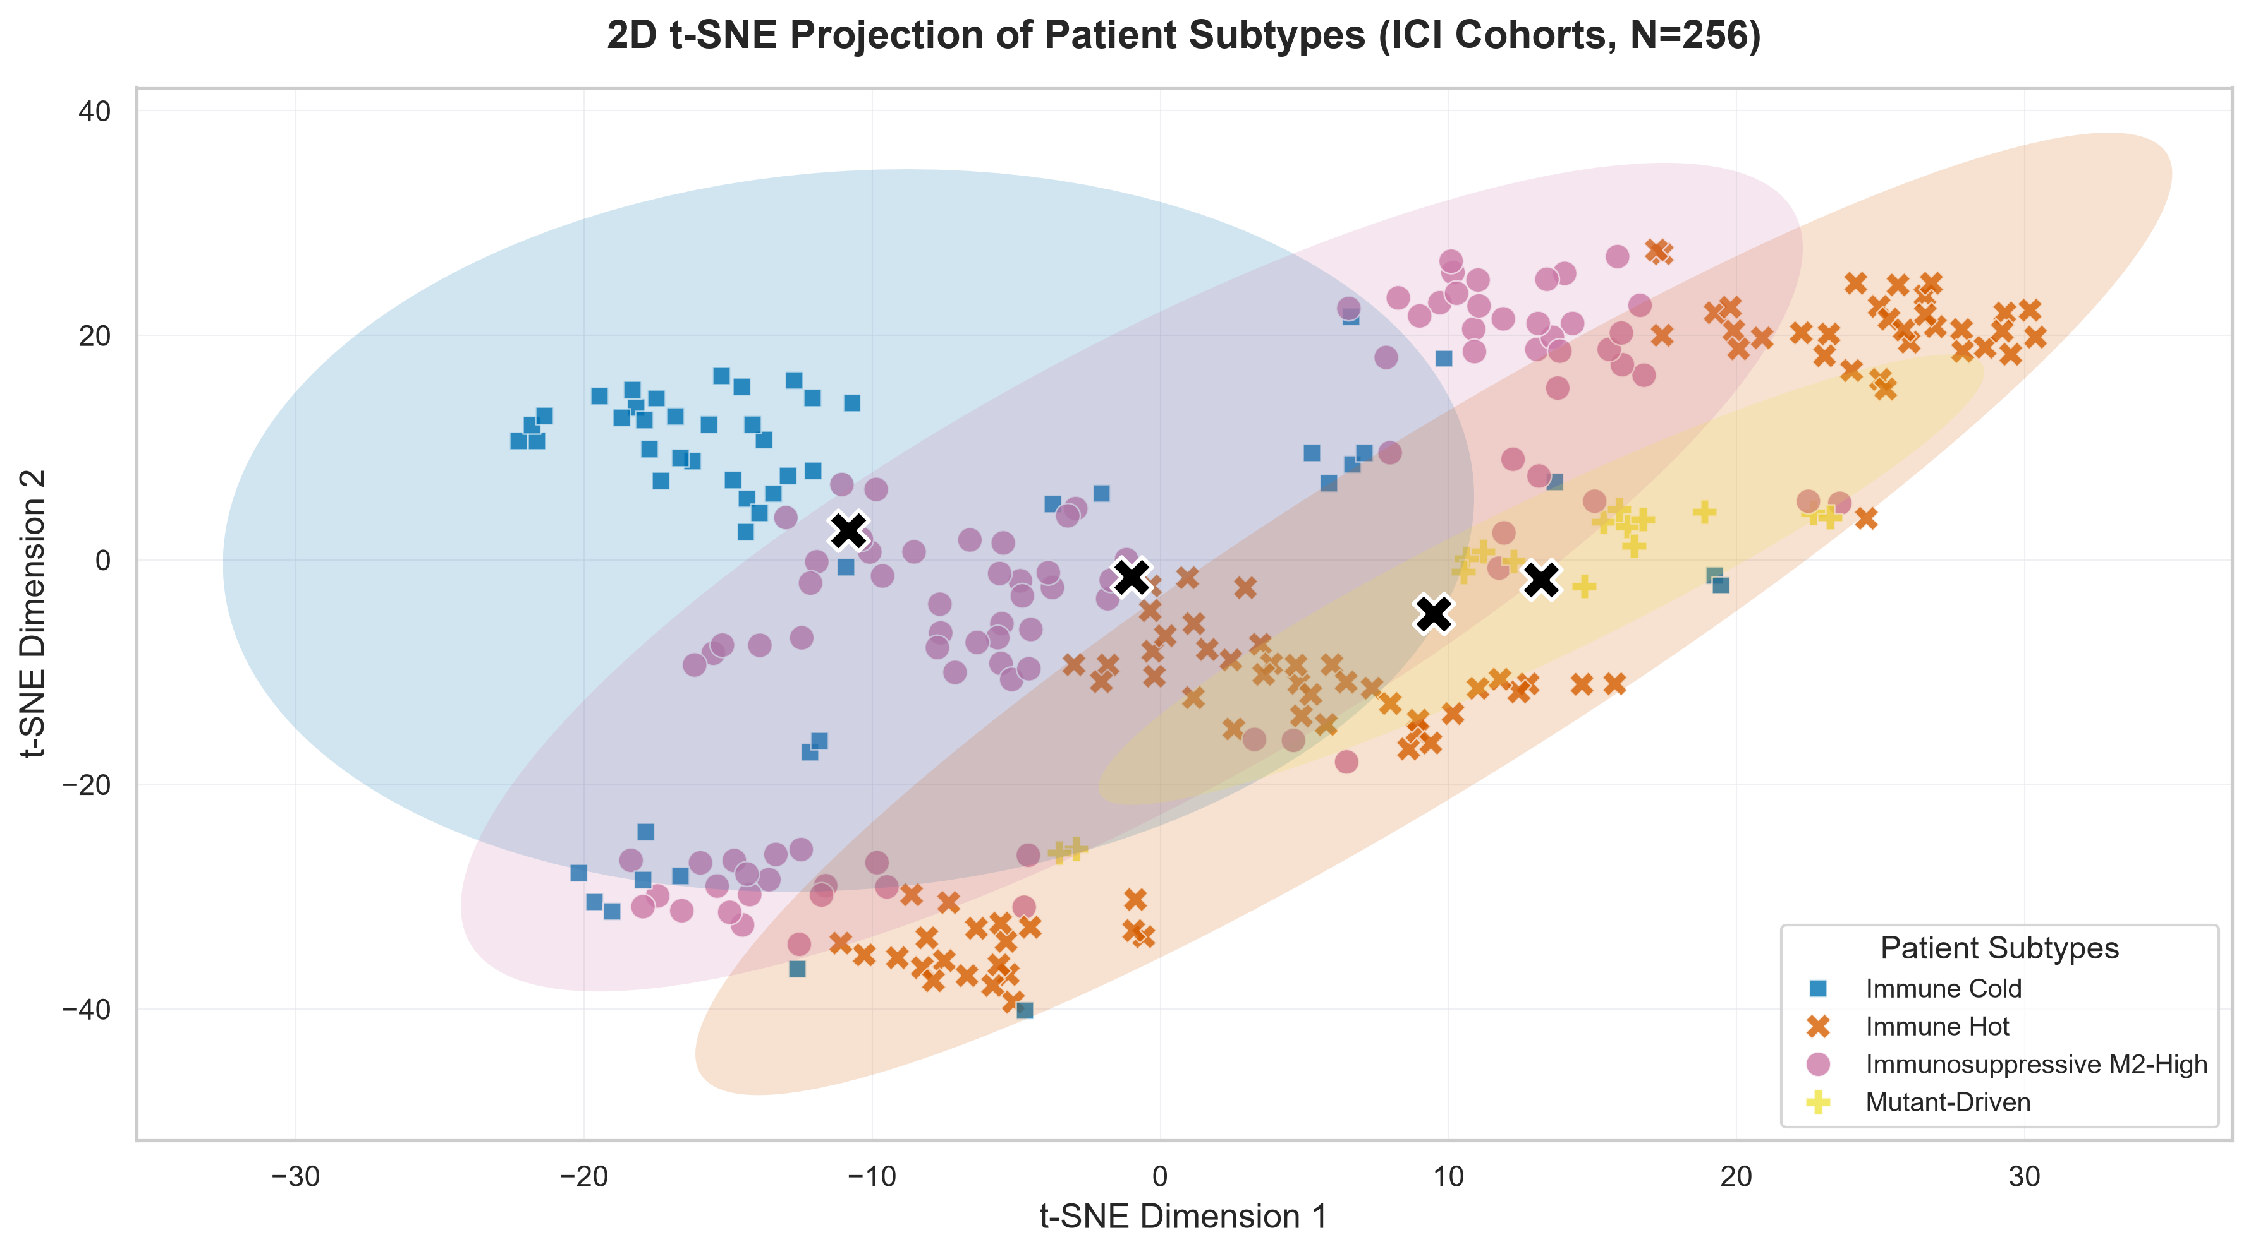
Do our cohorts cluster?
Does applying a two-stage unsupervised Gaussian Mixture Model (GMM) stratification to the anti-PD-1 ICI trial cohorts reveal any natural clustering?
2D t-SNE projection of patient subtypes (ICI cohorts, N = 256)
Takeaway: Yes, our data clusters naturally into 4 groups: immune hot, immune cold, mutant-driven, and immunosuppressive M2 High

Slide 22
Final Q1 Model Evaluation
Balancing predictive accuracy and clinical explainability identifies Support Vector Machines and regularised linear models as superior to complex tree ensembles for out-of-cohort response prediction
Q1 Model Benchmarking: Accuracy, Generalisability & Explainability
MODEL ARCHITECTURE | POOLED 5-FOLD CV AUC (95% CI) | BEST LOCO AUC (95% CI) [Cohort] | MODEL EXPLAINABILITY | CLINICAL ASSESSMENT
XGBOOST | 0.636 (0.56-0.71) | 0.575 (0.479-0.671) [Liu] Mean LOCO: 0.418 |  | Captures complex multi-gene non-linear interactions
RANDOM FOREST | 0.656 (0.58-0.73) | 0.621 (0.518-0.724) [Riaz] Mean LOCO: 0.511 |  | High feature importance stability; resistant to outliers
SVM | 0.684 (0.61-0.76) | 0.685 (0.586-0.784) [Riaz] Mean LOCO: 0.521 |  | Strongest OOC generalisation; good margin separation in high feature space
ELASTIC-NET LR | 0.593 (0.51-0.67) | 0.586 (0.490-0.682) [Liu] Mean LOCO: 0.557 |  | Regularised feature selection; highly interpretable but suffers from non
L1 LASSO LR | 0.596 (0.52-0.68) | 0.585 (0.388-0.782) [Hugo] Mean LOCO: 0.501 |  | Baseline linear odds ratio
Low (Black Box)
Low (Black Box)
Medium-Low
High (Linear Odds)
High (Linear Odds)
(Note: 95% CIs reflect standard error across evaluated validation folds / DeLong bootstrap iterations).
Takeaway: SVM delivers peak cross-cohort generalisability (AUC = 0.684 / 0.685), while ElasticNet offers the highest clinical interpretability with stable out-of-cohort performance.
Notes:
This table brings together the key benchmarking results.. Looking beyond predictive performance alone, we considered both accuracy and clinical interpretability.
SVM achieved the strongest predictive performance, benefiting from its ability to capture complex patterns in the feature space. But, ElasticNet provided the best balance between performance, interpretability, and stability across unseen cohorts, making it the more practical candidate for clinical translation and ethics committee approvals.
I’ll now hand over to Gift to discuss her drug-response analysis.

Slide 23
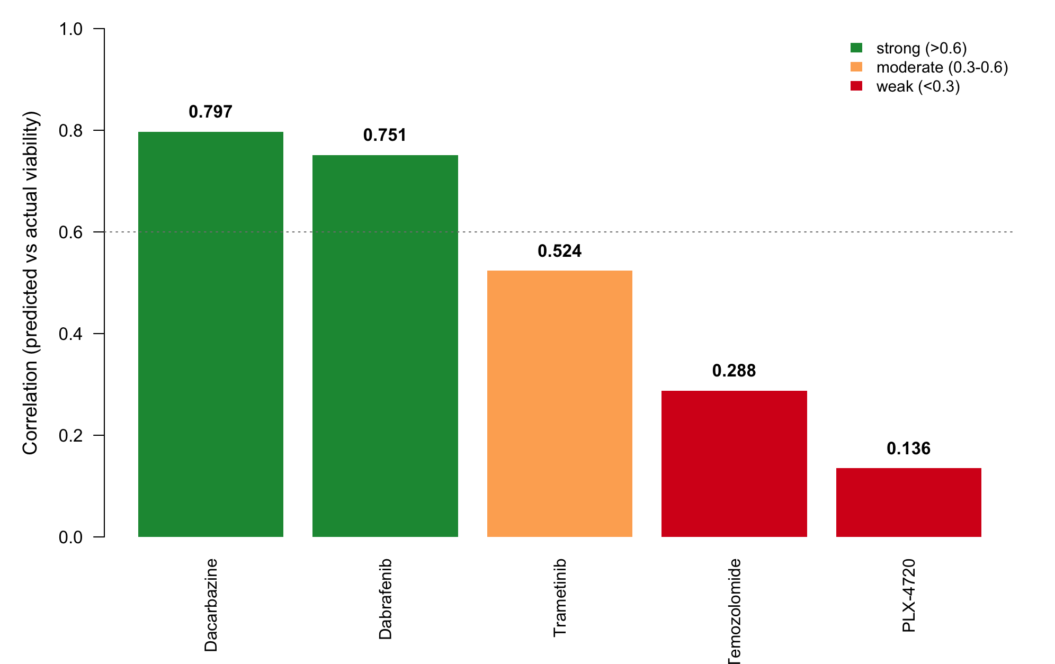
Predicting drug response from gene expression
LASSO models trained on melanoma cell lines across five standard-of-care agents
Model performance across five drugs
Two BRAF inhibitors (Dabrafenib, PLX-4720) - One MEK inhibitor (Trametinib) - Two chemotherapy agents (Dacarbazine, Temozolomide)
Drugs Modelled | Cell Lines | Test Set | Highest r | Significant
5 | 37 | 8 | 0.797 | 1 of 5
Takeaway: Dacarbazine has the highest correlation, but it is not the best model because every cell line survived at nearly the same rate,
so there was almost nothing to predict.
Notes:
These are five drugs, ranked by how well each model predicted on cells it had never seen. Two are BRAF inhibitors, one's a MEK inhibitor, and two are chemo. Dacarbazine came out highest at 0.797, then Dabrafenib at 0.751, down to PLX-4720 at 0.136.
But only one of these five is statistically significant, and it isn't the top one. Working out why is the interesting part.

Slide 24
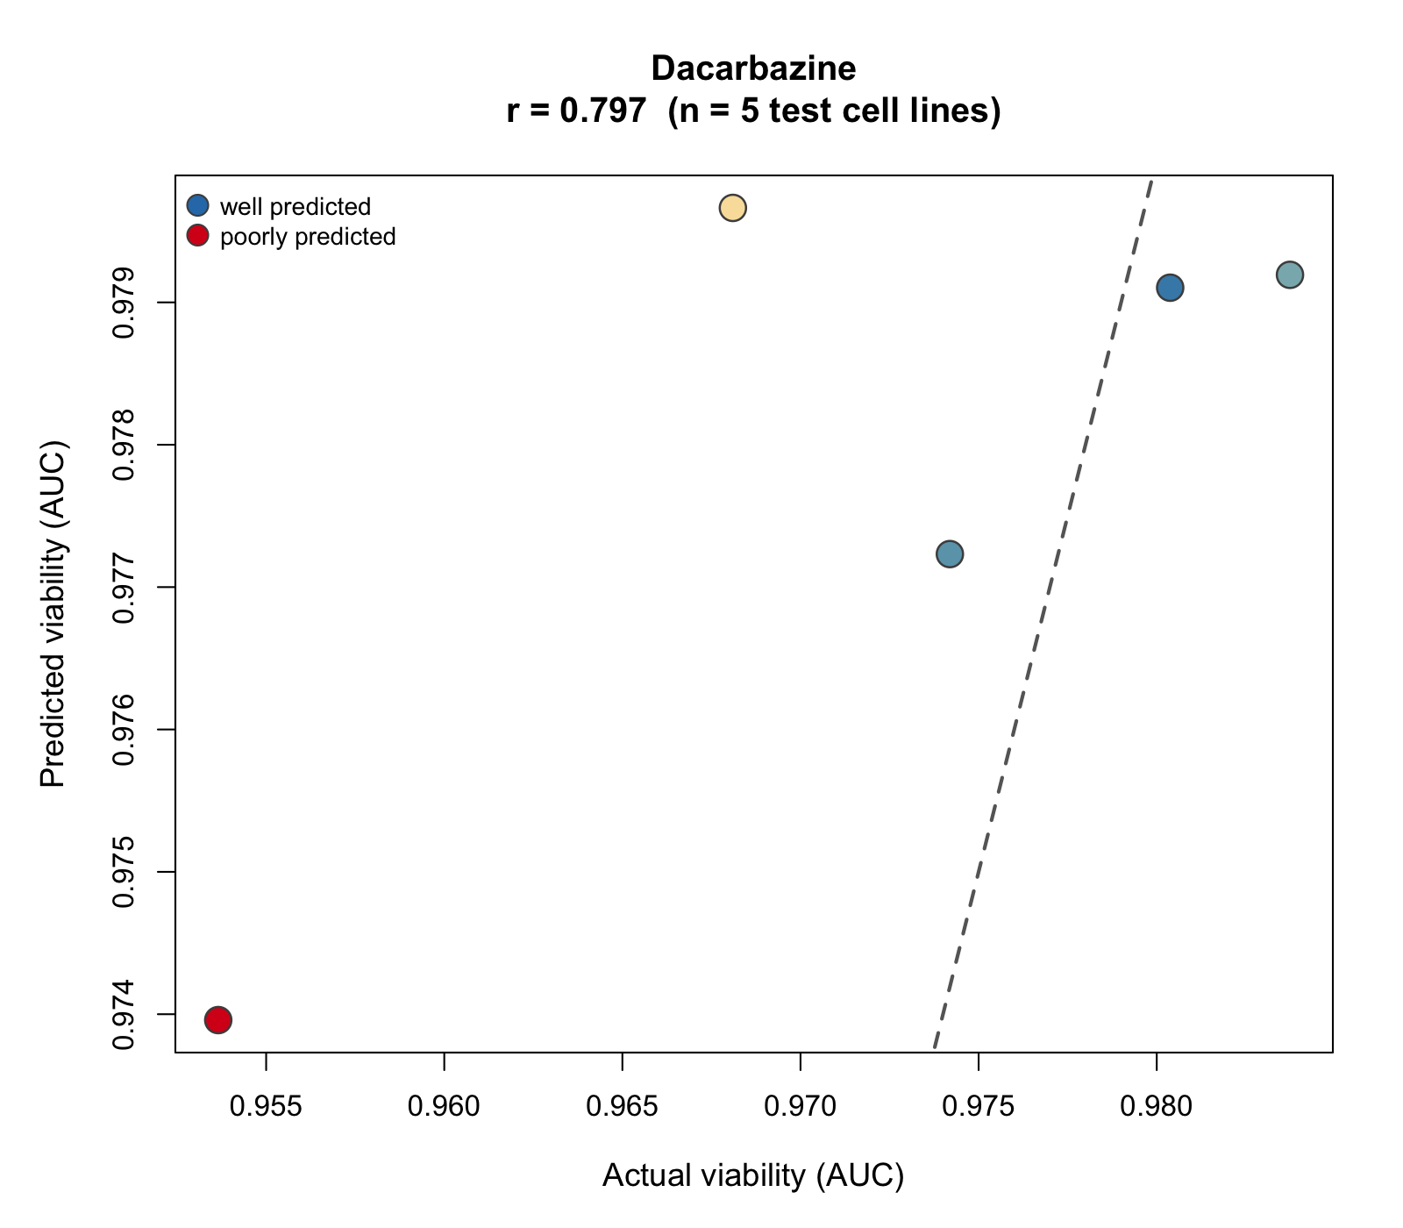
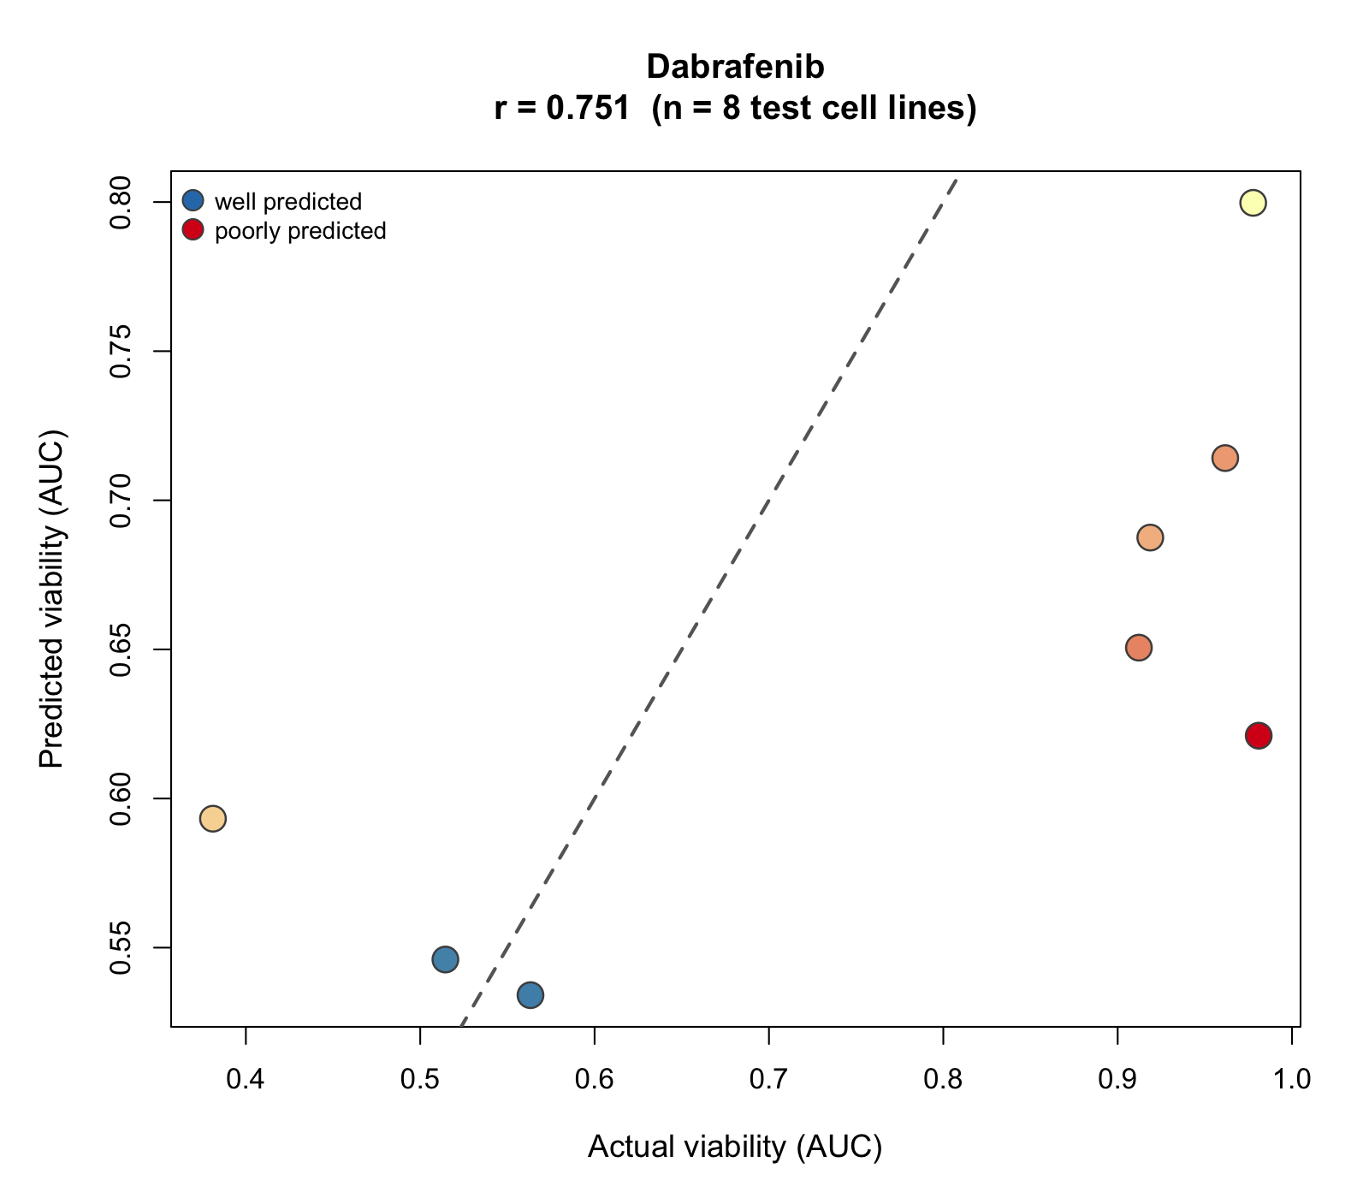
Results: The highest number is not the best result
Dacarbazine is a chemotherapy agent · Dabrafenib is a BRAF inhibitor
A high score means nothing if every cell responded the same (bottom axis on each plot)
Dacarbazine — no variation
range 0.03 · n = 5 · p = 0.106
Every cell survived at nearly the same rate. Nothing to predict.
Dabrafenib — real variation​
range 0.60 · n = 8 · p = 0.032​
Some died, some survived. The only significant model in the panel.
Takeaway: Chemotherapy attacks any cell that's dividing quickly, and melanoma barely reacts to it in a dish — so all the cells survived and there was nothing for the model to spot. Dabrafenib is different: it only kills cells with the broken BRAF switch, so some died and some didn't. Those real differences are what the model learns from, which is why only the targeted drugs gave a result we can trust.

Slide 25
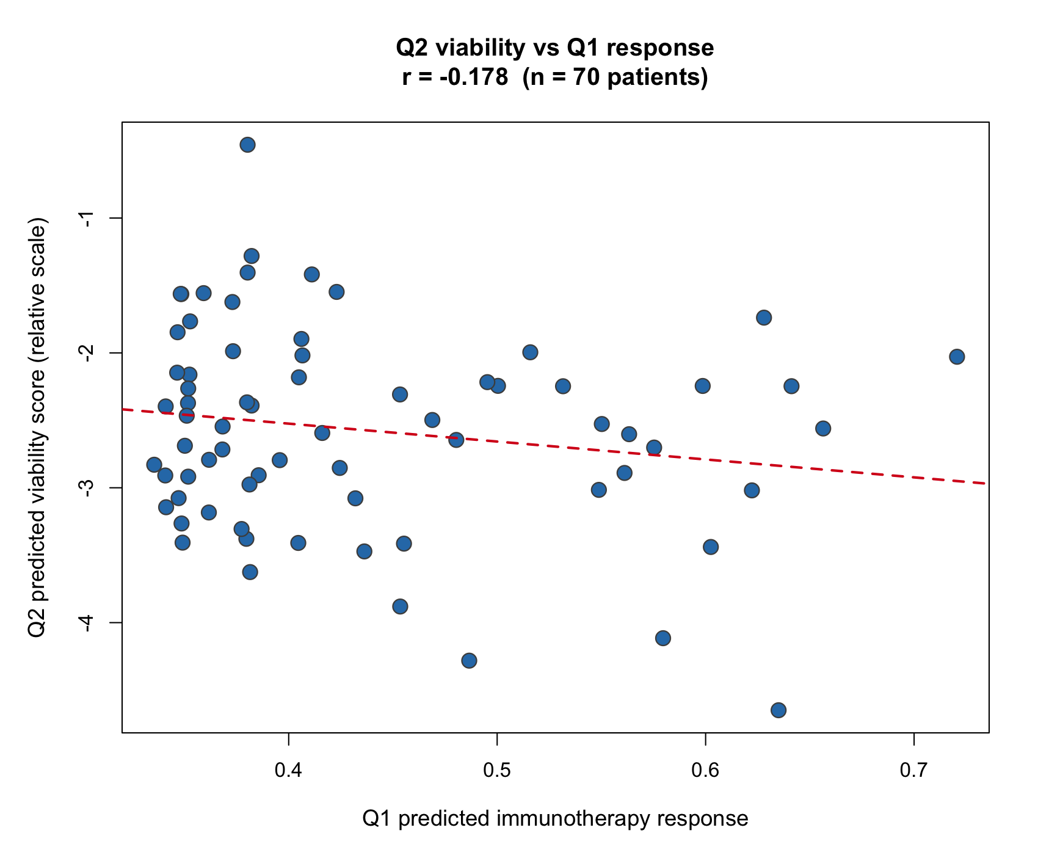
Does it agree with the immunotherapy predictor?”
Barely — immunotherapy response and drug-induced viability measure different biological outcomes,
DABRAFENIB vs Q1 PLX-4720 vs Q1
-0.178
−0.004
What the weak correllation tells us
0.178 is close to zero, meaning almost no relationship between the two predictions. The negative sign lines up with the fact that the scales run opposite ways, high viability is bad, high response is good, but the size of the number matters more than the sign, and this one is too small to call it agreement.
Each dot is one patient. The red line slopes down slightly, but the dots are a loose cloud rather than a line.
Takeaway: Weak agreement is expected. BRAF drugs block a protein inside the tumour cell, while immunotherapy works through the immune system, and my cells had no immune system at all. The two models measure different things, which is exactly why you'd run both.

Slide 26
Chapter 3
Can DepMap dependency and expression data identify melanoma-selective vulnerabilities and nominate potential new drug targets?

Slide 27
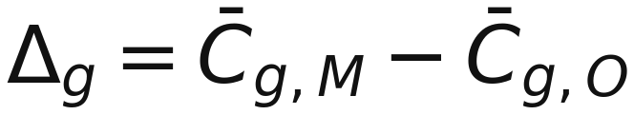
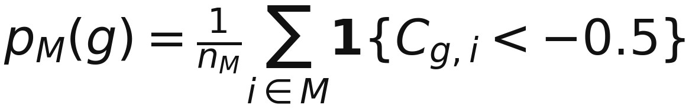
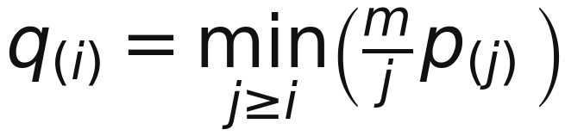
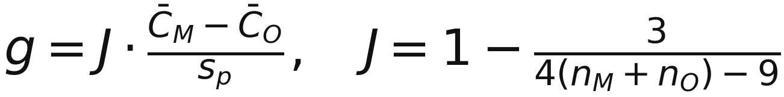
3.1a Methods for DepMap dependency screen and ranking
The screen first defined melanoma models, then compared CRISPR dependency in melanoma against all other cancer models.
DepMap inputs
Explicit melanoma group
Gene-level statistics
Candidate ranking
1. Cohort and matrices
2. Dependency, selectivity and statistics
3. Candidate rules and aggregate rank
• Inputs: Model metadata, CRISPR Chronos gene-effect scores, dependency probabilities, RNA expression, and inferred common-essential genes.
• Melanoma models were selected from OncoTree PrimaryDisease/Subtype, avoiding a broad “Skin” lineage definition.
• Gene symbols were cleaned and duplicate gene columns were averaged before analysis.
• Retain non-common-essential genes only.
• Primary dependency/selectivity: mean melanoma effect < −0.50 and selectivity < −0.20.
• Evidence filters: FDR < 0.05, melanoma dependent fraction ≥ 0.40, other-cancer dependent fraction ≤ 0.20.
• Expression filters: mean expression ≥ 1.0 log2(TPM+1) and expression prevalence ≥ 0.50.
• Minimum melanoma model overlap: n ≥ 10.
C = Chronos gene-effect score,
M = melanoma, O = other cancers.
Dependency
prevalance
Welch's two-sample t-test
Benjamini–Hochberg FDR,
Clip value to 1
S = 0.30R_effect + 0.30R_selectivity + 0.20R_prevalence
+ 0.10R_probability + 0.10R_FDR
Notation: Cg,i is the Chronos score for gene g in model i. More negative values indicate stronger dependency.
Hedges g
Welch’s test was used because gene-effect variance and group size can differ between melanoma and non-melanoma models. BH-FDR controlled the thousands of gene-wise tests.
Lower aggregate score indicates stronger combined evidence. This prevents a single metric from dominating the screen.
DepMap Consortium (2024)
Dempster et al. (2021)
🎯
Takeaway: SOX10 was selected through a transparent screen combining dependency strength, melanoma selectivity, prevalence, probability, expression, and FDR.
Notes:
The aim here was to use DepMap data to find potential new targets for melanoma.
I filtered out genes that are essential across most cancers, and focused on genes that melanoma cells depend on much more strongly than other cancer types.
SOX10 came out as the top result. Its average Chronos score was minus 1.37 in melanoma, compared with only minus 0.19 in other cancers. Around 84% of melanoma cell lines were dependent on SOX10, compared with less than 3% of non-melanoma models.
The analysis also picked up known melanoma genes, including BRAF and MAPK1. These acted as useful positive controls and gave us more confidence that the screen was identifying real melanoma biology.

Slide 28
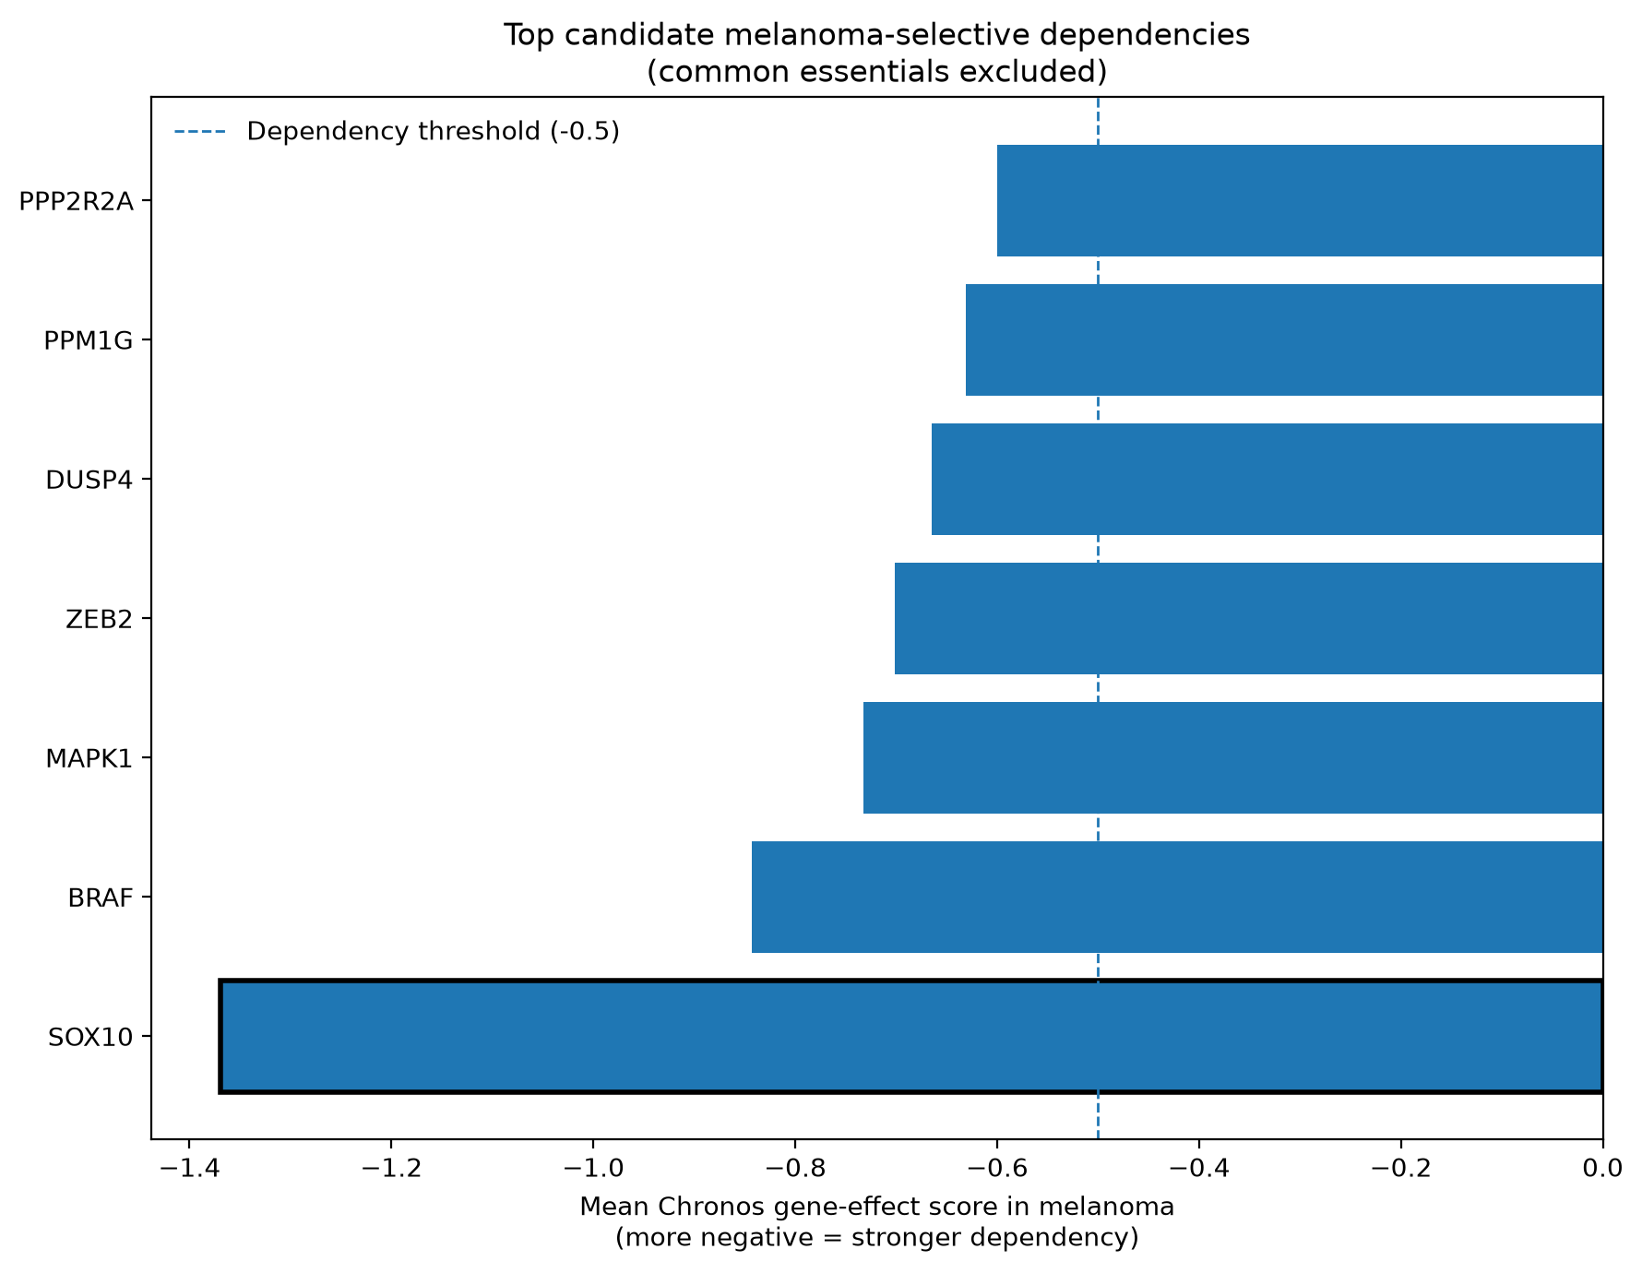
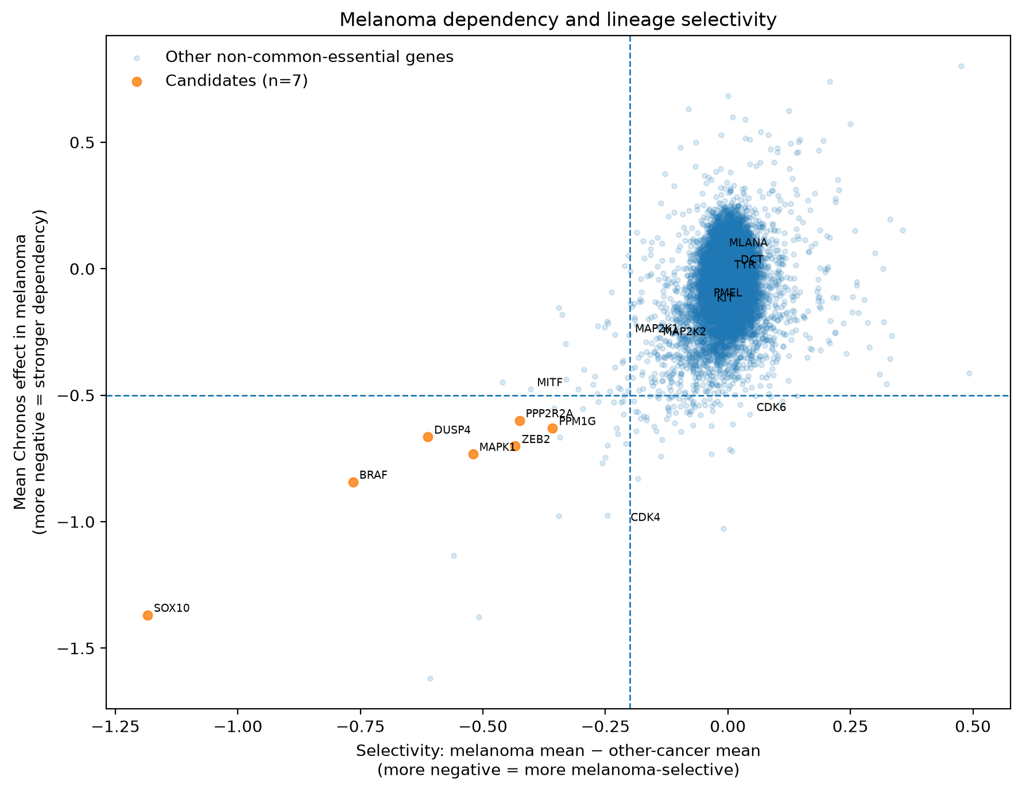
3.1b SOX10 is the strongest melanoma-selective dependency
DepMap CRISPR screening identifies SOX10 as the top selective vulnerability in melanoma.
🏆
Candidate rank
📉
Mean Chronos effect in melanoma
📈
Mean effect in other cancers
🎯
Melanoma selectivity
👥
Melanoma models dependent
#1
-1.369
-0.185
-1.185
84.0%
👥
Other-cancer models dependent
🛡
FDR
📊
Hedges' g
⏱
Mean dependency probability
🧬
Melanoma expression prevalence
2.8%
1.16 × 10⁻²⁰
-4.49
0.851
88.9%
Top filtered melanoma-selective dependencies (common essentials excluded)
Melanoma dependency and lineage selectivity
🔵
Common essentials excluded from ranking.
✅
BRAF and MAPK1 recovered which validates approach.
⭐
SOX10 combines strongest dependency with highest selectivity.
Takeaway: SOX10 is a robust, selective melanoma vulnerability, not a pan-cancer essential gene.
🎯
Takeaway:
Notes:
The aim here was to use DepMap data to find potential new targets for melanoma.
I filtered out genes that are essential across most cancers, and focused on genes that melanoma cells depend on much more strongly than other cancer types.
SOX10 came out as the top result. Its average Chronos score was minus 1.37 in melanoma, compared with only minus 0.19 in other cancers. Around 84% of melanoma cell lines were dependent on SOX10, compared with less than 3% of non-melanoma models.
The analysis also picked up known melanoma genes, including BRAF and MAPK1. These acted as useful positive controls and gave us more confidence that the screen was identifying real melanoma biology.

Slide 29
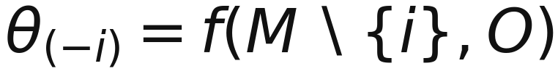
3.2a Methods for SOX10 validation and robustness checks
After SOX10 ranked first, the analysis tested whether the result was stable, broad across models, and biologically interpretable.
Primary SOX10 result
Resampling stability
Sensitivity analyses
Expression association
1. Primary SOX10 summary
2. Resampling and sensitivity
3. Expression–dependency association
• Mean Chronos effect: melanoma −1.369 vs other cancers −0.185.
• Selectivity: −1.185; FDR = 1.156 × 10⁻²⁰; Hedges’ g = −4.485.
• Melanoma dependent fraction: 0.840; other-cancer dependent fraction: 0.028.
• Mean dependency probability in melanoma: 0.851; expression prevalence: 0.889.
Bootstrap: melanoma and other-cancer values were resampled with replacement for 1,000 iterations; percentile CIs were computed for mean effect and selectivity.
• Expression and Chronos scores were compared across melanoma models using Spearman correlation.
• ρ = −0.3383, p = 0.003196.
• Negative ρ means higher SOX10 expression tended to coincide with more negative Chronos scores.
• This supports expression as a candidate biomarker of a SOX10-dependent state, not a perfect predictor.
Leave-one-out: each melanoma model was omitted once to check whether SOX10 depended on any single cell line.
Interpretation: SOX10 was not treated as melanoma-exclusive; it was treated as a melanoma-selective dependency.
• Threshold grid: dependency −0.40, −0.50, −0.60, −0.75.
• Selectivity grid: −0.10, −0.20, −0.30, −0.40.
Validation conclusion: the signal was stable across resampling, model omission, and threshold changes.
🎯
Takeaway: SOX10 remained robust under multiple checks, while expression–dependency heterogeneity motivated the search for tractable proxy targets.
Takeaway: SOX10 remained robust under multiple checks, while expression–dependency heterogeneity motivated the search for tractable proxy targets.
Notes:
The aim here was to use DepMap data to find potential new targets for melanoma.
I filtered out genes that are essential across most cancers, and focused on genes that melanoma cells depend on much more strongly than other cancer types.
SOX10 came out as the top result. Its average Chronos score was minus 1.37 in melanoma, compared with only minus 0.19 in other cancers. Around 84% of melanoma cell lines were dependent on SOX10, compared with less than 3% of non-melanoma models.
The analysis also picked up known melanoma genes, including BRAF and MAPK1. These acted as useful positive controls and gave us more confidence that the screen was identifying real melanoma biology.

Slide 30
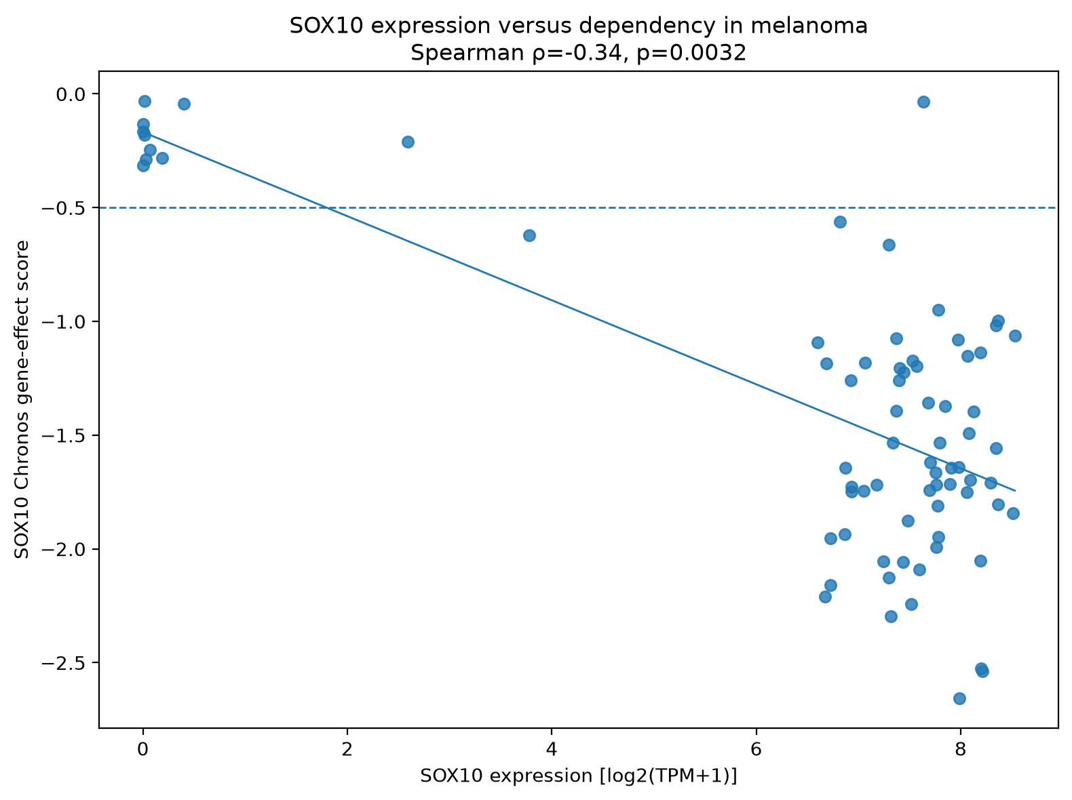
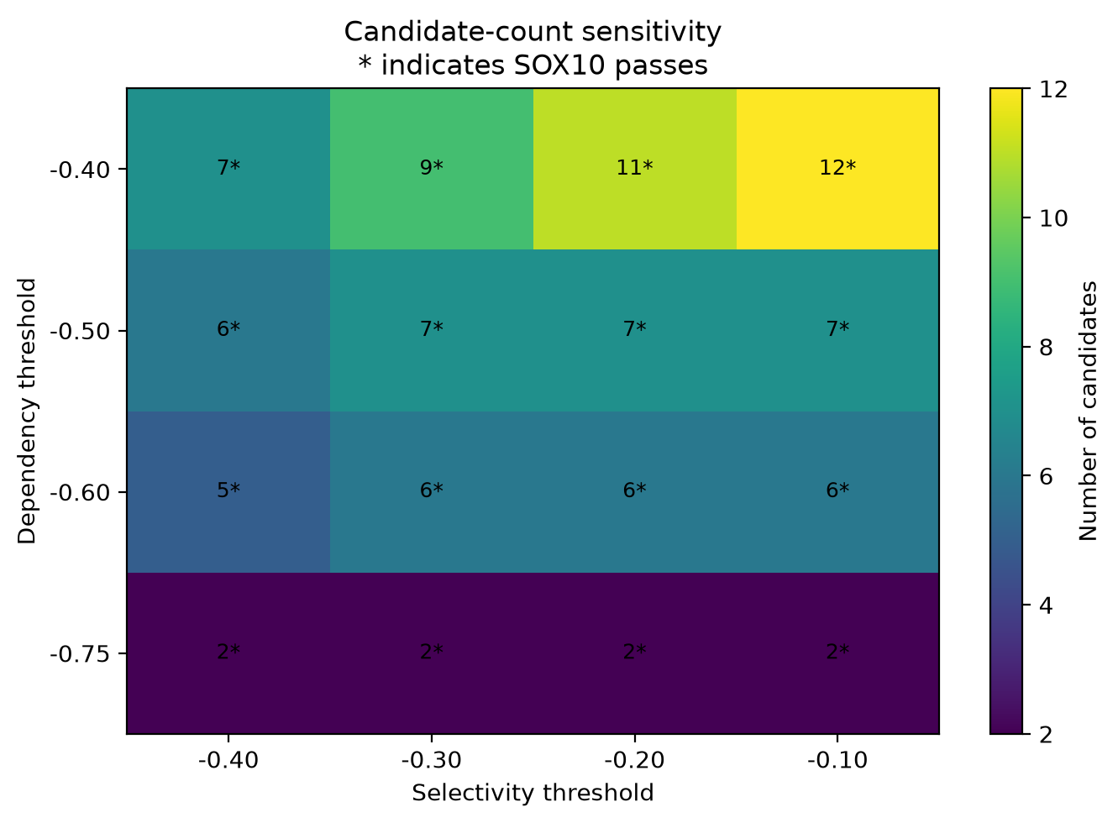
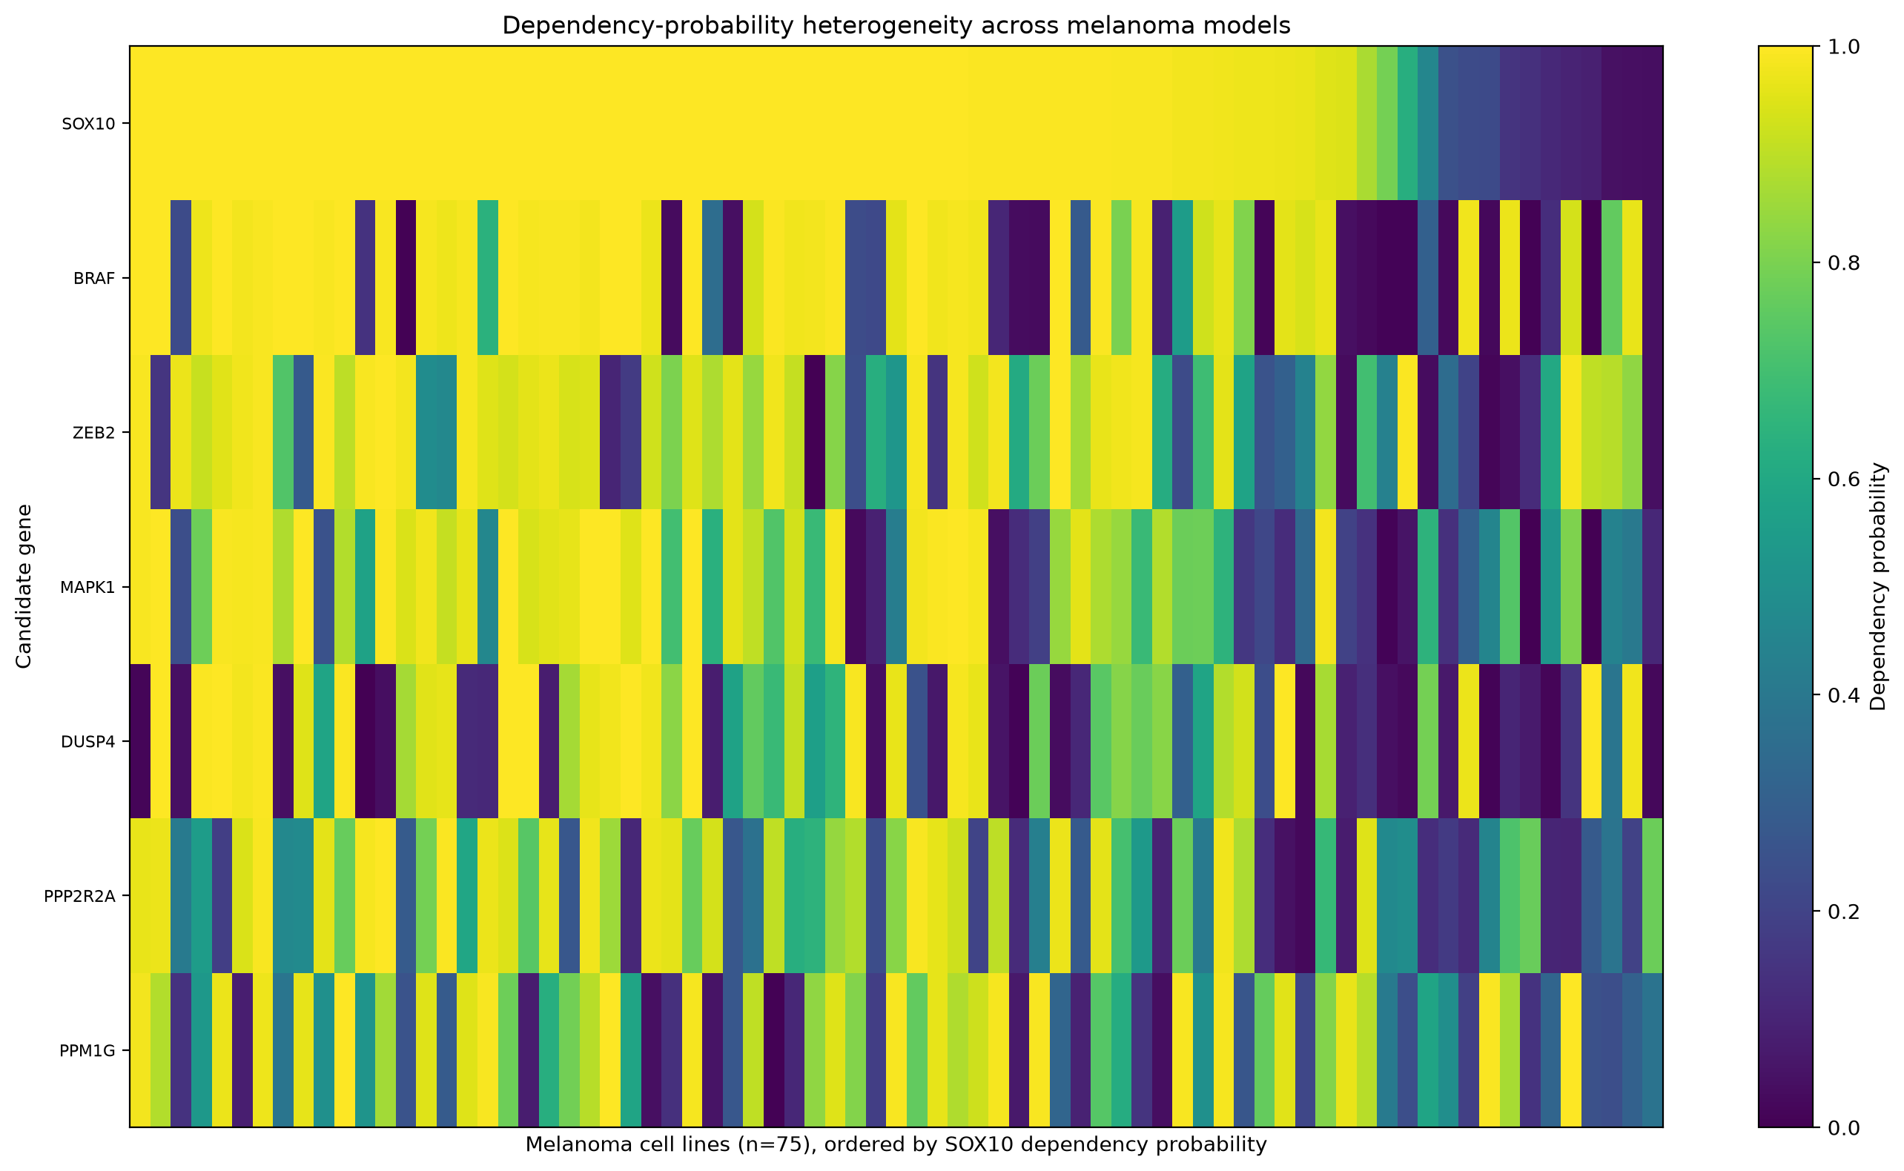
3.2b Validation: SOX10 dependency is broad but heterogeneous
Expression, prevalence, and robustness analyses support the SOX10 signal, while revealing residual melanoma-state heterogeneity.
📉
SOX10 expression vs. dependency
👥
Melanoma dependency prevalence
🛡
Bootstrap 95% CI — mean effect
🎯
Bootstrap 95% CI — selectivity
📊
Leave-one-model-out selectivity
ρ = -0.34, p = 0.0032
84%
-1.525 to -1.222
-1.339 to -1.036
-1.203 to -1.167
⭐ SOX10 passed every tested dependency / selectivity threshold combination.
SOX10 expression versus dependency in melanoma
Dependency-probability heterogeneity across melanoma models
Candidate-count sensitivity (* = SOX10 passes)
🛡
Robustness checks
• Bootstrap CIs remain strongly negative throughout.
• Leave-one-out selectivity: −1.203 to −1.167.
• Passes all dep./selectivity threshold combos.
• Higher SOX10 expression → stronger dependency.
🎯
Takeaway: SOX10 dependence is prevalent, biologically plausible, and statistically robust, but melanoma models remain heterogeneous.
Notes:
I then checked how robust this result was.
Most melanoma cell lines showed strong SOX10 dependency, although there was a smaller group that appeared less dependent.
Higher SOX10 expression was also linked to stronger dependency, but the relationship was only moderate. So expression may help identify sensitive tumours, but it would probably not work as a biomarker on its own.
Importantly, SOX10 remained the top selective dependency across different filtering thresholds and after removing individual cell lines. So the result was not being driven by one outlier or one particular cut-off.

Slide 31
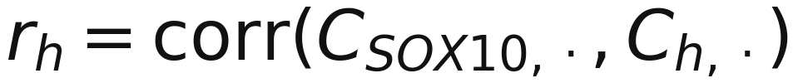
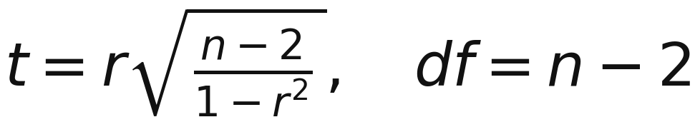
3.3a Methods for SOX10 co-dependency and proxy-target prioritisation
SOX10 is a transcription factor, so the next step searched for more tractable genes associated with the SOX10-dependent state.
SOX10 profile
Pan-cancer co-dependency
Melanoma filters
Druggability audit
1. Co-dependency calculation
2. Proxy filters
3. Ranking and manual audit
• Pan-cancer co-dependency: r ≥ 0.20, FDR ≤ 0.05, paired models ≥ 100.
• Melanoma dependency: mean melanoma effect ≤ −0.30.
• Melanoma selectivity: selectivity ≤ −0.10.
• Melanoma expression: mean expression ≥ 1.0 and expression prevalence ≥ 0.50.
• Common-essential genes removed.
S_proxy = 0.35R_coDep + 0.15R_melSpearman
+ 0.20R_effect + 0.20R_selectivity + 0.10R_prevalence
correlation significance equation
• For every gene h, the Chronos dependency profile was correlated with the SOX10 profile across approximately 1,150 cancer models.
• Positive r means models dependent on SOX10 also tend to be dependent on gene h.
• Correlation p-values were FDR-corrected across genes.
• Melanoma-specific Pearson and Spearman correlations were added for candidate ranking.
• Lower proxy score indicates stronger combined computational evidence.
• BRAF and MAPK1 recovery was treated as a positive-control sanity check, not proof of novelty.
• The 18 genes were reviewed for target class, compound availability, development stage, directionality, prior melanoma evidence, novelty, and safety concerns.
• Final tractable hypotheses: AMD1, PGM3, LCMT1.
Output: 18 computational proxy candidates retained for biological and pharmacological review.
Limitation: co-dependency suggests shared vulnerability/state; it does not prove direct regulation or druggability.
Takeaway: The proxy workflow moved from a strong but difficult-to-drug SOX10 dependency to tractable hypotheses associated with that dependency state.
Notes:
The aim here was to use DepMap data to find potential new targets for melanoma.
I filtered out genes that are essential across most cancers, and focused on genes that melanoma cells depend on much more strongly than other cancer types.
SOX10 came out as the top result. Its average Chronos score was minus 1.37 in melanoma, compared with only minus 0.19 in other cancers. Around 84% of melanoma cell lines were dependent on SOX10, compared with less than 3% of non-melanoma models.
The analysis also picked up known melanoma genes, including BRAF and MAPK1. These acted as useful positive controls and gave us more confidence that the screen was identifying real melanoma biology.

Slide 32
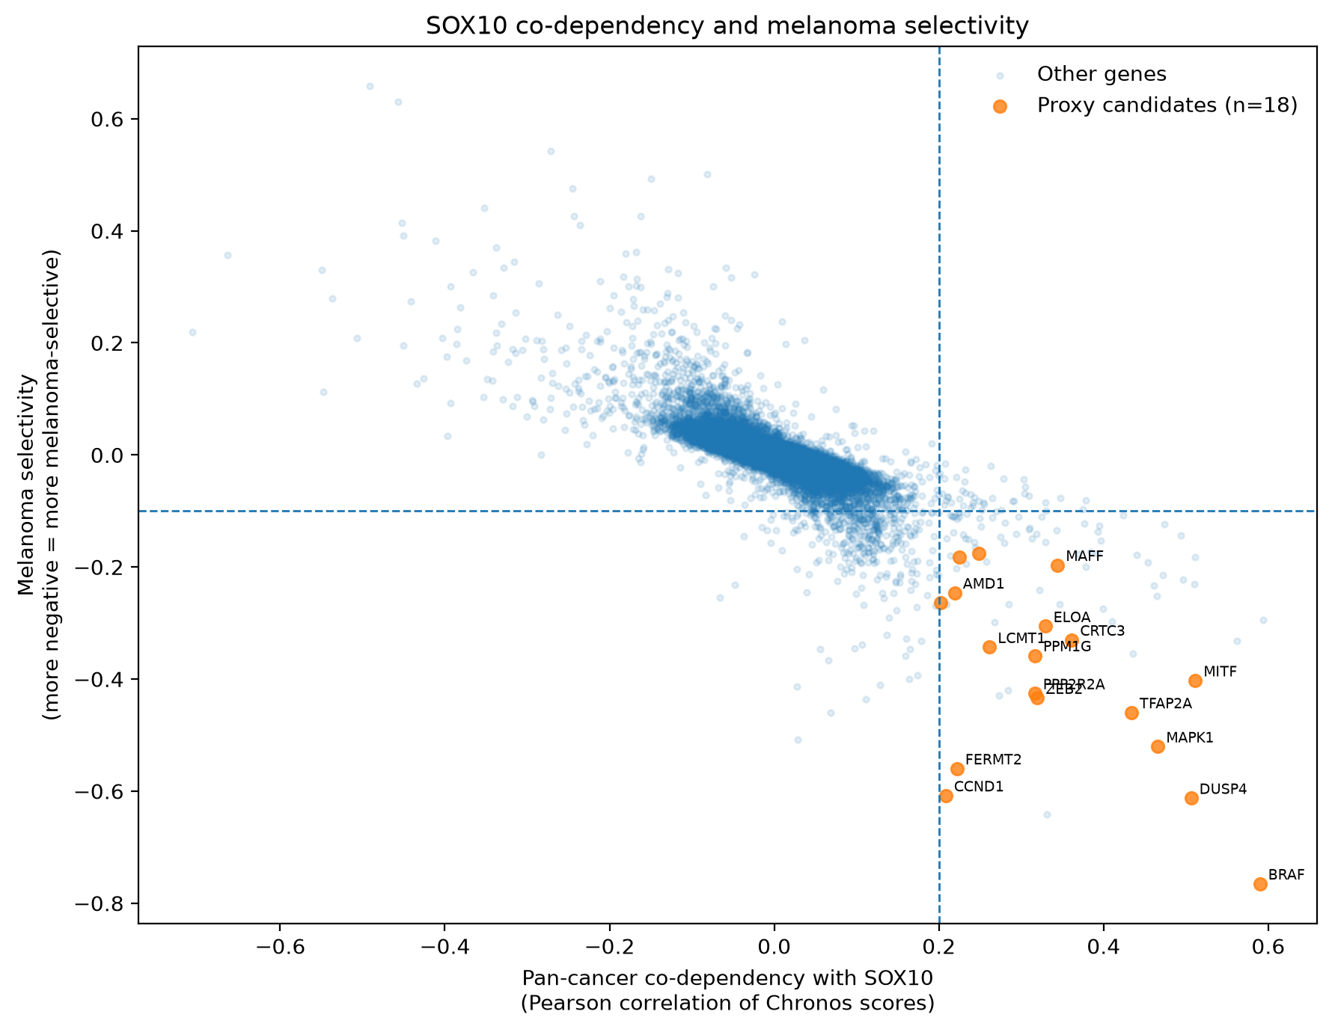
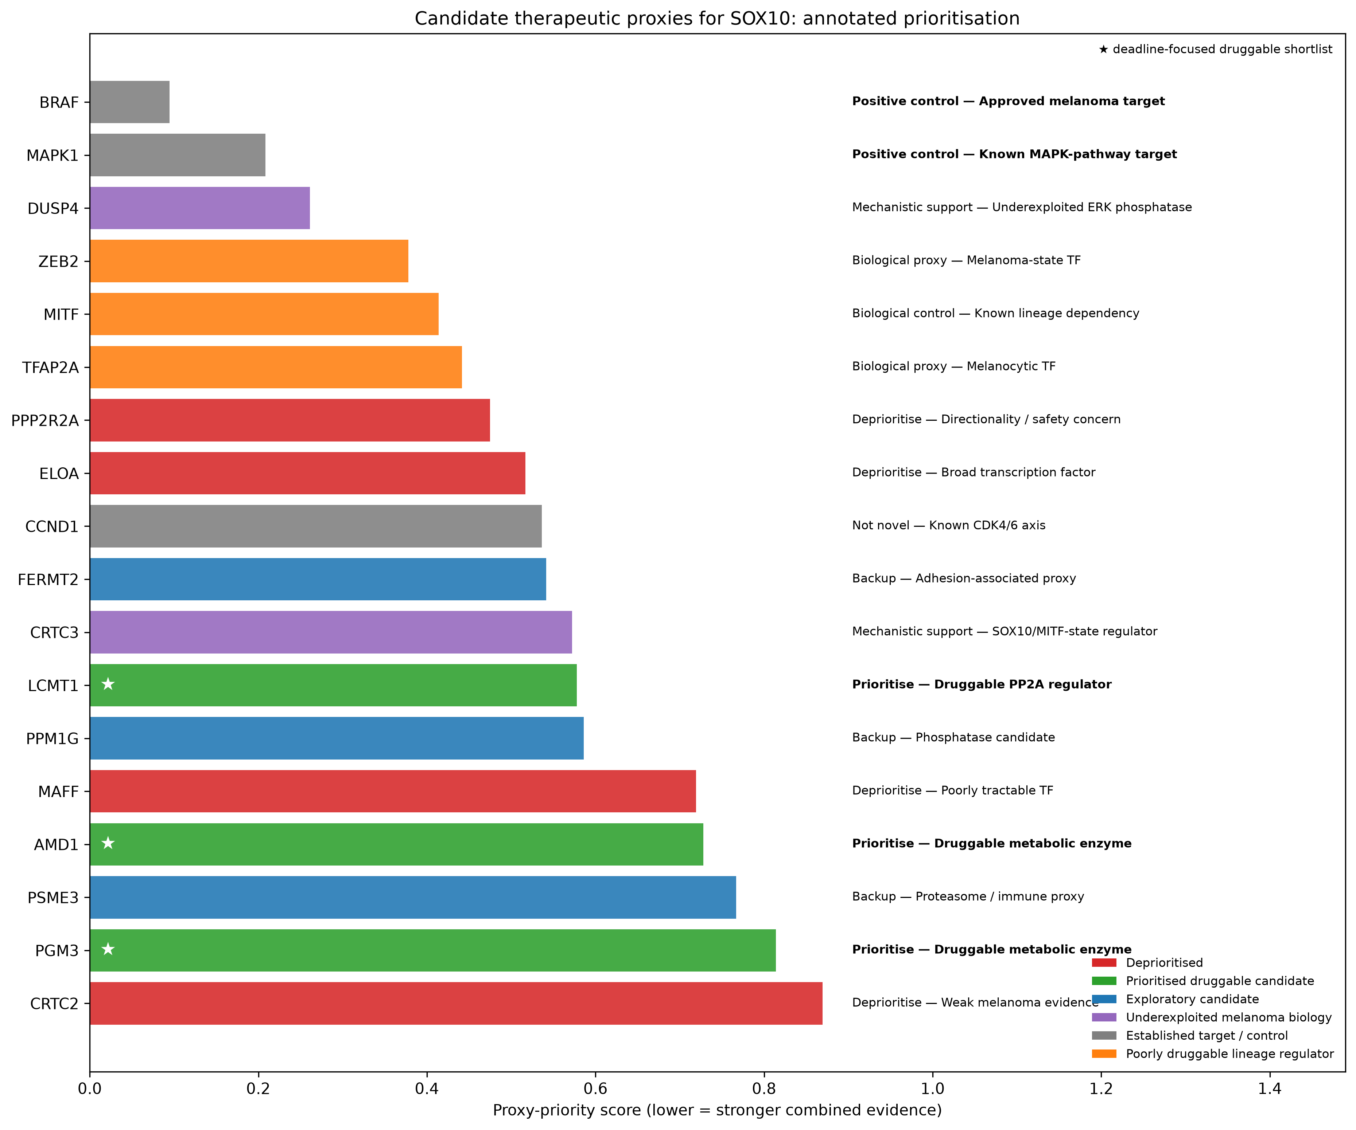
3.3b From SOX10 dependency to tractable proxy targets
Co-dependency analysis and translational filtering nominate druggable entry points into the SOX10-dependent melanoma state.
👥
Proxy candidates retained after filtering
🎯
Known biology recovered
⭐
Prioritised tractable proxies
📊
Screening platform models
🧬
Melanoma expression prevalence (median)
🔽
Selection approach
18
BRAF, MAPK1, CCND1
AMD1, PGM3, LCMT1
84.0% melanoma models
88.9%
Co-dependency + translational filtering
SOX10 co-dependency vs melanoma selectivity
Annotated prioritisation of 18 proxy candidates
Focused shortlist and rationale
AMD1
Best translational candidate
• Metabolic enzyme
• A direct inhibitor exists
• Melanoma application remains to be tested.
PGM3
Best novel preclinical candidate
• Metabolic enzyme
• Preclinical inhibition evidence in other cancers
LCMT1
Early tractable backup
• Enzymatic PP2A regulator
• Melanoma-relevant pharmacology
• Therapeutic-window concerns require follow-up
Lower proxy-priority score = stronger combined computational evidence.
BRAF & MAPK1 serve as positive controls.
What this analysis supports:
Candidate tractable proxies associated with the SOX10-dependent state.
⚖
What it does not yet prove:
Direct regulation of SOX10, selective tumour killing, or clinical superiority.
🎯
Takeaway: SOX10 may be difficult to drug directly, but AMD1, PGM3, and LCMT1 provide tractable entry points into the SOX10-dependent melanoma state.
Notes:
The main limitation is that SOX10 is a transcription factor, so it may be difficult to target directly with a drug.
I therefore searched for more druggable genes that showed similar dependency patterns to SOX10 across around 1,150 cancer models.
After filtering for co-dependency, melanoma selectivity, expression and essentiality, 18 candidates remained. I then considered their biological relevance, novelty and druggability, which gave a final shortlist of AMD1, PGM3 and LCMT1.
AMD1 already has a direct inhibitor, PGM3 has been inhibited in preclinical studies in other cancers, and LCMT1 regulates PP2A and may also be targetable.
These genes may provide indirect ways of targeting the SOX10-dependent melanoma state, although they would still need experimental validation.

Slide 33
3.4a Methods for SOX10 knockdown signature and LINCS mimic search
An independent perturbation dataset was used to ask which compounds produce expression changes similar to SOX10 suppression.
siSOX10 RNA-seq
Differential expression
Up/down signature
LINCS mimic query
1. Independent perturbation data
2. Differential-expression output
3. LINCS mimic interpretation
• Dataset: GSE256466 raw RNA-seq counts from seven melanoma cell lines treated with siSOX10 or siControl.
• Sample names were parsed into cell_line and treatment.
• Low-count genes were removed: retain genes with count ≥ 10 in at least 2 samples.
• Quality check: SOX10 and MITF decreased strongly after SOX10 knockdown.
design = ~ cell_line + treatment
• Mimic mode asks which compound signatures resemble SOX10 knockdown.
• Up-after-knockdown genes are matched to compound-up genes; down-after-knockdown genes are matched to compound-down genes.
• The output is a ranked list of compound signatures by compound, cell line, dose and time.
• The result is not a direct SOX10-inhibition assay or a melanoma-killing assay.
contrast: siSOX10 vs siControl
The model accounts for baseline differences between melanoma cell lines and estimates the common treatment effect of SOX10 knockdown.
This step is independent of DepMap and was used only to define a perturbation signature for compound matching.
Main use: exploratory drug-repurposing layer to motivate follow-up experiments.
The 150 strongest significant genes in each direction were exported as the two-sided LINCS input signature.
Takahashi et al., 2024
Takeaway: LINCS complements the DepMap target analysis by suggesting compound hypotheses, but it does not validate direct SOX10 targeting or melanoma-selective efficacy.
Notes:
The aim here was to use DepMap data to find potential new targets for melanoma.
I filtered out genes that are essential across most cancers, and focused on genes that melanoma cells depend on much more strongly than other cancer types.
SOX10 came out as the top result. Its average Chronos score was minus 1.37 in melanoma, compared with only minus 0.19 in other cancers. Around 84% of melanoma cell lines were dependent on SOX10, compared with less than 3% of non-melanoma models.
The analysis also picked up known melanoma genes, including BRAF and MAPK1. These acted as useful positive controls and gave us more confidence that the screen was identifying real melanoma biology.

Slide 34
3.4b LINCS mimic search: exploratory compound hypotheses
Independent SOX10-knockdown RNA-seq was used to ask which compounds mimic the SOX10-suppressed melanoma state.
⇅
Signature input (150↑ / 150↓)
✅
KD QC: SOX10 / MITF fold-change
📋
Signatures returned
⚗
Unique compounds identified
🔬
Melanoma-line signatures
💡
Interpretation strength
DE genes
SOX10 -2.30
MITF -2.91
50
34
21 / 50
Hypothesis-generating
What LINCS was asked
Top melanoma-line mimic matches (A375)
Exploratory Analysis
Score
Seven melanoma cell-line knockdown experiments
Rank
Compound / perturbation
Score
SOX10 knockdown RNA-seq
Cell
✅
6
16-hydroxytriptolide
0.070
• Seven melanoma cell-line knockdown experiment
A375
7
BRD-K28907958
0.070
✅
DE model controlled for cell-line baseline
A375
• DE model controlled for cell-line baseline
10
WZ-3105
0.070
A375
Strong QC: SOX10 and MITF both decrease
• Strong QC: SOX10 and MITF both decrease
11
teniposide
0.065
✅
A375
13
quinacrine
0.065
Useful as an exploratory compound-matching layer
Mimic mode question
A375
✅
14
mitoxantrone
0.065
Which compounds produce similar gene-expression changes?
A375
20
vorinostat
0.065
⚠
Scores are modest and condition-specific
A375
Mimic mode, still not direct SOX10 inhibition
Top overall hits were mostly non-melanoma-cell signatures; the table highlights melanoma-line results.
⚠
Not proof of SOX10 inhibition or killing
💡
Best to motivate PRISM/GDSC or wet-lab follow-up
💡
Hypothesis-generating drug-repurposing evidence
Subramanian et al. (2017)
Duan et al. (2016)
Takeaway: LINCS adds an exploratory compound layer : A375/SKMEL28 signatures mimic SOX10 knockdown, but the core claim remains the DepMap SOX10/proxy-target analysis.
🎯
Takeaway:
Notes:
Finally, I used LINCS as an exploratory drug-repurposing step.
I took the gene-expression changes caused by SOX10 knockdown and searched for drugs that produced a similar expression pattern.
This returned 50 signatures representing 34 compounds, including several results from melanoma cell lines. Some of the top A375 hits were vorinostat, mitoxantrone and quinacrine.
However, the similarity scores were quite modest. So this does not show that these drugs directly inhibit SOX10, or that they selectively kill melanoma cells.
Instead, these are early drug hypotheses that could be prioritised for further testing using PRISM, GDSC or wet-lab experiments.

Slide 35

See it live
Scan to see the Live Demo

Slide 36
Limitations
ODE only models BRAF-driven MAPK inhibition (vemurafenib/encorafenib + trametinib/binimetinib) . No NRAS-targeted arm, so NRAS-mutant patients aren't mechanistically covered by targeted therapy.
ODE immunotherapy checkpoint arm has no direct quantitative validation. TCGA-SKCM contains no direct anti-PD-1 treatment or response data.
The integrated recommendation's combination weights (statistical + mechanistic + molecular) are hand-set for interpretability, not fitted or validated against real outcomes.

Slide 37
Future Directions
Add an NRAS-targeted or combination-therapy arm to the ODE model.
Differentiate between BRAF V600E mutants and other BRAF mutants
Additional datasets to improve ML model training (see additional-datasets branch on github)
Fit/calibrate the integrated recommendation weights against real outcome data instead of hand-setting them.

Slide 38
References
Auslander N, Zhang G, Lee JS, Frederick DT, Miao B, Moll T, et al. Robust prediction of response to immune checkpoint blockade therapy in metastatic melanoma. Nat Med. 2018 Oct;24(10):1545–9. doi:10.1038/s41591-018-0157-9
Ayers M, Lunceford J, Nebozhyn M, Murphy E, Loboda A, Kaufman DR, et al. IFN-γ-related mRNA profile predicts clinical response to PD-1 blockade. J Clin Invest. 2017 Aug 1;127(8):2930–40. doi:10.1172/JCI91190​
Boutros A, Croce E, Ferrari M, Gili R, Massaro G, Marconcini R, et al. The treatment of advanced melanoma: current approaches and new challenges. Crit Rev Oncol Hematol. 2024;196:104276. doi:10.1016/j.critrevonc.2024.104276.​
Caraviello C, Nazzaro G, Tavoletti G, Boggio F, Denaro N, Murgia G, et al. Melanoma skin cancer: a comprehensive review of current knowledge. Cancers (Basel). 2025;17(17):2920. doi:10.3390/cancers17172920.
Charoentong P, Finotello F, Angelova M, Mayer C, Efremova M, Rieder D, et al. Pan-cancer immunogenomic analyses reveal genotype-immunophenotype relationships and predictors of response to checkpoint blockade. Cell Reports. 2017 Jan 3;18(1):248–62. doi:10.1016/j.celrep.2016.12.019
Dempster JM, Boyle I, Vazquez F, Root DE, Boehm JS, Hahn WC, et al. Chronos: a cell population dynamics model of CRISPR experiments that improves inference of gene fitness effects. Genome Biol. 2021 Dec 20;22(1):343. doi:10.1186/s13059-021-02540-7
Duan Q, Reid SP, Clark NR, Wang Z, Fernandez NF, Rouillard AD, et al. L1000CDS²: LINCS L1000 characteristic direction signatures search engine. npj Syst Biol Appl. 2016 Aug 4;2:16015. doi:10.1038/npjsba.2016.15
DepMap Consortium. DepMap 24Q2 Public [Dataset]. Broad Institute of MIT and Harvard; 2024. doi:10.6084/m9.figshare.25880521
Cirillo N. Global epidemiological trends in the incidence and mortality for melanoma. Skin Health Dis. 2025;5(1):84-86. doi:10.1093/skinhd/vzae013.​
Hugo W, Zaretsky JM, Sun L, Song C, Moreno BH, Hu-Lieskovan S, et al. Genomic and transcriptomic features of response to anti-PD-1 therapy in metastatic melanoma. Cell. 2016 Mar 24;165(1):35–44. doi:10.1016/j.cell.2016.02.065​
International Agency for Research on Cancer. Melanoma of skin fact sheet [Internet]. Lyon (FR): World Health Organization; 2024 [cited 2026 Aug 2]. Available from: https://gco.iarc.who.int/media/globocan/factsheets/cancers/16-melanoma-of-skin-fact-sheet.pdf​
Kholodenko BN. Negative feedback and ultrasensitivity can bring about oscillations in the mitogen-activated protein kinase cascades. Eur J Biochem. 2000 Mar;267(6):1583–8. doi:10.1046/j.1432-1327.2000.01197.x
Lai X, Friedman A. Combination therapy for melanoma with BRAF/MEK inhibitor and immune checkpoint inhibitor: a mathematical model. BMC Syst Biol. 2017 Jul 19;11(1):70. doi:10.1186/s12918-017-0446-9
Lazic T, Medeiros LJ. Molecular diagnosis of melanoma. In: Lomberk G, Urrutia R, editors. Molecular Diagnostics in Cancer Patients. Cham: Springer; 2024. p. 17-35. doi:10.1007/978-3-031-59128-0_2.
Liu J, Lichtenberg T, Hoadley KA, Poisson LM, Lazar AJ, Cherniack AD, et al. An integrated TCGA pan-cancer clinical data resource to drive high-quality survival outcome analytics. Cell. 2018 Apr 5;173(2):400-416.e11. doi:10.1016/j.cell.2018.02.052 ​
Liu D, Schilling B, Liu D, Sucker A, Livingstone E, Jerby-Arnon L, et al. Integrative molecular and clinical modeling of clinical outcomes to PD1 blockade in patients with metastatic melanoma. Nat Med. 2019 Dec;25(12):1916–27. doi:10.1038/s41591-019-0654-5 ​
Mroz EA, Rocco JW. Intratumor and intertumor heterogeneity in melanoma. J Invest Dermatol. 2017;137(11):2397-2400. doi:10.1016/j.jid.2017.06.024.​
National Cancer Registry Ireland. Cancer Trends No. 42: Skin Cancer [Internet]. Cork: National Cancer Registry Ireland; 2025 Mar [cited 2026 Aug 1]. Available from: https://www.ncri.ie/en/reports-publications/reports/cancer-trends-no-42-skin-cancer​
Nave O, Sigron M. A Mathematical Model for the Treatment of Melanoma with the BRAF/MEK Inhibitor and Anti-PD-1. Appl Sci. 2022 Dec 6;12(23):12474. doi:10.3390/app122312474
Pasquali S, Hadjinicolaou AV, Chiarion Sileni V, Rossi CR, Mocellin S. Overcoming immune evasion in melanoma. Int J Mol Sci. 2020;21(23):8984. doi:10.3390/ijms21238984.​
Pelosi E, Castelli G, Testa U. Braf-mutant melanomas: biology and therapy. Curr Oncol. 2024;31(12):7711-7737. doi:10.3390/curroncol31120568.​
Poulikakos PI, Zhang C, Bollag G, Shokat KM, Rosen N. RAF inhibitors transactivate RAF dimers and ERK signalling in cells with wild-type BRAF. Nature. 2010 Mar 18;464(7287):427–30. doi:10.1038/nature08902
Riaz N, Havel JJ, Makarov V, Desrichard A, Urba WJ, Sims JS, et al. Tumor and microenvironment evolution during immunotherapy with nivolumab. Cell. 2017 Nov 2;171(4):934-949.e16. doi:10.1016/j.cell.2017.09.028​
Rooney MS, Shukla SA, Wu CJ, Getz G, Hacohen N. Molecular and genetic properties of tumors associated with local immune cytolytic activity. Cell. 2015 Jan 15;160(1–2):48–61. doi:10.1016/j.cell.2014.12.033 ​
Rukhlenko OS, Khorsand F, Krstic A, Rozanc J, Alexopoulos LG, Rauch N, et al. Dissecting RAF Inhibitor Resistance by Structure-based Modeling Reveals Ways to Overcome Oncogenic RAS Signaling. Cell Syst. 2018 Aug 22;7(2):161–179.e14. doi:10.1016/j.cels.2018.06.002
Sade-Feldman M, Jiao YJ, Chen JH, Rooney MS, Barzily-Rokni M, Eliane JP, et al. Defining T cell states associated with response to checkpoint immunotherapy in melanoma. Cell. 2018;175(4):998-1013.e20. doi:10.1016/j.cell.2018.10.038.​
Subramanian A, Narayan R, Corsello SM, Peck DD, Natoli TE, Lu X, et al. A next generation connectivity map: L1000 platform and the first 1,000,000 profiles. Cell. 2017 Nov 30;171(6):1437–1452.e17. doi:10.1016/j.cell.2017.10.049
Takahashi M, Chong HB, Zhang S, Yang TY, Lazarov MJ, Harry S, et al. Dual adeno-associated virus-based bi-functional CRISPR-Cas9 genome editing in the mouse brain. Cell. 2024 May 9;187(10):2536–2556.e30. doi:10.1016/j.cell.2024.03.027

Slide 39
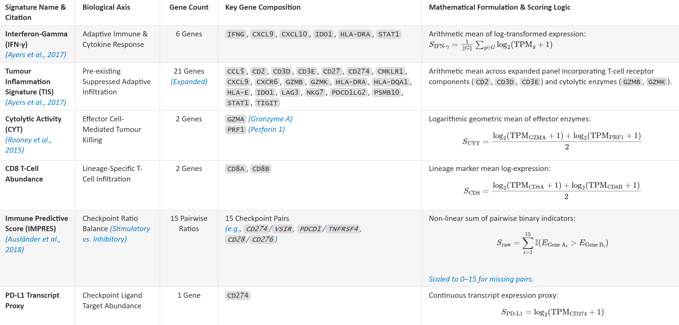
Appendix 1: Immune Signatures used in Q1

Slide 40
Appendix 2: GitHub Reference
https://github.com/gillespieza/melanoma-assignment-3.git

