Slide 1
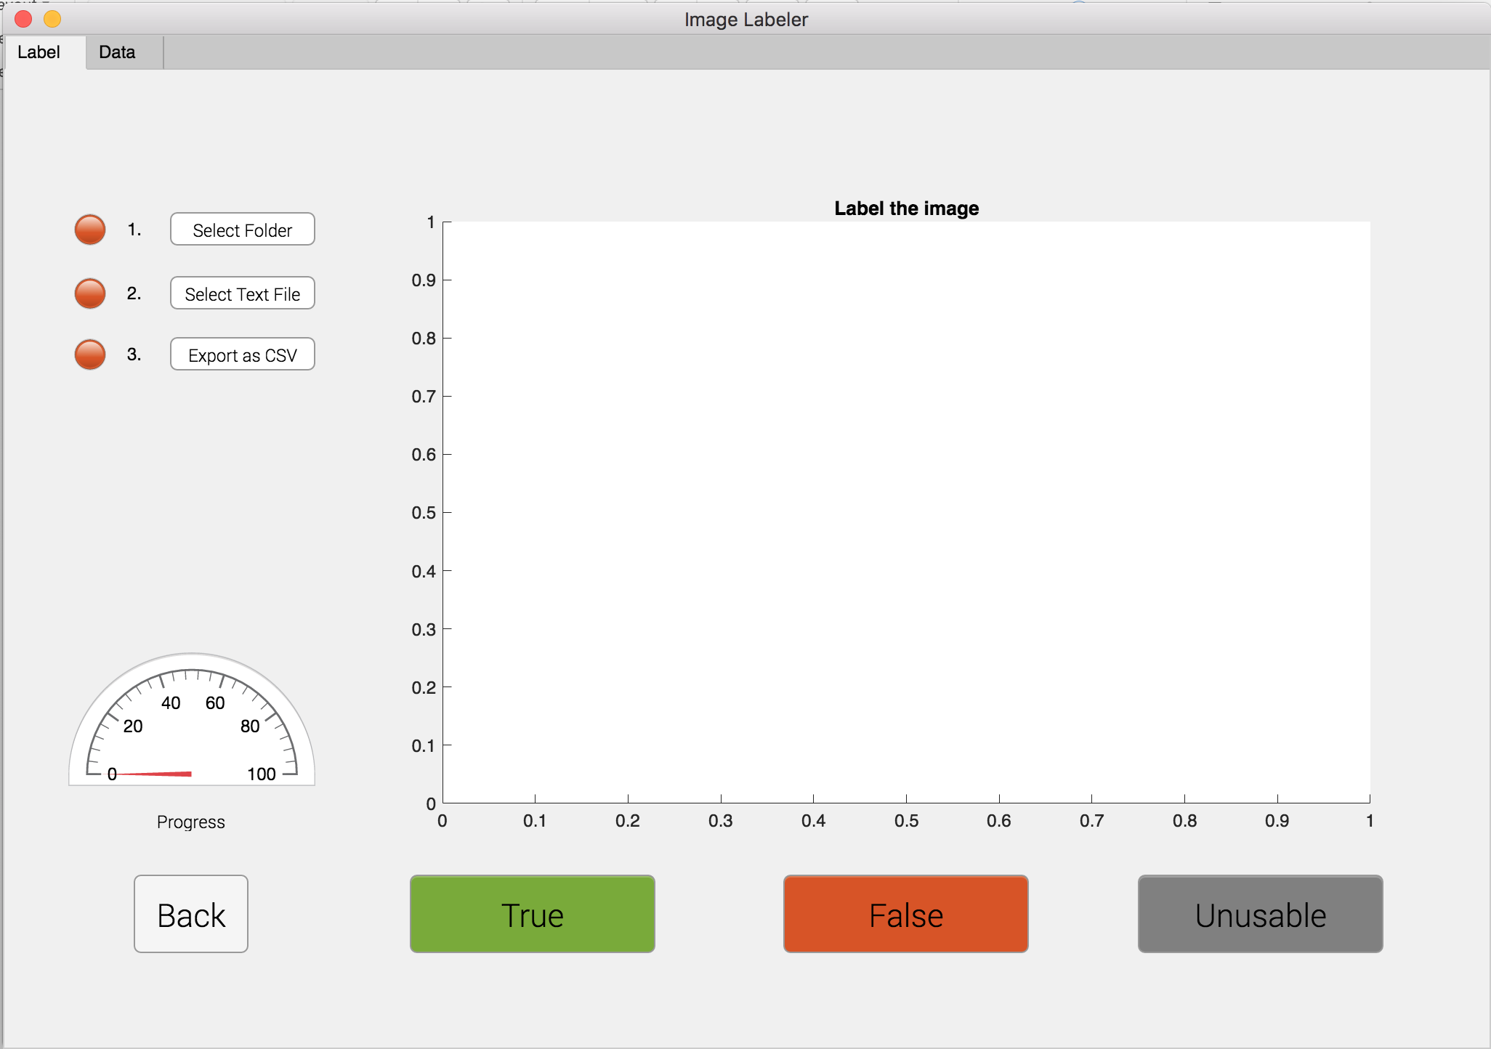
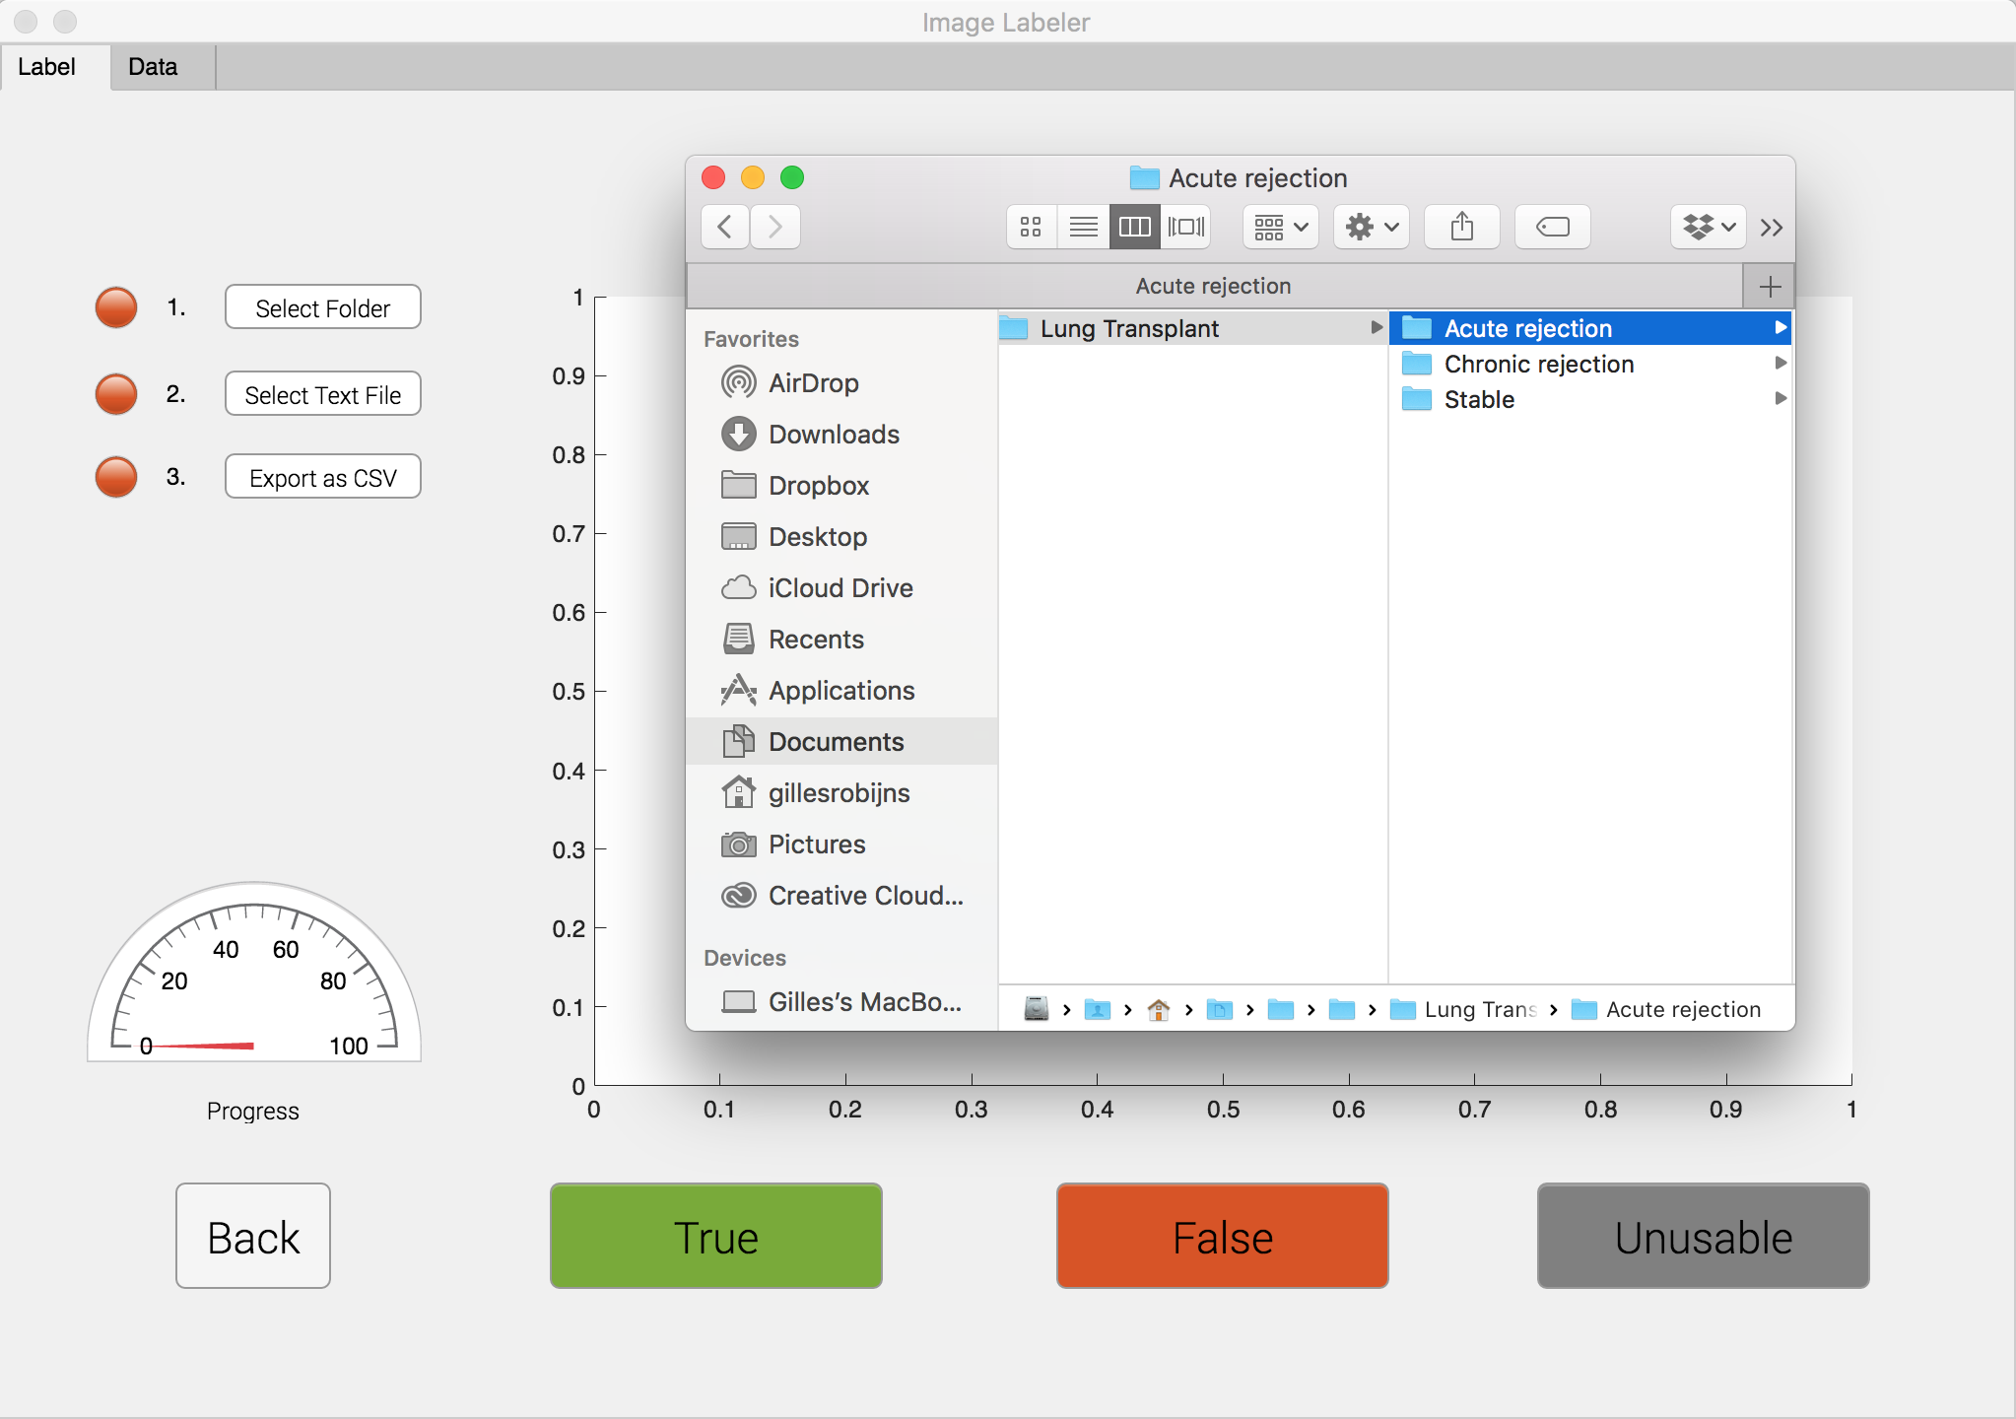
How to use the image labeler GUI
1
Open the file ‘imageLabeler.mlapp’. This will open the application in Matlab. The following screen will appear:
2
Click the button Select Folder and select one of the three folders (acute rejection, chronic rejection or stable) inside the master folder ’Lung Transplant’ where all the videos are saved. If successful, the red light will turn green.

Slide 2
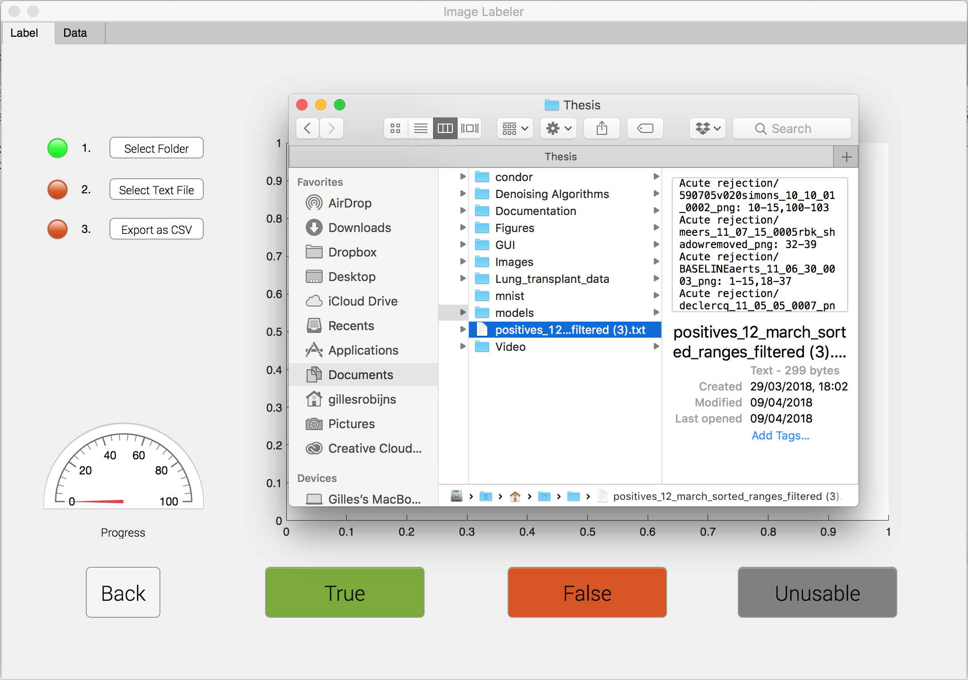
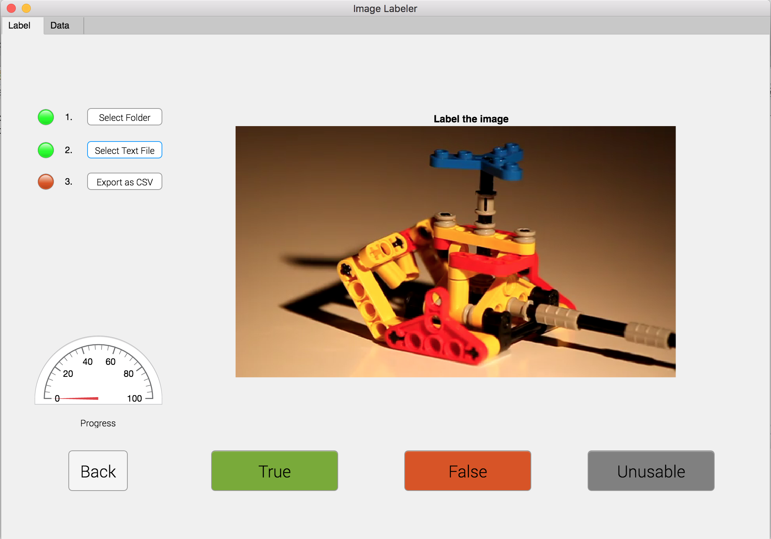
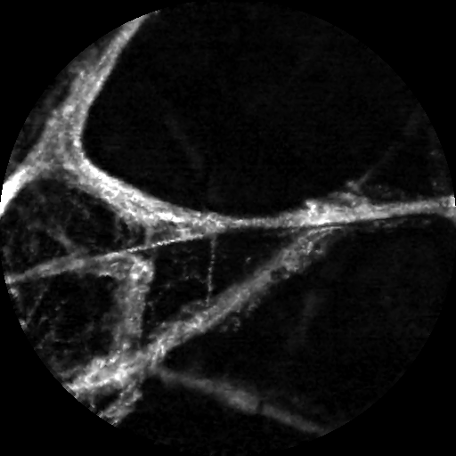
3
Click the button Select Text File and select the text file that contains all relevant frames from the videos. If successful, the second light will turn green.
4
Start labelling the images on the screen with True, False or Unusable. If an image was labelled incorrect, you can go back by pushing the back-button. The gauge above the back-button shows your progress.
Your progress is saved automatically, so you can resume your work even if the application was closed.

Slide 3
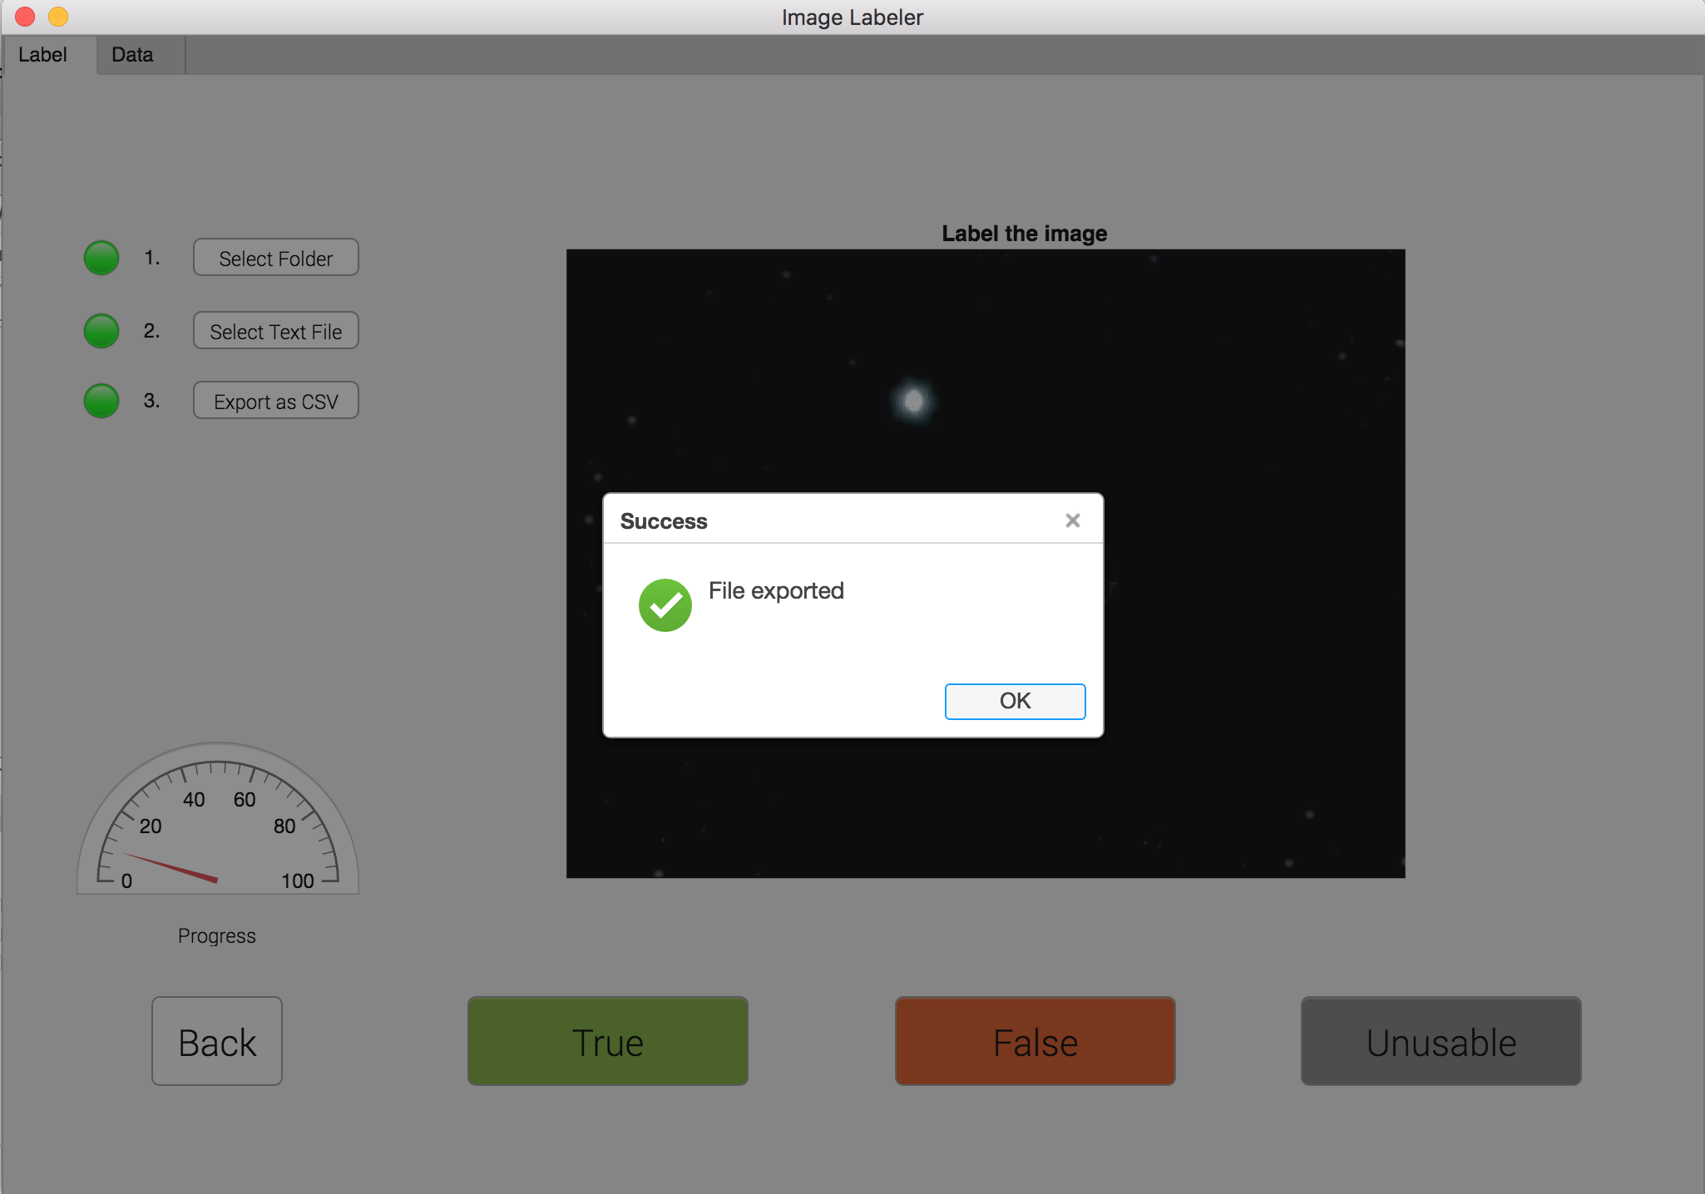
5
When all images are labelled, you will get a notification. Click export as CSV. This will save an excel file with all the labelled data to your current working folder in Matlab.
6
Start labelling the images on the screen with True, False or Unusable. If an image was labelled incorrect, you can go back by pushing the back-button. The gauge above the back-button shows your progress.
Your progress is saved automatically, so you can resume your work even if the application was closed.

