Slide 1
Do stricter gun laws reduce firearm gun deaths? Story 3 DATA 608 Gillian McGovern

Slide 2
Introduction

Slide 3
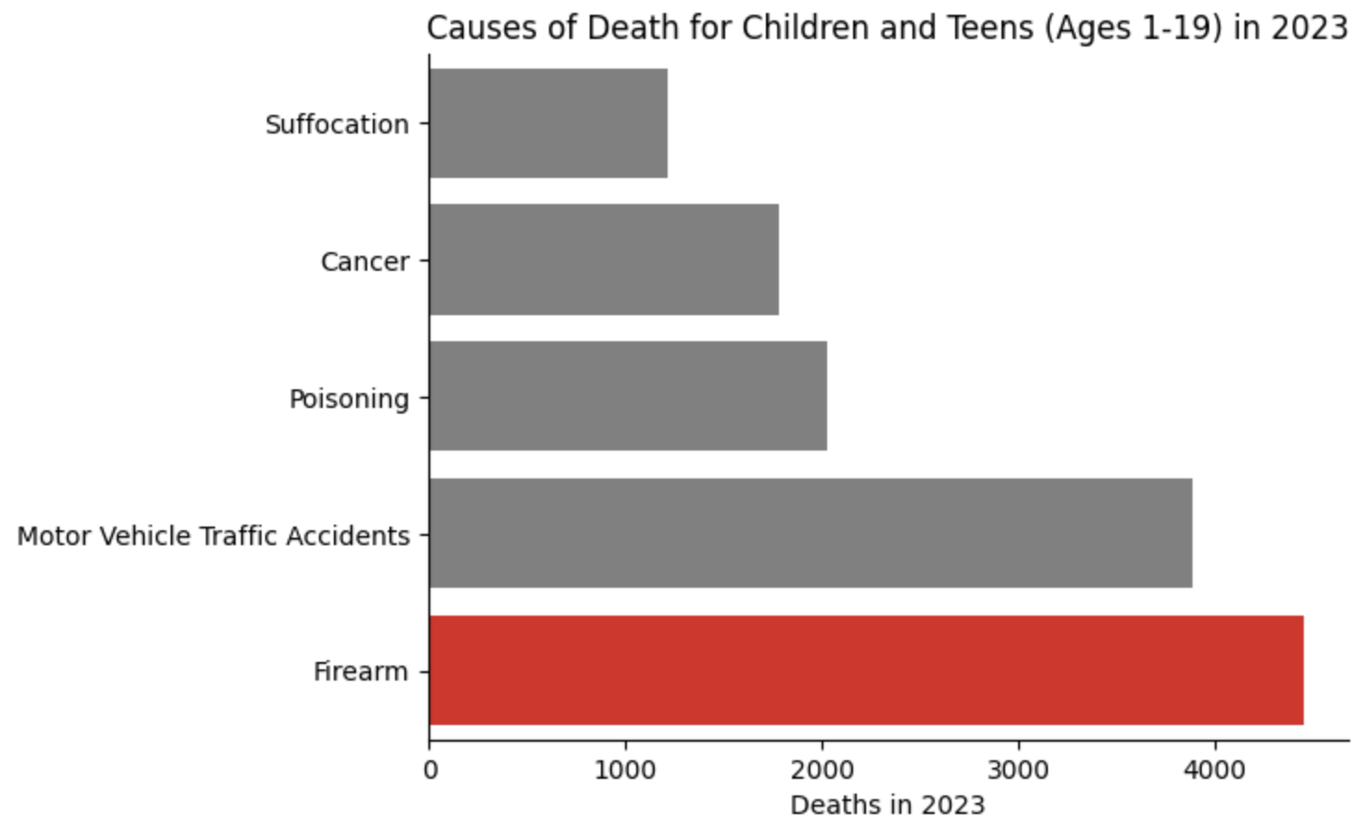
Leading Causes of Death: Children and Teens, 2023
Gun violoence is major issue:
Firearms are the leading cause of death for children and teens
Data provided by the CDC Wonder API and Everytown.

Slide 4
Firearm Mortality in the US

Slide 5
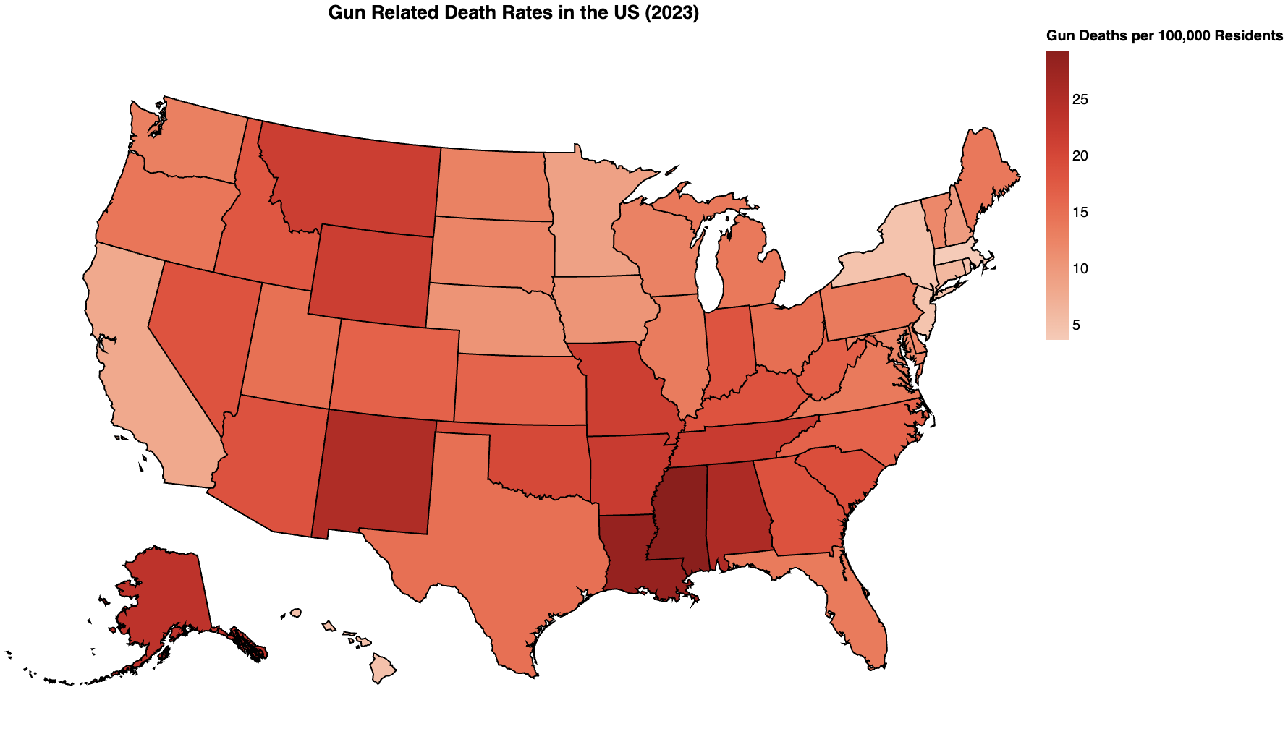
Gun Related Death Rates in the US, 2023
Gun death rates vary by region:
Southern and more rural states such as Mississippi, Louisiana, and Alabama have the highest gun death rates
East coast and major city states such as Massachusetts, New Jersey, and New York have the lowest gun death rates
Death rate data provided by the CDC Wonder API and Everytown.

Slide 6
The Effect of State Gun Laws
Conclusion

Slide 7
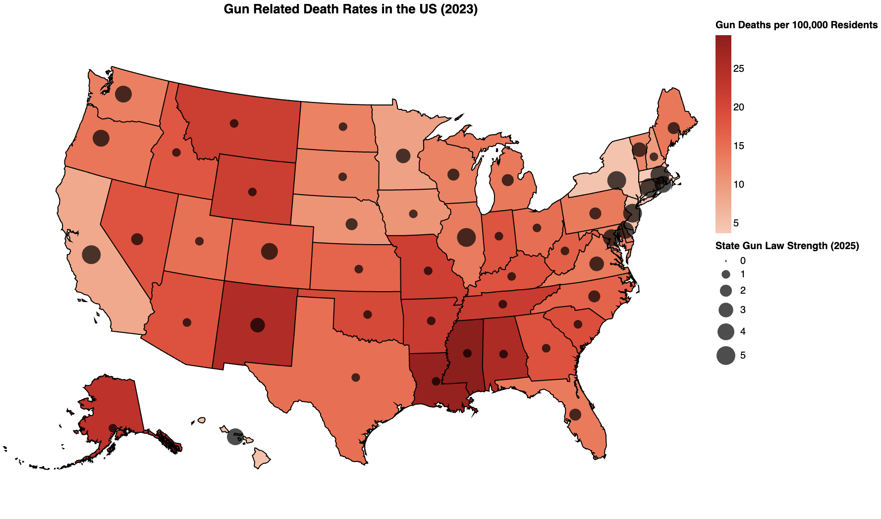
Gun Related Death Rates and Gun Law Strength
Lowest gun death rates states have stricter gun laws:
Idaho, Mississippi, Arkansas, and Montana have the weakest gun laws
California, Massachusetts, Illinois, and New York have the strictest gun laws
Death rate data provided by the CDC Wonder API and Everytown. Gun law strength data provided by Everytown.

Slide 8
Thank you

