Slide 1

THE PHONEBOOK APPLICATION
Made By:
Kartik Gill , 991551120

Slide 2
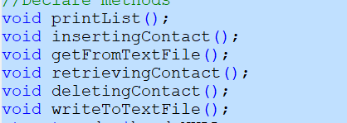
Methods Used
Main Method
InsertingContact
retrievingContact
deletingContact
printlist
writeToTextFile
getfromFromTextFile

Slide 3
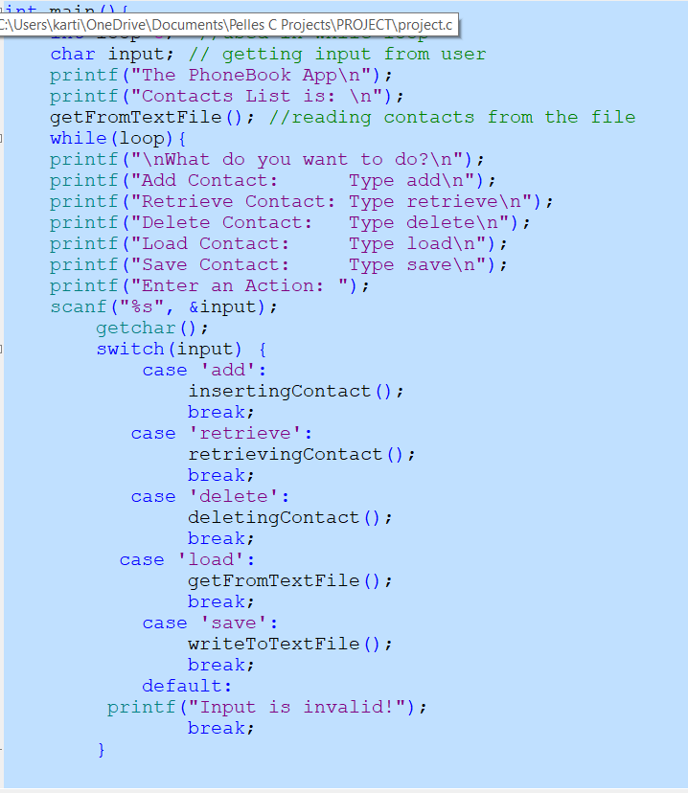
Main Method
The first method which opens up after running the application. It includes calling up of all other function, getting user input and act accordingly

Slide 4
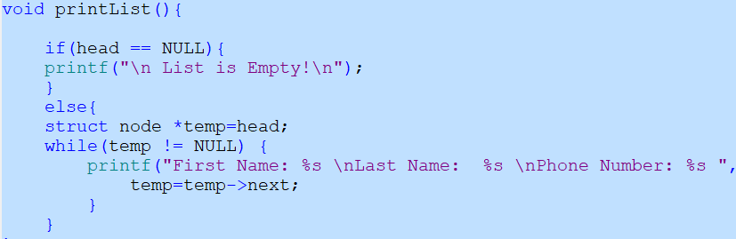
PrintList method
Used to print the contacts which are asked for and displays contacts from the text file

Slide 5
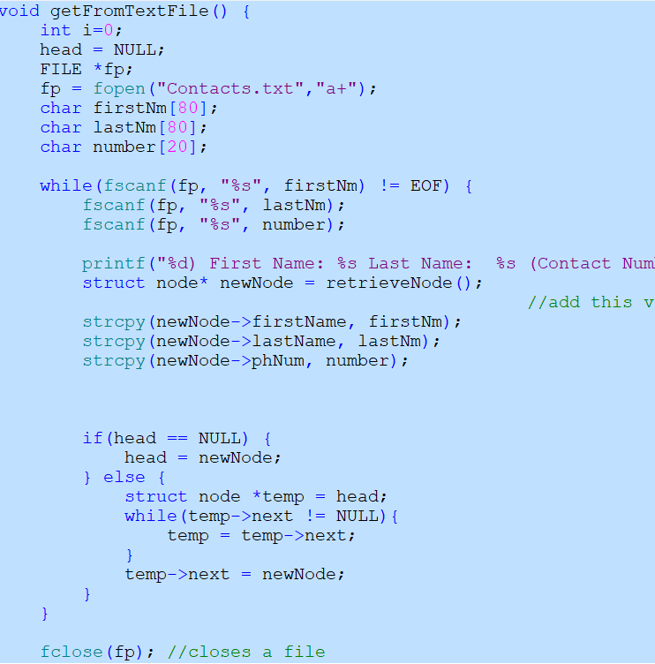
GetFromtextfile
It helps to read the content from the file, then add it to link list
Also prints up the value

Slide 6
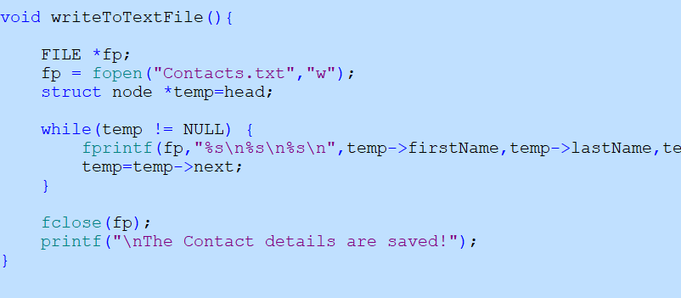
WriteTotextFile
Only works well, if the user saves the data

Slide 7
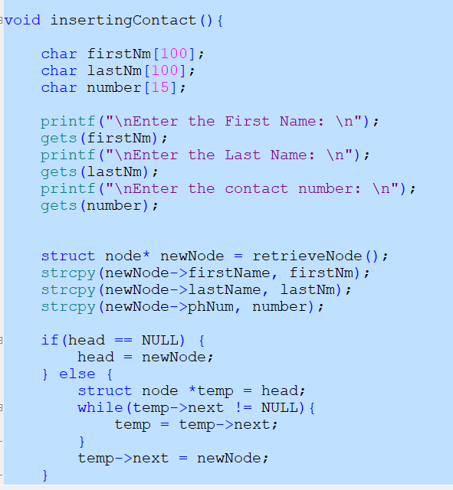
InsertingContact
It helps to add a new contact to linked list and structure
Adds everthing to the end of the file.

Slide 8
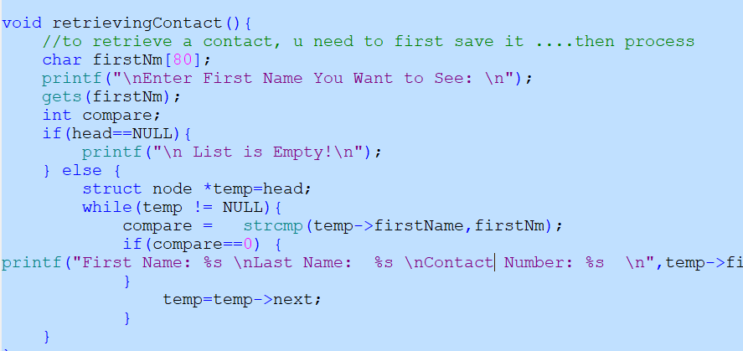
retrievingContact
Gives back the contact details after searching it in the linked list

Slide 9
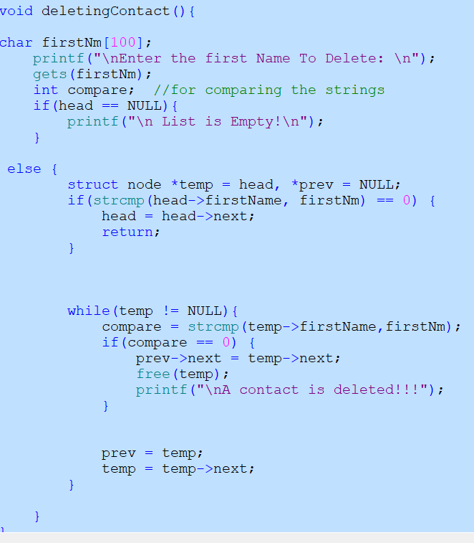
DeletingContact
Compare the first name in the file and list
Also helps to set the previous node to set equal to current node.

Slide 10
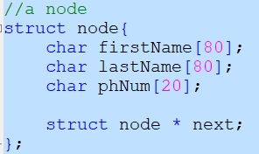
Various other things used:
Structure
Pointers

Slide 11

Output of the Application.

Slide 12
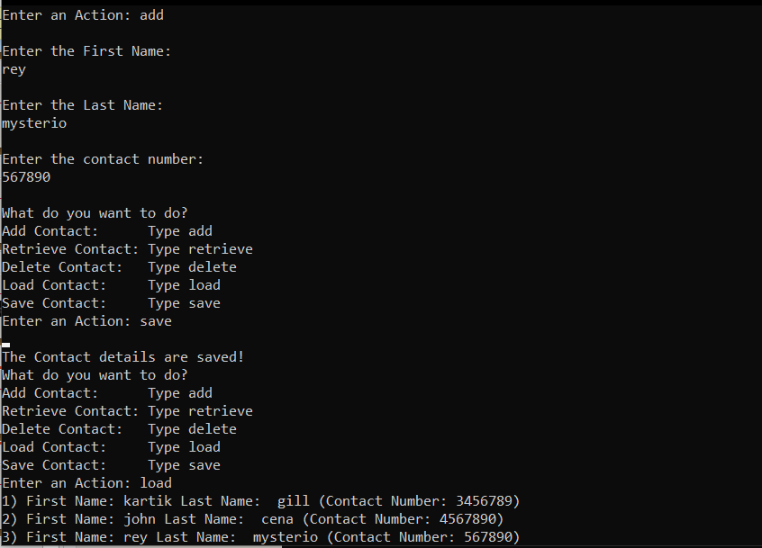
Output:

Slide 13
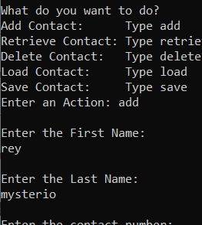

Slide 14
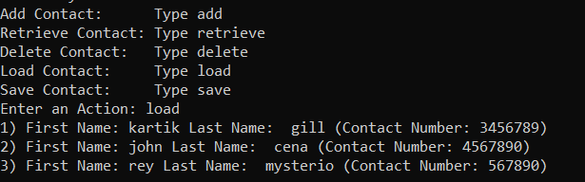

Slide 15
