Slide 1
INDUSTRIAL TRAINING PROJECT
Smart Paper Mill
Production Monitoring Dashboard
A real-time, role-based web dashboard for monitoring paper production
Industrial training carried out at SATIA INDUSTRIES LIMITED
Submitted by
Manreet Gill (UID: 24BCS10479)
B.E. Computer Science & Engineering - Chandigarh University
June 2026
Notes:
Good morning/afternoon. I'm presenting my industrial training project, the Smart Paper Mill Production Monitoring Dashboard, developed in the context of Satia Industries Limited - a wheat-straw based writing and printing paper manufacturer. All data shown is fictional but industry-realistic; no confidential company data is used.

Slide 2
THE GAP
Problem & Objectives
Problem: production, quality (GSM / moisture), machine status and downtime are recorded manually in registers and spreadsheets - no single, real-time view, and problems are caught late.
Objective: a centralised, role-based web dashboard for real-time production monitoring.
Capture output plus quality and downtime in a database, with live machine telemetry and automatic threshold alerts.
Compute OEE and KPIs, export reports (CSV / PDF), and enforce secure, role-based access - all on standard student hardware.
Smart Paper Mill Production Monitoring Dashboard - Satia Industries Ltd.
1
Notes:
I'll start with the gap and what I set out to build. Today the plant's data lives on paper and in spreadsheets, so there's no live picture and issues are noticed late. The objective was a single role-based dashboard that captures production, quality and downtime, shows live machine data, raises automatic alerts, computes OEE and exports reports - with proper security, on a normal laptop.

Slide 3
TOOLS
Technology Stack
Layer | Technology | Why
Front-end | HTML5, CSS3, JavaScript, Chart.js | Lightweight, no build step
Back-end | Python - Flask (REST API + static) | Same-origin API & UI
Database | SQLite (MySQL is production target) | Zero-config persistence
Security | bcrypt, PyJWT | Hashed passwords + JWT auth
Real-time | Server-Sent Events (SSE) | Live push, zero extra deps
Testing / Deploy | pytest (94 tests); gunicorn / Render | Verified; free hosting
Smart Paper Mill Production Monitoring Dashboard - Satia Industries Ltd.
2
Notes:
The stack is deliberately free, open-source and lightweight: a vanilla HTML/CSS/JS front-end with Chart.js, a Flask back-end serving both the API and the pages, SQLite for storage, bcrypt and JWT for security, and Server-Sent Events for the live feed. Everything runs on a normal laptop.

Slide 4
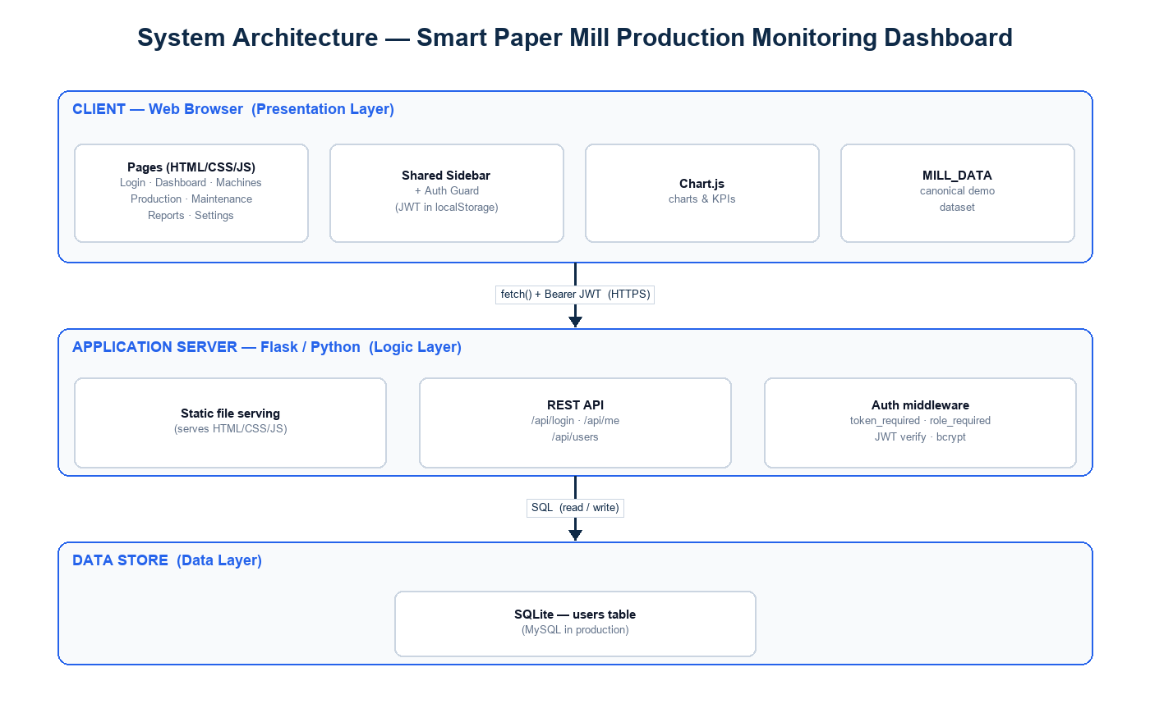
DESIGN
System Architecture
Three-tier: browser front-end -> Flask REST API + SSE -> SQLite database (same origin).
Smart Paper Mill Production Monitoring Dashboard - Satia Industries Ltd.
3
Notes:
The design is a clean three-tier architecture: the browser runs the pages and charts, a single Flask app serves the front-end and the REST API on the same origin and pushes the live stream, and SQLite holds all persisted data.

Slide 5
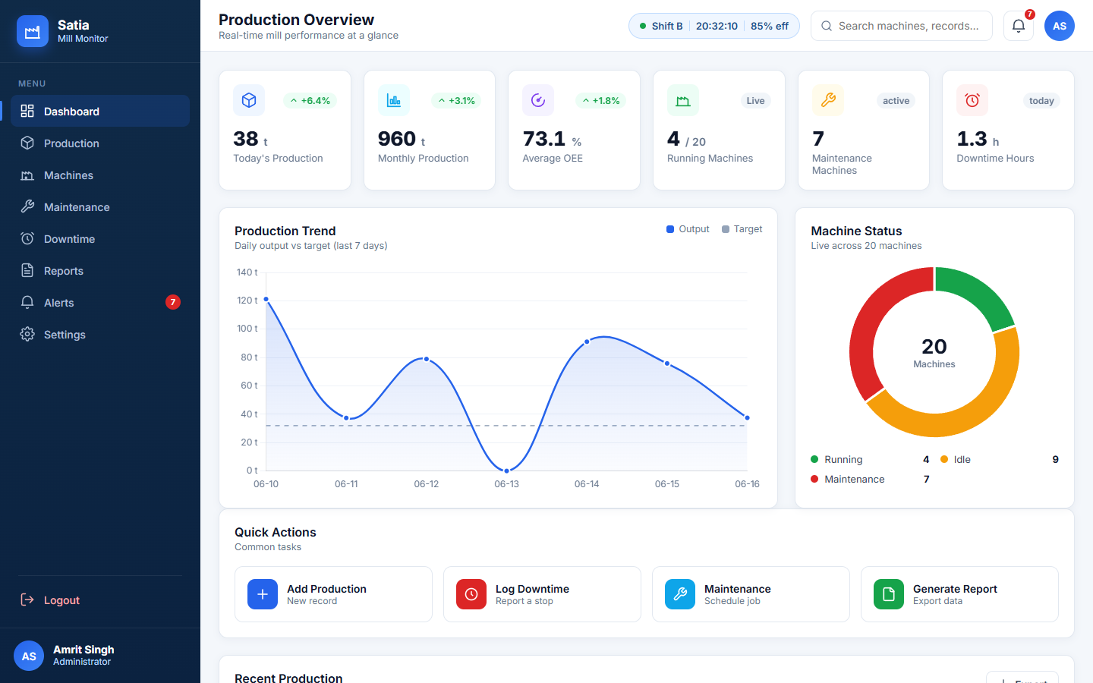
WALKTHROUGH
Dashboard
Live overview: KPI cards (incl. average OEE), production-trend and machine-status charts.
Smart Paper Mill Production Monitoring Dashboard - Satia Industries Ltd.
4
Notes:
This is the dashboard - the landing screen, with six KPI cards including average OEE, a production-trend chart and a machine-status doughnut. The KPIs and charts read live from the API, so they reflect data entered through the app.

Slide 6
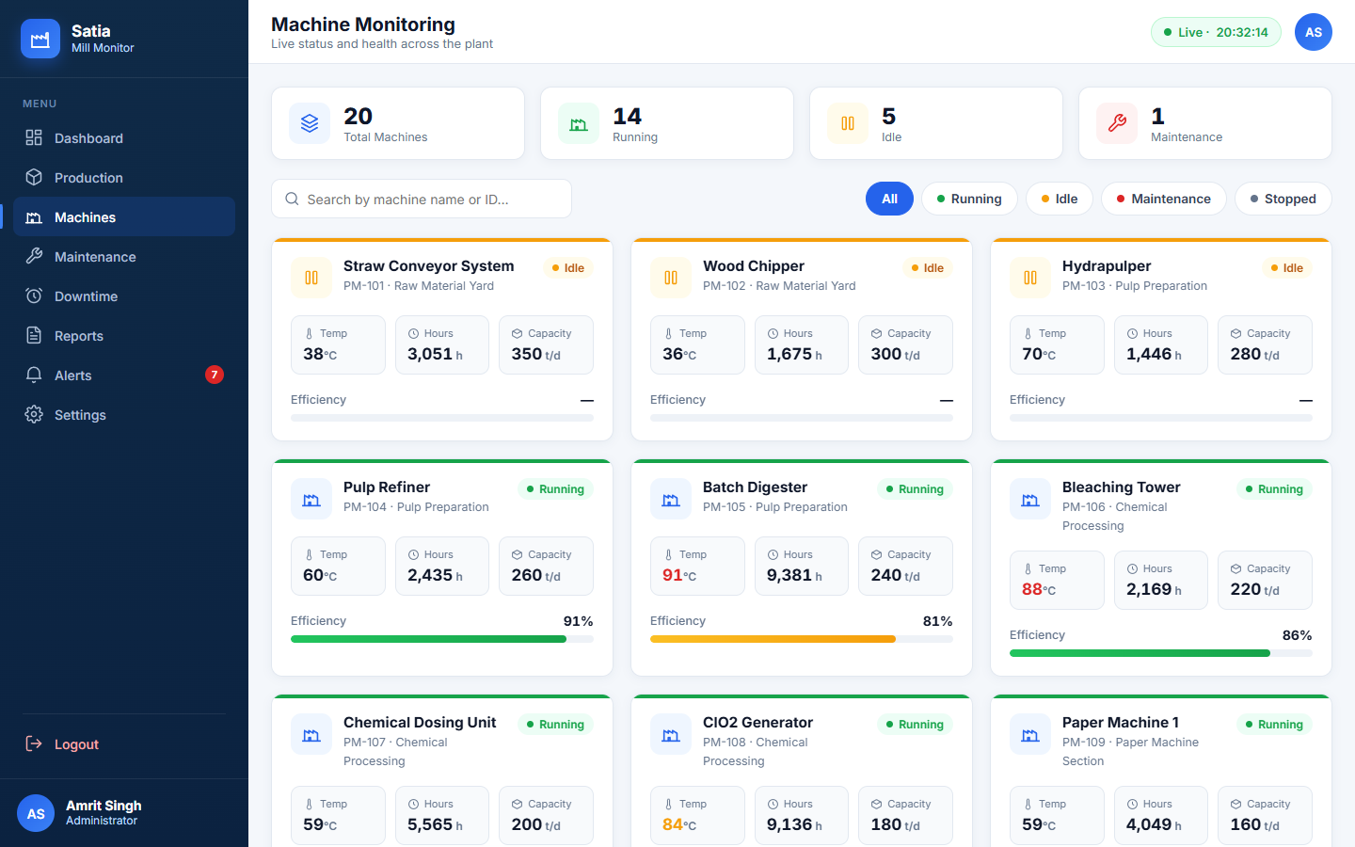
WALKTHROUGH
Machine Monitoring
Colour-coded status board - Running / Idle / Stopped / Maintenance - with live telemetry.
Smart Paper Mill Production Monitoring Dashboard - Satia Industries Ltd.
5
Notes:
The machine-monitoring page is a colour-coded status board with search and status filters and a card per machine showing temperature, hours, capacity and efficiency - with temperature and efficiency updating live via the server stream.

Slide 7
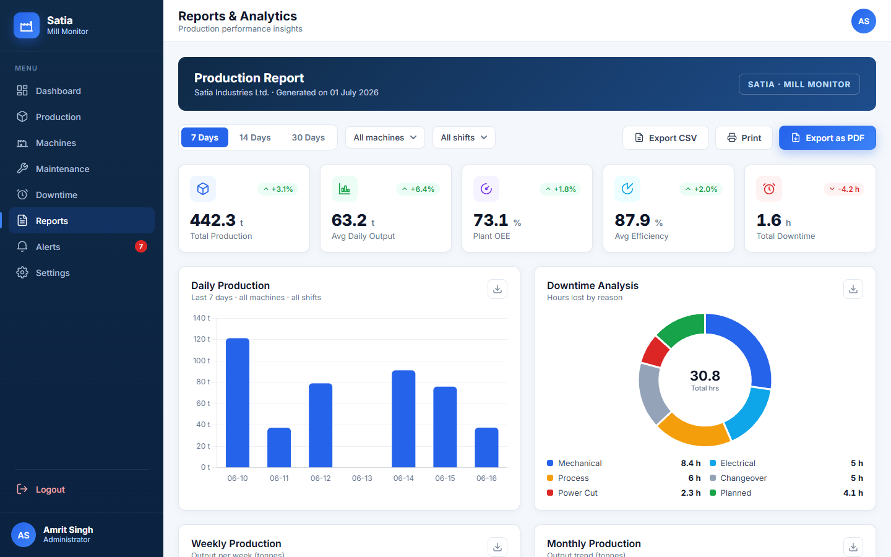
WALKTHROUGH
Reports & Analytics
Filtered reports, plant OEE, downtime breakdown, and CSV / PDF export.
Smart Paper Mill Production Monitoring Dashboard - Satia Industries Ltd.
6
Notes:
The reports page turns the raw data into analytics - summary KPIs, a live daily-production chart, a downtime-by-reason breakdown and OEE by machine - all filterable by period, machine and shift, and exportable to CSV or PDF.

Slide 8
HIGHLIGHTS
Real-Time, OEE & Alerts
Live telemetry: the server pushes temperature & efficiency to open pages via SSE, updating every few seconds without a reload.
API-driven: dashboard KPIs, the daily report and alerts reflect records entered through the app, with graceful fallback when offline.
Quality & OEE: every record captures GSM / moisture / speed against admin-editable limits; OEE = Availability x Performance x Quality is charted per machine.
Threshold alerts: out-of-spec quality and over-limit downtime raise alerts that can be filtered by severity and acknowledged.
Smart Paper Mill Production Monitoring Dashboard - Satia Industries Ltd.
7
Notes:
A few technical highlights: live telemetry via Server-Sent Events; KPIs, reports and alerts that read live from the API with a fallback when offline; quality capture of GSM, moisture and speed against editable limits; OEE charted per machine; and automatic threshold-driven alerts you can acknowledge.

Slide 9
RESULTS
Testing & Outcomes
94 / 94 automated tests passing (pytest) - authentication, role-based access, full CRUD, quality & thresholds, live stream and audit log.
A working, end-to-end application with real auth, role-based access and persistence that survives restarts.
A complete documentation set - SRS, project report and role-based user manuals - and a deploy-ready build for free hosting (Render).
Hands-on experience across full-stack development, REST APIs, security, testing and deployment.
Smart Paper Mill Production Monitoring Dashboard - Satia Industries Ltd.
8
Notes:
On results: the back-end is backed by 94 passing automated tests covering auth, roles, CRUD, thresholds, streaming and the audit log. The outcome is a complete, working application with real authentication and persistence, a full documentation set, and a deploy-ready build - and genuine full-stack experience for me.

Slide 10
Thank You
Questions & Discussion
Manreet Gill - B.E. CSE, Chandigarh University
Industrial Training Project - Satia Industries Limited
Notes:
That concludes the presentation. Thank you - I'm happy to take any questions, and I can demonstrate the running application live: logging in as different roles, entering a production record and watching the dashboard, reports and alerts update in real time.

