Slide 1
INDUSTRIAL TRAINING PROJECT - 2026
Smart Paper Mill
Production Monitoring Dashboard
A real-time, role-based web dashboard for monitoring paper production
Industrial training carried out at SATIA INDUSTRIES LIMITED
Submitted by
[STUDENT NAME] (UID: [____________])
B.E. Computer Science & Engineering - Chandigarh University
[MONTH] [YEAR]
Notes:
Good morning/afternoon. I'm presenting my industrial training project, the Smart Paper Mill Production Monitoring Dashboard, developed in the context of Satia Industries Limited - a wheat-straw based writing and printing paper manufacturer. All data shown is fictional but industry-realistic; no confidential company data is used.

Slide 2
OUTLINE
Agenda
1. Organisation & domain
2. Problem statement
3. Objectives & scope
4. Technology stack
5. System architecture
6. Database design
7. Security & user roles
8. Modules & key features
9. Real-time monitoring
10. Quality, OEE & alerts
11. Testing & results
12. Challenges & future scope
Smart Paper Mill Production Monitoring Dashboard - Satia Industries Ltd.
1
Notes:
Here's the flow: I'll start with the company and the problem, cover objectives and scope, then walk through the technology, architecture and database. After that the modules and the real-time and analytics features, and finally testing, results and future scope.

Slide 3
CONTEXT
Organisation & Domain
Satia Industries Ltd. - a leading agro-residue paper manufacturer producing writing & printing paper primarily from wheat straw and wood pulp.
Production flows through several stages: pulping -> stock preparation -> paper machine (PM) -> finishing, run on multiple paper machines.
Key process parameters: output (tonnes), GSM, moisture, machine speed, temperature, running hours and efficiency.
Continuous, round-the-clock operation across three shifts (A / B / C) makes timely visibility of production, quality and machine health business-critical.
  Disclaimer: all figures in this project are simulated and industry-realistic - no confidential Satia data is used.
Smart Paper Mill Production Monitoring Dashboard - Satia Industries Ltd.
2
Notes:
Satia is one of India's larger eco-friendly paper makers, using wheat straw instead of felling trees. Paper-making is a continuous process across several stages and runs 24x7 in three shifts, so managers need a single, live view of what every machine is doing. I want to stress that all the data in the system is fictional but realistic.

Slide 4
MOTIVATION
Problem Statement
Production is recorded manually in shift registers, logbooks and disconnected spreadsheets kept separately for each section.
No consolidated, real-time view of output, quality (GSM / moisture), machine status, downtime or efficiency across the plant.
Out-of-spec quality and excessive downtime are often detected late, after the shift, when corrective action is harder.
KPIs such as OEE are tedious to compute by hand, and management reports take time to compile from scattered sources.
Data is hard to secure, audit or share role-by-role across the organisation.
Smart Paper Mill Production Monitoring Dashboard - Satia Industries Ltd.
3
Notes:
The core problem is that today the data lives on paper and in spreadsheets. There's no single live picture, problems are caught late, and computing KPIs or generating reports is slow and manual. That's the gap this project addresses.

Slide 5
GOALS
Objectives
Provide a centralised, role-based web dashboard for real-time production monitoring.
Capture production output and quality parameters (GSM, moisture, speed) plus downtime events, persisted in a database.
Show live machine status and telemetry and raise threshold-driven alerts automatically.
Compute OEE and key KPIs and let users export reports (CSV / PDF).
Enforce secure authentication and access control, and run on standard, low-cost student hardware and a normal browser.
Smart Paper Mill Production Monitoring Dashboard - Satia Industries Ltd.
4
Notes:
The objectives follow directly from the problem: one centralised role-based dashboard; capture of output, quality and downtime that actually persists; live status and automatic alerts; OEE and exportable reports; and proper security - all while staying lightweight enough to run on a normal laptop.

Slide 6
BOUNDARIES
Scope
In scope: a complete web application - responsive front-end, REST API back-end and a database - with four user roles and nine functional modules.
In scope: authentication, production & quality entry, machine monitoring, maintenance, downtime logging, reports, alerts, settings and an admin panel.
Simulated sensors: live machine telemetry is streamed from the server to mimic a real sensor feed, since plant PLC/DCS hardware is not available to a student project.
Out of scope: direct PLC / DCS / IoT sensor integration, ERP/SAP integration, and a native mobile application - identified instead as future scope.
Smart Paper Mill Production Monitoring Dashboard - Satia Industries Ltd.
5
Notes:
To keep the project achievable, the scope is the full software stack with four roles and nine modules. The one honest simplification is that real plant sensors are simulated by a server stream - I don't have access to the mill's control hardware. Deeper integrations are listed as future work.

Slide 7
TOOLS
Technology Stack
Layer | Technology | Why
Front-end | HTML5, CSS3, JavaScript, Chart.js | Lightweight, no build step, runs anywhere
Back-end | Python - Flask (REST API + static) | Simple, same-origin API & UI
Database | SQLite (MySQL is production target) | Zero-config, file-based persistence
Security | bcrypt, PyJWT | Hashed passwords + stateless JWT auth
Real-time | Server-Sent Events (SSE) | Live push with zero extra dependencies
Testing | pytest (94 automated tests) | Reproducible backend verification
Docs / Deploy | python-docx, Matplotlib; gunicorn / Render | Auto-generated docs; free hosting
Smart Paper Mill Production Monitoring Dashboard - Satia Industries Ltd.
6
Notes:
The stack is deliberately free, open-source and lightweight. A vanilla HTML/CSS/JS front-end with Chart.js, a Flask back-end that serves both the API and the pages same-origin, SQLite for persistence, bcrypt and JWT for security, and Server-Sent Events for the live feed - chosen over Socket.IO because it needs no extra dependencies. Everything runs on a normal laptop.

Slide 8
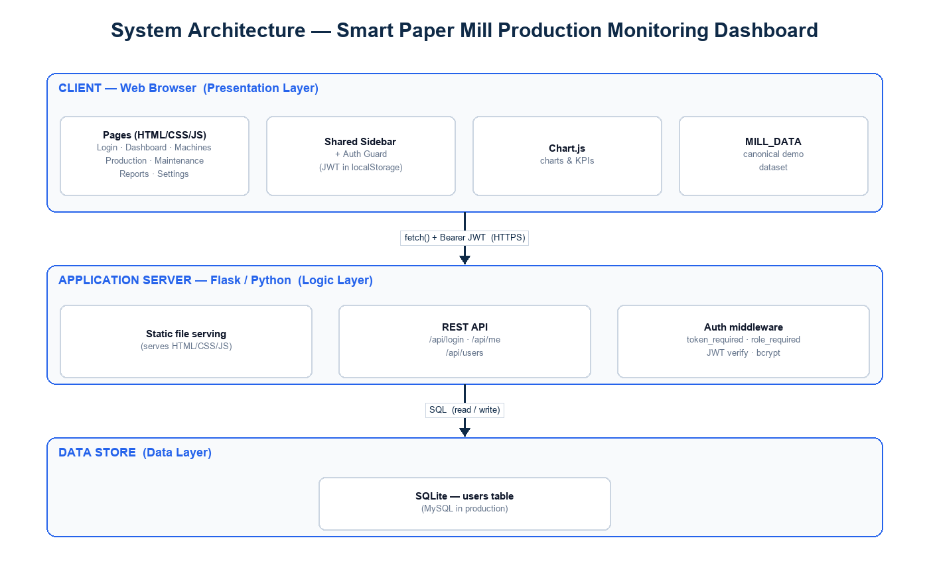
DESIGN
System Architecture
Three-tier architecture: browser front-end -> Flask REST API + SSE -> SQLite database (same origin).
Smart Paper Mill Production Monitoring Dashboard - Satia Industries Ltd.
7
Notes:
Architecturally it's a clean three-tier design. The browser runs the pages and charts; a single Flask application serves both the static front-end and the REST API on the same origin and also pushes the live SSE stream; and SQLite holds all persisted data. Same-origin serving keeps authentication and deployment simple.

Slide 9
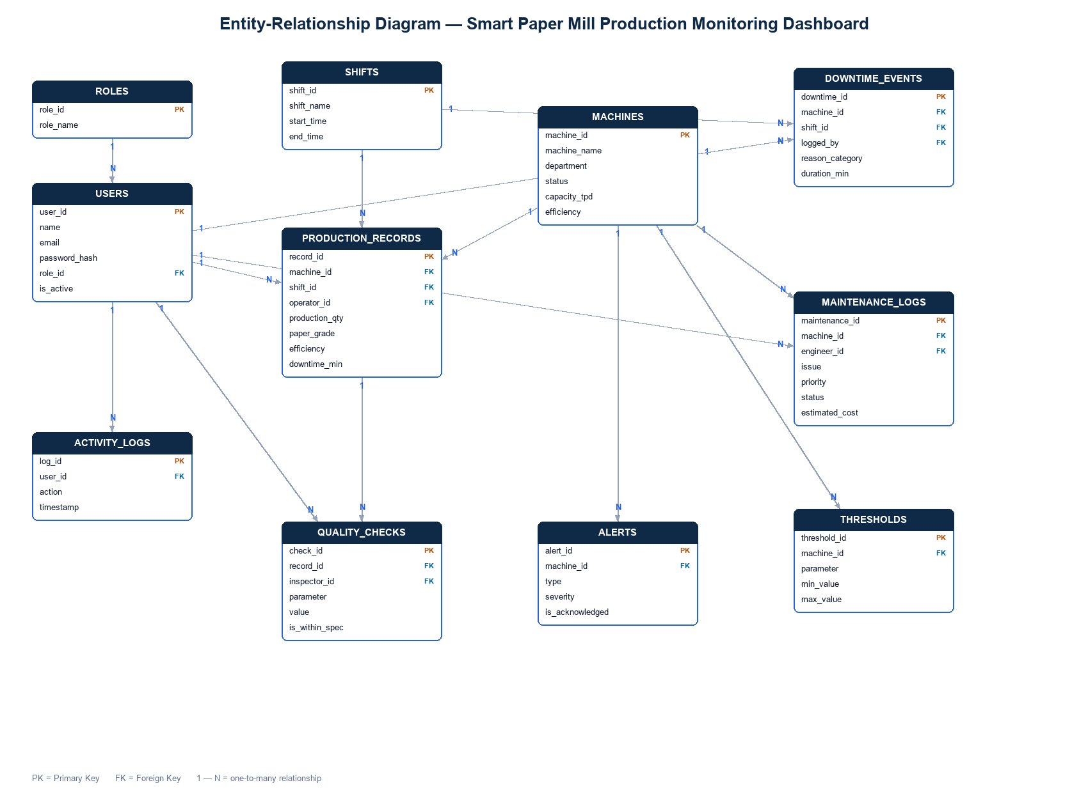
DATA
Database Design
Core tables: users, production_records, maintenance_logs, downtime_events, machines, thresholds, activity_logs.
Smart Paper Mill Production Monitoring Dashboard - Satia Industries Ltd.
8
Notes:
The database centres on production records, with supporting tables for users, machines, maintenance logs, downtime events, configurable thresholds and an activity/audit log. Production records carry the quality fields - GSM, moisture and speed - alongside output, grade and shift.

Slide 10
SECURITY
User Roles & Access Control
Role | Representative permissions
Administrator | Full access; manage users, machines & thresholds; view audit log
Plant Manager | View all dashboards & reports; oversee production, OEE and downtime
Shift Supervisor | Log production, downtime and maintenance for their shift
Machine Operator | Enter production & quality readings; view machine status & alerts
Smart Paper Mill Production Monitoring Dashboard - Satia Industries Ltd.
9
Notes:
Access is role-based with four roles. Security rests on three pillars: bcrypt-hashed passwords, stateless JWT tokens, and role-required checks on every protected API endpoint. Sensitive actions are written to an audit log. So an operator can enter readings but cannot, for example, manage users - that's enforced on the server, not just hidden in the UI.

Slide 11
FUNCTIONALITY
Modules & Key Features
Dashboard - KPI cards (incl. average OEE), production-trend & machine-status charts, live feed.
Production - record output and GSM / moisture / speed; out-of-spec values flagged.
Machines - colour-coded status board (Running / Idle / Stopped / Maintenance) with live temperature & efficiency.
Maintenance & Downtime - log and track jobs by priority/status; capture stoppages with auto-computed duration.
Reports, Alerts, Settings & Admin - filtered reports with CSV/PDF export, threshold alerts, dark mode, and user/machine/threshold management.
Smart Paper Mill Production Monitoring Dashboard - Satia Industries Ltd.
10
Notes:
Functionally there are nine modules. The dashboard is the landing view with KPIs and charts. Production captures output and the three quality parameters. Machines is a live colour-coded status board. Maintenance and downtime track jobs and stoppages. And reports, alerts, settings and the admin panel round it out - including CSV/PDF export, dark mode and full admin control.

Slide 12
LIVE
Real-Time Monitoring
The server pushes live readings (temperature, efficiency) to every open page using Server-Sent Events over an authenticated stream.
Machine cards and the dashboard's live indicator update every few seconds without reloading the page; a 'Live' timestamp shows freshness.
KPIs, reports and alerts are API-driven: records entered through the app immediately feed the dashboard KPIs, the daily report and the alerts list.
Pages degrade gracefully - if the backend is unavailable they fall back to a seeded demonstration dataset, so the UI never breaks.
Smart Paper Mill Production Monitoring Dashboard - Satia Industries Ltd.
11
Notes:
A flagship feature is real-time monitoring. The Flask server streams live machine readings using Server-Sent Events on an authenticated channel, so machine cards and the dashboard update every few seconds with no page reload. I also wired the dashboard KPIs, the daily report and the alerts to read live from the API - so if you enter a record it shows up immediately - with a graceful fallback to seeded data when offline.

Slide 13
ANALYTICS
Quality, OEE & Alerts
Every production record carries quality readings - GSM, moisture and machine speed - validated against configurable limits.
Thresholds: GSM 45-120, moisture <= 6.5%, temperature <= 88 deg C, efficiency >= 75%, downtime <= 60 min (all admin-editable).
OEE = Availability x Performance x Quality is computed and charted per machine.
Threshold-driven alerts are raised automatically for out-of-spec GSM/moisture and over-limit downtime, with acknowledge & severity filtering.
Smart Paper Mill Production Monitoring Dashboard - Satia Industries Ltd.
12
Notes:
On the analytics side, each record stores GSM, moisture and speed, checked against limits that the admin can edit. OEE - availability times performance times quality - is computed and charted per machine. And the alerts page derives warnings live by comparing the actual data against those thresholds, so an out-of-spec sheet or an over-long stoppage raises an alert you can acknowledge.

Slide 14
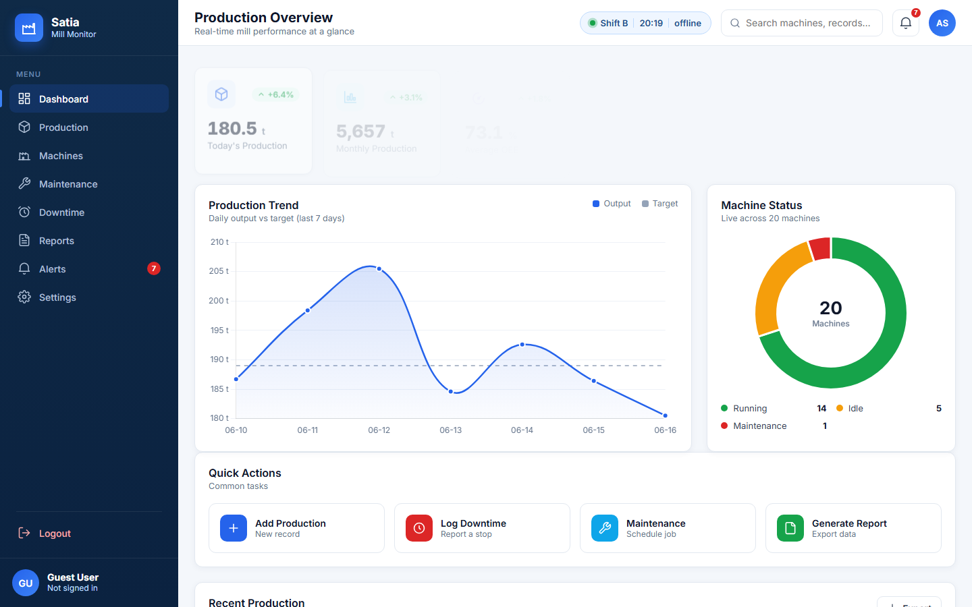
WALKTHROUGH
Dashboard
Live production overview: KPI cards, production-trend and machine-status charts, and quick actions.
Smart Paper Mill Production Monitoring Dashboard - Satia Industries Ltd.
13
Notes:
This is the dashboard - the landing screen. Six KPI cards including average OEE, a production-trend line chart against target, a machine-status doughnut, quick actions and a recent-production table. The KPIs and charts read live from the API, so they reflect data entered through the app.

Slide 15
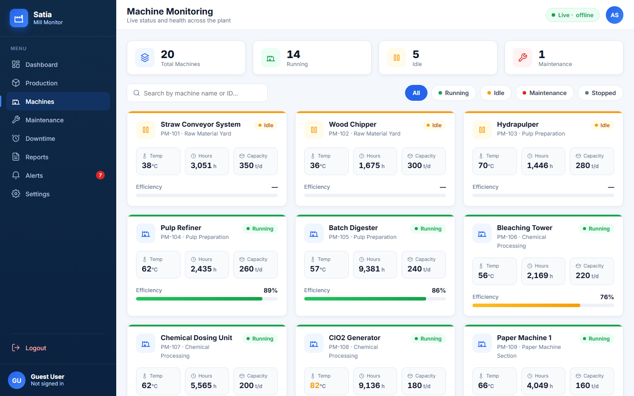
WALKTHROUGH
Machine Monitoring
Colour-coded status board - Running / Idle / Stopped / Maintenance - with live temperature & efficiency.
Smart Paper Mill Production Monitoring Dashboard - Satia Industries Ltd.
14
Notes:
The machine-monitoring page is a colour-coded status board. Summary chips at the top, search and status filters - including the Stopped state - and a card per machine showing temperature, running hours, capacity and an efficiency bar. Temperature and efficiency update live via the server stream.

Slide 16
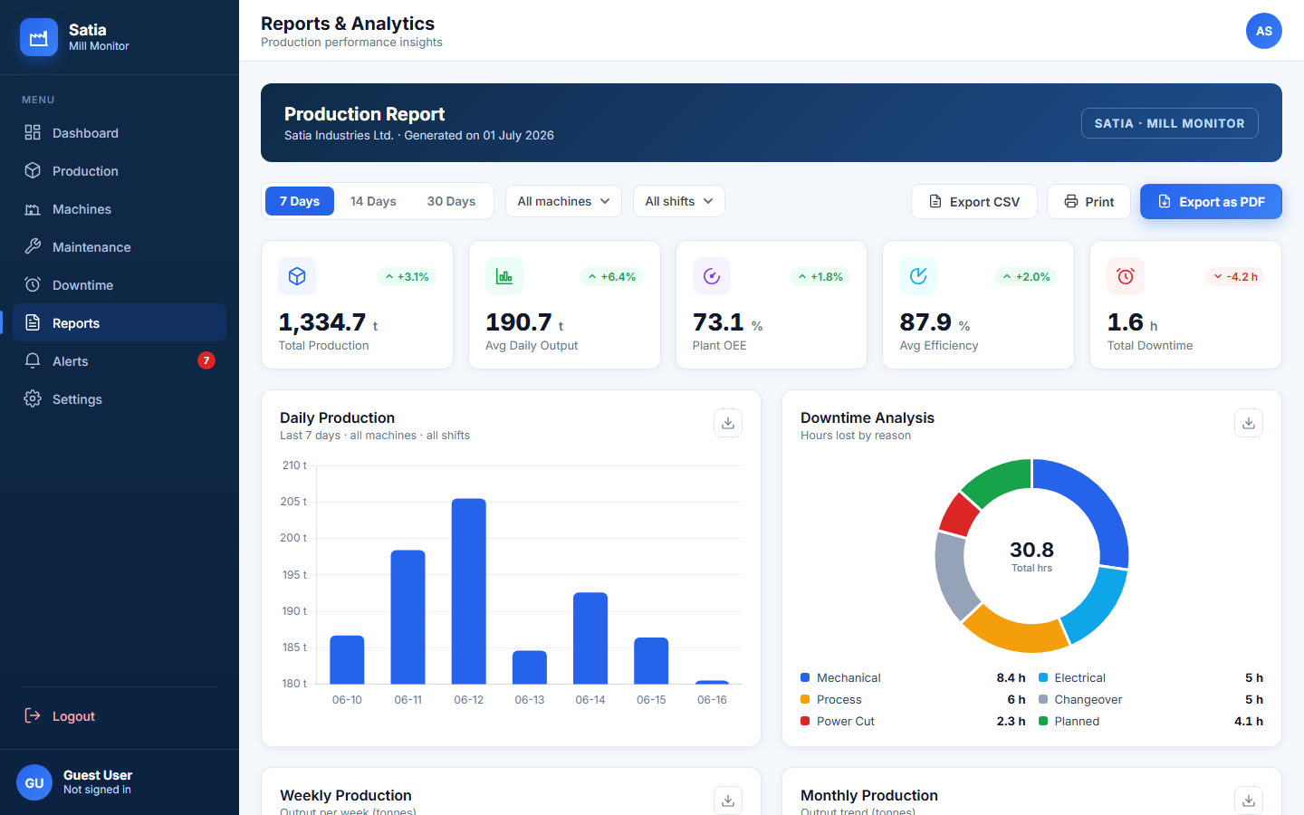
WALKTHROUGH
Reports & Analytics
Period / machine / shift filters, plant OEE, downtime breakdown, and CSV / PDF export.
Smart Paper Mill Production Monitoring Dashboard - Satia Industries Ltd.
15
Notes:
The reports page turns the raw data into analytics: summary KPIs, a daily-production chart that reads live from the API, a downtime-by-reason breakdown, weekly and monthly views and OEE by machine - all filterable by period, machine and shift, and exportable to CSV or PDF.

Slide 17
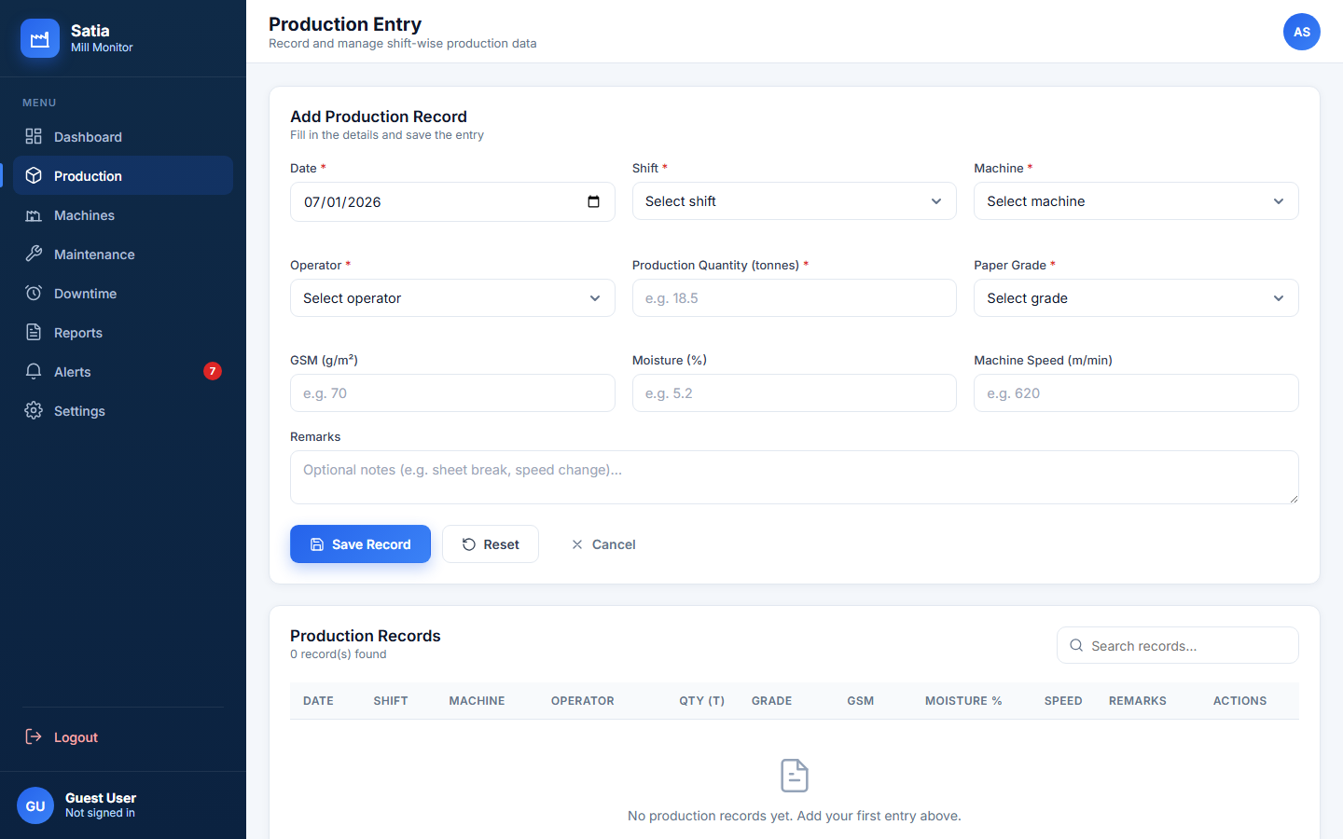
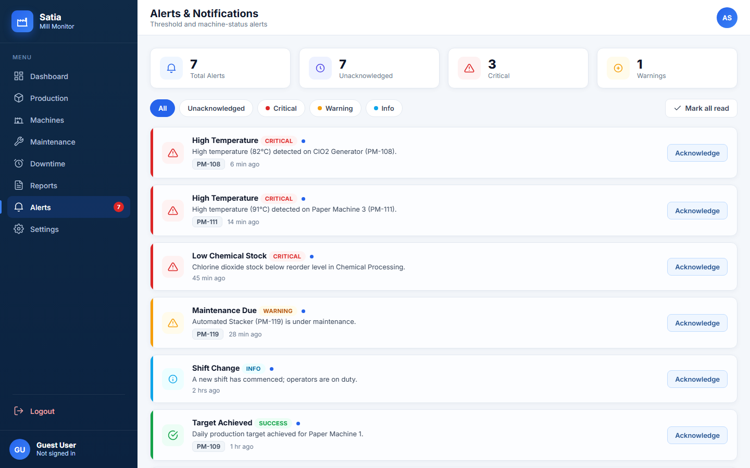
WALKTHROUGH
Production Entry & Alerts
Production entry with GSM / moisture / speed quality capture.
Threshold-driven alerts with severity filtering and acknowledgement.
Smart Paper Mill Production Monitoring Dashboard - Satia Industries Ltd.
16
Notes:
On the left, the production-entry screen captures output plus the quality parameters - GSM, moisture and speed - which are validated against the configured limits. On the right, the alerts page, which raises threshold-driven warnings for out-of-spec quality and excessive downtime that a supervisor can filter by severity and acknowledge.

Slide 18
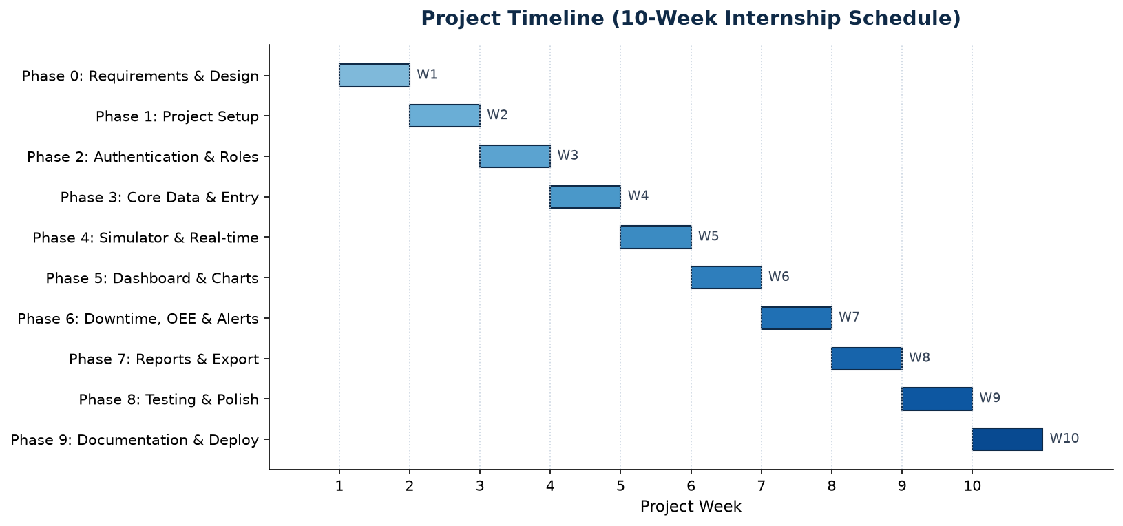
PLAN
Project Timeline
Phased delivery: requirements & design -> module build -> backend & security -> testing, docs & deployment.
Smart Paper Mill Production Monitoring Dashboard - Satia Industries Ltd.
17
Notes:
The work was delivered in phases - starting with requirements and design, then building the modules, then the real back-end with authentication and persistence, and finally testing, documentation and deployment. This Gantt chart summarises that schedule.

Slide 19
VERIFICATION
Testing & Quality Assurance
Test area | Coverage
Authentication & JWT | Valid/invalid login, token guard, expiry handling
Role-based access control | Allowed vs. forbidden endpoints per role (403/200)
Production / Maintenance / Downtime | Full create-read-update-delete + validation
Quality & thresholds | GSM / moisture / speed fields and limit checks
Live stream & audit | Authenticated SSE; audit-log entries
Role workflows | End-to-end tasks for each of the four roles
Smart Paper Mill Production Monitoring Dashboard - Satia Industries Ltd.
18
Notes:
Quality is backed by 94 automated tests in pytest - 36 in the core API suite and 58 in a role-workflow suite - each running against an isolated temporary database. They cover authentication, role-based access, full CRUD on production, maintenance and downtime, the quality fields and thresholds, the live stream and the audit log. All 94 pass.

Slide 20
OUTCOME
Results & Outcomes
A working, end-to-end web application with real authentication, role-based access and database persistence that survives restarts.
Live telemetry plus API-driven KPIs, reports and alerts across the dashboard.
A canonical, seeded dataset (machines, production, maintenance, operators) for a consistent, repeatable demonstration.
94/94 automated tests passing, and a complete documentation set - SRS, project report and role-based user manuals.
Deployment-ready for free hosting (Render) via gunicorn, with no paid services.
Smart Paper Mill Production Monitoring Dashboard - Satia Industries Ltd.
19
Notes:
The outcome is a complete, working application - not a mock-up. Real login and roles, data that persists across restarts, live telemetry, a consistent demo dataset, 94 passing tests, full documentation including an SRS, report and user manuals, and it's ready to deploy free on Render.

Slide 21
REFLECTION
Challenges & Learnings
Simulating real-time data without hardware - solved cleanly with Server-Sent Events instead of polling or heavyweight sockets.
Keeping documentation consistent with code - a single source of truth (canonical dataset + build scripts) prevented drift.
Security details - e.g. correct JWT subject typing and enforcing role checks on the server, not just the UI.
Designing for constraints - the whole stack had to run on a low-spec laptop and a normal browser, which shaped every technology choice.
Gained hands-on experience across full-stack development, REST APIs, auth, testing and deployment.
Smart Paper Mill Production Monitoring Dashboard - Satia Industries Ltd.
20
Notes:
The main challenges were simulating live data without plant hardware - solved with SSE - and keeping a large set of documents consistent with evolving code, which I handled with a single canonical dataset and generator scripts. I also learned a lot about practical security and about designing within real hardware constraints. Overall it was genuine full-stack experience.

Slide 22
NEXT
Future Scope
Integrate real plant sensors via PLC / DCS / IoT gateways to replace the simulated feed.
Migrate to MySQL / PostgreSQL for multi-user, production-scale deployment.
Add predictive maintenance using machine-learning on historical machine data.
Deliver a mobile app and email / SMS alert notifications for supervisors on the move.
Extend to multi-plant / multi-line monitoring with consolidated group dashboards.
Smart Paper Mill Production Monitoring Dashboard - Satia Industries Ltd.
21
Notes:
Looking ahead, the natural next steps are connecting real sensors through PLC or IoT gateways, moving to a production database, adding predictive maintenance with machine learning, a mobile app with push and SMS alerts, and scaling from one mill to multiple plants.

Slide 23
SUMMARY
Conclusion
The project delivers a secure, real-time, role-based monitoring dashboard that turns manual, scattered records into a single live view of the plant.
It demonstrates a complete, tested and documented full-stack system built entirely with free, open-source tools.
It directly addresses the industry need for timely production, quality and machine-health visibility - and provides a clear path to a sensor-connected production system.
Smart Paper Mill Production Monitoring Dashboard - Satia Industries Ltd.
22
Notes:
To conclude: the project replaces manual logbooks with a secure, real-time, role-based dashboard - a complete, tested and documented full-stack system built with free tools, and a solid foundation for a fully sensor-connected solution. Thank you.

Slide 24
Thank You
Questions & Discussion
[STUDENT NAME] - B.E. CSE, Chandigarh University
Industrial Training Project - Satia Industries Limited
Notes:
That concludes the presentation. Thank you - I'm happy to take any questions, and I can demonstrate the running application live: logging in as different roles, entering a production record and watching the dashboard, reports and alerts update in real time.

