Slide 1
Superstore (USA)
Team Member:
Sal Gill
Siddharth Krishnan
Bill Enkhbat

Slide 2
Tips to be Covered
Objective
Data Source
Modelling
Visualization
Challenges
Conclusions
Questions

Slide 3
Objective
Show a visualization using the database via Plotly
Three graphs with dropdown and interactivity

Slide 4
Data
Superstore (USA - Sales & Profit)
  George Weston LTD. > Loblaws > Superstore
  Loblaws own over 2,300 stores
Data cleaning and merging (long,lat)
Creating the database

Slide 5
Libraries
Dash is an open source library which enables us to create web applications with Plotly.
Dash - HTML – Component : Itenables us to use HTML & CSS with PythonAvoid wordiness: use key words and phrases only

Slide 6
Challenges
Understanding the requirements
Cleaning and merging data
Javascript and Flasks

Slide 7
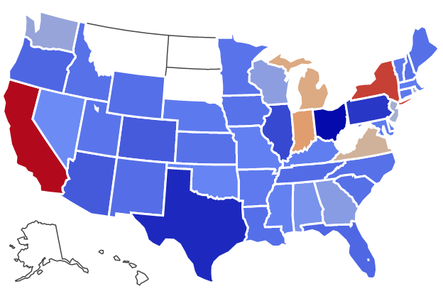
US – Superstore Profit by State

Slide 8
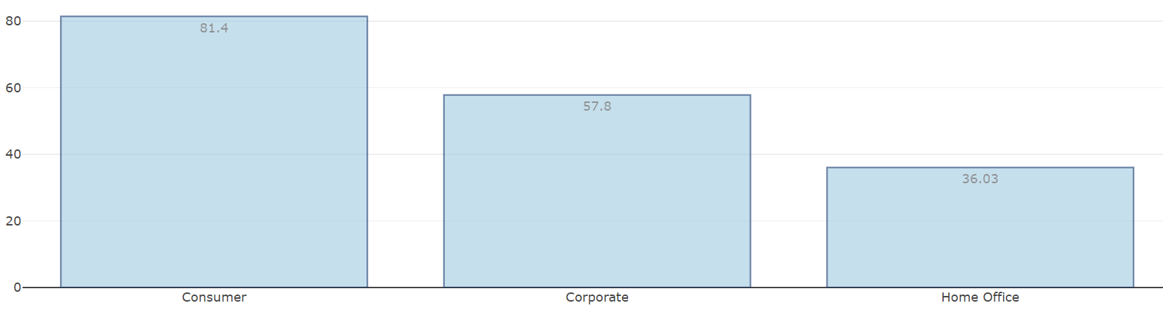
Top 3 Most Profitable Segment

Slide 9
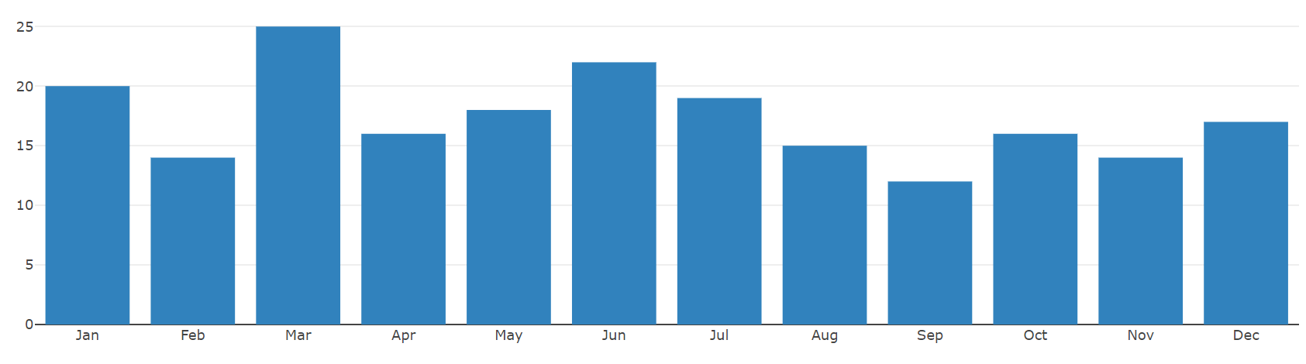
Monthly Orders

Slide 10
Questions?
THANK YOU!
☺

Slide 11
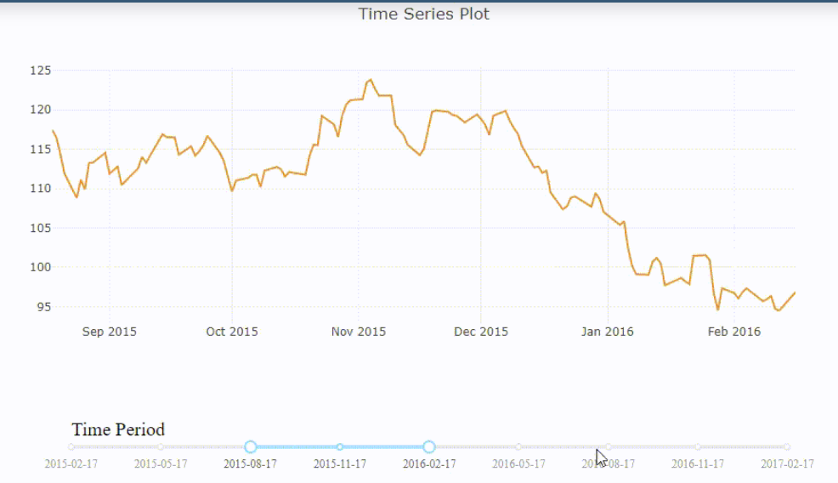
Time Series

