Slide 1
GR, GPCRs, G proteins including Ras: Get your G on
Amy Gill
Endo I
Week 2 review
10/15/13

Slide 2
Glucocorticoid receptor signaling

Slide 3
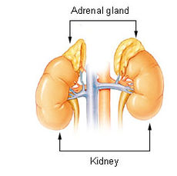
Glucocorticoids are adrenal stress hormones
cortisol
Help the body respond to stress
Energy mobilization
Glucose
Lipids (FFAs)
Anti-inflammatory
Much more
Ligands to know
Cortisol (endogenous)
Dexamethasone (synthetic)
stress

Slide 4

Glucocorticoid receptor (GR) is a nuclear receptor
Intracellular
Ligand must cross plasma membrane
Transcription factors (TFs)
Bind glucocorticoid response elements (GREs)
Affect transcription of target genes
Activating
Repressing
Depends on GRE, phosphorylation, tissue
cortisol
GR
GR
GRE
gene

Slide 5



A bit more detail on GR activation
cortisol
GR in inactive chaperone complex
Ligand binding leads to dissociation
GR homodimerizes
Phosphorylation = full activation
Translocates to nucleus
Binds GRE
Promotes or inhibits transcription
GR
FKBP52
GR
GR
GR
GR
GR
GRE
gene

Slide 6
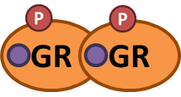
GR phosphorylation
Multiple phosphorylation sites
Not just on/off
Different phosphosites have different activity on different genes
Want to figure out what a phosphosite does? Mutate it!
S→A

Slide 7
How do nuclear receptors modify transcription?
Recruit coactivators or corepressors
Interact with RNA Pol II complex
Direct
Mediator complex
Modify chromatin
Acetylate histones to loosen their grip on DNA
Or deacetylate them to tighten DNA
Other chromatin remodeling
Whole idea – modify access of transcription machinery to promoters

Slide 8
Techniques for studying TFs
Need to know these – techniques in test Qs
Co-IP – study cofactor interactions
ChIP and ChIP-Seq– figure out where TFs bind DNA
Luciferase reporter – study promoter activity

Slide 9
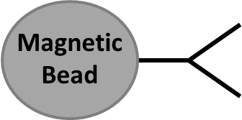



Co-IP (co-immunoprecipitation)
Cell lysate
Ru-486 (GR antagonist)
+ Cortisol
Cortisol
Add antibody against protein of interest (GR)
Basal
?
GR
GR
?
SRC-1
?
Hsp90
Pull down your protein (and any other proteins stuck to it)
Western blot for proteins you think might be stuck to the target

Slide 10
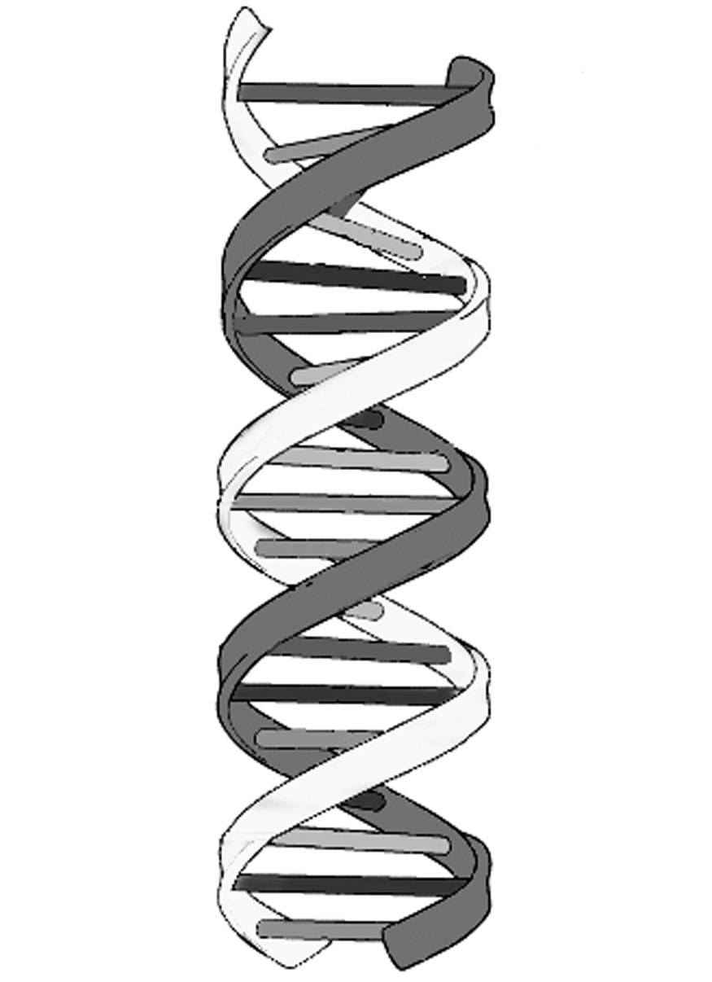
ChIP and ChIP-Seq
Cross-link proteins to DNA
Cell lysate
PCR for specific target sequences (ChIP)
Add antibody against protein of interest (GR)
GR
Sequencing to identify all DNA targets (ChIP-Seq)

Slide 11

Luciferase reporter
Promoter region
Luciferase
Luciferase
+ luciferin =
Promoter of interest drives luciferase expression
Allows you to study promoter activity
Promoter bashing (homework): figuring out which bits of the promoter affect transcription

Slide 12
GPCRs: G protein coupled receptors

Slide 13
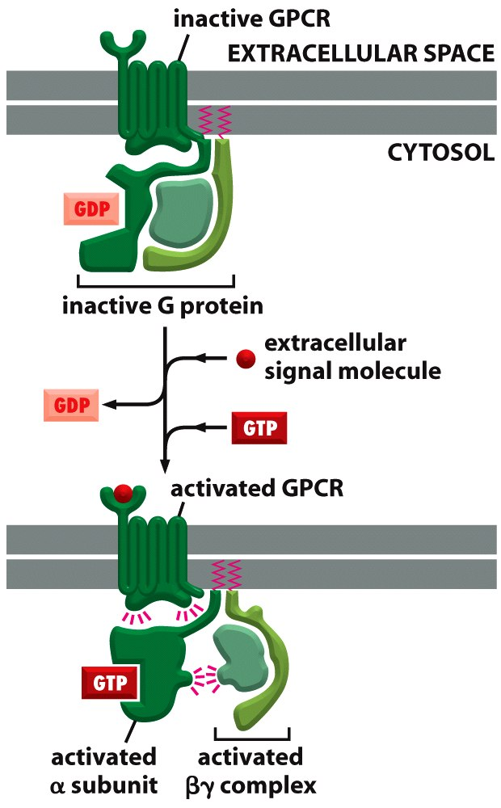
GPCR basics
Cell surface receptors
Coupled with heterotrimeric G proteins (αβγ)
Ligand binding leads to GDP→GTP exchange in Gα
Allows α to separate from βγ and activate downstream effectors

Slide 14


G protein basics
β
β
α
α
γ
γ
inactive
active
Needs help to exchange GDP for GTP
Is a GTPase
cleaves GTP to GDP all by itself
self-inactivating timer

Slide 15

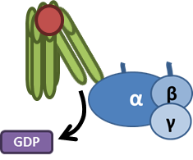


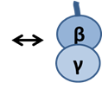

G protein activation, step by step

Slide 16
Three types of G proteins you should know
Adenylyl cylase
Describes the catalytic activity of α subunit
G_{s} – activates adenylyl cyclase (↑cAMP)
G_{i} – inhibits adenylyl cyclase (↓cAMP)
G_{q} – stimulates phospholipase C (↑DAG and ↑IP₃)
G_{s}
G_{i}
G_{q}
PLC
cAMP
DAG
IP₃
PKA
PKC
Ca²⁺

Slide 17
Adrenergic receptors – classical GPCRs
Epinephrine and norepinephrine secreted by adrenal glands
Control fight-or-flight response
Different receptors
α_{1,} α₂, β₁, β₂
Different cell types
Different sensitivities to agonists and antagonists

Slide 18
Adrenergic receptor activation causes a conformational change by releasing an ionic lock
TM3 and TM6 are held together by an ionic lock
DRY motif by 3
E by 6
R⁺-E⁻ ionic bond
Ligand binding protonates D
Forces R to let go of E
Allows TM6 to swing away
Allows interaction with G protein and catalytic activity
What if you had a mutant where the D was an A?
Y
C term
Y
R
E
R
E
D
D

Slide 19
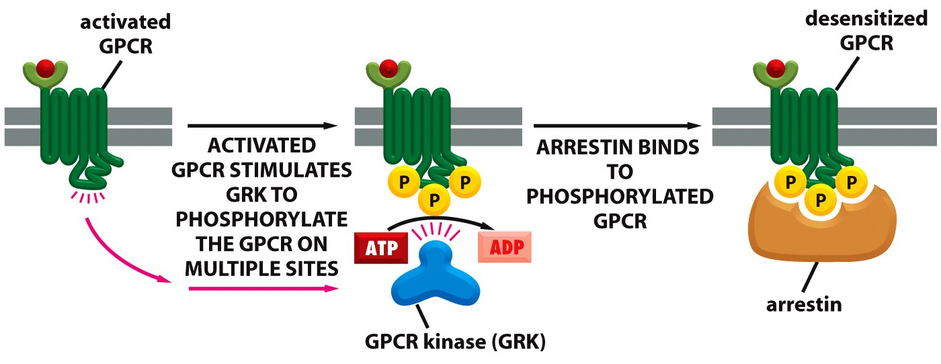
Turning off GPCR signaling with arrestin
Activated GPCR is phosphorylated
Phosphorylation blocks Gα binding (inactivation)
Phosphorylation recruits arrestin
Arrestin promotes receptor endocytosis (sequestration)

Slide 20
McCune-Albright syndrome
Activating mutations of G_{s} α subunit
Can cause problems with hormones whose secretion is controlled by GPCRs
Classic symptoms
Café au lait spots
Fibrous dysplasia
Precocious puberty

Slide 21
Ras signaling

Slide 22
Ras basics
Ras
GEF
Ras
GAP
inactive
active
Membrane-anchored monomeric G protein – GTP = active, GDP = inactive
GEF (guanine nucleotide exchange factor) promotes release of GDP
Allows GTP binding
Promotes activation
We’ve seen these before – GPCRs are GEFs for heterotrimeric G proteins
Ras is a GTPase, but its GTP hydrolysis is really slow
Stays on until turned off
Contrast with built-in inactivation of heterotrimeric G proteins
GAP (GTPase activating protein) stimulates GTPase ability of Ras
Promotes GTP→GDP cleavage
Promotes inactivation

Slide 23
Ras GEFs and GAPs
Ras GEFs
Ras GAPs
Pry open guanine nucleotide binding site to release GDP
Cytoplasmic GTP quickly fills the gap
Same mechanism as GPCRs with heterotrimeric G proteins
The Ras GEF = Sos
Stick an arginine finger into the Ras active site
Stabilize transition state of Ras GTP hydrolysis
Increase the GTPase ability of Ras (hence GTPase activating protein)
One Ras GAP = neurofibromin
Mutation = neurofibromatosis
Characterized by tumor growth

Slide 24
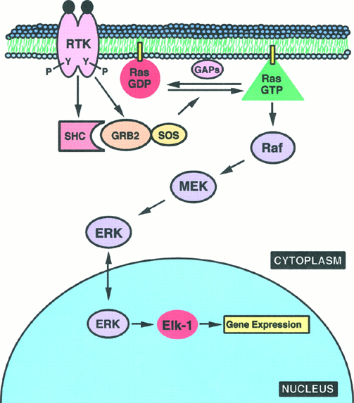
Ras promotes cell proliferation
Signals downstream of RTKs
Activates MAPK cascade
Promotes growth and proliferation

Slide 25
Ras mutations in cancer
Ras is an oncogene
Up to 30% of all cancers have activating mutations of Ras
Mutation usually prevents GTP cleavage – permanently stuck on
Since Ras promotes proliferation, this can drive uncontrolled cell expansion – cancer

Slide 26
Week 2 review complete!

Slide 27
Homework 1 Review
Amy Gill
10/15/13

Slide 28
Question 1
Mama
Mama
P
Yo

Slide 29
Mama
Mama
P
Yo
?
?
A
B

Slide 30
Wild-type mouse
Yo
A
Mama
P
B
Mama
P

Slide 31
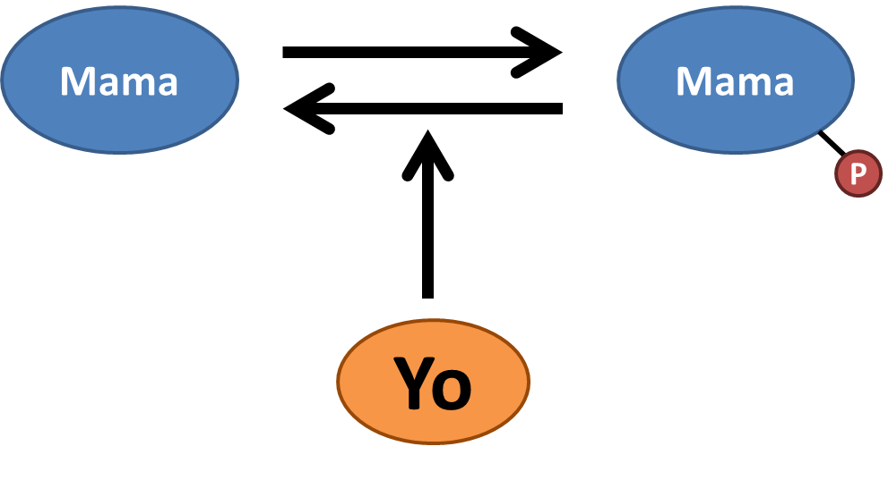
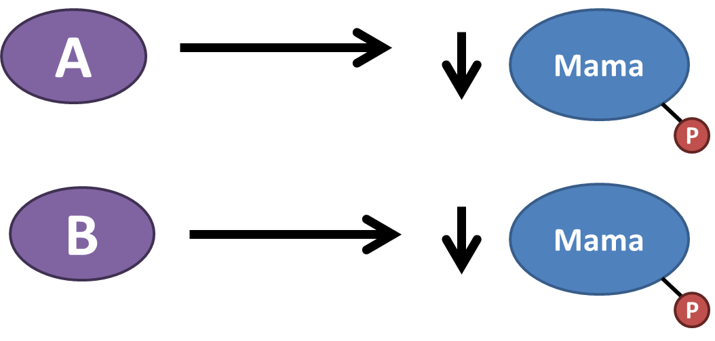
Transgenic overexpression

Slide 32
Mutant Yo knock-in

Slide 33
Mutant Yo knock-in

Slide 34
Mutant Yo knock-in
B
Yo
Mama
P

Slide 35
Wild-type Yo knockout

Slide 36
Mutant Yo knock-in
B
Yo
Mama
P

Slide 37
Mutant Yo knock-in
B
Yo
Mama
P

Slide 38
B
Yo
Mama
P
A
Mama
Not through
Yo
P

Slide 39
A
?
?
Mama
Mama
P
Yo
B

Slide 40
Question 2 – promoter bashing
Where are promoter elements?
Are elements activating or repressing?

Slide 41
0 to -217: no activity

Slide 42
Activating site leads to transcription
0 to -212: no activity
-212 to -395: activating element

Slide 43
0 to -212: no activity
-212 to -395: activating element
-395 to -602: no activity

Slide 44
Repressive sites reduce transcription
0 to -212: no activity
-212 to -395: activating element
-395 to -602: no activity
-602 to -823: repressing element

Slide 45
Multiple activating sites could overcome repression
0 to -212: no activity
-212 to -395: activating element
-395 to -602: no activity
-602 to -823: repressing element
-823 to -1007: activating element

Slide 46
The promoter blueprint
0 to -212: no activity
-212 to -395: activating element
-395 to -602: no activity
-602 to -823: repressing element
-823 to -1007: activating element
-1007
-823
-602
-395
-212
-17
A
R
A
Luciferase

Slide 47
Question 3
oline
cutler
cutler
P
dline

Slide 48
Question 3
?
oline
trestman
cutler
cutler
P
?
dline

Slide 49
Again, break down the data
Make sure to use all of the data

Slide 50
Lane 1 v 2
Trestman decreases pCutler
Unclear whether it acts through oline or dline
Just know dline activity > oline activity

Slide 51
Lane 1 v 4
Trestman still decreases pCutler in the absence of oline
Trestman acts by promoting dline activity

Slide 52
Lane 1 v 3
Difference between 1 and 3 = basal oline activity
Basal oline activity

Slide 53
Lane 2 v 4
Difference between 2 and 4 should be oline activity
But there’s no difference between 2 and 4
Therefore, trestman blocks oline activity
Oline activity
without trestman
Oline activity
with trestman

Slide 54
Question 3 results
oline
trestman
cutler
cutler
P
dline

Slide 55
Questions?
Feel free to contact TAs or Dr Brady
That’s what we’re here for

