Slide 1
cGMP: Vision to Viagra

Slide 2
Light to vision
Light hits rod cell
Signal transduction
Decrease in dark current
Hyperpolarization
Decrease in neurotransmission
Vision

Slide 3
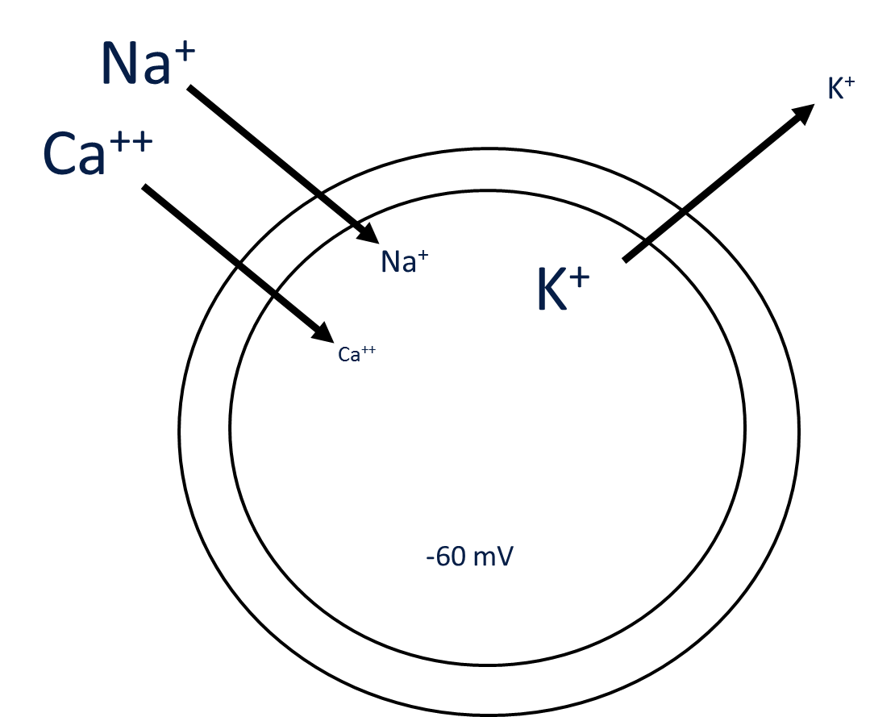
Polarization
Membrane potential
Controlled by ion flow
Ca²⁺
Na⁺
K⁺
More positive = depolarization
More negative = hyperpolarization
In neurons, depolarization drives neurotransmission
Light drives hyperpolarization

Slide 4
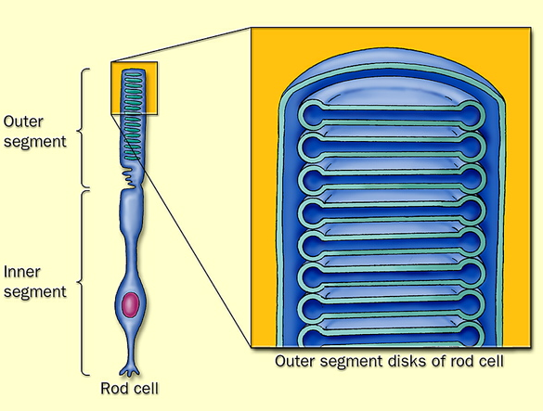
Rod (and cone) cell structure
Specialized neurons
Outer segment: disks specialized for light-driven signaling
GPCR in disk membrane
Ligand inside disk
Suborganization keeps signaling localized
Allows rapid response

Slide 5
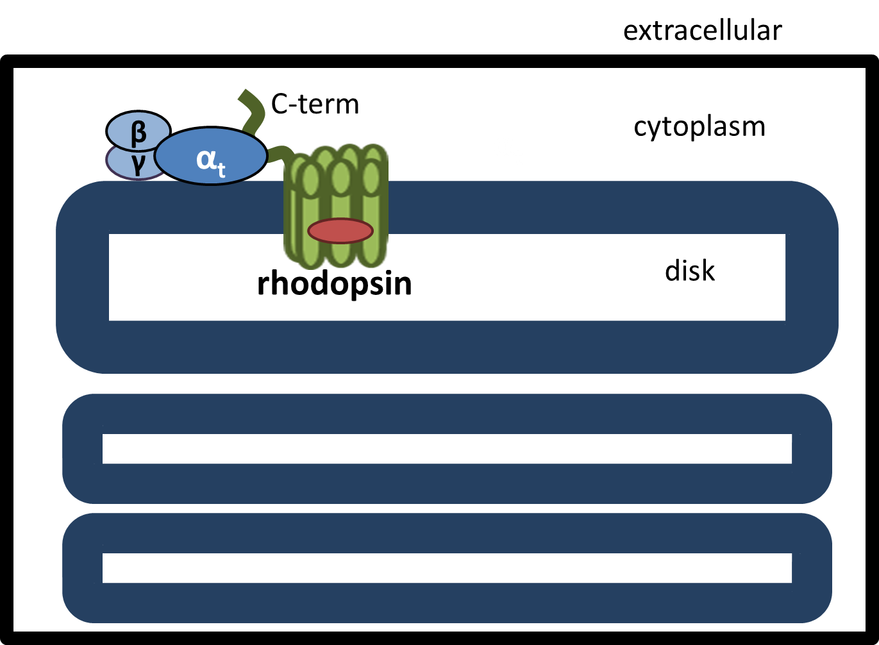
Rhodopsin
Opsin: GPCR in disk membrane
Pre-bound to ligand
11-cis-retinal
Ligand-bound form is called rhodopsin
Light isomerizes ligand to activate GPCR
Activates G_{t}

Slide 6
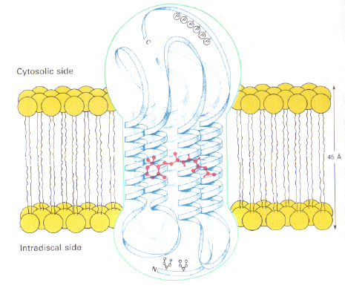
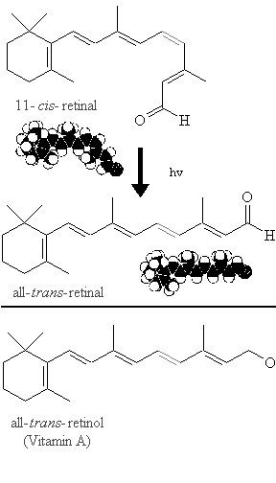
Rhodopsin: Ligand Binding
GPCR Ligand: Retinal
11-cis-retinal is covalently pre-bound to our opsin (rhodopsin)
11-cis-retinal = inverse agonist, therefore eliminating ALL basal activity
Activation…light!
Upon receptor activation, 11-cis isomerizes to all-trans-retinal
AT-retinal is a strong AGONIST, signaling will occur
Why do it this way?
Reduce Noise: Inverse Agonist totally shuts down the receptor in the absence of light
Speed: Don’t have to wait for loading of ligand, it’s essentially already there
INVERSE AGONIST
STRONG
AGONIST

Slide 7
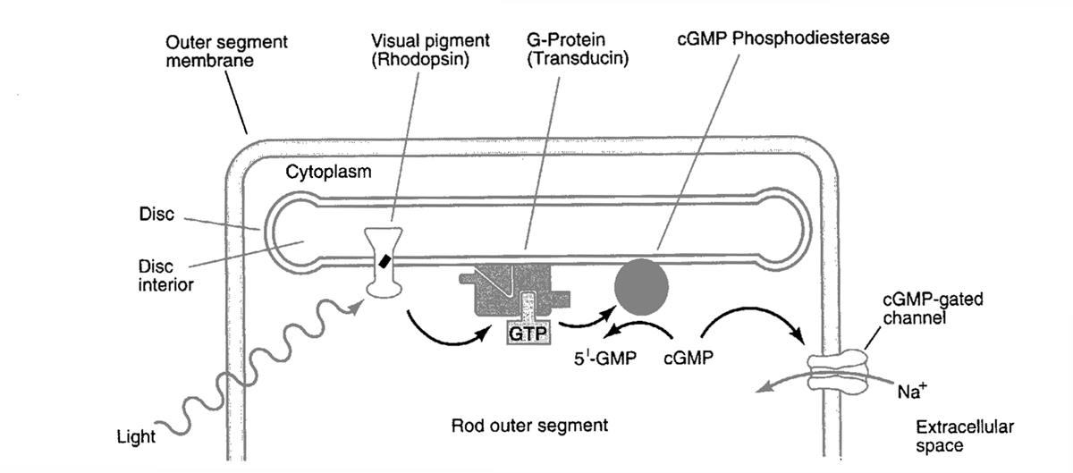
G-Proteins & Rhodopsin Signaling
Light activates rhodopsin (GPCR)
Rhodopsin acts as a GEF for G_{t}
Active Gα_{t} activates PDE
PDE reduces cytoplasmic cGMP
cGMP-gated Na⁺ channels close
Hyperpolarization
Decreases neurotransmission

Slide 8



Rhodopsin signaling activates a cGMP phosphodiesterase (PDE)
PDEs break down cyclic nucleotides
cGMP
GMP
PDE
β
α_{t}
γ
α_{t}
λ
rhodopsin

Slide 9
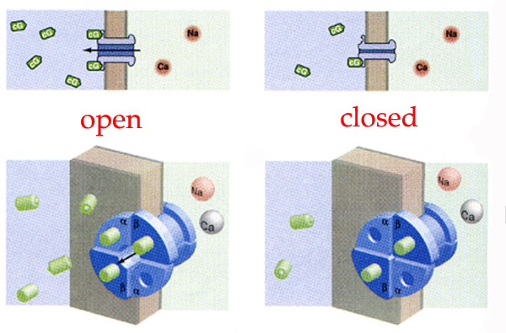
cGMP controls cGMP Gated Na+ Channels
Channel, not a pump or receptor
cGMP-gated Na+ channels have four subunits that can bind cGMP
Number bound will determine if channel is open or closed
3-4 bound (high cGMP) = open
0-2 bound (low cGMP)= closed
Allows for sensitivity in the system
More control based on [cGMP] in the cell

Slide 10
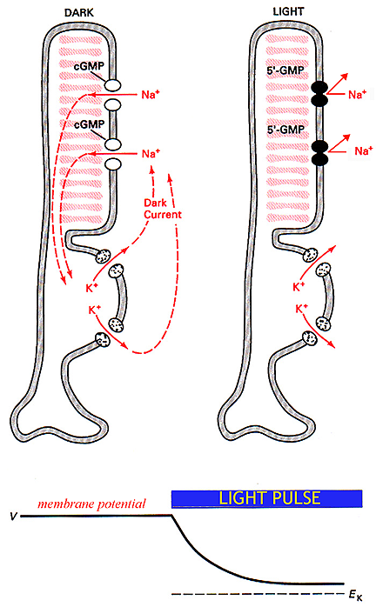
Dark Current
Dark Current = Equilibrium
Dark: Na⁺ in = K⁺ out
cGMP present
Na⁺ channels open
Equal current
Light: Na⁺ < K⁺ out
cGMP decrease
Na⁺ channels close
Cell becomes more negative
Hyperpolarization

Slide 11
5. (10 pts) You generate a knockout mouse whose rod and cone cells express 50% fewer functioning K+ channels. You then subject wild type and knockout mice to increasing amounts of light and measure their visual responses. How would the knockout response compare to the wild type response?
Less K⁺ efflux
Harder to hyperpolarize rods and cones
Need more light to get same visual response

Slide 12
One last look at the pathway

Slide 13
cGMP in smooth muscle relaxation: control of vasodilation

Slide 14
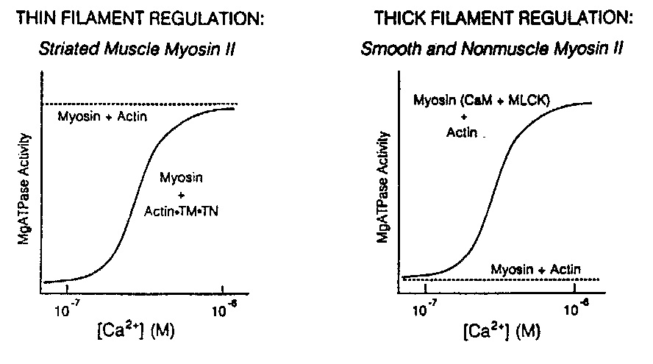
The two things you need for cell signaling
Difference between basal and stimulated state
A way to stimulate – effectors
Basal activity too high: no change in activity
Stimulation is ineffective: no way to get a response

Slide 15
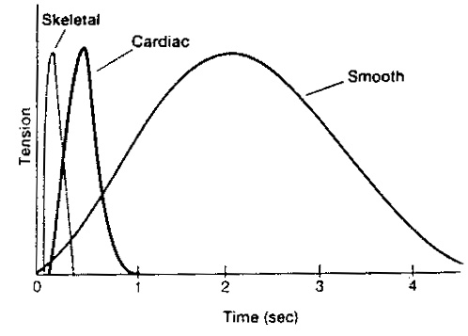
Smooth vs Skeletal Muscle
Smooth muscle contraction and relaxation has a much longer duration than skeletal due to the activation mechanism
Skeletal: Ca²⁺ displaces tropomyosin to allow actin/myosin interaction (fast)
Smooth: Ca²⁺ causes a series of signaling events that leads to phosphorylation of MLC which can then bind actin (slow)

Slide 16
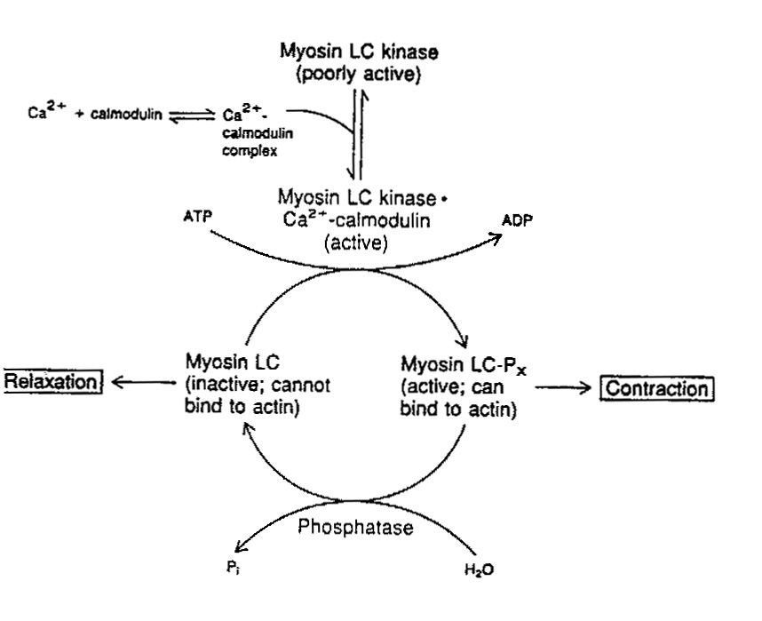
Smooth Muscle: MLCK
Myosin must be phosphorylated to bind actin
MLCK
Kinase for MLC
requires Ca²⁺
Relaxation → need to turn on phosphatase to inactivate myosin

Slide 17
Smooth Muscle Relaxation
Endothelium
ACh
Smooth Muscle
Arg
Ca²⁺
NOS
GTP
NO
NO
sGC
MLC phosphatase
cGMP
MLC
(relax)
p-MLC
(contract)
MLC kinase
Ca²⁺

Slide 18
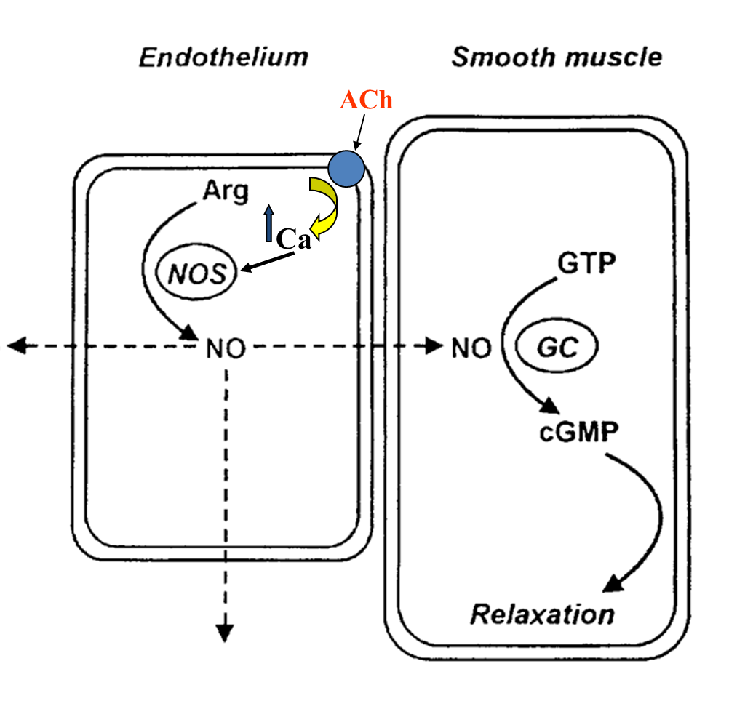
Smooth muscle relaxation requires the endothelium
↑ Ca²⁺ → NOS
Can’t do this in smooth muscle: Ca²⁺ causes contraction
NO generated in endothelium diffuses into smooth muscle

Slide 19
4. (10 pts) Your competitor tells you he generated a novel mouse model where the acetylcholine receptor is not expressed in the endothelium but is now expressed in smooth muscle. The mice die quickly of severe hypertension. Can you give him TWO reasons why this result occurred?
Ca²⁺ increase in smooth muscle causes contraction.
NO is generated in the endothelium. No NO, less smooth muscle relaxation.

Slide 20
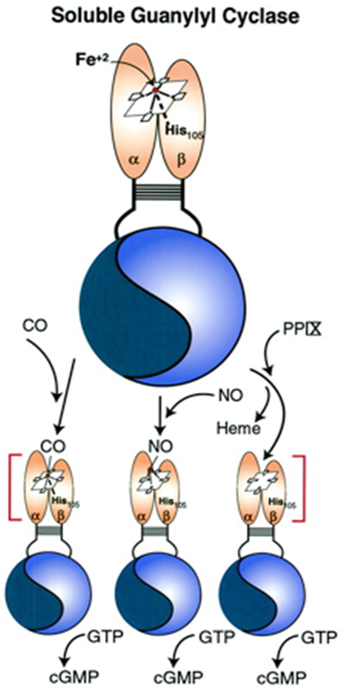

NO activates soluble GC → cGMP
Ligand binds the Fe on the heme porphyrin ring
Causes conformational change to activate the GC catalytic domain → cGMP
active
inactive

Slide 21
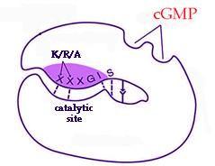
cGMP promotes smooth muscle relaxation
GTP
G-cyclase
NO•
PKG
cGMP
PDE-5
VIAGRA
Relaxation
GMP

Slide 22
cGMP activates PKG
Autoinhibited in basal state
cGMP binding allows unfolding and exposes kinase active site
Auto-inhibitory domain
N-Term
cGMP-
binding
Catalytic
C-Term

Slide 23
How PKG promotes SM Relaxation
Decreases Ca²⁺, which decreases myosin light chain kinase activity
Promotes myosin phosphatase (PP1) activation to dephosphorylate MLC and stop myosin-actin interaction
Mysoin targeting subunit (MYPT1) brings PP1 in proximity with myosin to dephosphorylate it and inhibit actin binding
MYPT1 kinase phosphorylation prevents PP1 binding
PKG phosphorylation prevents MYPT1K phosphorylation
PKG (+)
PP1
S695
T696
MYPT1K (-)
MYPT1
Myosin

Slide 24
3. (15 pts) Patients taking Viagra are warned that they may experience a sudden drop in blood pressure. Please detail at the protein level how Viagra could be causing this off-target effect in smooth muscle.
Viagra increases cGMP by inhibiting PDE activity
cGMP activates PKG
PKG promotes myosin light chain dephosphorylation
Reducing Ca²⁺
Increasing PP1 activity
Less myosin phosphorylation → smooth muscle relaxation → vasodilation

Slide 25
Smooth Muscle Relaxation Recap
Endothelium
Smooth Muscle
Arg
Ca²⁺
NOS
GTP
NO
NO
sGC
MLC phosphatase
cGMP
MLC
(relax)
p-MLC
(contract)
MLC kinase
Ca²⁺

