Slide 1
cAMP and PKA
Amy Gill
Week 5 review
11/5/13

Slide 2
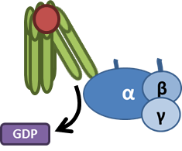

cAMP generation
Adenylate cyclase
ATP
cAMP
G_{s}, G_{i}

Slide 3
How was cAMP discovered?
Knew epinephrine promotes glycogen breakdown
Knew phosphorylase breaks down glycogen
How does epinephrine signal to phosphorylase?
glycogen
epinephrine
glucose
glycogen
phosphorylase
glucose
???
epinephrine
phosphorylase

Slide 4
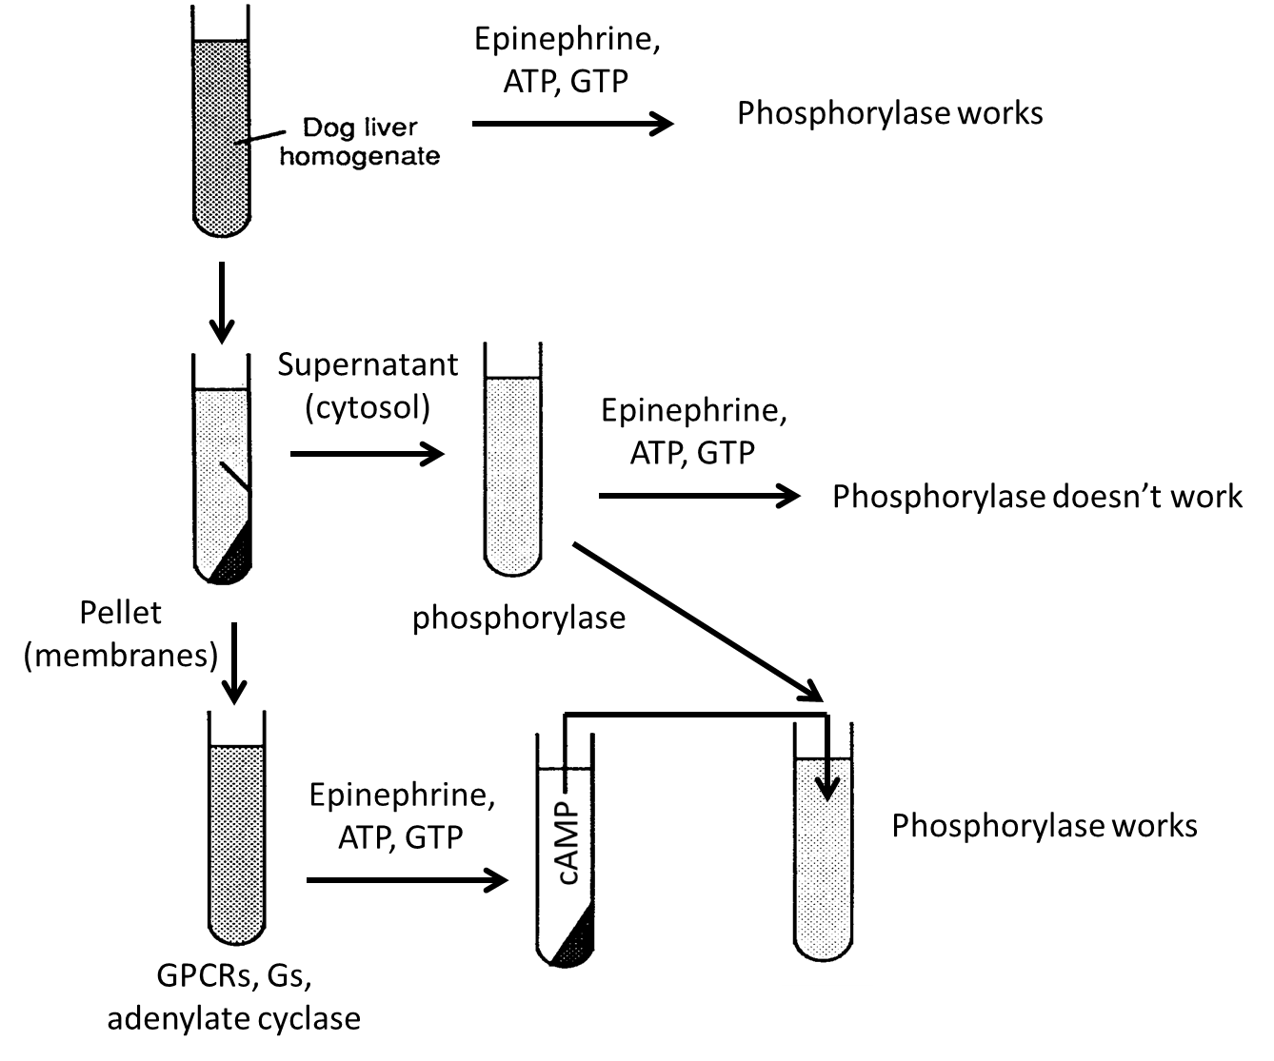
Discovery of second messengers
Something is generated by membranes + epinephrine that transduces the epinephrine signal

Slide 5
Three drugs to know for experimental analysis of cAMP signaling
Cholera toxin (CTX)
Pertussis toxin (PTX)
Forskolin
All increase cAMP, but by different mechanisms

Slide 6
CTX stimulates Gα_{s}
CTX inhibits α_{s} GTPase ability
Increases amount of GTP-α_{s}
Adenylate cyclase
CTX
cAMP
s

Slide 7
PTX inhibits Gα_{i}
PTX inhibits GDP→GTP exchange of α_{i}
Decreases amount of GTP-α_{i}
Adenylate cyclase
PTX
cAMP
i

Slide 8
Forskolin activates adenylate cyclase
Direct activation independent of any G protein
Adenylate cyclase
Forskolin
cAMP

Slide 9
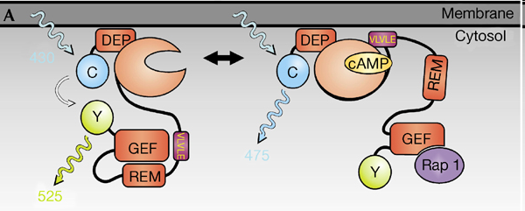
cAMP biosensors
FRET-based sensor of cAMP levels
No cAMP: FRET domains interact
cAMP bound: FRET domains do not interact
Inverse of Ca²⁺ biosensors

Slide 10
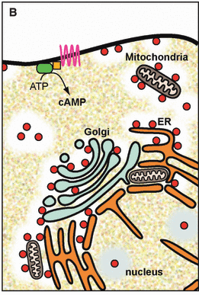
Local [cAMP] is controlled by PDEs
PDEs targeted to subcellular structures or molecules
PDEs cleave cAMP→5’-AMP
PDEs will reduce local levels of cAMP
Kind of like Ca²⁺ buffers
Keep cAMP signaling spatially localized
But irreversible cAMP cleavage versus chelation of Ca²⁺

Slide 11
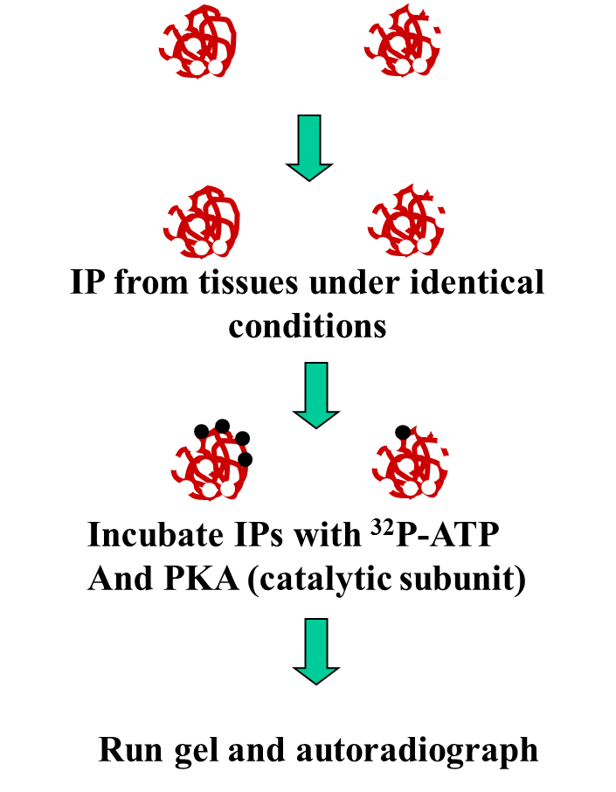
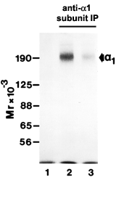
Back phosphorylation
control
treated
A way to figure out whether a specific kinase phosphorylates a protein under certain conditions
Treat cells with various conditions
IP protein from cells
Incubate proteins with ³²P-ATP and kinase
Radioactive ³²P will be incorporated into any empty phosphosites for that kinase (fills in the blanks)
Measure radiation
Figure out how the conditions affect phosphorylation of those specific kinase sites

Slide 12
³²P labeling cells vs back phosphorylation
³²P labeling
Back phosphorylation
Labels everything phosphorylated in the cell
Not kinase specific
High background – difficult to discriminate between small numbers of phosphosites
Labels phosphosites that were not phosphorylated in the cell
Kinase specific
Filling in the blanks – can be lower background
6 sites v 9 sites…hard to see difference
4 sites v 1 site…clear difference

Slide 13
cAMP effectors
cAMP gated ion channels
EPACs
PKA

Slide 14
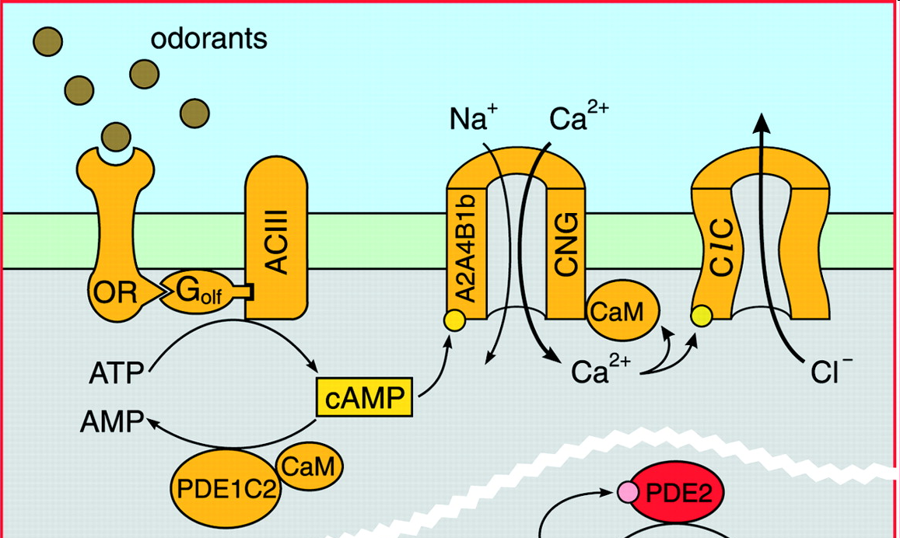
Olfactory signal transduction
G_{olf} ≈ G_{s}
↑cAMP → increased probability of opening cAMP gated Na^{+/}Ca²⁺ channels
Ca²⁺ binds CaM
CaM opens Cl⁻ channels
Depolarization
CaM also activates a PDE – negative feedback loop

Slide 15
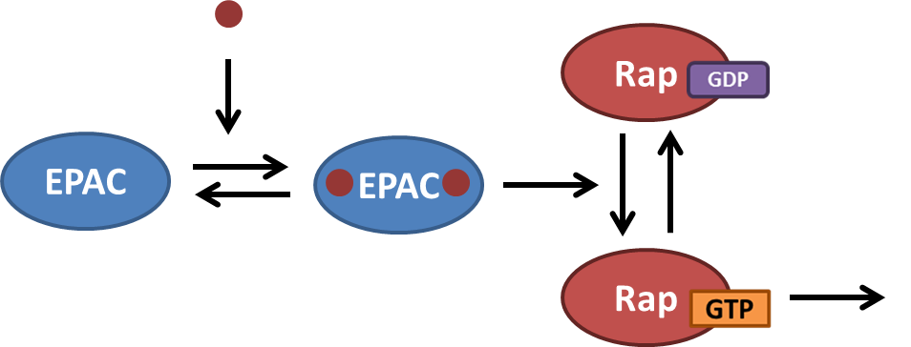
EPACs activate small monomeric GTPases
cAMP
effectors
EPACs are autoinhibitory
cAMP binding exposes the catalytic site

Slide 16
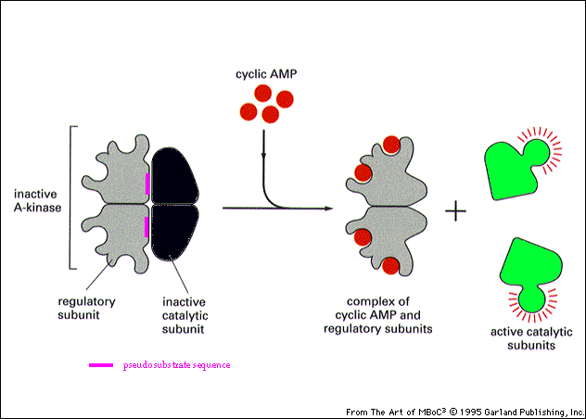
cAMP activates PKA
PKA phosphorylates targets with a consensus site – RRXS
Pseudosubstrate inhibition – sites that approximate the consensus site but can’t be phosphorylated (RRXA) inhibit PKA
Regulatory subunit works by pseudosubstrate inhibition

Slide 17
The cAMP-PKA pathway
Adenylate cyclase
ATP
cAMP
G_{s}, G_{i}
PKA
effectors
Inactive PKA
Active PKA

Slide 18
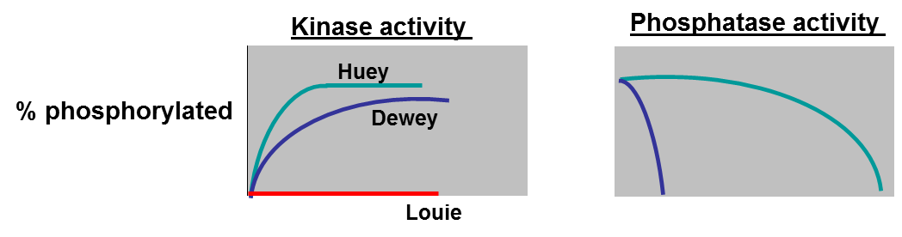
What controls the amount of target phosphorylation when PKA is active?
Dewey
Huey
Exposed consensus motif – RRXS
Other amino acids around consensus motif affect efficiency of phosphorylation
Phosphatase activity directed at each protein

Slide 19
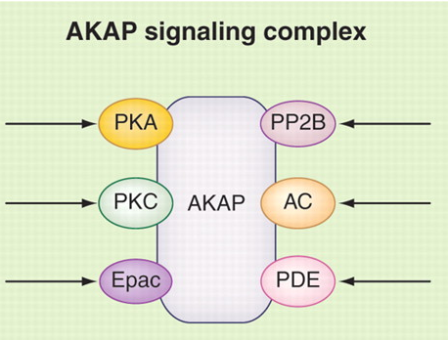
AKAPs are scaffolds that localize PKA and substrates
Bring PKA and substrates together
Target to subcellular location
Can colocalize with effectors and inhibitors
Integrate signaling systems
PKA
substrate
AKAP

Slide 20
Control of heart function
For stronger contractions:
More Ca²⁺ entry into cell
Bigger Ca²⁺ release from SR
To increase heart rate:
Contract more frequently
Relax faster
Ca²⁺ release from effectors
Ca²⁺ reuptake into SR

Slide 21
PKA acts on 3 main substrates in the heart
L-type Ca²⁺ channels
Control force of contraction
Troponin
Control heart rate
Phospholamban (PLB)
Control heart rate

Slide 22
L-type Ca²⁺ channel
VOC
C terminus is autoinhibitory
Phosphorylation by PKA relieves autoinhibition
PKA increases the probability of the channel being open
PKA targeted to channel by AKAP
PKA → ↑ Ca²⁺ entry → ↑ force of contraction

Slide 23
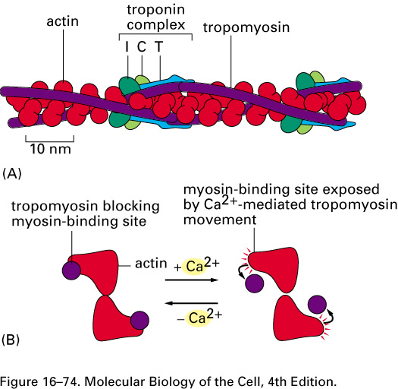
Troponin – PKA increases Ca²⁺ release
pTroponin releases Ca²⁺ faster
Actin-myosin contractions stop sooner
Faster relaxation

Slide 24
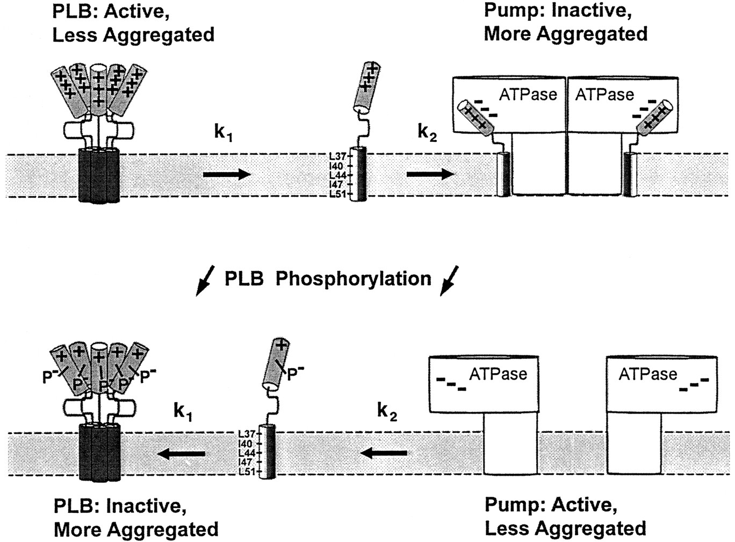
Phospholamban (PLB) inhibition of SERCA is relieved by PKA
PLB binds and inhibits SERCA
PKA phosphorylation promotes PLB aggregation, moving it away from SERCA
SERCA activity is increased
Faster Ca²⁺ reuptake
Faster relaxation

Slide 25
Crosstalk between cAMP and Ca²⁺
Ca²⁺ channels are regulated by PKA
L-type Ca²⁺ channel
SERCA (via PLB)
Ca²⁺ release from effectors is regulated by PKA
Troponin
CaM activates adenylate cyclase

Slide 26
That’s all for week 5…
Good luck on your midterm!
TA review session:
Thursday 5:30 pm
BSLC 109

