Slide 1
Calcium signaling
Amy Gill
Endo I
Week 4 review
10/29/13

Slide 2
Ca²⁺ is an important second messenger
Ca²⁺ signaling is important in lots of contexts
Fertilization
Muscle contraction
Response to hormones
…
Spatial and temporal aspects of Ca²⁺ transients are key

Slide 3

Cells maintain big Ca²⁺ gradients
Extracellular
HIGH Ca²⁺
Pumps maintain the gradients using ATP
SERCA pumps Ca²⁺ into ER
Ca²⁺ channels allow Ca²⁺ to flow down its concentration gradient into the cytosol
Channels don’t use ATP, but it took ATP to establish the gradient
cytosol
_{low} Ca²⁺
ER
HIGH Ca²⁺
pump
channel

Slide 4
Tools for studying calcium signaling
Fura-2
FRET biosensors
EGTA
Thapsigargen (Tg)

Slide 5
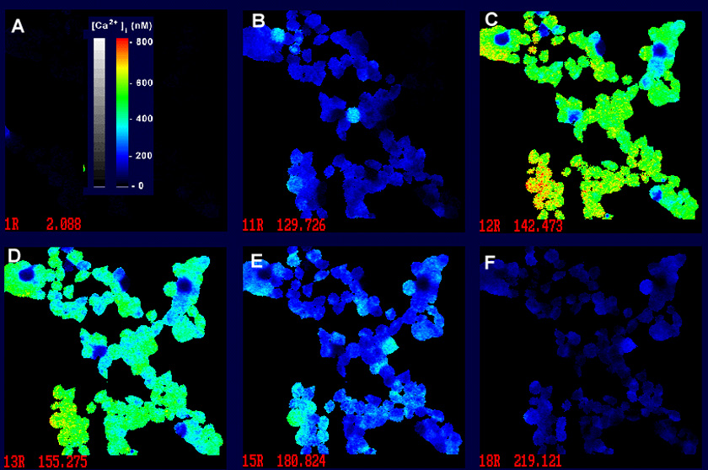
Fura-2
Cytosolic Ca²⁺ sensor
Ca²⁺ binding causes fluorescence

Slide 6
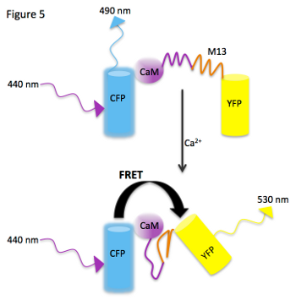
FRET biosensors
Ca²⁺ binding brings FRET partners close together and changes wavelength of fluorescence
Can be targeted to intracellular compartments like ER

Slide 7
EGTA
EGTA
no EGTA
BK
BK
Calcium chelator
Depletes a solution of Ca²⁺
Can be used to determine whether Ca²⁺ in cytosol comes from inside or outside the cell
fura-2 fluorescence
Vsp
Vsp
EGF
EGF
time

Slide 8
Thapsigargen
Tg
add hormone
Empties ER Ca²⁺ stores
Irreversible inhibitor of SERCA pump
Initial addition causes a Ca²⁺ transient
But ER can’t refill, so blocks subsequent ER Ca²⁺ release
fura-2 fluorescence
time

Slide 9
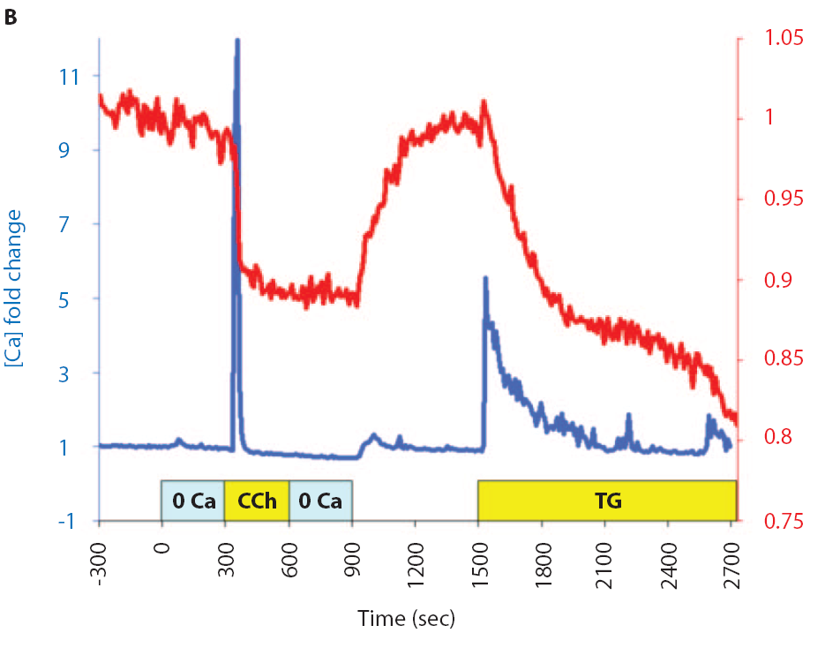
Putting it together
Red – ER Ca²⁺ (FRET biosensor)
Blue – cytosolic Ca²⁺ (Fura-2)
Shaded area: EGTA

Slide 10
Putting it together
CCh triggers Ca²⁺ release from ER
Ca²⁺ pumped out of cell
ER stores can’t refill because no extracellular Ca²⁺
Then add Ca²⁺ to medium and ER stores refill
Tg empties ER Ca²⁺ stores

Slide 11
4 important Ca²⁺ channels
Plasma membrane
Receptor operated channels (ROCs)
Voltage operated channels (VOCs)
ER membrane
Ryanodine receptor (RyR)
IP₃ receptor (IP3R)

Slide 12
ROC: Receptor Operated (Calcium) Channel – open when ligand is bound
Ligand binds ROC receptor, opens channel, lets Ca²⁺ in
ROC
Ca++
RYR
ER

Slide 13
VOC: Voltage Operated Channel – open when cell depolarizes
opens VOC
2:
VOC
3:
1:
Ca++
Action Potential from nerves causes depolarization
ER
cytoplasm
increases above -70 mV
11-5

Slide 14
ROCs and VOCs don’t cause Ca²⁺ transients alone
Only let in a really small amount of Ca²⁺
Big Ca²⁺ release comes from ER in response
**CALCIUM INDUCED CALCIUM RELEASE**

Slide 15
Ryanodine receptors (RyR) allow Ca²⁺ induced Ca²⁺ release
ROC or VOC lets in a little Ca²⁺ (too small to detect)
Ca²⁺ binds and opens RyR Ca²⁺ channels on ER
RyRs release a LOT more Ca²⁺ - this is the observed Ca²⁺ transient
ROC
VOC
Ca²⁺
Ca²⁺
RYR
RYR
ER

Slide 16
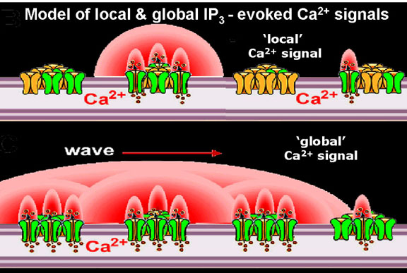
Calcium-induced calcium release
Initial burst of Ca²⁺
Opens nearby RyRs, releasing more Ca²⁺
Opens more nearby RyRs
Wave of Ca²⁺

Slide 17
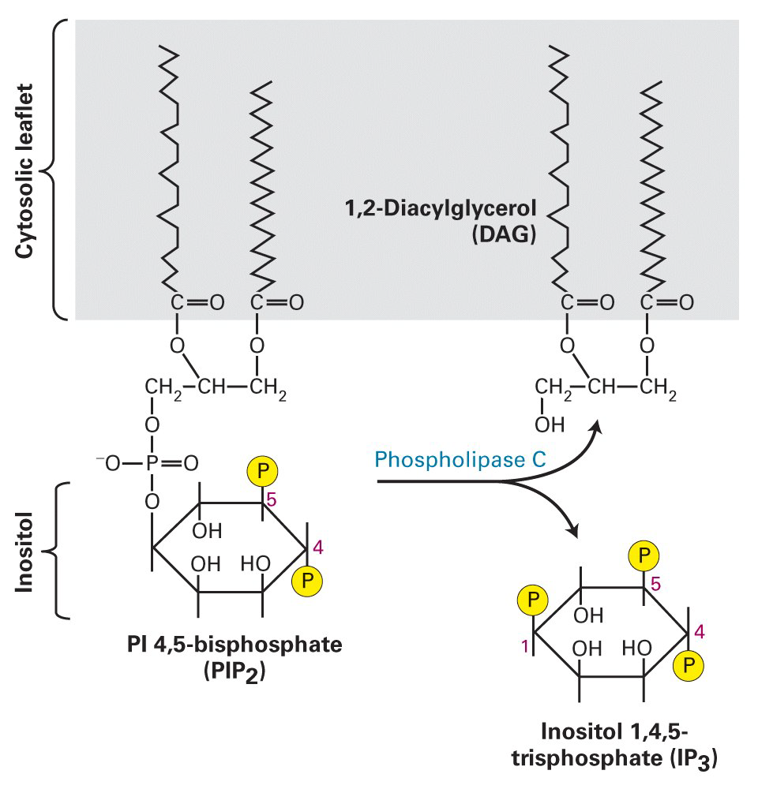
The last receptor…IP3R
ER Ca²⁺ channel that binds IP₃ – open when IP₃ bound
Phospholipase C (PLC) generates IP₃ by cleaving PIP₂ in the plasma membrane
↑ PLC activity =↑ IP₃
IP₃ and DAG – 2 more second messengers

Slide 18
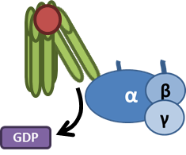



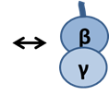

PLC activation starts with GPCRs that activate G_{q}
G_{q}
G_{q}
G_{q}

Slide 19
G_{q} activates PLC to produce IP_{3,} activating IP3R to release Ca²⁺
PIP₂
DAG
PLC
IP₃
RyR
RyR
IP3R
IP₃

Slide 20
Ca²⁺ release from IP3R triggers Ca²⁺-induced Ca²⁺ release from RyRs
PIP₂
DAG
PLC
IP₃
RyR
RyR
IP3R
IP₃

Slide 21
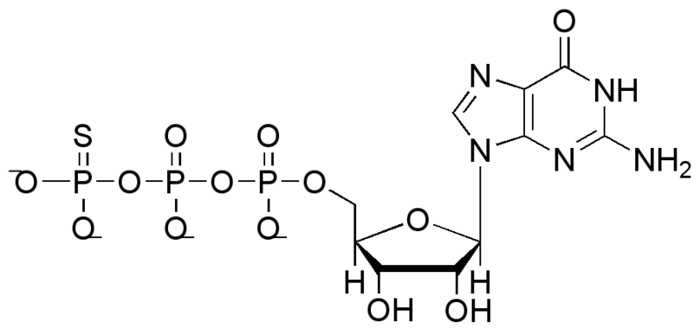
GTPγS – a tool to figure out if a G protein is involved in a process
Blocks GTP→GDP hydrolysis
Non-hydrolyzable form of GTP
Activates G proteins independent of hormones and receptors

Slide 22
Buffers keep Ca²⁺ signals localized
Region 1
[Ca++]
time
Calcium ion
Buffering protein
Region 2
[Ca++]
11-26
time

Slide 23
PLCzeta and fertilization
The sperm injects a small amount of constitutively active
PLC zeta to initiate calcium wave in egg.
Generates IP₃ independent of any hormone/receptor.
PIP2
PLCζ
IP3
IP3R
[Ca++]
11-30

Slide 24
Calcium effectors
Protein kinase C (PKC)
Calmodulin
Myosin Light Chain Kinase (MLCK)
CaM protein kinase II (CaMPKII)
Calcineurin

Slide 25

PKC is activated by DAG and Ca²⁺
(though some isoforms require only DAG, and other require neither DAG nor Ca²⁺…but the main ones require both)
PIP₂
DAG
PLC
PKC
Kinase activity
IP₃
RyR
RyR
IP3R
IP₃

Slide 26
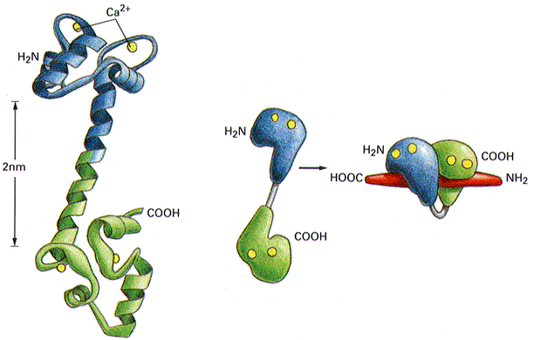
Calmodulin (CaM)
4 binding sites for Ca²⁺
Ca²⁺ causes a conformational change
CaM with Ca²⁺ binds a wide range of effectors
Most Ca²⁺ regulated proteins have no Ca²⁺ binding sites, but bind CaM

Slide 27
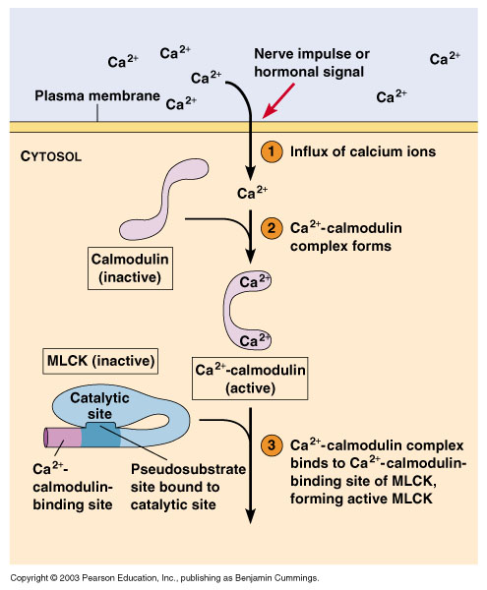
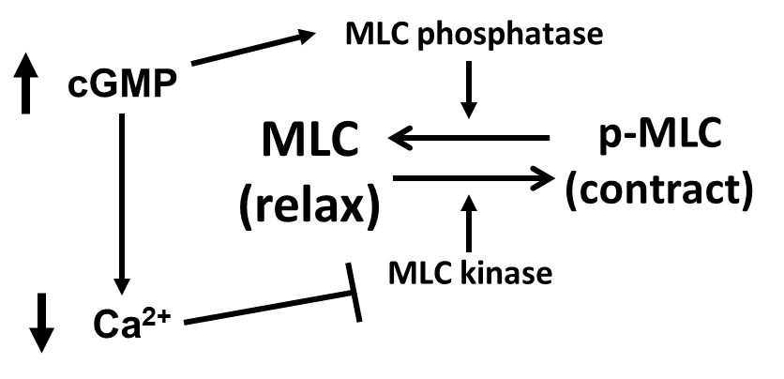

CaM activates MLCK by relieving autoinhibition
Remember this whole thing in smooth muscle? This is how Ca²⁺ activates MLCK and promotes smooth muscle contraction.

Slide 28
CaMPKII – a CaM regulated protein kinase
Autoinhibitory domain blocks catalytic activity
CaM binding domain
CBD
AID
CD
Catalytic domain
AD
Association domain allows multimerization
A big complex of several identical subunits

Slide 29
CaM binding relieves autoinhibition and activates catalytic domain
Ca-CaM
Ca-CaM
CBD
AID
CD
CBD
AID
CD
AD
AD

Slide 30
CaMPKII subunits can activate each other by autophosphorylation
substrate phosphorylation
autophosphorylation
Ca-CaM
CBD
AID
CD
AD
CBD
AID
CD
p
substrate phosphorylation
AD

Slide 31
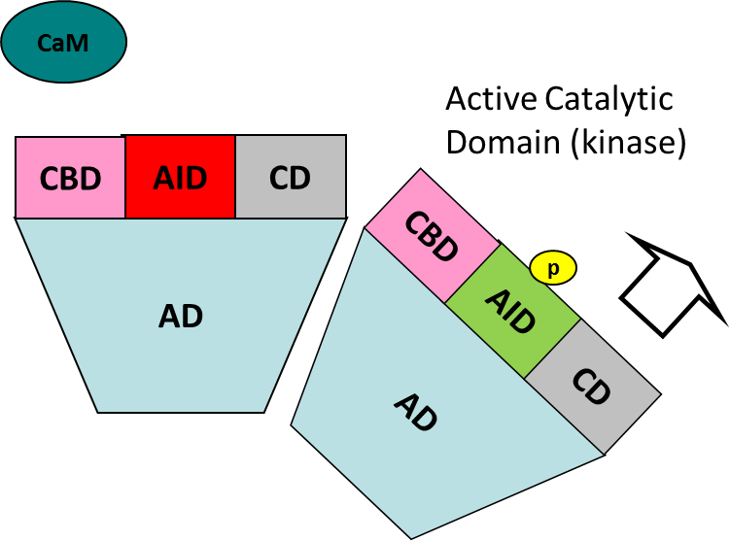
Phosphorylated CaMPKII subunits can stay active after Ca²⁺ transient ends - memory
CaMKII activity
CaM binding and activation
Long decay as autophosphorylation is removed
cytosol calcium

Slide 32
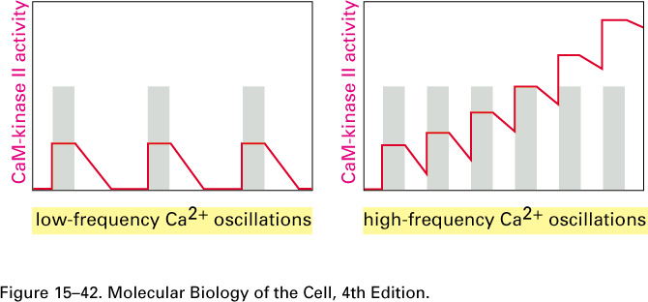
CaMPKII and signal decoding
CaM-PK II is sensitive to the spacing of the calcium spikes.
If a second burst of calcium were to hit the cell faster than the decay period, then the effect on CaMPKII would be cumulative.
12-15

Slide 33
Calcineurin – a CaM-dependent phosphatase
cytosol
CaM binding activates phosphatase
Calcineurin dephosphorylates and activates NFAT, an inflammatory TF
Ca/CaM
Calcineurin
NFAT
NFAT
p
nucleus
NFAT
IL-2

Slide 34


CaM activates a Ras GEF, promoting Ras activation
Ras
GAP
Ras
GEF
Ca-CaM
Ca-CaM
inactive GEF

Slide 35
Ca²⁺ partially activates phosphorylase kinase
PK activates glycogen phosphorylase, promoting glycogen breakdown
You’ll appreciate this more when talk about glycogen regulation…but it’s important
cAMP/PKA and Ca²⁺ synergistically activate PK
cAMP PKA
Ca++
PK
Glycogen breakdown for energy production

Slide 36
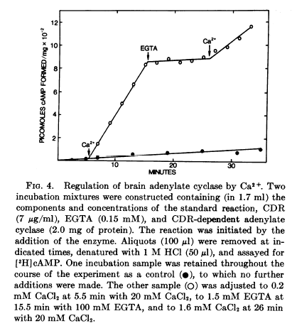
Crosstalk between pathways-Ca/cAMP
Many adenylate cyclases and phosphodiesterases are Ca- dependent
Ca²⁺ transients can control cAMP levels
12-25

Slide 37
Let’s talk data analysis
7. (25 pts) You study the novel PP1 targeting protein “clavis” in smooth muscle. You stimulate smooth muscle samples with the novel drug chillaxin (CL) and they relax. To the CL treated cells, you then add the agent hyperkinin (HK) and the smooth muscle contracts. Next, you repeat the experiment with untreated cells (-), cells stimulated with CL or cells stimulated with CL and then HK (CL->HK). You immunoprecipitate myosin light chains and determine levels of A) myosin light chains; B) clavis; C) phosphorylated clavis; D) PP1 present in the immunoprecipitation. Incorporating all of the results, elucidate the role that clavis plays in altering smooth muscle tone, including your top candidate for the kinase that phosphorylates clavis.
Addition: - CL CL->HK
Myosin Light Chain
Clavis
Phospho-Clavis
PP1
Need to go through methodically – use all the data

Slide 38
MLC does not change
CL and HK do not change MLC expression
Clavis does not change
CL and HK do not change association of MLC and Clavis
These are loading controls – ensure you’re looking at a system with equal protein input
Addition: - CL CL->HK
Myosin Light Chain
Clavis
Phospho-Clavis
PP1

Slide 39
CL increases phospho-Clavis
HK reduces phospho-Clavis
Suggests phospho-Clavis promotes smooth muscle relaxation
Addition: - CL CL->HK
Myosin Light Chain
Clavis
Phospho-Clavis
PP1

Slide 40
CL increases PP1 association with MLC
HK reduces PP1 association to baseline
PP1 association correlates with phospho-Clavis levels
Possible phospho-Clavis recruits PP1
Addition: - CL CL->HK
Myosin Light Chain
Clavis
Phospho-Clavis
PP1

Slide 41
So, the data suggest…
pClavis promotes smooth muscle relaxation
When pClavis increases, more PP1 is recruited to MLC
PP1 promotes smooth muscle relaxation
Model: pClavis promotes smooth muscle relaxation by recruiting PP1 to MLC
Addition: - CL CL->HK
Myosin Light Chain
Clavis
Phospho-Clavis
PP1

Slide 42
That’s all, folks!

