Slide 1
Final review
Endo I
Amy Gill, Brandon Boland, Danika Bakke
12/5/13

Slide 2
Part 1: Tyrosine kinases and insulin signaling overview
Techniques for measuring protein phosphorylation
Receptor tyrosine kinases (RTKs)
Non-receptor tyrosine kinase – Src
Insulin signaling
MAPK (mitogenesis)
PI3K/Akt (metabolism)

Slide 3
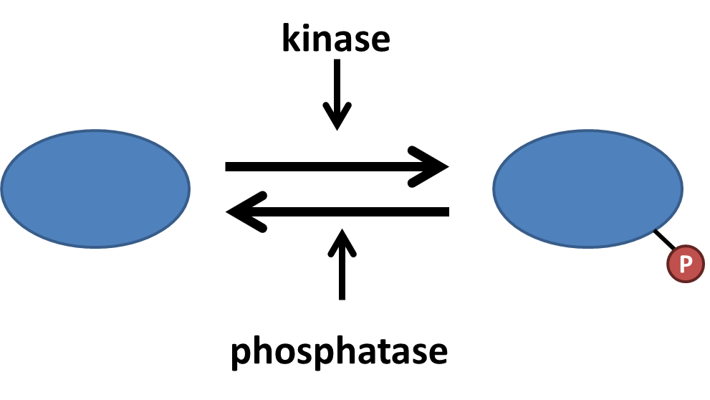
Protein phosphorylation is a common mechanism of regulating protein function
Serine (S), threonine (T), and tyrosine (Y) can be phosphorylated
Kinases are typically either serine/threonine kinases or tyrosine kinases
Can alter protein conformation, protein-protein associations, catalytic activity

Slide 4
Detecting protein phosphorylation
³²P labeling
Labels all ATP
Detects all phosphorylation events
Phospho-specific antibodies
Detect either pS, pT, or pY
Detects phosphorylation of all proteins
Phospho-protein antibodies
Detects specific phospho-sites on specific proteins
The most specific…and most useful experimentally

Slide 5
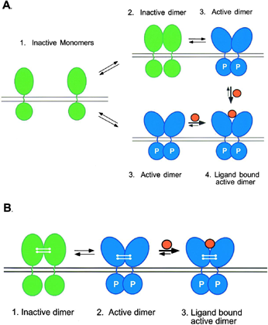
Receptor tyrosine kinases
Built-in tyrosine kinase activity
Function as dimers
Ligand stabilizes RTK in active conformation
RTK activation leads to auto-trans phosphorylation

Slide 6
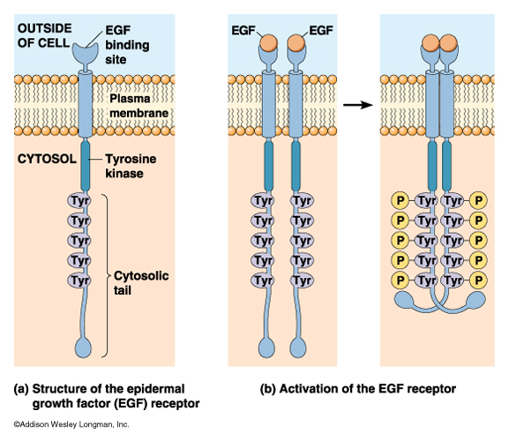
RTK activation leads to auto-trans phosphorylation
Each monomer phosphorylates its partner on many sites
pY are docking sites for effectors
Importantly, one pY is in the kinase domain activation loop

Slide 7
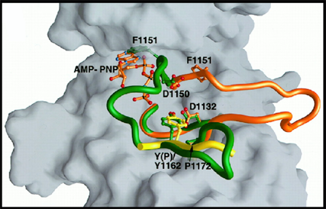
Phosphorylation of the activation loop exposes the RTK catalytic domain
Inactive state (green): activation loop occludes catalytic domain
Active state (orange): activation loop swings open, exposing the catalytic domain
Result of ligand binding
Activation loop phosphorylation stabilizes the open conformation

Slide 8
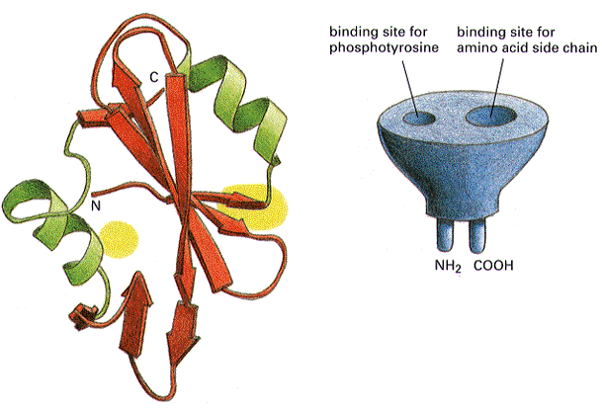
SH2 and PTB domains bind pY
Recognize pY in a specific context
Surrounding amino acids allow discrimination
Common mechanism by which proteins bind RTKs
Proteins with these domains play many roles
Adaptors
RTK kinase targets
Effectors

Slide 9
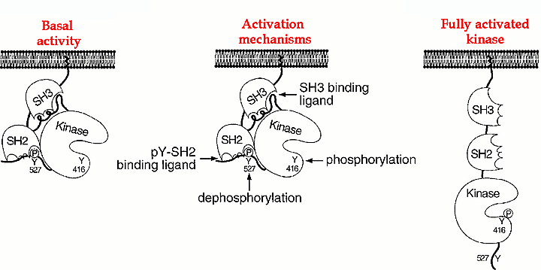
Non-receptor tyrosine kinases: mechanism of Src activation
Inhibitory C-term pY
To activate:
Disrupt self-SH3 association
Disrupt self-SH2 association (dephosphorylate C-term)
Phosphorylate activation loop

Slide 10
2. (15 pts) Compared to wild type Src, how would you predict that inhibition of the SH2 domain function on Src affect its: 1) basal activity and 2) increase in activity caused by a hormone? Why?
Basal activity increased, since can’t bind the inhibitory pY on the C term tail
Degree of stimulation decreased because basal activity is higher

Slide 11
Insulin – an RTK ligand that regulates glucose metabolism

Slide 12
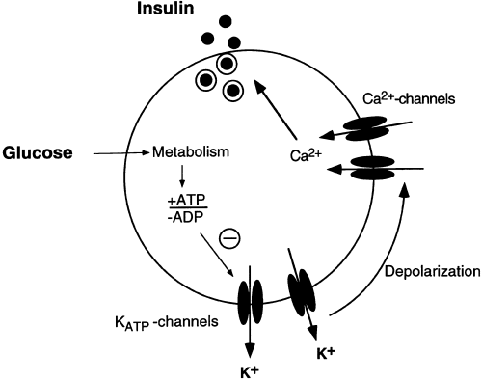
Insulin release involves beta cell depolarization
Glucose enters cell and is converted to ATP
ATP closes ATP-dependent K⁺ channels
Depolarization (K⁺ trapped)
Increased probability of voltage-dependent Ca²⁺ channels being open
Ca²⁺ increases insulin vesicle fusion with the plasma membrane
Insulin is released

Slide 13

Insulin signaling: RTK control of mitogenesis and metabolism
insulin
glucose
IR
GLUT4
PIP₃
Shc
PI3K
Grb2
P
P
Sos
P
P
Glucose uptake
Akt
Raf
MAPK cascade
GSK3
MEK
ERK
PP1
Glycogen synthase
Growth,
proliferation
Glycogen storage

Slide 14
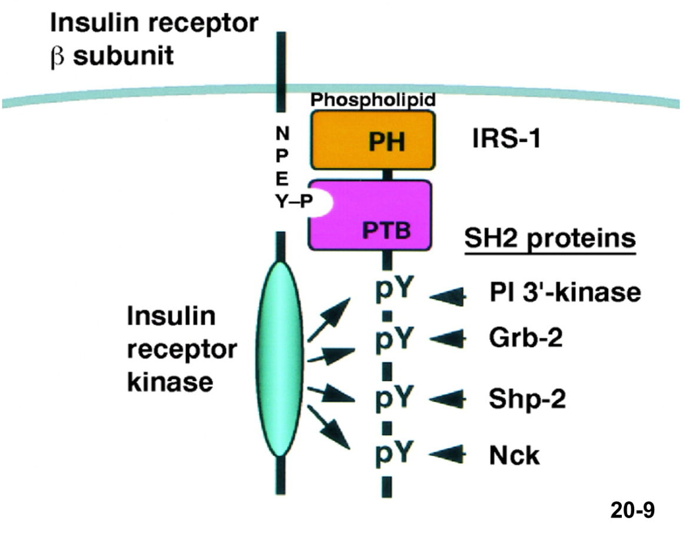
IR phosphorylates itself and IRS-1, a key scaffold for insulin signaling
IR phosphorylates many tyrosines on IRS-1
IRS-1 can recruit downstream effectors of insulin signaling
Efficiency: relieves protein crowding around active IR
Amplification: IR can activate many IRS-1
Diversification: many different effectors can interact with IRS-1

Slide 15
Insulin regulates mitogenesis through the MAPK cascade
insulin
IR
Shc
P
P
Sos
Grb2
P
Raf
MEK
ERK
Growth,
proliferation

Slide 16

IR activates Ras by recruiting adapter proteins and a Ras-GEF
IR
Insulin binding leads to IR auto-trans phosphorylation
pY on IR is recognized by Shc PTB domain
IR phosphorylates Shc
Grb2 binds p-Shc through its SH2 domain
Grb2 binding to Shc increases Sos activity
Sos is a GEF for Ras
P
PTB
GLUT4
Shc
P
SH2
Grb2
Sos
Sos

Slide 17
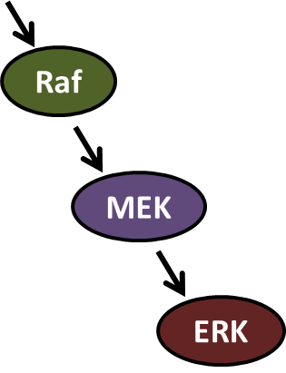
Ras activates the Raf-MEK-ERK MAPK cascade
Kinase cascade allows amplification
MEK is a dual specificity kinase
Consensus motif: TEY
Effect: pTEpY
ERK phosphorylates transcription factors involved in growth and proliferation
MAP3K
MAP2K
MAPK

Slide 18
11. (20 pts) Your friend has mutated the two regulatory phosphorylation sites in MAPK to either alanine (A) or aspartic acid (D). She then knocked-in these constructs into cells, treated with insulin and performed ³²P-labeling (left side) and activity assays (right side). Unfortunately, she lost her notes so she only is sure that #1 is wild-type MAPK. Which pair of data (2-5) corresponds to the A mutant or the D mutant? Why?
A mutation – can’t be phosphorylated, constitutively inactive – lane 4
D mutation – can’t be phosphorylated, constitutively active – lane 2

Slide 19
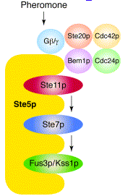
Scaffolds regulate efficiency and localization of MAPK signaling
Colocalization of MAPK components makes signaling more efficient
Scaffolds can target MAPKs to different intracellular locations
Scaffolds can also modulate MAPK signaling by recruiting activators, phosphatases, etc

Slide 20
Insulin regulates metabolism through PI3K
insulin
glucose
IR
GLUT4
PIP₃
PI3K
P
P
P
Glucose uptake
Akt
GSK3
Glycogen synthase
Glycogen storage

Slide 21

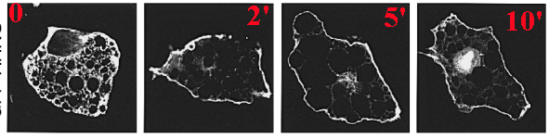
PI3K phosphorylates PIP₂ to PIP₃, which recruits PH domains to the membrane
PIP₂
PIP₃
PIP₃
PH
IRS-1
PI3K
GFP-PH domain after insulin stimulation

Slide 22
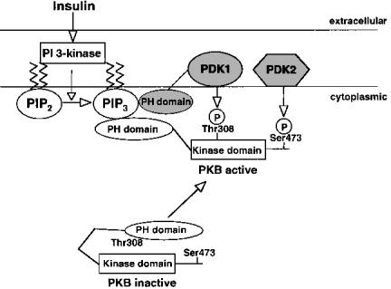
PIP₃ activates Akt
Akt is normally folded on itself
Akt PH domain binds to PIP₃, exposing the kinase domain
Phosphorylation stabilizes Akt in the active form
Active Akt can dissociate from membranes and find substrates

Slide 23
Akt promotes glucose uptake and glycogen synthesis
Glucose
IR
AKT
PI3’-K
GLUT4
Glucose
wortmannin
GSK-3
Glucose-6-P
Glycogen Synthase
UDP-Glucose
Glycogen

Slide 24
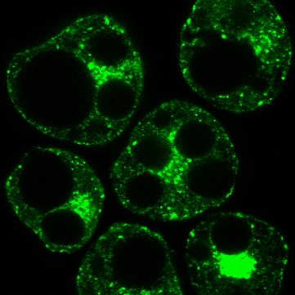
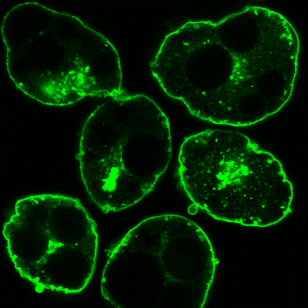
Insulin stimulates GLUT4 translocation, promoting glucose uptake
control
GLUT4 = glucose transporter
GLUT4 stored in vesicles in perinuclear region
Insulin stimulates GLUT4 relocation to plasma membrane (PM) in a PI3K-Akt dependent manner
Increases translocation of vesicles
Increases generation of vesicles from endosome
Decreases GLUT4 reuptake
More GLUT4 at PM = more glucose uptake
No effect on channel efficacy, just channel number at PM
insulin

Slide 25
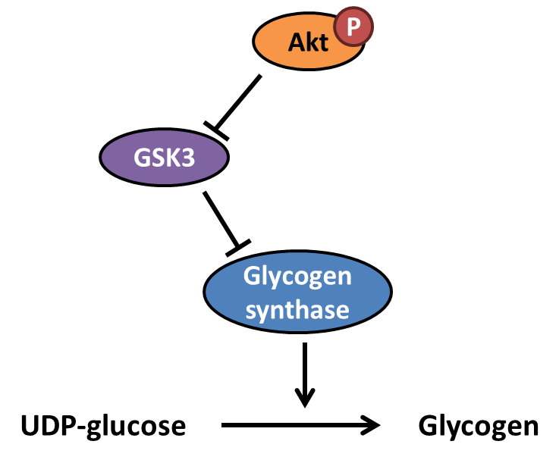
Akt promotes glycogen synthesis by inhibiting GSK3
Glycogen synthase adds glucose units to glycogen
GSK3 phosphorylates and inhibits glycogen synthase
Akt phosphorylates and inhibits GSK3
Therefore, Akt indirectly activates glycogen synthase

Slide 26
3. (14 pts) The development of obesity is associated with the reduction of systemic insulin sensitivity. You have isolated a novel secreted factor “Stuffin” from fat cells and studied its action on skeletal muscle cells. You pretreat cells -/+ Stuffin for 24 hr, and then you treat cells -/+ insulin. You measure: A) ³²P-labeling of IRS-1; B) tyrosine phosphorylation of IRS-1 using phospho-tyrosine antibodies; C) total levels of IRS-1; D) GSK3 activity. Please explain how Stuffin is impacting insulin signaling in muscle cells.

Slide 27
Lanes 1 and 3
Stuffin decreases total IRS-1
Stuffin increases ³²P labeling but not pY
Suggests Stuffin increases S/T phosphorylation of IRS-1
IRS-1 western blot
³²P labeling
pY antibody
Total IRS-1

Slide 28
Lanes 2 and 4
IRS-1 western blot
Stuffin decreases insulin-mediated Y phosphorylation
Partly due to decreased IRS-1 levels…but pY decrease is out of proportion
Suggests Stuffin inhibits insulin-mediated Y phosphorylation of IRS-1
³²P labeling
pY antibody
Total IRS-1

Slide 29
GSK3 activity assay
Stuffin reduces insulin-mediated GSK3 inhibition
Makes sense since Stuffin reduces IRS-1 pY
IRS-1 normally activates PI3K-Akt
Akt normally inhibits GSK3
Reducing IRS-1 pY reduces Akt activity
Effect of Stuffin

Slide 30
Conclusions
Stuffin increases pS/T on IRS-1
Stuffin decreases IRS-1 levels
Stuffin inhibits insulin-mediated IRS-1 pY
By inhibiting IRS-1 pY, Stuffin blocks PI3K-Akt signaling, leading to increased GSK3 activity

Slide 31
Necessary vs sufficient
Necessary
Inhibiting the factor blocks the response
Sufficient
Adding or overexpressing the factor alone recapitulates the response
This is an important distinction and is therefore quite likely to be on the final

Slide 32
Necessary vs. Sufficient
A
B
C
Response
A
B
C
D
E
F
X
X
X
X
Response
Pathway in both cases is NECESSARY
Notes:
1

Slide 33
Necessary vs. Sufficient
A
B
C
Response
A
B
C
D
E
F
X
Response
Pathway 1 is NECESSARY and SUFFICIENT
Pathway 2 is NECESSARY w/o being SUFFICIENT
Notes:
1

Slide 34
End of part 1

