Slide 1
Glycogen metabolism and regulation of energy stores
Amy Gill
Week 8 review
11/26/13

Slide 2
General topics to be covered
Regulation of glycogen metabolism
Methods
Yeast two-hybrid assay
Dominant negative proteins
Hepatic glucose output and storage
Regulation of lipolysis in adipose tissue
NGF

Slide 3
Regulation of glycogen metabolism
Less active glycogen synthase
GSK3
and other kinases
P
GLYCOGEN SYNTHASE
PHOSPHORYLASE A
GLUCOSE + GLYCOGEN (N)
GLYCOGEN (N+1)
P
Phosphorylase kinase
Phosphorylase B

Slide 4
Glycogen phosphorylase is activated by phosphorylation
Glycogen breakdown
cAMP
Glycogen
phosphorylase b
insulin
covalent
PKA
Phosphorylase
kinase
Protein Phosphatase-1
(PP1)
allosteric
P
Glycogen
phosphorylase a
Ca²⁺
AMP
LOW ENERGY STATE
HIGH ENERGY STATE

Slide 5
Glycogen synthase is progressively inhibited by phosphorylation
PP1
GSK3
2
2a
1a 1
3a 3b 3c 4 5
9 phosphosites
More phosphorylation = less activity
Allows flexibility in the amount of glycogen breakdown – tunable to cellular needs

Slide 6
Insulin regulates glycogen metabolism through PI3K/Akt and PP1
insulin
glucose
IR
GLUT4
PIP₃
PI3K
P
P
P
Glucose uptake
Akt
GSK3
PP1
Glycogen synthase
Glycogen storage

Slide 7
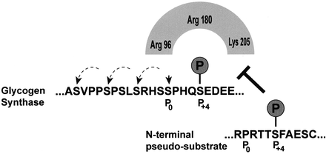
GSK3 inhibits glycogen synthase through hierarchical phosphorylation
Priming Kinase (not GSK-3)
GSK3 consensus motif: SxxxpS
Priming kinase phosphorylates the first serine to generate GSK3 consensus motif
Each GSK3-mediated phosphorylation generates another consensus motif
Not all phosphosites are equally important – mutating an earlier phosphosite will have more profound effects

Slide 8
Akt inactivates GSK3 by generating a pseudosubstrate
Akt phosphorylates GSK3 N-term, generating a PxxxpS motif
GSK3 binds its own tail – pseudosubstrate inhibition

Slide 9
PP1 is targeted to glycogen and other intracellular locations by targeting proteins
Over 80 targeting proteins
Allows specificity in PP1 activity, even though it is broadly used
Signals can regulate targeting subunits
MYPT1 – myosin
PTG – glycogen
PP1
T Subunit
Cell Structure

Slide 10
Technique: Yeast two-hybrid screening
Goal: identify proteins that interact with your protein of interest
Take advantage of the modular nature of transcription factors
We’ll go through this in detail
AD
PREY
BAIT
BD
Amino acid synthesis gene

Slide 11
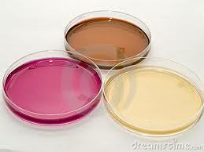
The Basis: Transcription Based Selection
Grow yeast on selective medium (e.g. amino acid deficient medium)
Only yeast that make their own amino acids will survive.
AD
BD
Transcription = survival
Amino acid synthesis gene
A transcription factor regulates the selective gene.
Only yeast with a functional transcription factor will survive.

Slide 12
BD
AD
PREY
BAIT
Protein of interest
Possible interaction partner
AD
PREY
BAIT
BD
Amino acid synthesis gene

Slide 13
If the bait and prey do not interact, there will be relatively little transcription. These yeast will not make the missing amino acids, and will not survive.
AD
PREY
BAIT
BD
Amino acid synthesis gene

Slide 14
If the bait and prey interact, it is more likely that the activating domain will activate transcription.
These yeast are more likely to survive.
BAIT
PREY
AD
BD
Amino acid synthesis gene

Slide 15
Y2H: Advantages and Disadvantages
Relatively fast
High throughput
Unbiased
Easy to read results
Lots of false positives: need to validate findings
False negatives too
Interactions must be independent of covalent modifications – yeast don’t have the same kinases, etc

Slide 16
PTG acts as a Metabolic Scaffold – PP1 activates glycogen synthase, inactivates glycogen phosphorylase
IR
PP1
PP1
P
P
P
PP1
GS
PP1
GP
PTG
PTG
PTG
Glycogen
21-19
Notes:
1

Slide 17
PP1- and Glycogen Synthase-Binding to PTG is Essential for Function
21
15
Scaffolding – substrate
recruitment
Glycogen/mg protein
(fold change)
10
5
PP1 Targeting
0
Mock
PTG
DE
GS/GP-
VF
PP1-
Glycogen synthase and glycogen phosphorylase binding domain
PP1 binding domain

Slide 18
Summary of Insulin’s Effects
IR
P
P
Ras
P
P
Sos
IRS
Shc
P
Grb2
P
P
P
p85
PI3’-K
MK cascade
wortmannin
PD98059
AKT
GSK3
PP1
mitogenesis
GLUT4
translocation
Protein dephosphorylation/
Glycogen synthesis
21-22
Notes:
1

Slide 19
Dominant negative proteins
Inactive proteins that actively inhibit normal signal transduction
Often bind to other signaling components and block their function
Often due to active site mutations – bind other signaling factors but prevent their activation
Note that not all inactive proteins are dominant negatives

Slide 20


Dominant negative RasN17 binds Sos but can’t be activated
Binds Sos but can’t be activated
Gets stuck to Sos
Soaks up Sos so it can’t activate other proteins (like endogenous Ras)
Normal Ras
RasN17
Sos
Sos
+
N17
Sos

Slide 21
Effects of exercise on glucose metabolism
Muscle cells – use glycogen, then increase GLUT4 translocation (independent of insulin)
Increase blood flow to muscle – increase glucose delivery
Liver – increase gluconeogenesis
Adipose – break down lipids to generate glycerol (for liver) and FFA (for muscle)

Slide 22
Cori Cycle
Liver
Muscle
Glycerol
(adipose)
FFA
(adipose)
G6P
Glucose
G2
G4
Glucose
Gluconeogenesis
Bloodstream
Glycolysis (ATP)
Pyruvate
Pyruvate
Lactate
Lactate
Alanine
Alanine
22-18
Notes:
1

Slide 23
Hepatic Glucose Output
Glucose
*present in liver,
not SK. muscle
GLUT2*
Glucose
G6Pase*
Pyruvate
G-6-P
cAMP
PEPCK*
Phosphorylase
G-1-P
Glycogen
Gluconeogenesis
Glycogenolysis
23-2b
Notes:
1

Slide 24
Increasing hepatic glucose output
glucagon
Activate glycogen phosphorylase (cAMP-PKA)
Stimulate transcription of gluconeogenesis enzymes (PEPCK, G6Pase) via PGC-1α
cAMP
PKA
Phosphorylase B
Phosphorylase A
Glygocen breakdown

Slide 25
PGC-1α is a CREB-regulated TF that indirectly activates G6Pase and PEPCK transcription
glucagon
CREB
cAMP
PGC-1α
PGC-1α
PGC-1α
FOXO1
FOXO1
FOXO1
PEPCK, G6Pase

Slide 26
Insulin acts in the liver to increase glycogen storage and decrease hepatic glucose output
insulin
glucose
IR
GLUT4
PIP₃
PI3K
P
P
FOXO1
P
Glucose uptake
Akt
gluconeogenesis
GSK3
Glycogen phosphorylase
PP1
Glycogen synthase
Glycogen storage
Glycogen breakdown

Slide 27
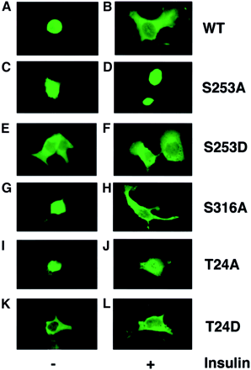
Phosphorylation of FOXO1 excludes it from the nucleus, blocking TF activity
Insulin-mediated Akt phosphorylation of FOXO1 moves it to the cytoplasm
Phosphorylation of these sites regulates translocation from the nucleus (hierarchical phosphorylation, these are more important)
Phosphorylation of this site is less important in determining FOXO1 location (hierarchical phosphorylation)

Slide 28
Insulin effects in adipose tissue
Stimulates glucose uptake (GLUT4 translocation)
Glucose used to generate triglycerides from FFA
Inhibits cAMP-driven lipolysis
Activates a PDE that breaks down cAMP
Activates PP1, which dephosphorylates proteins important for lipolysis
Perilipins
HSL
Diagram on next slide

Slide 29
Insulin Exerts Anti-Lipolytic Effects
Akt
IR
β-AR
AC
PDE3B
G_{S}
cAMP
5’-AMP
ATP
PP1
PKA
FFA + Glycerol
Perilipins
HSL
Triglyceride
22-16

Slide 30
NGF – a neuron survival factor
In development, many more neurons are created than are necessary
Neurons that successfully make connections receive NGF and survive

Slide 31
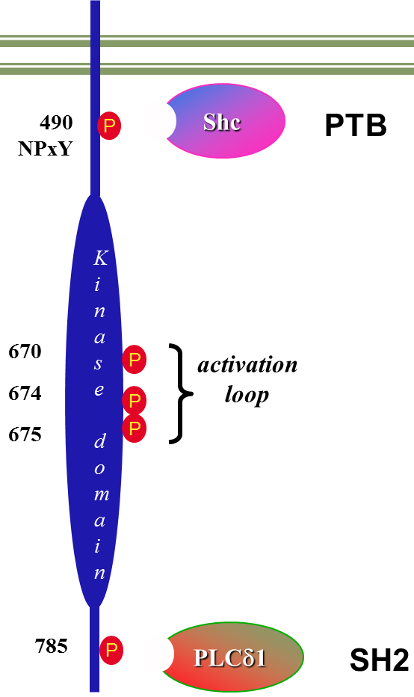
NGF has two receptors, one of which is a RTK
TrkA

Slide 32
NGF Regulates Differentiation (MAPK) and
Apoptosis (PI3’K/Akt) by Different Pathways
TrkA
pTyr phos
PD98059
PI3’K
MAPK
wortmannin
Anti-Apoptosis
Differentiation
23-19
Notes:
1

Slide 33
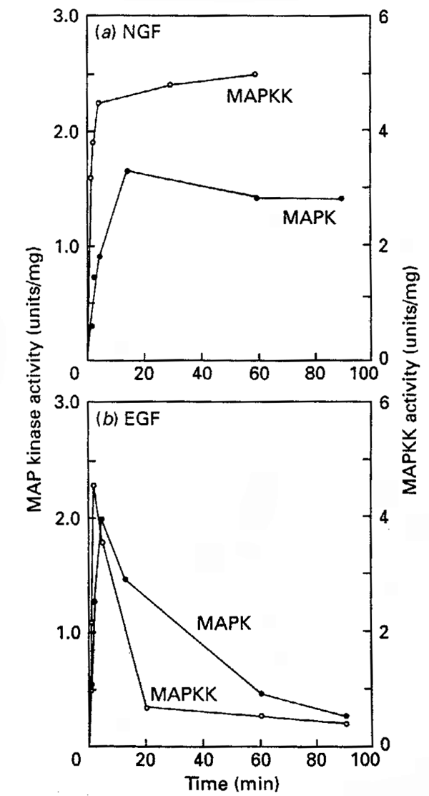
NGF, EGF, and insulin activate the same pathways but have different effects
Insulin promotes GLUT4 translocation partly by a parallel pathway
EGF activates MAPK as a short burst and promotes cell growth/proliferation
NGF activates sustained MAPK and promotes differentiation

Slide 34
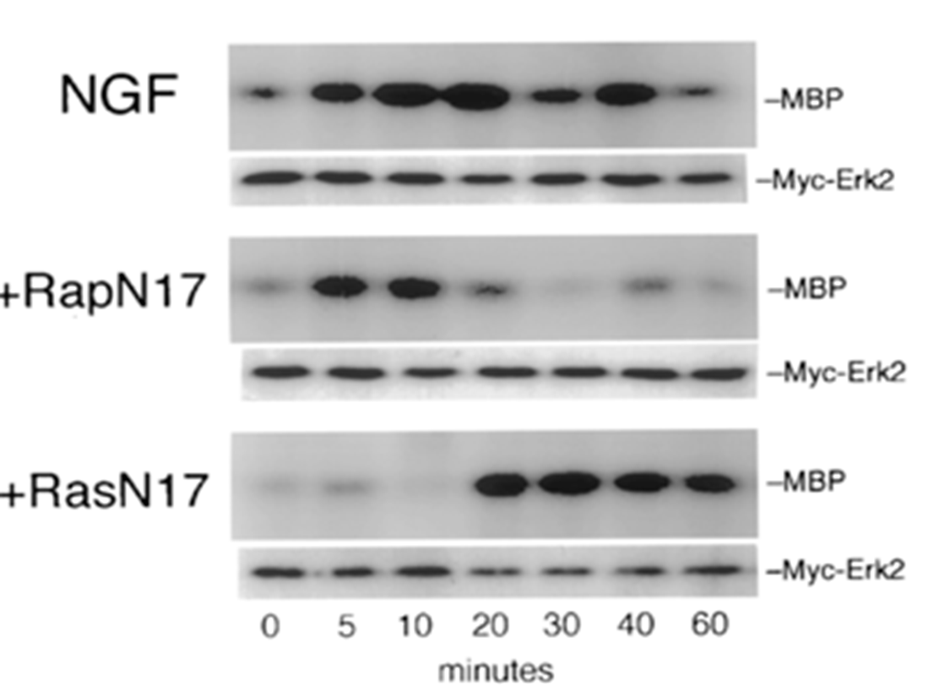
NGF elicits a sustained MAPK response by activating an early and a late pathway
NGF activates two different G proteins
Early effect: Ras activation
Shared with EGF
Burst of MAPK
Late effect: Rap activation
Sustained activation of MAPK

