Slide 1
Tyrosine kinases and insulin signaling
Amy Gill
Week 7 Review
11/19/13

Slide 2
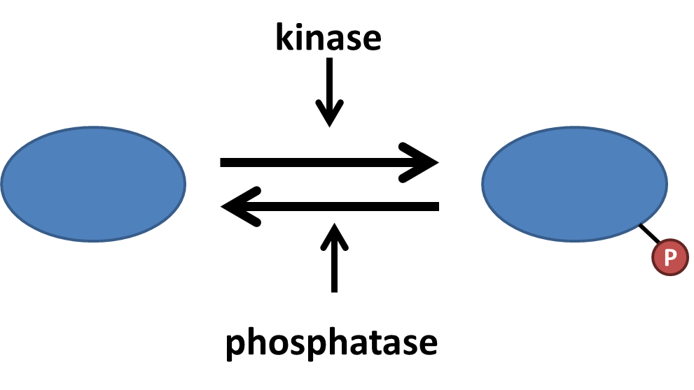
Protein phosphorylation is a common mechanism of regulating protein function
Serine (S), threonine (T), and tyrosine (Y) can be phosphorylated
Kinases are typically either serine/threonine kinases or tyrosine kinases
Can alter protein conformation, protein-protein associations, catalytic activity

Slide 3
Detecting protein phosphorylation
³²P labeling
Labels all ATP
Detects all phosphorylation events
Phospho-specific antibodies
Detect either pS, pT, or pY
Detects phosphorylation of all proteins
Phospho-protein antibodies
Detects specific phospho-sites on specific proteins
The most specific…and most useful experimentally

Slide 4
Tyrosine phosphorylation represents 1-2% of total phosphorylation
pH 1.9
S
T
Y
pH 3.5

Slide 5
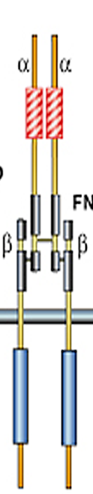
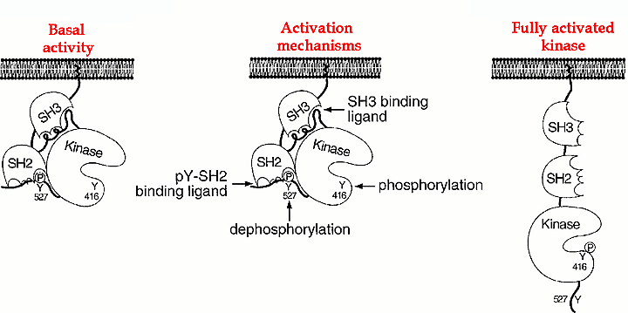
Many receptors signal through tyrosine phosphorylation
Receptor tyrosine kinases (RTKs)
Non-receptor tyrosine kinases
Receptors associated with tyrosine kinases
JAK2
JAK2
Built-in tyrosine kinase activity
Associated tyrosine kinases
Example:
Insulin receptor (IR)
Example:
Leptin receptor
Example:
Src

Slide 6
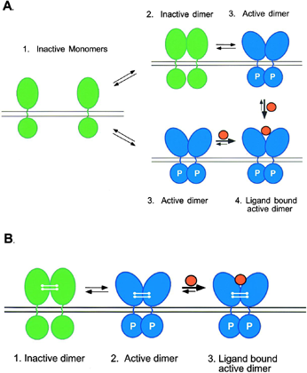
RTK activation involves dimerization and phosphorylation
Ligand stabilizes RTK in active conformation
RTK activation leads to phosphorylation on many residues

Slide 7
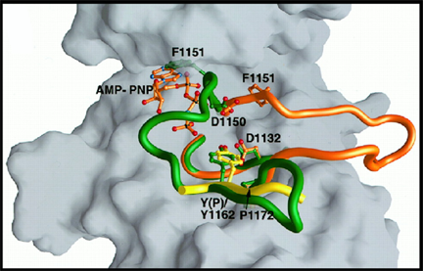
Phosphorylation of the activation loop exposes the RTK catalytic domain
Inactive state (green): activation loop occludes catalytic domain
Active state (orange): activation loop swings open, exposing the catalytic domain
Activation loop phosphorylation stabilizes the open conformation

Slide 8
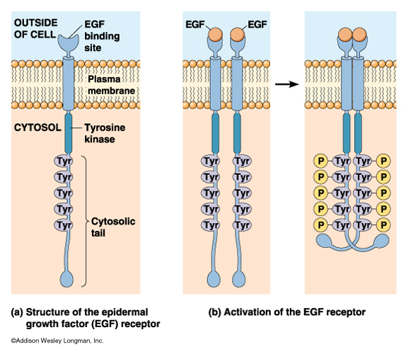
RTK activation leads to auto-trans phosphorylation
Each monomer phosphorylates its partner
pY are docking sites for effectors

Slide 9
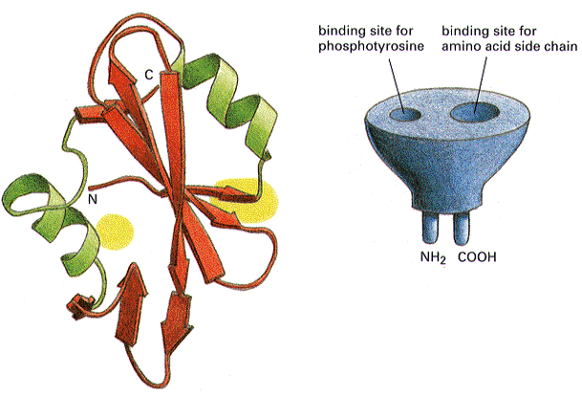
SH2 and PTB domains bind pY
Recognize pY in a specific context
Surrounding amino acids allow discrimination
Common mechanism by which effectors bind RTKs

Slide 10
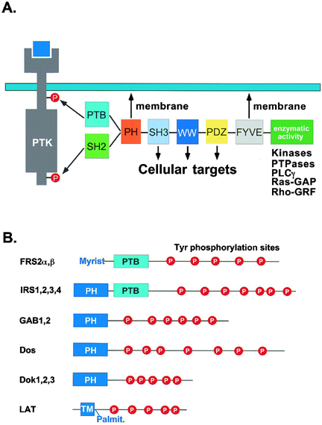
Proteins that interact with RTKs are often modular

Slide 11
Non-receptor tyrosine kinases: mechanism of Src activation
To activate:
Disrupt self-SH3 association
Disrupt self-SH2 association (dephosphorylate C-term)
Phosphorylate activation loop

Slide 12
Insulin has a variety of effects that lower blood glucose
Muscle
Increase glucose uptake (GLUT4 translocation)
Increase glycogen storage
Liver
Increase glycogen storage
Decrease glucose production
Fat
Increase glucose uptake (GLUT4 translocation)
Increase fat storage
Different effects in different tissues are due to different downstream effectors

Slide 13
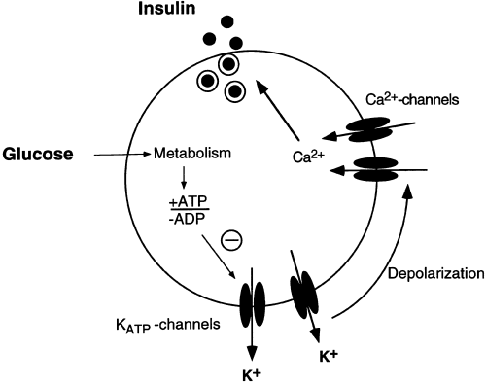
Insulin release involves beta cell depolarization
Glucose enters cell and is converted to ATP
ATP closes ATP-dependent K⁺ channels
Depolarization (K⁺ trapped)
Increased probability of voltage-dependent Ca²⁺ channels being open
Ca²⁺ increases insulin vesicle fusion with the plasma membrane
Insulin is released

Slide 14

Insulin signaling in muscle cells: RTK control of mitogenesis and metabolism
insulin
glucose
IR
GLUT4
PIP₃
Shc
PI3K
Grb2
P
P
Sos
P
P
Glucose uptake
Akt
Raf
MAPK cascade
GSK3
MEK
ERK
Glycogen synthase
Growth,
proliferation
Glycogen storage

Slide 15
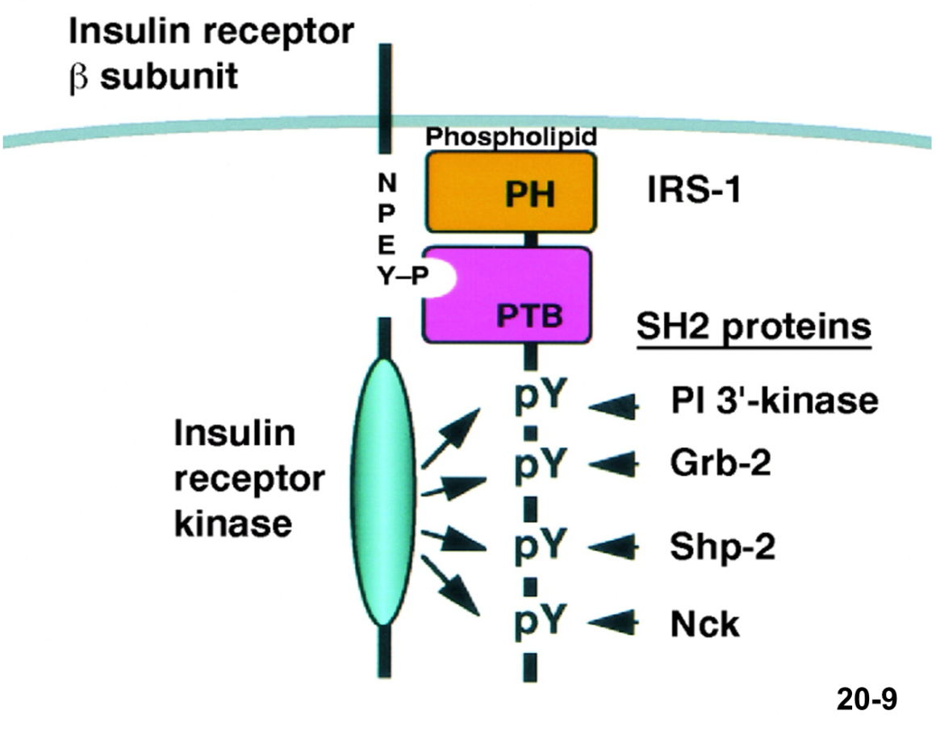
IR phosphorylates itself and IRS-1, a key scaffold for insulin signaling
IR phosphorylates many tyrosines on IRS-1
IRS-1 can recruit downstream effectors of insulin signaling
Efficiency: relieves protein crowding around active IR
Amplification: IR can activate many IRS-1
Diversification: many different effectors can interact with IRS-1

Slide 16
Insulin regulates mitogenesis through the MAPK cascade
insulin
IR
Shc
P
P
Sos
Grb2
P
Raf
MEK
ERK
Growth,
proliferation

Slide 17

IR activates Ras by recruiting adapter proteins and a Ras-GEF
IR
Insulin binding leads to IR auto-trans phosphorylation
pY on IR is recognized by Shc PTB domain
IR phosphorylates Shc
Grb2 binds p-Shc through its SH2 domain
Grb2 binding to Shc increases Sos activity
Sos is a GEF for Ras
P
PTB
GLUT4
Shc
P
SH2
Grb2
Sos
Sos

Slide 18
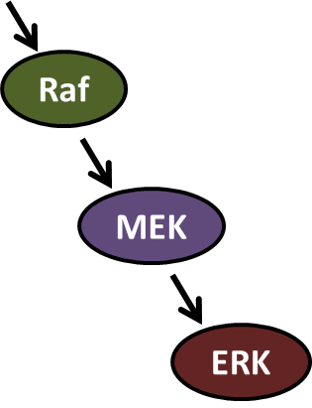
Ras activates the Raf-MEK-ERK MAPK cascade
ERK phosphorylates transcription factors involved in growth and proliferation
Kinase cascade allows amplification
Multiple steps = multiple points for crosstalk
Integration
Modulation
MAP3K
MAP2K
MAPK

Slide 19
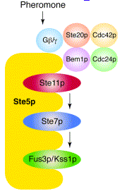
Scaffolds regulate efficiency and localization of MAPK signaling
Colocalization of MAPK components makes signaling faster
Scaffolds can target MAPKs to different intracellular locations (like AKAPs)

Slide 20
Insulin regulates metabolism through PI3K
insulin
glucose
IR
GLUT4
PIP₃
PI3K
P
P
P
Glucose uptake
Akt
GSK3
Glycogen synthase
Glycogen storage

Slide 21

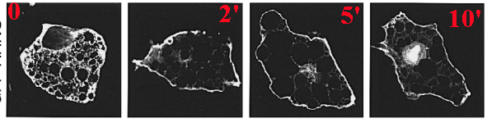
PI3K phosphorylates PIP₂ to PIP₃, which recruits PH domains to the membrane
PIP₂
PIP₃
PIP₃
PH
IRS-1
PI3K
GFP-PH domain after insulin stimulation

Slide 22
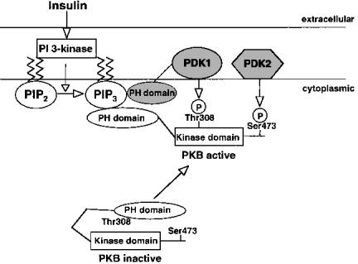
PIP₃ activates Akt
Akt is normally folded on itself
Akt PH domain binds to PIP₃, exposing the kinase domain
Phosphorylation stabilizes Akt in the active form
Active Akt can dissociate from membranes and find substrates

Slide 23
Akt promotes glucose uptake and glycogen synthesis
Glucose
IR
AKT
PI3’-K
GLUT4
Glucose
wortmannin
GSK-3
Glucose-6-P
Glycogen Synthase
UDP-Glucose
Glycogen

Slide 24
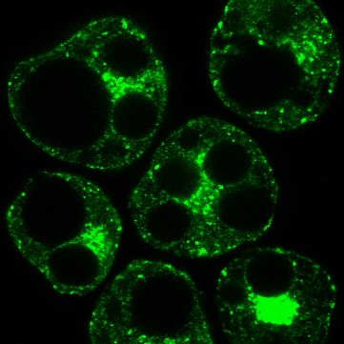
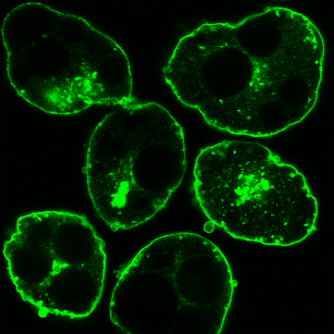
Insulin stimulates GLUT4 translocation, promoting glucose uptake
control
GLUT4 stored in vesicles in perinuclear region
Insulin stimulates GLUT4 relocation to plasma membrane (PM) in a PI3K-Akt dependent manner
Increases translocation of vesicles
Increases generation of vesicles from endosome
Decreases GLUT4 reuptake
More GLUT4 at PM = more glucose uptake
No effect on channel efficacy, just channel number at PM
insulin

Slide 25
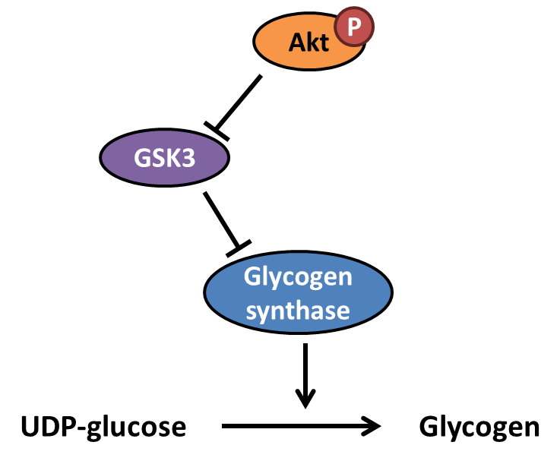
Akt promotes glycogen synthesis by inhibiting GSK3
Glycogen synthase adds glucose units to glycogen
GSK3 phosphorylates and inhibits glycogen synthase
Akt phosphorylates and inhibits GSK3
Therefore, Akt indirectly activates glycogen synthase

Slide 26
Necessary vs sufficient
Necessary
Inhibiting the factor blocks the response
Sufficient
Adding or overexpressing the factor alone recapitulates the response
This is an important distinction and is therefore quite likely to be on the final

Slide 27
Necessary vs. Sufficient
A
B
C
Response
A
B
C
D
E
F
X
X
X
X
Response
Pathway in both cases is NECESSARY
Notes:
1

Slide 28
Necessary vs. Sufficient
A
B
C
Response
A
B
C
D
E
F
X
Response
Pathway 1 is NECESSARY and SUFFICIENT
Pathway 2 is NECESSARY w/o being SUFFICIENT
Notes:
1

Slide 29
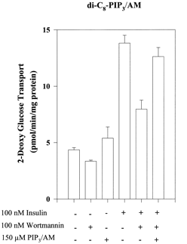
PI3K is necessary but not sufficient for GLUT4 translocation
Lane 4
insulin stimulates glucose transport (GLUT4 translocation)
Lane 5
inhibiting PI3K blocks insulin-dependent glucose transport
PI3K is necessary for insulin to stimulate GLUT4 translocation
Lane 3
Adding PIP₃ alone does not stimulate glucose transport
PI3K is not sufficient for GLUT4 translocation
Therefore, insulin must also regulate another pathway that stimulates GLUT4 translocation

Slide 30
The End
Any questions?

