Slide 1
HBP1 promotes neuroblastoma differentiation by inhibiting MYCN transcription factor activity
Amy Gill
Committee on Cancer Biology
Preliminary Examination
20 September 2012

Slide 2
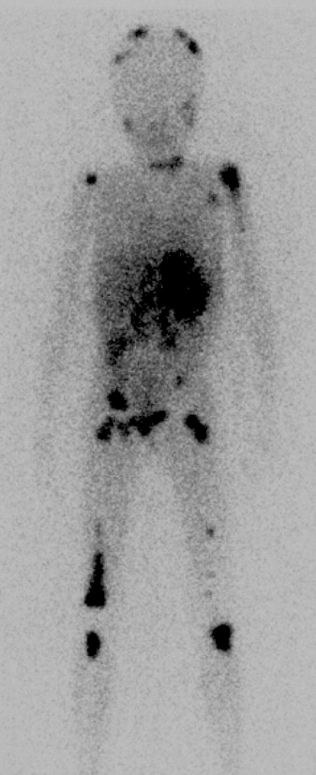
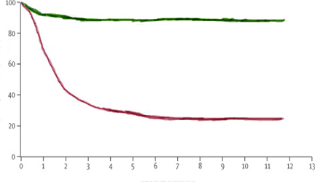
Neuroblastoma (NB) is a cancer of the developing nervous system
MIBG scan of a child with stage 4 neuroblastoma²
Most common pediatric solid tumor
7-10% pediatric cancer cases¹
15% pediatric cancer deaths²
Exhibits extreme clinical heterogeneity
Event-free survival of high and low risk NB (adapted from 1)
Low risk
>90% EFS
EFS (%)
High risk
<40% EFS
Years since diagnosis
¹Brodeur 2003 ²Maris et al., 2007

Slide 3
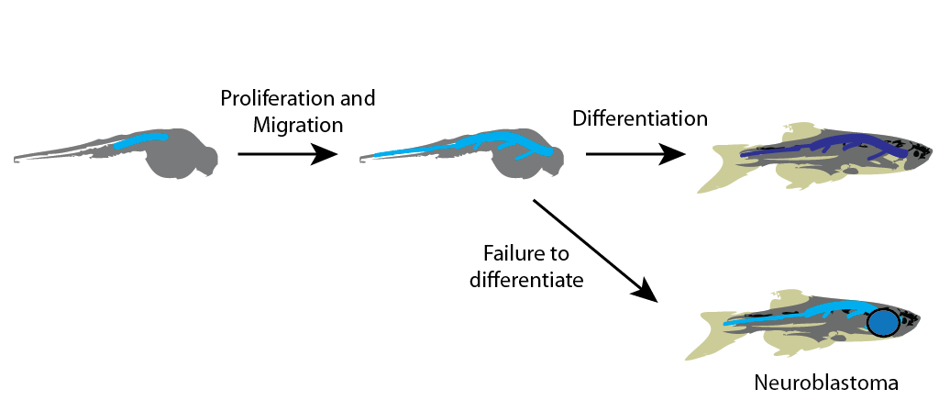
NB is a disorder of sympathetic nervous system development
SNs
Mature sympathetic neurons
Normally, the neural crest gives rise to a lineage of sympathetic neuroblasts (SNs), which proliferate and migrate
Activation of differentiation makes SNs mature or undergo apoptosis
NB derives from SNs that continue to proliferate and fail to differentiate

Slide 4
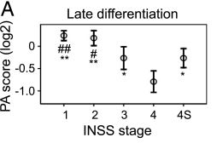
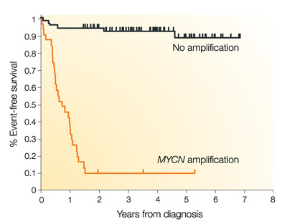
What distinguishes low- and high-risk NB?
NB expression of neuronal differentiation gene signature¹
Non-biological features
Stage
Age
Biological features
Favorable NB expresses more neuronal differentiation proteins
Most important prognostic factor: MYCN amplification (25%)
Event-free survival of infants <1 year old with metastatic NB based on MYCN status²
¹Fredlund et al., 2008 ²Brodeur 2003

Slide 5
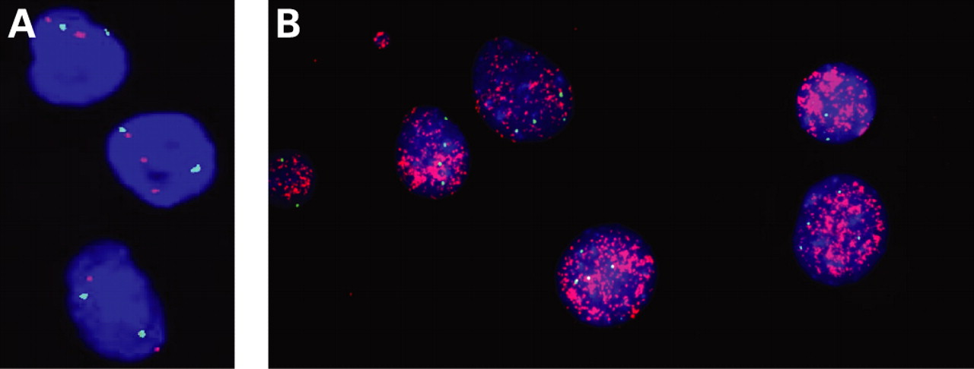
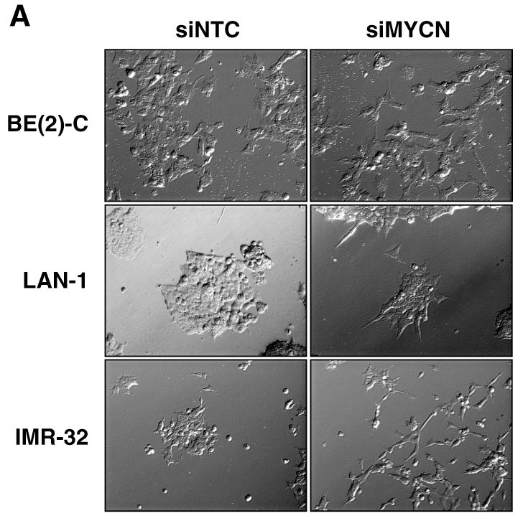
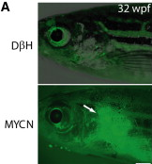
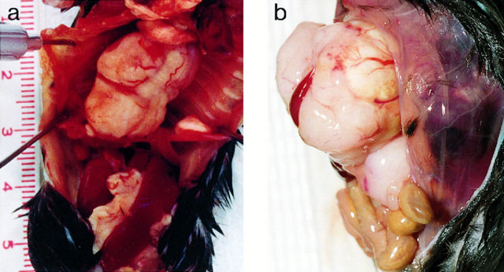
Myc TFs are important in NB pathogenesis
MYCN amplification is the biggest prognostic factor for poor outcome in NB²
High risk MYCN-nonamplified NB typically overexpresses c-myc and/or Myc family target genes^{3,4}
MYCN overexpression is sufficient to produce NB in mouse⁵ and zebrafish⁶
siRNA KD of MYCN in NB cell lines leads to growth arrest, neuronal differentiation, apoptosis⁷
FISH with MYCN probe (red) and chr 2 centromere control probe (green) in NB cells¹
MYCN-induced NB in mice⁵
MYCN-induced NB in
zebrafish⁶
MYCN KD-induced differentiation of NB cell lines⁷
¹Schmitt et al., 2008 ²Tang et al., 2006 ³Westermann et al., 2008 ⁴Fredlund et al., 2008 ⁵Weiss et al., 1997 ⁶Zhu et al., 2012 ⁷Kang et al., 2006

Slide 6
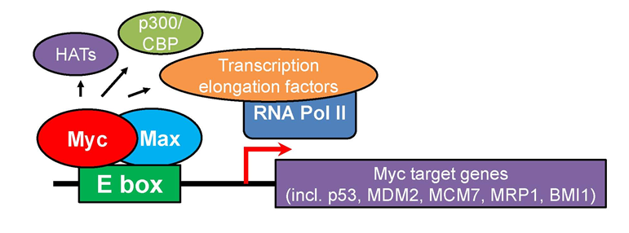
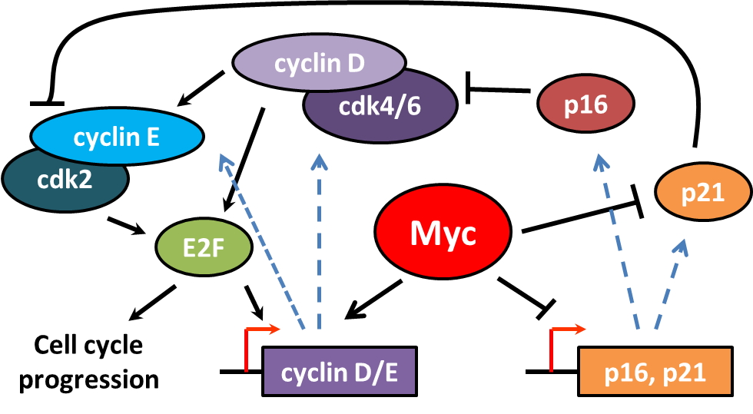
Myc family TFs promote proliferation
Required for G1/S phase cell cycle progression¹
Downregulation of myc family members accompanies terminal differentiation¹
¹Westermark et al., 2011

Slide 7
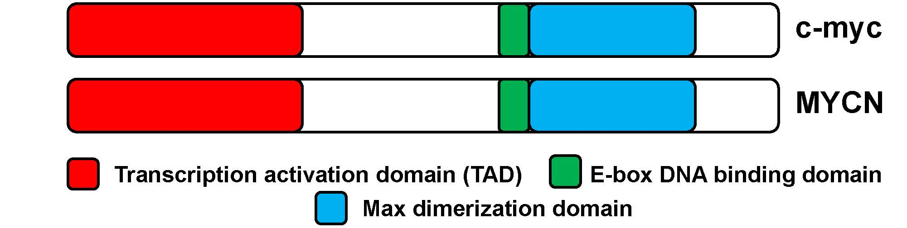
c-myc and MYCN have highly similar biochemical properties
Similarities
Differences
Domain structure¹
Protein binding partners¹
TF activity¹
DNA binding sites
Target genes
Location of expression¹
c-myc: all proliferating adult cell types
MYCN: some embryonic cell types (incl. SNs)
¹Westermark et al., 2011

Slide 8
Favorable NB has very high rates of spontaneous regression and differentiation
10-100x more frequent than any other cancer¹
Typically in a subset of patients < 18 mo
Both localized and disseminated (stage 4S) tumors²
Favorable biology
30-95% regress or mature w observation alone³
Possible mechanism: reactivation of SN differentiation pathways
QUESTION: What mechanism drives tumor regression? Which genes/proteins are important?
¹Pritchard and Hickman, 1994 ²Iwanaka et al., 2005 ³Nishihira et al., 2000

Slide 9
What genes/proteins contribute to NB regression?
Two microarray studies to find genes differentially expressed in favorable and unfavorable NB subtypes
Benard et al., 2008: Stage 4 v 4S: 29 tumors, 3 actively regressing
Hiyama et al., 2004: Favorable biomarkers v unfavorable biomarkers: 20 tumors, 4 actively regressing

Slide 10
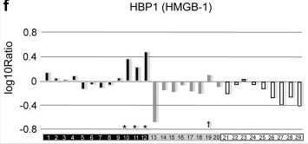
HBP1 is upregulated in regressing NB
Both identified HBP1 – specifically upregulated in 4S tumors that were actively regressing^{1,2}
Regressing NB 4S
[1yr⁻] 4S
[1yr⁻] 4
[1yr⁺] 4
Benard et al., 2008
¹Benard et al., 2008 ²Hiyama et al., 2004

Slide 11
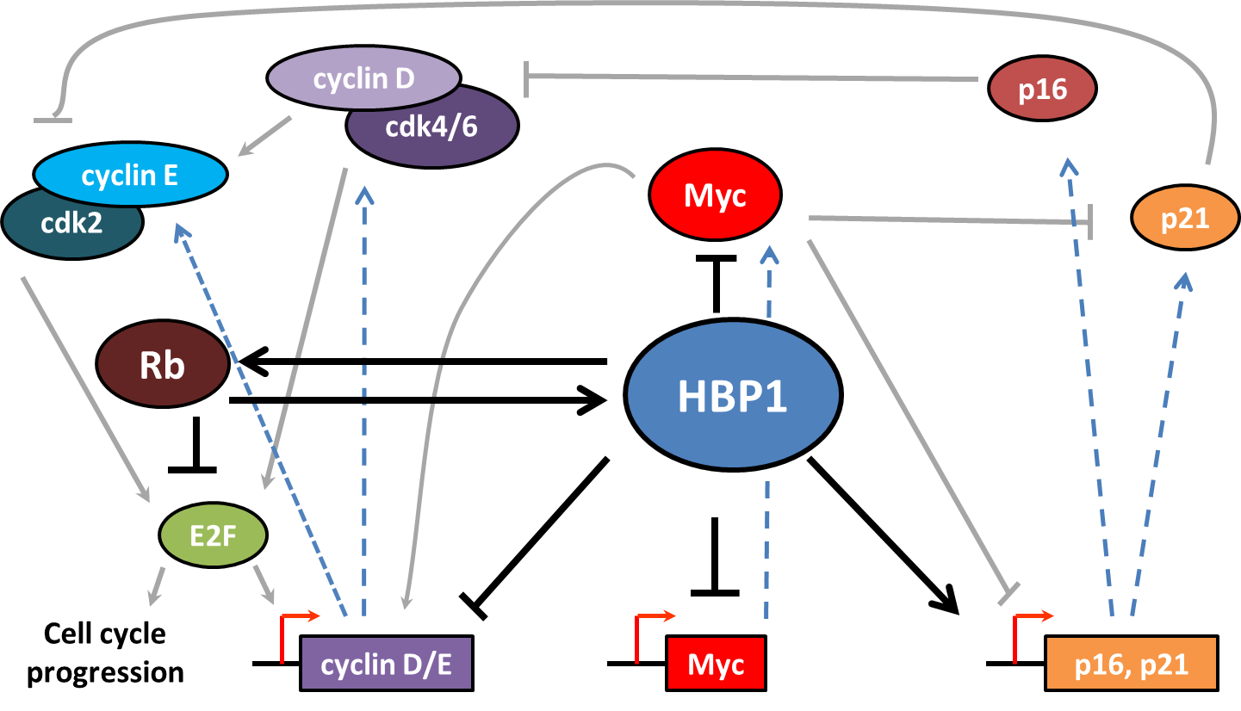
HBP1 is a TF that regulates cell cycle progression
Represses cyclin and myc expression^{1,6}
Activates CDKI expression^{4,5}
Represses G1/S transition¹⁻⁶
Promotes cell cycle arrest^{1,2}
¹Tevosian et al., 1997 ²Lavender et al., 1997 ³Shih et al., 1998 ⁴Li et al., 2010 ⁵Gartel et al., 1998 ⁶Sampson et al., 2001

Slide 12
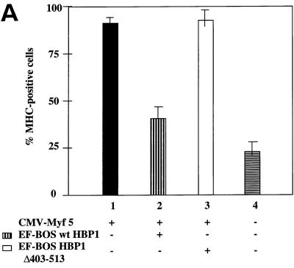
HBP1 plays a role in differentiation
Expression leads to cell cycle arrest and differentiation in many cell types
Muscle^{1,2}
Skin³
Myeloid cells^{4,5}
Proposed to be a general regulator of differentiation
Acts through general cell cycle control factors
Does not appear to be cell type specific
Shih et al., 1998
Together with evidence of selective HBP1 expression in regressing NB, these data suggest the hypothesis that HBP1 is involved in SN and NB differentiation.
¹Tevosian et al., 1997 ²Shih et al., 1998 ³Borrelli et al., 2010 ⁴Lin et al., 2001 ⁵Yao et al., 2005

Slide 13
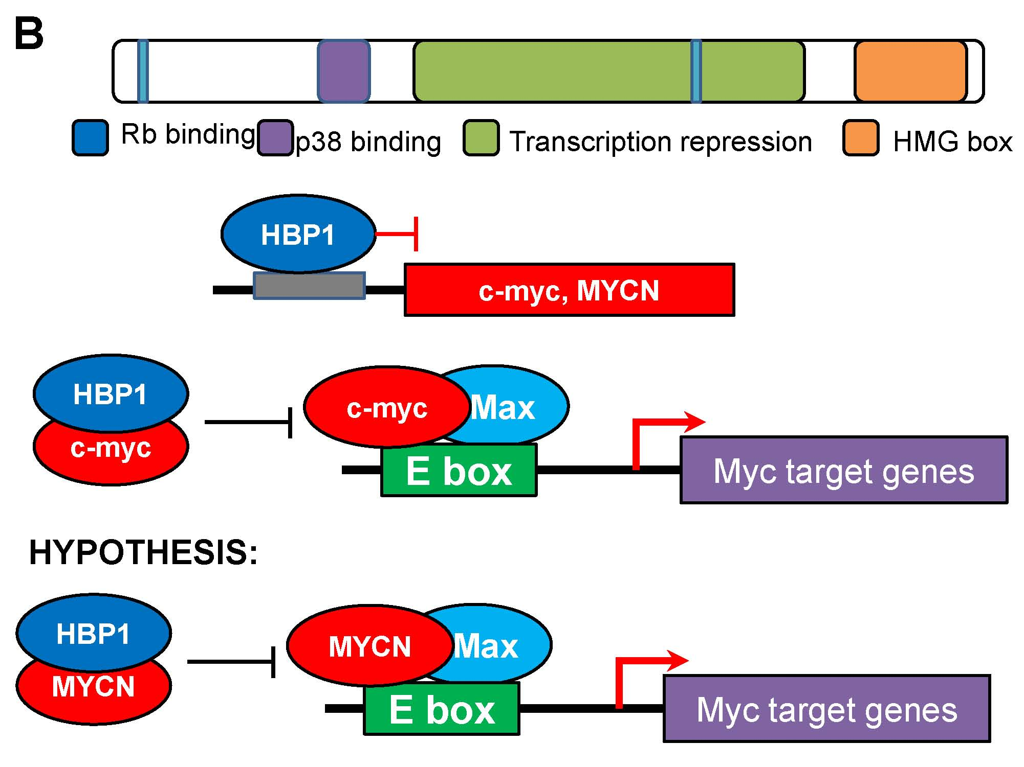
HBP1 inhibits Myc family gene expression and c-myc TF activity
¹Tevosian et al., 1997 ²Escamilla-Powers et al., 2010

Slide 14

I hypothesize that HBP1 can also bind MYCN and inhibit MYCN TF activity
HBP1 binding

Slide 15
HYPOTHESIS
HBP1 promotes terminal differentiation of SNs and NB cells by inhibiting MYCN TF activity

Slide 16
Specific aims
SPECIFIC AIM 1 – To test the hypothesis that HBP1 promotes terminal differentiation of NB cells in culture and in zebrafish
SPECIFIC AIM 2 – To test the hypothesis that HBP1 binds MYCN protein and inhibits MYCN TF activity

Slide 17
Contribution of this study
What is known
What I am adding
HBP1 promotes differentiation of many cell types
HBP1 transcriptionally represses c-myc and MYCN
HBP1 inhibits c-myc TF activity at protein level
HBP1 is upregulated in regressing NB
Loss of MYCN promotes NB differentiation and apoptosis
HBP1 promotes SN differentiation
HBP1 promotes NB regression
HBP1 inhibits MYCN TF activity at protein level
Expression of an endogenous factor can stimulate NB regression
Support for NB regression as reflection of normal development
Suggests a possible mechanism for NB regression

Slide 18
Significance and Innovation
Establishing a possible mechanism of SN differentiation and NB regression
Studying an endogenous regulator of NB regression
Exploit unique natural history and biology of NB
Natural mechanisms of regression could be used to manipulate high-risk NB
Potentially useful in other embryonic tumors
Clinical applicability of endogenous MYCN inhibitor
Drug that induces HBP1 expression or stabilizes HBP1 could reduce MYCN/c-myc oncogenic activity
Potentially useful in high-risk NB, incl. MYCN amplified
Notes:
HBP1 induction is a possible therapeutic mechanism for treating high-risk NB

Slide 19
EXPERIMENTAL DESIGN

Slide 20
Experimental Design
AIM 1 – Does HBP1 promotes terminal differentiation of NB cells in culture and in zebrafish?
1A: NB cell culture
1B: Zebrafish – normal SNs and NB cells
AIM 2 –Does HBP1 bind MYCN protein and inhibit MYCN TF activity?
2A: HBP1-MYCN binding
2B: Inhibiting MYCN TF activity

Slide 21
AIM 1
Does HBP1 promotes terminal differentiation of NB cells in culture and in zebrafish?
1A: Does HBP1 promote terminal differentiation in NB cell lines?
1B: Does HBP1 overexpression promote differentiation of SNs and promote NB regression in zebrafish?

Slide 22
Aim 1A: Does HBP1 promote terminal differentiation in NB cell lines?
Experiment 1A.1: Is HBP1 overexpression sufficient to induce differentiation of NB cell lines?
Experiment 1A.2: How does HBP1 overexpression/knockdown affect NB sensitivity to differentiation by RA and TPA?
Sample | Transfection | Experiments
HBP1 overexpression | pEF-BOS-HBP1 plasmid | 1A.1, 1A.2
Overexpression (-) ctrl | pEF-BOS empty plasmid | 1A.1, 1A.2
HBP1 knockdown | shRNA | 1A.2
Knockdown (-) ctrl | Scramble shRNA | 1A.2

Slide 23
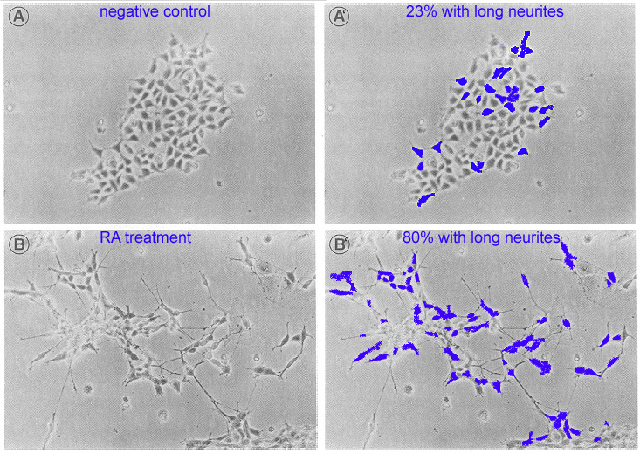
Experiment 1A.1: Is HBP1 overexp sufficient to induce differentiation of NB cell lines?
Cell lines: SH-SY5Y, SK-N-AS, LA-N-5, LA-N-1
Transfect w pEF-BOS-HBP1 or pEF-BOS ctrl
Every day for 8 days, examine 5 random 100x fields by light microscopy: determine % cells with neurites
Alternative: ICC for neuronal differentiation markers: NSE, NPY, GAP43
Adapted from Haussler et al., 1983
Expected results: HBP1 overexp will induce neurite extension (marker of differentiation) within 8 days of transfection.

Slide 24
Experiment 1A.2: How does HBP1 overexpression/knockdown affect NB sensitivity to differentiation by RA and TPA?
Same cell lines as 1A.1
Same HBP1 overexp method
HBP1 KD: shRNA transfection
24h after transfection, treat cells with RA, TPA, or EtOH (-)
Every day for 8 days, examine 5 random 100x fields by light microscopy: determine % cells with neurites longer than cell body
Drug | Carrier | Dosages | References
13-cis-retinoic acid (RA) | ethanol | 0.1, 1, 10 µM | 12, 60, 61
12-O-tetradecanoyl phorbol-13-acetate (TPA) | ethanol | 0.3, 3, 30 nM | 26
Ethanol (neg ctrl) | N/A | N/A | N/A

Slide 25
1A.2: Expected results*
Increased [drug] -> increased diff
Negative control
Max %
SN Diff.
0
0
0.1
0.3
1
3
10
30
RA Dose (μM)
TPA Dose (nM)
*Simulated data

Slide 26
1A.2: Expected results*
HBP1 knockdown
Increased [drug] -> increased diff
HBP1 knockdown decreases diff
HBP1 overexp increases diff
Negative control
HBP1 overexpression
Max %
SN Diff.
1
3
RA Dose (μM)
TPA Dose (nM)
*Simulated data

Slide 27
1A.2: Expected results*
HBP1 knockdown
Increased [drug] -> increased diff
HBP1 KD decreases diff
HBP1 overexp increases diff
HBP1 KD increases [drug] required for diff, HBP1 decreases [drug]
Negative control
HBP1 overexpression
Max %
SN Diff.
0
0
0.1
0.3
1
3
10
30
RA Dose (μM)
TPA Dose (nM)
*Simulated data

Slide 28
1A.2: Expected results*
HBP1 knockdown
Increased [drug] -> increased diff
HBP1 KD decreases diff
HBP1 overexp increases diff
HBP1 KD increases [drug] required for diff, HBP1 decreases [drug]
HBP1 overexp -> diff without drug
HBP1 overexp is cooperative with drug in promoting diff
Negative control
HBP1 overexpression
Max %
SN Diff.
0
0
0.1
0.3
1
3
10
30
RA Dose (μM)
TPA Dose (nM)
*Simulated data

Slide 29
1A.2: Expected results*
HBP1 knockdown
Increased [drug] -> increased diff
HBP1 KD decreases diff
HBP1 overexp increases diff
HBP1 KD increases [drug] required for diff, HBP1 decreases [drug]
HBP1 overexp -> diff without drug
HBP1 overexp is cooperative with drug in promoting diff
Negative control
HBP1 overexpression
Max %
SN Diff.
0
0
0.1
0.3
1
3
10
30
RA Dose (μM)
TPA Dose (nM)
*Simulated data

Slide 30
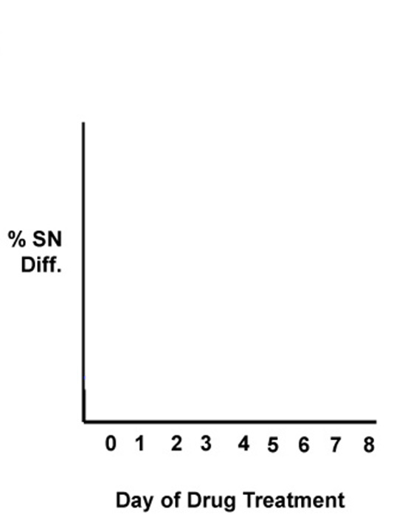
1A.2: Expected results*
RA, (-) ctrl
(-) ctrl, (-) ctrl
*Simulated data

Slide 31
1A.2: Expected results*
RA, (-) ctrl
RA, HBP1 kd
(-) ctrl, (-) ctrl
(-) ctrl, HBP1 kd
*Simulated data

Slide 32
1A.2: Expected results*
RA, HBP1 overexp
RA, (-) ctrl
RA, HBP1 kd
(-) ctrl, HBP1 overexp
(-) ctrl, (-) ctrl
(-) ctrl, HBP1 kd
*Simulated data

Slide 33
Aim 1B: Does HBP1 overexpression promote differentiation of SNs and promote NB regression in zebrafish?
Experiment 1B.1: How is SN population size and differentiation rate affected by HBP1 overexpression?
Tg fish, fluorescent SNs, +/- inducible HBP1 overexp
Follow SN population size over time by FM
IF microscopy for markers of neuronal differentiation on fixed sections
Experiment 1B.2: Does HBP1 overexpression induce NB regression in zebrafish?
Breed NB model fish w HBP1 inducible fish
Let them get NB, then induce HBP1 overexp – does HBP1 overexpression induce tumor regression?

Slide 34


Aim 1B prep
Goal: make a zebrafish that inducibly expresses HBP1 in SNs
Dβh:mCherry
Dβh:TetON:HBP1;mCherry
+ dox/dex

Slide 35
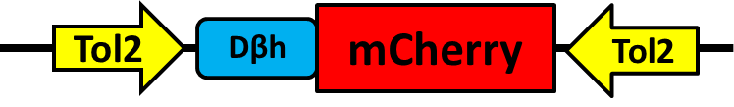
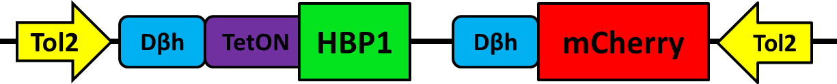
Prep step 1B.a: engineer Tol2 plasmids

Slide 36
Prep step 1B.a: engineer Tol2 plasmids
Tol2 – transposon system for high efficiency zebrafish Tg engineering

Slide 37
Prep step 1B.a: engineer Tol2 plasmids
Dβh – dopamine β-hydroxylase promoter
SN-specific promoter

Slide 38
Prep step 1B.a: engineer Tol2 plasmids
TetON – inducible promoter
Turned on by doxycycline/dexamethasone (dox/dex)

Slide 39
Prep step 1B.a: engineer Tol2 plasmids
mCherry – fluorescent marker to trace SNs

Slide 40
Prep step 1B.b: Establish transgenic fish
Dβh:TetON:HBP1;mCherry
+
Tol2 transposase
Dβh:mCherry
+
Tol2 transposase
Inject 200-300 WT embryos with each plasmid

Slide 41

Prep step 1B.b: Establish transgenic fish
Dβh:TetON:HBP1;mCherry
+
Tol2 transposase
Dβh:mCherry
+
Tol2 transposase
3 wks: screen for transgene integration

Slide 42
Prep step 1B.b: Establish transgenic fish
Dβh:TetON:HBP1;mCherry
+
Tol2 transposase
Dβh:mCherry
+
Tol2 transposase
x
x
3 months: breed fish

Slide 43

Prep step 1B.b: Establish transgenic fish
Dβh:TetON:HBP1;mCherry
+
Tol2 transposase
Dβh:mCherry
+
Tol2 transposase
x
x
3 months: breed fish
Screen F1 progeny for stable transgene integration

Slide 44
Prep step 1B.b: Establish transgenic fish
Dβh:mCherry
Dβh:TetON:HBP1;mCherry
+ dox/dex
Alternatives: Zebrafish HBP1 instead of human HBP1
TH promoter instead of Dβh

Slide 45

Experiment 1B.1: How is SN population size and differentiation rate affected by HBP1 overexpression?
100 Tg(Dβh:mCherry)
100 Tg(Dβh:TetON:HBP1;mCherry)
3
6
9
12
15
18
21
24
27
*
Day 0
Harvest embryos,
Raise in dex/dox
Day 30
Measure SN population size – whole body imaging
Sac 10 fish, IF for markers of neuronal differentiation (NSE, NPY, GAP43)
Expected results: HBP1 will decrease the SN population size and increase the rate of neuronal differentiation

Slide 46




Experiment 1B.2: Does HBP1 overexpression induce NB regression in zebrafish?
Cross Tg(Dβh:TetON:HBP1;mCherry) with Tg(Dβh:EGFP-MYCN) NB model fish²⁴
Raise fish without dox/dex for 20 weeks, screen for NB
- dox/dex
+ dox/dex
Image each fish 1/week for 20 weeks to monitor NB size
Expected results: NB tumor burden of HBP1-positive fish treated with dox/dex will decrease over time.

Slide 47
AIM 2
Does HBP1 bind MYCN protein and inhibit MYCN TF activity?
2A: Does HBP1 interact with MYCN protein?
2B: Does HBP1 inhibit MYCN-induced transcription?

Slide 48
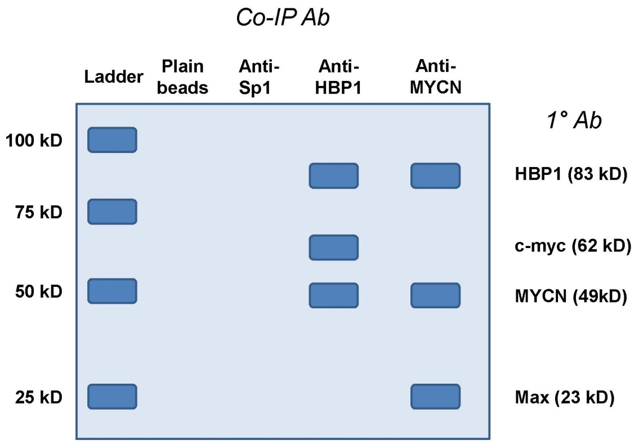
Aim 2A: Does HBP1 interact with MYCN protein?
Experiment: Co-IP with SH-SY5Y NB cell lysate
*Simulated data

Slide 49
Aim 2B: Does HBP1 inhibit MYCN-induced transcription?
Experiment 2B.1: Does HBP1 inhibit MYCN binding to DNA?
Experiment 2B.2: Does HBP1 affect mRNA levels of MYCN target genes?

Slide 50
Experiment 2B.1: Does HBP1 inhibit MYCN binding to DNA?
Evaluate MYCN binding to target gene promoters in HBP1 overexp, KD, ctrl LA-N-5 cells
ChIP w anti-MYCN antibody
qPCR for target gene promoters
p53, MDM2, MCM7, MRP1, BMI1
ALTERNATIVE: ChIP-seq, if results are negative or inconclusive for this gene set. ChIP-seq will give data for all MYCN target genes – more comprehensive view of MYCN TF activity.
Expected results: HBP1 overexpression will reduce MYCN binding to target gene promoters, and HBP1 KD will increase MYCN binding to target gene promoters.

Slide 51
Experiment 2B.2: Does HBP1 affect mRNA levels of MYCN target genes?
Expected Results*
Evaluate mRNA levels of MYCN target genes by qRT-PCR
HBP1 overexp, KD, and ctrl LA-N-5 cells
MYCN target genes: p53, MDM2, MCM7, MRP1, BMI1
MYCN target [RNA]
HBP1
KD
(-)
HBP1
overexp
ALTERNATIVE: expression microarray – more comprehensive view of MYCN TF activity.
*Simulated data

Slide 52
Summary
Some forms of NB spontaneously regress – mechanism unknown
Forms that don’t regress are difficult to treat – possible to induce regression?
HBP1 is selectively expressed in regressing NB
HBP1 acts in part through Myc TFs
HYPOTHESIS: HBP1 promotes terminal differentiation of SNs and NB cells by inhibiting MYCN TF activity
AIM 1: HBP1 promotes SN differentiation and NB regression
1A: cell culture 1B: zebrafish
AIM 2: HBP1 inhibits MYCN TF activity
2A: HBP1-MYCN binding 2B: MYCN target gene expression
SIGNIFICANCE: Establish mechanism of NB regression,
clinical application of HBP1 induction

Slide 53
Acknowledgments
PRELIM COMMITTEE
Sue Cohn
Mark Lingen
Kay Macleod
CCB STUDENTS
Ayelet Sivan
Alan Chang
Keston Aquino-Michaels
Daniel Rabe
Robin Zhang
PROFESSORS
Vicky Prince
Matthew Brady
Rich Jones
JONES LAB GROUP
Thank you!

