Slide 1
The role of Blimp1 in radiogenic breast cancer
Amy Gill
Thesis Proposal
Committee on Cancer Biology
November 7, 2013
Notes:
Our lab is particularly interested in Blimp1, a factor we’ve shown is an important modulator of radiogenic cancer risk.
My project involves following up on this story and determining how Blimp1 modulates radiogenic cancer risk

Slide 2
Radiogenic cancer is a complication of radiation therapy (RT)
10% of children treated with RT developed a second malignant neoplasm (SMN) within 30 years
Hodgkin’s lymphoma (HL) survivors have the highest risk of radiogenic cancers
18% of men, 26% of women (30 years post-treatment)
Radiogenic breast cancer is particularly common
20% of female HL survivors (30 years post-treatment)
40% risk in female HL survivors who received > 40 Gy IR
Worse prognosis than sporadic breast cancer
What modulates radiogenic cancer risk?

Slide 3
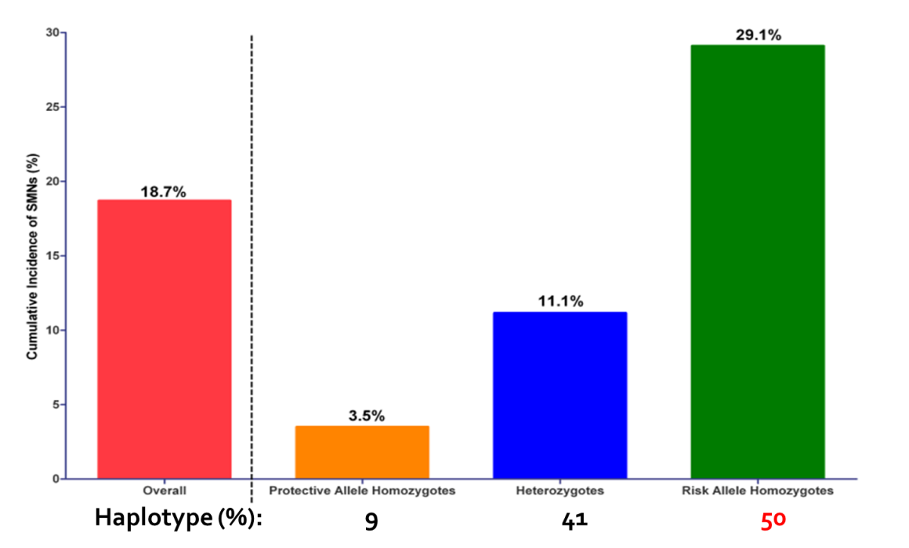
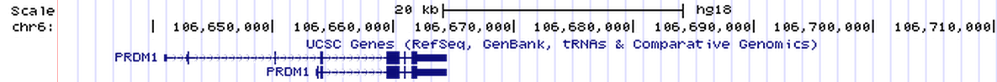
Genetic variants in the PRDM1 locus are associated with radiogenic cancer risk
GWAS: survivors of pediatric HL treated with thoracic radiation
Cases: SMN in the field of radiation (n=158)
Controls: did not develop a SMN (n=153)
Two SNPs near PRDM1 are strongly associated with SMNs
rs4946728 (allelic OR = 3.32)
rs1040411 (allelic OR = 2.39)
Best et al 2011
rs4946728
rs1040411
Notes:
Genotype specific penetrance of radiogenic cancer
Risk haplotype is extremely common, and the cancer phenotype is highly penetrant, but only in the context of radiation exposure

Slide 4
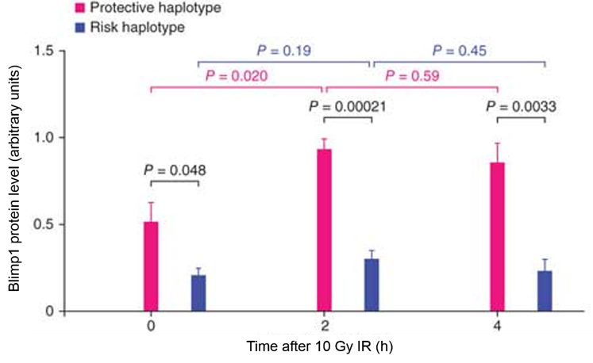
Risk haplotype is associated impaired induction of Blimp1 by IR in LCLs
Adapted from Best et al 2011
Suggests Blimp1 activation protects against radiogenic cancer
How does Blimp1 modulate radiogenic cancer risk?
Notes:
Orient to the data – pink is protective, blue is risk
Basal blimp1 expression levels are higher in the protective haplotype
Rapid and prolonged induction of Blimp1 in protective haplotype but not risk haplotype

Slide 5
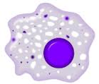
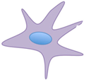
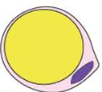
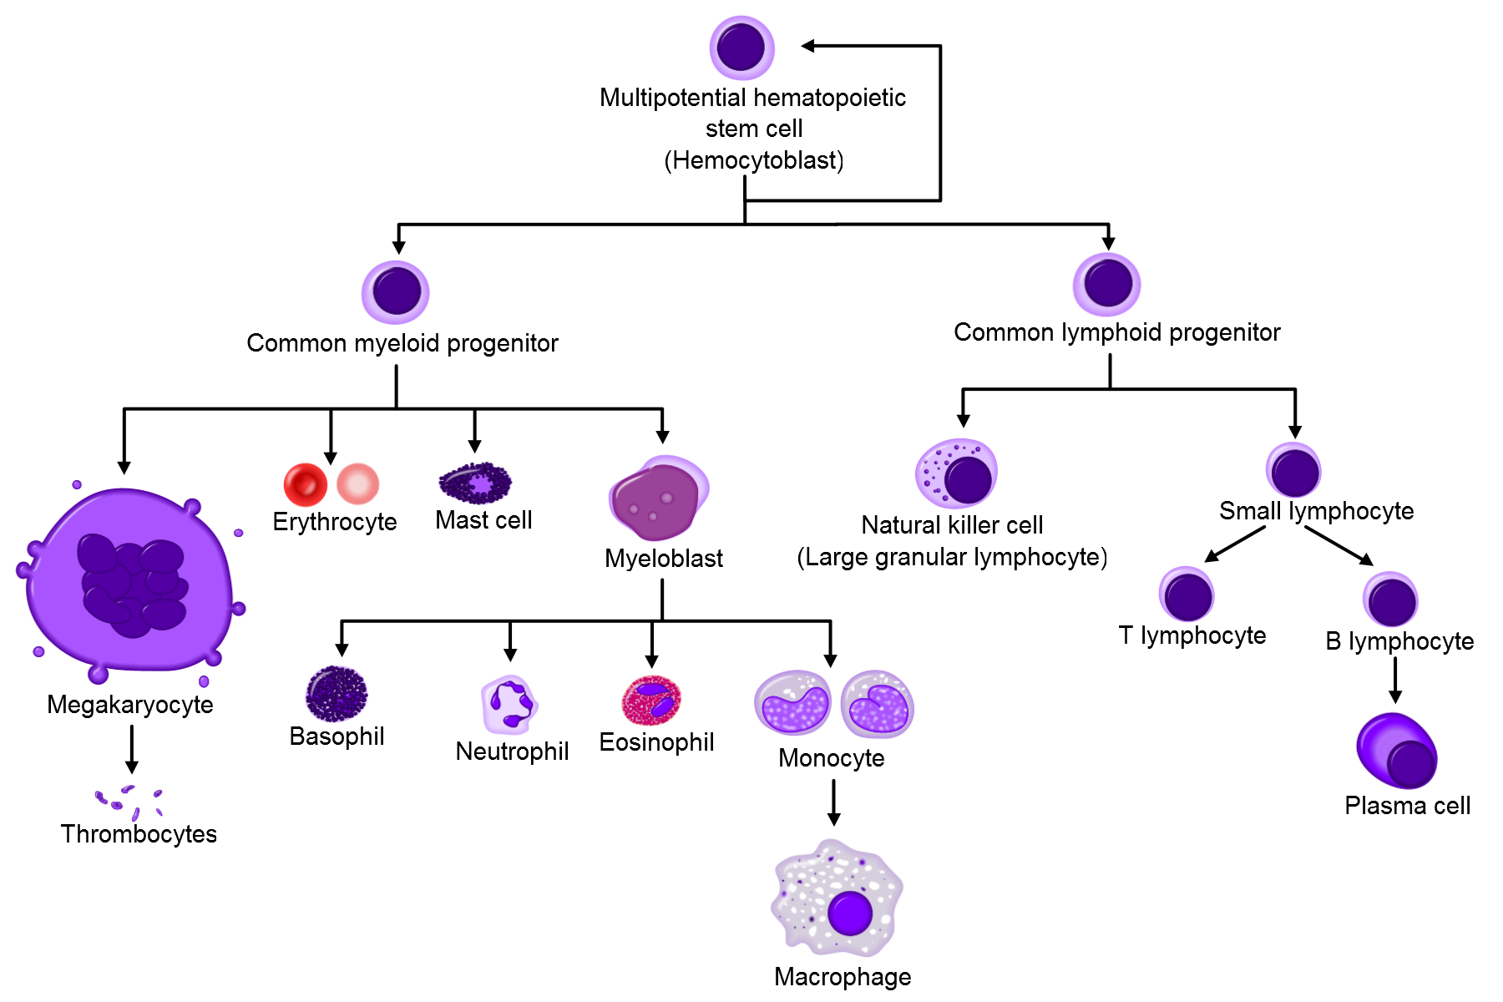
IR affects breast epithelial cells and their microenvironment
IR
breast epithelial cell
monocyte
macrophage
fibroblast
adipocyte
T cell
Notes:
The purpose of my project is to understand the role of Blimp1 in radiation carcinogenesis, but radiation carcinogenesis is a complex thing
In order to understand how something can modulate radiogenic cancer risk, we need to understand how radiation causes cancer
Radiation affects the entire tissue – in this case, the breast microenvironment. we have to consider effects on both the epithelium and the microenvironment

Slide 6
Hypothesis
IR-mediated Blimp1 activation protects against breast tumorigenesis by modulating stress response pathways in breast cells and/or immune cells.

Slide 7
Blimp1 is a transcriptional repressor with key roles in stress response processes
Blimp1
?
c-Myc
IL-2
Fos
IL-6
TNFα
PI3K
IFN-β
IFN-γ
cytokines
Proliferation and survival
Notes:
Blimp1 is involved in a wide variety of processes, but the most relevant for our project are its roles in stress response

Slide 8
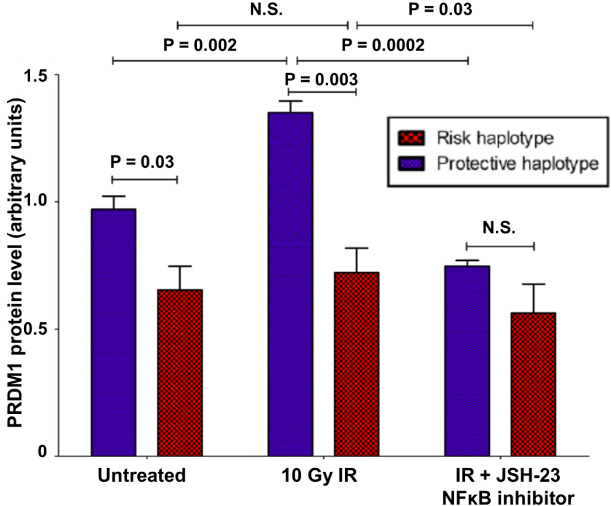
Several stresses induce Blimp1 expression by activating NFκB
Bacterial antigens
ER stress
Viral infection
Cytokines
IR?
NFκB
NFκB inhibition blocks IR-mediated activation of Blimp1 in LCLs
Blimp1
Adapted from Best et al 2011
Notes:
Blimp1 activation in stress response is typically nfkb dependent
Blue is protective
Red is risk
As before, in the protective haplotype IR induces Blimp1
However, nfkb inhibition abrogates Blimp1 induction
This is also interesting because nfkb is typically thought of as tumorigenic, but this suggests a role for it in inducing a tumor suppressor

Slide 9
Blimp1 could protect against IR-induced epithelial cell transformation
IR
DNA damage
mutation
transformation
Cell cycle arrest
Apoptosis
Blimp1
Stressors induce Blimp1 expression in epithelial cells
ER stress activates Blimp1 in HeLa cells¹
5-FU activates Blimp1 in colon cancer cells, leading to cell cycle arrest²
RelB NFκB activates Blimp1 in breast cancer cells³
¹Doody et al 2006 ²Yan et al 2007 ³Wang et al 2009

Slide 10

IR can promote transformation by causing acute and chronic inflammation
IR
cytokines
Macrophage infiltration and activation
T cell response
Notes:
Alternatively, blimp1 could act through the microenvironment
The main effect of IR on the microenv is induction of acute and chronic inflammation
Inflammation promotes cancer, largely because activated inflammatory cells secrete cytokines and growth factors that promote survival and proliferation of transformed cells, and potentially also because they induce oxidative stress that increases mutation risk

Slide 11
Blimp1 is a negative feedback regulator that terminates inflammation
inflammation
NFκB
Blimp1
reduced
cytokines
reduced
activated immune cell number
Notes:
This is interesting because blimp1 is a known regulator of inflammation
Blimp1 is important for terminating immune responses
promotes activation-induced cell death of a variety of cell types including t cells
Reduces proliferation of immune cells
Reduces cytokine secretion, which reduces recruitment of new inflammatory cells and also removes growth and survival factors for the immune cells present
Loss of blimp1 in hematopoietic cells, particularly t cells, causes a lethal autoimmune disease
Blimp1 modulation of inflammation might be important for the function of the haplotype – haplotype is also associated with protection against autoimmune diseases
In these ways, blimp1 reduces inflammation
Of potential interest, this also leads to nfkb repression, so it’s a full feedback loop

Slide 12
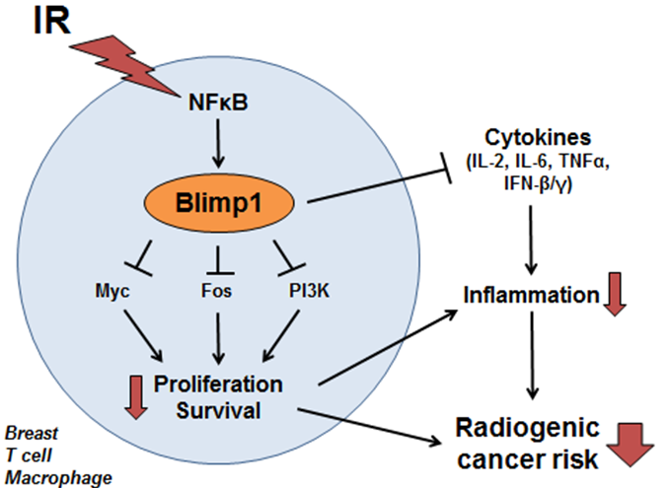
Working hypothesis

Slide 13
Specific aims
Aim 1: To determine whether IR activates Blimp1 in breast and/or immune cells in an NFκB-dependent manner.
Aim 2: To determine the cellular and molecular consequences of IR-mediated Blimp1 activation.
Aim 3: To determine whether Blimp1 protects against radiogenic cancers in vivo in mice.

Slide 14
Aim 1: To determine whether IR activates Blimp1 in breast and/or immune cells in an NFκB-dependent manner
1a: Determine whether IR activates Blimp1 in breast epithelial cells, T cells, and monocytes
1b: Determine whether NFκB mediates Blimp1 induction by IR

Slide 15

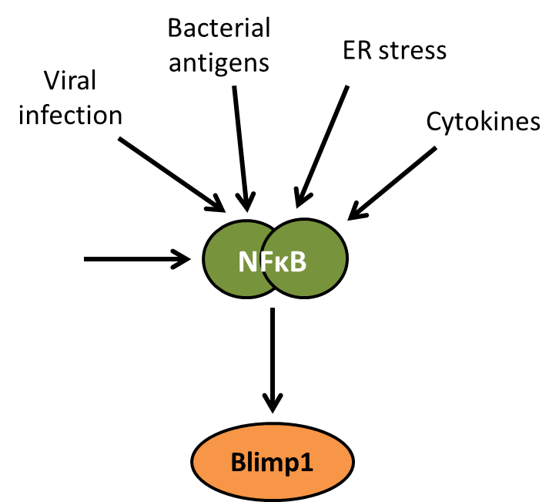
Aim 1 rationale
Blimp1 is a stress response factor in both breast epithelial cells and immune cells
Blimp1
IR?
NFκB inhibition blocks IR-mediated activation of Blimp1 in LCLs
Best et al 2011

Slide 16
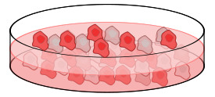
Aim 1a: Does IR activate Blimp1 in breast epithelial cells, T cells, and/or monocytes?
1a(i): Time course of Blimp1 induction
5 Gy IR
sham
Western for Blimp1 protein
Cell lysate
Time course (0-72h)
Homozygous protective cell lines
RNA
RT-PCR for Blimp1 RNA
Breast: HCC1599, HCC1806
T cell: MOLT16
Monocytes: AML-193
Goals: Determine cell types that activate Blimp1 after IR
Find time point of maximal Blimp1 activation after IR

Slide 17
Aim 1a: Does IR activate Blimp1 in breast epithelial cells, T cells, and/or monocytes?
1a(ii): Dose response curve of Blimp1 induction
Range of IR
10 cGy – 10 Gy
sham
Western for Blimp1 protein
Cell lysate
Collect at time point determined in aim 1a(ii)
Homozygous protective cell lines
RNA
RT-PCR for Blimp1α/β
Breast: HCC1599, HCC1806
T cell: MOLT16
Monocytes: AML-193
Goal: Determine IR dose that maximally activates Blimp1

Slide 18
Aim 1a: Expected results
IR activates Blimp1 in one or more cell types
If multiple cell types activate Blimp1, we will prioritize the cell type with the largest IR-induced change in Blimp1
Follow-up will also be guided by animal data
Identify time point of maximal Blimp1 activation after IR
Identify optimal IR dose that maximally activates Blimp1

Slide 19
Aim 1a: Pitfalls and alternatives
If Blimp1 is not induced by IR in these cell lines:
Test other cell lines of each tissue with the protective or heterozygous haplotype
Test for IR-mediated Blimp1 activation in other cell types with known roles for Blimp1 (B, NK, granulocytes)
Test Blimp1 induction in primary cells
In parallel: examine Blimp1 expression in vivo using Blimp1-YFP reporter mice

Slide 20
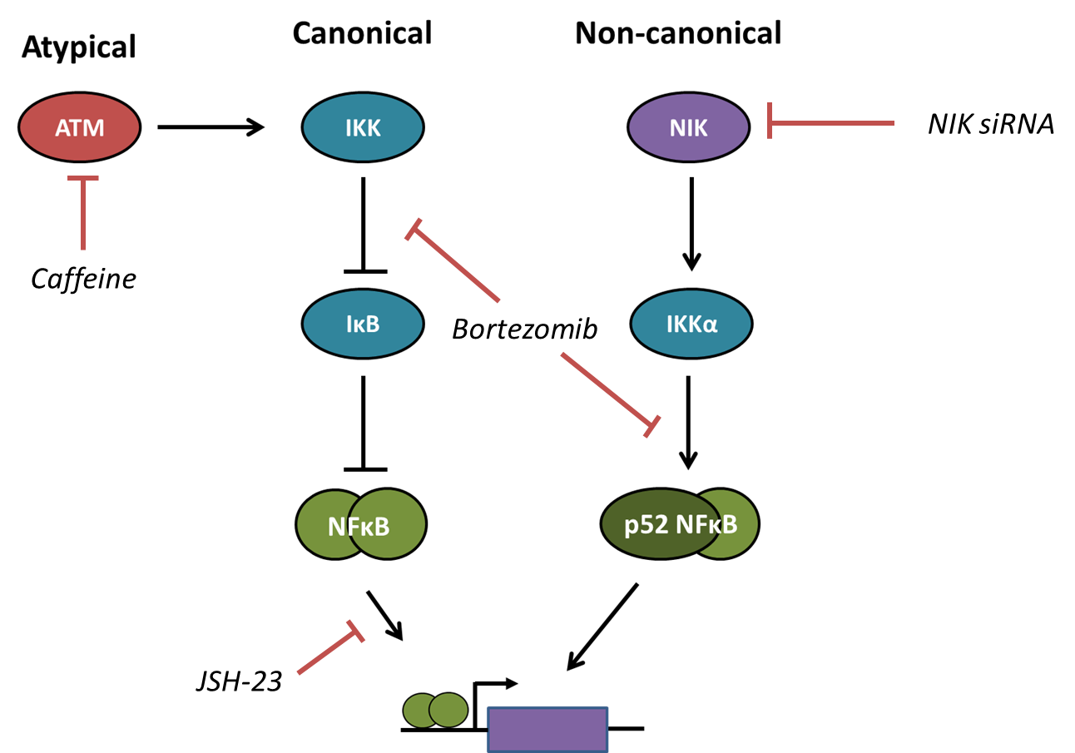
Aim 1b(i): Does NFκB inhibition block IR-induced Blimp1 activation?
EXPECTED RESULTS
Conditions that inhibit Blimp1 activation | IR activates Blimp1 through…
Bortezomib | Any NFκB pathway
Caffeine and JSH-23 | Atypical pathway
JSH-23 but not caffeine | Canonical pathway
NIK siRNA | Non-canonical pathway
Blimp1
Blimp1 RNA
Blimp1 protein

Slide 21
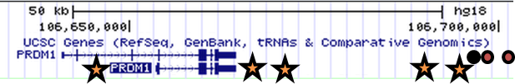
Aim 1b(ii): Does NFκB bind the PRDM1 locus in response to IR?
Treat cells with IR or sham, p65 ChIP, RT-PCR
RT-PCR candidate NFκB binding sites
If NFκB binds a site in IR treated but not sham treated cells, we will conclude that NFκB binds this site in response to IR
If NFκB binds a site both before and after IR, we will conclude that NFκB binds this site in an IR-independent manner
NFκB site
Index SNPs
Candidate functional SNP

Slide 22
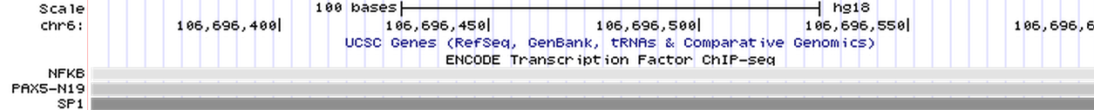
Aim 1b(ii): Future directions
If NFκB binds this site after IR:
Test whether the risk haplotype impairs NFκB binding after IR
Test whether SP1 binds the putative functional SNP in the risk haplotype (but not protective)
Determine whether SP1 binding occludes NFκB binding in response to IR

Slide 23
Aim 1b: Pitfalls and alternatives
NFκB may not mediate IR-driven Blimp1 activation
Can test other pathways known to induce Blimp1 (p38, MAPK, STAT, JNK)
Can take an unbiased approach by performing a drug screen
Multiple NFκB pathways may regulate Blimp1
Can attempt to further characterize the upstream factors activated by IR that induce NFκB
NFκB dimers that do not include p65 may bind and regulate PRDM1
Can repeat with IP against p52, other subunits
NFκB may bind sites other than the 5 tested
Can identify and test ENCODE NFκB sites with imperfect consensus sequences

Slide 24
Aim 1 summary
Identify whether IR activates Blimp1 in breast epithelium, T cells, and/or monocytes
Identify the time of maximal Blimp1 induction after IR
Identify the IR dose that maximally activates Blimp1
Demonstrate that NFκB activates Blimp1 in response to IR
Determine which NFκB pathways activate Blimp1 after IR
Determine where NFκB binds the Blimp1 locus in response to IR

Slide 25
Aim 2: Determine the cellular and molecular consequences of IR-mediated Blimp1 activation
2a: Establish Blimp1 knockdown and overexpression systems
2b: Analyze the effects of IR-mediated Blimp1 expression on breast and inflammatory cell proliferation and survival by flow cytometry
2c: Analyze the effects of IR-mediated Blimp1 induction on candidate Blimp1 target genes by RT-PCR and ChIP

Slide 26
Aim 2 rationale
Regulation of epithelial or immune cell proliferation and survival could protect against radiogenic cancer
Blimp1 regulates proliferation and survival in several cell types
Blimp1 represses a variety of target genes that modulate proliferation and survival
Blimp1
c-Myc
IL-2
Fos
IL-6
TNFα
PI3K
IFN-β
IFN-γ
cytokines
Proliferation Survival

Slide 27
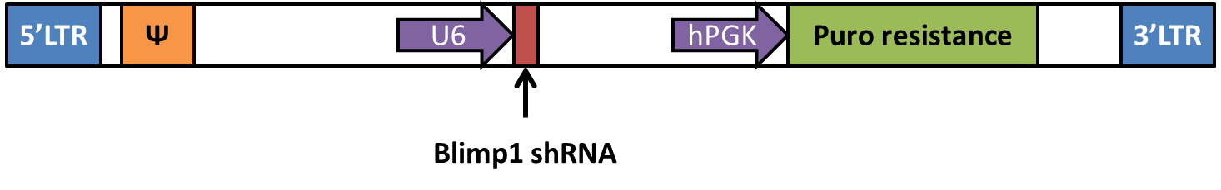
Aim 2a: Establish Blimp1 knockdown and overexpression systems
I have cloned 5 lentiviral Blimp1 shRNA vectors and generated virus
Alternative: commercially available shRNAs

Slide 28
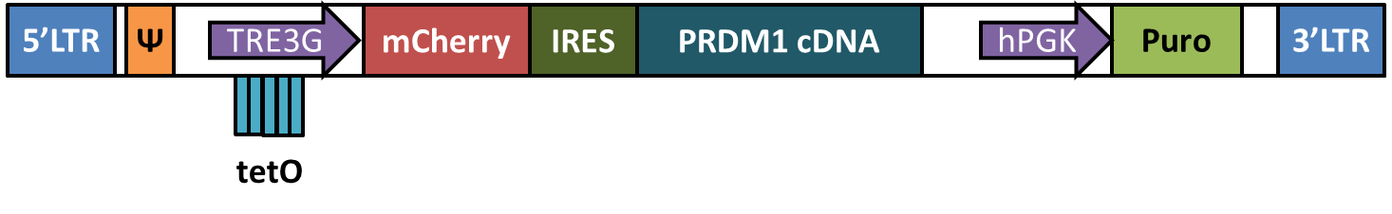
Aim 2a: Establish Blimp1 knockdown and overexpression systems
Currently cloning lentiviral Tet-inducible Blimp1 overexpression vectors
Can control kinetics of Blimp1 overexpression

Slide 29
Aim 2b: Does IR-mediated Blimp1 induction reduce proliferation and promote apoptosis?
IR or sham treat Blimp1 wild-type, kd, o/e cells
Analyze survival and proliferation by flow cytometry
Cell cycle analysis by PI staining
DNA synthesis by BrdU incorporation
Apoptosis by annexin V

Slide 30
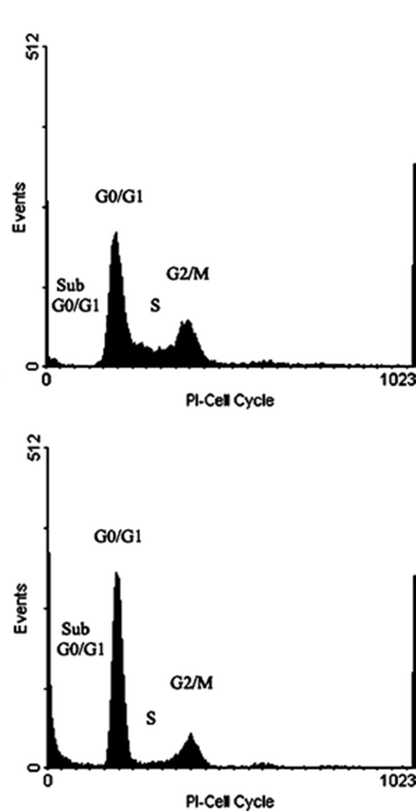
Aim 2b: Expected results
+ IR
Blimp1 kd
If S phase fraction and BrdU incorporation:
Blimp1 o/e < Blimp1 wild-type < Blimp1 kd
IR-mediated Blimp1 expression promotes cell cycle arrest and reduces proliferation
If sub-G1 fraction and annexin V staining:
Blimp1 o/e > Blimp1 wild-type > Blimp1 kd
IR-mediated Blimp1 expression reduces cell survival by promoting apoptosis
Blimp1 wt or o/e
Sample results from Li et al 2009

Slide 31
Aim 2b: Pitfalls and alternatives
Time course may be required to determine optimal points to measure proliferation and survival

Slide 32
Aim 2c: Does IR-activated Blimp1 repress candidate target genes?
Treat wild-type, kd, o/e cells with IR or sham
RT-PCR for primary transcripts
If Blimp1 reduces primary transcript levels, ChIP for Blimp1 at target locus
Blimp1
c-Myc
IL-2
Fos
IL-6
PI3K
TNFα
IFN-β
Y
Proliferation and survival factors
Blimp1
IFN-γ
cytokines

Slide 33
Aim 2c: Expected results
Blimp1 represses one or more candidate genes
IR decreases primary transcript levels in wild-type but not Blimp1 kd cells
IR induces Blimp1 binding to target gene locus
Additional evidence to strengthen this conclusion
Further repression of primary transcript levels in Blimp1 o/e cells
Decreased Blimp1 binding to target site in kd and increased Blimp1 binding in o/e
If a target is repressed by Blimp1, we will knock down that target and determine its effects on radiation response

Slide 34
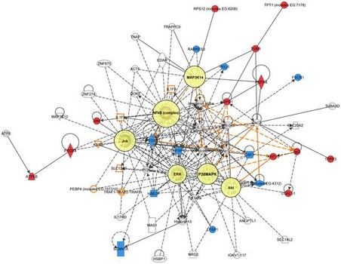
Aim 2c: Pitfalls and alternatives
These candidate genes may not be the effectors of Blimp1 after IR
Unbiased approach: expression microarrays
Expression repressed by IR in wt but de-repressed in kd → Blimp1 target gene after IR
Follow up with ChIP, RT-PCR
In silico analysis of Blimp1 regulated networks
Our expression data
ChIP-seq data
Radiation response expression signatures
Inflammation expression signatures
Infer important Blimp1 response network components
Potential problem: haplotype (most samples will have risk haplotype)
Blimp1 wt
Blimp1 kd
Blimp1 wt sham | Blimp1 kd sham
Blimp1 wt IR | Blimp1 kd IR
sham
IR
4 groups for expression microarrays

Slide 35
Aim 2 summary
Determine whether IR-activated Blimp1 represses proliferation and/or survival
Identify Blimp1 target genes in the context of IR
This can lead to further study of Blimp1 effectors and the molecular mechanisms that lead to protection against radiogenic cancer

Slide 36
Aim 3: Determine whether Blimp1 protects against radiogenic cancers in vivo in mice
3a: Determine whether Blimp1 knockdown in the irradiated mammary gland reduces radiogenic breast cancer latency
3b: Determine whether global Blimp1 deficiency increases the risk of radiogenic cancer
Notes:
Disclaimer: we know that these experiments are largely observational, designed to determine whether blimp1 regulates radiogenic breast cancer risk but not looking at mechanism.
First step is to show that blimp1 actually is important in radiogenic cancer
Will follow up with mechanistic experiments based on aims 1 and 2

Slide 37
Aim 3 rationale
Genetic variants that affect Blimp1 expression are associated with radiogenic cancer risk
The risk allele is associated with reduced Blimp1 expression and impaired Blimp1 induction by IR
This suggests Blimp1 deficiency increases radiogenic cancer risk
However, this has never been shown directly

Slide 38
Why BALB/c?
Most radiation sensitive strain¹
Highly susceptible to radiogenic cancers²
Increased risk of cellular transformation by IR²
Currently crossing C57BL/6 Blimp1^{flox} mice onto BALB/c background
¹Storer et al 1988 ²Ullrich et al 1996

Slide 39

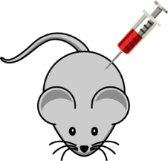

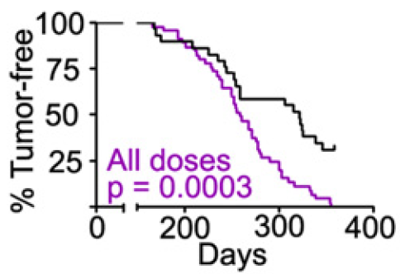
Aim 3a:
Experimental design
Dissociated mammary epithelium
8-10 week old p53^{-/-}
Does Blimp1 knockdown in mammary epithelial cells decrease radiogenic breast cancer latency?
Transduce with shRNA
(-) ctrl
(scramble)
Blimp1 shRNA
Inject into cleared mammary fat pad
(3 week old wild-type)
Irradiate at 8-10 weeks (1 Gy)
Measure breast tumor latency and incidence for 1 year
Secondary endpoints: tumor growth, histology
**In collaboration with the Barcellos-Hoff lab (NYU)
Notes:
If shrna doesn’t work, there is a dominant negative mutant of Blimp1 available that we could transduce instead

Slide 40


Aim 3a: Pitfalls and alternatives
Breast cancer cell lines from aim 2
Variable efficiency of lentiviral transduction
Include GFP marker in lentiviral construct
Sort for GFP⁺ cells to enrich for transduced cells
If Blimp1 knockdown decreases latency:
Repeat with and without IR
Determine whether Blimp1 has an effect independent of IR
Repeat with overexpressed Blimp1
Determine whether increased Blimp1 dosage is protective against radiogenic cancer
Alternative experiment: xenograft Blimp1 wild-type or knockdown breast cancer cell lines
(-) ctrl
(scramble)
Blimp1 shRNA
Xenograft into immunodeficient mice
1 Gy IR
Measure breast tumor growth and invasion

Slide 41

Aim 3a: alternative design (microenvironment)
Blimp1^{+/+}
Blimp1^{+/-}
Cleared mammary fat pad, 8-10 weeks old
Does Blimp1 deficiency in the microenvironment decrease radiogenic breast cancer latency?
Radiation chimera experiment¹ with Blimp1^{+/-} mice
Reported latency for p53^{-/-} cells in irradiated wild-type host: 9 months¹
Expected results: Blimp1^{+/-} mice develop breast cancer with a shorter latency than Blimp1^{+/+} mice
Treat with 1 Gy IR
Implant with p53^{-/-} mammary epithelium
Measure breast tumor latency and incidence for 1 year
¹Nguyen et al 2011

Slide 42
Should we prioritize the epithelium or microenvironment?
Benefit of mammary epithelium
Availability of animals – can start as soon as lentiviruses are ready
Drawback of microenvironment
Requires BALB/c Blimp1^{+/-} mice
We are generating these for aim 3b
However, they will not be ready for ~1 year
Will use cell culture data from aim 1a and Blimp1-YFP expression data to prioritize mouse experiments

Slide 43
Aim 3b: Does Blimp1 deficiency increase radiogenic cancer risk?
C57BL/6
Blimp1^{fl/fl}
BALB/c
First, need to make BALB/c Blimp1^{+/-} mice
Cross C57BL/6 Blimp1^{flox/flox} mice onto BALB/c background by speed congenics
Delete Blimp1^{flox} in germline with CMV-Cre
BALB/c
Blimp1^{+/-}
BALB/c
CMV-Cre
BALB/c
Blimp1^{fl/+}

Slide 44
Aim 3b: Does Blimp1 deficiency increase radiogenic cancer risk?
p53^{+/-}
Blimp1^{+/-}
Irradiated p53^{+/-} mice develop a wide range of tumors with a 40 week median latency
Expected results:
Blimp1^{+/-} mice will not develop tumors
p53^{+/-} mice will develop tumors with the reported latency
Blimp1^{+/-}p53^{+/-} mice will have reduced tumor latency by 2 months
Secondary endpoints
Growth rate, tissue type, histology
Blimp1^{+/-}
p53^{+/-}
Blimp1^{+/-}
p53^{+/-}
1 Gy IR
8-10 wks
Measure tumor incidence and latency for 1 year

Slide 45
Aim 3b: Pitfalls and alternatives
If Blimp1 deficiency has a clear effect on radiation carcinogenesis in p53^{+/-} mice, we will repeat with and without IR to determine whether Blimp1 affects tumorigenesis in the absence of IR
Follow-up experiments to elucidate the mechanism of Blimp1 protection against radiation carcinogenesis based on findings in aims 1 and 2

Slide 46

Alternative experiment: Does Blimp1 deficiency accelerate development of inflammation-driven skin cancers?
Carcinomas develop in wild-type mice with median latency 32 weeks¹
100% penetrance in wild-type mice by 40 weeks¹
Multiple carcinomas per mouse in wild-type
Expected results: Blimp1^{+/-} mice will develop more tumors at a shorter latency relative to wild-type
Benefits: quick to get mice, quick results
Drawback: does not test IR
C57BL/6
Blimp1^{+/+}
C57BL/6
Blimp1^{+/-}
Treat skin with DMBA
(10 nmol weekly)
Measure tumor latency, number, growth, histology
¹Reiners et al 1984

Slide 47
Aim 3 summary
Demonstrate that Blimp1 knockdown in the breast increases radiogenic breast cancer risk
Demonstrate that global Blimp1 deficiency increases the risk of all radiogenic cancers
[Alternative] Demonstrate that Blimp1 deficiency in the irradiated microenvironment increases radiogenic breast cancer risk
[Alternative] Demonstrate that Blimp1 deficiency increases the risk of reactive skin cancer

Slide 48
Summary

Slide 49
Summary – Aim 1

Slide 50
Summary – Aim 2

Slide 51
Summary – Aim 3

Slide 52
Acknowledgments
Cunningham lab
Aurelie Desgardin
Fangming Tang
Barry Sandall
Gabby Lapping-Carr
Jisu Shin
Holly Yang
Onel lab
Sapana Vora
Kate Wolak
Mark Sasaki
Eric Hungate
Imge Hulur
CCB students
Alan Chang
Robin Zhang
Keston Aquino-Michaels
Hari Singhal
Ayelet Sivan
Mentors
John Cunningham
Ken Onel
Thesis committee
Geof Greene
Kay Macleod
Other faculty
Matthew Brady

