Slide 1
Reinforcement Learning for Android Malware Detection

Slide 2
Project Supervisor :
Dr. Om Prakash Vyas
Group Members :
IIT2016053 - Surabhi Gogte
IIT2016088 - Simran Gill
IIT2016103 - Chahak Sharma

Slide 3
Problem Statement
Propose a reinforcement learning model for Android Malware detection and compare the accuracy with the previous Machine Learning and Deep Learning models.

Slide 4
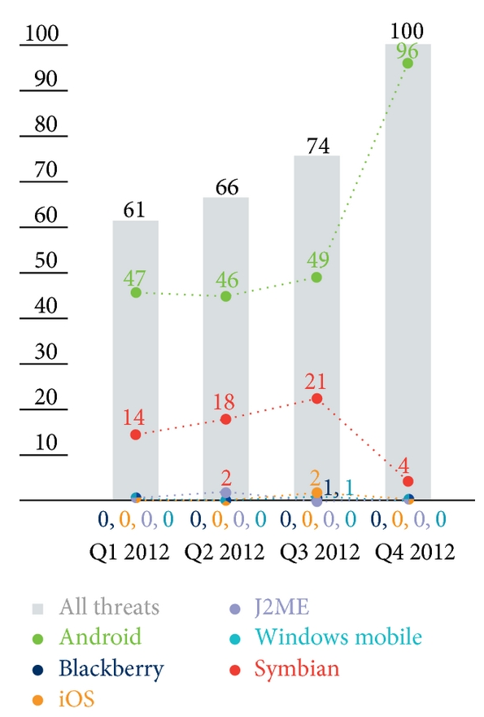
Motivation
Recent studies show that the amount of malware that targeted other mobile platforms gradually decreased , whereas Android showed a contrasting result.
The reason for the increase in Android malware was its open source policy and its leniency to market application verification .
The main motivation behind this research is to apply reinforcement learning for android malware detection and compare it with the previous works done using Deep Learning.

Slide 5
LITERATURE
REVIEW

Slide 6
Android Malware Types :
Trojan: it is a program containing a risk factor in effect . It executes malware when running the application.
Spyware: it is secretly installed on device to collect information. It repeatedly opens pop-ups and causes inconvenience by changing a device’s settings or being difficult to delete.
Root permission acquisition (exploit): it acquires root permissions to clear security settings and make additional attacks.
Installer (dropper): it conceals malware in a program and guides users to run malware and spyware.

Slide 7
Linear SVM
Traditionally behavior based analysis technique have been used for malware detection.
Behavior-based detection involves the inconvenience of having to determine malware infection status by examining numerous features.
SVM has high performance and can classify non linear data.
Of the input features, unnecessary ones are removed by the SVM machine learning classifier itself and the modeling is carried out.
For SVM True Positive Results came to be 0.999 with 99.7% accuracy and precision of 0.992 .
SVM has FPR = 0.004, which could be determined as the best classifier because its ratio of incorrectly classifying normal applications as malicious is small, and it shows far better performance than other classifiers also in terms of accuracy and precision.

Slide 8
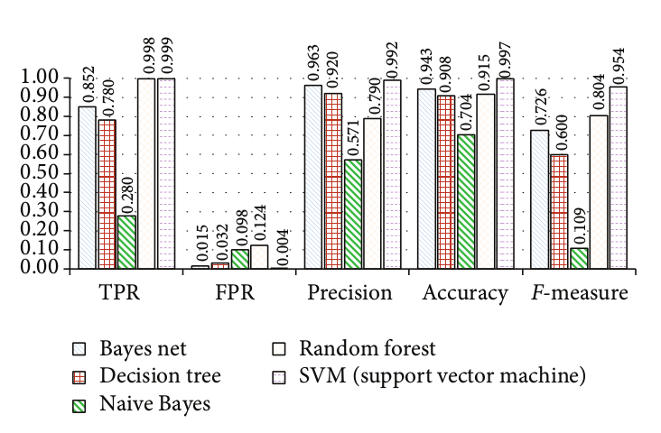
Comparison with other ML Algorithms

Slide 9
Feature Selection using Random Forest Classifier
The dataset is divided into training and testing set using n-cross validation.
Bayesian Probability of each feature is calculated.
The ranks of features is calculated based on ranking value.
A backward elimination approach is used to eliminate features in which importance of a feature is determined by variance of classification accuracy with or without the feature

Slide 10
Reinforcement Learning for Solving Classification Problems
In this paper, RL is combined with multilayer perceptrons to find Value function of each state .
x^{i} is taken as a input vector of length m and y^{i} is target class belonging to the input.We have a dataset D = {(x₁ , y₁), . . . , (x_{n} , y_{n})} of labeled examples.
There is a single reward function that is independent of the target class.
The agent with the same class as a training instance will select actions to maximize its obtained rewards, whereas an agent of another class will select actions that minimize its obtained rewards.
For testing purposes ,all values V_{i}(s₀) for all classes i and agents AC_{i} belonging to these classes.
The input vector is classified with the predicted class y_{p} belonging to the agent with the largest state value: y_{p} = arg max V_{i}(s₀).

Slide 11
PROPOSED
METHODOLOGY :
Reinforcement Learning

Slide 12
Dataset
We would be using The Drebin Dataset to train our Reinforcement Learning Model.
Dataset consisting of feature vectors of 215 attributes extracted from 15,036 applications (5,560 malware apps from Drebin project and 9,476 benign apps).
Contains 5560 malware files collected from August 2010 to October 2012.
Drebin is one of the most popular benchmark datasets for Android malware detection.

Slide 13
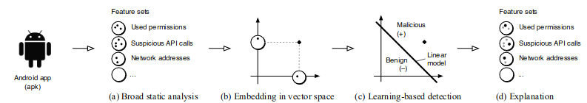
Drebin - Dataset
Gathers features from an APK files or application’s code
Embedded these into a joint vector space .
Further applied SVM for learning based detection .
For each detected application the respective patterns can be extracted, mapped to meaningful descriptions and then provided to the user as explanation for the detection.

Slide 14
Feature Selection
More the number of features, more is the chance of decreased accuracy and increased training time.
Redundant features need to be removed and we need to select top features for classification.
We used 2 methods for feature selection-
Random Forest Classifier (Accuracy - 87.5%)
Extremely Randomised Tree Classifier(Extra Trees Classifiers). (Accuracy - 91.25%)
In both,importance of each feature is calculated and the top ranked features are selected.

Slide 15
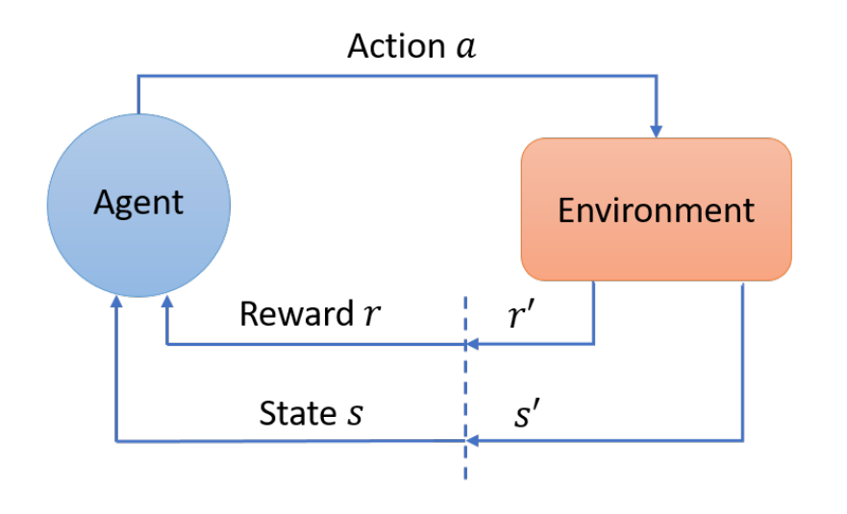
Reinforcement Learning Preliminary
Concept of state,action, and reward.
It is a trial and error approach .
Agent takes action at each time step that causes two changes :
current state of the environment is changed to a new state,
agent receives a reward or penalty from the environment.
Given a state, the reward is a function that can tell the agent how good or bad an action is.
Based on received rewards, the agent learns to take more good actions and gradually filter out bad actions.
Fig. Iterative process of agent-environment interactions.

Slide 16
Markov Decision Processes (MDP’s)
Formally RL can be described as Markov Decision Processes (MDP’s) which consists of: ( S, A, T, R, Ɣ )
set of states S .
set of actions A,
transition dynamics T(s_{t+1}|s_{t},a_{t}) : that map a state-action pair at time t onto a distribution of states at time t+1.
an instantaneous reward function R(s_{t}, a_{t}, s_{t+1}).
a discount factor Ɣ between 0 and 1 : this quantifies the difference in importance between immediate rewards and future rewards.
Memorylessness : Once the current state is known, the history of the prev states can be erased because the current Markov state contains all useful information from the history.
Notes:
1- Behavior-based detection [16–20] is a method of detecting invasion status by comparatively analyzing predetermined attack patterns and process behavior that occur in a system.
sequential decision-making MDP

Slide 17
MDP Formulation
( S, A, T, R, Ɣ )
S : each state is a tuple of possible combination of feature values.
A : actions defined are either benign or malicious.
T : next state is defined as the next tuple in the dataset.
R : if predicted true reward of +1 else a penalty of -1.
γ : discount factor is chosen as 0.95

Slide 18
Algorithm used: Q-Learning
Q-learning uses Q(s,a) to iteratively improve the behaviour of agent.
Q(s,a) : is the estimation of how good it is to take action a on state s.
Reward and Episode : At every step of state transition , agent receives a reward . When agent is at one of its terminating state , an episode is said to end.
Bellman Equation
Choose action based on ϵ - greedy policy : either take an action with max q value or perform a random action .

Slide 19
The Bellman Equation
Q(s,a) : old q value
ɑ : learning rate
R(s,a) : reward at state s and action a
Ɣ : discount factor
Max Q(s’,a’) : estimate of optimal future value
We calculate the new Q value for state s , when a action a is performed.
We maintain a Q table to store the q value of each state-action pair.

Slide 20
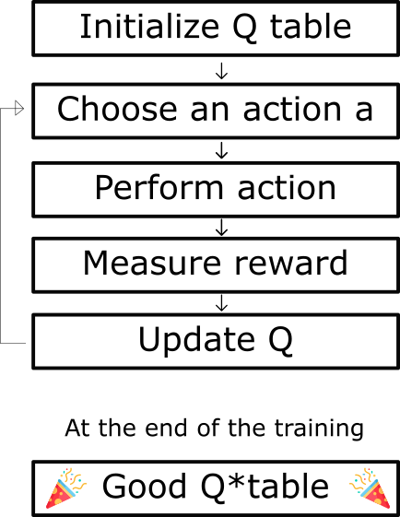
Algorithm of Q-learning

Slide 21
Implementation
Select features from dataset .
Cleaning the dataset.
Check for NULL values.
Replace S and B with 0 and 1 for easy processing.
Shuffle the entries of dataset.
Divide dataset into 70% training and 30% testing.
Create a table that maps each entry in x to a unique number for reference later .

Slide 22
Implementation
Make a Q - table with dimensions = No_of_combinations* no_of_actions , initialised with value 0 .
No_of_combinations = 2^no_of_features.
No_of_action = 2 ( either malware or not ).
Action function : if selected action type = 0 then no malware , else malware.
Reward Function : if the action matches the actual entry in Y_train then Reward of 1 , else Penalty of -1.

Slide 23
Intial state (first row)
If random number > 𝛆
No
Yes
Select random action
Select action with max Q value
Calculate reward
Iterate over other rows
Iterate over episodes
Find new Q using Bellman Equation
Update Q table
Go to next state

Slide 24
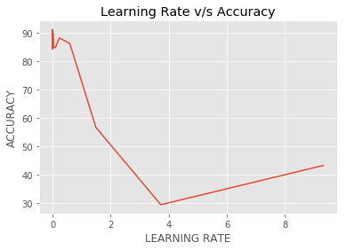
Results
We obtained the maximum accuracy of 91.287% at the learning rate of 0.0003 with an F1 score of 0.873

Slide 25
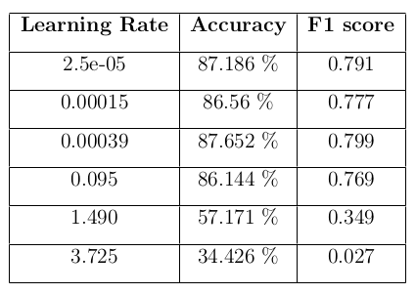
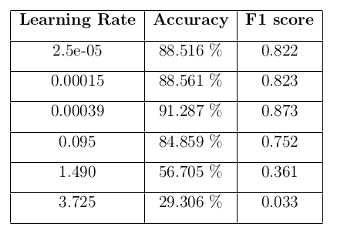
Results-
Using Random Forest Classifier
Using Extra Trees Classifier

Slide 26
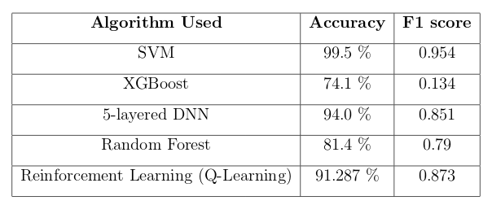
Results
Reinforcement Learning vs Other Algorithms

Slide 27
Project Timeline
Aug
Sep
Oct
Nov
Literature Survey
Selection of dataset
Results and Comparison
Application of Reinforcement Q - learning

Slide 28
References
Mobile Threat Report Q4 , 2012
Hyo-Sik Ham, Hwan-Hee Kim, Myung-Sup Kim and Mi-Jung Choi. Linear SVM-Based Android Malware Detection for Reliable IoT Services 2014
Random forest classifier combined with feature selection for breast cancer diagnosis and prognostic." Journal of Biomedical Science and Engineering 6.05 (2013): 551.
Reinforcement learning algorithms for solving classification problems." 2011 IEEE Symposium on Adaptive Dynamic Programming and Reinforcement Learning (ADPRL). IEEE, 2011.
Arp, Daniel, et al. "Drebin: Effective and explainable detection of android malware in your pocket." Ndss. Vol. 14. 2014.
Thanh Thi Nguyen and Vijay Janapa Reddi. Deep Reinforcement Learning for Cyber Security, 2019
A. Gosavi Reinforcement Learning: A Tutorial Survey and Recent Advances, 2009
Kai Arulkumaran, Marc Peter Deisenroth, Miles Brundage, and Anil Anthony Bharath. Deep Reinforcement Learning : A brief survey, 2017.

Slide 29

THANKYOU !

