Slide 1
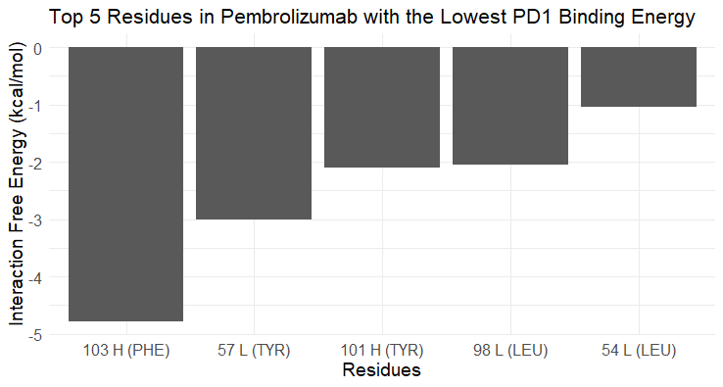
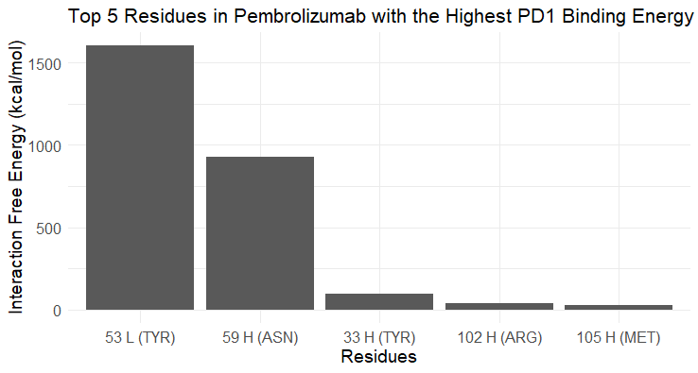
a
c
b
d

Slide 2

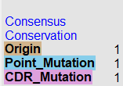





Heavy Chain CDR 1
Heavy Chain CDR 2
Heavy Chain CDR 3
Light Chain CDR 1

