Slide 1






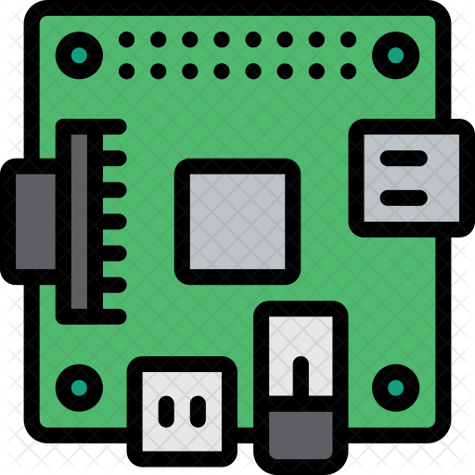


One Platform with Jury
4<
USB
Timekeeper Box
Announcer
HDMI
Marshall Scoreboard
Marshal
USB
Referee Box + Down
Clock
USB
Platform 1 Switch
Publicresults fly.dev
Jury Box
Jury
HDMI
Phone/remote Scoreboards
Attempt Board
Rpi400
HDMI
Competition Router
Internet Access Cellular Router
Main Scoreboard 1
Rpi400
HDMI
Facebook Live Streaming
Main Scoreboard 2
Rpi400
owlcms
HDMI
Warmup Scoreboard
Rpi400
Secretary
OBS Video

Slide 2
One Platform with Jury Recommended Setup
4<
USB
Timekeeper Box
Announcer
HDMI
Marshall Scoreboard
Marshal
USB
Note: A single laptop can display the countdown clock and the jury scoreboard (using an optical HDMI , and run both the referee box and jury box. (using 5m USB cable)
Referee Box + Down
Clock
USB
Platform 1 Switch
Publicresults fly.dev
Jury Box
Jury
HDMI
Phone/remote Scoreboards
Main Attempt Board
Rpi400
HDMI
Competition Router
Internet Access Cellular Router
Main Scoreboard
HDMI
Facebook Live Streaming
Warmup Scoreboard
Rpi400
HDMI
Warmup Attempt Board
Secretary + owlcms
OBS Video

Slide 3
Two platforms No Jury
4<
USB
Timekeeper Box
Announcer
HDMI
Marshall Scoreboard
Marshal
USB
Referee Box + Down
Clock
HDMI
Platform 1 Switch
Publicresults fly.dev
Attempt Board
Rpi400
HDMI
Phone/remote Scoreboards
Main Scoreboard
HDMI
Competition Router
Internet Access Cellular Router
Warmup Scoreboard
Rpi400
owlcms
Facebook Live Streaming
OBS Video
Secretary
Platform 2 Switch
Extra platforms are identical to Platform 1

