Slide 1

Training NN to Play Mastermind
alon Lapid and MEREDITH SIMPSON

Slide 2
Project goals
Write a python program that learns a mastermind playing policy that is competitive with existing policies and better than a naïve playing policy
Build a generic framework to evaluate any arbitrary mastermind policy

Slide 3
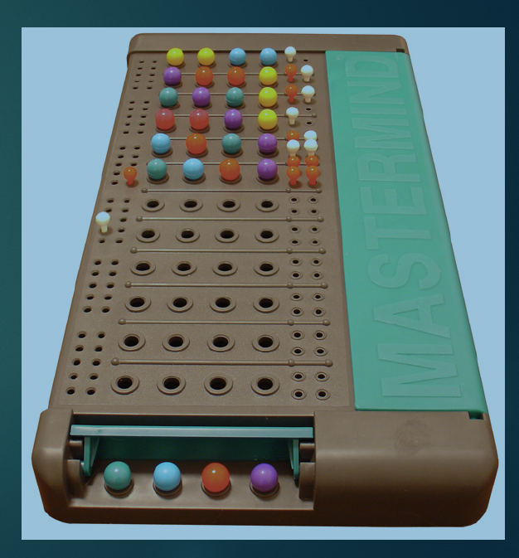
What is Mastermind?
Codebreaking game for two players:
Codemaker chooses 4 peg code
6 possible colors, duplicates count
6⁴ different patterns
Codebreaker guesses 4 peg code
Codemaker replies with # of exact matcher and inexact matches
Example:
Codemaker picks (Red, Blue, Red, Red)
Codebreaker guesses (Red, Green, Blue, Green)
Codemaker returns (1,1)

Slide 4
Game Policy
A Mastermind playing policy (s): a guess choosing algorithm in each turn of the game until the secret code is guessed (win condition)
s is a list of qualifying guess candidates that are consistent with previous guesses and responses
Example: a guess of {Red,Red,Green,Green with a response of {0,1} we know that {Red,Red, Red, Red} is not consistent but {Green,Blue,Blue,Blue} is.
Evaluated by simulating it playing against all 1296 possible secret codes
Notes:
The average guesses to win is the score of the policy. The lower the better.

Slide 5
Previous Work
Professor Donald Knuth was able to construct a policy that wins in 5 guess at the worst case and by 4.477 on average
Koyoma and Lai, 1993 found an optimal Mastermind Strategy that guess the code in 4.34 guesses on average (6 guess in the worst case)
Summary the most successful mastermind playing policies (Barteld Kooi1 2005) :
Policy name | Average guess to win
Knuth worst case | 4.476
Expected size | 4.395
Entropy | 4.415
Most parts | 4.373
Optimal (Koyoma and Lai) | 4.340

Slide 6
Strategy Tree
Provides a full description of how to play the full game given any response
Directed graph with 15 children nodes (one for each possible response)
First guess
Guess for
{0,0} response
Guess for
{0,1} response
Guess for
{0,2} response
Winning if
{4,0} response
…..

Slide 7
Policy Evaluation Framework
Policy to evaluate
guess = (s)
Strategy tree
Games Simulator
Policy score and statistics
Notes:
1. Policy function takes state s (list of qualifying guess candidates) and generates a guess
2. Strategy game tree is generated from the policy to be able to simulate many games efficiently
3. The simulator is constructed with a strategy tree as an input
4. The simulator simulates games against all secret codes and generates the score for the policy (average guesses to win)

Slide 8
Random Policy
Pick a guess randomly from the list of qualifying candidates
If winning guess quit
2) Based on the response, filters out the candidate list
Go to 1)
Advantage : Execution time is extremely fast so many strategy trees can be built and evaluated in a unit of time keeping the one that gives the best result. So we can search many trees for better and better random policies.

Slide 9
Random Policy Results
Best strategy found after days of executions – yielded 4.511 guess to win on average

Slide 10
Improved Knuth Policy
Assign a score to each possible guess based on worst-case scoring algorithm.
Pick the guess with the best (lowest score)score. In case of a tie prefer a guess from the qualifying candidates.
Quit if guess is a winning guess.
2) Filter out the candidates list based on the response.
Return to step 1.
Worst-case scoring algorithm
For the guess under evaluation:
Compute all the different 15 lists of qualifying candidates, one for each possible response, from the existing list of qualifying candidates.
The length of the longest list is the score of the guess.

Slide 11
Improved Knuth Policy Results
Building a strategy tree out of Knuth policy takes a while but it yields right a way a good result of 4.476 guesses on average to win. Shuffling the full list of guesses randomly and rerunning it repeatedly ,capturing the best result, yields 4.451 average guesses as the best result

Slide 12
Temporal Difference or Monte Carlo?
Temporal Difference: updates model after each guess
Monte Carlo: updates model after each episode
Decided on Monte Carlo approach because each episode is short and captures high-quality information
NN learns and updates itself using backpropagation on the outcome of many games
Notes:
(typically no more than 10 guesses ) and captures high-quality information. Our NN will learn and update itself using the outcome of many games.
The number of guesses to win in a game propagates back to each guess in the game
as a score of how far the guess was from winning. A NN network will be trained based on the guess and its score that will act as label

Slide 13
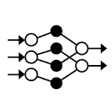
Our NN Policy
NN
Guess candidate
Features extraction
14 Features
NN output (guess score)
Assign a score to each qualified candidate guess based on the NN output
Pick the guess with the best (lowest) score
If it is a winning guess, quit
2) Based on the response, filters out the candidates list
Return to step 1
Feature extraction: Any given guess has 15 potential lists of qualifying candidates corresponding to each of the 15 possible responses. The number of elements in each list will be a feature to the NN model.

Slide 14
Example
First guess: {Red, Red, Green, Green}
15 different lists of qualifying candidates:
{0,0} -> [list 1]
{0,1} - > [list 2]
….
{4,0} -> [list 15]
NN Features: len(list 1), len(list 2) len(list 14)

Slide 15
Training the NN – MCTS approach
Inspired by MTCS, we initially generated game episodes using the random play strategy.
Each guess in the game was converted to its features (see previous slide) while the number of guesses reminds to the end of the episodes (winning ) was used as a label.
That way the network could learn the connection between a guess(represented by its features) and how far it is from winning.
After the NN was trained with initial data – we started playing games with it and its output was used as more training examples to train the network again and again.
Training examples
Episodes from Random strategy
Improve the NN by making gradient training steps
Generate Episodes from
NN Strategy
Capture best score
More training examples

Slide 16
NN Strategy Results
NN strategy – games distribution
Guess to win | Total games
1 | 1
2 | 13
3 | 112
4 | 553
5 | 592
6 | 25
After little more than 1.7k iterations the NN learned to play mastermind with 4.386 guess to win on average!

Slide 17
NN Results with 7 colors and 4 slots
Averaged 4.775 guess to win after ~700 iterations!

Slide 18
Summary
NN strategy competitive with existing state of the art policies
Revised Knuth policy improved average score with same worst case score
Policy | Average # of guesses to win | Worst case # of guesses to win
Knuth worst case | 4.476 | 5
Expected size | 4.395 | 6
Entropy | 4.415 | 6
Most parts | 4.373 | 6
Optimal (Koyoma and Lai) | 4.340 | 6
Our Knuth worst case optimized | 4.451 | 5
Our NN | 4.4386 | 6

Slide 19
Works Cited

