Slide 1

Training NN for playing Mastermind
By: alon Lapid
MEREDITH SIMPSON

Slide 2
Project goals
Write a python program that learns a mastermind playing policy that is competitive with existing policies and better than a naïve playing policy
Use AI techniques we learned in class.
Build a generic framework to evaluate any arbitrary mastermind policy

Slide 3
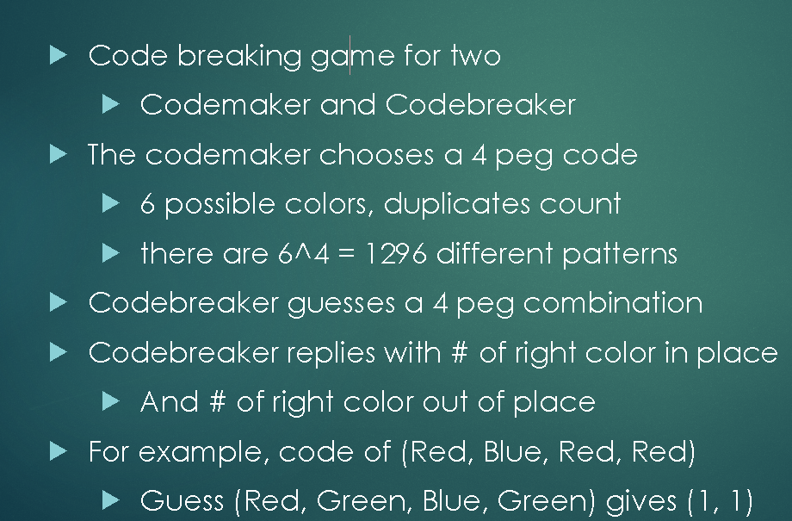
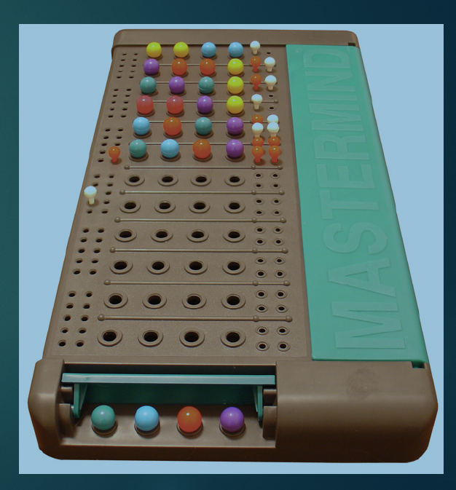
What is Mastermind?

Slide 4
Game Policy
- A Mastermind playing policy (s) where s is a state, is defined as a guess choosing algorithm in each turn of the game until the secret code is guessed (win condition)
- The state s is a list of qualifying guess candidates that are consistent with previous guesses and responses, namely, they are potentially the secret code chosen by the code maker. For example, after the guess {Red,Red,Green,Green} and a response of {0,1} we know that {Red,Red, Red, Red} is not consistent but {Green,Blue,Blue,Blue} is.
- A specific game policy is evaluated by simulating it playing against all the 1296 possible secret codes. The average guesses to win is the score of the policy. The lower the better.

Slide 5
Previous works for Mastermind’s playing strategies
Professor Donald Knuth was able to construct a policy that wins in 5 guess at the worst case and by 4.477 on average https://www.cs.uni.edu/~wallingf/teaching/cs3530/resources/knuth-mastermind.pdf
Koyoma and Lai, 1993 found an optimal Mastermind Strategy that guess the code by 4.34 guesses on average (6 guess in the worst case)
Summary of few of the most successful mastermind playing policies are summarized below based on Barteld Kooi1 2005 :
Policy name | Average guess to win
Knuth worst case | 4.476
Expected size | 4.395
Entropy | 4.415
Most parts | 4.373
Optimal (Koyoma and Lai) | 4.340

Slide 6
Strategy tree
Provides a full description of how to play the full game given any response. It is a directed graph with 15 children nodes – one for each possible response :
First guess
Guess for
{0,0} response
Guess for
{0,1} response
Guess for
{0,2} response
Winning if
{4,0} response
…..

Slide 7
Policy evaluation framework
Policy to evaluate
guess = (s)
Strategy tree generation
Strategy Tree
1. A policy function that takes state S (list of qualifying guess candidates ) and generates a guess
2. A strategy game tree is generated from the policy to be able to simulate many games efficiently
3. The simulator is constructed with a strategy tree as an input
4. The simulator simulates games against all secret codes and generates the score for the policy (average guesses to win)
Games Simulator
Policy score and statistics

Slide 8
(Improved) Knuth Policy
Assign a score to each possible guess based on the worst-case scoring algorithm – see below
Pick the guess with the best (lowest score)score. In case of a tie prefer a guess from the qualifying candidates
If winning guess quit
2) Based on the response, filters out the candidates list
Go to 1)
worst-case scoring algorithm
For the guess evaluated, compute all the different 15 lists of qualifying candidates ,one for each possible response, from the existing list of qualifying candidates.
The length of the longest list is the score of the guess.
Building a strategy tree out of Knuth policy takes a while but it yields right a way a good result of 4.476 guesses on average to win. Shuffling the full list of guesses randomly and rerunning it repeatedly ,capturing the best result, yields 4.451 average guesses as the best result

Slide 9
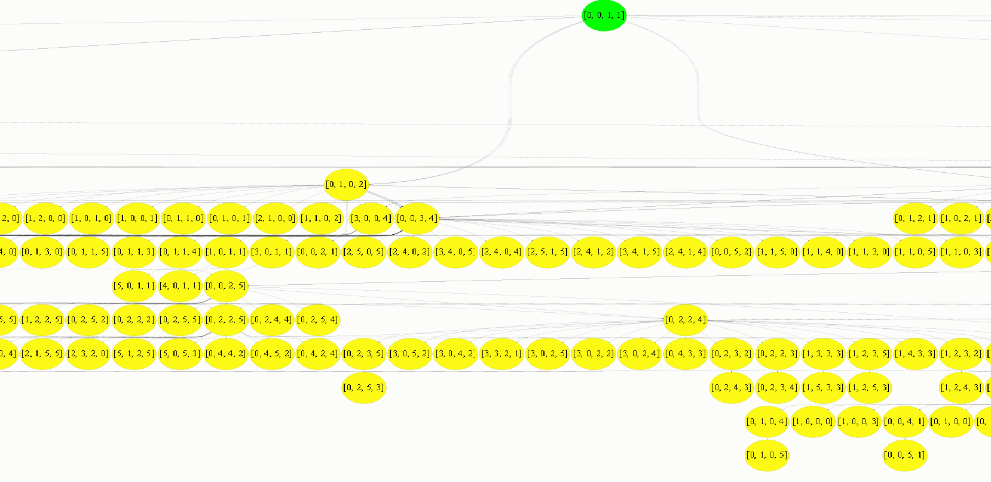
Knuth Strategy tree example

Slide 10
Random Policy
Pick a guess randomly from the list of qualifying candidates
If winning guess quit
2) Based on the response, filters out the candidate list
Go to 1)
Advantage : Execution time is extremely fast so many strategy trees can be built and evaluated in a unit of time keeping the one that gives the best result. So we can search many trees for better and better random policies.
Best strategy found after days of executions – yielded 4.511 guess to win on average

Slide 11
Our NN Dilemma: TD or Monte Carlo ?
Temporal Difference – updates the model after each guess
Monte Carlo – updates the model after the whole game (episode)
We decided to take the Monte Carlo approach because each episode is short (typically no more than 10 guesses ) and captures high-quality information. Our NN will learn and update itself using the outcome of many games.
How Monte Carlo approach is used ?
The number of guesses to win in a game will propagate back to each guess in the game
as a score of how far the guess was from winning. A NN network will be trained based on the guess and its score that will act as label

Slide 12
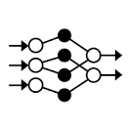
Our NN Policy
Assign a score to each qualified candidate guess based on the NN output
Pick the guess with the best (lowest)score
If winning guess quit
2) Based on the response ,filters out the candidates list
Go to 1)
NN
Guess candidate
Features extraction
Features
NN output (guess score)
Features extraction :
If a given guess will be asked it will potentially have 15 different lists of qualifying candidates corresponding to each of the 15 possible responses. The number of elements in each list will be a feature to the NN model.
Example : For the first guess of {Red,Red,Green,Green} we can get 15 different lists of qualifying candidates:
{0,0} -> [list 1]
{0,1} - > [list 2]
….
{4,0} -> [list 15]
The features for the NN will be: len(list 1), len(list 2) …. len(list 15)

Slide 13
Training the NN – MCTS approach
Inspired by MTCS, we initially generated game episodes using the random play strategy.
Each guess in the game was converted to its features (see previous slide) while the number of guesses reminds to the end of the episodes (winning ) was used as a label.
That way the network could learn the connection between a guess(represented by its features) and how far it is from winning.
After the NN was trained with initial data – we started playing games with it and its output was used as more training examples to train the network again and again.
Training examples
Episodes from Random strategy
Improve the NN by making gradient training steps
Generate Episodes from
NN Strategy
Capture best score
More training examples

Slide 14
NN strategy results
NN strategy – games distribution
Guess to win | Total games
1 | 1
2 | 13
3 | 112
4 | 553
5 | 592
6 | 25
After little more than 1.7k iterations the NN learned to play mastermind with 4.386 guess to win on average!

Slide 15
Trying NN with 7 colors and 4 slots
After little more than 700 iterations the NN learned to play mastermind with 4.775 guess to win on average!

Slide 16
Summary
Our NN based strategy yielded competitive results compare to existing ,state of the art, policies
We were able to improve Knuth policy average score while maintaining its worst case result
Policy name | Average guess to win | Worst case number of guesses to win
Knuth worst case | 4.476 | 5
Expected size | 4.395 | 6
Entropy | 4.415 | 6
Most parts | 4.373 | 6
Optimal (Koyoma and Lai) | 4.340 | 6
Our Knuth worst case optimized | 4.451 | 5
Our NN | 4.4386 | 6

