Slide 1

Learning heuristics for playing Mastermind
By: alon Lapid

Slide 2
Project goals
Learn a mastermind playing policy that is competitive with existing Knuth’s policy and better than a naïve playing policy
Use AI techniques we learned in class.
Build a generic framework to evaluate any arbitrary mastermind policy

Slide 3
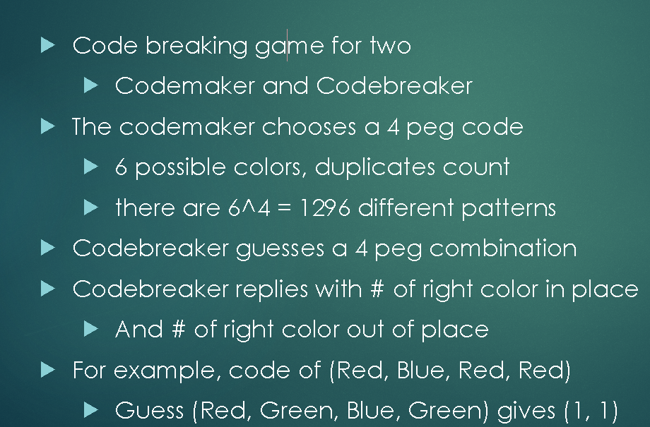
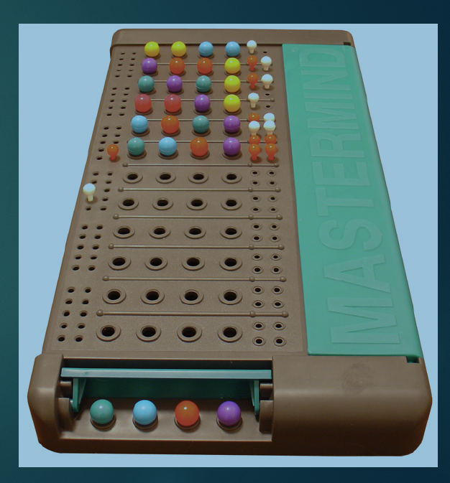
What is Mastermind?

Slide 4
Game Policy
- A Mastermind playing policy (s) where s is a state, is defined as a guess choosing algorithm in each turn of the game until the secret code is guessed (winning)
- The state s is a list of qualifying guess candidates that are consistent with previous guesses and responses, namely, they are potentially the secret code chosen by the code maker. For example, after the guess {Red,Red,Green,Green} and a response of {0,1} we know that {Red,Red, Red, Red} is not consistent but {Green,Blue,Blue,Blue} is.
- A specific game policy is evaluated by simulating it playing against all the 1296 possible secret codes. The average guesses to win is the score of the policy. The lower the better.

Slide 5
Previous work in Mastermind Policy

Slide 6
Policy Simulator framework

Slide 7
Random Policy

Slide 8
Knuth Policy

Slide 9
Our NN Policy

Slide 10
Summary

